Slide 1
Ray Tracing and the Universe
Eric Haines
Distinguished Engineer
NVIDIA

Slide 2
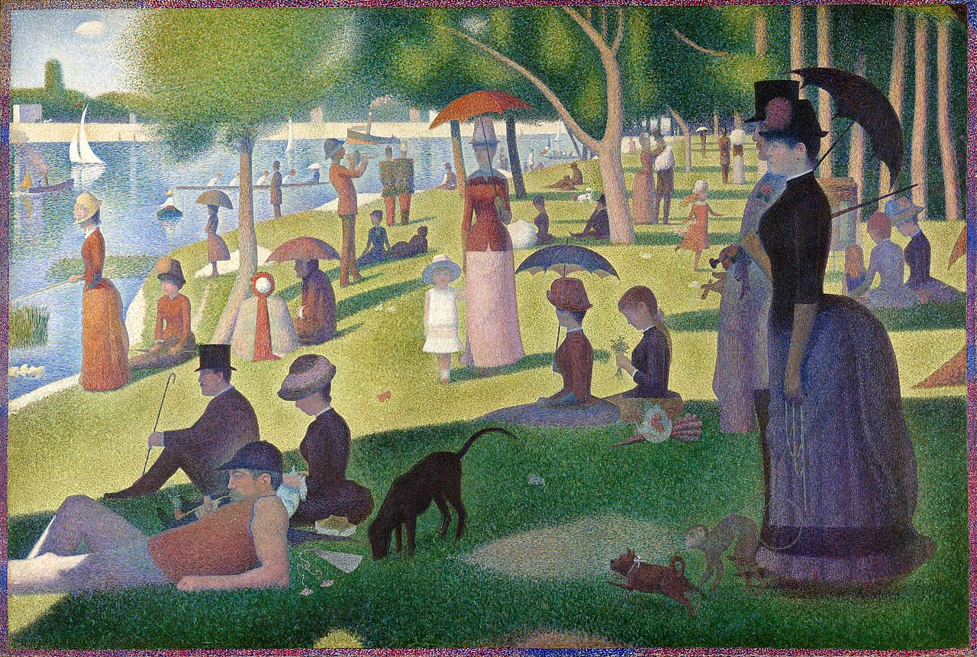
How to paint a scene?
A Sunday Afternoon on the Island of La Grande Jatte, Georges Seurat
Notes:
Source: Ray Tracing Gems

Slide 3
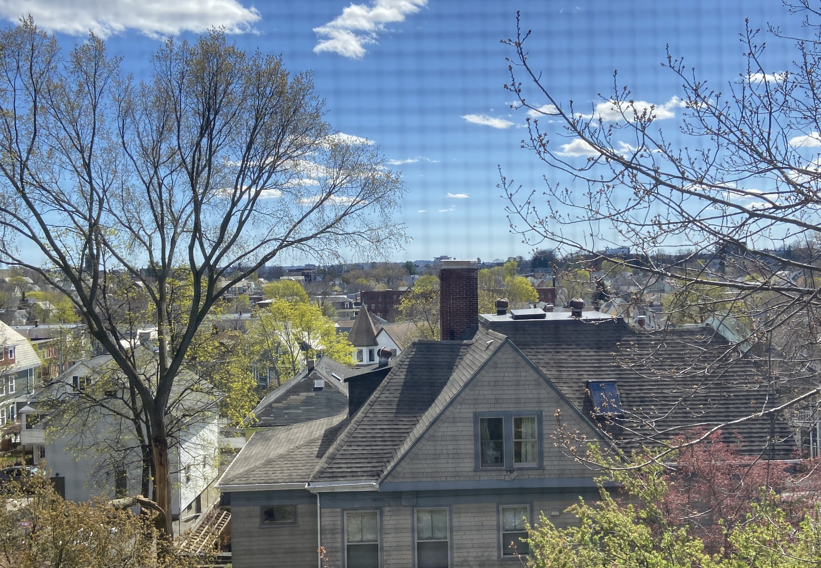
How to render an image?
What to put in each pixel?
Notes:
Source: Ray Tracing Gems

Slide 4
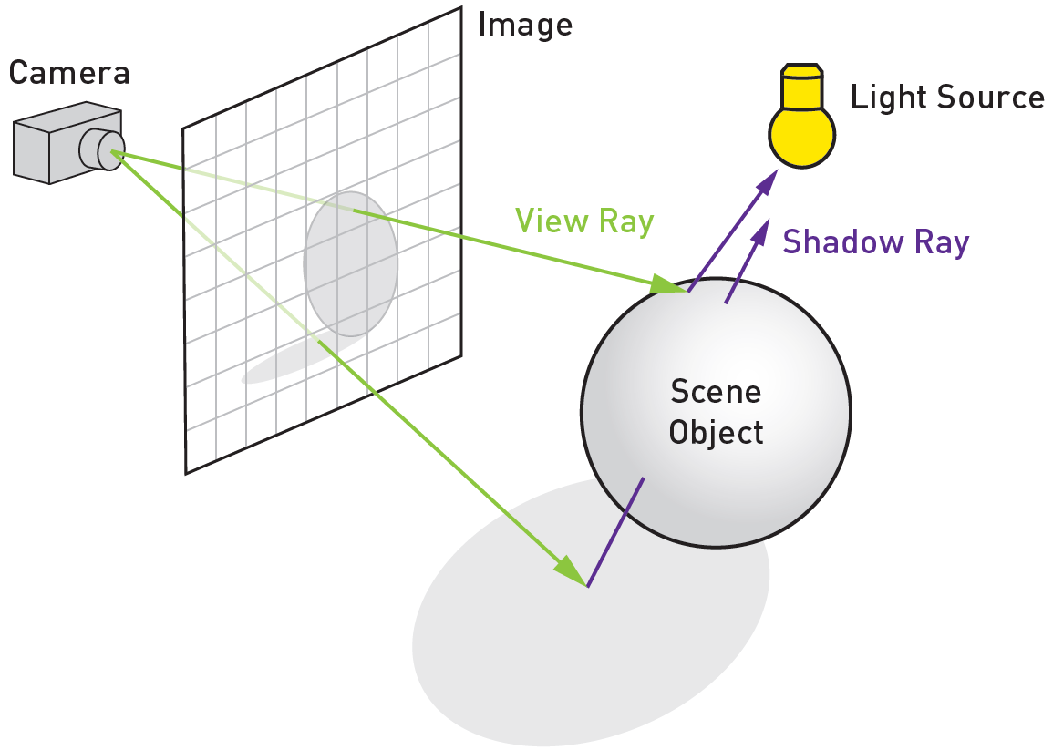
Rays from the eye
Rays for shadows date back to Appel in 1968
Notes:
Source: Ray Tracing Gems

Slide 5
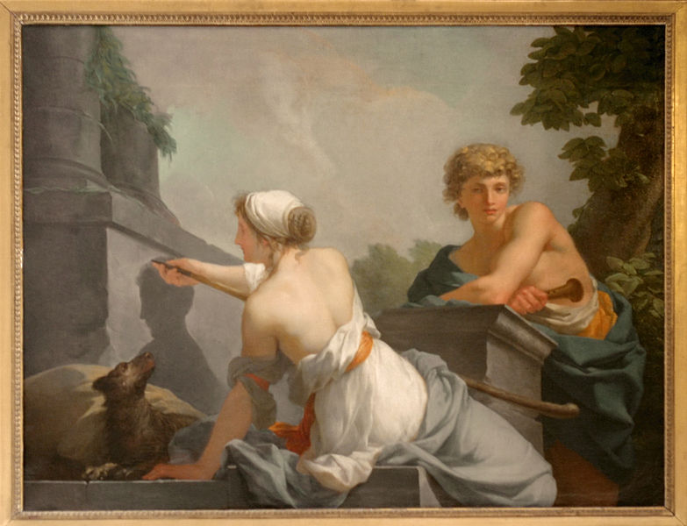
Tracing Rays is Ancient
Pliny tells the story of Kora of Sicyon, who draws an outline of her love, ~600 BC
“The Origin of Painting,” by Jean-Baptiste Regnault
Notes:
https://en.wikipedia.org/wiki/Butades, image from https://en.wikipedia.org/wiki/Jean-Baptiste_Regnault

Slide 6
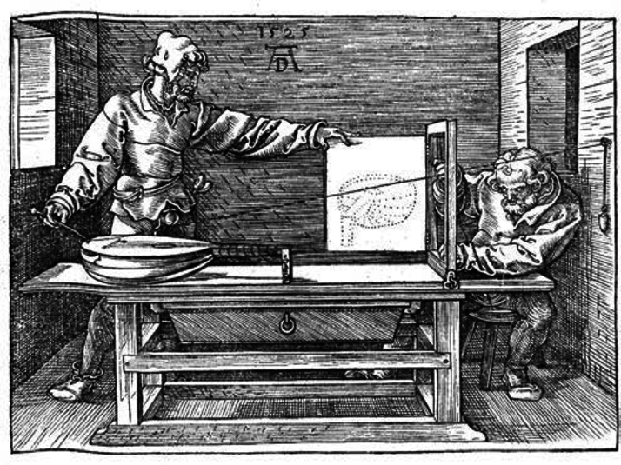
Tracing Rays is Old
Perspective machine, Dürer, 1525.
Notes:
https://en.wikipedia.org/wiki/Perspective_machine#:~:text=1525%3A%20Albrecht%20D%C3%BCrer%2C%20in%20his,machine%20in%20the%20same%20year.

Slide 7
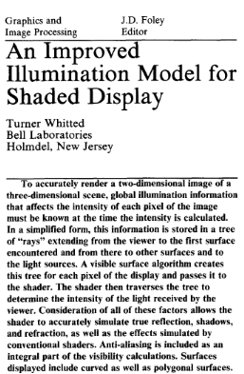
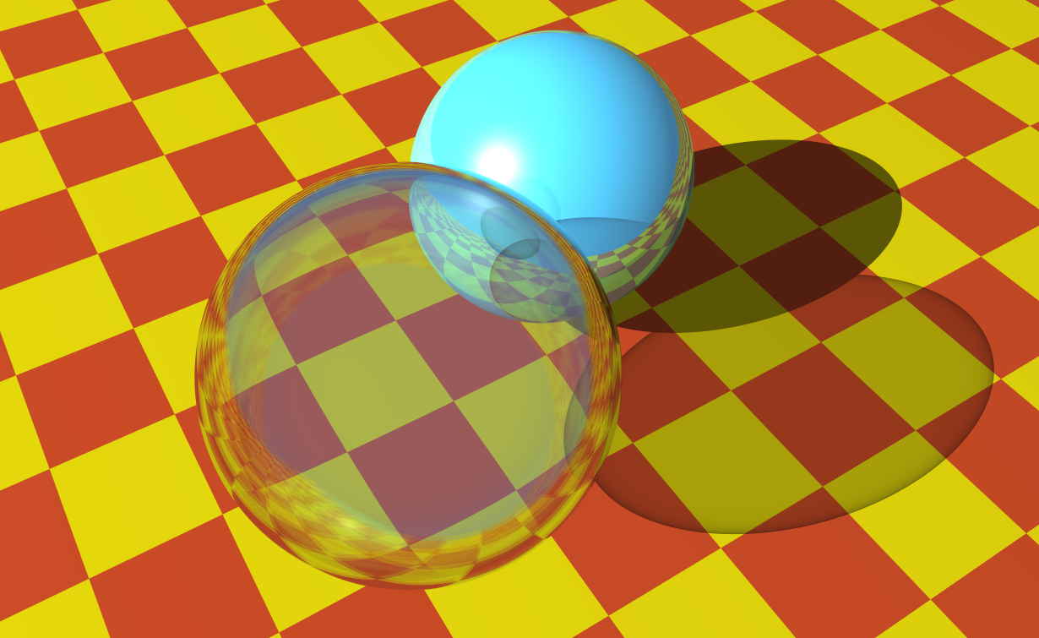
1980: Classical Ray Tracing
Image now generated in real time in NVIDIA OptiX™ (was 74 minutes per frame in 1980)
Notes:
He even talks about previous ray tracing algorithms, such as MAGI and Arthur Appel 1968. Douglas Kay in 1979, ”TRANSPARENCY FOR COMPUTER SYNTHESIZED IMAGES”, almost did it.

Slide 8
eye
glass
Classical Ray Tracing
Notes:
My own, started from Pete’s “1-Overview” intro to RT course slide

Slide 9
eye
shadow ray
glass
Classical Ray Tracing
Notes:
My own, started from Pete’s “1-Overview” intro to RT course slide

Slide 10
eye
shadow rays
glass
Classical Ray Tracing
Notes:
My own, started from Pete’s “1-Overview” intro to RT course slide

Slide 11
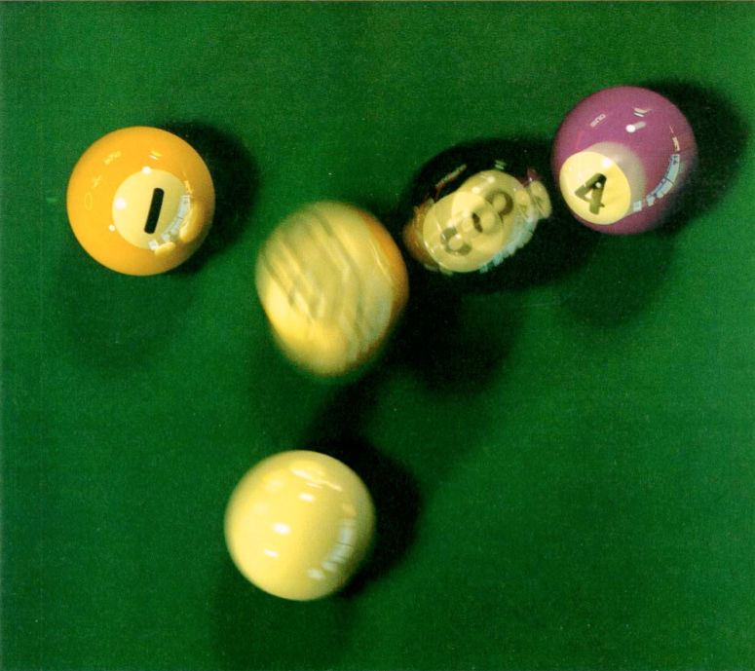
1984: Cook Stochastic (“Distribution”) Ray Tracing
Allow shadow rays to go to a random point on area light.
Allow specular rays to be perturbed specularly around the ideal reflection.
Shoot sometime during the frame for motion blur.
glossy surface
By Robert L. Cook, Tom Porter, and Loren Carpenter, Pixar
Notes:
https://graphics.pixar.com/library/indexAuthorRobert_L_Cook.html
https://graphics.pixar.com/library/DistributedRayTracing/
Source: ACM, though better to credit Pixar (rights assignment has changed over the decades), SIGGRAPH 2019 OptiX course.pptx uses this image.

Slide 12
area light
eye
shadow rays
Stochastic Ray Tracing

Slide 13
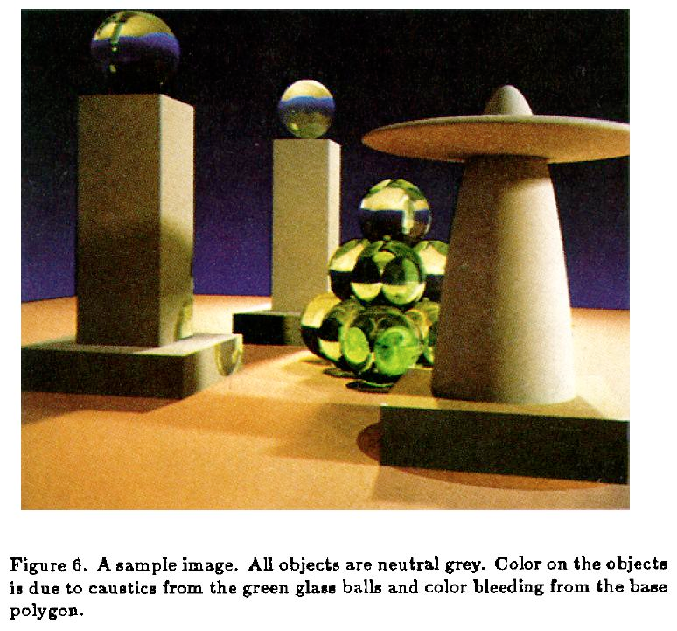
1986: Kajiya-Style Diffuse Interreflection
Path tracing: shoot each ray and follow it along a series of interreflections.
“The Rendering Equation”
Guaranteed to give the right answer at the limit.
diffuse surface reflection
By James Kajiya, California Institute of Technology
Notes:
Note recursion: ray continues along a path until a light is hit (or something entirely black or considered “unchangeable,” such as an environment map.
Source: ACM, or Caltech.

Slide 14
Path Tracing
Secondary ray
pixel samples
eye
Primary ray
diffuse box

Slide 15
Path Tracing
pixel samples
eye
diffuse box
Use all paths’ contributions
Notes:
My own, started from

Slide 16
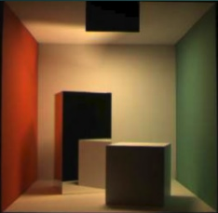
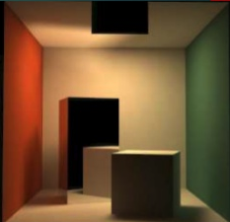
Which One Is Real?
Notes:
Left image is a photograph, right image is rendered by path tracing. This famous ground-truth test of a renderer is the origin of the “Cornell box” 3D models—there’s a real box at Cornell.

Slide 17
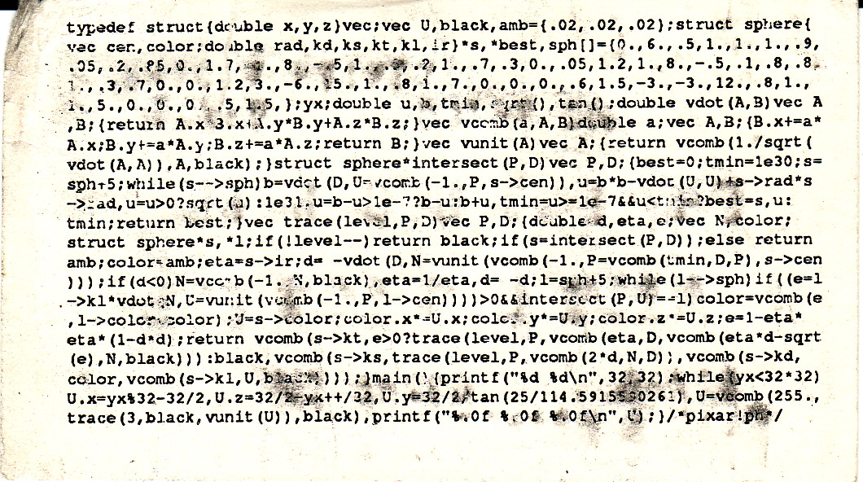
Why Ray Tracing is Great
The back of Paul Heckbert’s business card, 1607 bytes. Includes tricks from Darwyn Peachey and Joe Cychosz
Notes:
From 1987, seminal paper being Ray Tracing Jell-O Brand Gelatin

Slide 18
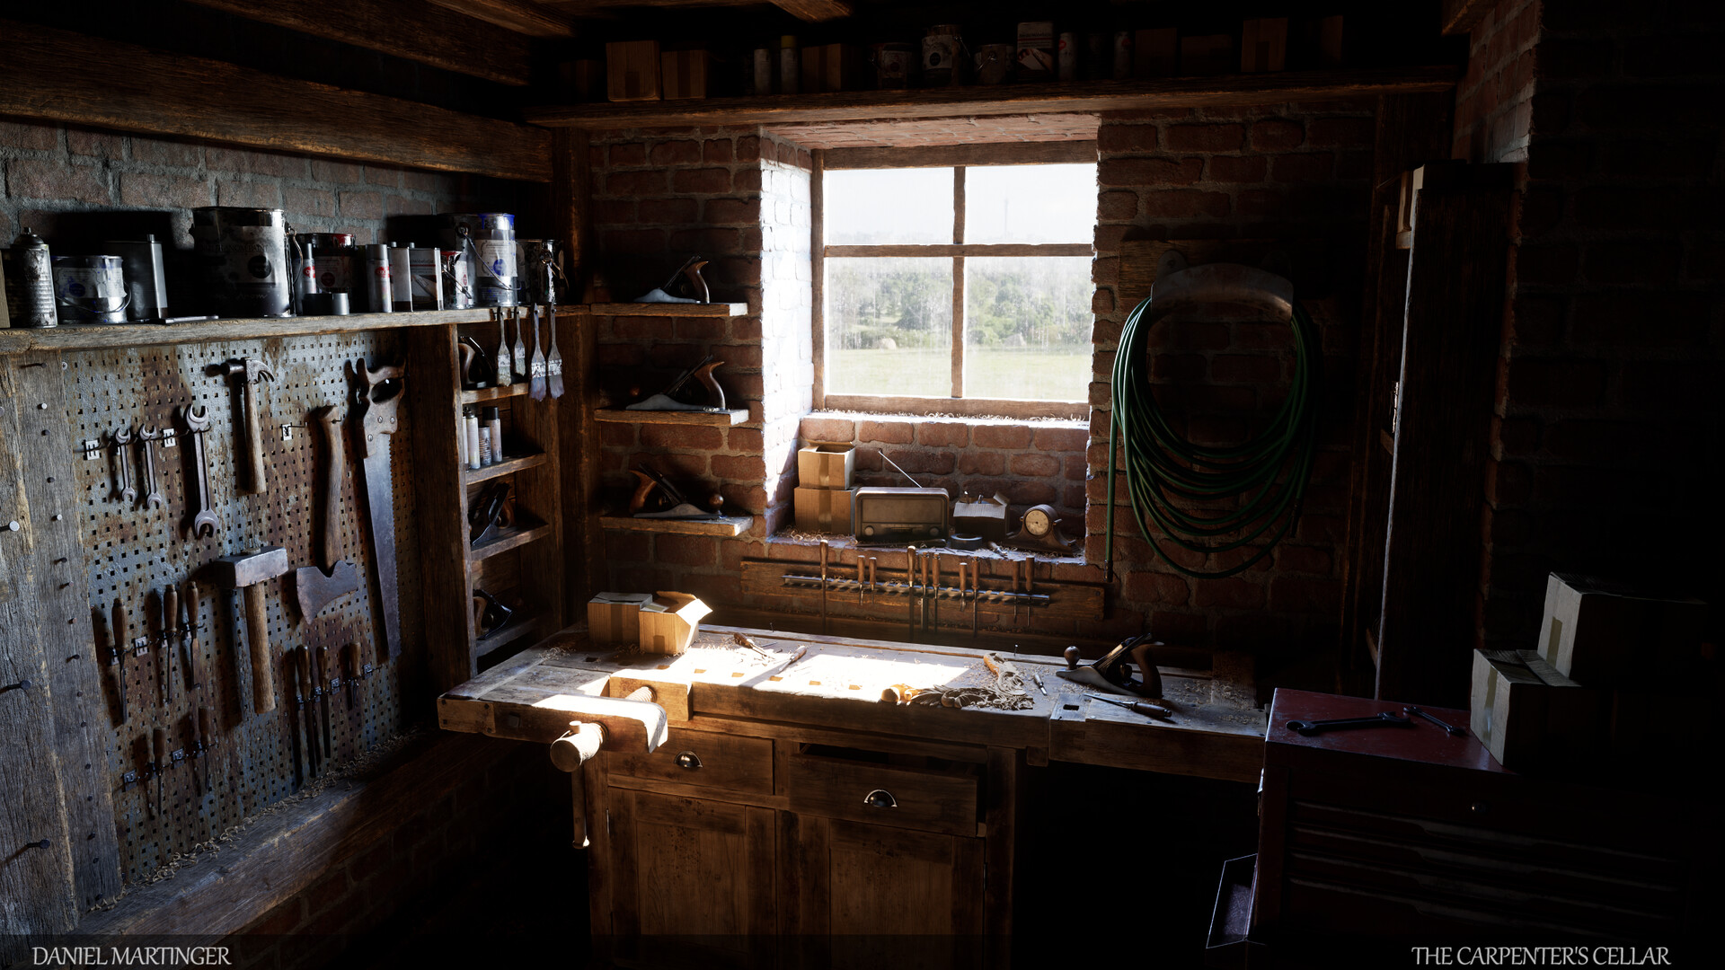
From Simplicity…
“The Carpenter’s Cellar,”
by Daniel Martinger
In the Unreal 5 Engine
Notes:
In Unreal Engine 5: https://developer.nvidia.com/blog/raising-the-bar-for-path-traced-rendering-in-unreal-engine-5-qa-with-3d-artist-daniel-martinger/

Slide 19
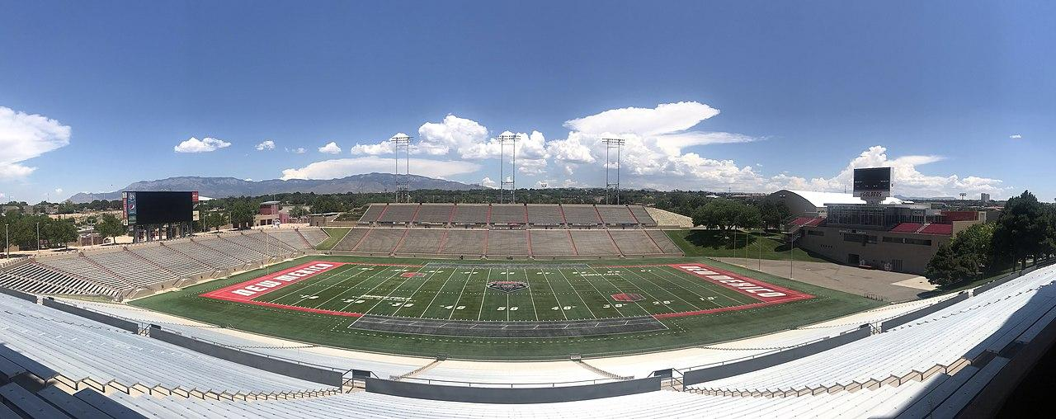
Embarrassingly Parallel
Image from Wikimedia Commons, File:UNM - Dreamstyle Stadium panorama.jpg
Notes:
https://blogs.nvidia.com/blog/2018/08/01/ray-tracing-global-illumination-turner-whitted/ - includes the Compleat Angler film
https://commons.wikimedia.org/wiki/File:UNM_-_Dreamstyle_Stadium_panorama.jpg

Slide 20
Moore’s Law Is Ending (Really!)
End of the Line
» 2X / 20 yrs.
(3%/yr.)
Amdahl’s Law
» 2X / 6 yrs.
(12%/yr.)
100,000
End of Dennard Scaling
» Multicore 2X / 3.5 yrs.
(23%/yr.)
10,000
1,000
RISC 2X / 1.5 yrs.
(52%/yr.)
Performance vs. VAX11-780
100
10
CISC 2X / 2.5 yrs.
(22%/yr.)
1
1980
1985
1990
1995
2000
2005
2010
2015
Figure after Norman P. Jouppi, Cliff Young, Nishant Patil, David Patterson, “A Domain-Specific Architecture for Deep Neural Networks,” Communications of the ACM, September 2018, Vol. 61 No. 9, Pages 50-59.
Notes:
“performance on standard processor benchmarks will not double before 2038”

Slide 21

Moore’s Law is Ending (Really!)
GPU Computing
10⁷
10⁵
1.1X per year
CPU Performance
10³
1.5X per year
Single-threaded perf
Original data up to the year 2010 collected and plotted by M. Horowitz, F. Labonte, O. Shacham, K. Olukotun, L. Hammond, and C. Batten
New plot and data collected for 2010-2015 by K. Rupp
40 Years of CPU Trend Data
Notes:
Jensen’s version from Kevin Acocella

Slide 22
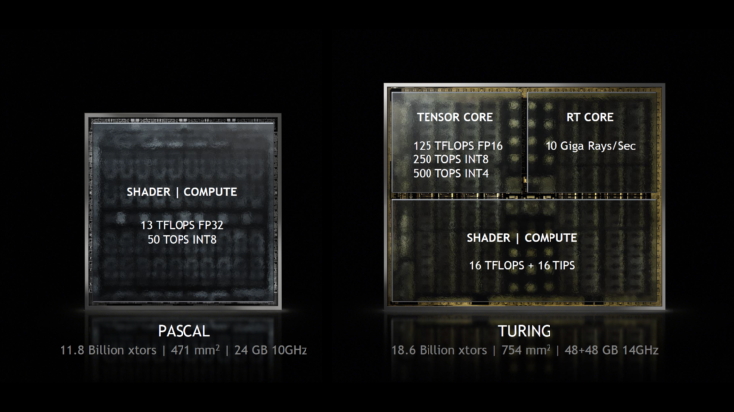
More Special-Purpose Hardware

Slide 23
GPU Memory Capacity in Gigabytes
DGX-2
DGX-1
DGX Station
GV100 + NVLink
M6000 24 GB
GV100
K6000
6000
FX 5800
FX 5600
FX 5500
FX 4400
FX 4000
Products referenced include NVIDIA® Quadro® GPUs; NVIDIA DGX™ and DGX Station™; and NVIDIA NVLink™
Notes:
4K: 3840 x 2160 pixels takes 33 MB (including alpha) – means 30 images is 1 GB

Slide 24
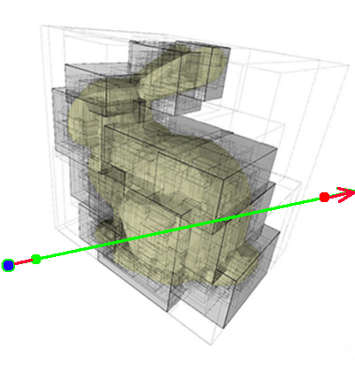
RT Cores
RT Cores perform:
Ray-bounding volume hierarchy (BVH) traversal
Ray-triangle intersection
Notes:
SM – streaming multiprocessor

Slide 25
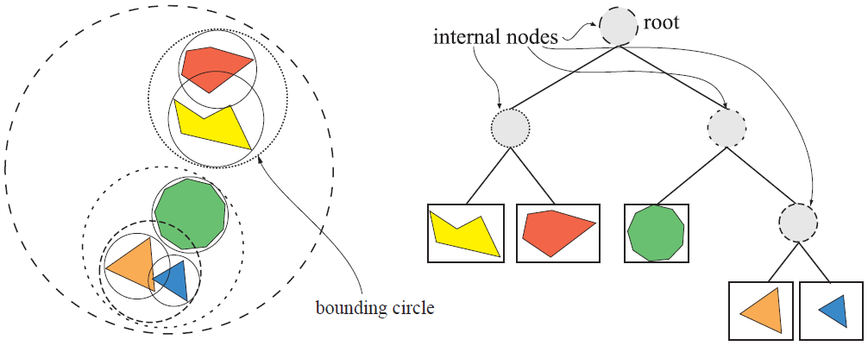
The Bounding Volume Hierarchy (BVH)
Image courtesy of Real-Time Rendering
Notes:
Nested grids do see use for voxel/volume rendering, and k-d trees for point clouds
Source: Real-Time Rendering (Eric coauthored, made figure)

Slide 26
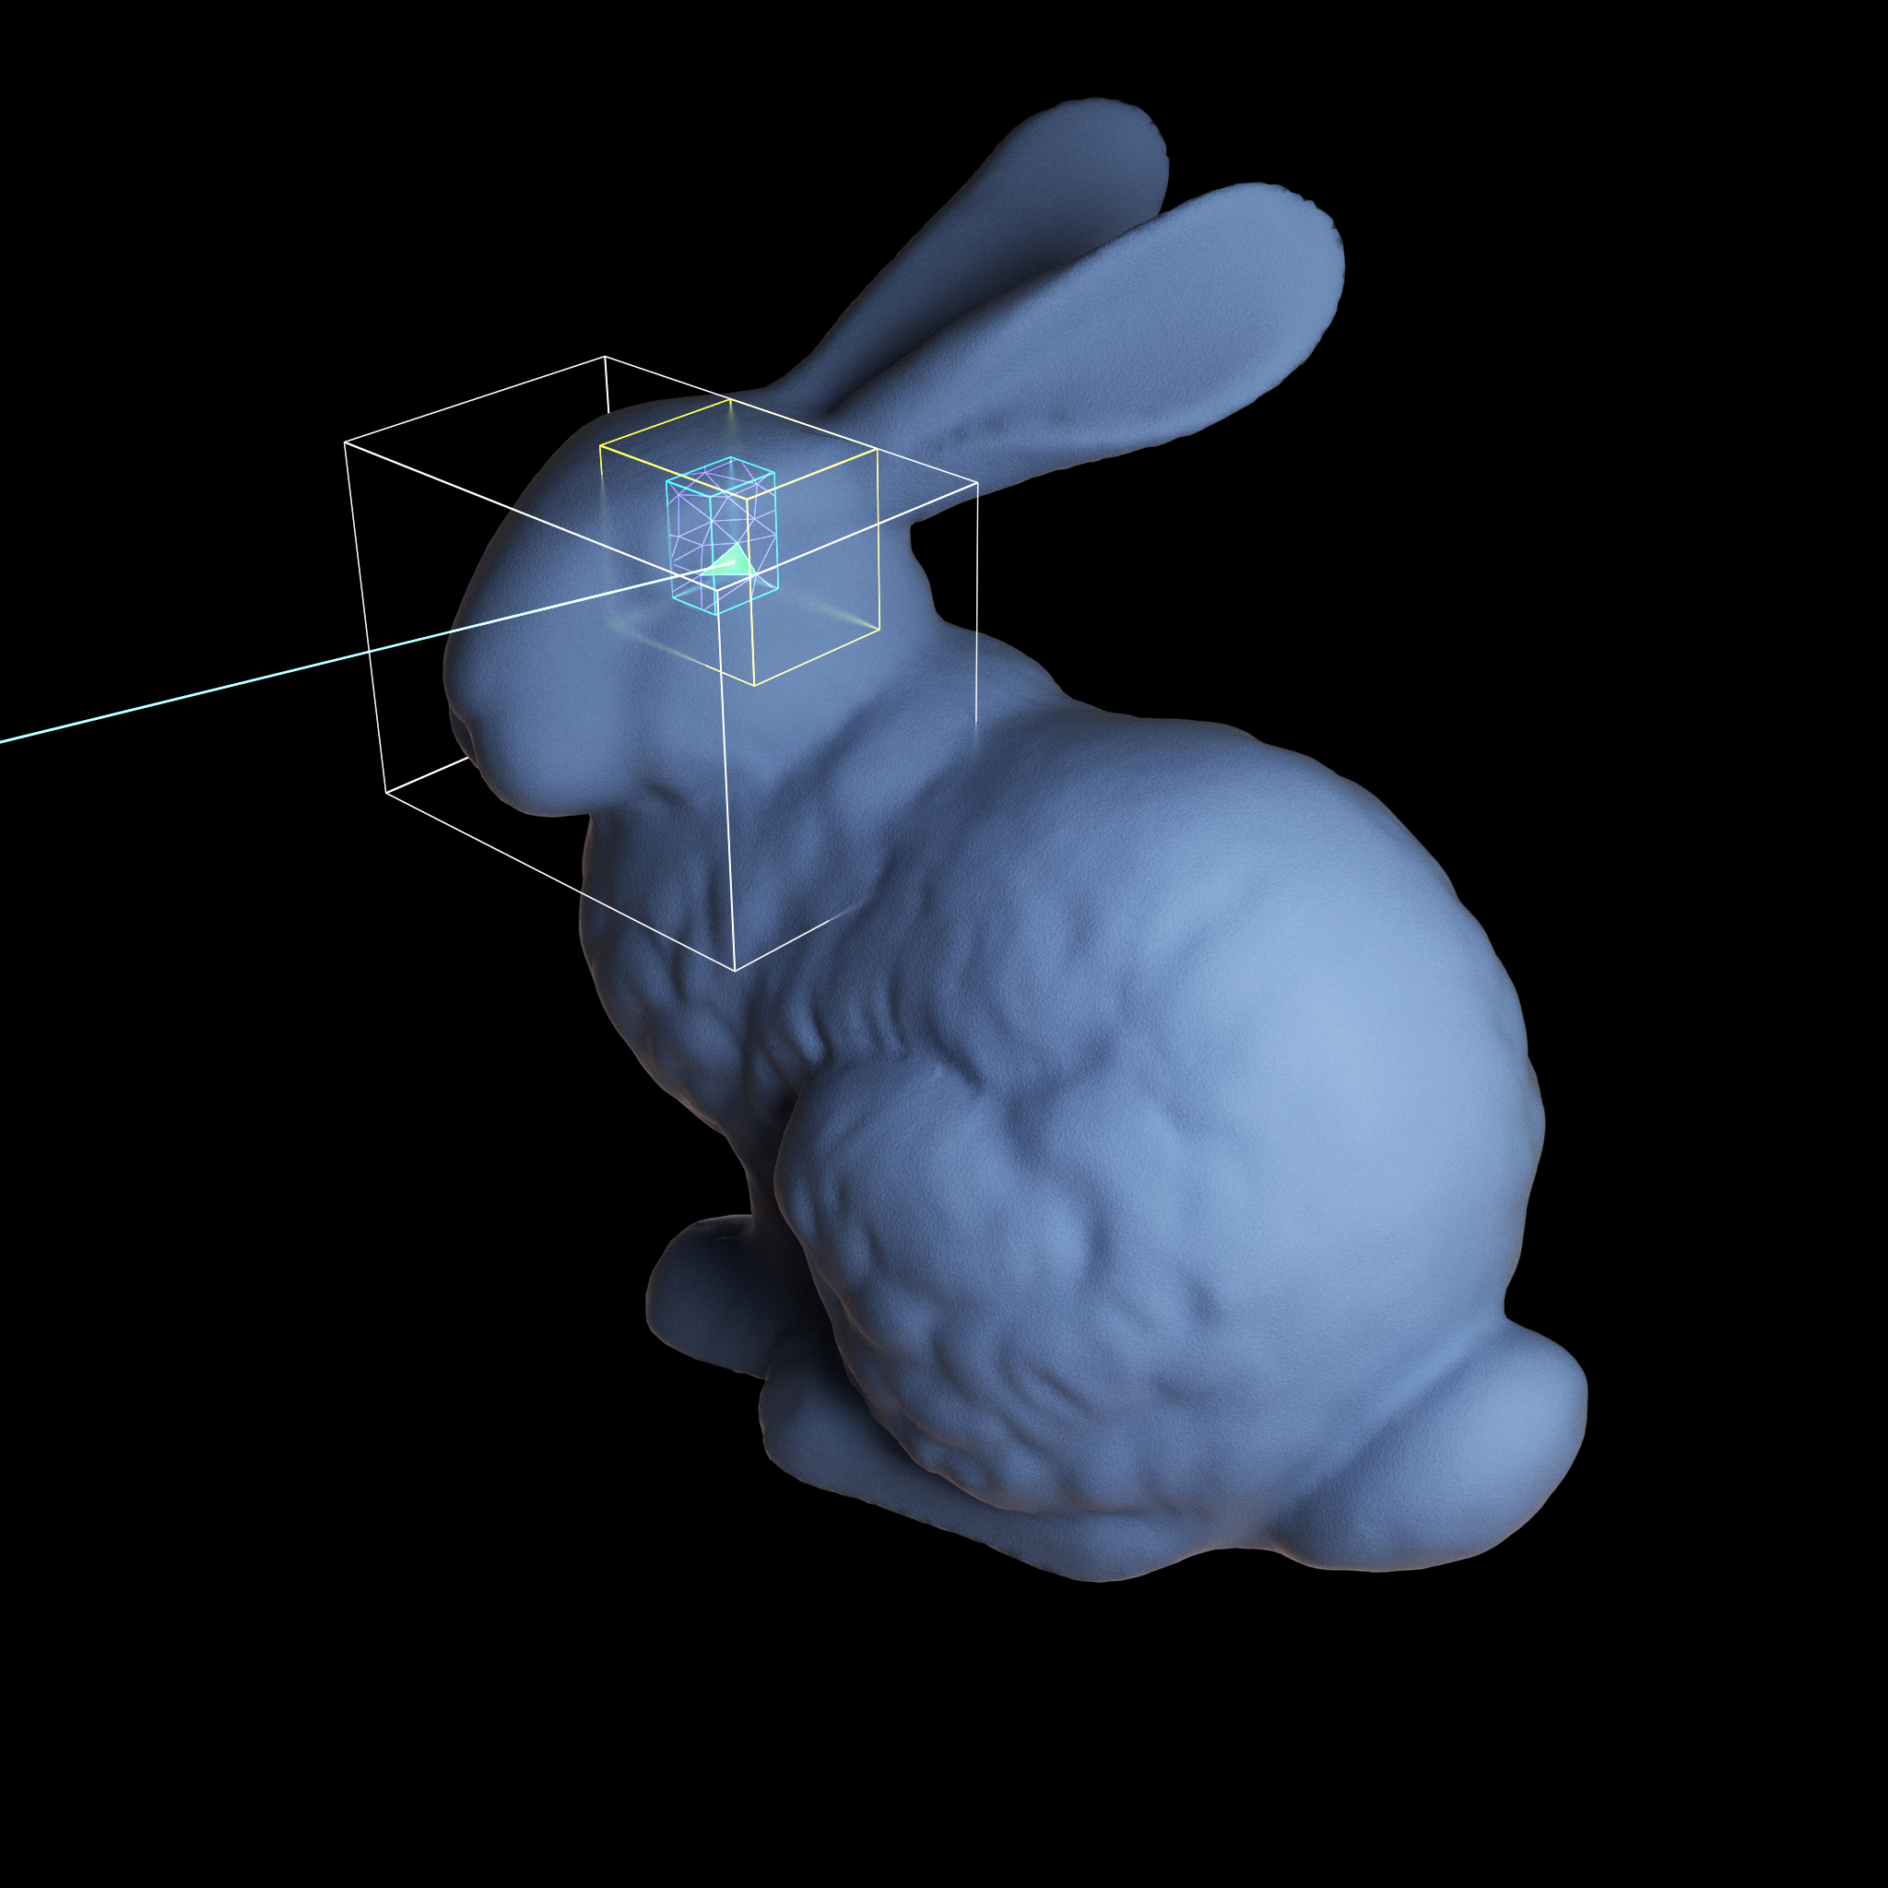

BVH Algorithm
Notes:
Quick refresher on how RT tackles the scene representation problem.
10 box tests + 10 triangle tests vs 1000 triangle tests.
BVH not a new idea. Been around for decades. But devil is in the details if you want it really fast. Lots of research around that, both construction and traversal, from NV and many others.
Source: Steve Parker’s HPG 2019 talk

Slide 27
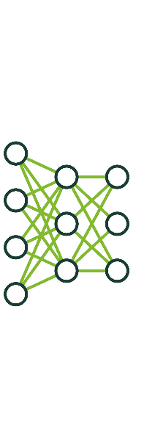

Deep Learning for Image Denoising
Training
Data
Training
Trained Neural
Network
Inferencing
Trained network detects noise and reconstructs
Rendered 20,000 training images
Apply trained network to noisy images
Training on progression of images
Notes:
Developing an application that benefits from DL is different from traditional software development, where software engineers must carefully craft lots of source code to cover every possible input the application may receive.
From NVIDIA’s “Deep Learning for Rendering” 2018
At the core of a DL application, much of that source code is replaced by a neural network.
To build a DL application, first a data scientist designs, trains and validates a neural network to perform a specific task.
The task could be anything, like identifying types of vehicles in an image, reading the speed limit sign as it goes whizzing past, translating English to Chinese, etc.
The trained neural network can then be integrated into a software application that feeds it new inputs to analyze, or “infer” based on its training.
The application may be deployed as a cloud service, on an embedded platforms, in an automobiles, or other platforms.
As you would expect, the amount of time and power it takes to complete inference tasks is one of the most important considerations for DL applications, since this determines both the quality/value of the user experience and the cost of deploying the application.

Slide 28
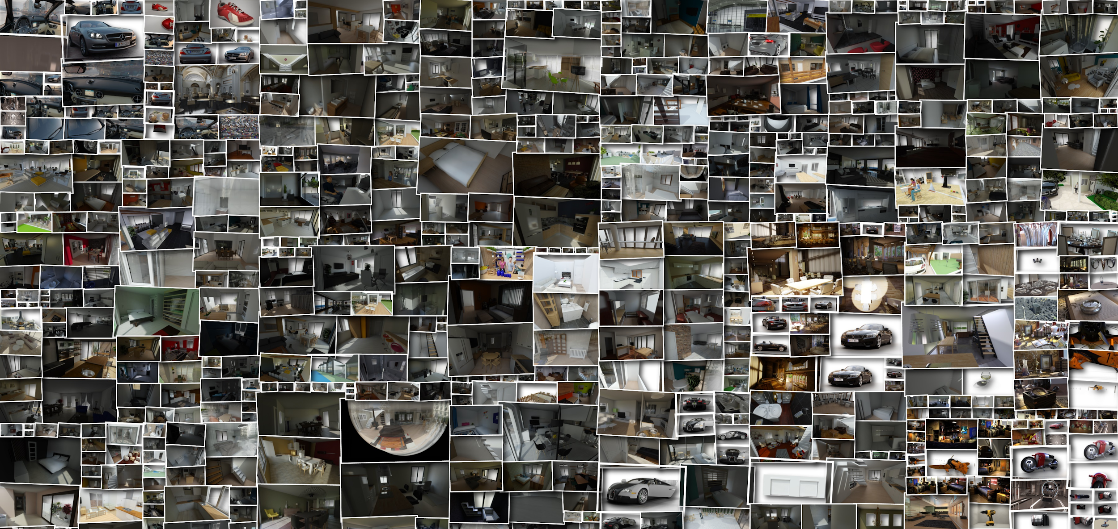
Training Set
Notes:
From NVIDIA’s “Deep Learning for Rendering” 2018

Slide 29
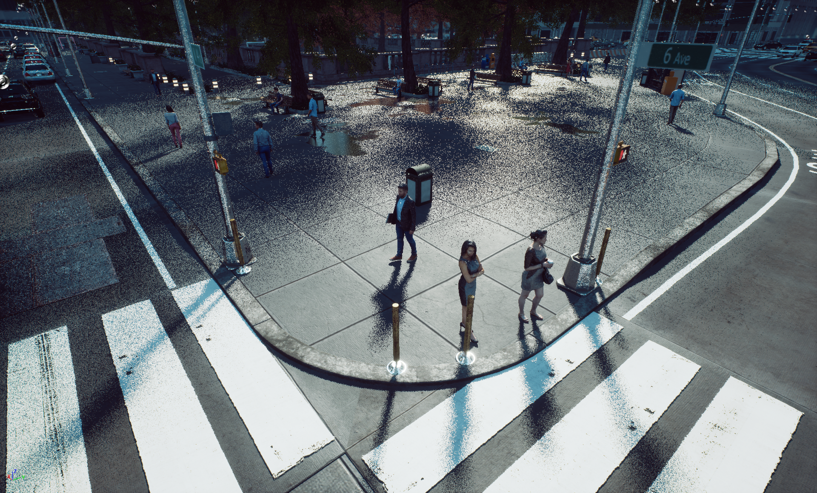
1 spp Ray Traced Shadows
Notes:
Test scene for raytraced shadows. Overcast sky so shadows are soft.
This what it looks like at 1spp without denoising.

Slide 30
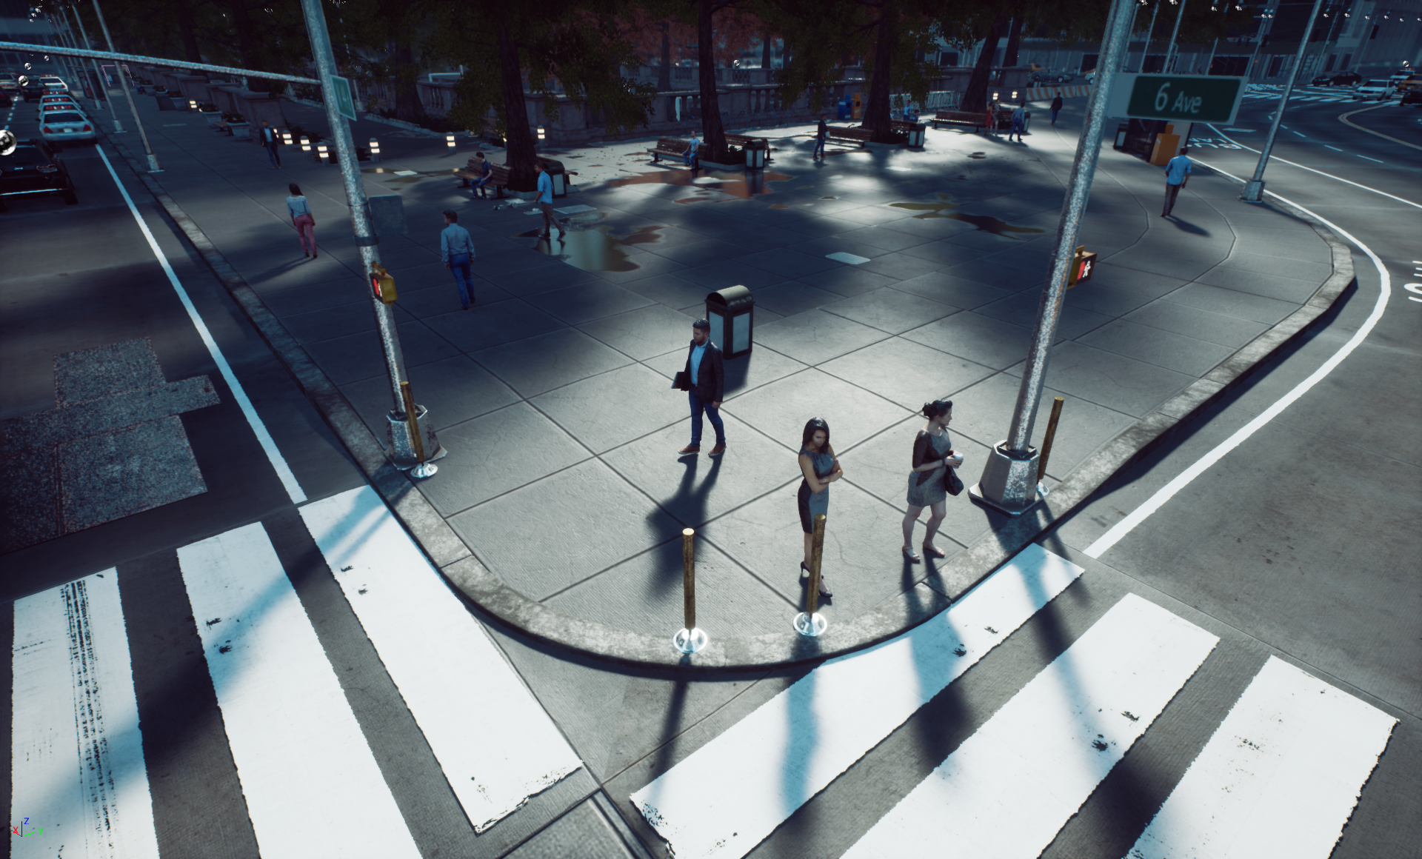
1 spp Ray Traced Shadows + Denoising
Notes:
And this is the results of applying our denoisers to 1spp ray traced shadows.
What this does is cleverly re-use and blend the samples from neighbor pixels as well as previous frames.
So this is a combination of spatial and temporal filtering.

Slide 31
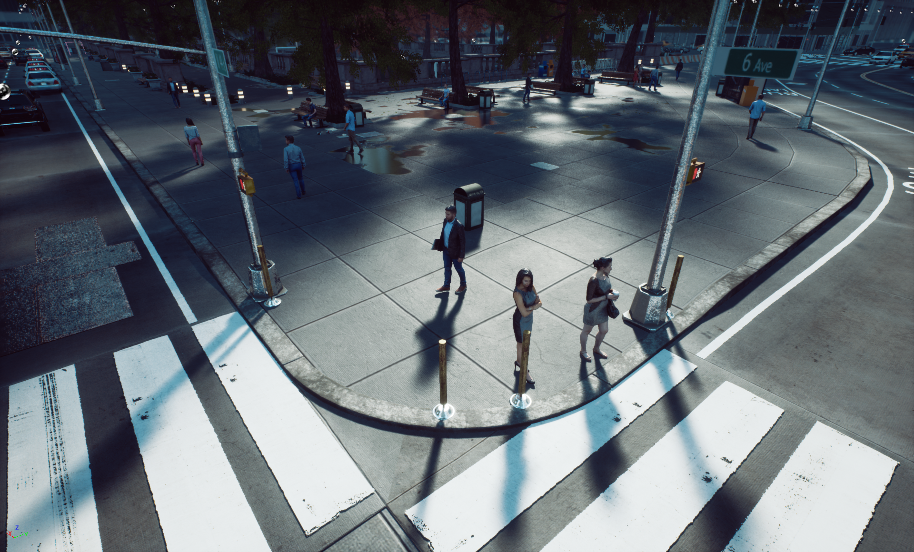
Ray Traced Shadow Ground Truth
Notes:
And this is the ground truth, using hundreds of rays per pixel and no denoising.
We got really close with 1spp denoised!

Slide 32
Some Uses for Rays
What do we see in a direction from a location?
Is there something in between two locations?
What is this location inside of, if anything?
Notes:
https://www.fastcompany.com/90736343/how-epic-games-is-changing-gaming-and-maybe-the-metaverse

Slide 33
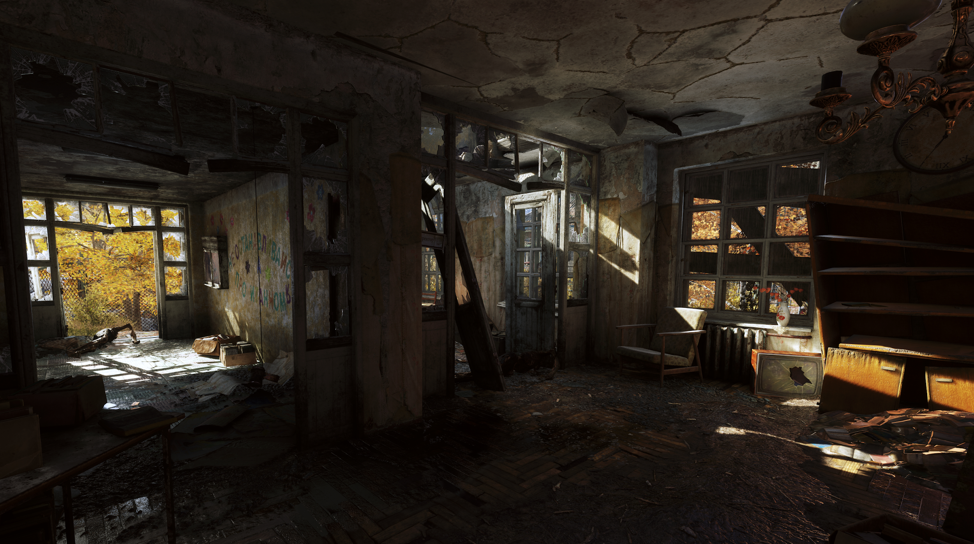
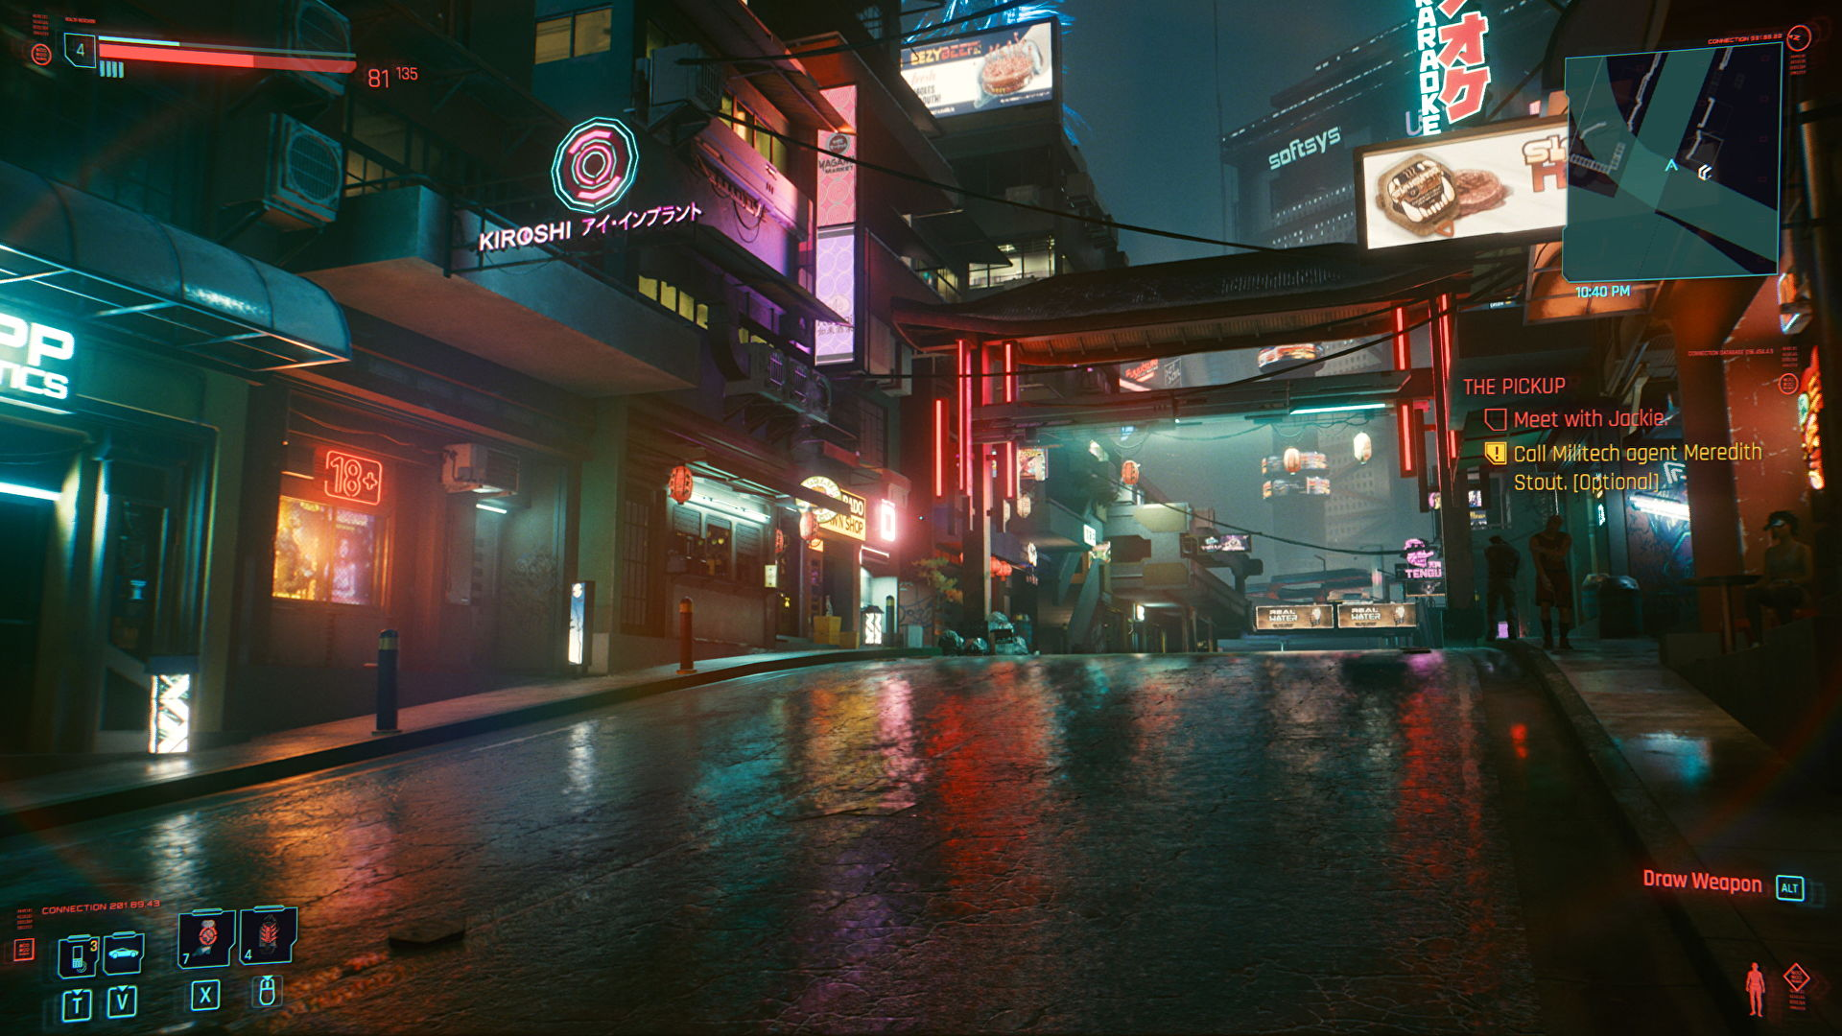
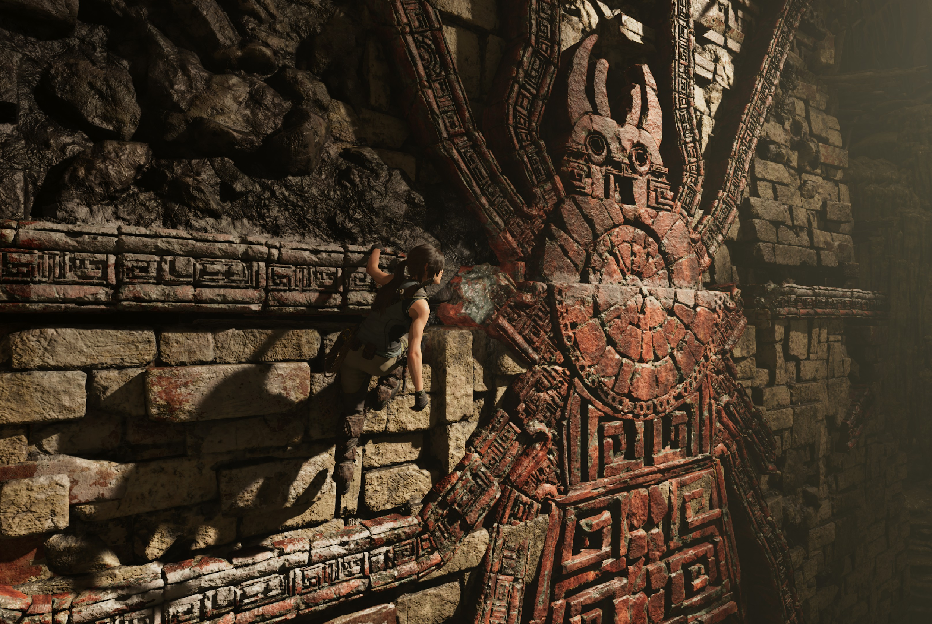
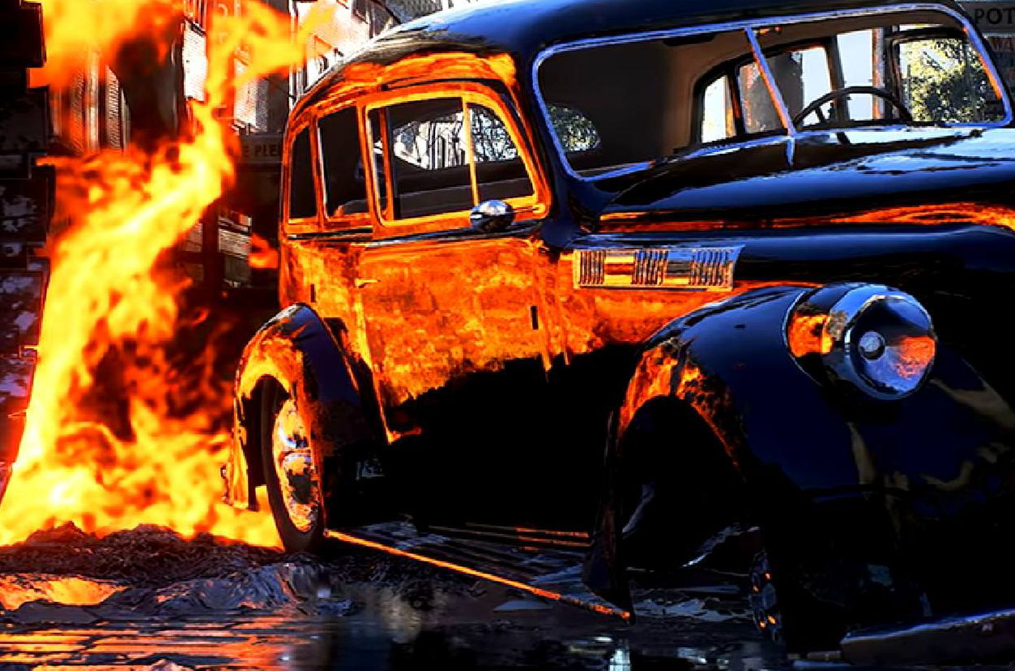
Ray Tracing Techniques
Global Illumination (GI)
Reflections
Metro Exodus
Cyberpunk 2077
Battlefield V
Shadow of the Tomb Raider
Shadows
Notes:
Updated from Steve Parker (HPG 2019) and Chris Wyman (SIGGRAPH 2019 “The Path To Performance: Scaling Game Path Tracing”). Partners where we worked on the tech.

Slide 34
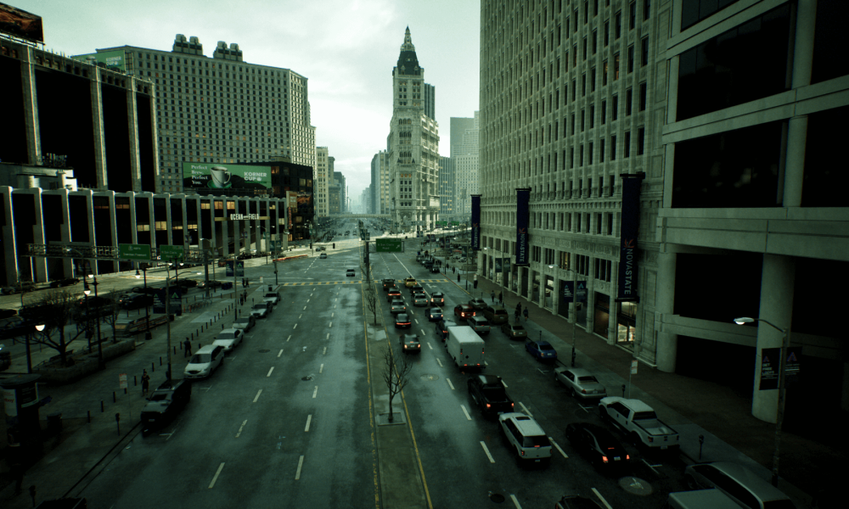
Ray Tracing: Media & Entertainment
Rasterization & ray tracing hybrid, Playstation 5
The Matrix Awakens
from Epic on Unreal Engine
Notes:
https://www.fastcompany.com/90736343/how-epic-games-is-changing-gaming-and-maybe-the-metaverse

Slide 35
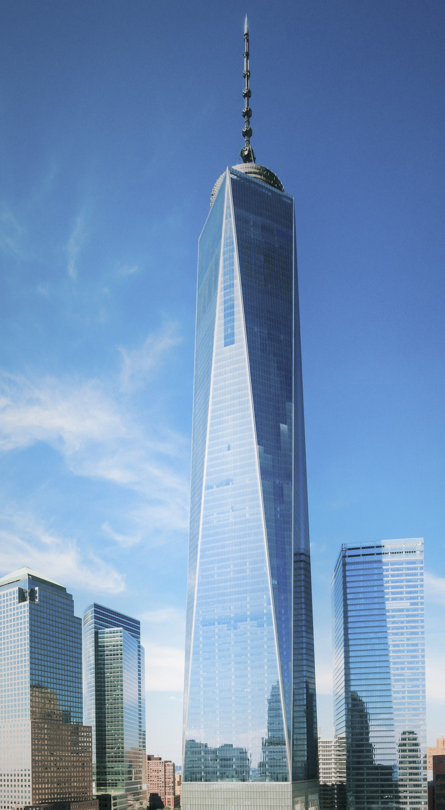
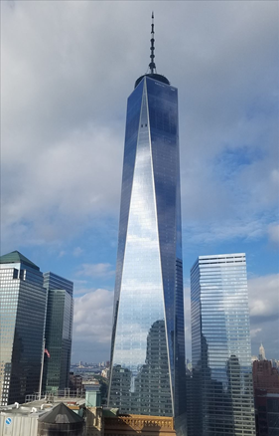
Ray Tracing: Architectural Design
World Trade Center,
from “Ray Tracing: A Tool for All,” by Jon Peddie

Slide 36
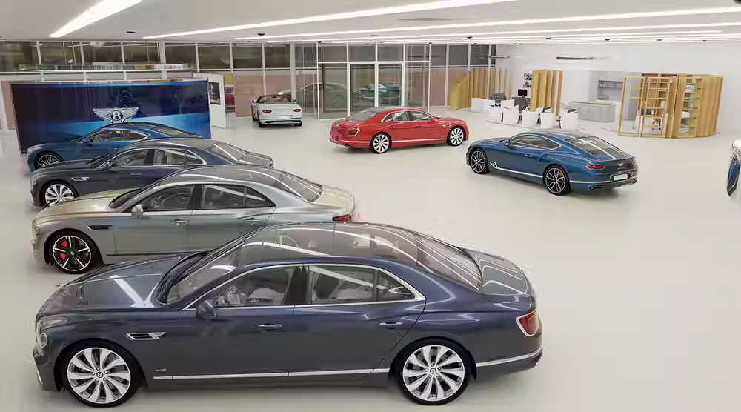
Ray Tracing: Industrial Design
Bentley Motors virtual showroom, 110+ GB data, using the open source OSPRay Studio application

Slide 37
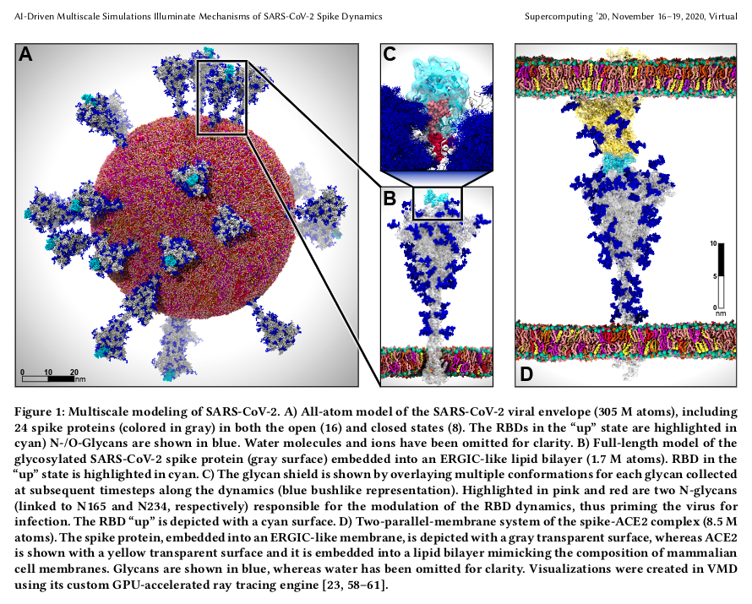
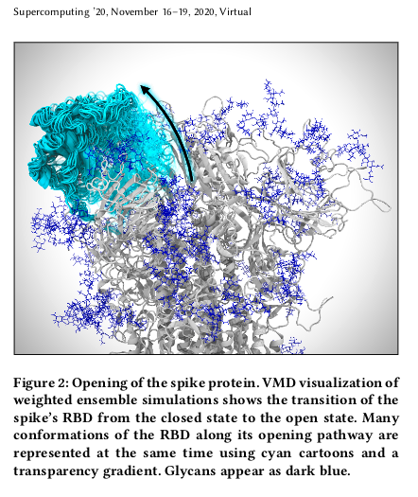
Ray Tracing: Scientific Visualization
Notes:
1.7 million atoms, visible in real-time.

Slide 38
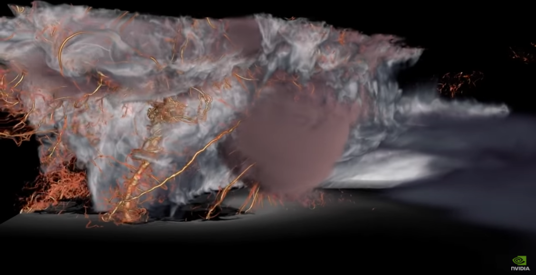
Ray Tracing: Scientific Visualization
Supercell thunderstorm visualization, University of Wisconsin
Notes:
Ray Marching
https://www.youtube.com/watch?v=SonfENaSesw&t=198s – done with Omniverse

Slide 39
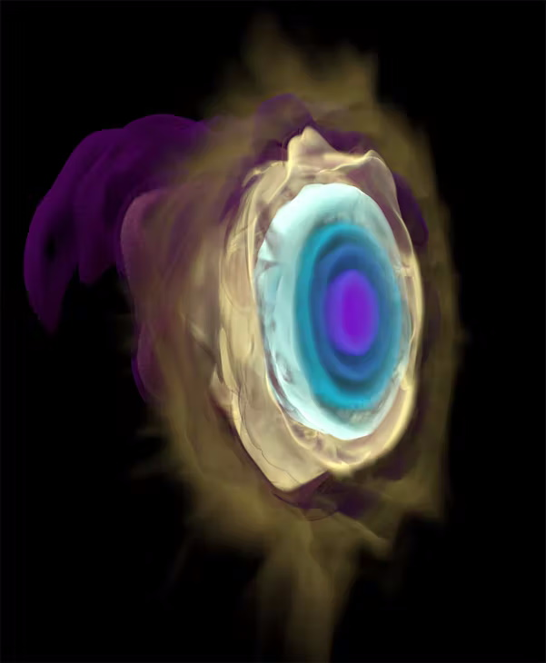
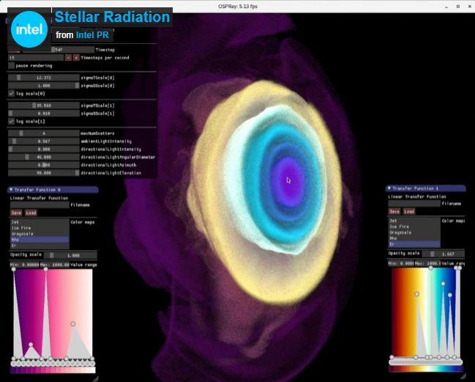
Ray Tracing: Scientific Visualization
Stellar radiation vis. by G.P. Johnson & J. Insley, Argonne National Lab
Notes:
Ray Marching
https://www.electronicdesign.com/industrial-automation/article/21131013/ray-tracing-one-size-does-not-fit-all

Slide 40
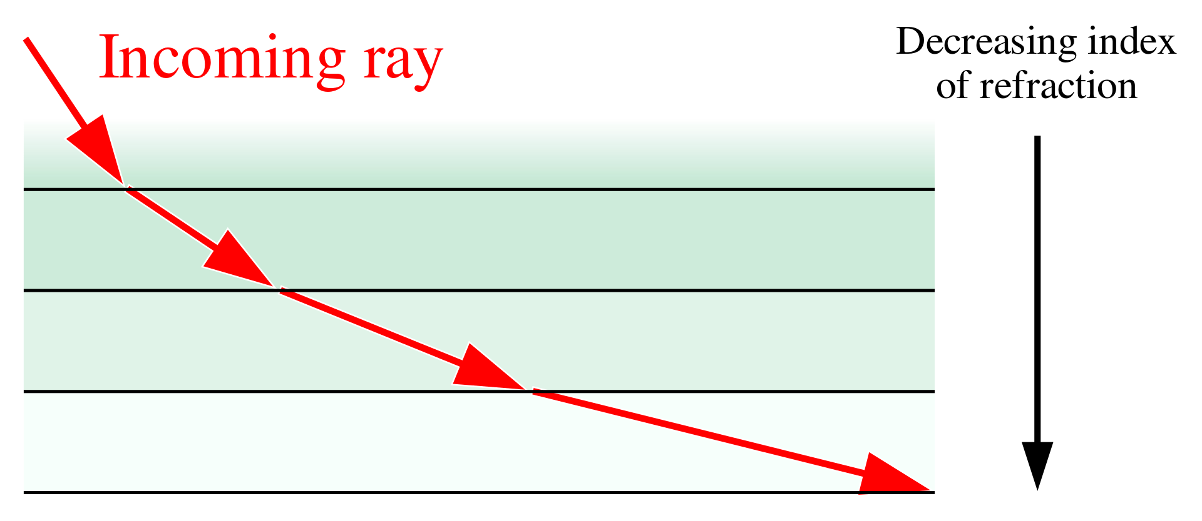
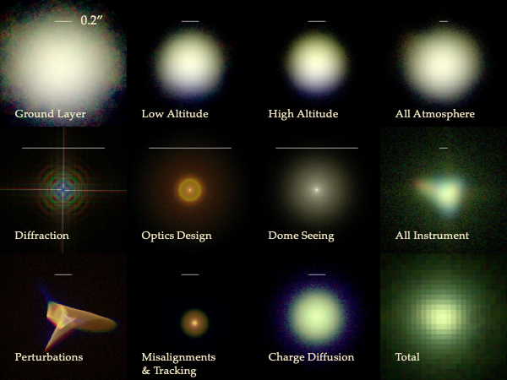
Ray Tracing: Telescope Design
PhoSim simulation of how light interacts with an imaging system
Light bends as it moves through the Earth’s atmosphere
Notes:
More Ray Marching
https://en.wikipedia.org/wiki/Ray_tracing_(physics)
https://bitbucket.org/phosim/phosim_release/wiki/Home

Slide 41
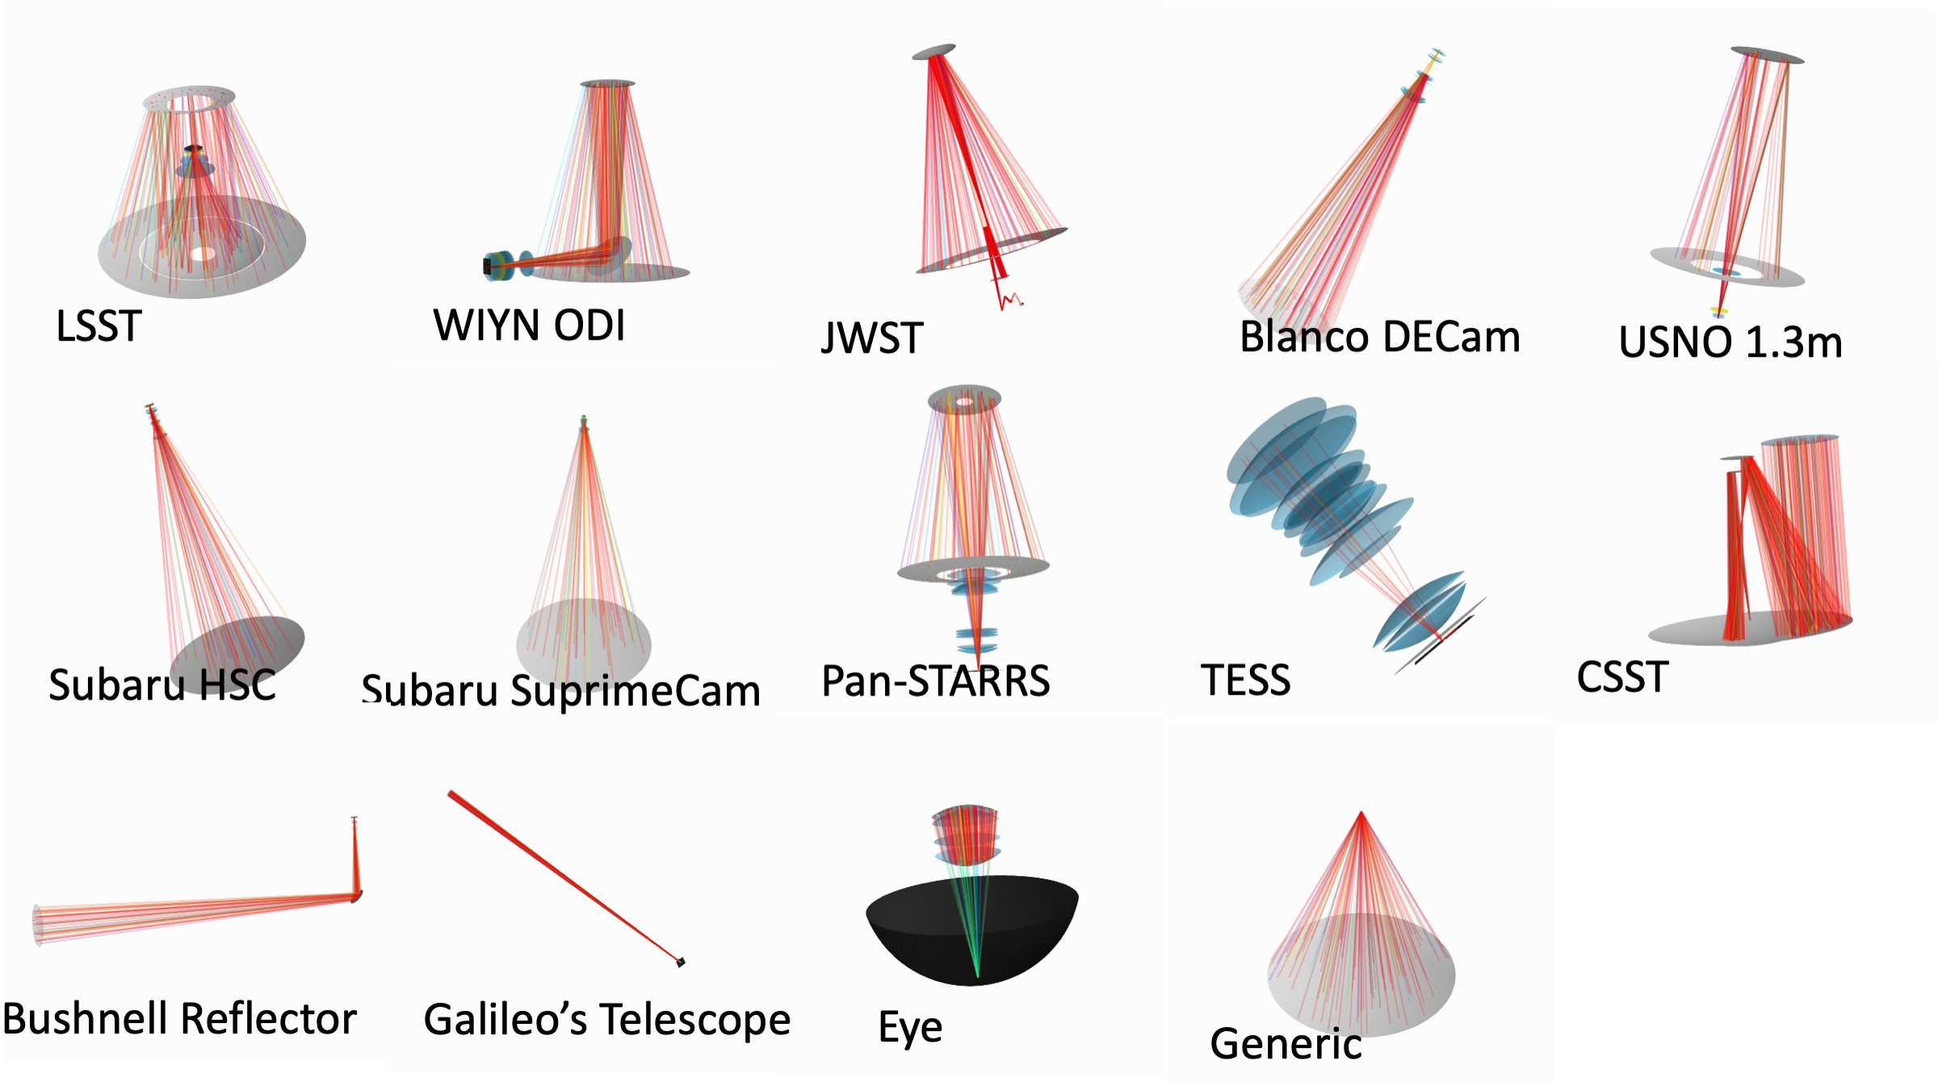
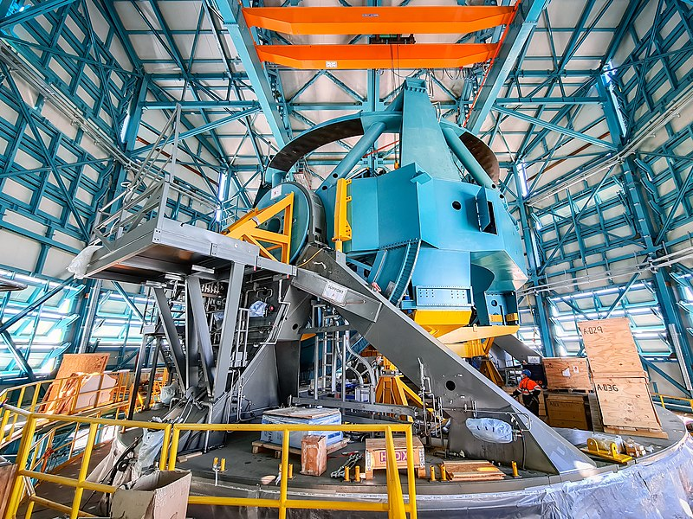
Ray Tracing: Telescope Design
Vera C. Rubin Observatory, currently under construction in Chile
Notes:
https://en.wikipedia.org/wiki/Vera_C._Rubin_Observatory
https://bitbucket.org/phosim/phosim_release/wiki/Home

Slide 42
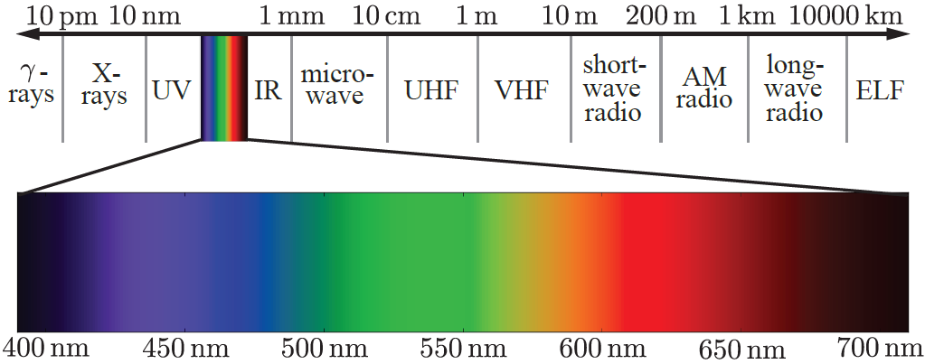
Photons
Notes:
Leftmost: Gamma rays have the smallest wavelengths and the most energy of any wave in the electromagnetic spectrum. They are produced by the hottest and most energetic objects in the universe, such as neutron stars and pulsars, supernova explosions, and regions around black holes.
ELF – Extremely low frequency (ELF) fields includes alternating current (AC) fields and other electromagnetic, non-ionizing radiation from 1 Hz to 300 Hz. ELF fields at 60 Hz are produced by power lines, electrical wiring, and electrical equipment. Some epidemiological studies have suggested increased cancer risk associated with magnetic field exposures near electric power lines.

Slide 43
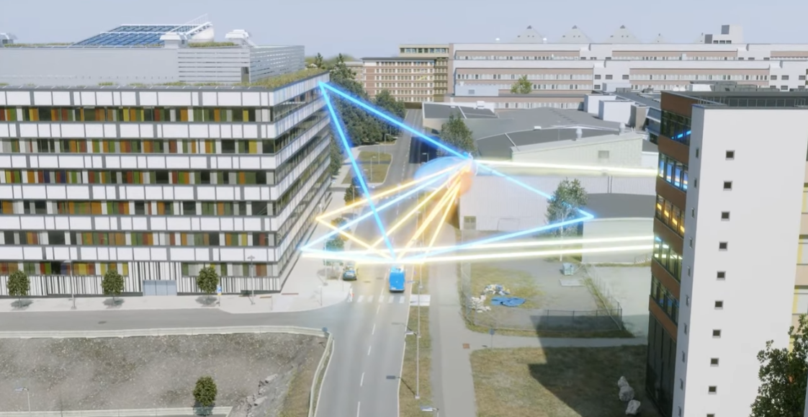
Ray Tracing: 5G Propagation Simulation
Digital Twin by Ericsson
Notes:
https://www.youtube.com/watch?v=yTbUSXJ8M-8

Slide 44
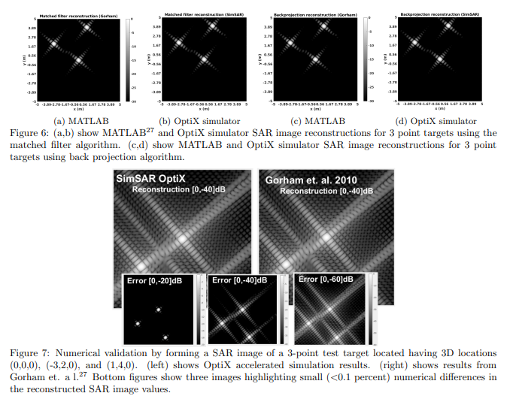
Ray Tracing: Synthetic Aperture Radar
From Andrew R. Willis, Md Sajjad Hossain and Jamie Godwin, “Hardware-Accelerated SAR Simulation with NVIDIA-RTX Technology”
Notes:
Used in target recognition, mapping, surveillance, oceanography, geology, forestry (biomass, deforestation), disaster monitoring (volcano eruptions, oil spills, flooding), and infrastructure tracking (urban growth, structure mapping).
https://arxiv.org/pdf/2005.09736.pdf

Slide 45
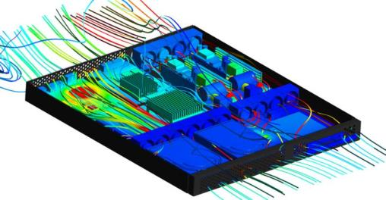
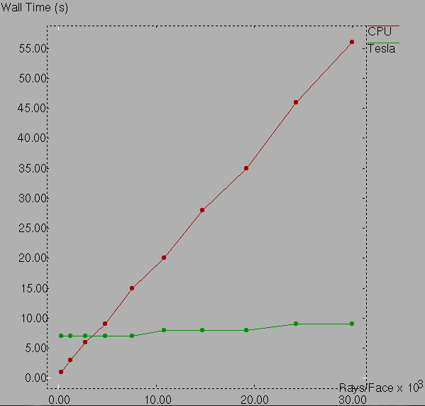

Ray Tracing: Simulation of Heat Transfer
NOTE: Growing CPU time of view-factor computations inhibit proper inclusion of radiation HT effects
NOTE: GPU time remains low even as view-factor computations grow very large
Integral to version 14.5
OptiX in 2016, before ray tracing enhanced GPUs
Notes:
From 2016

Slide 46
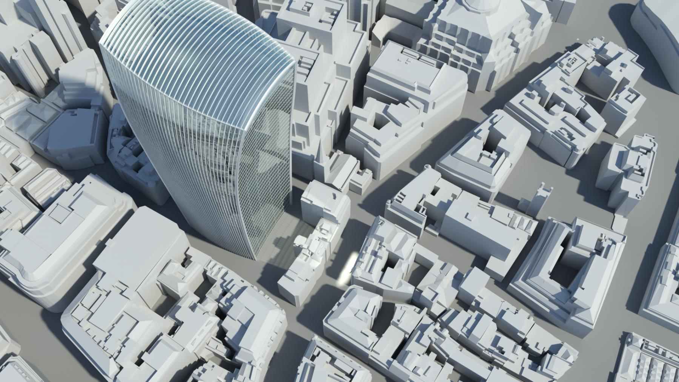
Using Iray to Measure Light
Notes:
The curved building focuses the sun on a spot, making for a “burn zone” for cars, etc. – melted a Jaguar
https://www.solidsmack.com/cad/nvidia-melts-jaguar-cars-with-death-rays-to-show-off-rendering-power/

Slide 47
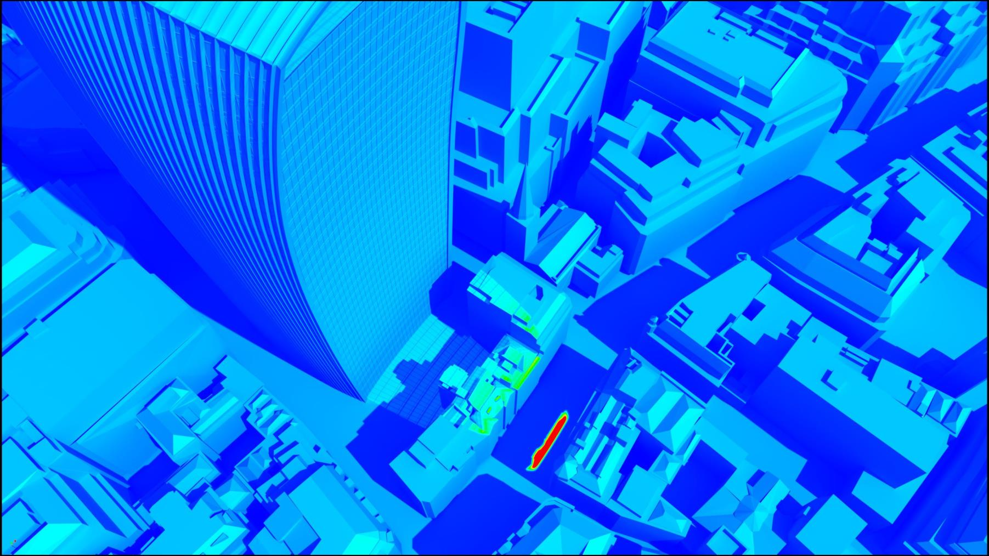
Using Iray to Measure Light
Illumination Measurement
In Lux/Foot Candles

Slide 48
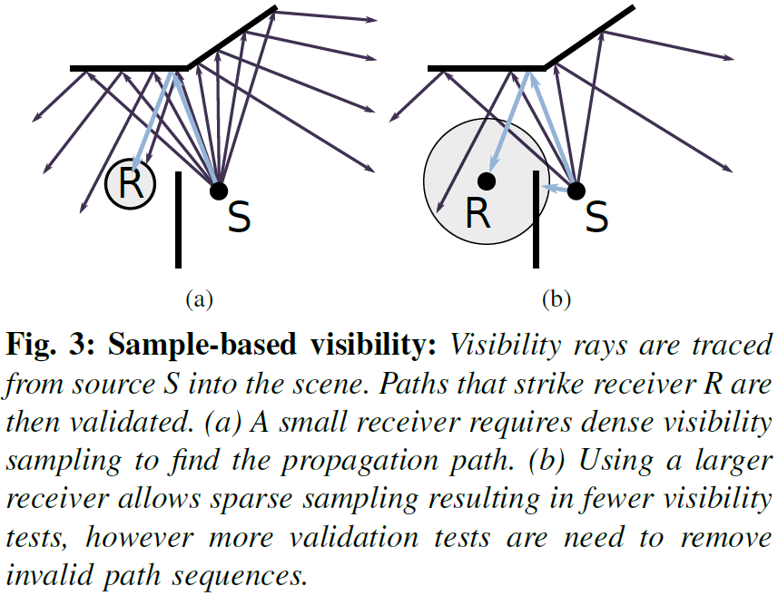
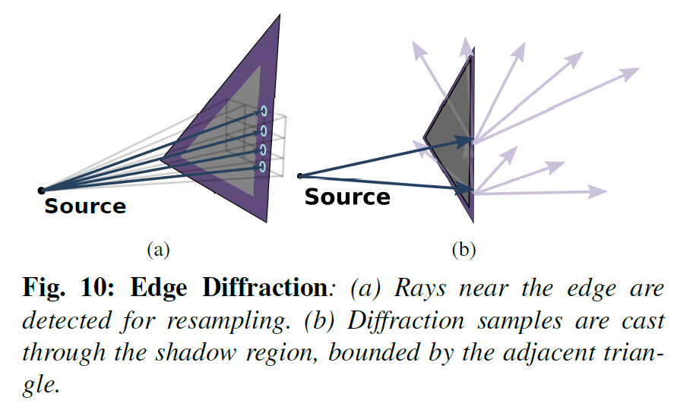
Ray Tracing: Audio Simulation
from "Guided Multiview Ray Tracing for Fast Auralization" by Micah Taylor, Anish Chandak, Qi Mo, Christian Lauterbach, Carl Schissler, and Dinesh Manocha, 2012

Slide 49
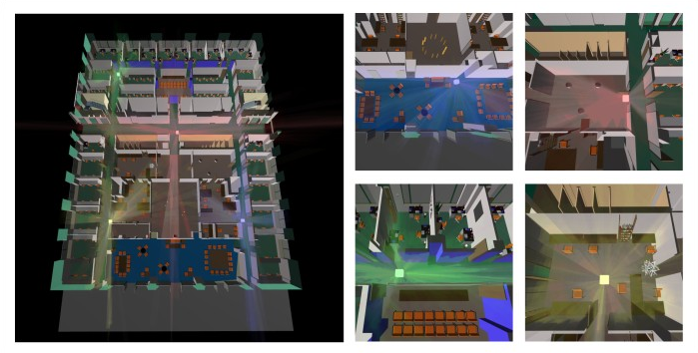
Ray Tracing: Audio Simulation
Dolby: Sound propagation

Slide 50


Ray Tracing: Seismology
Notes:
https://en.wikipedia.org/wiki/Ray_tracing_(physics)
https://web.ics.purdue.edu/~nowack/geos557/lecture14c-dir/lecture14c.htm

Slide 51

Ray Tracing: Collision Detection and Response
from Ray-Traced Collision Detection: Interpenetration Control and Multi-GPU Performance, by François Lehericey, Valérie Gouranton, Bruno Arnaldi
Notes:
Source: Ray Tracing Gems

Slide 52


Ray Tracing: Training Robots
Anymal, a robot dog, trained by ETH Zurich and Swiss-Mile with Isaac Sim. Left: virtual world; right: real world
Notes:
https://developer.nvidia.com/isaac-sim
https://www.youtube.com/watch?v=VW-dOMBFj7o

Slide 53

Ray Tracing: Simulation for Self-Driving Cars
Notes:
https://www.nvidia.com/en-us/self-driving-cars/simulation/
https://youtu.be/UoPXzzK_g1Q

Slide 54


Two Non-Technical References
Wayne Carlson book available for free at https://bit.ly/cghistory
Notes:
https://www.amazon.com/Ray-Tracing-Tool-Jon-Peddie/dp/3030174891 – 2019
Free book 2013

Slide 55

Questions?
For technical info:
http://bit.ly/rtrtinfo
Notes:
Source: Eric Haines, taken at NVIDIA booth
http://bit.ly/rtrtinfo and http://raytracinggems.com

Slide 56

Notes:
https://cesium.com/open-metaverse-podcast/the-evolution-of-computer-graphics/

Slide 57

Marbles RTX
Ampere | 1440p @ 30 fps
Depth of Field
130 Area Lights
Notes:
Marbles at GTC
Marbles Now
720p @ 25 fps
1440p @ 30 fps
DLSS for AA (no scaling)
DLSS Upscaling
Recorded on RTX8000 (TU102)
Recorded on A6000 (GA102)
Indirect GI is on
Indirect GI is on
No DOF
DOF
1 dome light + 1 indirect light
85+ Lights

Slide 58

Dedicated hardware FTW
Notes:
I think there’s even more performance and quality to be gained here by software. Not just tuning, though that is important, but also being clever about sampling and filtering.

Slide 59


How to paint a scene?
Study for “A Sunday Afternoon on the Island of La Grande Jatte,” Georges Seurat
Notes:
Source: Ray Tracing Gems

