Slide 1
From Ray to Path Tracing:
Navigating through Dimensions
SIGGRAPH 2020
Emmanuel Turquin
Unity Technologies
Notes:
Hi everyone, I’m Emmanuel.
Don’t you think that this beautiful art perfectly conveys the feeling of getting lost in some distant, unknown dimensions? Hopefully, by the end of this presentation, we will have found our way through!

Slide 2
The rise of Path Tracing in production rendering
Not so long ago, offline production rendering was still dominated by REYES or Scanline
Direct lighting only, and tricks to approximate indirect effects
Little by little, more ray tracing was blended in:
ambient occlusion, reflections and refractions, soft shadows,
one-bounce indirect diffuse, ...
Nowadays, a vast majority of offline production renderers are using Path Tracing
Notes:
But let’s rewind a bit: I was fortunate enough to experience firsthand the advent of path tracing in the animation and visual effects industries, from a time when it was deemed completely impractical, a dozen or so years ago, to a point of ubiquity nowadays.
The transition happened gradually, with more and more ray-tracing effects, such as ambient occlusion, reflections and refractions, soft shadows or one-bounce indirect diffuse lighting, mixed into a REYES or Scanline architecture.

Slide 3
The rise of Path Tracing in production rendering
Not so long ago, offline production rendering was still dominated by REYES or Scanline
Direct lighting only, and tricks to approximate indirect effects
Little by little, more ray tracing was blended in:
ambient occlusion, reflections and refractions, soft shadows,
one-bounce indirect diffuse, ...
Nowadays, a vast majority of offline production renderers are using Path Tracing
The Path to Path-Traced Movies [Christensen 2016]
Guest Editor’s Introduction: Special Issue on Production Rendering [Pharr 2018A]
Notes:
If you want to learn more about this shift, I’d recommend this detailed survey, by Christensen and Jarosz, as well as the Introduction to the ToG special issue on Production Rendering, by Matt Pharr.

Slide 4
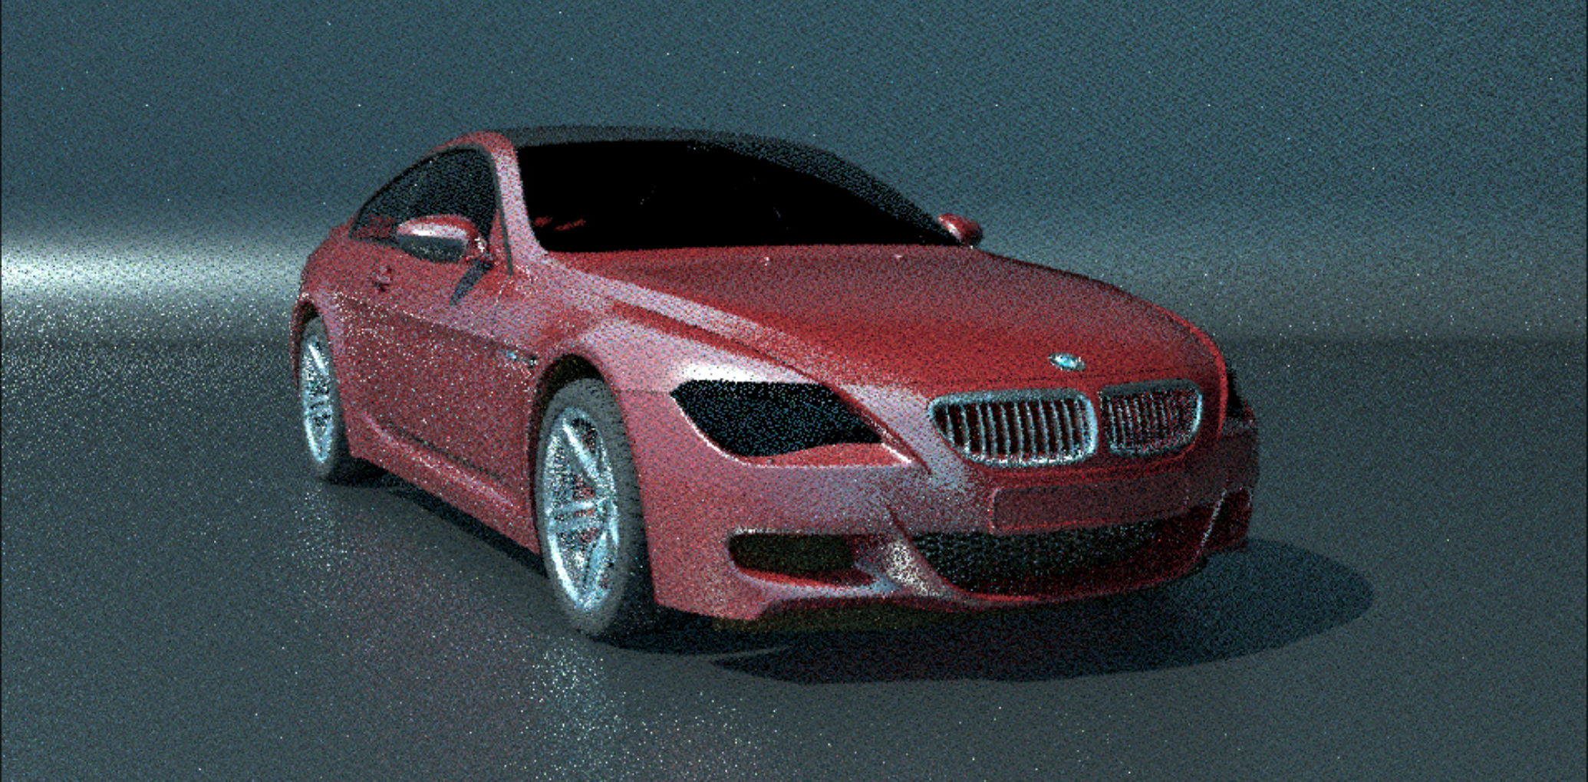
Ray Tracing: from offline to real-time
Adopting Lessons from Offline Ray-Tracing to Real-Time Ray Tracing for Practical Pipelines [Pharr 2018B]
Notes:
Speaking of him, he also gave a great presentation, in this very same course 2 years ago, where he highlighted the parallel between the early days of ray tracing as a companion to REYES, to what it is now for real-time and rasterization.
We see many well-known algorithms being re-implemented to take advantage of new hardware, so it seems only natural to delve into years and years of ray tracing in action, and adapt this knowledge and best practices to their GPU-accelerated variants.
Matt identified 4 categories of concepts and lessons we should carry from the offline world:

Slide 5
Ray Tracing: from offline to real-time
Choose your rays wisely
Monte Carlo integration
Variance, error
Importance sampling
Multiple importance sampling
Notes:
The first one introduced Monte Carlo Integration, the concepts of variance and error, importance sampling and multiple importance sampling.

Slide 6
Ray Tracing: from offline to real-time
Choose your rays wisely
Choose your (not) RND numbers carefully
Monte Carlo integration
Variance, error
Importance sampling
Multiple importance sampling
Domain warping [Pharr 2019]
Quasi-random sequences
Low discrepancy, stratification
Notes:
The second focused on domain warping (which was the subject of another great presentation of his, last year), but also quasi-random sequences and their critical low-discrepancy and stratification properties.

Slide 7
Ray Tracing: from offline to real-time
Choose your rays wisely
Choose your (not) RND numbers carefully
Monte Carlo integration
Variance, error
Importance sampling
Multiple importance sampling
Domain warping [Pharr 2019]
Quasi-random sequences
Low discrepancy, stratification
Spend your ray budget where it’s most useful
Adaptive Sampling
Notes:
The third was all about adaptive sampling, and how to best adjust the number of rays traced per pixel.

Slide 8
Ray Tracing: from offline to real-time
Choose your rays wisely
Choose your (not) RND numbers carefully
Monte Carlo integration
Variance, error
Importance sampling
Multiple importance sampling
Domain warping [Pharr 2019]
Quasi-random sequences
Low discrepancy, stratification
Spend your ray budget where it’s most useful
Understand and defend against error
Adaptive Sampling
Intensity clamping
Path regularization
Notes:
And the fourth and last one dealt with eliminating “fireflies”, those pesky high-valued pixels, by intensity clamping and path regularization.
Note that in addition to his presentation slides, you can also find more details on most of these points in the corresponding chapters of the “Ray-Tracing Gems” book.

Slide 9
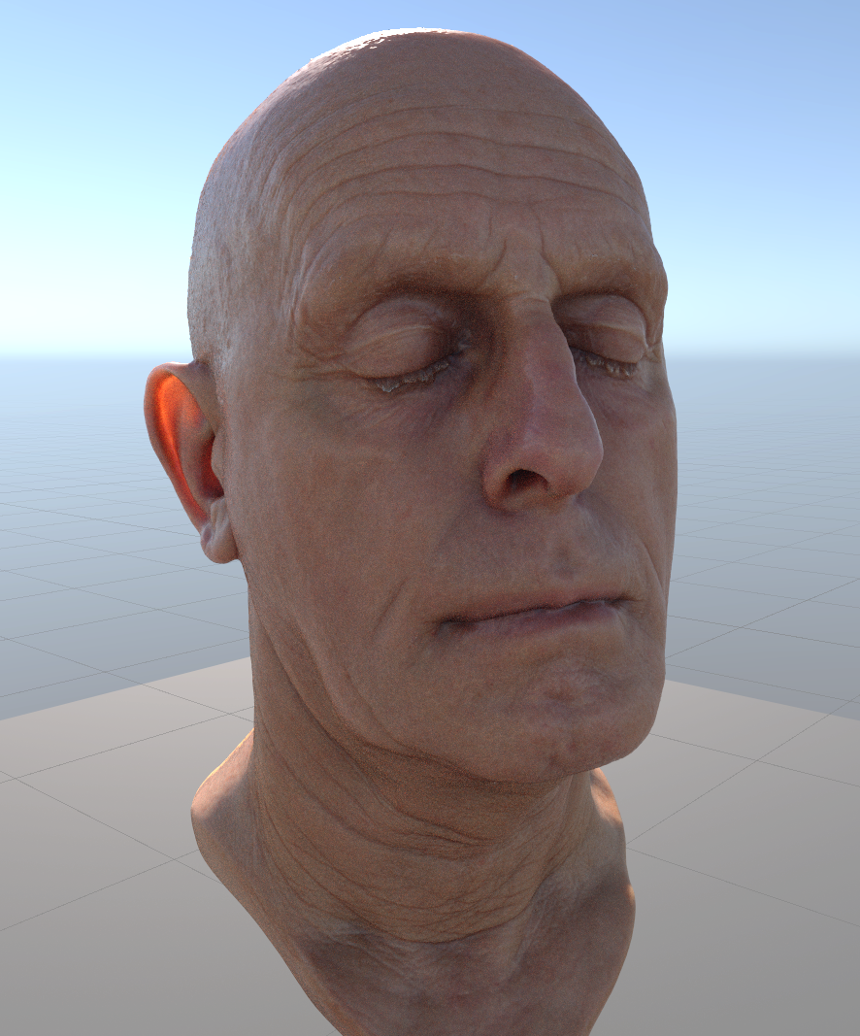
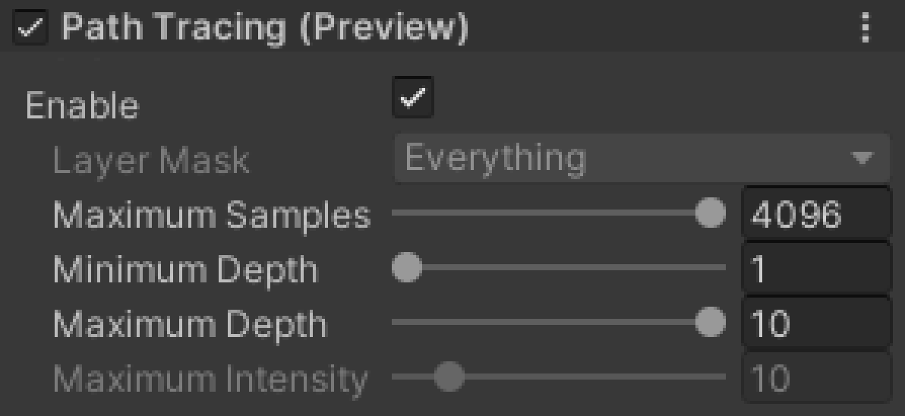
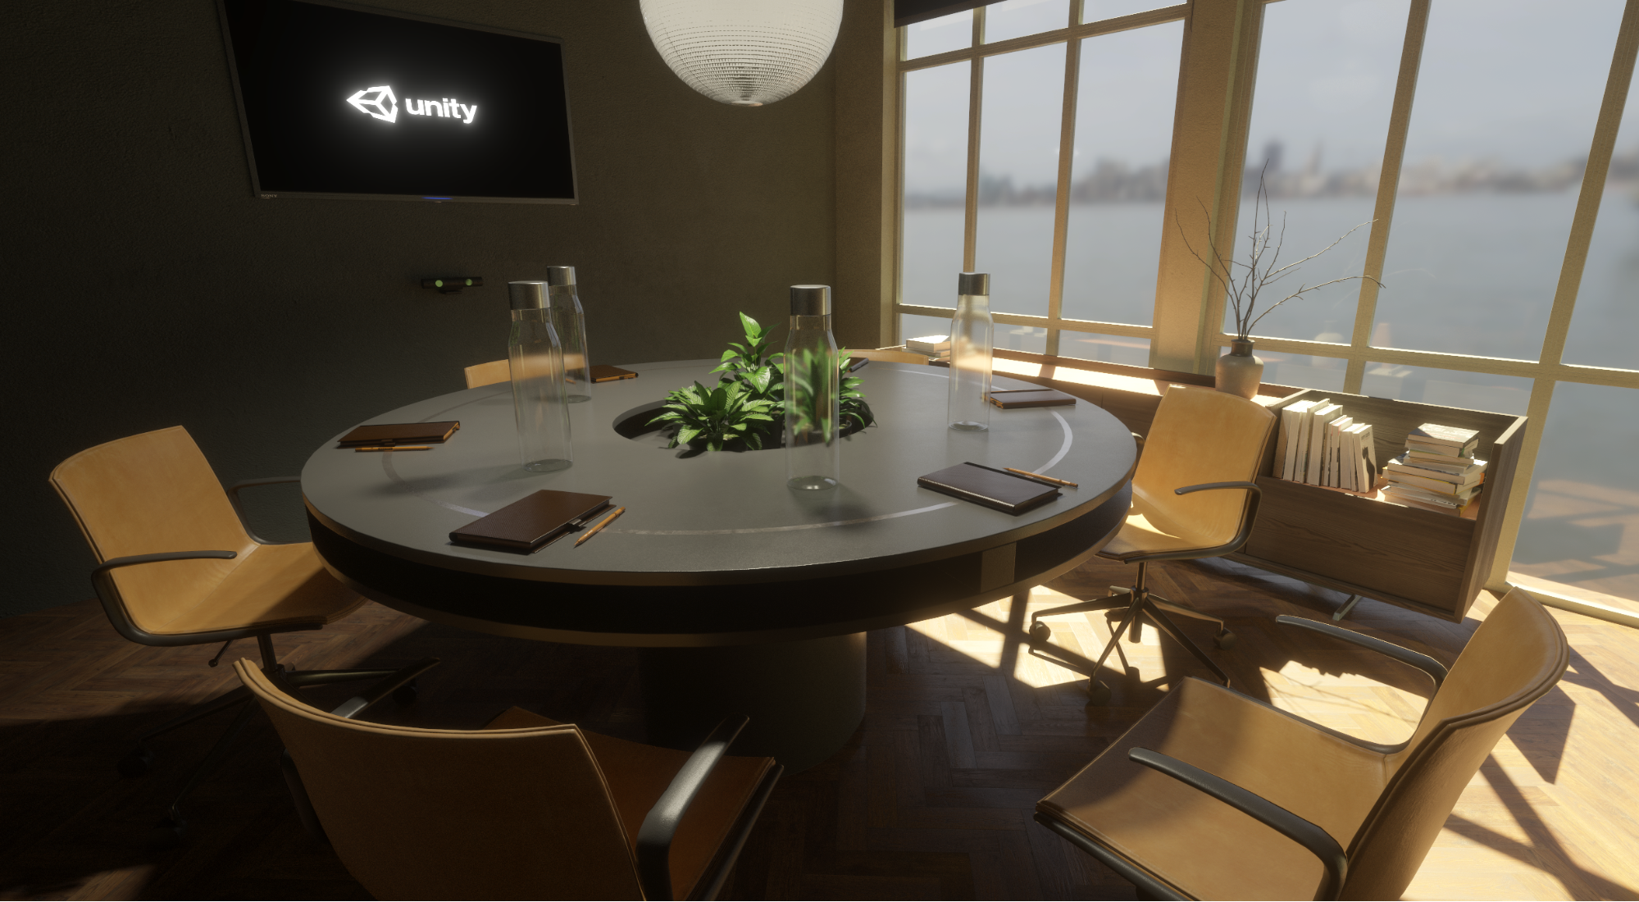
Unity’s Path Tracer
Part of the High Definition Render Pipeline (HDRP)
https://github.com/Unity-Technologies/Graphics
Uses DirectX 12 and DXR
Progressive, unidirectional
One sample per pixel, per frame
Supports most of HDRP’s lights and materials
Notes:
It will come as no surprise that many of those valuable lessons found their way into the Path Tracer we are implementing as part of Unity’s High Definition Render Pipeline, whose source is available on Github.
In short, it is a progressive, unidirectional path tracer, that runs at real-time to interactive framerate, with one sample per pixel, per frame (on a PC with a DXR-ready GPU).
It is not meant to be used in games, but rather to generate beautiful images or cinematics, and can serve as a visual reference when implementing other algorithms (such as our ray-traced effects)
As you can see, we have kept the controls to a bare minimum, for simplicity’s sake.
Note that these example screenshots have been taken directly from the Unity’s Editor scene view, after convergence. You can also record images as an off-screen process, which offers additional motion blur support.

Slide 10
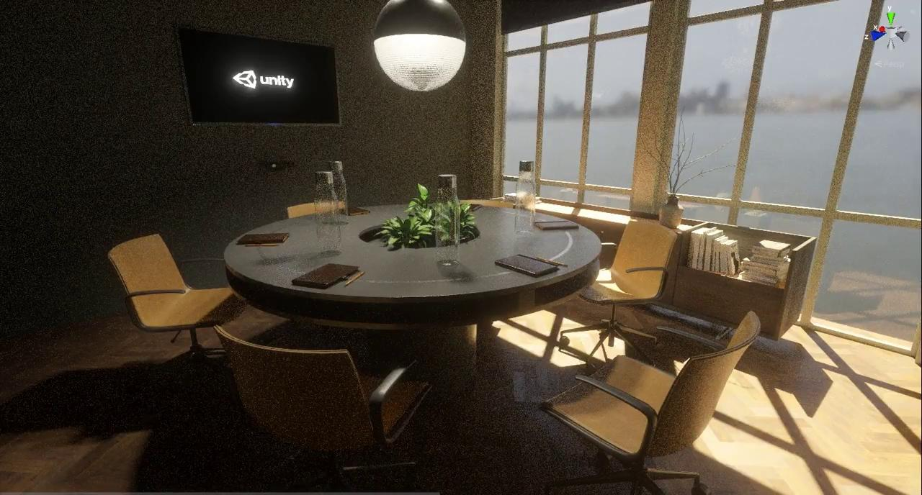
Unity’s Path Tracer
Notes:
While working in the editor or in-game, progressive accumulation starts automatically whenever the scene is not being modified, as shown in this short video.
https://blogs.unity3d.com/2020/03/06/high-definition-render-pipeline-real-time-ray-tracing-is-now-in-preview/

Slide 11
Cues from the offline world
Choose your rays wisely
Choose your (not) RND numbers carefully
Monte Carlo integration
Variance, error
Importance sampling
Multiple importance sampling
Domain warping
Quasi-random sequences
Low discrepancy, stratification
Spend your ray budget where it’s most useful
Understand and defend against error
Adaptive Sampling
Intensity clamping
Path regularization
Notes:
Now, when it comes to this presentation, and given my overwhelmingly offline background, I too wanted to share things I have learned from this experience, that would still be valuable and applicable in real-time (or interactive) rendering.
Evidently, Matt has introduced many of the most important topics already, and I wanted to avoid overlap as much as possible. But quickly, something came to mind:
Just like the ray-traced effects we see appear in game engines these days (including Unity), the first ones to be brought in production rendering where inherently 2D -- like Ambient Occlusion, that Matt covered, where you are integrating over an hemisphere.
There is an abundance of material about 2D sampling and its applications, and I’m sure that many of you have taken advantage of these resources already, and implemented your own versions.

Slide 12
Cues from the offline world
Choose your rays wisely
Choose your (not) RND numbers carefully
Monte Carlo integration
Variance, error
Importance sampling
Multiple importance sampling
Domain warping
Quasi-random sequences
Low discrepancy, stratification
Spend your ray budget where it’s most useful
Understand and defend against error
Adaptive Sampling
Intensity clamping
Path regularization
Transition from 2D to high-dimensional sampling
Notes:
And yet, when transitioning from 2D to higher dimensions, documentation becomes sparser, and can get very technical, and dare I say, a bit “dry”.
High-dimensional sampling is a subject that I found particularly challenging to wrap my head around, as it is difficult to even visualize. But given its major impact on the quality of the results, it is not one to ignore.
That’s why I’d like to try and help you avoid some of the pitfalls I encountered or fell into myself, hopefully in an intuitive manner, as we journey from 2D to the dozens of dimensions usually at play in a path tracer, one at a time.
Let’s begin from a familiar starting point:

Slide 13
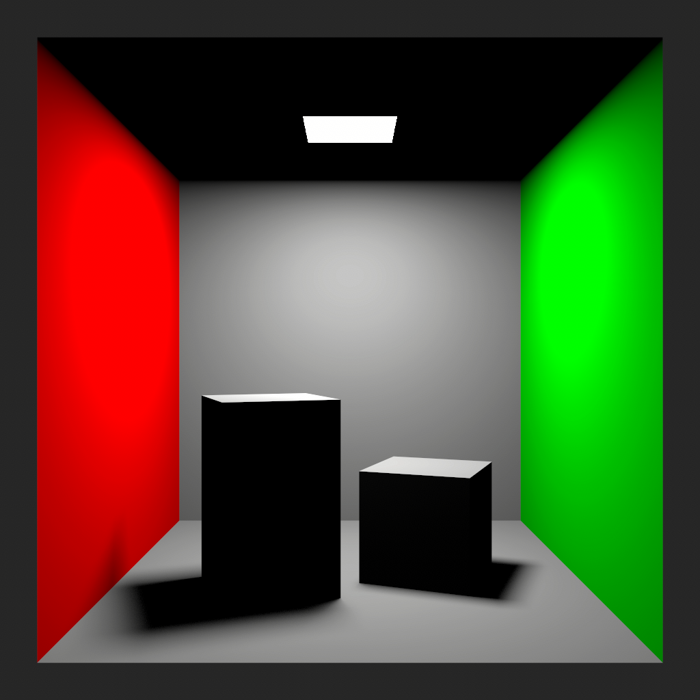
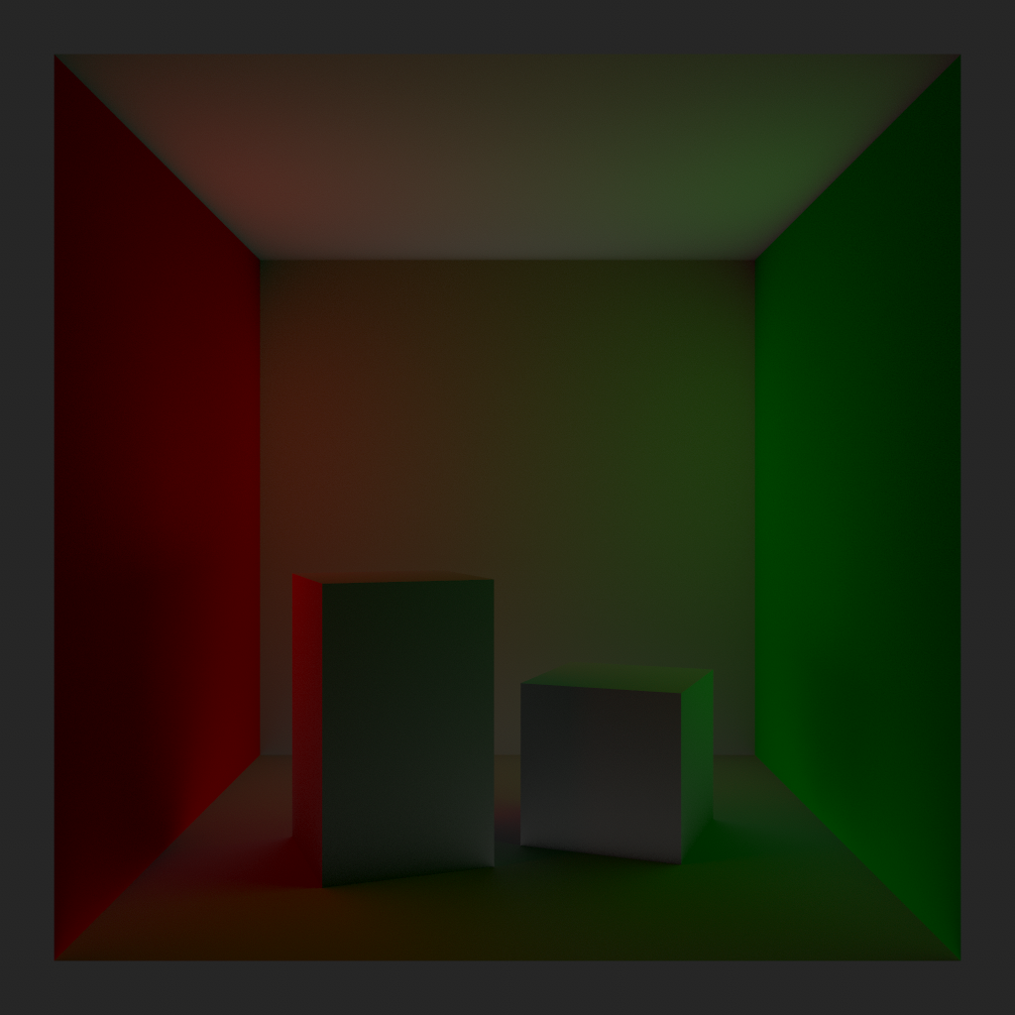
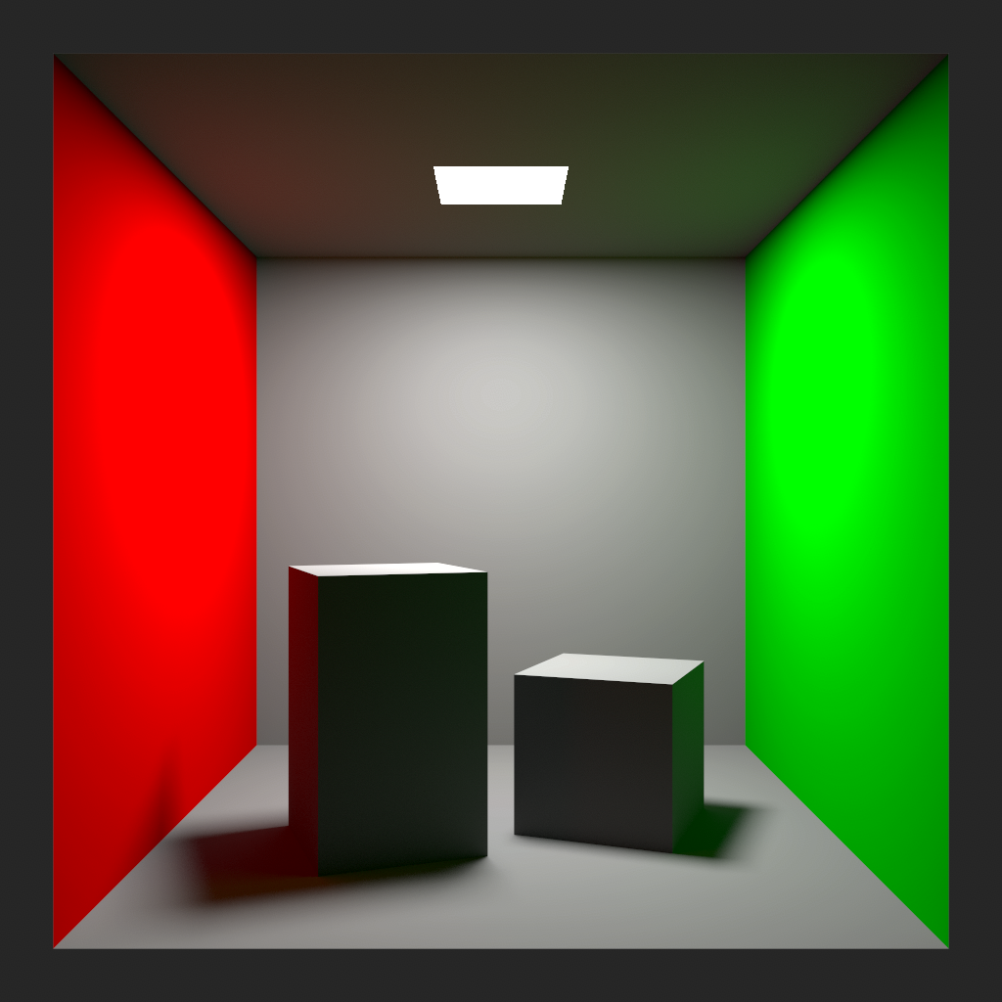
One-bounce Indirect Diffuse
A.k.a. “Global Illumination”
+
=
Notes:
One bounce indirect diffuse. And for an even homier feel, let’s do it on a Cornell Box. ;)

Slide 14
One-bounce Indirect Diffuse
Offline
Real-Time
Pixel
Position
Normal
Albedo
REYES, Scanline
Start from
Rasterization
Irradiance caching
[Tabellion 2004]
Simplified shading
Monte Carlo Integration
Notes:
The typical setting, in offline and real-time, is remarkably similar:
You want to perform the computation about once per pixel: at the vertices of micropolygons in the case of REYES, or from a fragment in scanline or rasterization.
You have at your disposal a position, normal and material properties, in particular an albedo.
From there, you trace rays to gather illumination values at the intersections via Monte Carlo integration, either by getting them from a cache (textures for instance, as in Tabellion and Lamorlette seminal paper), or computing them quickly and approximately.

Slide 15



Quick Monte Carlo Recap
cosine-weighted
importance sampling
Notes:
Let’s do a lightning-quick interlude/recap on Monte Carlo: you want to estimate an unknown function F (in our case, it is the indirect diffuse lighting), by averaging values of F taken at random points Xi.
To improve convergence, you can distribute these points following a Probability Density Function (PDF) P, which ideally is proportional to F (or at least a known portion of F). Here, we will use cosine-weighted importance sampling to turn our random points into rays, perfect for a diffuse BRDF.

Slide 16

Quasi Monte Carlo (QMC)
Deterministic, low-discrepancy sequences/sets
(Halton, Hammersley, Larcher-Pillichshammer)
Better convergence rate than with random
Sobol, or (0-2) Sequence
No need to know sample count
Notes:
Instead of taking fully random points, you can speed up convergence further by using quasi-random low-discrepancy sets or sequences, whose properties have been optimized for Monte Carlo.
One of those is known as (0, 2), or 2D Sobol, and offers particularly enticing properties.
As a sequence (as opposed to sets), you don’t need to know beforehand how many samples you are going to use (which is ideal for adaptive or progressive rendering). Every count (or prefix) will offer very similar -- and good -- properties

Slide 17
Quasi Monte Carlo (QMC)
Deterministic, low-discrepancy sequences/sets
(Halton, Hammersley, Larcher-Pillichshammer)
Better convergence rate than with random
Sobol, or (0-2) Sequence
No need to know sample count
Fantastic stratification properties
Notes:
In particular, and this is actually where its name comes from, it offers fantastic stratification: at powers-of-four counts, you are even guaranteed to find one sample (no more, no less) in all elementary interval: here for 16 samples, 4x4

Slide 18
Quasi Monte Carlo (QMC)
Deterministic, low-discrepancy sequences/sets
(Halton, Hammersley, Larcher-Pillichshammer)
Better convergence rate than with random
Sobol, or (0-2) Sequence
No need to know sample count
Fantastic stratification properties
Notes:
8x2

Slide 19
Quasi Monte Carlo (QMC)
Deterministic, low-discrepancy sequences/sets
(Halton, Hammersley, Larcher-Pillichshammer)
Better convergence rate than with random
Sobol, or (0-2) Sequence
No need to know sample count
Fantastic stratification properties
Notes:
Both ways.

Slide 20
Quasi Monte Carlo (QMC)
Deterministic, low-discrepancy sequences/sets
(Halton, Hammersley, Larcher-Pillichshammer)
Better convergence rate than with random
Sobol, or (0-2) Sequence
No need to know sample count
Fantastic stratification properties
Notes:
And 16x1.

Slide 21
Quasi Monte Carlo (QMC)
Deterministic, low-discrepancy sequences/sets
(Halton, Hammersley, Larcher-Pillichshammer)
Better convergence rate than with random
Sobol, or (0-2) Sequence
No need to know sample count
Fantastic stratification properties
Notes:
This adapts really well to all shapes of domains you may integrate on, and will be our 2D quasi-random sequence of choice.

Slide 22
Back to Indirect Diffuse
+
=
Notes:
Ok, let’s go back to our indirect diffuse computation.

Slide 23
Back to Indirect Diffuse
Notes:
This is what we are after.

Slide 24
Back to Indirect Diffuse
Notes:
Let’s see what happens at the pixel level, for instance the one highlighted in blue. We shoot rays from that position.

Slide 25

Back to Indirect Diffuse
Fast Computation
Texture Read
...
...
256 samples
Notes:
Let’s say, for the sake of argument, that we can afford 256 BRDF rays. As mentioned before, at each intersection we have either a fast computation or a texture read.
For sure, this gives a high quality, noise-free result (albeit slightly biased), in the vein of the image we’ve already seen.
Now, let’s introduce a bit more ray-tracing.

Slide 26
Introducing Light Sampling
256 samples
...
...
256 samples
Notes:
We start with the same BRDF sampling.
But instead or fast approximate or precomputed direct lighting values, let’s integrate them on the fly, by sampling the area light. It is another 2D integral (bringing the total to 4D), in which we aim at distributing rays uniformly within the solid angle subtended by the light.
If we really want to match the previous quality level at each gather point, we need an exceedingly well converged computation, so let’s go with 256 samples, reusing the exact same (0, 2) sequence.
The overall result would of course look very good, but this ray explosion is prohibitively expensive, and…

Slide 27

Introducing Light Sampling
256 samples
...
...
256 samples
Notes:
... we cannot seriously consider doing this.

Slide 28


Introducing Light Sampling
4 samples
...
...
64 samples
Notes:
Let’s be a bit more realistic then. We shoot 64 rays from the initial position instead of 256, and try evaluating direct lighting at each intersection point, but this time with 4 samples only. This gives us a more reasonable total of 256 light rays.
We keep using the exact same sequence at each location.

Slide 29

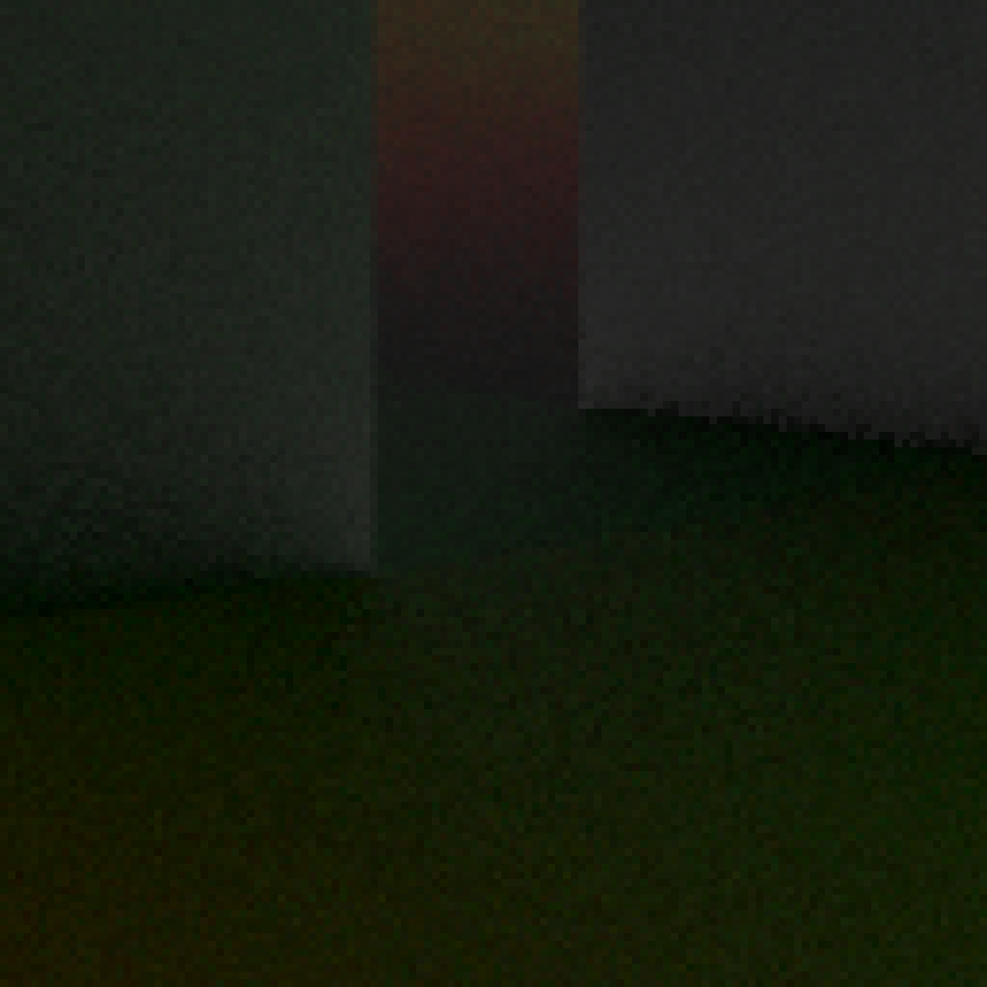
Introducing Light Sampling
Notes:
And this is what we get. It is noisier, as expected, but doesn’t look too bad (at least, we cannot notice any major issue).
Astute viewers may wonder where this white noise pattern comes from, given that we supposedly use the same quasi-random sequence in every pixel... and they would be right to do so.

Slide 30
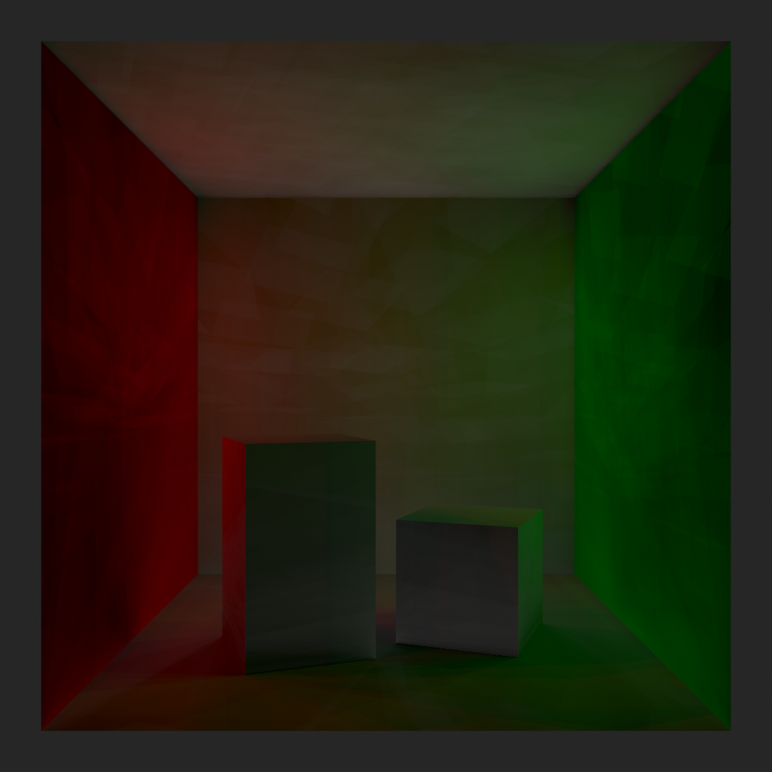

Introducing Light Sampling
(
)
Without pixel randomization
Horrible correlation artefacts,
we will get back to this later...
Notes:
This is what it should look like! And is our first encounter with really bad correlation artefacts. But as we focus on the computation and its error within a pixel, let’s accept for the moment that some randomization has been applied between pixels, we’ll get back to this later.

Slide 31
Introducing Light Sampling
Notes:
All in all, the result looks acceptable on this scene, but let’s move away from the Cornell Box, and test our current approach on a different configuration.

Slide 32
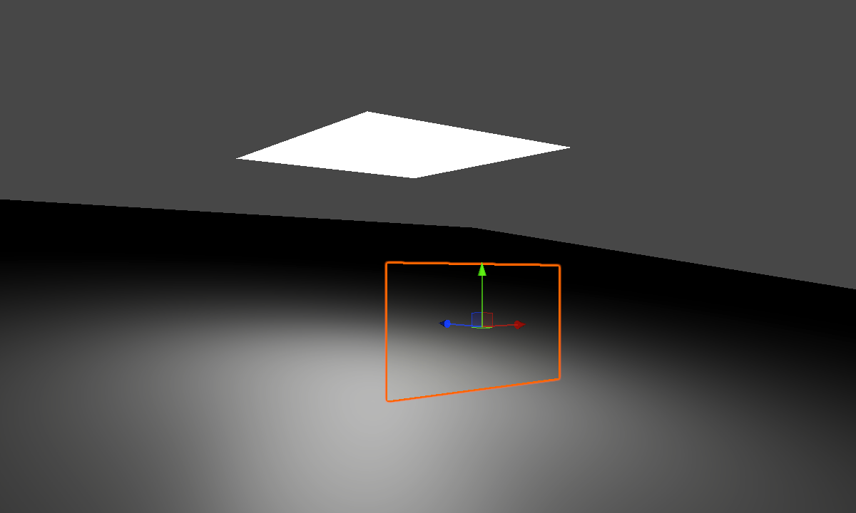
Through the Looking Glass
Area Light
Thin Glass Sheet
Index of Refraction = 1
Diffuse Ground
Notes:
Here we have a large area light over a slanted, diffuse ground. Right in front of the camera is a thin glass sheet, with an index of refraction of 1 (hence, fully transmissive).
This would be the debug version of a fairly common scenario, where most (if not all) of your scene is behind a window.

Slide 33

Through the Looking Glass
256 samples
Notes:
For the pixels in which the ground is directly visible from the camera, we simply use 256 light samples.

Slide 34
Through the Looking Glass
4 samples
...
...
64 samples
Notes:
On the other hand, for the pixels covered by the thin sheet, we apply the exact same scheme as before: 64 BSDF samples followed by 4 light samples.
The only difference is that, this time around, our BSDF is a sharp transmissive GGX lobe, rather than a Lambertian reflection. All transmitted rays are as coherent as can be (actually identical), and thus intersect the ground at the exact same location.
Given that we are using 64*4=256 light samples, we would hope to get no visual difference between the points behind the sheet, and the others.

Slide 35
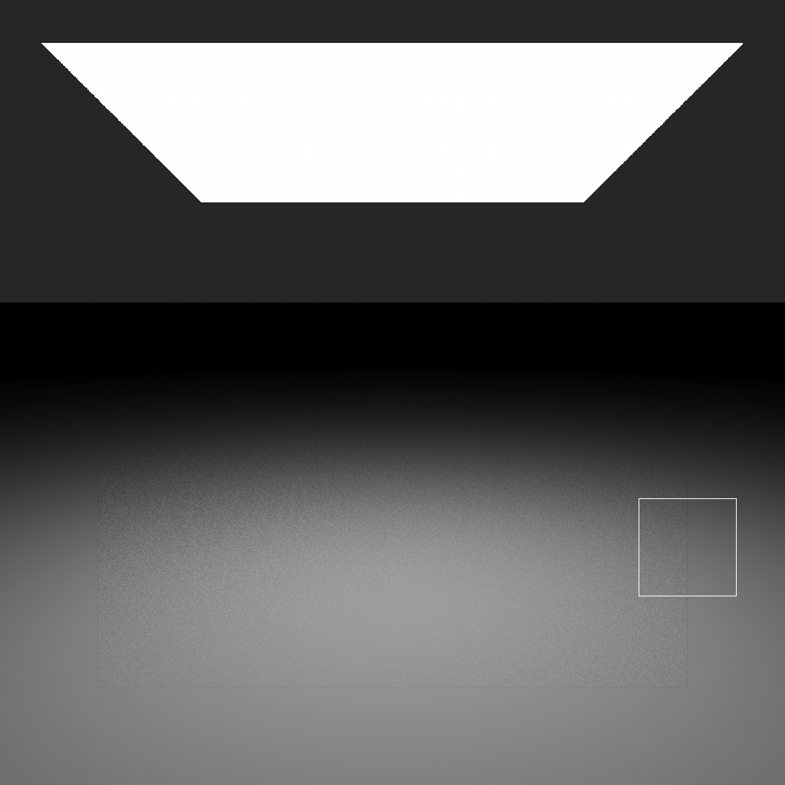
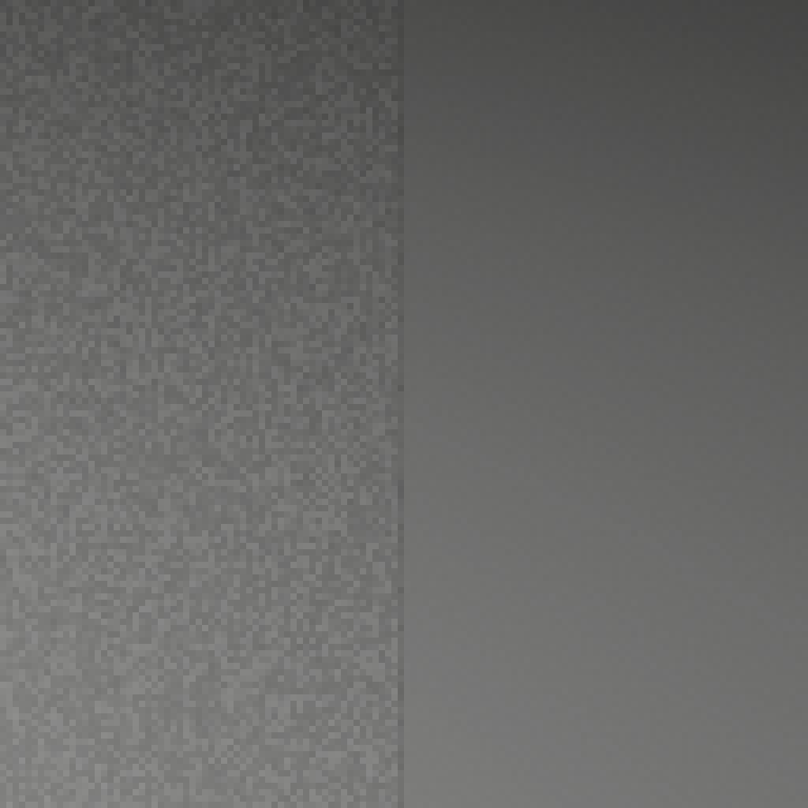
Through the Looking Glass
Notes:
Oh, this is bad… The noise level is way worst behind the glass. Let’s analyse the situation.

Slide 36
Through the Looking Glass
4 samples
U
U
U
=
...
...
64 samples
Notes:
In our previous scene, the incoherent nature of Lambertian BRDF sampling produced highly varied positions and normals as starting points of the light sampling stage, and masked the deficiency of our sampling strategy, whereas here all light rays start from the same point. Reusing the same samples all the time effectively turns our 256 rays into... 4… What a waste!

Slide 37
Through the Looking Glass
4 samples
U
U
U
=
...
...
64 samples
Notes:
The time has come to rethink our approach.

Slide 38
Through the Looking Glass
2D
...
First pass: light sampling
...
Intermediate results
...
2D
Second pass: BSDF sampling / gathering
Notes:
We started from a purely 2D integral, where the points we were reaching from BSDF sampling were fully solved already (or quickly so). And we are still treating the computations at those points as independent integrals, and expect each of them to be well converged into intermediate results, before merely gathering those results in a second, separate pass.
Instead of nested 2D computations, we must consider all 4 dimensions at once.

Slide 39

Through the Looking Glass
0 - 3 0 - 3 0 - 3 0 - 3
4 samples
U
U
U
=
...
...
64 samples
Notes:
What does it translate into here? We should definitely improve the coverage of our 4D domain. The first 2D are already quite well covered, but it is definitely not the case for the next 2.
But what if, instead of reusing the first 4 samples each and every time...

Slide 40



Through the Looking Glass
0 - 3 4 - 7 8 - 11 252 - 255
256 samples
U
U
U
=
...
...
64 samples
i = 0 1 2 63
Notes:
...we simply keep using the next ones in the sequence? And here, as we have a fixed splitting factor on the rays, the indices are very easy to track, too: for each light sampling computation , we are using sample 4i to 4i + 3.
Granted, if each lighting position is very different from its counterparts, as was the case with the Cornell box, it won’t make a big difference (but will be at least as good, given the properties or our sequence).
However, if positions are more similar (or even as in our current scene, exactly the same)...

Slide 41
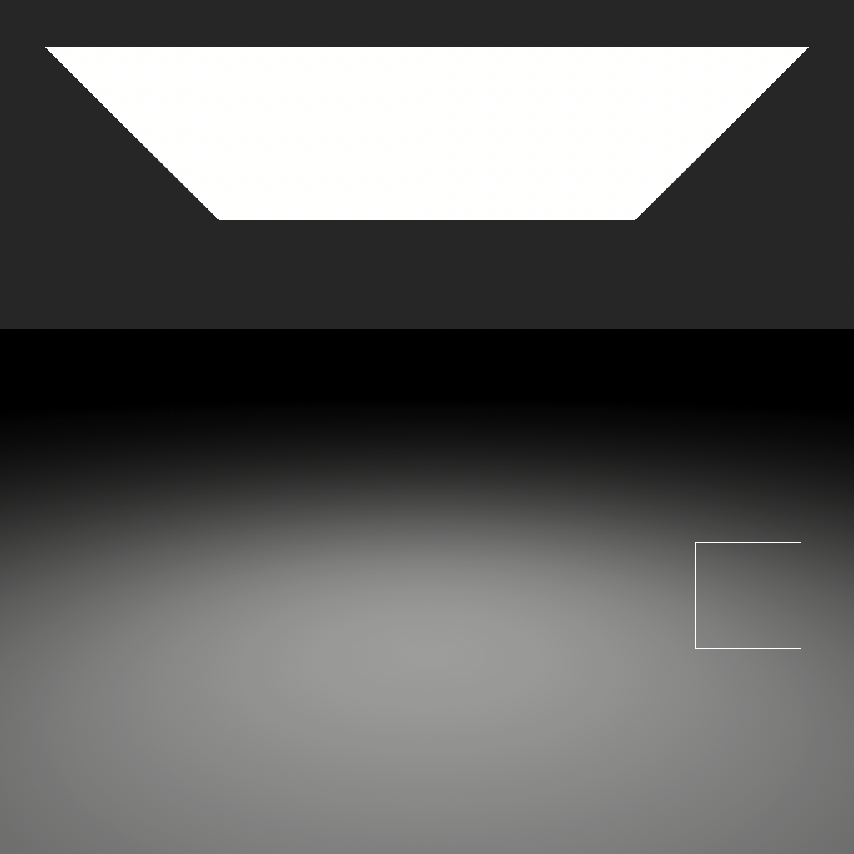

Through the Looking Glass
Notes:
… we will get the best possible result! Just as we were hoping for, the thin sheet is now completely indistinguishable, and the whole result very clean.
Actually, our sampling budget seems a bit overkill now.

Slide 42




Through the Looking Glass
0 1 2 63
64 samples
U
U
U
=
...
...
64 samples
i = 0 1 2 63
Notes:
Let’s take it down a notch, and take the opportunity to simplify our process a bit, by getting rid of the 4x splitting factor. Getting our sample index is even simpler than before: it’s just i.

Slide 43
Through the Looking Glass
64 samples
Notes:
Accordingly, let’s use 64 light samples on the ground fragments directly visible to the camera.

Slide 44
Through the Looking Glass
Notes:
Yeah… We can barely notice any difference.

Slide 45
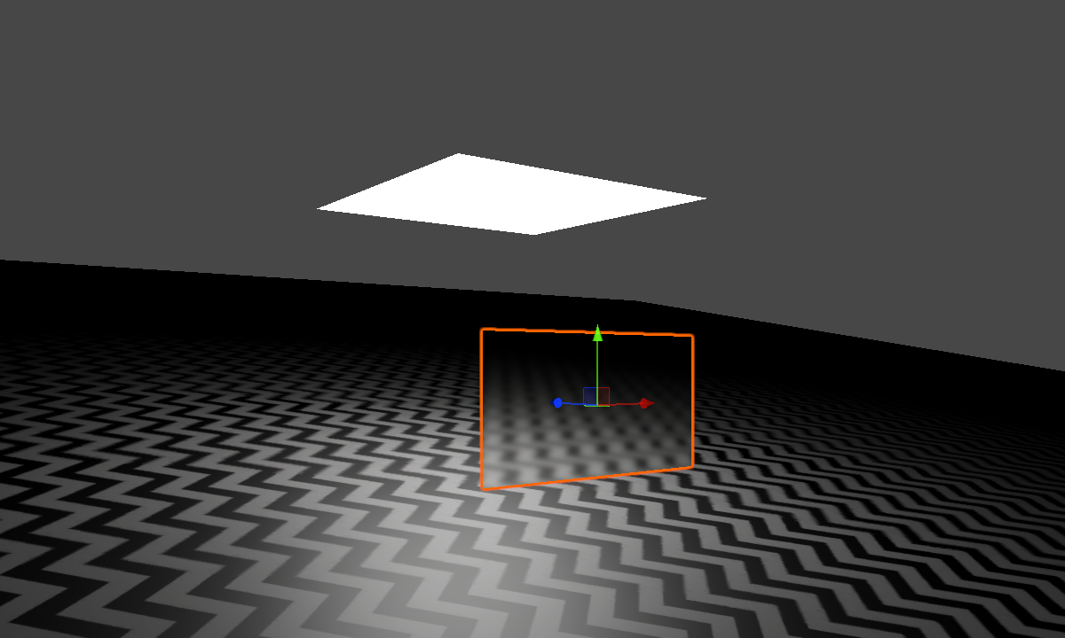
Through the Looking Glass - Part II
Area Light
Thin Glass Sheet
Index of Refraction = 1.5
Smoothness = 0.75
Diffuse Ground
Notes:
Ok, let’s assemble a slightly different scenario, that will put our sampling budget more to the test. We make our thin glass sheet rougher, and to better appreciate the effect of this roughness, we texture the ground.

Slide 46
Through the Looking Glass - Part II
64 samples
Notes:
This part is unchanged.

Slide 47
Through the Looking Glass - Part II
0 1 2 63
64 samples
U
U
U
=
...
...
64 samples
Notes:
But the BSDF rays spawned by the rough glass are of course less coherent than before. Ok, let’s see what we get...

Slide 48
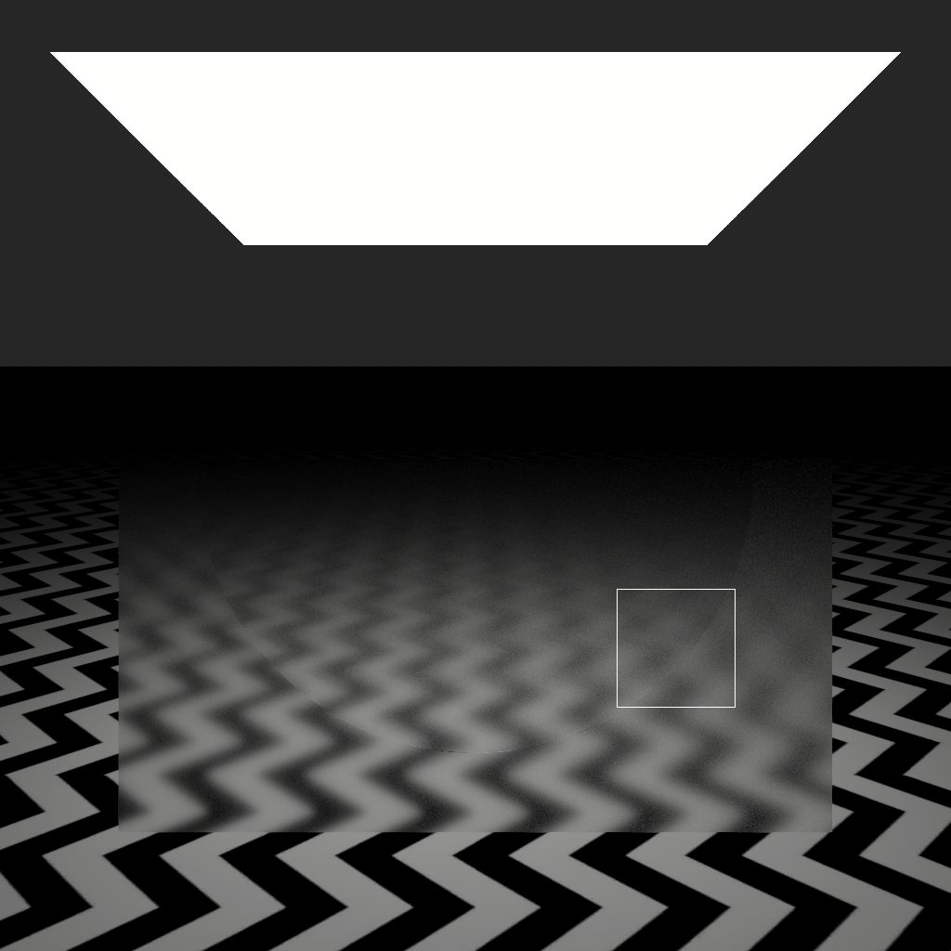

Through the Looking Glass - Part II
Notes:
Oh my, what is that?!

Slide 49
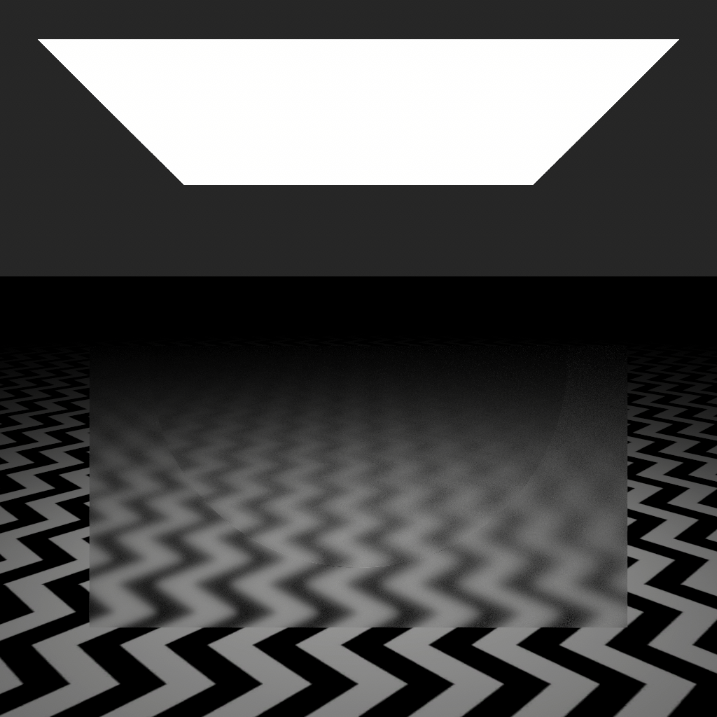

Through the Looking Glass - Part II
Notes:
Well… Remember this guy? ;)

Slide 50
Through the Looking Glass - Part II
We encountered a bad case of correlation between pixels
Now, we have bad correlation between some dimensions
of our 4D sequence, within a pixel
Notes:
This is our second encounter, and (spoiler alert!) not the last, with correlation artefacts.
First time around, it was between pixels reusing the exact same QMC sequences.
And now it is between dimensions of our 4D sequence, within a pixel. Let’s inspect it.

Slide 51
Closer look at our 4D sequence
1
2
3
Same visualization as in [Jarosz 2019]
0
1
2
Notes:
For that, we want to check out different 2D projections of our 4D points. We follow the visualization convention used in the Orthogonal Array paper, by Jarosz et al (whose content we will mention later):
You can see on the axes the indices corresponding to each dimension, and in each cell of the array, we will display the corresponding 2D slice.
These are the 2D slices for dimensions (0,1), and (2,3), which are the ones we use in our sampling routines. By our own design, they are the same.

Slide 52
Closer look at our 4D sequence
1
2 ≡ 0
3 ≡ 1
0
1
2 ≡ 0
Notes:
Now let’s look at the “diagnonal” slices.
(0,3) and (1,2) are also the same.
We are left with (0,2) and (1,3), which are equivalent to… (0,0) and (1,1)... Ohhhh...

Slide 53

Closer look at our 4D sequence
1
2 ≡ 0
3 ≡ 1
0
1
2 ≡ 0
Notes:
Yeah, as bad as expected. That is horrible correlation between these dimensions (but nothing surprising, given that we reuse the exact same 2D points twice).

Slide 54
Closer look at our 4D sequence
1
2 ≡ 0
3 ≡ 1
0
1
2 ≡ 0
Notes:
As an example, one of the implications (and not even the worst) is that, if your sample is on the left half of slice (0,1), it will also be on the left half of slice (2,3).

Slide 55
Closer look at our 4D sequence
1
2 ≡ 0
if dot(HBTDF, N) < threshold
sample first half of area light
else
sample second half of area light
3 ≡ 1
0
1
2 ≡ 0
Notes:
Given our current rendering algorithm, this would translate into:
“If some condition on my BSDF sampling is satisfied, only sample the left half of the area light, otherwise the right half”.
This is one cause of the severe correlation artefacts we are witnessing here.
Of course, we’d want to sample the whole light, no matter what happens during BSDF sampling.

Slide 56
Randomized QMC
We built a 4D sequence by padding 2D sequences together
This ensures good properties in some 2D slices, but we need to be mindful of other projections
We want either good correlation or complete independence
3
2
1
0
Notes:
Putting together low-dimensional sequences to build a higher-dimensional one, as we did, is often referred to as “padding”.
In addition to the slices corresponding to the original sequences, we need to be mindful of what happens in the other projections:
we ideally want “good correlation” (as in stratification, for instance), or if not possible full independence.
And for that, let’s reintroduce some randomness.

Slide 57

Randomized QMC
?
We built a 4D sequence by padding 2D sequences together
This ensures good properties in some 2D slices, but we need to be mindful of other projections
We want either good correlation or complete independence
3
3
2
2
1
1
0
0
Notes:
What can we do perturb dimensions 2 and 3?

Slide 58
Randomized QMC
?
We built a 4D sequence by padding 2D sequences together
This ensures good properties in some 2D slices, but we need to be mindful of other projections
We want either good correlation or complete independence
3
3
2
- Cranley-Patterson rotation
- XOR Scrambling
- Owen Scrambling
[Kollig 2002]
2
1
1
0
0
Notes:
Kollig and Keller, in a 2002 paper, propose 3 different techniques.

Slide 59

Cranley-Patterson Rotation
xoutput = fmod(xinput + randx, 1.0)
youtput = fmod(yinput + randy, 1.0)
Pros
+ Simple
Cons
- Breaks stratification properties
Notes:
The first one is called Cranley-Patterson rotation: It simply consists in a random toroidal shift. Unfortunately, it doesn’t really help with correlation, and has the bad taste of damaging the stratification properties of the (0,2) sequence, as the points are not aligned with power-of-two strata anymore.

Slide 60
Cranley-Patterson Rotation
xoutput = fmod(xinput + randx, 1.0)
youtput = fmod(yinput + randy, 1.0)
Pros
+ Simple
Cons
- Breaks stratification properties
Notes:
Let’s consider something else.

Slide 61

XOR Scrambling
xoutput = xinput ^ randx
youtput = yinput ^ randy
(in integer form)
Pros
+ Even simpler
+ Keeps stratification intact
Cons
- Doesn’t help much with (0, 2) structure
Notes:
The second one is even simpler, it is just a XOR!
Intuitively, it splits for each dimension the domain in two, randomly decides whether to flip those 2 regions or not, and does so recursively, down to our bit precision. At each level, it applies the same flip (or lack thereof) to all concerned subdomains.
This time, it keeps the stratification intact (as could have been surmised, after description of the algorithm).
As a slight negative, it doesn’t really break the aligned patterns observed in the original sequence, which can in turn cause minor artefacts in the renders.

Slide 62


XOR Scrambling
(
)
This is what we used to break screen space correlation, with one random value per pixel
Notes:
Oh and by the way, this is what we used to randomize each pixel in all our previous renders, and it definitely did the trick there.

Slide 63

Owen Scrambling
Too complex for a two-liner ;)
See [Kollig 2002]
Pros
+ Keeps stratification intact
+ Helps with breaking (0, 2) structure
Cons
- Much more involved
- Some random values give better results
Notes:
The third option is Owen Scrambling, and it shares similarities with XOR Scrambling, only with more randomness.
It also splits the domain in two regions for each dimension, and randomly flips them or not, but then each recursive decision is made independently from the others, at the same level. These recursive decisions are known as a permutation tree.
Not only does it keep stratification intact, but this time it even helps with making original aligned structures less pronounced. It has been shown to improve the convergence properties over the non-scrambled sequence!
However, the more complicated computation makes it less suitable for online scrambling (even less so in a real-time application), not to mention that all permutation trees will not offer the same scrambling quality, making it advisable to try and compare different ones.

Slide 64
Randomized QMC
We built a 4D sequence by padding 2D sequences together
This ensures good properties in some 2D slices, but we need to be mindful of other projections
We want either good correlation or complete independence
3
3
XOR Scrambling
2
2
1
1
0
0
Notes:
For now, we settle on XOR Scrambling. Let’s check if it helped with our render.

Slide 65
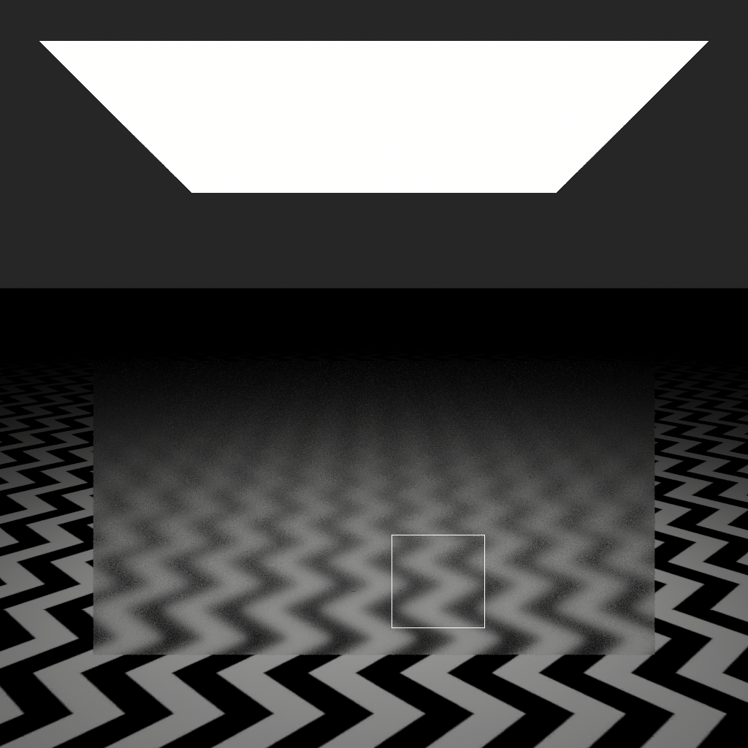
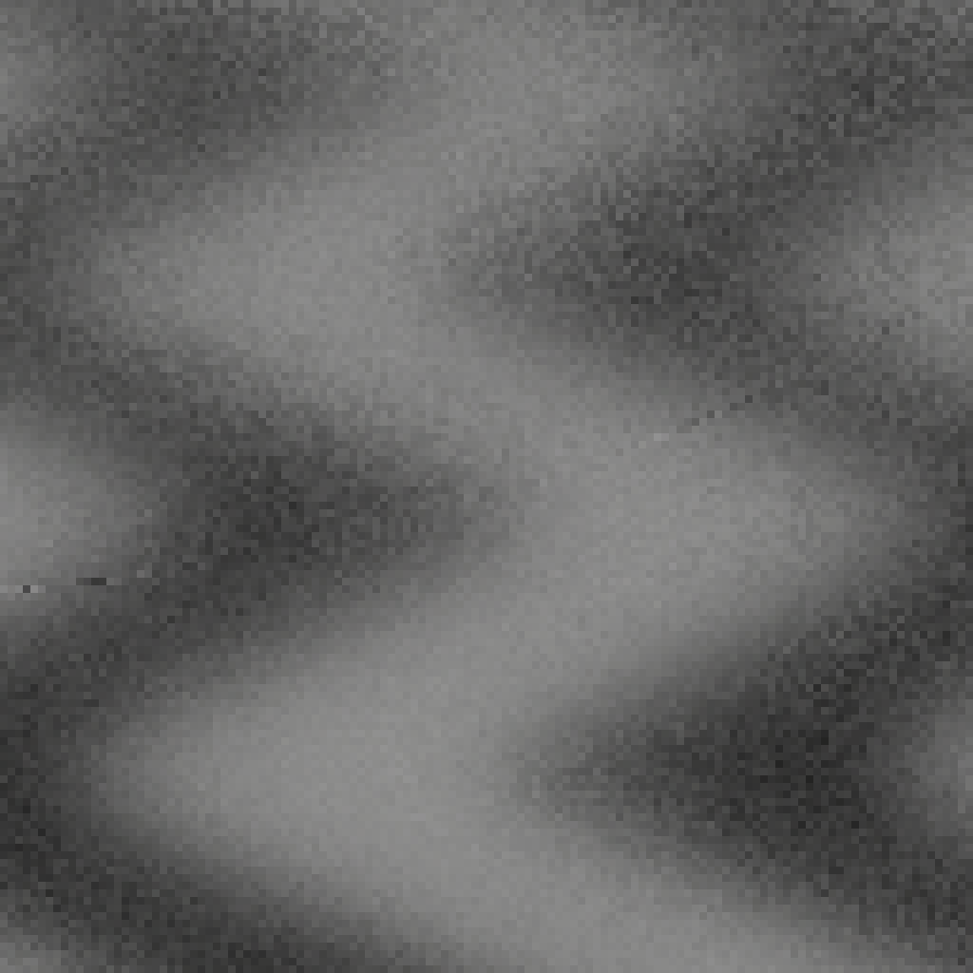
Through the Looking Glass - Part II
Notes:
It’s not as horrendous as before, but not great either. We can notice many artefacts that are quite distinguishable from noise, and that no sample count will help get rid of, sadly.
Let’s inspect the different 2D projections of our XOR scrambled sequence.

Slide 66
Closer look at our XOR scrambled sequence
1
2
3
0
1
2
Notes:
We already know those.

Slide 67


Closer look at our XOR scrambled sequence
1
2
3
0
1
2
Notes:
These do not look bad, and...

Slide 68


Closer look at our XOR scrambled sequence
1
2
3
0
1
2
Notes:
… unfortunately odd-odd, even-even projections are almost as bad as before. In hindsight, we should have known, given what this scrambling does:

Slide 69
Closer look at our XOR scrambled sequence
1
2
3
0
1
2
Notes:
Compared to the observation we made before scrambling, the only difference is: if your sample is on the left half of slice (0,1), it will either always be on the left, or on the right half of slice (2, 3) (depending on the first bit or our scrambling value).

Slide 70
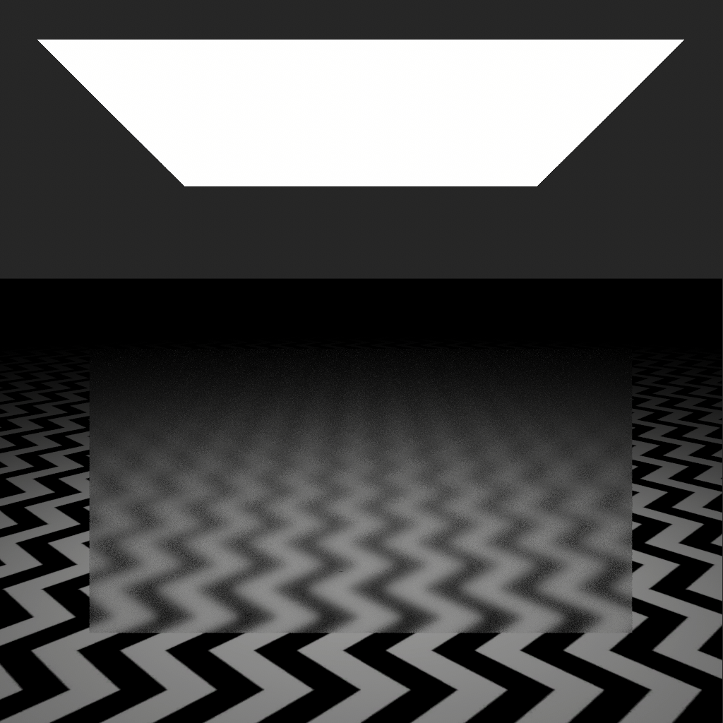
Closer look at our XOR scrambled sequence
1
2
if dot(HBTDF, N) < threshold
sample first half of area light
else
sample second half of area light
3
0
1
2
Notes:
In this particular scrambling, it was left-left.
The domain coverage is a bit better than before though, so the artefacts are less striking.

Slide 71


Closer look at our XOR scrambled sequence
1
2
3
Owen Scrambling does not help either
(as expected, by design)
0
1
2
Notes:
Owen Scrambling doesn’t really help with this either, unsurprisingly, given that the first bit of the scrambling value has the exact same effect as in XOR Scrambling.

Slide 72
Breaking correlation between 2D sequences
To solve those correlation issues, we need even more randomness, for instance by shuffling the indices of our padded 2D sequences:
Full random permutation of indices [Kollig 02]
Pros
+ Definitely breaks correlation
Cons
- Needs to know max samples
- Hurts properties of 2D sub-sequences
(prefix, stratification)
Notes:
What we have tried so far made the artefacts less noticeable, but doesn’t fully address the correlation problem.
Kollig and Keller acknowledge as much, and propose to randomly shuffle the indices of each 2D sequence, making them completely independent from one another.
While this rids us of correlation once and for all, this also hurts the properties of our sequence a lot, essentially turning all “diagonal” slices into pure random.
This is far from ideal, but let’s see what effect it has on our render:

Slide 73

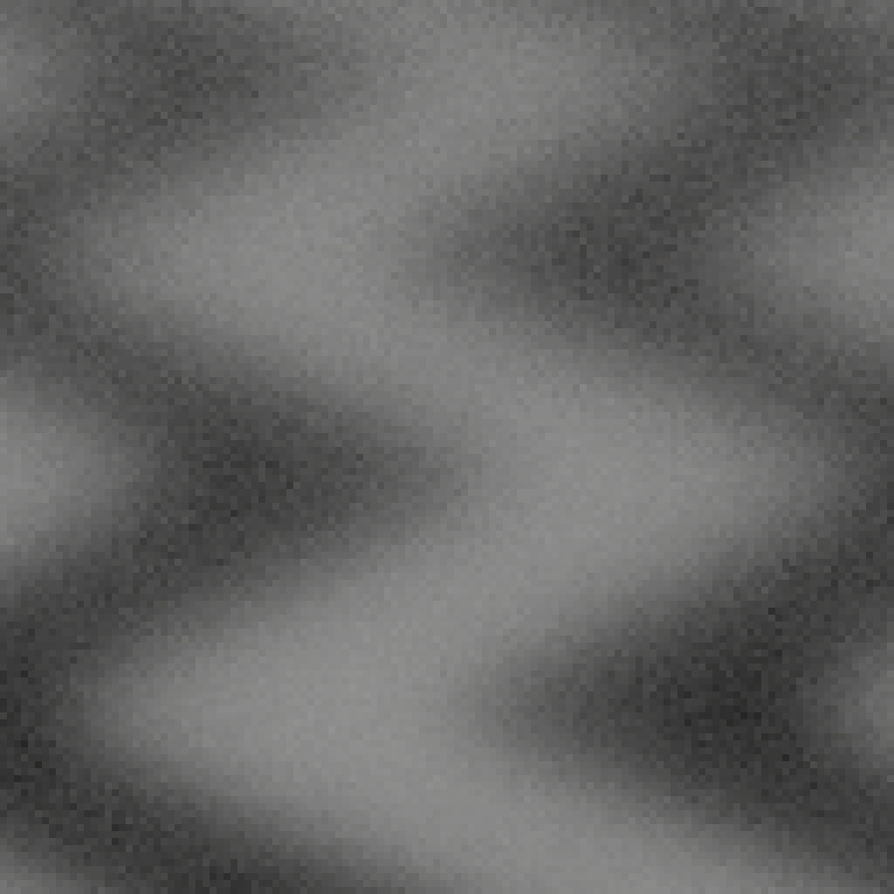
Breaking correlation between 2D sequences
Notes:
Ok, the artefacts are completely gone indeed.

Slide 74
Breaking correlation between 2D sequences
Non shuffled
Notes:
Here is the non-shuffled version for comparison.

Slide 75
Breaking correlation between 2D sequences
Shuffled
Notes:
And again with the random shuffling.

Slide 76
Breaking correlation between 2D sequences
To solve those correlation issues, we need even more randomness, for instance by shuffling the indices of our padded 2D sequences:
Full random permutation of indices [Kollig 02]
Random permutation of specific strata [PBRT]
Pros
+ Definitely breaks correlation
Cons
- Needs to know max samples
- Hurts properties of 2D sub-sequences
(prefix, stratification)
Pros
+ Keeps properties as much as possible
Cons
- Does it offer guarantees?
(tried a weak variant, it failed eventually)
Notes:
Another option, proposed in the PBRT book, consists in applying index shuffling only on specific power-of-two aligned strata (and then sub-strata, recursively).
For instance, with 32 samples, shuffling 8 groups of 4 indices, and then shuffling the 4 indices within each of the groups.
This is an intermediate solution, where we try to keep stratification in the “diagonal” slices as much as possible, rather than going full random.
However, it is not guaranteed to get us rid of our correlation troubles: as a matter of fact, I tried a weak variant of this method in the past, after being confronted with a clear sampling artefact.
On each XOR scrambled (0,2) sequence, I would only randomly flip indices 2 by 2, in an attempt to maintain stratification as much as possible. The artefact vanished, letting me think that this minimal randomization was enough… Only for another similar issue to pop up few weeks later.

Slide 77
Breaking correlation between 2D sequences
To solve those correlation issues, we need even more randomness, for instance by shuffling the indices of our padded 2D sequences:
Full random permutation of indices [Kollig 02]
Random permutation of specific strata [PBRT]
Pros
+ Definitely breaks correlation
Cons
- Needs to know max samples
- Hurts properties of 2D sub-sequences
(prefix, stratification)
Pros
+ Keeps properties as much as possible
Cons
- Does it offer guarantees?
(tried a weak variant, it failed eventually)
Question: Could it be generalized by
Owen Scrambling on the indices?
Notes:
Something that I have never tested but think would work as a generalization of this method, is to apply Owen Scrambling on the indices, to shuffle them. But as we know already, this scrambling method is not the cheapest...

Slide 78
Conclusion on the Padding strategy
While it is great to maintain optimal properties on targeted 2D projections, there is no fully satisfying approach to get rid of correlation issues between dimensions
Notes:
In the end, none of this shuffling methods is completely satisfying, each with pros but also significant cons.

Slide 79
Conclusion on the Padding strategy
While it is great to maintain optimal properties on targeted 2D projections, there is no fully satisfying approach to get rid of correlation issues between dimensions
Correlated Multi-Jittered Sampling [Kensler 2013]
Sets of stratified points of size MxN
Padding and some form of progressive sampling made possible by a hash-based permutation
Notes:
We have other options though:
The Pixar Renderman team has proposed alternatives that offer different trade-offs, generally for the better:
The first, “Correlated Multi-Jittered”, can generate sets of points of size MxN, and solves the padding correlation and progressive sampling with a hash-based permutation, inspired by cryptography.
On the downside, it offers little guarantee on the properties of the prefixes

Slide 80
Conclusion on the Padding strategy
While it is great to maintain optimal properties on targeted 2D projections, there is no fully satisfying approach to get rid of correlation issues between dimensions
Correlated Multi-Jittered Sampling [Kensler 2013]
Sets of stratified points of size MxN
Padding and some form of progressive sampling made possible by a hash-based permutation
Progressive Multi-Jittered Sample Sequences [Christensen 2018]
Progressive sequence
Same great stratification properties as (0, 2)
Extension to high dimensions by greedy padding (can become costly)
Notes:
The second is an improvement in every respect, except that the padding is based on a greedy optimization that can become costly for very high dimensions. Nevertheless, this solution is an excellent candidate if storing a precomputed sequence of points is acceptable.
In any case, those papers are highly recommended reads, as they also offer a thorough survey and comparison with many methods.

Slide 81
Conclusion on the Padding strategy
While it is great to maintain optimal properties on targeted 2D projections, there is no fully satisfying approach to get rid of correlation issues between dimensions
Correlated Multi-Jittered Sampling [Kensler 2013]
Sets of stratified points of size MxN
Padding and some form of progressive sampling made possible by a hash-based permutation
Progressive Multi-Jittered Sample Sequences [Christensen 2018]
Progressive sequence
Same great stratification properties as (0, 2)
Extension to high dimensions by greedy padding (can become costly)
Anything else?
Notes:
But is there anything else, that would be usable out of the box?

Slide 82
High-dimensional QMC sequences
Designed with high-dimensional use in mind:
no padding, scrambling or shuffling necessary
There are others (Halton, Hammersley), but will focus on Sobol,
whose first two dimensions we already know very well:
(0, 2) Sequence
Notes:
Yes there is, in the form of high-dimensional QMC sequences! With these, no need for any padding, scrambling or shuffling, they are usable in arbitrary number of dimensions right away.
In particular, we will focus on the Sobol sequence, which is a generalization of the (0,2) sequence we have been using so far.

Slide 83




High-dimensional Sobol
Reference implementation in graphics by Leonhard Grünschloß [Grünschloß], adapted from a Math paper by Joe and Kuo [Joe 2008]
Many possible Sobol sequences, this one optimizes the stratification properties of 2D projections in the low dimensions, for low sample counts:
1
3
5
7
9
0
2
4
6
8
Notes:
Without going into details, the dimensions of Sobol are generated from direction matrices. The choice of these matrices influences directly the sequence properties, but fortunately for us, all the hard work of building a good sequence for computer graphics has already been done by Leonard Grunschloss, who implemented a math paper by Joe and Kuo.
Here we can see the first 10 dimensions, as successive 2D slices...

Slide 84




High-dimensional Sobol
1
2
3
All 2D projections for the first 4 dimensions
0
1
2
Notes:
… but any pairing of dimensions gives really good results! Gone are the issues that we noticed earlier, during our various attempts at padding.

Slide 85





High-dimensional Sobol
If we go up in dimensions, we can indeed find significantly worst quality 2D slices:
107
118
157
175
233
106
117
156
174
232
==> Make sure to use the lowest dimensions for the most important parts of your integrand
Notes:
This being said, the quality degrades somewhat as you go higher in the dimensions. Here are examples of slices whose properties are not too good, with 64 samples.
Therefore, it is good practice to use the lowest possible dimensions for the most important parts of your integrand.

Slide 86




High-dimensional Sobol
An extra refinement consists in applying Owen Scrambling to all dimensions
As mentioned before, it helps break aligned patterns characteristic of the sequence, and improves convergence rate
1
3
5
7
9
0
2
4
6
8
Since it is not a fast process (especially for real-time), it can be precomputed and stored for a number of samples ==> This is what is done in HDRP, with 256 points in 256D
Notes:
To improve convergence properties even further, you can apply Owen Scrambling to all dimensions.
You can see in those projections that the diagonally-aligned patterns are mostly gone.
Again, it is not a blazingly fast process, so it can be a good option to precompute and store some points.
In HDRP, as we focused on real-time ray-tracing effects which require few samples, we settled on a small texture storing 256 points in 256 dimensions.
And with this, we are reaching the end of our journey… But wait, there is one more thing!

Slide 87
Icing on the cake: blue noise in screen space
Bad correlation
Notes:
Time for this guy to make a comeback!

Slide 88
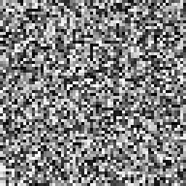
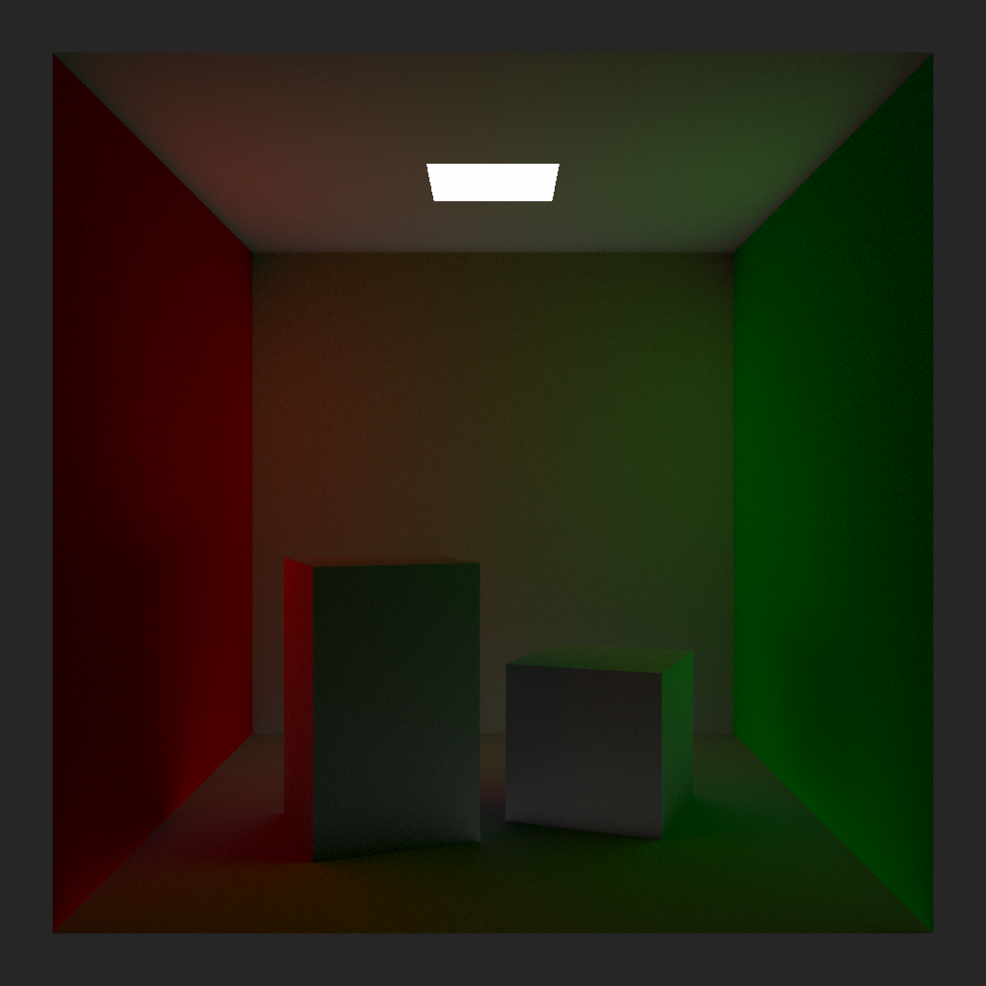
Icing on the cake: blue noise in screen space
Random XOR scrambling
Bad correlation
No correlation (white noise)
Notes:
We already distributed the integration error as white noise in screen space, by applying a XOR scrambling on our points, with a different random value for each pixel.
But actually, we can go one step further and distribute it as a pattern that is much more pleasing to the eye:

Slide 89
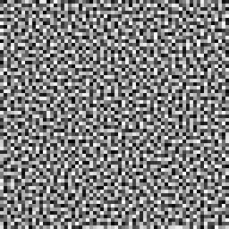

Icing on the cake: blue noise in screen space
Random XOR scrambling
[Heitz 2019]
Bad correlation
No correlation (white noise)
Good correlation (blue noise)
Notes:
Blue noise.
This idea was first introduced by Georgiev and Fajardo 4 years ago, and improved upon last year, in a paper co-authored by our great colleagues at Unity Labs Grenoble.
Cherry on top: It costs barely more than the random scrambling we were applying.

Slide 90


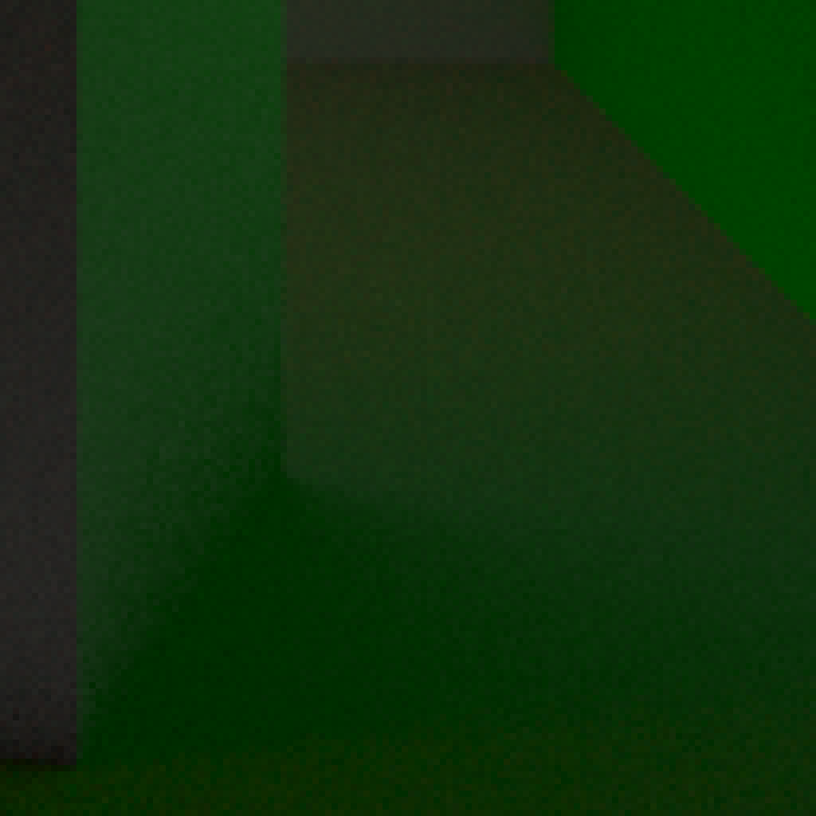
Icing on the cake: blue noise in screen space
No correlation (white noise)
Notes:
Honestly, the difference is really subtle here, as the image is rather well converged with 64 samples, and it is indirect lighting only, ...

Slide 91

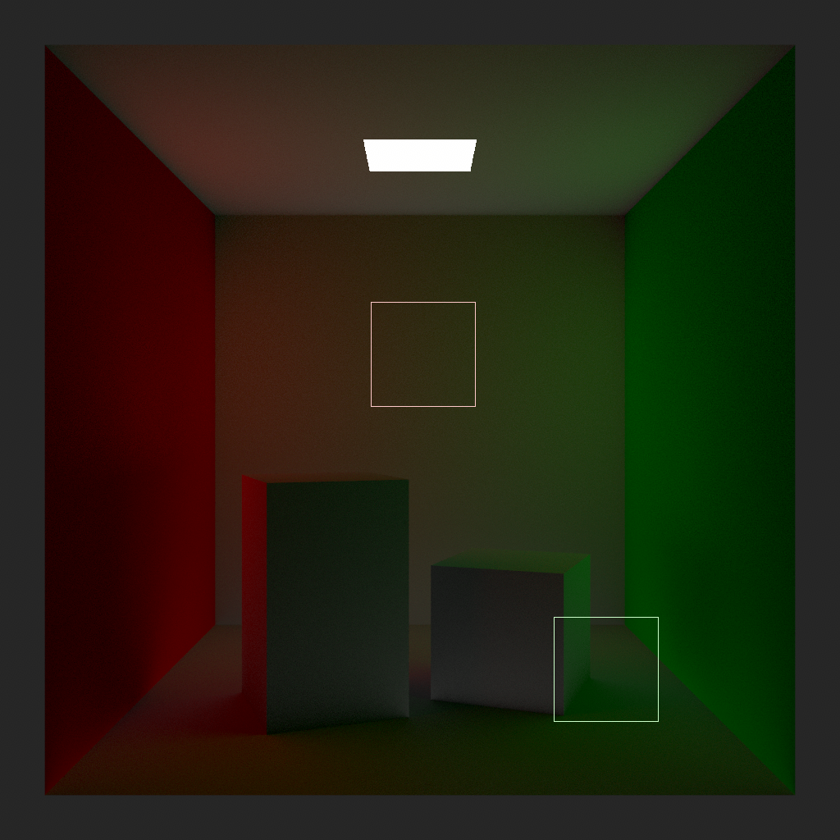

Icing on the cake: blue noise in screen space
Good correlation (blue noise)
Notes:
… which definitely isn’t the best scenario to showcase this technique.
[go back and forth a couple times]

Slide 92
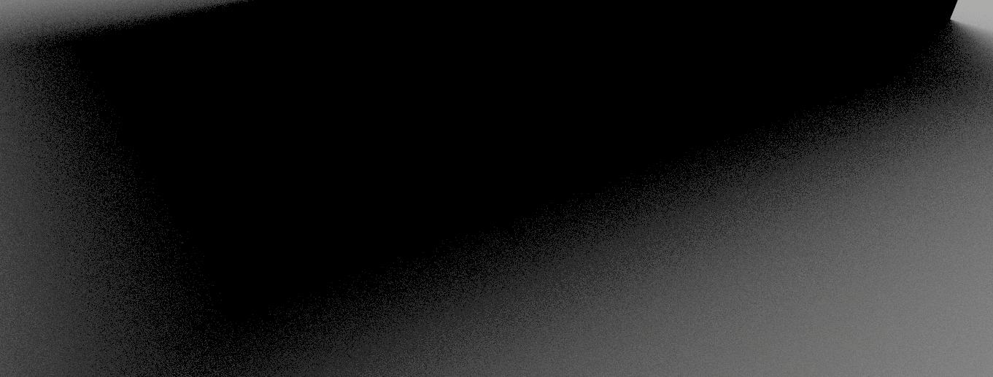
Icing on the cake: blue noise in screen space
White noise
Notes:
It is much more visible here, on a direct lighting penumbra region, with 16 samples.

Slide 93

Icing on the cake: blue noise in screen space
Blue noise
Notes:
[go back and forth a couple times]
Now that we have our final high-dimensional sequence, how can we put it to good use? Do we really need 200+ dimensions? Let’s head back to where we left our rendering algorithm.

Slide 94
Transition to Unidirectional Path Tracing
2D
...
Light Sampling
...
2D
0
1
2
N
BSDF Sampling
Rasterized
Fragment
Total: 4D
Notes:
It is still a basic 4D, indirect only computation.

Slide 95

Transition to Unidirectional Path Tracing
2D
...
Second Scatter Event
2D
...
First Scatter Event
MIS
0
1
2
...
N
2D
Camera Rays
Total: 6D
Notes:
Let’s extend our path length and make them start from the camera, instead of a rasterized fragment, by sampling the pixel; this will allow us to get better antialiasing. We’re now up to 6D.
While we are at it, let’s add Multiple Importance Sampling at each depth (rather than either only material, or light sampling). Incidentally, we now compute the full lighting, not just indirect.
Knowing which sample index to use is as simple as can be, since we don’t have any split along the path: it is just the index of the camera ray.

Slide 96
Transition to Unidirectional Path Tracing
2D
...
+
+
+
+
w_{M} w_{L}
Second Scatter Event
2D
...
+
+
w_{M} w_{L}
+
+
First Scatter Event
0
1
2
...
N
2D
Camera Rays
Total: 6D
Notes:
Note that you can and should reuse the same sample for light and material sampling at a given depth, since they are independent integral computations, merely combined together in a weighted sum by MIS.
Knowing which dimension to use is directly related to the ray depth: for now, we are using two per depth.

Slide 97
Transition to Unidirectional Path Tracing
4D
...
Second Scatter Event
4D
...
Light Pick
First Scatter Event
BSDF Pick
0
1
2
...
N
4D
DOF
Camera Rays
Total: 12D
Notes:
At the camera level, we can add Depth-of-Field effects, for an additional 2D.
A proper PBR material is never just one BSDF. We will need an additional dimension per depth to stochastically pick which BSDF we sample.
Similarly, we will likely be in presence of more than one light, and will also need to pick one to sample.
In addition, we use a dimension for Russian roulette, bringing the total up to 4 per ray depth.

Slide 98
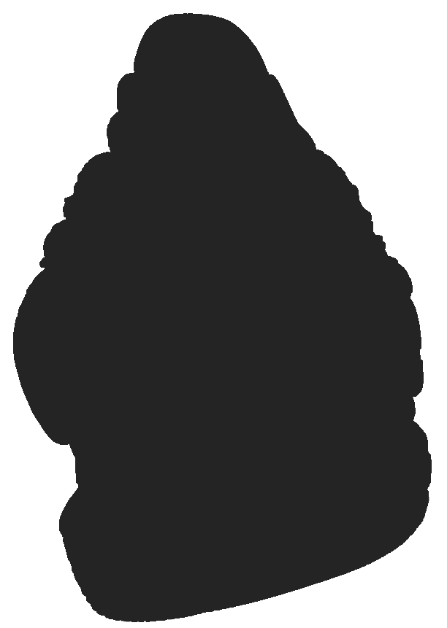
Transition to Unidirectional Path Tracing
4D
...
Tenth Scatter Event
...
...
...
...
4D
...
Second Scatter Event
4D
...
Light Pick
First Scatter Event
BSDF Pick*
0
1
2
...
N
4D
*or Random Walk SSS:
using up to 64D!
DOF
Camera Rays
Total: 44D
Notes:
And you can generalize that to as deep a path as you need. In our implementation, we limit the depth to 10.
Add up to 64 dimensions (!!!) for our random walk subsurface scattering, and this brings the total to... 108! Those 256 dimensions we store weren’t such a luxury after all! ;)
And there you have it, we turned our good old indirect diffuse computation into a full unidirectional path tracer (and potentially progressive adaptive, thanks to the properties of the QMC sequence we chose).
But wait… where is motion blur?

Slide 99
How about motion blur?
...
...
...
...
4D
...
Second Scatter Event
4D
...
Light Pick
First Scatter Event
BSDF Pick*
...
Time (stochastic)
1D
i=0
1
2
...
N
4D
DOF
Camera Rays
Notes:
In an offline renderer, you would just be able to allocate a dimension of your sequence to time, and sample it like anything else along your path.
Unfortunately, going back and forth in time in a real time engine is not that convenient.
On the other hand, we can easily play the animation at any speed we see fit.

Slide 100
How about motion blur?
...
...
...
...
4D
...
Second Scatter Event
4D
...
Light Pick
First Scatter Event
BSDF Pick*
...
Time (linear)
1D
i=0
1
2
...
N
4D
DOF
Camera Rays
Notes:
When we use the path tracer with our off-screen recorder, in order to render a video, we know exactly how many samples we will use per image (which is not true of the live, progressive mode).
We can then advance through time with the appropriate offset at each sub-frame, corresponding to one path-tracer sample, so that we end up with the right animation speed at the targeted video FPS.
Correlation- or even stratification-wise, sampling time linearly is not an issue at all, as it plays nicely with all other dimensions of our sequence, turning it into something similar to the Hammersley set, whose first dimension is i/N.

Slide 101
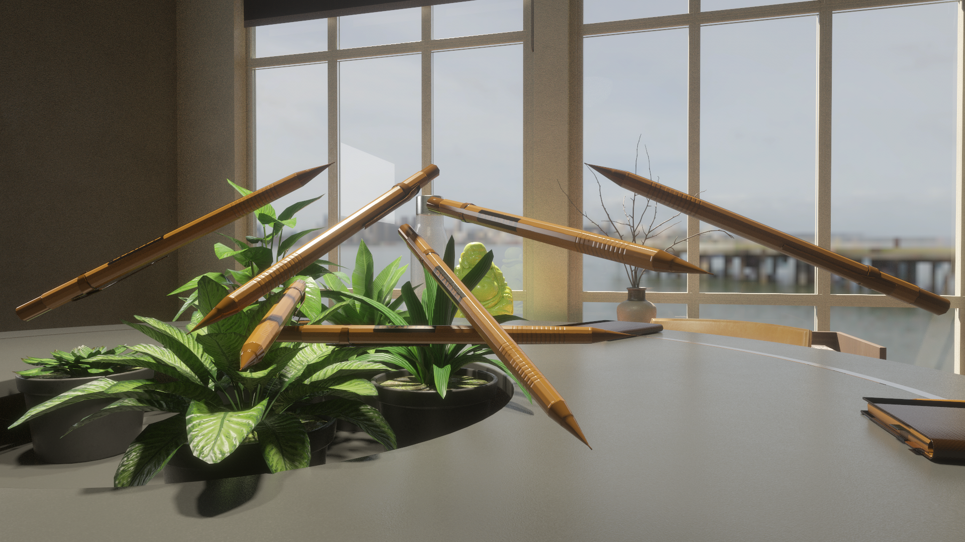
How about motion blur?
Notes:
And here is an example, without,

Slide 102

How about motion blur?
Notes:
And with motion blur.
[go back and forth a couple times]
And with that, we reach the end of this presentation.

Slide 103
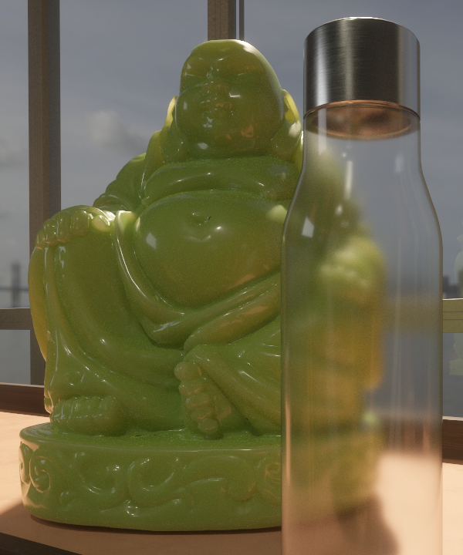
Final dimension
When going high-dimensional:
consider all dimensions at once
avoid thinking in terms of recursive, lower-dimension integrals (even if more natural to start that way)
Notes:
What to take away from it?
First, I hope we’ve shown that, when tackling a high-dimensional problem, things get a lot easier conceptually when considering all dimensions at once, rather than thinking in terms of recursive, lower-dimensional integrals, even though they may feel more familiar.
For path tracing, it translates into considering the global integral in path space, and the paths from start to end as your samples.

Slide 104
Final dimension
When going high-dimensional:
consider all dimensions at once
avoid thinking in terms of recursive, lower-dimension integrals (even if more natural to start that way)
Sequences of choice for real-time (precomputed):
A Low-Discrepancy Sampler that Distributes Monte Carlo
Errors as a Blue Noise in Screen Space [Heitz 2019]
Progressive Multi-Jittered Sample Sequences [Christensen 2018]
Notes:
The quasi-random sequences I’d recommend using would either be the one that we have picked in HDRP, by Heitz et al., or the PMJ sequence by Christensen et al., which can offer very similar properties, and for which the blue noise error diffusion could easily be adapted.
They are perfect for progressive and/or adaptive algorithms, and give excellent results for the low sampling budgets that real-time will likely impose on us.
Precomputing sequences feels like a no-brainer, as it gives us latitude to obtain the best possible properties, through potentially heavy optimization computations; furthermore, they can be stored within a minimal footprint (256*256*8bits = 64KB in HDRP).

Slide 105
Final dimension
When going high-dimensional:
consider all dimensions at once
avoid thinking in terms of recursive, lower-dimension integrals (even if more natural to start that way)
Sequences of choice for real-time (precomputed):
A Low-Discrepancy Sampler that Distributes Monte Carlo
Errors as a Blue Noise in Screen Space [Heitz 2019]
Progressive Multi-Jittered Sample Sequences [Christensen 2018]
Notable recent work on high-dimensional sets:
Orthogonal Array Sampling for Monte Carlo Rendering [Jarosz 2019]
Notes:
Will we see even better sequences any time soon? There hasn’t been much published research on non-padded, high-dimensional sequences in recent years.
One notable exception is last year’s “Orthogonal Array” paper by Jarosz et al., that produces point sets with excellent stratification properties between all dimensions. We have yet to see if it can be extended to sequences.

Slide 106
Final dimension
When going high-dimensional:
consider all dimensions at once
avoid thinking in terms of recursive, lower-dimension integrals (even if more natural to start that way)
Sequences of choice for real-time (precomputed):
A Low-Discrepancy Sampler that Distributes Monte Carlo
Errors as a Blue Noise in Screen Space [Heitz 2019]
Progressive Multi-Jittered Sample Sequences [Christensen 2018]
Notable recent work on high-dimensional sets:
Orthogonal Array Sampling for Monte Carlo Rendering [Jarosz 2019]
Future of real-time path tracing?
Reframing Light Transport for Real Time [Wyman 2020]
Notes:
As touched upon earlier, the current Unity path tracer is targeted towards interactive look-dev sessions, and producing the most beautiful images and videos possible.
It is not meant for 60fps with a typical game scene -- at least not yet.
To get there, I agree with Chris Wyman, who in his HPG keynote this July, reiterated that future real-time light-transport algorithms can’t just be straight ports of their offline counterparts.
But whatever shape or form they may take, having a good grasp on high-dimensional Monte-Carlo integration will always prove useful, and I hope that our little exploration today can help a bit with that.

Slide 107
Acknowledgments
Pavlos Mavridis
Laurent Belcour
Sébastien Lagarde
Natasha Tatarchuk
Notes:
Last but not least: I would like to thank my colleagues, who helped a great deal putting together this presentation.

Slide 108
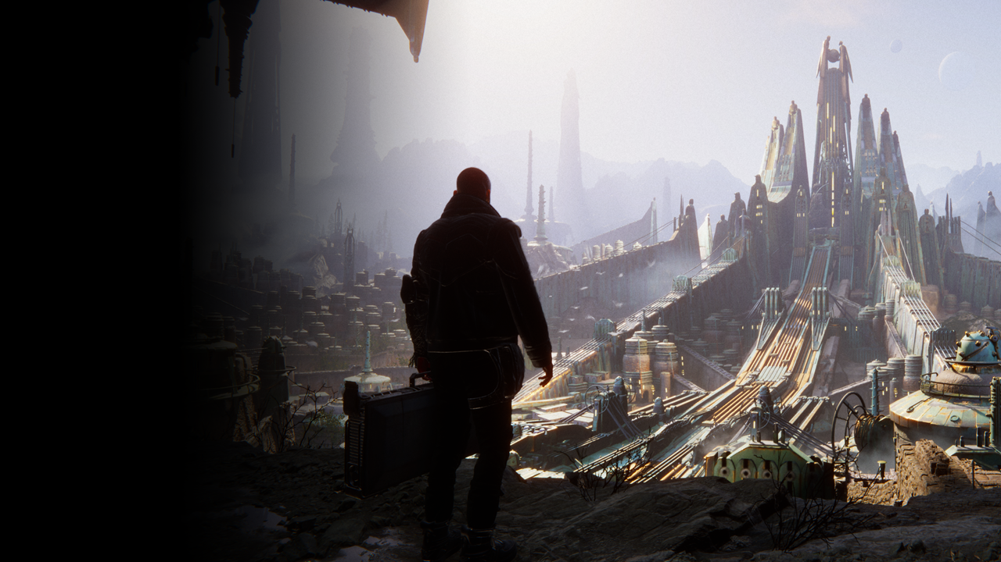
We are hiring
Notes:
And by the way, if you’d like to join us and come work on more cool stuff, our graphics team is hiring across many locations in the world.

Slide 109


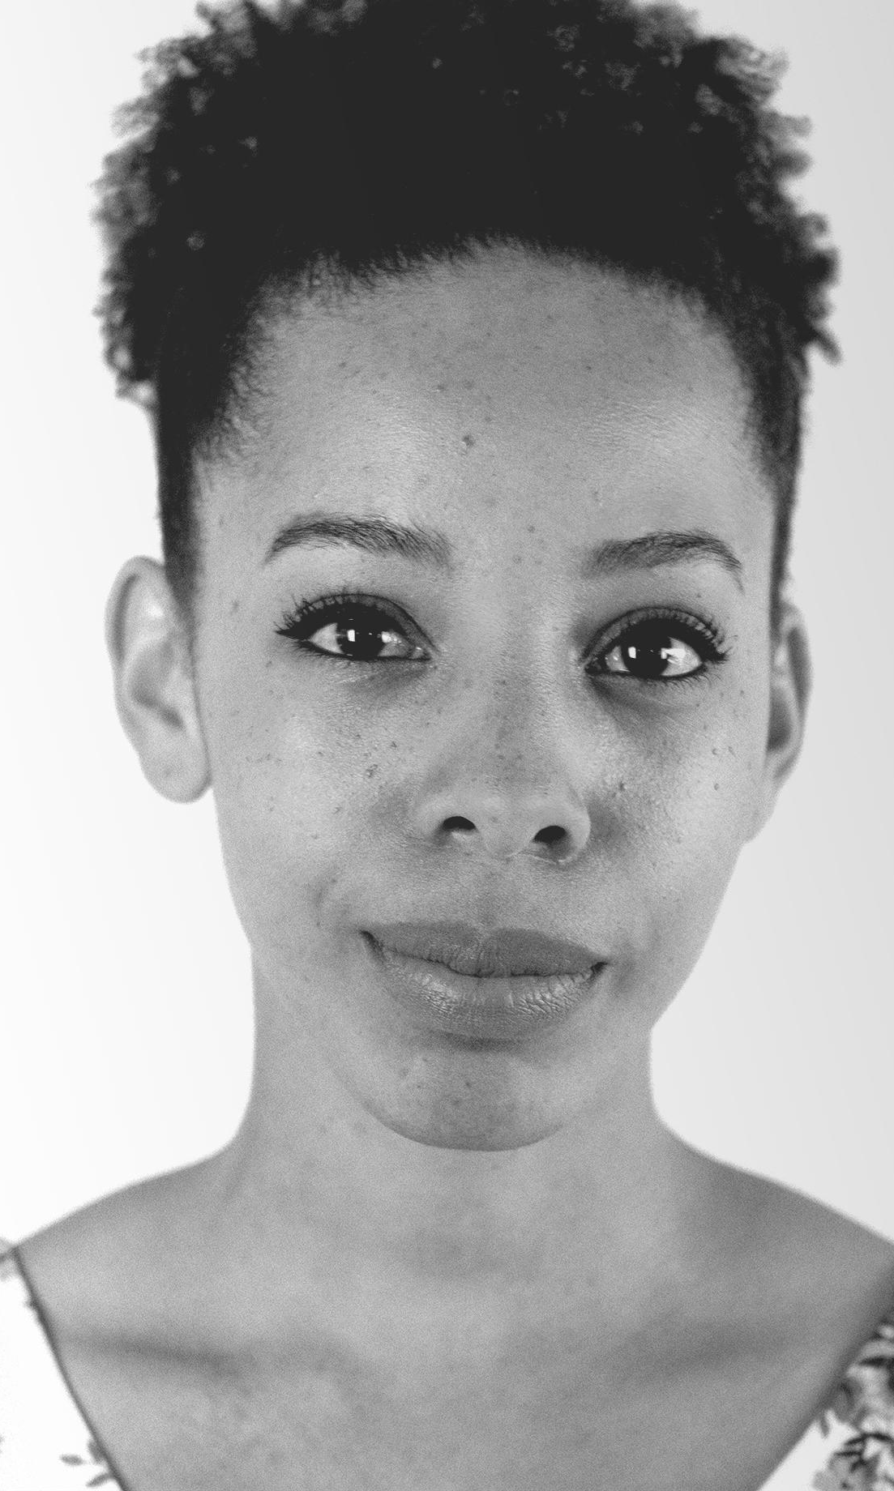
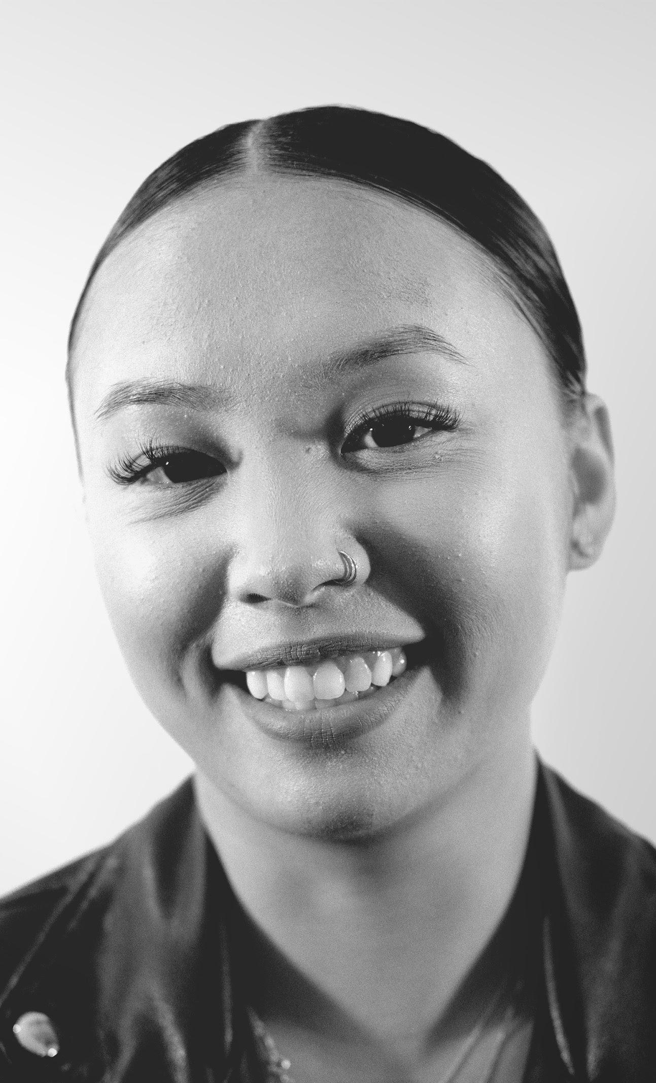
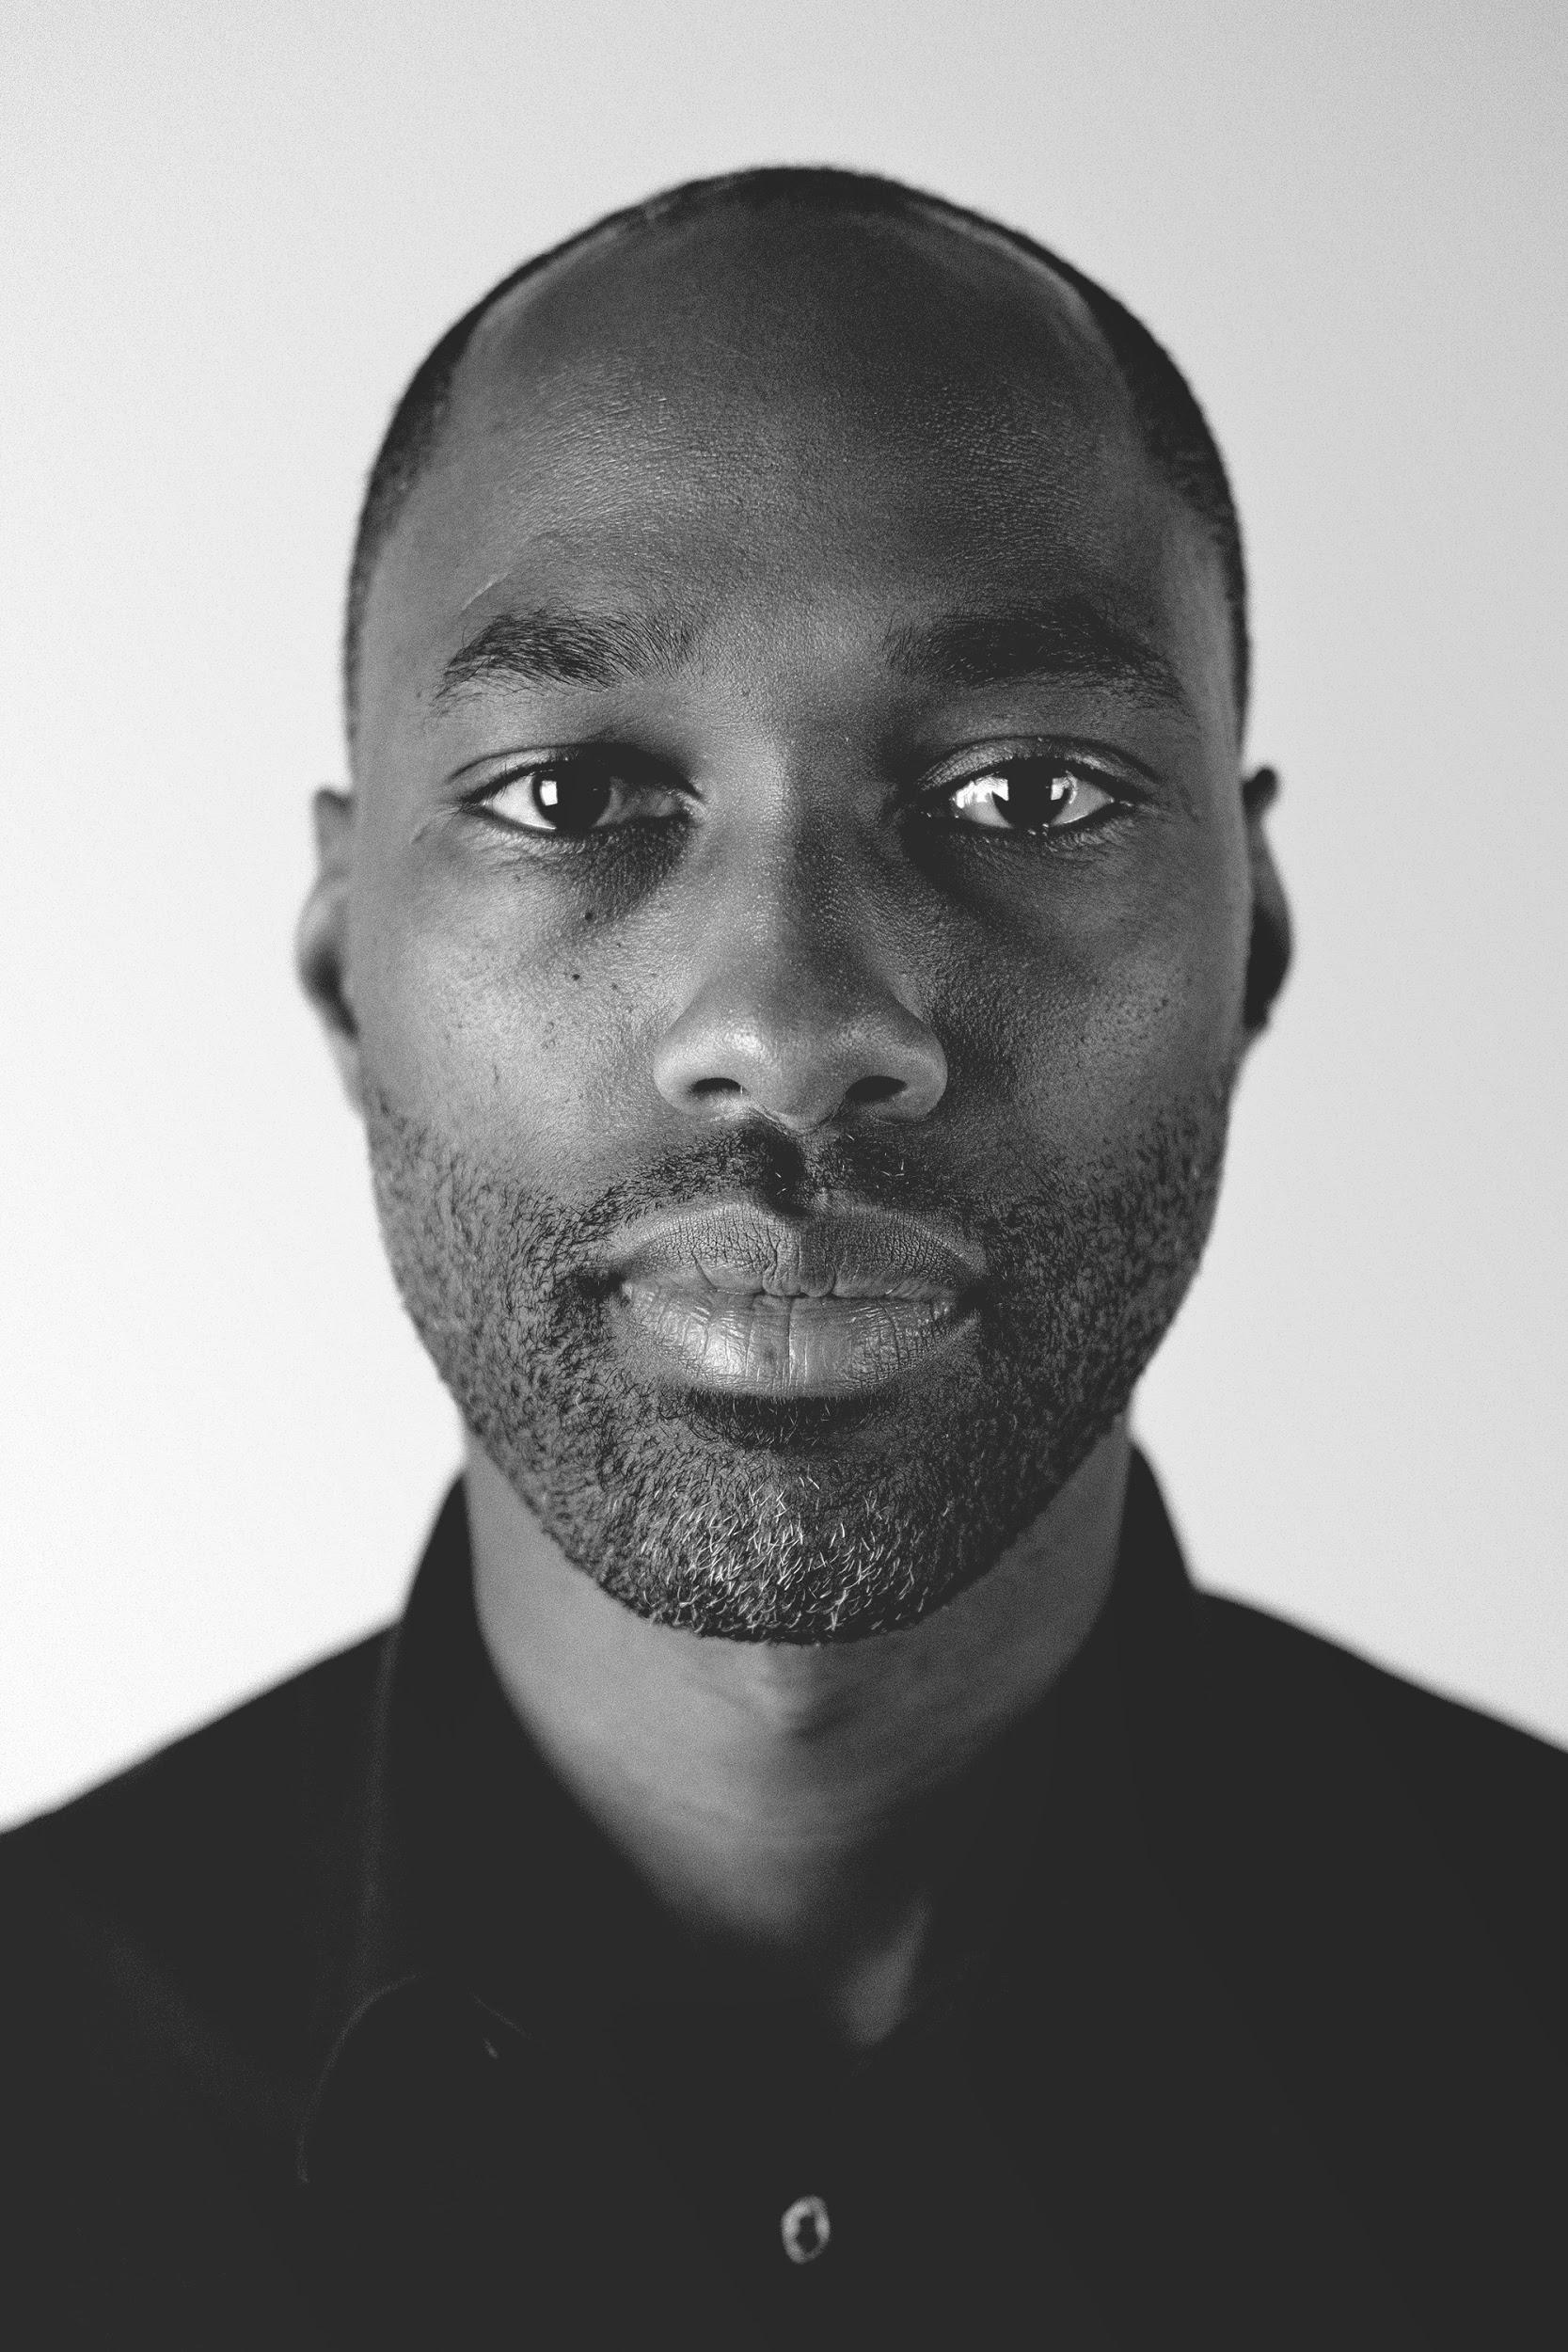

We are hiring
Together, we empower real-time creativity around the world.
careers.unity.com
365 open positions across 37 locations in 11 departments
Notes:
You can find all the details on our website.

Slide 110
Thank you!
Slides Available:
advances.realtimerendering.com
Notes:
Thank you all for watching!
The slides (including all references) are available to download from this address.

Slide 111
References
[Christensen 2016] The Path to Path-Traced Movies, Per Christensen and Wojciech Jarosz,
Foundation and Trends in Computer Graphics and Vision, volume 10, number 2, 2016
[Christensen 2018] Progressive Multi-Jittered Sample Sequences, Per Christensen et al., EGSR 2018
[Cook 1984] Distributed Ray Tracing, Robert L. Cook, ACM SIGGRAPH 1984
[Cook 1986] Stochastic Sampling in Computer Graphics, Robert L. Cook, ACM SIGGRAPH 1986
[Georgiev 2019] Blue-Noise Dithered Sampling, Iliyan Georgiev, ACM SIGGRAPH Course 2019,
https://sites.google.com/view/myfavoritesamples
[Grünschloß] Leonard Grünschloß website, http://gruenschloss.org/
[Heitz 2019] A Low-Discrepancy Sampler that Distributes Monte Carlo Errors as a Blue Noise in Screen Space,
Eric Heitz et al., ACM SIGGRAPH Short Paper 2019
[Jarosz 2019] Orthogonal Array Sampling for Monte Carlo Rendering, Wojciech Jarosz et al., EGSR 2019
[Joe 2008] Constructing Sobol Sequences with Better Two-Dimensional Projections, Stephen Joe and Frances Y. Kuo,
SIAM Journal on Scientific Computing, Volume 30, Issue 5, August 2008

Slide 112
References
[Kensler 2013] Correlated Multi-Jittered Sampling, Andrew Kensler, Pixar Technical Memo 2013
[Kollig 2002] Efficient Multidimensional Sampling, Thomas Kollig and Alexander Keller, EG 2002
[PBRT] Physically Based Rendering: From Theory To Implementation, http://www.pbr-book.org/
[Pharr 2018A] Guest Editor’s Introduction: Special Issue on Production Rendering, Matt Pharr,
ACM Trans. Graph. 37, 3, Article 28 (July 2018)
[Pharr 2018B] Adopting Lessons from Offline Ray-Tracing to Real-Time Ray Tracing for Practical Pipelines,
Matt Pharr, ACM SIGGRAPH Course 2018, https://advances.realtimerendering.com/s2018
[Pharr 2019] Warp and Effect, Matt Pharr, ACM SIGGRAPH Course 2019, https://sites.google.com/view/myfavoritesamples
[RTGems] Ray Tracing Gems, http://www.realtimerendering.com/raytracinggems/
[Tabellion 2004] An Approximate Global Illumination System for Computer Generated Films,
Eric Tabellion and Arnauld Lamorlette, ACM SIGGRAPH 2004
[Wyman 2020] Reframing Light Transport for Real Time, HPG 2020 Keynote, https://www.youtube.com/watch?v=hhUUb5Op1-4

Slide 113
