Slide 1
mesh shading
Towards greater efficiency in geometry processing

Slide 2


Slide 3
outline
Geometry – at the core of computer graphics
A brief history of geometry processing
  Provide context and motivation for improvements
  How did we end up here?
Mesh shading – the new programming model
  One of the biggest graphics pipeline innovations in almost a decade!
Emerging applications of mesh shading and future directions
Notes:
Computer graphics is all about dealing with geometry. So my talk is about geometry processing and its evolution.
The major emphasis of our latest GPU architecture, called Turing, is on accelerating ray tracing an artificial intelligence.
But somewhat less obvious, Turing is also a major refresh in terms of its graphics pipeline architecture, specifically for geometry processing.
So we’ll talk about mesh shading – the new, improved model for geometry.
But it is important to understand these innovations in the context of the past, so we’ll take a holistic look at the history of geometry processing.
Finally, will review some of the exciting use cases of mesh shading.
I hope to ignite your interest in these improvements so that you can go learn more about them and start thinking about how you can apply them in your work.

Slide 4
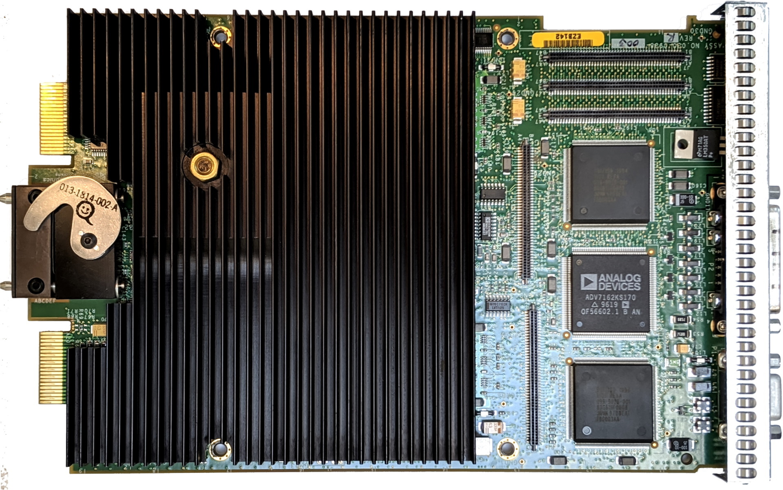
In the beginning…
Memory-mapped hardware
  Simple, procedural interface
CPU responsible for bulk of the work
  Hardware TnL in workstation, then consumer
Triangle is a unit of processing
Strips/fans for vertex reuse
  1 vertex defines a new primitive
glBegin(GL_TRIANGLES);
glVertex3f(x0, y0, z0);
glVertex3f(x1, y1, z1);
glVertex3f(x2, y2, z2);
glEnd();
Notes:
Not claiming to correctly represent the full taxonomy of graphics hardware here… But we’ll assume that our starting point is some of the earliest hardware rasterizers.
The bulk of the work was performed on the CPU, then functions of the backend of the geometry pipe such as triangle edge setup were gradually incorporated in FF hardware.
Hardware transform and lighting – basically, implementation of OpenGL geometry pipeline, was among the earliest functions to be accelerated in dedicated hardware.
Incidentally, this is a photo of SGI Octane’s GPU, which didn’t even support texture mapping in its basic configuration, yet it had a hardware-accelerated “geometry engine”.
Hardware at the time exposed a simple interface, consisting of memory mapped registers, programmed directly from host.
Polygon count was low, so such an interface was justified.
Individual triangles were fundamental units of processing.
Software could also organize them in strips or fans, to express vertex reuse. With these geometry structures, a new primitive can be introduced with just 1 vertex.
This assumption had implications for future designs.

Slide 5
Vertex shading
Limited per-vertex programmability
  Pure functions with bounded output – fire and forget
  Complex processing still happens on the host
Geometry represented with index and vertex arrays
  DMA engines pulling the data in
  Cache at the top of the pipe captures vertex reuse – serial process
Pipeline largely optimized for 1 vertex/triangle per clock
  Limited by raster throughput
Notes:
As applications were demanding more sophisticated vertex processing, it became clear that the fixed-function model was too limiting.
Vertex shading enabled limited programmability at the per-vertex level.
Vertex shader is a fire-and-forget pure function, in the sense that it doesn’t have side effects and has well defined and bounded output (attributes).
Bounded output is important for scheduling – hardware can pre-allocate output space before shader launch and guarantee that it will run to completion.
At the same time, the bandwidth of the procedural interface became insufficient to support growing geometric complexity of the workloads.
Instead, applications would represent geometry using explicit vertex and index arrays, triangle lists became de-facto standard.
Since vertex shading was costly, a cache was introduced at the top of the pipe – recently used vertices would hit in the cache which avoids re-running potentially costly vertex shaders.
The hardware was largely built around 1 new vertex per triangle per clock (assuming strip topology) – triangles were rasterized serially, one at a time.

Slide 6
Programmable shaders era
In-pipeline geometry generation
  Geometry/tessellation shaders
  Can do limited programmable culling – patches, triangles
Shaders still run as singleton threads
Distributed raster allows for > 1 triangle/clk
  Serial index buffer scanning becomes more of a bottleneck
Complexity starts piling up…
  Multiple “fixed-role” shader stages
Notes:
The concept of programmable shading exploded the industry, giving developers a lot of control over the pipeline.
New programmable stages were added, enabling geometry to be generated on the fly: with geometry shaders, applications could inject new primitives into the pipeline and remove primitivies from processing.
However, the basic scheduling model remained unchanged – shaders were still run as singletons, with hardware provisioning output space for invidiual threads.
It had significant efficiency implications in certain cases – for example, geometry shaders could only generate new primitives serially, and the output space had to be pre-allocated for the worst-case expansion.
We’ll take a closer look at tessellation in a moment, since it will provide important motivation for further improvements…
Another change that happened around the same time was distributed raster – consumer GPU embraced modular design, integrating multiple parallel “rendering pipelines”, capable of rasterizing more than 1 tri/clk across the system. This emphasized the serial index scanning bottleneck at the top of the pipe.
At the API level, the programming model incorporated multiple shader stages, each with its own dedicated function.

Slide 7
tessellation
Patches
Expanding pipeline – geometry amplification
  Hull shader controls the # of domain shaders to run
Producer-consumer scheduling
  Data flow stays on-die – pipelined memory
  Work redistributed for efficiency
Topology generated in fixed-function
  Fixed patterns too limiting for some apps
  Potential performance bottlenecks
Hull shader
LOD factors
Patch constants and control points
Topology generation
Domain shader
Domain
Domain
To raster
Notes:
Let’s take a closer look at tessellation…
Tessellation is all about work amplification – a single patch may get diced into thousands of primitives. The single-thread model was inadequate to support this kind of expansion.
So a peculiar two-stage model was adopted…
A hull shader is run per-patch, determining the amount of dicing – effectively, the number of domain shader instances to run. Then, appropriate number of domain shaders are launched as a separate stage.
This two-stage model is important for two reasons.
First, because each shader instance still has bounded output, hardware can schedule them in fixed output space – a small on-chip memory buffer can be used to time-multiplex multiple shader invocations.
That way, all data flow is fully contained on-die – no external memory bandwidth is used.
Second, because the amount of expansion is determined dynamically and can be very high, hardware can redistribute work – domain shaders can be scheduled across a large number of parallel processors.
Let’s keep these two benefits of the tessellation expansion model in mind.
One downside of the tessellation model is that the topology of the tessellated mesh is generated by fixed function hardware. Not only is this functionally limiting, but can also become a performance bottleneck due to serial process of topology generation.

Slide 8
Compute –the GPU becomes a proper computer
Compute tiled lighting
Flexible cooperating thread groups
  Application-defined, no fixed roles
  Threads can share data and synchronize
Bulk synchronous scheduling
  Wide grids launched one at a time
  No backpressure
Enabled a whole set of clever techniques
  Tile-based deferred shading
  Compute-based culling, …
Pixel-parallel tile frustum
Synchronize
Light-parallel cull
Synchronize
Pixel-parallel shade
Notes:
The introduction of compute shading was another huge innovation that enabled a whole new set of clever techniques.
The GPU could now be programmed like a more conventional data parallel machine.
In compute, application programs to data-parallel groups of threads, rather than individual singleton threads. Threads within these groups can cooperate and share data.
Also, threads have no fixed roles – application is free to assign them to elements of the problem domain, reusing the same threads in different phases of the computation.
Compute threads don’t have any notion of pipeline “output” – they simply read and write background memory. Application launches regular grids of threads, one at a time.
In that sense, scheduling is bulk synchronous – output of one grid has to be completely written to memory, before subsequent grid can pick it up.
One great application of this powerful model is the popular compute tiled lighting – where threads in the group change roles, as they go through different phases of execution.

Slide 9
Graphics vs compute – split personality of the GPU
Index fetch and dedup
Global
memory
Vertex
Hull
Thread group launch
Topology generation
Compute
Domain
Geometry
Rasterization
Notes:
So on one hand we have the graphics pipeline, with all of its efficiency and producer-consumer scheduling; on the other hand we have compute, which provides ultimate flexibility,
but can’t communicate with graphics directly…
In effect, we have two different “personalities” of the GPU, and they can only communicate through memory. This creates two problems:
First, limited available external memory bandwidth introduces performance bottlenecks and has implications for scalability of the system.
Second, since the two “personalities” are not scheduled as a pipeline, input/output memory has to be sized for the worst case. Sometimes, this worst-case size can be really bad, to the point of being impractical – consider a geometry synthesis application running as a compute shader, when the amount of geometry it is generating is not known ahead of time.
Can we somehow integrate the two models and get the benefit of both worlds?

Slide 10
What if we pipelined compute into raster?
Global
memory
Thread group launch
???
Rasterization
Notes:
What if we enabled the compute shader to feed into raster directly, through on-chip memory?
Like this…

Slide 11
Basic mesh shading model
Global
memory
Thread group launch
Mesh shader
Rasterization
Meshlet
Notes:
… and that’s exactly what mesh shading does.
Mesh shaders are application-defined thread groups, that can be programmed like compute, but they are scheduled with backpressure from graphics.
Compute thread groups now have bounded-sized output – as we saw, this is critical in enabling efficient pipeline scheduling.
Just like in the graphics pipeline, this output can be placed in on-chip memory, eliminating the bandwidth bottleneck of the split personality model.
The output of the mesh shader thread group is called a “meshlet” – a formal representation of the rasterizer’s input.
Let’s look at it next…

Slide 12
Meshlet – a standardized interface to screen-space
struct {
N
Prim count
vtx #0
u₀
v₀
…
r₀
g₀
b₀
x₀
y₀
z₀
w₀
0
1
2
a₀
b₀
c₀
…
prim #0
vtx #1
u₁
v₁
…
r₁
g₁
b₁
x₁
y₁
z₁
w₁
1
2
3
a₁
b₁
c₁
…
prim #1
vtx #2
u₂
v₂
…
r₂
g₂
b₂
x₂
y₂
z₂
w₂
3
2
0
a₂
b₂
c₂
…
prim #2
vtx #3
u₃
v₃
…
r₃
g₃
b₃
x₃
y₃
z₃
w₃
…
…
3
7
8
a_{N-1}
b_{N-1}
c_{N-1}
…
prim #N-1
vtx #M-1
u_{M-1}
v_{M-1}
…
r_{M-1}
g_{M-1}
b_{M-1}
x_{M-1}
y_{M-1}
z_{M-1}
w_{M-1}
}
Vertex attributes
Topology
Primitive attributes
Notes:
A meshlet is a fixed-size structure, defining a small set of connected primitives (hence the name). A meshlet would typically be on the order of hundred of vertices and hundred of primitives in size.
Thanks to its small size, it can be placed in pipelined on-chip memory.
Within the meshlet structure, there are three main sections:
An array of clip-space vertices, and their corresponding attributes such as colors and texture coordinates.
A list of indices represents topology of the output mesh, indirecting into the vertex array – they represent primitives to be rasterized.
Associated with each primitive is a list of primitive attributes.
Note that this notion of primitive attributes doesn’t exist in the conventional graphics pipeline, which only has “flat shaded” attributes, defined at provoking vertices.
Because with meshlets connectivity of the mesh is defined explicitly, it makes more sense to declare primitive attributes explicitly too, rather than using the old implicit convention.
Note that all fields can be written by the shader – including topology and the primitive count.

Slide 13

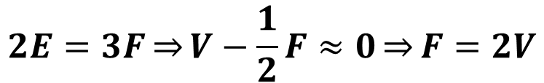
Mesh shader programming model
Application-defined thread roles
  Like compute
  Cooperatively generate output meshlet
Combines vertex and geometry shading
  Assume ratio of faces to vertices is ~fixed
  Limited dynamic expansion
Vertex-parallel transform
Synchronize
Primitive-parallel cull
Synchronize
$$V+F−E=2(1−g)$$
Vertex-parallel shade
$$2E=3F\overset{⇒}{}V−\frac{1}{2}F≈0\underset{⇒}{}F=2V$$
For triangles:
Notes:
Just like compute, mesh shader threads do not have pre-assigned roles – application is free to define roles for them.
All threads in the group work cooperatively to fill out output meshlet.
So they can leverage tricks, similar in spirit to compute tile lighting…
For example, they can optimize vertex shading by applying the transform to vertex positions first in the vertex-parallel phase, then using the results of this computation in primitive-parallel phase to determine culling status of each primitive. The primitive parallel phase can then tag vertices of visible primitives, and switch to vertex-parallel phase again to shade them.
Because the index list can be freely rewritten by the mesh shader, it can remove some primitives from the output, or add new ones.
In this sense, mesh shaders combine functions of vertex and geometry shaders.
One important consideration is the implicit assumption that the ratio of vertices to primitives contained within a meshlet is approximately fixed – so that the same, fixed set of threads can be used to process vertices or primitives efficiently.
As a footnote, in case of triangles, the highest ratio between primitives and vertices that makes sense to target is two to one, given Euler’s relation for manifolds.

Slide 14
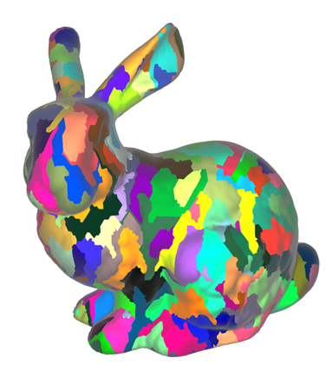
What about the input?
Input representation is application-defined
  Custom compression, non-B-rep schemes…
  Directly addressable using mesh shader id
Fixed-function at the top of the pipe is gone…
  No index dedup, no vertex attribute pull
  Avoids serialization point – scalability
App responsible for exploiting vertex reuse
  Can pre-compute optimized primitive clustering
  No repeated work at runtime – power savings
Notes:
So what about mesh shader inputs?
The short answer is that unlike outputs, the inputs are completely application-defined. Each mesh shader thread group is given a unique ID, which it can use to find its input in memory.
The model doesn’t place any constraints on the format of the input, other than that it has to be directly addressable.
For example, applications can use custom compression schemes, or represent geometry in alternative forms – as voxels, or other non-boundary representations. In that sense, mesh shaders can be thought of as a powerful framework for geometry synthesis – more on that in a moment…
It’s also worth noting that the fixed-function vertex caching hardware at the top of the pipe is gone – since we can’t make any assumptions about the structure of the input, all bets are off.
It has the benefit of eliminating the serialization point, which means that the overall system performance can scale much better.
So how do we exploit vertex reuse then? One option is to simply pre-compute it – similar to the classical vertex optimizers which reorder indices, a pre-process can output optimized primitive clusters, encoding references to unique vertices explicitly. Those clusters can be thought of as “input” meshlets.
Because in most cases topology of the mesh doesn’t change very often, the results of this precomputation can be reused over large number of frames. Static meshes can be pre-processed only once.
Note that meshlets can actually exceed vertex cache sizes in conventional GPUs, which implies that the vertex reuse ratio can be much closer to the ideal of 2:1. In practice, we’ve seen ratios of 1.6:1.

Slide 15
Dynamic expansion
Geometry synthesis requires support for amplification
  Generalize the tessellation expansion model
  Remove fixed-function topology generation
Patches
Tasks
Hull shader
Task shader
LOD factors
Expansion factor N
Patch constants and control points
Task to mesh shader payload
Topology generation
Thread group launch
Domain shader
Mesh shader
Domain
Domain
Domain
Domain
To raster
To raster
Notes:
We also want to support larger scale geometry synthesis applications with this framework.
As we saw with tessellation, dynamic expansion requires a two-stage scheduling model. We want to capture the same efficiency, but at the same time retaining the compute-like flexibility of the mesh shader (thread group-based execution, no fixed thread roles).
So mimicking tessellation, we add another shader stage called task shaders. Task shaders are also launched as application-defined thread groups, which also have bounded output. Unlike mesh shaders, the output of the task shader isn’t structured – it is simply a blob of data which is made available to all instances of their children mesh shaders.
Application defines what’s contained in the task shader payload – it may represent control points of a patch, or it may contain pointers to structures in memory for subsequent processing by mesh shaders.
Like hull shaders, task shaders control how many instances of mesh shader thread groups to launch post-expansion, by outputting expansion factor N which is interpreted by the hardware literally (unlike LOD factors in tessellation).
The function of topology generation is subsumed by mesh shaders, so the corresponding fixed-function hardware is removed, eliminating another potential serialization bottleneck, leading to greater efficiency and scalaibility.

Slide 16
Geometry Pipeline with task and mesh shaders
Global
memory
Thread group launch
Task shader
Thread group launch
Mesh shader
Rasterization
Notes:
So putting it all together, here’s the full task-mesh shader pipeline.
Task shaders are launched from host, like a compute grid, and each task shader thread group gets a system-provided ID, so that it knows which part of the problem domain to work on.
Each task shader thread group can specify how many mesh shader thread groups to spawn post-expansion.
Each mesh shader thread group gets an ID which is local to that spawn event..

Slide 17
task and mesh subsume the old shader stages
Index fetch and dedup
Global
memory
Vertex
Thread group launch
Hull
Task shader
Topology generation
Thread group launch
Domain
Mesh shader
Geometry
Rasterization
Primitive rasterization
Notes:
Comparing to the old geometry pipeline, task and mesh shaders subsume the old fixed-role shader stages…
Hull and vertex shaders are subsumed by task shaders.
Domain and geometry shaders are subsumed by mesh shaders.
Note how shader stages executing at similar computation frequencies are effectively fused into a single shader stage.
This facilitates more efficient data flow between them.
Work redistribution point in-between is retained to support work amplification scenarios.

Slide 18
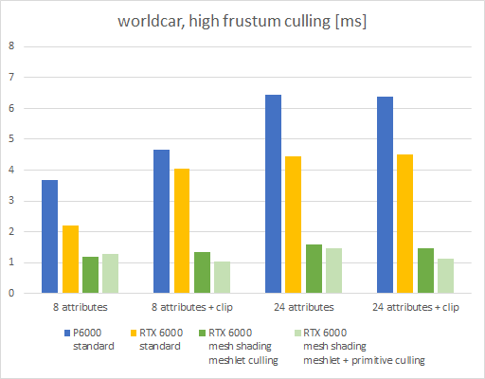
Mesh shader culling
Work by Christoph Kubisch @ NV
Task shaders cull clusters of primitives
  Frustum, backface, subpixel
  >> per-primitive FF culling
Leverages pre-computation
  Localized primitive clusters
  Precompute normal spread, etc.
Also more compact
  25-50% less memory than index buffer!
https://github.com/nvpro-samples/gl_vk_meshlet_cadscene
Notes:
Now let‘s review some of the emerging applications of task and mesh shaders. Not enough time to go over them in detail, but I‘ll provide references.
Culling is perhaps the most obvious use case of the mesh shader framework. More specifically, exploiting task shaders to cull clusters of primitives at once.
This is far more efficient than fixed-function culling, that can only operate at the scope of individual primitives, while still being much finer grained than culling at the object level.
Task shader culling can leverage pre-computed properties of a given decomposition of the mesh into clusters, such as cluster bounding boxes, or per-primitive normal distribution statistics.
Alternative culling strategies become possible, such as occlusion culling – which isn‘t availble in the conventional pipeline.
Mesh shaders can also further cull individual primtivies, further saving on attribute processing costs within meshlets. It may or may not be beneficial, depending on the application.
It also turns out that the meshlet-based representation is more compact than the index-buffer based representation, and can sometimes save up to 50% of memory footprint (32 b indices).
Christoph Kubisch gave a talk on this technique at GTC 2019, you can also refer to the Vulkan meshlet sample we released at this link.

Slide 19

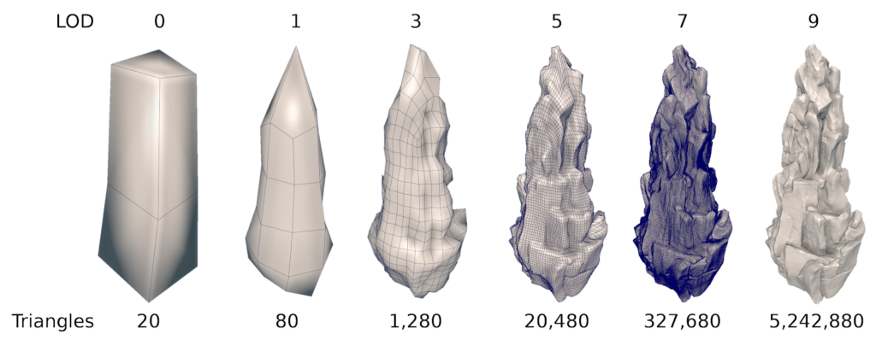
Dynamic LOD management
Work by Manuel Kraemer, Alexey Panteleev et al @ NV
NVIDIA’s “Asteroids” demo
  50M+ triangles per frame
Dynamic LOD using task shaders
  Select from a set of precomputed LODs
  Spawn mesh shaders to render
  No CPU intervention!
For more details, don’t miss
  “Applications of mesh shading”
  Tomorrow July 30th 9am
  Room 501AB
Notes:
Another great application for the mesh shader framework is dynamic LOD management. This use case is illustrated in our Asteroids demo.
The demo renders a large field of highly detailed asteroids, where each asteroid is rendered at a dynamically determined LOD level, appropriate for its screen-space footprint.
The entire asteroid field is rendered without any CPU intervention, with all LOD management logic being done with task and mesh shaders.
Each asteroid is represented at multiple levels of detail as sets of precomputed meshlet clusters in memory. Each task shader thread group corresponds to a single asteroid instance, determining its screen-space footprint and required LOD level.
Based on the precomputed meshlet decomposition, it calculates the number of mesh shader thread groups to launch.
It also sends a pointer to the asteroid mesh data in memory to all of its children.
Each child mesh shader thread group, knowing its ID and the base pointer sent from the parent task shader, loads appropriate cluster of primitives to be output as a meshlet.
Primitive clusters are precomputed using a scheme I mentioned previously.
For more details, I encourage you to attend our talk at 9am tomorrow on applications of mesh shading.
https://www.youtube.com/watch?v=CRfZYJ_sk5E

Slide 20
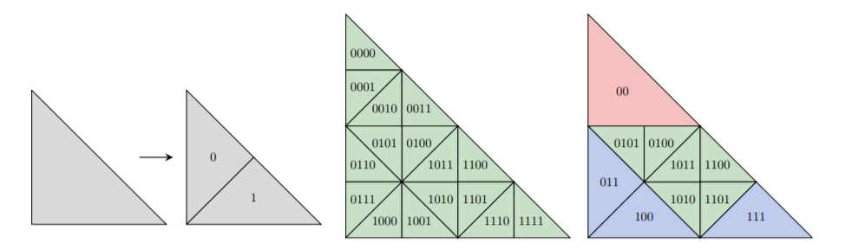
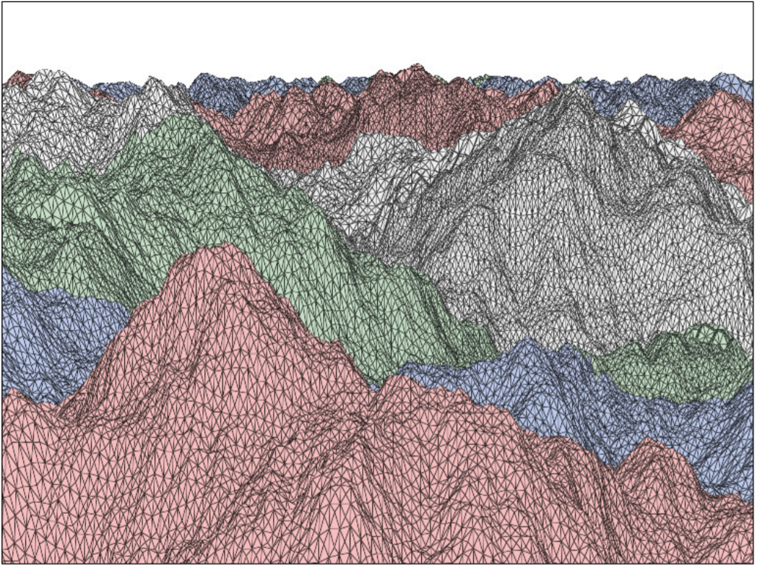
Adaptive tessellation
Work by Jonathan Dupuy et al @ Unity
and Cyril Crassin @ NV
Dynamic triangle subdivision scheme
  Efficient encoding using binary keys
  Incremental refinement over multiple frames
Mesh shaders enable single-pass pipeline
  Task shaders update implicit subdivision
  Mesh shaders decode from binary keys
Refer to Adaptive GPU tessellation
https://github.com/jdupuy/opengl-framework/tree/master/demo-isubd-terrain
Notes:
Adaptive tessellation work by Jonathan Dupuy and others from Unity and Cyril Crassin from NV.
A clever implicit subdivision scheme leveraging binary keys for efficient encoding of subdivision sequence. Every frame, a single step of subdivision or merging is done on the binary keys.
Target LOD is reached over the course of multiple frames. Implicit subdivision representation is decoded from binary keys into triangles.
Original implementation used compute shaders and multipassing through memory.
Mesh shading enables entire pipeline to run in a single pass: task shaders are responsible for updating implicit subvidision representation and spawning mesh shaders for the current frame.
Mesh shaders emit a regularly subdivided patch of triangles, decoded from keys.

Slide 21
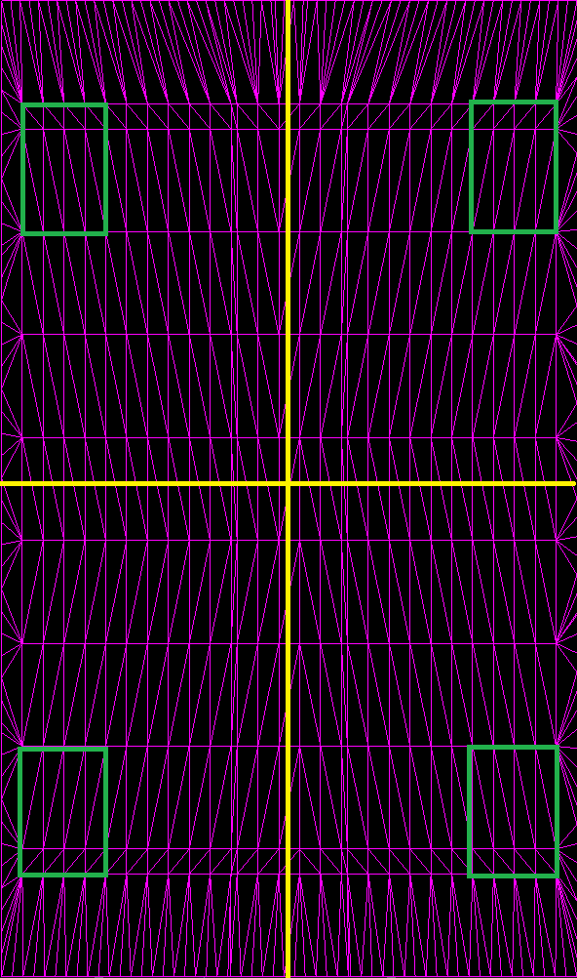
Emulating dx11 tessellation
Work by Rahul Sathe @ NV
Because we can! ☺
  But also: higher tessellation factors, better culling
Use look-up tables of partial tessellations in memory
  Exploit symmetry to save space
  Task shaders compute auxiliary data, spawn mesh shaders
  Mesh shaders load from tables, compute per-thread U,V
Work in progress…
Also in the talk tomorrow @ 9am
Notes:
Finally, another interesting tessellation experiment – a work by Rahul Sathe from NVIDIA.
This is experimental work in progress aiming to re-implement fixed-function DX11 tessellation using task and mesh shaders.
It primarily serves as a functional validation of the expressiveness of the mesh shader framework, but it can also have practical benefits, such as support for higher tessellation factors or finer-grained culling.
The basic idea is to precompute partial tessellations and store them in look-up tables in memory. Since tessellation pattern are symmetric, these lookup tables can be made fairly compact.
Task shaders perform functions of hull shaders – compute LOD factors, converting them to the number of mesh shader thread groups required to process the patch.
Each patch is segmented into interior region, which is tessellated using a regular pattern, and exterior region – a “picture frame” stitching outer edges with the inner edges. Each mesh shader thread group is assigned to work on a section of the interior or exterior region. Each thread is then responsible for computing appropriate parameter-space coordiantes and performing functions of a domain shader.
This is largely work in progress, please come tomorrow at 9am if you’re interested in details.

Slide 22
summary
Mesh shading – new programming model for geometry
  Combines flexibility of compute and efficiency of pipeline scheduling
  Streamlined pipeline through elimination of serial bottlenecks
  Enables greater efficiency and control in geometry processing
Opportunities for new applications to embrace mesh shading
  LOD management, data structure traversal, geometry synthesis, proceduralism
Available today
  {VK/GL/SPV/GLSL}_NV_mesh_shader
  NVAPI

Slide 23
Questions?
Email me at yuralsky@nvidia.com

