Slide 1
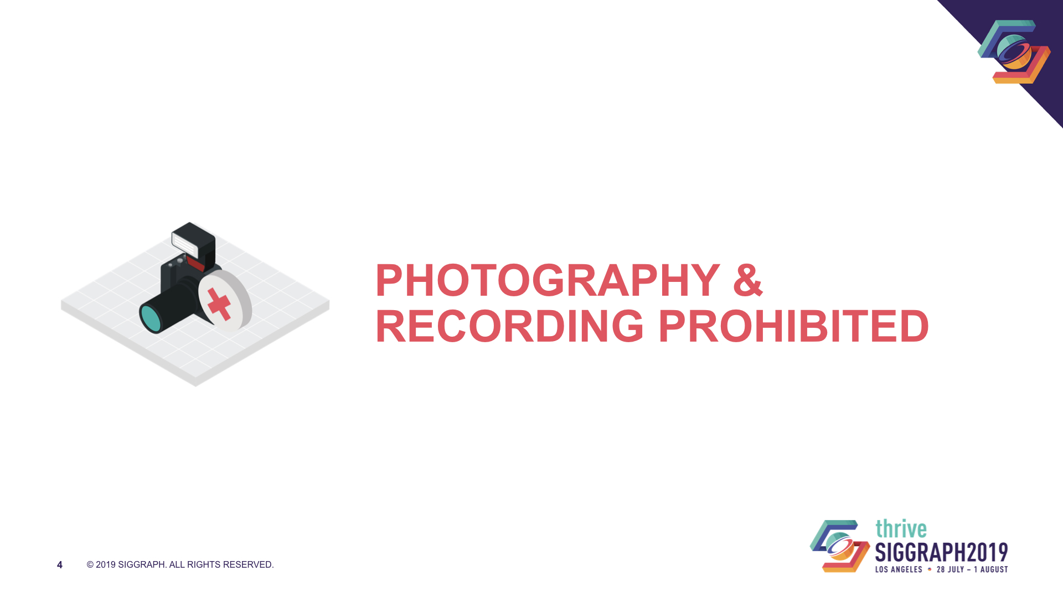

Slide 2
A Journey Through Implementing
Multiscattering BRDFs & Area Lights
Stephen McAuley
Notes:
Thanks for the introduction and good morning everyone!
This talk begins back in February of this year when Natasha sent me a message, asking me to speak at I3D. For those who don’t know, I3D is another computer graphics conference like SIGGRAPH, which focuses on interactive rendering and so brings together academics and games industry professionals. Natasha suggested that it would be great if I could do a talk explaining what it’s like taking some research from start to finish into a video game. At the time I really wasn’t sure if I actually had anything to talk about. My last shipped game was Far Cry 5 which was over a year ago, and you tend to do research at the start of a production and that was a number of years ago now and fading from my memory. But as it was Natasha asking, I said yes anyway, gave her a rather generic talk title and description and started to think.
At the same time I’d been doing some research on multiscattering BRDFs and area lights. I’d got some initial quick results, but as the weeks progressed I was hitting more and more difficulties that I needed to solve. So on the one hand I was thinking about how I could do a talk on getting research into production, and on the other I was implementing research into production and hitting a lot of difficulties… and after a while I finally put two and two together and this talk was the result.
So this is an explanation of research that I’ve been doing into multiscattering BRDFs and area lights, the problems that I’ve faced, and some of my solutions. Of course, there are also some open problems too that I’d like everyone’s help with. I also hope this contains some useful visuals and information about whether you’d like to get these features in your game too. Finally, at the end I’ll give a quick summary of some things I learned when implementing this that applies to academics and a little bit also to us game developers.

Slide 3
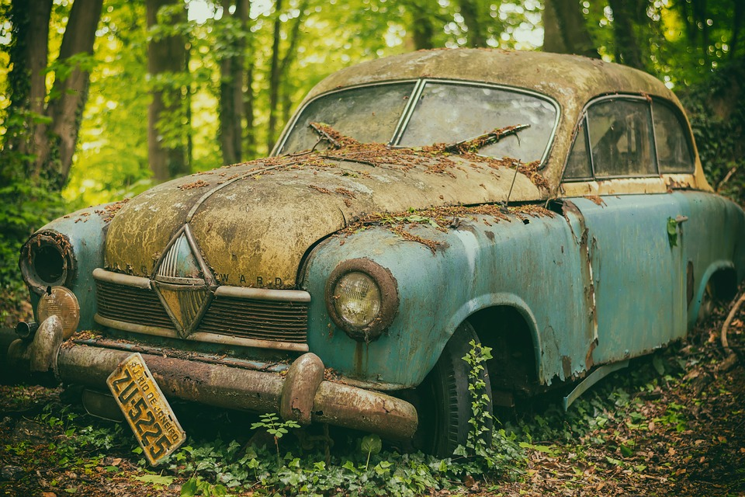
Notes:
At the end of Far Cry 5, I was feeling our material system was getting a little out of date. Sure, it used to be pretty good, but we were still pretty much based on the Disney BRDF model from 2012, but with Lambertian diffuse rather than the Disney diffuse model. A lot of research had been coming out and I thought it was about time I did an upgrade and saw what was out there, and what benefit it could bring us.
There were some problems mentioned by artists too. Generally people still wanted more specular being visible, and another wish was a slightly softer falloff for diffuse. Plus, of course everyone wants the game to look more realistic, and better materials and lighting are a key route to that.

Slide 4
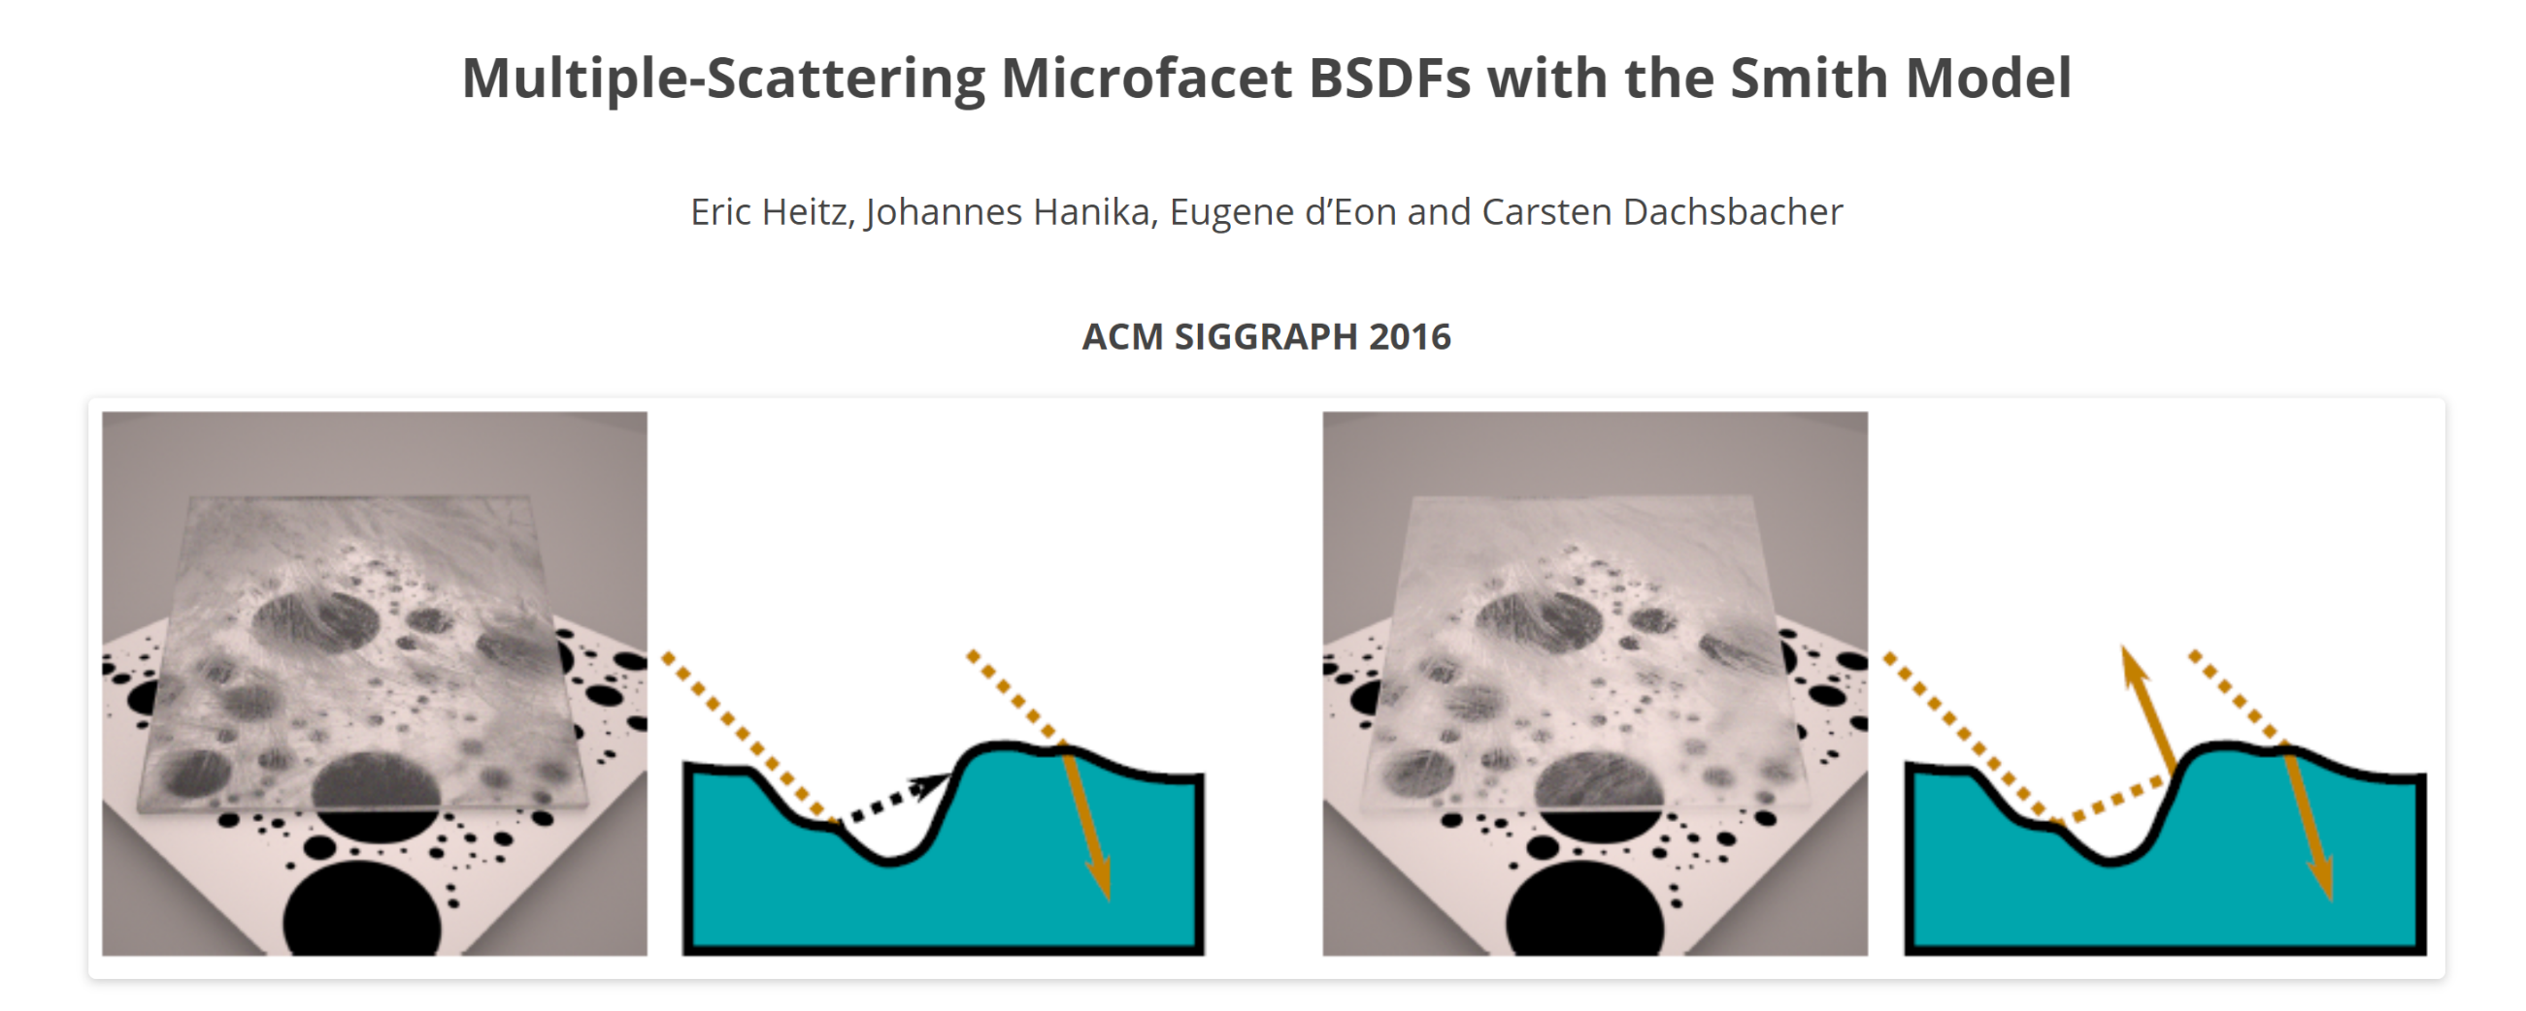
[Heitz16a]
Notes:
The paper that had interested me most in the last few years, was this excellent paper from Eric Heitz et. al. It was the first paper to really bring multiple scattering to my attention, and made me realise how much energy we’re losing with our standard specular models. This was a revelation to me – I’d spent a lot of time evangelising energy conservation… only to find that actually, I’d been pretty happy to lose a lot.
I had absolutely no idea what to do about the problem though. The paper did some rather brute force solutions, but it didn’t really provide a clear path to finding a real-time approximation.
Of course, someone was going to do that eventually…

Slide 5
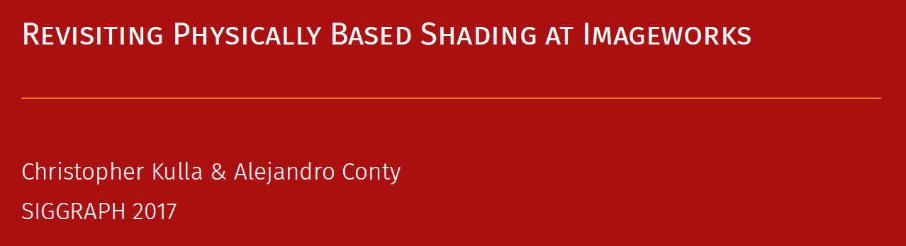
[Kulla17]
Notes:
There’s where Chris Kulla and Alejandro Conty from Sony Imageworks come in. They presented their approximation to multiscattering specular at SIGGRAPH 2017, by a simple trick designed to preserve energy. It reduced to some simple formulae and easily calculable LUTs, so this very much seemed like a winner.

Slide 6


If the energy reflected for a given BRDF f and a viewing direction is:
Then find a multiscattering BRDF f_{ms} such that energy is preserved:
Notes:
It’s a pretty simple idea. We observe that we need a BRDF that makes up for the missing lost energy.

Slide 7


The following BRDF fits that equation:
Where:
Notes:
So we find a BRDF that fits, based upon the energy reflected in a given direction by a BRDF, and the average energy. This all works great…

Slide 8


In fact, that only holds for 100% reflective microfacets. Energy is lost between each bounce.
Sum the loss and scale f_{ms} by:
Where:
Notes:
…but actually we do want some lost energy, as energy is lost (absorbed by the surface) each bounce. So we sum the loss for infinite bounces and scale our multiscattering BRDF by the following equation. F here is of course the Fresnel, which gives us a fraction of the average energy lost at each bounce.

Slide 9


Need to Calculate:
For a given roughness
1-E(μ)
E_{avg}
F_{avg}
Notes:
But what do we need to do if we need to implement this? Well, we need to calculate three things. One minus the energy in a given direction, for a given surface roughness, the average energy for a given roughness, and the average Fresnel for a given specular colour. This is going to involve some integration over the hemisphere and some fitting, so I pulled out Visual Studio and Mathematica.

Slide 10
std::fstream isotropicEnergyFile;
isotropicEnergyFile.open("isotropic_reflected_energy.csv", std::ios_base::out);
for (int j = 0; j < NumSmoothnessSamples; ++j)
{
float s = float(j) / float(NumSmoothnessSamples - 1);
float a = GGXAlphaFromSmoothness(s);
for (int i = 0; i < NumDirectionSamples; ++i)
{
float mu = float(i) / float(NumDirectionSamples - 1);
float isotropicReflectedEnergy = IsotropicReflectedEnergy(mu, a);
char outputLine[128];
sprintf_s(outputLine, sizeof(outputLine), "%12.10f, ", 1.0f - isotropicReflectedEnergy);
isotropicEnergyFile.write(outputLine, strlen(outputLine));
}
isotropicEnergyFile.write("\n", 1);
}
isotropicEnergyFile.close();
1-E(μ)
Notes:
First I had to integrate the BRDF over the hemisphere to get one minus the reflected energy, and we store this in a 2D LUT parameterised by the cosine of the angle and the surface roughness (or smoothness, in our case).

Slide 11
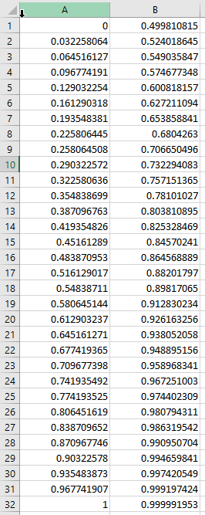
float AverageEnergy(float alpha)
{
static const int NumBRDFSamples = 16384;
float averageEnergy = 0.0f;
for (int i = 0; i < NumBRDFSamples; ++i)
{
float u, v;
GetQuasiRandomSequence(i, u, v);
float3 h = UniformSampleHemisphere(u, v);
float isotropicReflectedEnergy = IsotropicReflectedEnergy(h.z, alpha);
averageEnergy += isotropicReflectedEnergy * h.z;
}
averageEnergy *= 2.0f;
averageEnergy /= NumBRDFSamples;
return averageEnergy;
}
E_{avg}
Notes:
Then we needed to take that energy reflected in a given direction, and integrate that over the hemisphere to get the average energy for a given roughness. Then I took that data into Mathematica and found a fit.

Slide 12
1-E(μ)
float AverageEnergy(float smoothness)
{
float r = -0.0761947f - 0.383026f * smoothness;
r = 1.04997f + smoothness * r;
r = 0.409255f + smoothness * r;
return min(0.999f, r);
}
E_{avg}
float3 AverageFresnel(float3 specularColor)
{
return specularColor + (1.0f - specularColor) * (1.0f / 21.0f);
}
F_{avg}
Notes:
Throw in a simple analytic integration of Schlick Fresnel to give the average Fresnel, and we end up with the following functions and look up tables we can use in our shaders…
So implementing this paper wasn’t particularly hard, but it did take knowledge of Mathematica and the time to write some C++ code to generate the LUTs.
Let’s look at the results!

Slide 13
Dielectrics
Multiscattering Specular Off
Notes:
We start here with a row of spheres, smoothness increasing from left to right…

Slide 14
Dielectrics
Multiscattering Specular On
Notes:
We turn multiscattering specular on… and… well… do you see any difference? Actually, if we toggle back and forth, we *do* see a small change on the roughest spheres, but it’s really hard to tell. This isn’t giving us the big win that we might have wanted.
But before we give up, we should try this on metals.

Slide 15
Metals
Multiscattering Specular Off
Notes:
Again, we start with some gold spheres with the multiscattering specular off…

Slide 16
Metals
Multiscattering Specular On
Notes:
…and when we turn it on, wow, there’s a huge difference here. Essentially, the greater specular reflectance means that less energy is being lost each bounce, so it’s having a much bigger effect.
In fact, papers about multiscattering specular do mention this helps rough metals the most, so perhaps I should have paid more attention to those.
So this might not give the huge win on our overall image we’re looking for. A typical Far Cry “postcard” shot involves lots of nature, such as trees, rocks and dirt that are dielectrics. But we do have vehicles and weapons that are metals, and this is going to improve their visuals a lot. In fact our lead artist in charge of them absolutely loves the effect this is giving, so that’s one win we can be very happy with.

Slide 17
Multiscattering Diffuse
Notes:
With multiscattering specular working successfully, we decided to switch and implement a new diffuse model.

Slide 18
Goals:
Improvements to Lambertian diffuse
Multiscattering is taken into account
Diffuse reacts to surface roughness
Diffuse depends on the distribution of normals
Diffuse and specular are energy conserving
Notes:
Lambertian diffuse is pretty poor, and we wanted the following improvements:
Multiscattering is taken into account – we’ve learned from specular that we’re losing energy from single-scattering, can we solve this for diffuse too?
It reacts to the surface roughness. This should give us more interesting materials, and also hopefully more detail preservation in the distance. For instance, we have problems on objects such as rocks and tree trunks with strong normals. As they go into the distance the mip maps get flat and we no longer see the strong diffuse lighting we saw previously. We’d ideally like to do some sort of appearance filtering and this might fit in nicely with our existing appearance filtering for specular.
It reacts to the distribution of normals – if we’re using a GGX distribution for specular, can we do the same for diffuse?
Diffuse vs specular is energy conserving. Maybe this means diffuse is too bright vs specular, which would diminish the amount of specular we’re seeing, which is one of the original things we were looking to improve.

Slide 19
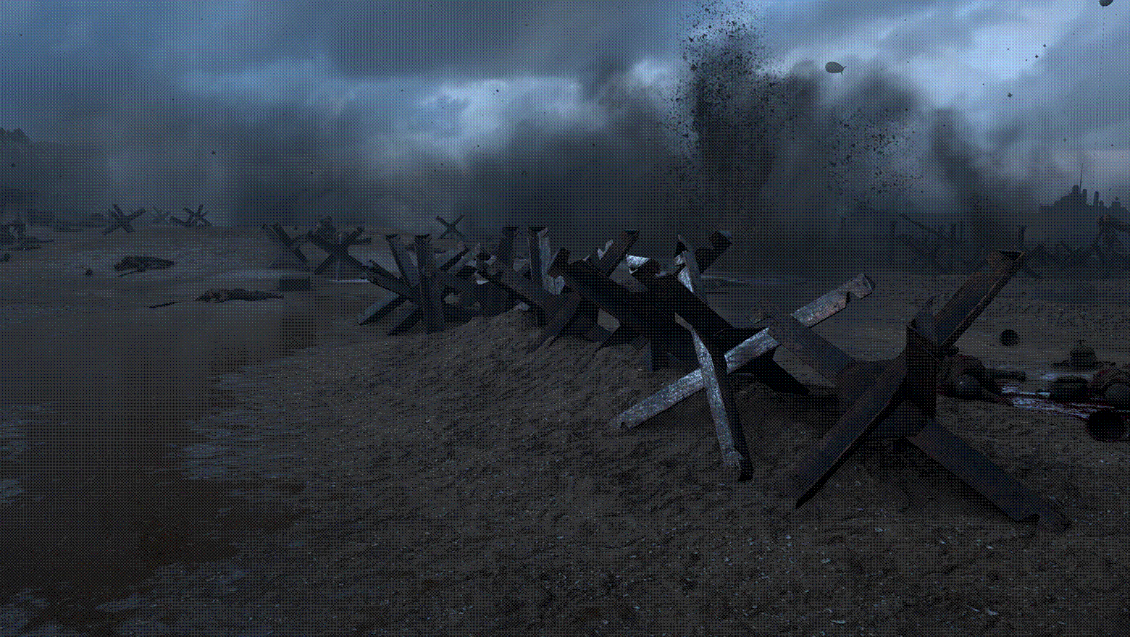
Material Advances in Call of Duty: WWII [Chan18]
Notes:
Thankfully, someone else had come up with a model that fitted all those requirements. Danny Chan from Sledgehammer games gave an excellent presentation at Advances in Real-Time Rendering last year which had a lot of great ideas for improving our materials in games, but he also included a multiscattering diffuse model that essentially met all our requirements.

Slide 20
Notes:
The base of the new diffuse model goes back to the same paper that inspired our interest in multiple scattering specular BRDFs. Danny Chan used the source code provided to generate data for a multiple-scattering diffuse model, and then found a fit.

Slide 21
float MultiScatteringDiffuseBRDF(float lDotH, float nDotL, float nDotV,
float nDotH, float smoothness)
{
// Burley to CoD gloss reparametrization
// CoD : alpha2 = 2 / (1 + 2^(18g))
// Burley: alpha2 = (1 - g)^4
float g = saturate(0.18455f * log(2.0f / pow(1.0f - smoothness, 4.0f) - 1.0f));
float f0 = lDotH + pow(1.0f – lDotH, 5.0f);
float f1 = (1.0f - 0.75f * pow(1.0f – nDotL, 5.0f))
* (1.0f - 0.75f * pow(1.0f – nDotV, 5.0f));
float t = saturate(2.2f * g - 0.5f);
float fd = f0 + (f1 - f0) * t;
float fb = ((34.5f * g - 59.0f) * g + 24.5f) * lDotH
* exp2(-max(73.2f * g - 21.2f, 8.9f) * sqrt(nDotH));
return fd + fb;
}
Notes:
The fitting process as explained in the presentation is pretty complex, but at the end it results in a relatively simple function that we can use in our shaders.
[Thanks to William Bussière for this code]

Slide 22
float MultiScatteringDiffuseBRDF(float lDotH, float nDotL, float nDotV,
float nDotH, float smoothness)
{
// Burley to CoD gloss reparametrization
// CoD : alpha2 = 2 / (1 + 2^(18g))
// Burley: alpha2 = (1 - g)^4
float g = saturate(0.18455f * log(2.0f / pow(1.0f - smoothness, 4.0f) - 1.0f));
float f0 = lDotH + pow5(1.0f - lDotH);
float f1 = (1.0f - 0.75f * pow5(1.0f - nDotL))
* (1.0f - 0.75f * pow5(1.0f - nDotV));
float t = saturate(2.2f * g - 0.5f);
float fd = f0 + (f1 - f0) * t;
float fb = ((34.5f * g - 59.0f) * g + 24.5f) * lDotH
* exp2(-max(73.2f * g - 21.2f, 8.9f) * sqrt(nDotH));
return fd + fb;
}
Notes:
But let me highlight one line. In his paper, Danny fitted against a different parameterisation of surface smoothness than we do. Hence we have to add some extra instructions to convert between the two… or of course, we have to spend the time running the model ourselves and doing our own fit, which would be another significant amount of work.

Slide 23
Lambert Diffuse
Notes:
Let’s look at some results. Here are spheres increasing in smoothness from left to right, which with Lambert diffuse has absolutely no effect – they all look the same.
Now let’s turn the multiscattering diffuse on…

Slide 24
Multiscattering Diffuse
Notes:
And we see some nice retroreflection happening for the rough spheres, and a softer falloff for the smoother spheres. In fact, one of our art directors always complained about the harsh falloff for diffuse, nearly preferring gamma-space rather than linear-space lighting because of the softness of the falloff. So this looks like it’s going to be something that’s going to help the game.
Another thing that’s interesting though is seeing how the ground plane in these pictures is changing, getting darker with the multiscattering diffuse. I point this out as this is actually one of the biggest effects of multiscattering diffuse you can see in the game. If you think of a postcard shot, with sky and terrain, then this is changing the ratio between those two and affects the whole image. We’ll have to see in the future how this benefits our lighting artists.

Slide 25
Difference x8
Notes:
I’ll just highlight the differences more, given that I’m aware that it might not be easy to see the differences on a projector, so this might make them a little more visible. For the smooth spheres on the right you can see the edge falloff at glancing viewing angles, plus the smoother falloff at glancing light angles. For the rough spheres on the left you can see the extra retroreflectivity that flattens the lighting.

Slide 26
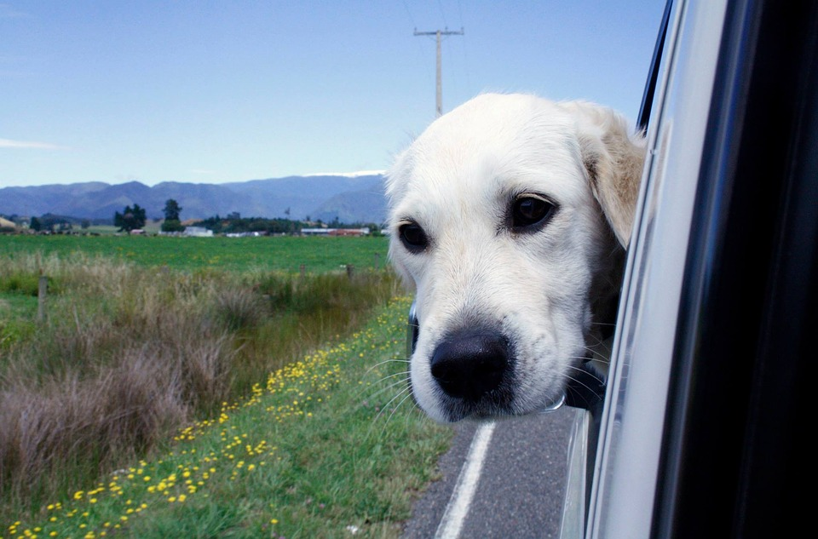
“Are we there yet?”
Notes:
So we have our new diffuse and specular models, so we’re done, right?
Sadly… not… we’re not even close…

Slide 27
Surface Type | Diffuse BRDF | Specular BRDF
Skin | Pre-Integrated Subsurface Scattering (Lambert) | GGX
Hair | Lambert | Modified Marschner
Car Paint | Lambert | Two GGX lobes (Top layer and bottom layer)
Cloth | Lambert | Ashikhmin Cloth + Disney Sheen
Translucent | Two wrapped Lambert lobes (Front and back) | GGX
Default | Lambert | GGX
Notes:
Far Cry actually has lots of BRDFs that we need to replace, not just GGX for specular and Lambert for diffuse. So if we want to upgrade our diffuse lighting, then ideally we’d update our pre-integrated subsurface scattering too, plus we need to find a way to mimic wrapped lighting for Lambert. For specular, if we want to be energy-preserving in all cases then we might need to do it for hair and cloth too.

Slide 28
Light Type | Diffuse Evaluation | Specular Evaluation
Direct | Analytic | Analytic
Indirect | Spherical Harmonics | Screen-Space Reflections Pre-Integrated Cube Maps Pre-Integrated BRDF
Notes:
But we also have different light types. For direct lighting we have simple analytic evaluation, this is straightforward. But we also have spherical harmonics and cube maps for indirect lighting. Frankly, we’re not always great at making our indirect lighting obey the BRDFs – we do nothing for evaluating the skin with SH right now, for instance. But it feels like we’re missing a huge opportunity to increase the amount of specular lighting we have on direct lighting only, but not on the environment.

Slide 29
Problems:
No multiscattering indirect specular
No multiscattering specular on hair
No multiscattering indirect diffuse
No multiscattering diffuse on skin
No multiscattering wrapped diffuse
Notes:
Let’s summarise our problems. We don’t have multiscattering BRDFs on our indirect lighting, our subsurface scattering BRDFs – which includes our wrapped diffuse and skin – and finally we don’t have a solution for hair. I’ll leave off cloth as it’s not so important – the BRDF is a bit of a hack anyway that almost compensates for energy loss in cloth materials. Also note that we don’t have a solution for indirect diffuse on skin currently either in our engine, so there are pre-existing problems that we’re already living with.

Slide 30
Problems:
No multiscattering indirect specular
No multiscattering wrapped diffuse
No multiscattering diffuse on skin
No multiscattering indirect diffuse
No multiscattering specular on hair
Notes:
The first problem we’ll try to solve is indirect specular, as this will almost certainly have the biggest impact on the game, particularly on our rough metals.

Slide 31

Indirect specular
Notes:
So let’s give it a go. This is the base formula we’re trying to solve for environment lighting. In this case, the environment light comes from a cubemap, and we’re integrating over the hemisphere. The problem is, for games we can’t do this integration per-pixel in real-time – it would require too many samples of the cubemap. So we have some approximations.

Slide 32

Split-Sum Approximation [Karis13]
Notes:
We approximate the result by using this split-sum integral, from Brian Karis’ work in 2013. We pre-integrate the cubemap for different roughnesses (with results for higher roughnesses stored in the lower-mip levels of the cubemap), and we integrate the BRDF part into a LUT. This also works pretty well for screen-space reflections too – they just replace the pre-integrated cubemap, and we still use the same LUT.

Slide 33

Environment Map BRDF
Notes:
We call the LUT the environment BRDF, and if we use Schlick’s Fresnel approximation, we’re able to split it into two components…

Slide 34
Environment Map BRDF
Notes:
This means that the LUT is just two dimensions – the cosine of the outgoing angle (the view direction), and the roughness of the surface. The F0 term, the specular reflectance, is factored out.

Slide 35
Multiscattering Environment Map BRDF
Notes:
At first I thought adding the multiscattering BRDF into this would be easy. We’re preintegrating, so we just add the MS BRDF into the BRDF we’re integrating, at no extra cost! So this is what the multiscattering part of the environment BRDF looks like.

Slide 36
Multiscattering Environment Map BRDF
Notes:
However, once we expand the average Fresnel term, we realise that things aren’t so simple after all. If we’re going to just add this to our existing environment BRDF, we want a nice linear dependency on F0… and we don’t have that here. So I had an idea, why don’t we do a power expansion of the function and see what we get?

Slide 37
Multiscattering Environment Map BRDF
Notes:
We get an approximation like this, which is nice and simple and we can add to our environment map BRDF. We could even take more power terms of F0 and bake them into our environment BRDF if we wanted, getting an environment BRDF of three or four components instead of two.
At the time, I thought that two coefficients would be enough. I thought that the F0 term for dielectrics tends to be less than 0.1, so the subsequent power terms wouldn’t really matter… at the time I guess I forgot that multiscattering specular makes the biggest difference for rough *metals*, with much higher specular reflectances…

Slide 38
Multiscattering Environment Map BRDF
Notes:
This means that when we update the environment map BRDF with the multiscattering terms… umm… well, you can barely see any difference. In fact, in 8 bits I’m not sure there is a difference at all, but in 16 bits there definitely is… but you’ll just have to trust me.

Slide 39
Environment Map BRDF
Notes:
If we see how this looks on metals, this is with the standard environment map BRDF…

Slide 40
Multiscattering Environment Map BRDF
Notes:
…and this is with the multiscattering environment BRDF. We see a small difference for metals, but nowhere near the big difference we should be seeing, comparing for our results with a direct light.
So I was puzzling over a solution for this…

Slide 41
[FdezAgüera19]
Notes:
… and around the same time this paper came out! It’s always really exciting to see someone working on exactly the same things you were working on… and this was a paper solving a really relevant problem for games, so kudos to the author and JCGT. It’s also pretty great to extend existing work, making Kulla and Conty’s work applicable to real-time image based lighting.

Slide 42
The paper observes that the single-scattering energy is in fact the sum of the red and green channels in our environment BRDF:
It also observes that E_{avg} can be approximated as E(μ)
Notes:
This paper makes the clever observation (as have others) that the sum of the red and green channels in the environment BRDF is in fact the same as the outgoing energy in that direction. It also observes that this term can approximate the average energy.

Slide 43
Given that F_{avg} can be calculated analytically, and multiply-scattered light is diffuse, we get the following formula:
float2 FssEss = envBRDF.x + F0 * envBRDF.y;
float Ess = envBRDF.x + envBRDF.y;
float Ems = 1.0f - Ess;
float Favg = F0 + (1.0f / 21.0f) * (1.0f - F0);
float Fms = FssEss * Favg / (1.0f - Favg * (1.0f - Ess));
float Lss = FssEss * radiance;
float Lms = Fms * Ems * irradiance;
return Lss + Lms;
Notes:
The paper then arrives at the following simple formula for the multiple-scattering part of the lighting. It helps of course that terms like the average Fresnel are easily calculable. But the paper notes that multiply-scattered light is diffuse, so it decides to take the irradiance of the lighting rather than radiance, recommending sampling a lower mip-level of the cubemap or storing the irradiance in spherical harmonics.
Now, that’s all well and good, but I’m a game developer and I’m lazy. I also want to save as many instructions, particularly texture samples, as possible, so I don’t like the irradiance part very much.

Slide 44
Given that F_{avg} can be calculated analytically, and multiply-scattered light is diffuse, we get the following formula:
float2 FssEss = envBRDF.x + F0 * envBRDF.y;
float Ess = envBRDF.x + envBRDF.y;
float Ems = 1.0f - Ess;
float Favg = F0 + (1.0f / 21.0f) * (1.0f - F0);
float Fms = FssEss * Favg / (1.0f - Favg * (1.0f - Ess));
float Lss = FssEss * radiance;
float Lms = Fms * Ems * radiance;
return Lss + Lms;
Notes:
We’re getting the biggest impact of multiscattering on rough metals, this means that specular lighting we’re sampling is pretty diffuse anyway, so maybe this doesn’t matter too much. Perhaps we could just sub in the radiance for the irradiance and things will still look OK.
So let’s look at some results:

Slide 45
Single Scattering
Notes:
We’ll of course be looking at metals, and this is with the standard environment map BRDF…

Slide 46
Fdez-Agüera
Notes:
This is the Fdez-Agüera approximation which is great, since now we’re really compensating for that lost energy.

Slide 47
Approximation to Fdez-Agüera
Notes:
And here’s my approximation to Fdez-Agüera… which… looks virtually no different. It seems like my approximation was valid, at least in my case.

Slide 48

This gives a multiscattering formula for the environment BRDF as:
Notes:
The great thing about this is it gives us a formula for a multiscattering BRDF that can just scale the single scattering BRDF, which is pretty awesome, as we might be able to apply it to other things. The funny thing with this is that after I’d figured this out…

Slide 49

[Turquin19]
Notes:
… a tech report from Emmanuel Turquin came out that observed from Heitz’s original paper that the multiscattering lobe looked very much like a scaled version of the single-scattering, and thus came up with this approximation. This isn’t a great deal different from what we just derived from the Fdez-Agüera. Again, this is awesome because we have someone else researching in the same area, coming up with a very pragmatic approximation that we can try out straight away. Another example of building upon some very successful existing work and contributing to the discussion.
Let’s see some results!

Slide 50
Approximation to Fdez-Agüera
Notes:
This is my approximation to Fdez-Agüera

Slide 51
Turquin
Notes:
And this is Emmanuel Turquin’s. The two are pretty different, particularly in terms of colour, and Emmanuel Turquin’s seems to be a little bit brighter. I haven’t had the time to do a ground-truth comparison, but there are two options here!
But we should also look at how these two new approaches to a multiscattering specular BRDF work for direct lighting, and how they compare with the approach from Sony Imageworks, which we initially implemented. We’ll once again test on metal spheres.

Slide 52
Multiscattered Specular [Kulla17]
Notes:
This is our original approach, from Sony Imageworks.

Slide 53
Approximation to Fdez-Agüera
Notes:
This is with my approximation to Fdez-Agüera, scaling the single scattering lobe. You can see a pretty big difference to the shape of the highlight, particularly on those spheres of moderate roughness, where we’re losing a lot of energy at the edge. We’re also losing some energy at the bottom end.

Slide 54
Turquin
Notes:
And this is Emmanuel Turquin’s. You can see that this maintains the problems with Fdez-Aguera, with the shape of the highlight not matching the Sony Imageworks approach, but it’s a bit brighter for rough surfaces which matches the Sony Imageworks approach. This makes me think that Turquin’s method is the best we have for environment lighting, but for direct lighting the Sony Imageworks preserves more energy at grazing angles. However, once again, some ground truth comparison is needed!
I should also mention here that if you want yet another solution for multiscattering specular for environment lighting, Stephen Hill has recently done some work in the same area, and in a recent blog post he advocates a four-term environment BRDF that solves the issue of multiscattering for environment lighting in a slightly different way. That’s well worth reading if you can, and want to think about even more ways to approach this issue.

Slide 55
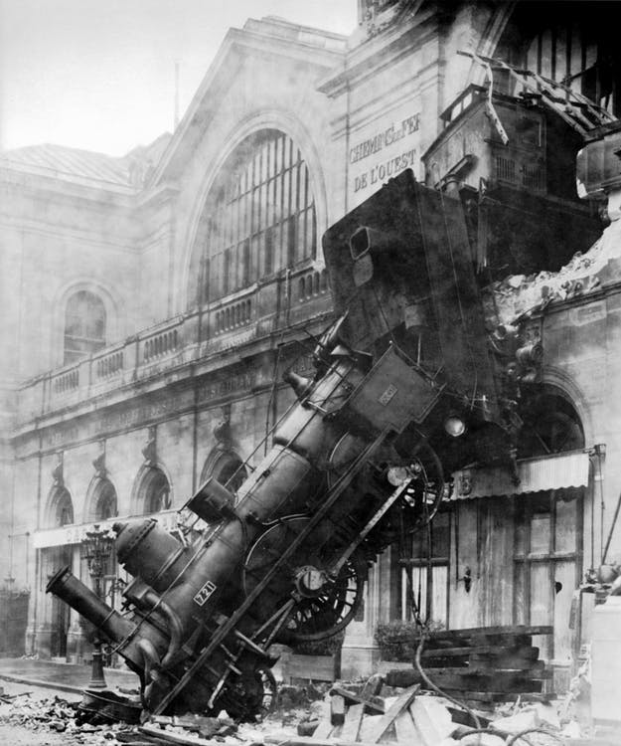
Notes:
However, when I started looking at this topic of environment lighting, there was something in the Fdez-Agüera paper that very nearly derailed me completely. Let’s look at one of the equations, calculating the average Fresnel.

Slide 56
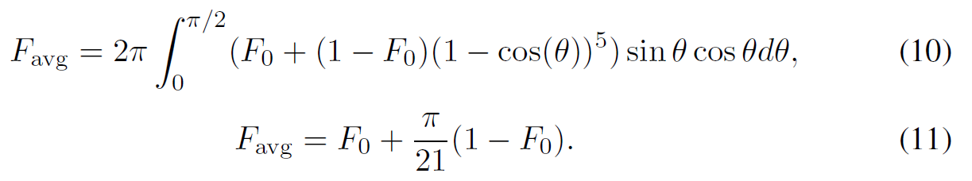
Notes:
What really threw me was the added factor of pi, which was present in this and in other equations. When I’d been implementing the Sony Imageworks paper myself, I’d been dividing these integrals by pi as a normalisation factor, which gave me what seemed to be the correct results. But I already had enough self-doubt about my mathematical ability that I was a little unsure about what I’d done. So seeing these equations in a published peer-reviewed paper that were different than mine was really confusing, and I didn’t know what to do. Was everything I’d done wrong?
Well, I plugged away, and became more convinced that the factor of pi was wrong. I was going to send an e-mail to the author querying… when I saw this tweet…

Slide 57
Notes:
I was so relieved! Thank you for the good Samaritan who reported it before I did. ☺

Slide 58
Problems:
No multiscattering indirect specular
No multiscattering specular on hair
No multiscattering indirect diffuse
No multiscattering diffuse on skin
No multiscattering wrapped diffuse
Notes:
Let’s return to our list of problems. The next is about multiscattering specular on hair…

Slide 59

Notes:
Sadly this is on our TO DO list for now. We could examine using our scaling factor on a single-scattering BRDF, but it’s a little more tricky with the transmittance and second specular lobe. So for now I have to leave you hanging, as we’re going to have to return to this at a later date.
Image credits: Sue Seecof, https://www.flickr.com/photos/126344637@N05/26013859361, licensed under https://creativecommons.org/licenses/by/2.0/

Slide 60
Problems:
No multiscattering indirect specular
No multiscattering specular on hair
No multiscattering indirect diffuse
No multiscattering diffuse on skin
No multiscattering wrapped diffuse
Notes:
But what about our final three problems – multiscattering for our subsurface scattering objects, and for indirect diffuse? Well, it turns out we’ll address solutions for these as we move to our next topic…

Slide 61
Area Lights
Notes:
…which is area lights.
This is something that complements us improving our materials – now we want to look at improving the lights themselves.

Slide 62
Goals:
Improve cinematic lighting:
  Softer light falloffs
More realistic specular response:
  Broader, more visible highlights
  Artists authoring smoother materials
Notes:
We’d really like to give our lighting artists more options in cinematics, and having area lights should give them more control over the diffuse falloff via the size of the light. We’ll also get more specular, with broader, more visible highlights. This could have an additional benefit where artists will start authoring smoother materials as 100% smooth surfaces will no longer look slightly odd with their infinitesimally small specular highlights.

Slide 63
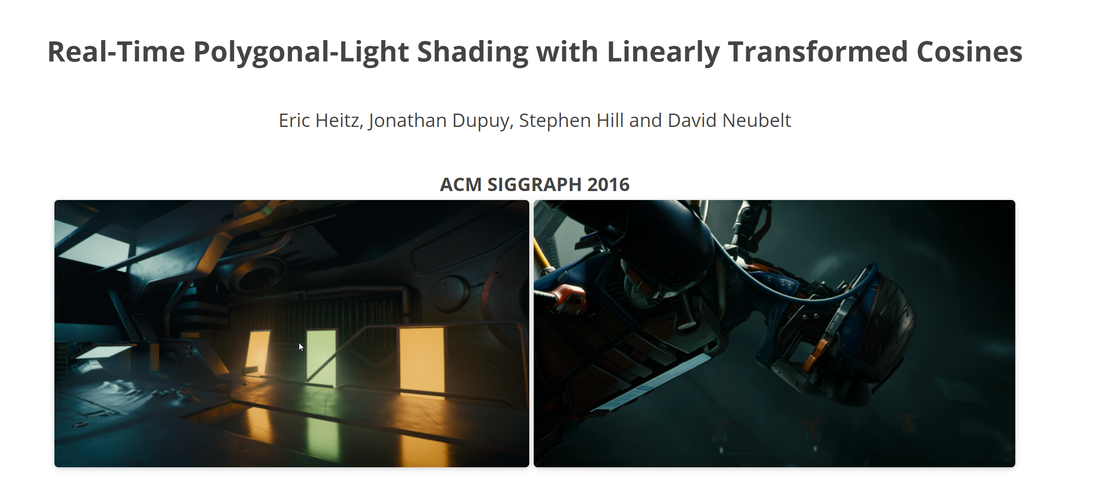
[Heitz16b]
Notes:
When looking at areas lights, it was a no-brainer to investigate using Linearly-Transformed Cosines, a paper from Eric Heitz and others from 2016, which described a real-time method of shading with polygonal lights, which could technically work with any BRDF.

Slide 64
Why LTCs?
Fast to implement
Full source code and demos available
Flexibility in performance and light types
Performant and robust
Notes:
We chose LTCs because we knew full source code was available, with demos, making them really quick to get in the game and try out. In fact, the most difficult bit was working out that I had to transpose matrices when converting the GLSL demo into HLSL. The full source code would also prove really useful later on when we had to make changes, because flexibility is important too. They already gave us quad lights, disk lights, line lights and texture mapped lights, plus a few scalable performance options, so that gave me a lot of confidence we could make things work. Plus, it was clear from the demos and the code that they were robust and suitable performance-wise for implementation in a game.

Slide 65
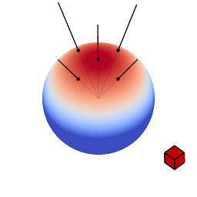
A clamped cosine distribution can be analytically integrated over polygonal shapes
Integrating a LTC over a
Notes:
Let’s explain briefly what LTCs are so everyone is on the same page...
LTCs are pretty simple to understand, which is the magic of the whole technique. You start by observing that to evaluate a polygonal area light, you need to integrate the polygon over a spherical distribution which is your BRDF. That’s a potentially unsolvable mathematical problem for many BRDFs, but we can observe that we have a clamped cosine distribution that CAN be analytically integrated over polygonal shapes.
[Thanks to Eric Heitz for the diagram]

Slide 66

We can linearly transform this distribution to approximate BRDFs
Integrating a LTC over a
Notes:
And we can linearly transform this distribution to fit arbitrary BRDFs, while maintaining its ability to be integrated.
[Thanks to Eric Heitz for the diagram]

Slide 67
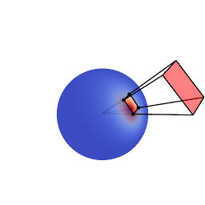
Integrating a polygon over an LTC becomes integrating a polygon over the analytically solvable clamped cosine distribution
Integrating a LTC over a
Notes:
So we want to fit our BRDF to a linearly transformed cosine, then when integrating over a polygon, we can apply the inverse transform and the answer just becomes integrating a polygon over a clamped cosine distribution, which we know how to solve.
[Thanks to Eric Heitz for the diagram]

Slide 68

Q. LTCs always integrate to 1, but what about the actual magnitude of the BRDF?
Integrate the BRDF and store the magnitude in a LUT.
Separate out Fresnel so we can take F₀ into account.
[Hill16]
Integrating a LTC over a
Notes:
But LTCs always integrate to 1, whereas BRDFs might integrate to something less than 1. We need to scale by the magnitude of the BRDF, and also take the Fresnel term into account. So we just integrate the BRDF over the hemisphere and store the data in a LUT…

Slide 69
Apply Schlick’s approximation to Fresnel to get two components:
[Hill2016]
Integrating a LTC over a
Notes:
In fact, we can apply Schlick’s approximation to Fresnel and get two components, which we can composite together based upon the surface’s F0 term and scale the LTC by.
Now, this might look very familiar… precisely because it is. This is a slightly different parameterisation, but a very, very similar idea to that of the environment BRDF. That’s going to be very helpful later.

Slide 70
Implementation:
Offline, generate look up tables:
  Inverse matrix transform
  Magnitude and Fresnel
In the shader:
  Calculate area light coordinates
  Apply inverse transform
  Integrate polygon over sphere with a clamped cosine distribution
  Scale by BRDF magnitude and Fresnel
Inverse Matrix LUT
Magnitude and Fresnel LUT
Notes:
The implementation is relatively straightforward, thanks to all the excellent code and demos provided. Offline, you generate two look up tables for your BRDF, both parameterised on the outgoing angle and the surface roughness. The first contains coordinates of the inverse matrix transform, from the linearly transformed cosine approximation to your BRDF with that angle and roughness, back into a clamped cosine over the hemisphere. The second look up table is very similar to the environment BRDF that we discussed earlier, to scale the BRDF by its magnitude at a given viewing angle.

Slide 71
Point Light
Notes:
Let’s see how this looks with some dielectric spheres of increasing smoothness. I’m going to replace the sun light with a quad light:

Slide 72
Quad Light
Notes:
And that looks pretty awesome, particularly the specular highlight on smooth surfaces. We can also do a disk!

Slide 73
Disk Light
Notes:
That also looks pretty cool!
You’ll see that the diffuse is changing too. Implementing LTCs for Lambertian diffuse is trivial, since Lambertian diffuse IS the clamped cosine over a sphere. We get a nice softer falloff from the size of the area light, which I know artists will love.

Slide 74
“Are we there yet?”
Notes:
So we have area lights implemented for GGX and Lambert diffuse, so everything’s great, right?!

Slide 75
Surface Type | Diffuse BRDF | Specular BRDF
Skin | Pre-Integrated Subsurface Scattering (Lambert) | GGX
Hair | Lambert | Modified Marschner
Car Paint | Lambert | Two GGX lobes (Top layer and bottom layer)
Cloth | Lambert | Ashikhmin Cloth + Disney Sheen
Translucent | Two wrapped Lambert lobes (Front and back) | GGX
Default | Lambert | GGX
Notes:
But… we’re back at the combination problem. We don’t just have a GGX BRDF. The Lambert BRDF is trivial and already solved, since it is just a clamped cosine over the hemisphere, but what about the wrapped diffuse? The pre-integrated scattering? The hair and the cloth? These are similar problems to those we faced for our new diffuse and specular BRDFs.

Slide 76
Surface Type | Diffuse BRDF | Specular BRDF
Skin | Pre-Integrated Subsurface Scattering (Lambert) | GGX + Multiscattering Lobe
Hair | Multiscattering Diffuse | Modified Marschner + ???
Car Paint | Multiscattering Diffuse | Two GGX + Multiscattering Lobes (Top layer and bottom layer)
Cloth | Multiscattering Diffuse | Ashikhmin Cloth + Disney Sheen
Translucent | Two wrapped Lambert lobes (Front and back) | GGX + Multiscattering Lobe
Default | Multiscattering Diffuse | GGX + Multiscattering Lobe
Notes:
But in fact it’s got worse. Now we also have to make area lights work for multiscattering diffuse, and multiscattering specular too.

Slide 77
Light Type | Diffuse Evaluation | Specular Evaluation
Area | Analytic with Pre-Integrated BRDF | Analytic with Pre-Integrated BRDF
Direct | Analytic | Analytic
Indirect | Spherical Harmonics | Screen-Space Reflections Pre-Integrated Cube Maps Pre-Integrated BRDF
Notes:
Essentially, we’ve just added another light type that we have to evaluate all our BRDFs against.

Slide 78
Problems:
No implementation for cloth
No implementation for multiscattering diffuse
No implementation for multiscattering specular
How to combine LTCs with wrapped diffuse
How to combine LTCs with pre-integrated skin scattering
No implementation of Marschner approximation for hair
Notes:
So let’s summarise where we’re at. We have no LTC implementations for three base BRDFs – the cloth, the multiscattering diffuse and the hair. We also don’t have multiscattering specular, which we’ve just implemented for our non-area lighting path. Finally, we have no idea how to combine LTCs with wrapped diffuse and our pre-integrated skin scattering.

Slide 79
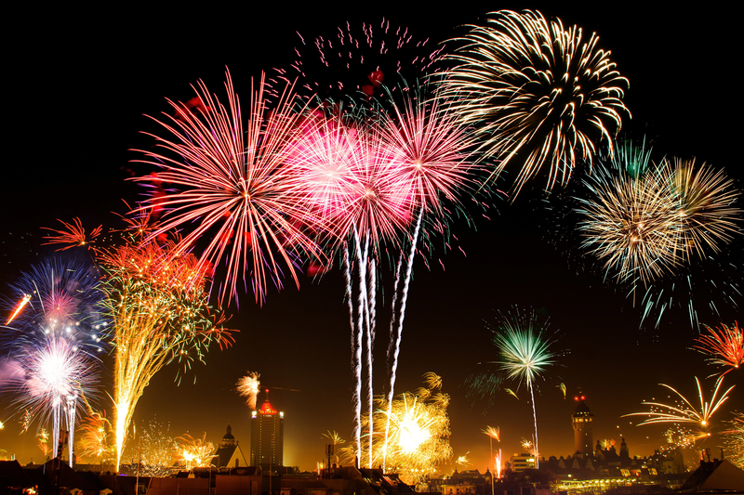
Source code available!
https://github.com/selfshadow/ltc_code
Notes:
But we have cause for celebration! The source code for LTCs is available, most importantly, the code to fit LTCs against an arbitrary BRDF. So I can just plug my BRDFs into that, run the fitting and create the LUTs, and I should be good to go.

Slide 80
Problems:
No implementation for cloth
No implementation for multiscattering diffuse
No implementation for multiscattering specular
How to combine LTCs with wrapped diffuse
How to combine LTCs with pre-integrated skin scattering
No implementation of Marschner approximation for hair
Notes:
So let’s first start by trying to get cloth and multiscattering diffuse working.

Slide 81
Magnitude and Fresnel LUT
Inverse Matrix LUT
LTCs for Multiscattering Diffuse
Notes:
So start by generating our LUTs for multiscattering diffuse. Not much is going on in the inverse matrix compared to GGX, but you’d expect that as roughness and viewing angle have a much smaller effect for this BRDF.

Slide 82
Lambert Diffuse
Notes:
Let’s start with our result for Lambertian diffuse…

Slide 83
Multiscattering Diffuse
Notes:
We can see the desired effect happening. The lighting is getting slightly flatter and more retroreflective for rough surfaces, but with a slightly stronger falloff for smooth surfaces. Smooth surfaces are also getting darker at a grazing viewing angle. This is great because the diffuse lighting on the material is responding exactly as for point lights, so we’ve achieved what we were looking for.

Slide 84
Magnitude and Fresnel LUT
Inverse Matrix LUT
LTCs for Ashikhmin Cloth [Ashikhmin00]
Notes:
We can also try this for our Ashikhmin cloth BRDF! Let’s see how this works…

Slide 85
Ashikhmin Cloth: Point Light
Notes:
This time we’ll compare against our point light cloth implementation. It’s the rougher surfaces that have the biggest retroreflection and sharpest effect in our cloth model, which you can see here.

Slide 86
Ashikhmin Cloth: Area Light
Notes:
This seems pretty good! It’s different for sure, it seems a little more diffuse. But that’s what we’d expect since we have a light with a size now. This still means that we’ll get the cloth effect on various materials, which is what we’re looking for.

Slide 87

Disney Sheen [Burley12]
Notes:
But in our engine we don’t just use the Ashikhmin cloth BRDF, we also use a sheen factor as suggested by Brent Burley at Disney. As it’s a BRDF, it’s also scaled by the N dot L term. So effectively, this is Lambertian diffuse with a Fresnel.

Slide 88
Lambert Diffuse
X
Magnitude and Fresnel LUT for Multiscattering Diffuse
Notes:
So this is actually fairly easy to calculate as an area light. We just use our Lambertian diffuse evaluation, with the Fresnel component from the Magnitude and Fresnel LUT from the multiscattering diffuse. Technically we should calculate one for Lambertian diffuse, but why have another LUT when you can just use one you already have? We sample it with smoothness 0.5, assuming that’s closest to Lambertian diffuse – we won’t get either the retroreflectivity from rough surfaces or the edge darkening from smooth surfaces.

Slide 89
Disney Sheen: Point Light
Notes:
This is what the sheen looks like with a point light. I’ve exaggerated the effect to make it more visible here, and it’s increasing in strength from left to right.

Slide 90
Disney Sheen: Area Light
Notes:
When we enable it for an area light, it’s actually a lot more subtle, where it becomes much more of a rim effect. Still, it makes our area lights usable for cloth as this rim effect is still present, and that’s going to communicate that this material is cloth. It feels a little like the Ashikhmin cloth BRDF for area lights – it’s not perfect, it’s not the best approximation, but it will work.

Slide 91
Problems:
No implementation for cloth
No implementation for multiscattering diffuse
No implementation for multiscattering specular
How to combine LTCs with wrapped diffuse
How to combine LTCs with pre-integrated skin scattering
No implementation of Marschner approximation for hair
Notes:
The next problem is multiscattering specular. We’ve just implemented this new BRDF that we want, but we need to get it working with LTCs…
Now, at first we might think that this is exactly the same as cloth and multiscattering diffuse, just use the fitting code with a different BRDF, but actually this has the same problem as a topic we’ve already discussed – indirect specular and the environment BRDF.

Slide 92

LTC magnitude and Fresnel relies on a linear dependency on F₀:
But our multiscattering BRDF has a non-linear dependency:
Notes:
Previously, we were able to break the BRDF down into a linear dependency on F0, and store two components in a LUT. But once again, the multiscattering BRDF is dependent on F0, in a non-linear way, so we can’t use this trick.

Slide 93
[FdezAgüera19]
Notes:
But we have a solution! We can use the same solution as for the environment BRDF!

Slide 94
We have a formula for a multiscattering BRDF:
E(μ) is the red channel in our magnitude and Fresnel LUT:
Notes:
Now, this gives us a formula for a multiscattering BRDF that can just scale the single scattering BRDF, which is awesome, because it’s fast and simple and can be applied to our LTCs. We can get the energy term from our magnitude and Fresnel LUT, just like we could from our environment BRDF.

Slide 95
[Turquin19]
Notes:
We could also use the formula from Emmanuel Turquin! Let’s try them out!

Slide 96
Single Scattering Specular
Notes:
Let’s start by looking at single scattering specular.

Slide 97
Approximation to Fdez-Agüera
Notes:
Now let’s use my approximation to Fdez-Agüera to get a multiscattering BRDF.

Slide 98
Turquin
Notes:
And finally, let’s look at Emmanuel Turquin’s solution. Once again, this is slightly brighter but with slightly less colour than the Fdez-Agüera approach.

Slide 99
Problems:
No implementation for cloth
No implementation for multiscattering diffuse
No implementation for multiscattering specular
How to combine LTCs with wrapped diffuse
How to combine LTCs with pre-integrated skin scattering
No implementation of Marschner approximation for hair
Notes:
The next problem to solve is wrapped lighting. What’s interesting is that we need to solve this problem for multiscattering diffuse as well as for area lights, so maybe there’s a solution that we can use for both.

Slide 100

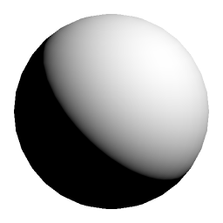
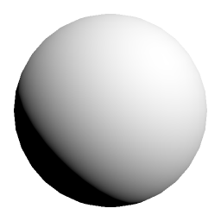
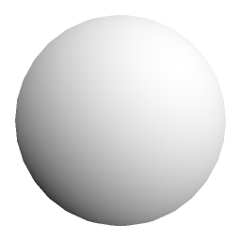
Wrapped Lambertian Diffuse:
w = 0
w = 0.5
w = 1.0
Notes:
Let’s start with a quick recap of wrapped diffuse. We take Lambertian diffuse, which is the cosine of the incoming light angle, and we just wrap it around the sphere. The wrap factor varies between 0, which has no effect, to 1 which wraps the lighting all the way around.
This is great and all, but how is this going to work for other BRDFs? For example, our new multiscattering diffuse model has a term dependent on the incoming angle and another term on the outgoing angle. Do we need to wrap both? What about for area lights?
I had an idea… rather than manipulating the cosine of the incoming light angle, like we are here, why don’t we just change the normal directly?

Slide 101


Rotate the normal towards the light
Notes:
If we rotate the normal towards the light, that will surely have the same effect? Then we can use that normal in all our normal lighting equations, with whatever BRDF we want.

Slide 102


Axis:
Angle:
Axis-angle rotation
Notes:
This boils down to just a simple axis-angle rotation. However, the rotation angle depends on how far we are around the sphere. When the normal is facing the light, when cos theta is 1, we don’t want to rotate at all. On the other hand, when we’re at the furthest point around the sphere we want to wrap, when cos theta is –w, then we want to rotate to the point where theta is pi/2.
However, in shader code we in fact want to avoid the costly inverse cosine, so instead we can blend between the sine of the angles…

Slide 103

Axis:
Sin Angle:
Axis-angle rotation
Notes:
...which is much, much faster!

Slide 104
float3 WrappedNormal(const float3 N, const float3 L, const float w)
{
float cosTheta = dot(N, L);
float wrappedCosTheta = saturate((cosTheta + w) / (1 + w));
float sinMaximumAngleChange = w;
float sinMinimumAngleChange = 0.0f;
float sinPhi = lerp(sinMaximumAngleChange, sinMinimumAngleChange, wrappedCosTheta);
float cosPhi = sqrt(1.0f - sinPhi * sinPhi);
return normalize(cosPhi * N + sinPhi * cross(cross(N, L), N));
}
Axis-angle rotation
Notes:
This ends up being a relatively simple shader function we can use to adjust our normal based upon the light direction and a wrapping factor.

Slide 105
Wrapping the lighting around the sphere adds energy:
w = 0
w = 0.5
w = 1.0
Notes:
But what about normalisation? If we’re wrapping the lighting further around the sphere then we’re effectively adding energy.

Slide 106
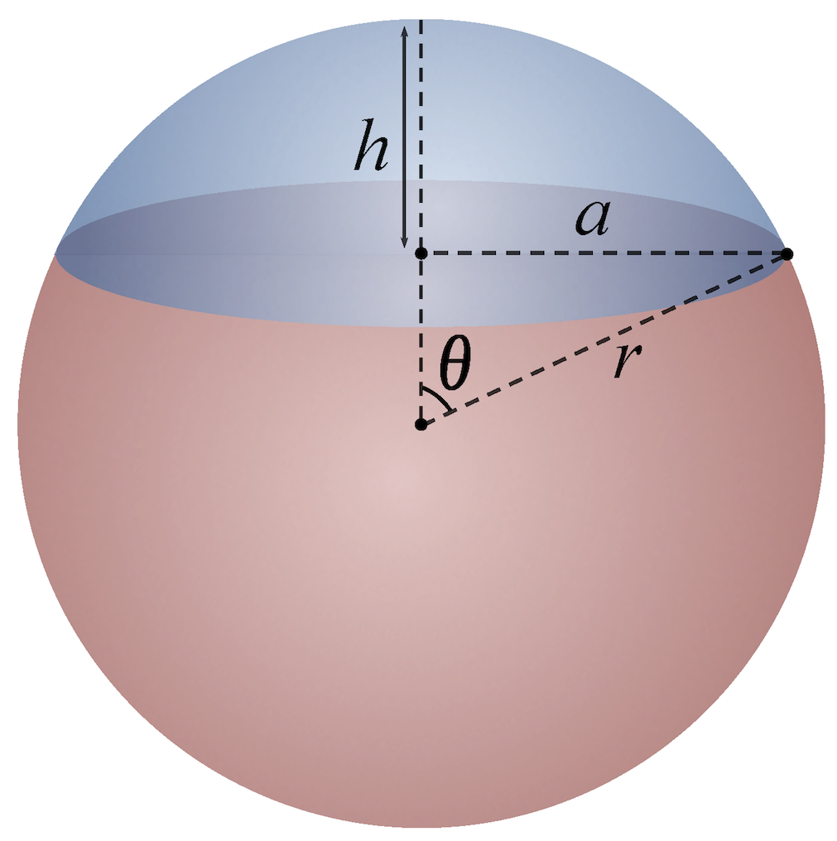

Surface area of spherical cap
Notes:
Well, it turns out we can normalise by looking at the surface area of a spherical cap on the sphere.
Image attribution:
By Jhmadden - Own work, CC BY-SA 4.0, https://commons.wikimedia.org/w/index.php?curid=44784311

Slide 107


Surface area of the extent of wrapped lighting on a unit sphere
Notes:
If we recall the definition of cos theta at the furthest extent around the sphere, and substitute that into the surface area of the spherical cap, then we get the following formula.
Image attribution:
By Jhmadden - Own work, CC BY-SA 4.0, https://commons.wikimedia.org/w/index.php?curid=44784311

Slide 108


Surface area of hemisphere:
Surface area of the extent of wrapped lighting on a unit sphere
Normalisation factor:
Notes:
Then, if we compare that to the surface area of the hemisphere, then we get the following simple normalisation factor.
Funnily enough, I actually wrote a blog post on normalising wrapped Lambert diffuse lighting in the past and this is the normalisation factor I came up with then. It was kind of to my surprise that I suddenly found another justification for it, and one that now works in different circumstances.

Slide 109
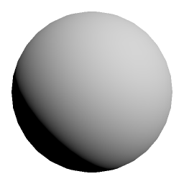
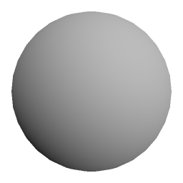
Normalised lighting:
w = 0
w = 0.5
w = 1.0
Notes:
Here are the results, which look much better.
Now, I’ll admit that this is a little inaccurate. As we’re blending the sine of the angles instead of the angles for performance, the normalisation factor won’t quite be right for the BRDF. But this is games so for performance’s sake, we think this should be “good enough”.
Let’s give this a try!

Slide 110
Multiscattering Diffuse, w = 0.0
Notes:
Let’s start by looking at point lights, and our base multiscattering diffuse model.

Slide 111
Multiscattering Diffuse, w = 0.5
Notes:
We can wrap 50% of the way around the sphere…

Slide 112
Multiscattering Diffuse, w = 1.0
Notes:
… and 100%, and everything seems to be holding up. The rougher spheres still feel rough with flatter lighting, which is exactly what we’re going for.

Slide 113
Area Light, w = 0.0
Notes:
Next we’ll check the result with area lights and LTCs.

Slide 114
Area Light, w = 0.5
Notes:
Once again we can wrap 50% of the way around the sphere…

Slide 115
Area Light, w = 1.0
Notes:
… and 100%, and we’re still getting the results we expect. This is pretty awesome, now we can pretty much apply wrapped lighting to everything! Let’s consider this problem solved.

Slide 116
Problems:
No implementation for cloth
No implementation for multiscattering diffuse
No implementation for multiscattering specular
How to combine LTCs with wrapped diffuse
How to combine LTCs with pre-integrated skin scattering
No implementation of Marschner approximation for hair
Notes:
Now that we’ve done wrapped diffuse, let’s move onto looking at pre-integrated scattering, which in some ways is very similar…

Slide 117

Pre-integrated scattering:
Integrate Lambert diffuse over spheres of different curvatures
curvature
cos theta
[Penner11]
Notes:
Pre-integrated scattering for skin is a technique presented by Eric Penner at SIGGRAPH 2011. The trick behind pre-integrated scattering is to integrate Lambert diffuse over spheres of different curvatures, with a skin scattering diffusion profile.

Slide 118
Pre-integrated scattering for multiscattering diffuse BRDF:
4D LUT required – adding view angle and roughness
curvature
cos theta
[Penner11]
Notes:
If we had to solve this for multiscattering diffuse, we’d have to integrate over the new BRDF… but that has two extra parameters compared with Lambert – viewing angle and roughness, which would make this an unfeasibly large 4D LUT. Of course, perhaps if we were to actually research this, maybe we could find a fit, or reduce the dimensionality… but this still isn’t going to solve the problem for area lights.

Slide 119
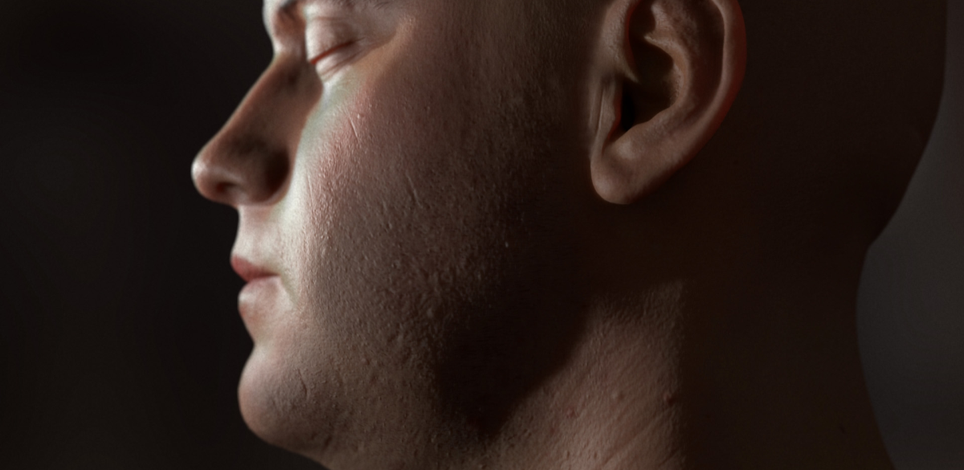
Separable Screen-Space Subsurface Scattering
[Jimenez12]
Notes:
But there is another solution here to skin scattering used in games: separable screen-space subsurface scattering. This runs in screen-space and blurs an existing lighting buffer, so this technically works with any BRDF… and area lights too. Even better, this also will work with our indirect diffuse lighting, which is something that we’re missing now.
It seems like back on Far Cry 3 when we had to choose between pre-integrated scattering and screen-space scattering, we bet on the wrong horse. Well, the first was much faster, both in implementation time and performance, but now…? It seems like the latter is much more flexible. Essentially, it’s orthogonal to our choices of BRDF and lighting, and that orthogonality can often be really important in rendering techniques.
[Thanks to Jorge Jimenez for permission to use this image]

Slide 120
Notes:
Sadly this is on our TO DO list for now, and it’s something we’ll have to return to at a later date. But it seems like it will solve our problems, and be more future proof.
Image credits: Sue Seecof, https://www.flickr.com/photos/126344637@N05/26013859361, licensed under https://creativecommons.org/licenses/by/2.0/

Slide 121
Problems:
No implementation for cloth
No implementation for multiscattering diffuse
No implementation for multiscattering specular
How to combine LTCs with wrapped diffuse
How to combine LTCs with pre-integrated skin scattering
No implementation of Marschner approximation for hair
Notes:
Our final unsolved problem is how to apply LTCs to hair.

Slide 122
Notes:
Well, sadly this is also on our TO DO list. Marschner hair has three lobes, essentially a reflection, a transmission, and a second-bounce reflection. Maybe this needs to be really expensive and we need to do LTC look ups for each lobe? Or perhaps we’ll have to find a different area light approximation, or just fall back to our point light solution. But once again, like for multiscattering specular, there doesn’t seem to be an intuitive answer for hair. Any help is of course appreciated!
Image credits: Sue Seecof, https://www.flickr.com/photos/126344637@N05/26013859361, licensed under https://creativecommons.org/licenses/by/2.0/

Slide 123
Remember this problem?
No multiscattering indirect specular
No multiscattering specular on hair
No multiscattering indirect diffuse
No multiscattering diffuse on skin
No multiscattering wrapped diffuse
Notes:
But there’s one more thing… remember this unsolved problem? How do we apply our multiscattering diffuse to our indirect lighting, which is stored in spherical harmonics?

Slide 124
We have a spherical harmonic projection for a clamped cosine distribution…
Notes:
Well… once again there’s a link to a problem we’ve already solved…
We can project a clamped cosine distribution into spherical harmonics, and use that to evaluate lighting projected into SH. But what we want is to project any BRDF (in this case our multiscattering diffuse BRDF) into spherical harmonics.
[Thanks to Eric Heitz for the diagram]

Slide 125
…and we have a mapping from an LTC to a clamped cosine distribution.
Notes:
But it just so happens that now we have a mapping from a linear-transformed cosine, with which we can approximate a BRDF, to a clamped cosine distribution! So perhaps we can use that to solve our problem.
[Thanks to Eric Heitz for the diagram]

Slide 126
LTCs for Spherical Harmonics
Treat SH bands as “area light source”
Rotate SH bands by LTC inverse matrix
Evaluate SH with cosine lobe
Scale result by BRDF magnitude
Notes:
For area lights, we take the coordinates of our light source and rotate them using the LTC inverse matrix. We’re going to treat our SH bands like an area light source and rotate them using the LTC inverse matrix, then evaluate by the cosine lobe. Then finally, we just scale the result by the BRDF magnitude like when we use LTCs for area lights.

Slide 127
LTCs for Spherical Harmonics
Treat SH bands as “area light source”
Rotate cosine lobe by LTC inverse matrix
Evaluate SH with cosine lobe
Scale result by BRDF magnitude
Notes:
But, as SH is rotationally invariant, we can actually just rotate our cosine lobe instead, which is much faster!

Slide 128
float2 uv = LTCTextureCoordinates(nDotV, smoothness);
float4 t1 = LTCMSDiffuseInvMatrixTexture.SampleLevel(Clamp, uv, 0);
float2 t2 = LTCMSDiffuseMagFresnelTexture.SampleLevel(Clamp, uv 0).rg;
// construct inverse matrix, mapping from BRDF to clamped cosine distribution
float3x3 Minv = LTCInverseMatrix(t1);
// construct orthonormal basis around N
float3 T1, T2;
T1 = normalize(V - N * dot(V, N));
T2 = normalize(cross(N, T1));
float3x3 R = float3x3(T1, T2, N);
float3 cosineLobeNormal = mul(float3(0.0f, 0.0f, 1.0f), mul(Minv, R));
SH3Coeffs shCosineLobe3 = SH3EvalCosineLobe(cosineLobeNormal);
// evaluate SH and scale by the BRDF magnitude
return SH3DotClamped(shR, shG, shB, shCosineLobe3) * t2.x;
Notes:
Here’s an example of some shader code. Note that as we’re rotating the SH also into the space of the normal with the matrix R, we’re rotating a cosine lobe that’s pointing straight up. That means that you can actually do some nice further optimisations to this code.
Now it’s time to look at some results.

Slide 129
Lambert Indirect Diffuse
Notes:
I’ve changed the lighting set up a bit for these shots. Here we are at dawn, with sky lighting only. You can see the sun is about to rise to our right hand side and the sky is a beautiful pink in that direction.
Now if we turn our multiscattering indirect diffuse on…

Slide 130
Multiscattering BRDF Indirect Diffuse
Notes:
You can see we get flatter lighting on the rough left hand spheres, but then a stronger falloff for glancing viewing angles as the spheres get smoother towards the right. The ground plane is also getting a little darker, as we saw for the multiscattering direct diffuse, so this is definitely going to have an impact on our world lighting.
Let’s compare against the ground truth…

Slide 131
Ground Truth*
Notes:
This is really close! In fact, the only real difference we see is that the bottom of the spheres are lighter for the ground truth, but if we were to compare Lambert we’d actually see the same – this is caused by SH ringing.
I put an asterix by ground truth because I always feel a little wary about claims of absolute truth in these situations. We generated this by sampling the SH over the hemisphere and scaling by the BRDF.
Let’s go back to look at our approximation…

Slide 132
Multiscattering BRDF Indirect Diffuse
Notes:
So this is great, but in case you feel those matrix multiplies and construction of an orthonormal basis might take too much time… I have a cheaper solution. Don’t rotate the SH at all, but still scale by the BRDF magnitude. Let’s compare.

Slide 133
Scaling by BRDF Magnitude Only
Notes:
So the colours shift, but the overall intensity stays the same. This is a pretty extreme example of lighting being different in the SH too, so perhaps in general cases it doesn’t matter so much. With scaling by the magnitude though you’re still going to get that falloff at glancing viewing angles for smooth surfaces which gives more definition to the objects, as well as having that effect on the overall luminance of the scene that darkening the ground plane will have.
This needs a little further research, but I hope this is a promising avenue to go down!

Slide 134
Problems Solved:
Multiscattering diffuse
    Direct, indirect and wrapped lighting
Multiscattering specular
    Direct and indirect lighting
Area lights
    Multiscattering diffuse and specular
    Cloth
    Wrapped lighting
Notes:
Let’s conclude by recapping where we’re at. We’ve implemented multiscattering diffuse and specular, as well as area lights. We’ve made our BRDFs work for direct and indirect lighting, as well as area lighting. Wrapped lighting works in all circumstances, and we have an implementation of area lighting for cloth.

Slide 135
Problems Remaining:
Hair
    Area lighting
    Multiscattering diffuse and specular
Skin
    Diffuse area lighting
    Multiscattering diffuse
Notes:
But sadly we still have the following problems left to solve. Nothing currently works with our hair shading, and neither for subsurface scattering on skin. At least for skin we have a plan of using separable screen-space subsurface scattering, but hair is definitely in the research area.

Slide 136
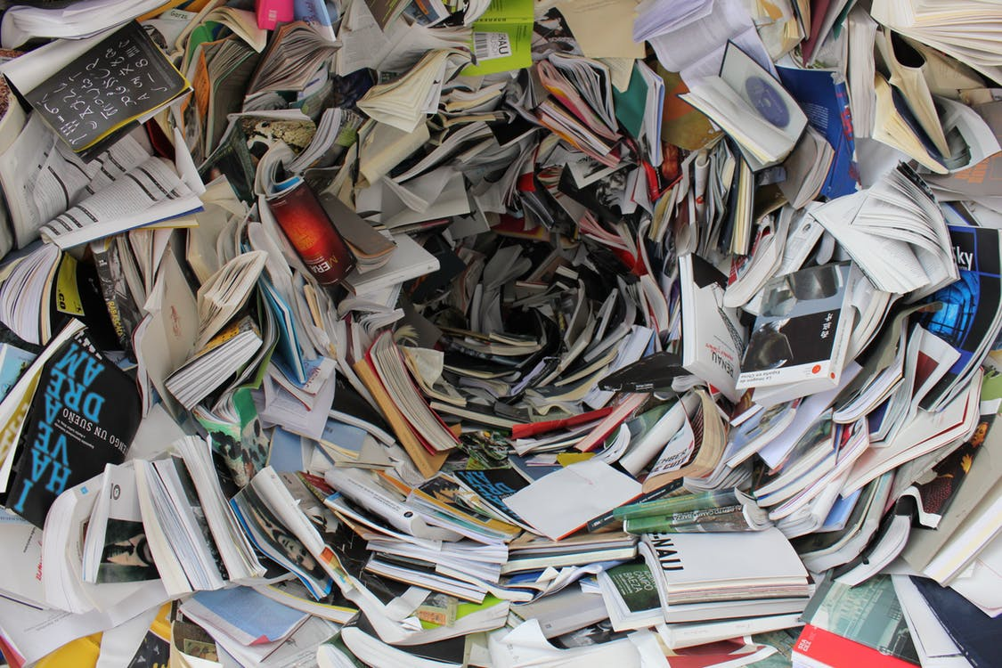
What have we learned?
Notes:
So we’re now at the end of our journey. We’ve tried to take some latest research into new multiscattering BRDFs and area lights, and put them into our game, and it’s been a bit more complicated than we initially would have hoped. But hopefully this journey has given us a few insights that we can learn together about uniting research and game production.

Slide 137

Takeaway #1: Source code is invaluable
Notes:
The first is that source code is invaluable. Having some simple shader code for Danny Chan’s multiscattering diffuse model was great, as we could implement it quickly. Having demos for area lights with LTCs also meant I had a working version of area lights in the game very quickly. But perhaps even more importantly, having the fitting code for LTCs was utterly invaluable because when I hit a hurdle and needed to work with more BRDFs than just Lambert diffuse and GGX, I was able to do so very easily.

Slide 138
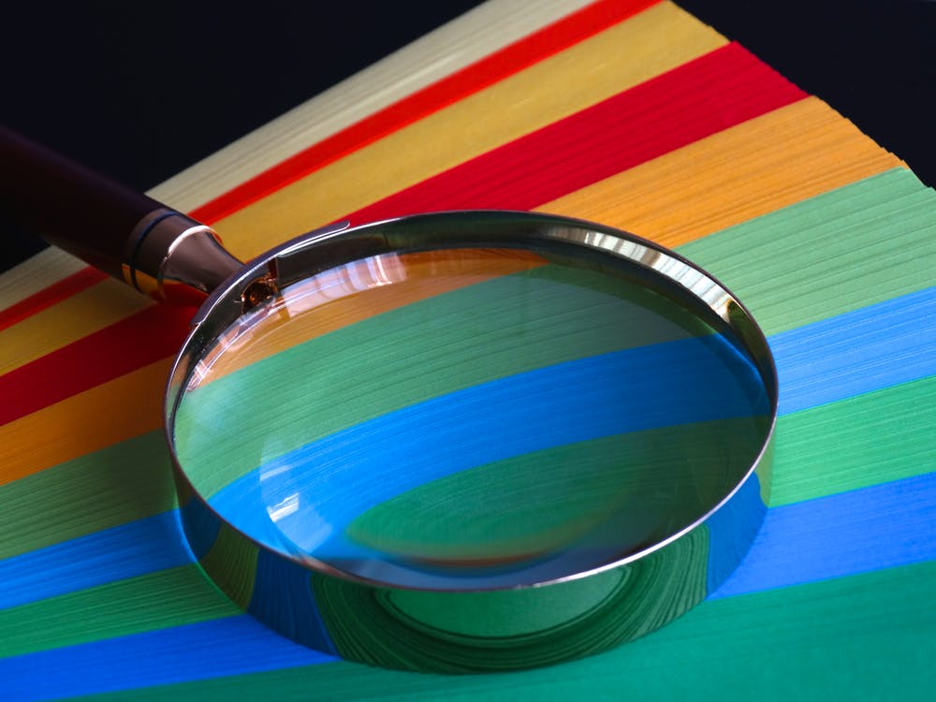
Takeaway #2: Separate insight from implementation
Notes:
This leads us nicely into Takeaway #2 – separating insight from implementation. The thing about LTCs is not that they allow us to get a real-time result of GGX specular with area lights, although that’s what the demos show. The research isn’t about that implementation detail. The research is about the insight that we can use LTCs to represent any BRDF. I just used that insight further myself to use LTCs to help with indirect diffuse with spherical harmonics.
This is good for us all to remember when writing papers but also when reading them. I remember a member of my team implementing a paper about a BRDF for the moon. It contained a BRDF from the sun light, but it also provided a sky light model too. Really, the sky light model was just there to make the image the researcher was rendering be complete. However, my colleague implemented both the sun model and the sky model, completely forgetting that we already had a much better sky model in game that was being applied. Now, that’s the job of us in games to spot the real insights in paper, and to forget the peripheral information, but sometimes it’s the job of researchers too to ensure the key insight in their paper is what stands out, not just some arbitrary implementation details.
That isn’t to say we can’t have papers 100% about implementation. In some ways the Fdez-Agüera paper is a fantastic example of this – focusing on how to get something working in a particular case, and as a game developer I love these papers. *But* I did personally take the model and extended it to more use cases, looking at the insight it provided into other problems.

Slide 139
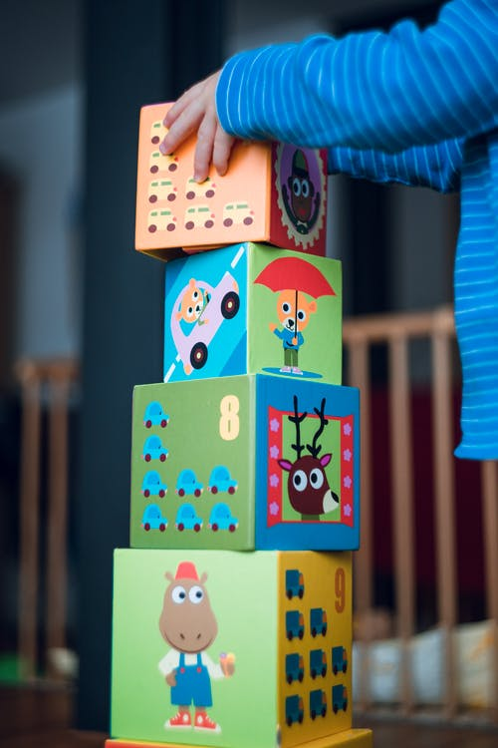
Takeaway #3: Build on successful existing work
Notes:
I guess I was building upon existing work. As was Fdez-Agüera when looking at multiscattering for environment lighting, or Emmanuel Turquin when developing his own multiscattering model. The more research we have in a given area the better! It’s even more important because if work is successful, we’re likely using it in games. And doing research to push what’s being used further really helps.
Even the concept of the environment map BRDF is something that has come up repeatedly. We were able to use it to get the energy of a BRDF in a given direction, and we also used a very similar concept to scale our LTCs. The fact that in games we already have some of this technology just makes implementing future papers based on that easier.
There is a word of caution here too. It’s looking likely that in the near future I’m going to be using LTCs to evaluate BRDFs, because I want to use area lights. That means if I’m going to implement a BRDF, I really want it to work with LTCs, otherwise I’m going to have a problem. Building on successful existing work also means understanding what’s already being used, and trying to make your research work with that. Or understanding that we might only come back to your research in 15 years once we’ve stopped doing LTCs and we’re all on ray tracing.
But the other benefit to building on existing work is that you might be solving problems that are within it. And today we hit a lot of problems.

Slide 140
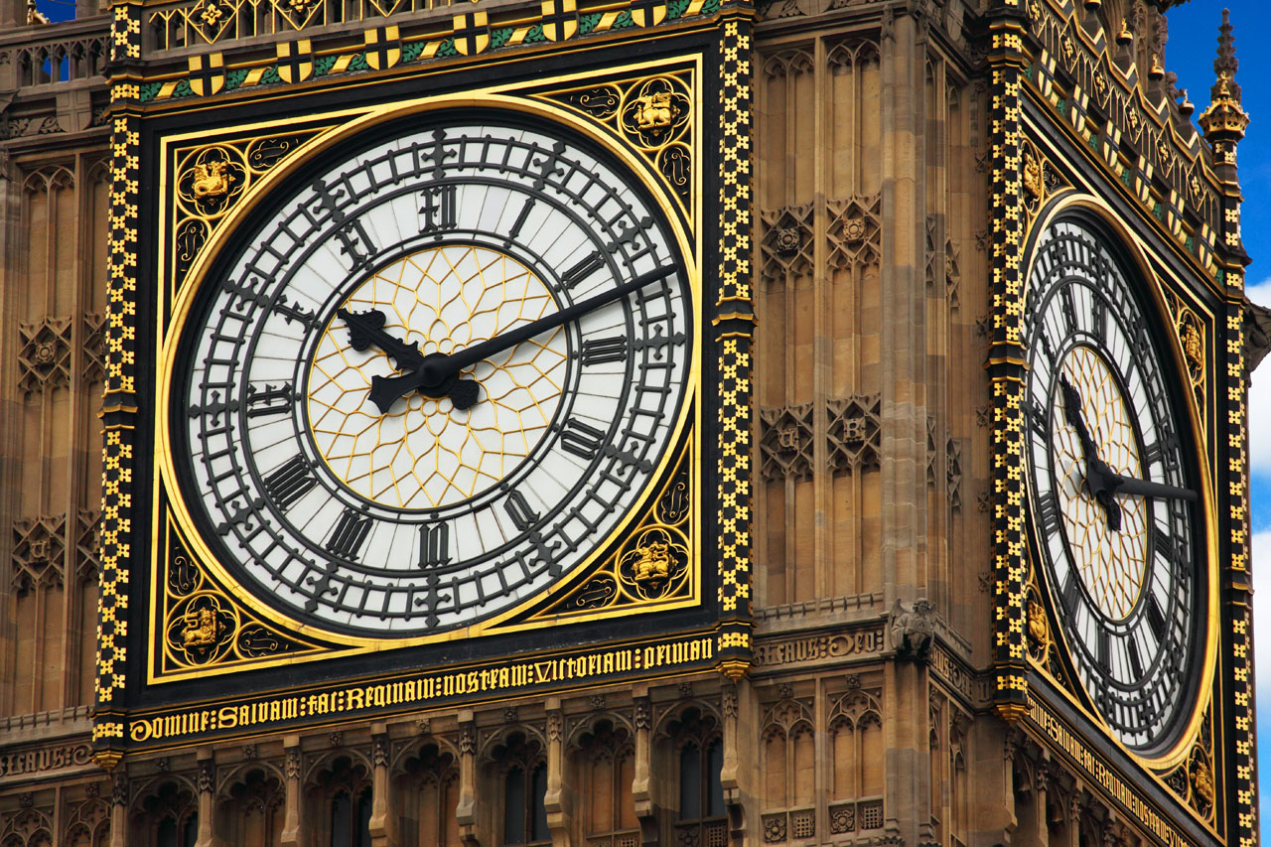
Takeaway #4: Never underestimate implementation time
Notes:
Never underestimate implementation time. And that’s coming from me, who was initially really pleasantly surprised with how quickly I got new BRDFs plus area lights into the game. Then I realised all the cases that I was missing. The skin, the hair, the cloth. How the new BRDFs didn’t necessarily play nicely with the area lights, and that those two strands of research were pretty independent that I had to try to unite. Still, there’s much more work to do – I need to implement a whole new technique for skin shading, check that it’s performant, and discover a solution for hair.
I say this to many people – to artists and producers I work with, to hardware manufacturers wanting us to implement their latest feature, to academics wanting us to implement their research, and to graphics programmers trying to get the latest feature into their engine. It often takes a lot longer than you think. Sure, the initial implementation might be simple, it might not take that much time. But I like to think that this is one of those 80:20 rules. The last 20% of the work very definitely takes 80% of the time, because our engines are incredibly complex and features don’t always play nicely together.

Slide 141
Epilogue: Implementation Details for Area Lights
Notes:
Now it’s time for a short epilogue at the end of our journey. What happens when you actually try to put area lights in game and make them usable? Well, we have to make them available for artists and give them a way to manage performance. Moreover, we wanted to experiment with making area lights a feature that could be enabled and disabled – so for example, only available on higher end platforms.

Slide 142
Goals:
Control over performance
  Radius falloff
  Cone angle falloff
Fall back to point lights
  Omni or spot light
Notes:
That gave us the following two major goals. We needed to give the artists control over the light falloff, in a similar way to the controls they have for omni or spot lights, with radius falloffs and cone angle falloffs. We also decided to have a fallback to an omni or spot light when area lights were disabled.

Slide 143
Goals:
Control over performance
  Radius falloff
  Cone angle falloff
Fall back to point lights
  Omni or spot light
Notes:
Let’s start by looking at these controls for performance. It turns out there there are two falloff controls that we already have that we’re going to use for area lights. The first and most important is a radius falloff, to ensure that beyond a certain distance from the light we’re not rendering anything.

Slide 144

r
Windowing Function [Karis13]
Notes:
We’re going to do that by using this windowing function, proposed by Brian Karis at SIGGRAPH 2013. If d is the distance from the light, and r is its radius, then this function gives a smooth falloff to zero at the boundary.

Slide 145

θ
φ
θ = inner angle
φ = outer angle
Cone Falloff
Notes:
Next is the cone falloffs. Technically, for a single sided quad light, the light should cast in the entire 180 degree plane in front of the light source. However, that can create some lights that fill a lot of space on screen, so instead we want to limit their range, exactly like we do for a spot light. In Far Cry we give artists control over the inner and outer cone angles of a spot light, so we do the same for an area light. I’ll give a few more details about how that works exactly when I talk about our solution for falling back to point lights.

Slide 146

Inverse Square Law
Notes:
Finally, another falloff function we tend to use is the inverse square law, which decreases light intensity with distance…

Slide 147
Accounted for in integration over the hemisphere
Notes:
…however, with area lights this is already accounted for in the integration of the light source over the hemisphere – as the light gets further away and thus the polygon has a smaller projected size, the light intensity decreases. So this is something fundamentally different than the falloff functions talked about above, which are windowing functions, whereas this is a property of the light integration itself. So we ignore this for area lights.

Slide 148
Goals:
Control over performance
  Radius falloff
  Cone angle falloff
Fall back to point lights
  Omni or spot light
Notes:
Now that we have appropriate control for performance, we can talk about our fall back to point lights. This is for lower end platforms, whereas area lights are for higher end.

Slide 149
Quad light falls back to spot light
Notes:
In our case, we replace the area light with a spot light at the same location, with the same inner and outer angle, and radius. If we simply replaced the area light with a point light at the same location, with the same falloff properties (that’s radius, inner angle and outer angle), we’d immediately notice that we’re missing light near the light source. But this is also the problem we have with using inner and outer cone angles as a falloff for area lights in the first place – where does the cone originate from? If it’s at the centre of the light source then we’ll essentially be making the area light into a point light, at least close to the light source, which isn’t ideal.
(Also, I’m going to be focusing on the case of a quad light here, but the extension to disk lights is trivial.)

Slide 150
projector distance
Move projector position behind the light source
Notes:
Instead, we can move the light back to a position that its frustum encompasses the area light source. In fact, an idea similar to this for where to cast shadows for area lights was proposed by Sebastien Lagarde and Charles De Rousiers at SIGGRAPH 2014 [Lagarde14]. Then we cull the part of the light behind the light source.

Slide 151
projector distance
Use cone apex for cone angle fall off for spot and quad light
Notes:
This helps us even when area lights are enabled, since this tells us where to place the apex of the cone for the cone angle fall off. This is really going to help the two match, as they’re going to have the same angular fall off from the same position.
This means we have to calculate the projector distance, the distance to move what I’m calling the projector, from which the cone emanates from, back behind the light.

Slide 152

p
d
φ
Calculate the projector distance p from outer angle and light source diameter
Notes:
This is some fairly simple trigonometry using the outer angle and the light source diameter.
For the light diameter, we use the length of the diagonal of the quad light source, like this.

Slide 153
Cone fits around quad light source
d
d
Worse fit for non-square light source shapes
Notes:
Yes, this means that it’s an approximation that gets much worse as the light deviates away from being a square. This could be improved by supporting elliptic cones, and that’s something we might look at in the future. And it goes without saying that this works much better for disk lights than for quad lights! But even for disk lights, given that they can be ellipses, we’d still ideally need support for elliptic cones.
Let’s now look at how good the fall back actually is for lights with different cone angles.

Slide 154
Quad light, 100° outer angle, 90° inner angle
Notes:
This is a quad light with a relatively narrow outer angle of 100 degrees. We’re going to use an inner angle of 90 degrees, pretty close to the outer angle as we don’t want the inner and outer to be used to provide any shape to the light, but rather just a soft falloff.

Slide 155
Fall back, 100° outer angle, 90° inner angle
Notes:
This is the spot light fall back, which ends up being slightly darker.

Slide 156
Quad light, 120° outer angle, 110° inner angle
Notes:
Let’s go back to a quad light of 120 degrees.

Slide 157
Fall back, 120° outer angle, 110° inner angle
Notes:
Again, the fall back is very close but slightly darker, and you see more visible changes to the shape of the fall off.

Slide 158
Quad light, 140° outer angle, 130° inner angle
Notes:
Finally, let’s look at a light of 140 degrees.

Slide 159
Fall back, 140° outer angle, 130° inner angle
Notes:
This is where the change gets more pronounced. The fall back is actually brighter nearer the edges.
I think this can be viewed as expected. For a spot light the only falloff is coming from the cone angle, but for a quad light we have a “falloff” coming from how much of the light source is visible at a given angle, and as we get to more glancing angles less is visible.
However, overall these fall backs are very acceptable. In fact, they’re so good that one of our lighting artists complained that area lights weren’t making enough of a difference. I took that complaint as a victory for this method.

Slide 160

Notes:
Thank you all for listening. And I’m happy to answer any questions you may have!

Slide 161
References
[Ashikhmin00] A Microfaced-based BRDF Generator, Michael Ashikhmin et. al., SIGGRAPH 2000
[Burley12] Physically Based Shading at Disney, Brent Burley, SIGGRAPH 2012
[Chan18] Material Advances in Call of Duty: WWII, Danny Chan, SIGGRAPH 2018
[FdezAgüera19] A Multiple-Scattering Microfacet Model for Real-Time Image-based Lighting, Carmelo J. Fdez-Agüera, JCGT Vol. 8, No. 1
[Heitz16a] Multiple-Scattering Microfacet BSDFs with the Smith Model, Eric Heitz et. al., SIGGRAPH 2016
[Heitz16b] Real-Time Polygonal-Light Shading with Linearly Transformed Cosines, Eric Heitz et. al., SIGGRAPH 2016
[Hill16] LTC Fresnel Approximation, Stephen Hill, Tech Report,
https://blog.selfshadow.com/publications/s2016-advances/s2016_ltc_fresnel.pdf
[Jimenez12] Separable Subsurface Scattering and Photorealistic Eyes Rendering, Jorge Jimenez, SIGGRAPH 2012
[Karis13] Real Shading in Unreal Engine 4, Brian Karis, SIGGRAPH 2013
[Kulla17] Revisiting Physically Based Shading at Imageworks, Christopher Kulla & Alejandro Conty, SIGGRAPH 2017
[Lagarde14] Moving Frostbite to PBR, Sébastien Lagarde & Charles De Rousiers, SIGGRAPH 2014
[Penner11] Pre-Integrated Skin Shading, Eric Penner, SIGGRAPH 2011
[Turquin19] Practical Multiple Scattering Compensation for Microfacet Models, Emmanuel Turquin, Tech Report, http://blog.selfshadow.com/publications/turquin/ms_comp_final.pdf

