Slide 1

Volumetric
Global Illumination
At Treyarch
JT Hooker
Treyarch Senior Graphics Engineer

Slide 2
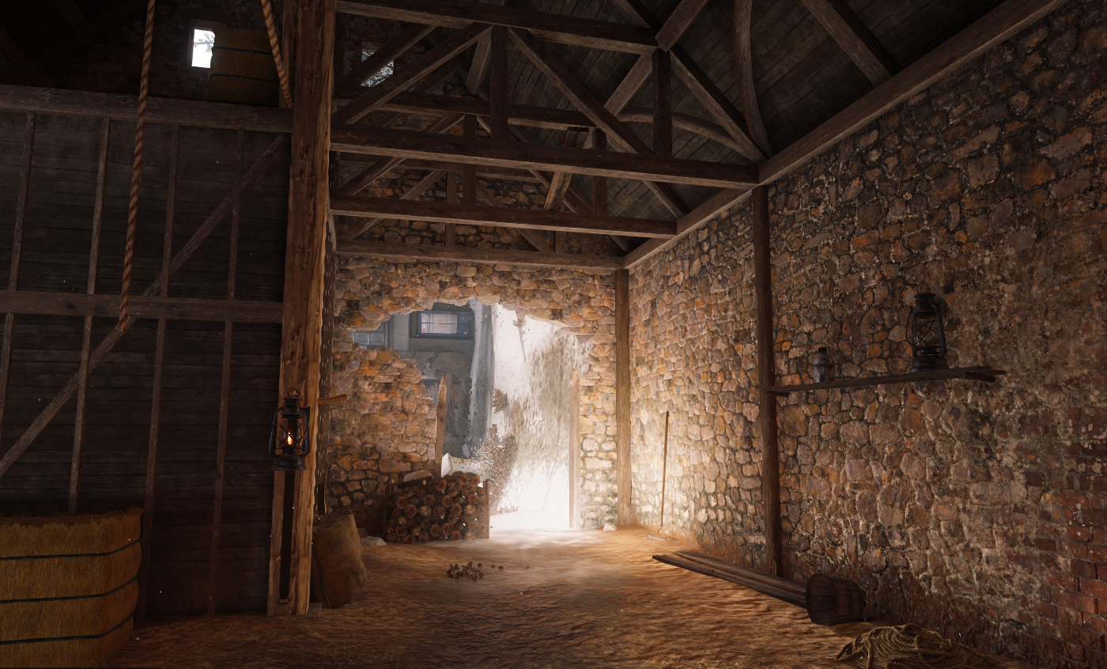
Volumetric Global Illumination
GI in volume texture
Lean texture data
IBL baked from probes
Convex blend shapes
Notes:
Today I’m going to introduce our all new approach to global illumination that we’ve developed. It is very similar to the traditional concept of irradiance volumes, where GI color data is stored in a volume texture. However, our implementation differs from those presented in previous years in that the texture data and runtime processing are extremely lightweight. Only three textures of color data is stored in the volumes and leaking is prevented by carefully placed soft convex shapes for attenuation. Additionally, the pre-computation, or “baking” of this data is very fast because we make use of our reflection probes in a technique that is similar to traditional image-based lighting.

Slide 3
Presentation Order
Where we started
Evolution along the way
Where we ended up
Notes:
I’m going to start by mentioning the tech we started with from previous Treyarch games. Then I’ll explain the various iterations and attempts we made along the way and why we ultimately didn’t stick with them. Then I’m going to give detailed information of our final implementation.

Slide 4
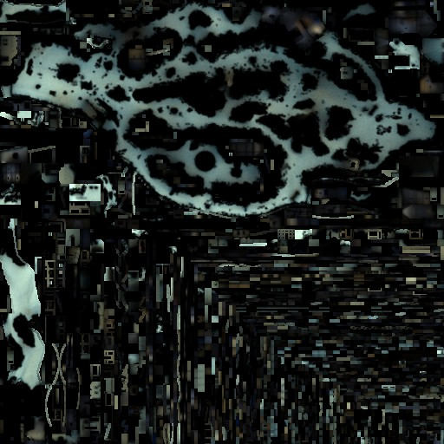
Traditional Approach: Lightmaps
Could be ok, but…
Notes:
I’ll start at the beginning, or what we had already in place in our engine. Treyarch has traditionally used Lightmaps to store and render GI data. Lightmaps look great and can definitely provide attractive visuals on current-gen hardware, but there are a few limitations that we wanted to solve nonetheless.

Slide 5
Lightmap Downsides
Works poorly on detailed
or intersecting geometry
Notes:
Can have issues with complex or intersecting geometry.

Slide 6
Lightmap Downsides
Doesn’t work at all on
dynamic geometry
Notes:
Don’t work on dynamics, like effects or characters in the scene, requiring a separate solution for them.

Slide 7
Lightmap Downsides
Software ray-tracing and
shading takes forever
Notes:
Historically our Lightmaps have been baked by an offline process that did ray-tracing and shading on the CPU, which could take hours to fully light a given map. It also required all of the shaders and lighting to be ported to CPU code for evaluation. And certain rendering tricks might not be picked up by the software raytracer.

Slide 8
Lightmap Downsides
Results not visible
in world editor
Notes:
Because this was an offline process that was dependent on final geometry, it meant that we did not have GI in our world editor, and it would take some effort just to get it loading in there.

Slide 9
Process of Invention
Deferred Renderer
Reflections already present
So how do we apply deferred GI?
Notes:
In order to understand where we ended up, it’s important to understand where our investigations started. We were working with a new deferred-lighting style engine, and we already had a solution for reflections that seemed to make sense in deferred. Namely application of reflection probes with attenuation, the same way lights are applied in deferred lighting.

Slide 10
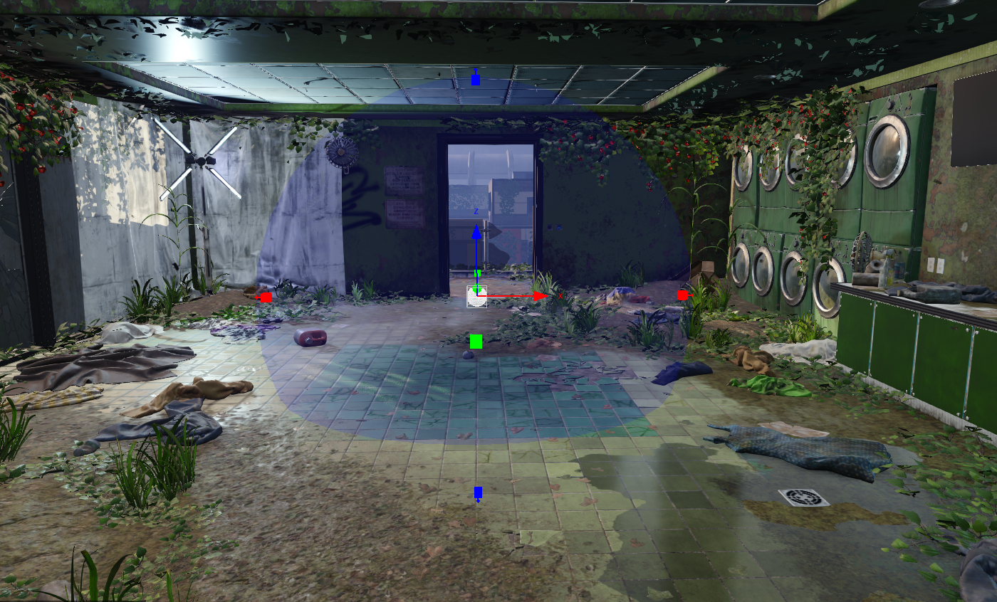
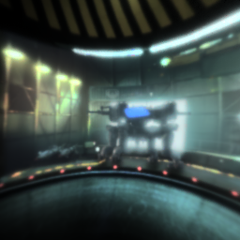
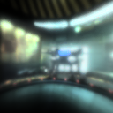


Reflection Probes as Diffuse Data
Higher Mips:
convolved specular
^{[DROBOT13]}
Lowest Mip:
diffuse irradiance
Real time IBL
Notes:
So the first idea was, how about we store a diffuse BRDF in the bottom mip of the reflection probes, and splat them into the scene as diffuse GI, just like we do with specular and reflections?
These probes would be applied with a spherical attenuation, like a point light. And we can even update the cube maps, downsample, and convolve them in on the fly for real-time GI!

Slide 11
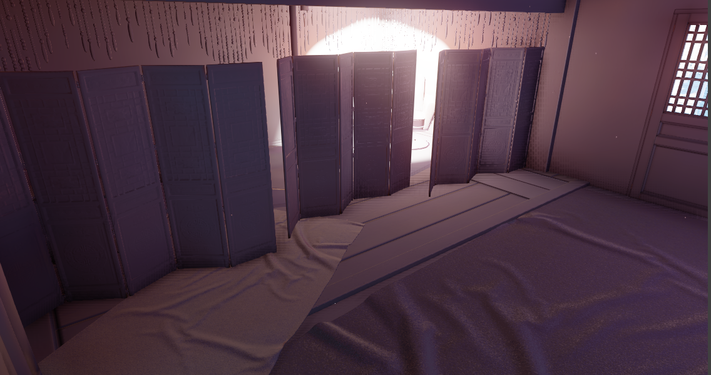
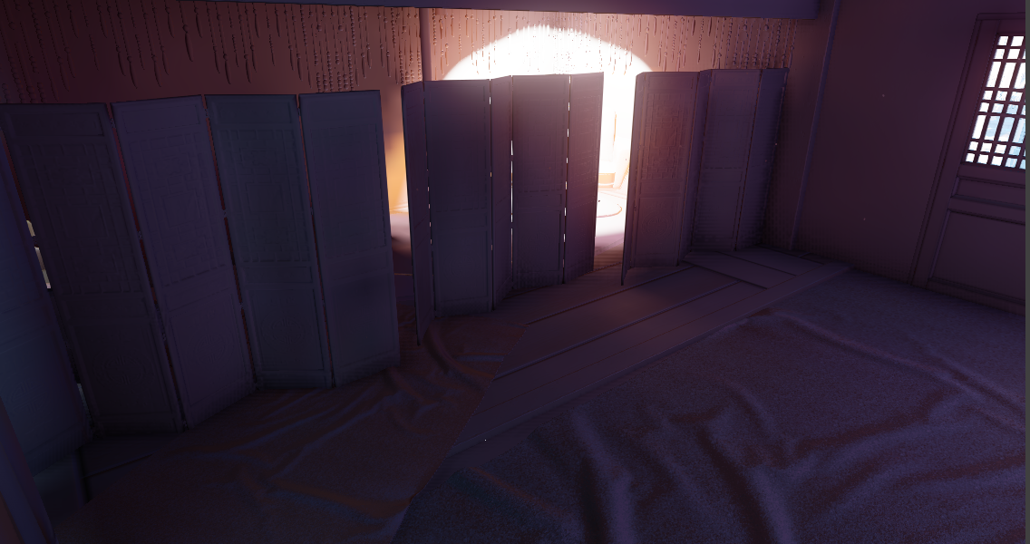
Occlusion Is A Problem
Notes:
There are many artifacts with this simple approach, but the most obvious is occlusion of bounced light. Because everything within the attenuation uses the same color, things that should be occluded from the bounced light are not.
It should look like this. We tried a couple of steps to address the issue. We started by surrounding the probe with a volume texture that contained a dimming factor to black out areas that should be occluded. This was sampled based on the relative position of the surface being evaluated. But even within areas that were not occluded there should be some difference in color, so we started storing a flat color multiplier to tint the irradiance we were sampling to match the local environment.

Slide 12
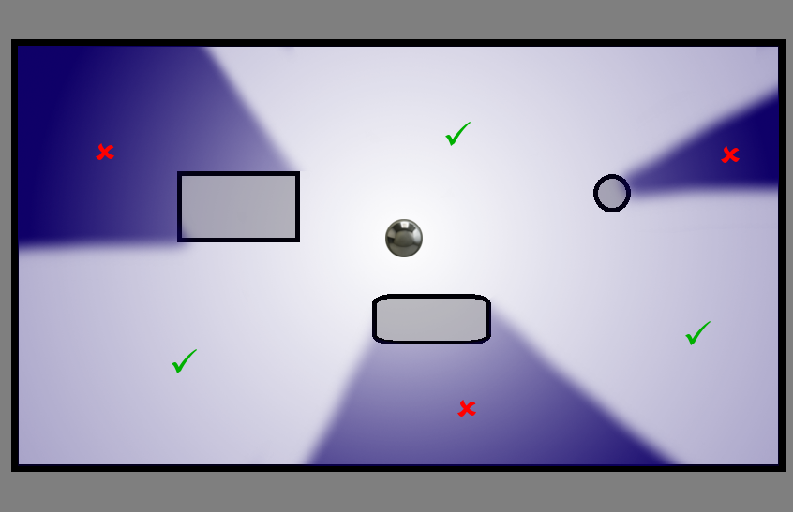
Visibility Is A Problem
Where the probe doesn’t see
Looks like shadows
Notes:
There were still several problems with this. The most obvious being that in the areas where probes don’t see, there was no lighting data to apply. Putting occlusion in the texture just resulted in dark areas that looked like shadows cast from the probe position, which has no relation to any light-casting object in the scene.

Slide 13
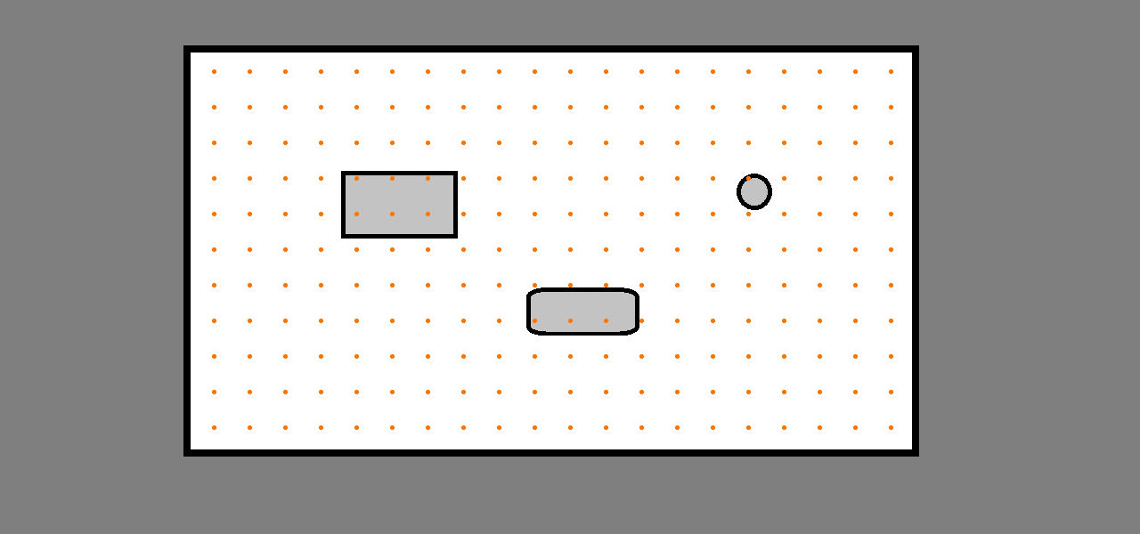
Irradiance Volume
[TATARCHUK05]
Notes:
Eventually we had to admit to ourselves what we really wanted was some form of irradiance volume. A uniform volume texture where each voxel in the texture stores a complete representation of the incoming light. Ideally we could just render a cube map for each point and store that data somehow.

Slide 14
Render a Reflection Probe Per Voxel?
138 Volumes × 40³ Voxels × 6 Faces
÷ 60 FPS ÷ 60 Seconds
= 14,720 Minutes (≈ 10 Days)
Notes:
Just for fun, lets run the numbers.
In an example level I looked at that’s not even that big we have 138 volumes. These are all different sizes and resolutions, but on average they are 40 texels wide in each dimension. Each voxel would need 6 faces rendered for a cube map.
Let’s pretend we get 60 fps when rendering these faces, 60 seconds in a minute comes to…
A mere 15,000 minutes, or just about 10 days. So we can’t really do this. But the results would look great, wouldn’t they?

Slide 15
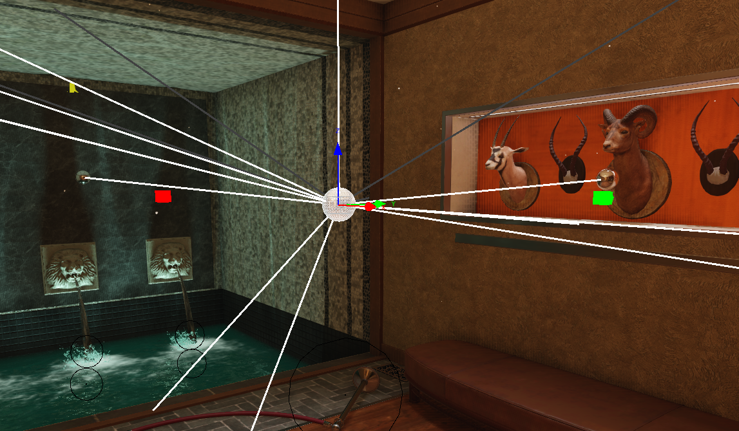
Collect Colors From Reflection Probes
Re-project cube maps
Combine to fill holes
^{[BUEHLER01]}
Notes:
So we’re thinking, how can we get cube maps from more vantage points? We could reproject the reflection probes we already have into each voxels space! Even better, we can combine the visibility from all of the nearby probes to fill in the visibility gaps from any given spot. And if there’s a dark corner somewhere we can’t see into, we can add even more probes just for visibility and throw away the reflections before they get to game if we don’t need them.

Slide 16
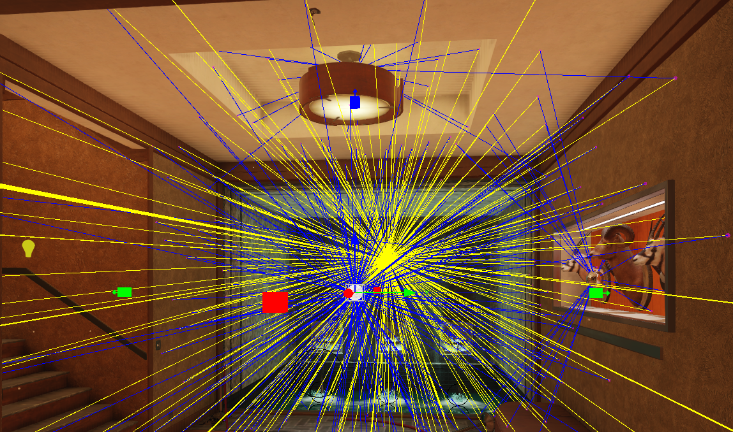
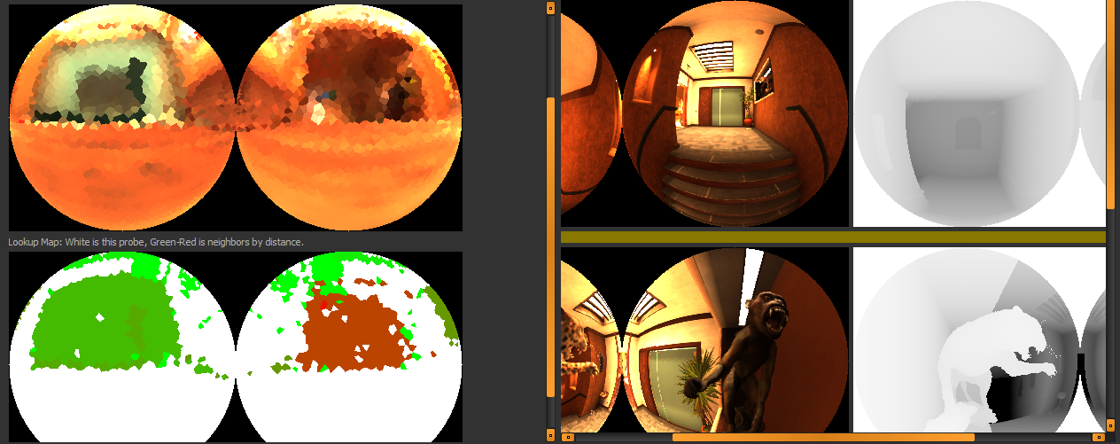
In Practice
  4096 rays per voxel
  15 neighbors considered
  Missed rays are in-painted
Notes:
Here’s an actual example of how we build our views from each voxel. We fire up to 4096 rays into the environment from each voxel. For each hit point, we look through the 15 closest neighbors and see who has visibility to that point. We can use the depth map from the cube map renders to see who has visibility. The best neighbor is chosen and color data is sampled and inserted into our image.
In this debugging tool we can see the results. A couple of the neighbor cubes are shown on the right. On the top left is the accumulated image. On the bottom left is a color code showing which probe each sample came from. The closest probe is white, with further probes ranging from green to red. Samples that didn’t have visibility from any probe will be in-painted with the average of all the other samples on that face of the cube map.

Slide 17
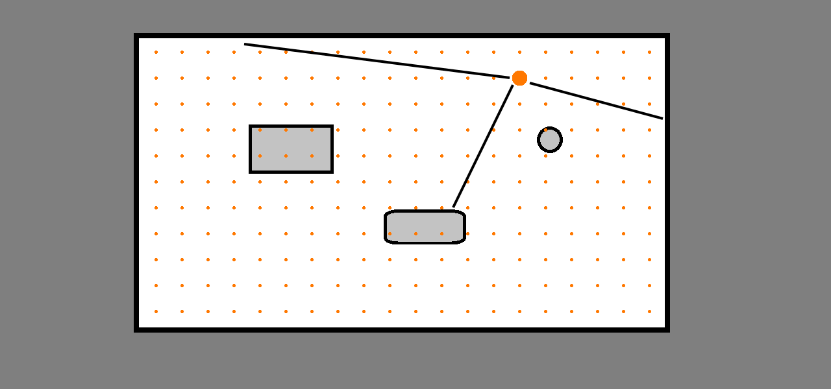
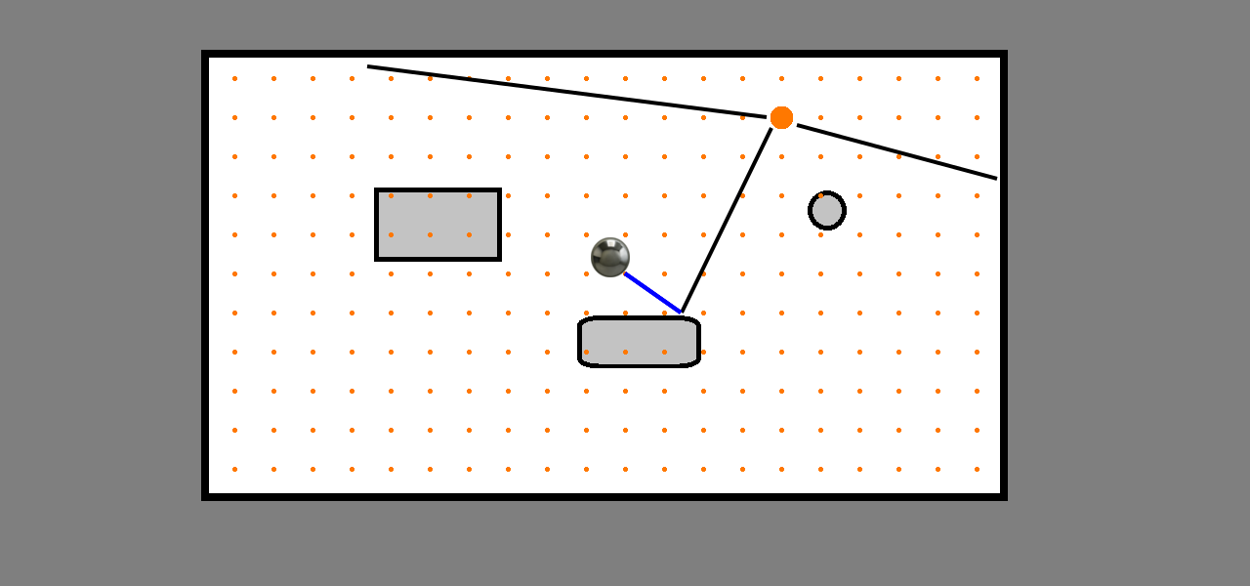
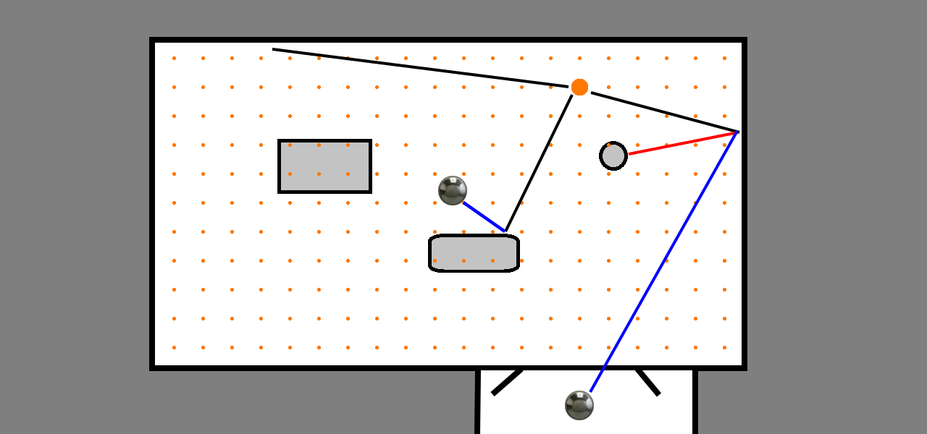
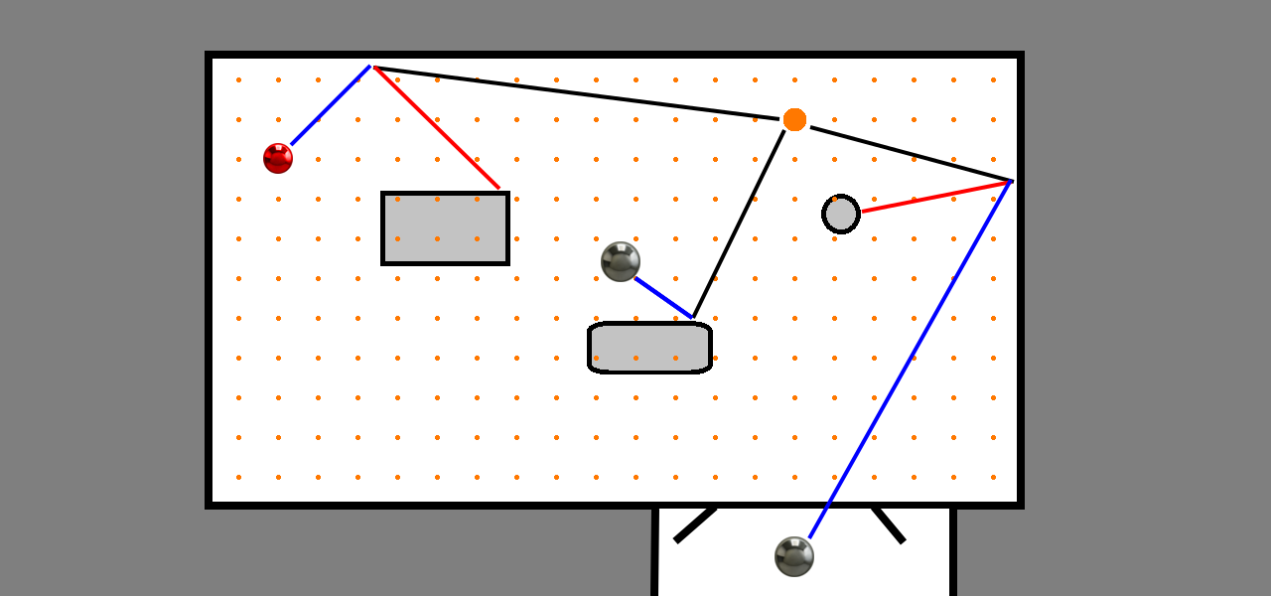
Re-Project From Existing Probes
Notes:
To help you visualize this, I’ll step through a few sample rays in this imaginary line-drawing room. In this example, lets say we’re trying to build the image for what’s visible to the voxel highlighted by the large orange dot. So we fire a few rays out into the environment. I’ve chosen to only look at three of them in this example. Lets look at the ray that hits the center obstacle first.
This surface is in direct view of the reflection probe in the center of the room, so we can draw color data from it. Next lets look at the ray that hits the wall on the right.
The central probe can’t see this spot on the wall because there’s a circle-type-thing blocking visibility. Although there is a probe in the hallway outside that can see this spot through the open door so we get color data from there.
For the last ray there’s a big rectangle in the way and neither of the probes can see this corner. Luckily our lighting artist has placed what we call a “virtual” probe back there to solve the problem, highlighted in red. These are probes that are hand placed to improve visibility in areas, but the cube maps they generate are only used for collecting GI data and are never exported to game as reflections.

Slide 18
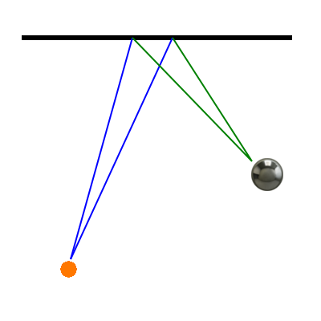
Reprojection
Neighbor candidates
sorted based on distance
What about spec?
Notes:
We evaluate probes in order of distance. Closer probes should have a clearer and more accurate view of the target area.
We briefly experimented with having the neighbors sorted by relative view angle. We did this because the specularity of the surface will be incorrect for the shifted viewpoint, and we’ll get incorrect distorted caustics. We disable direct specular from lights, but we can’t disable specular reflections or metallic surfaces will appear black. So by minimizing angular differences we minimize the issue. However the issue was still present and we eventually solved it by ignoring the view angle when rendering the reflections within the cube map. We bash the view angle to match the surface angle, meaning reflections-of-reflections for intermediate bounces are incorrect, but at least they’re consistent from one probe to the next and don’t cause seams between choosing one over another. Then we do a final pass to render the cube maps with correct reflections which you’ll see in-game.

Slide 19
Reprojection
Angle and distance
to surface
defines a solid angle
in the cube map
Notes:
Ray hits are reprojected into each probe’s view space
The initial ray is a cone defined by the direction and total number of samples.
Angle of incidence and distance define a cone in probe space, which in turn define a mip level to look at

Slide 20
Reprojection
Sample area validated against depth pyramid
If visible
appropriate mip sampled
Notes:
Visibility is evaluated using depth pyramid, then a sample is made.

Slide 21
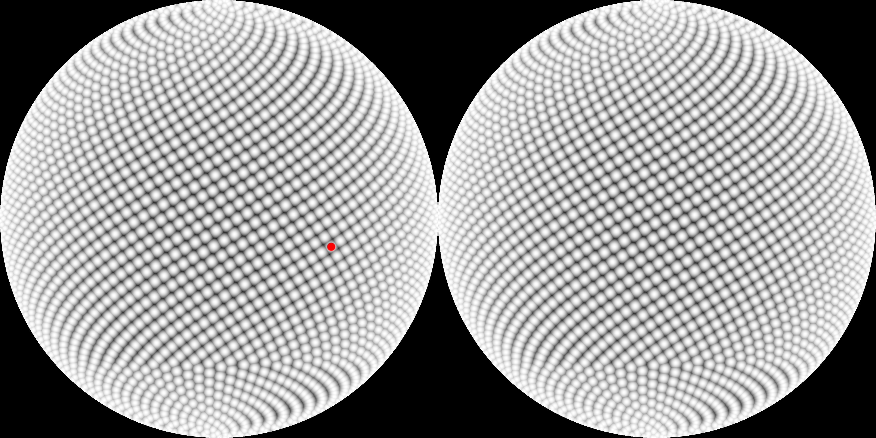
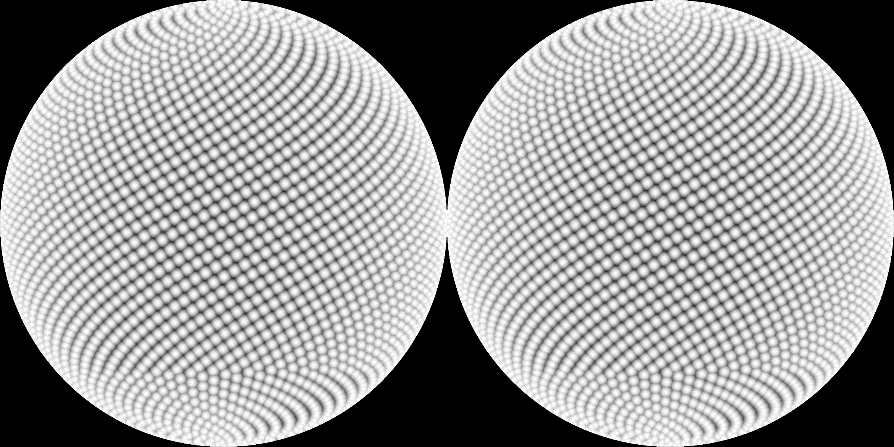
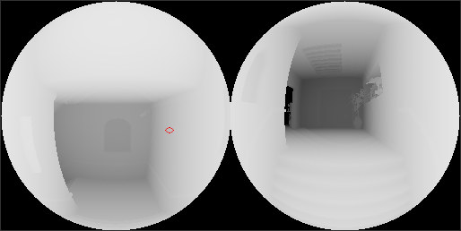
Reprojection Caluclation
Notes:
Here’s an example of a cube map waiting to be filled in by color data. Each little cell represents a sample ray we fired.
I’ve highlighted one ray in particular. For that ray, we’ll loop through a sorted list of all the candidate neighbor probes, stopping when we find one that can see the intersection point.
To see if we have visibility to the intersection point, we check the depth at that projected location. The relative distances of the probe and the voxel from the intersection point define an area within the cube map. We’ll check the appropriate mip in the depth pyramid to determine visibility.

Slide 22
Reprojection Calculation
distFromUnitCube = √( 1 + u² + v² ); // Compensation for cube-map shape.
angleOfVoxel = 4 * PI / numSamples; // Solid angle from voxel.
inSqrt = 1 + distFromVoxel² * angleOfVoxel * ( angleOfVoxel – 4PI ) / ( 4 * PI² * distFromProbe² );
angleOfProbe = 2PI * ( 1 – √inSqrt ); // Solid angle from reflection probe.
cubeRes = 1.0f / √( angleOfProbe * distFromUnitCube³ ); // Resolution needed for sample.
mipLevel = clamp( mipCount – log2( cubeRes ), 0, mipCount ); // Mip level to use.
return mipLevel;
Notes:
And here’s the math where we select which mip to finally look at. We take the uv into the probe cubemap and the relative distances from the probe and voxel as inputs. The solid angle of the sample relative to the voxel is defined by how many rays we’re firing. Then the relative distances allow us to derive the solid angle relative to the probe. This in turn defines which mip level we should sample from, where we’ve pre-convolved the incoming light.

Slide 23
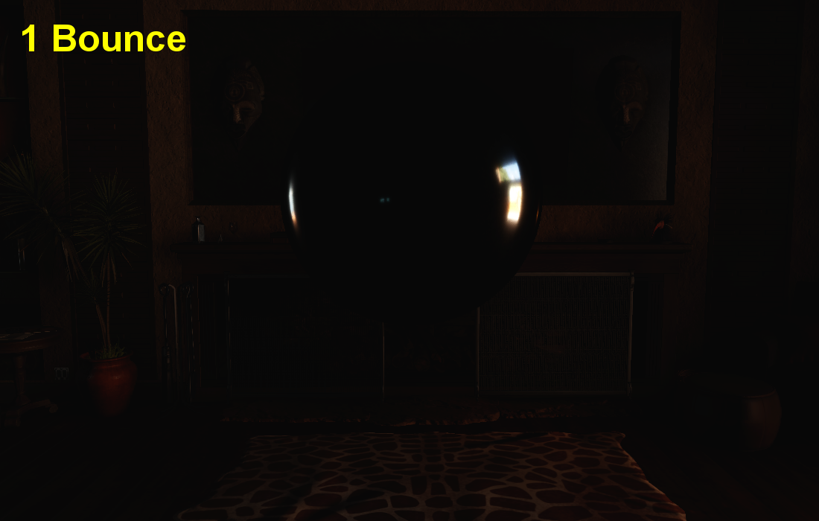
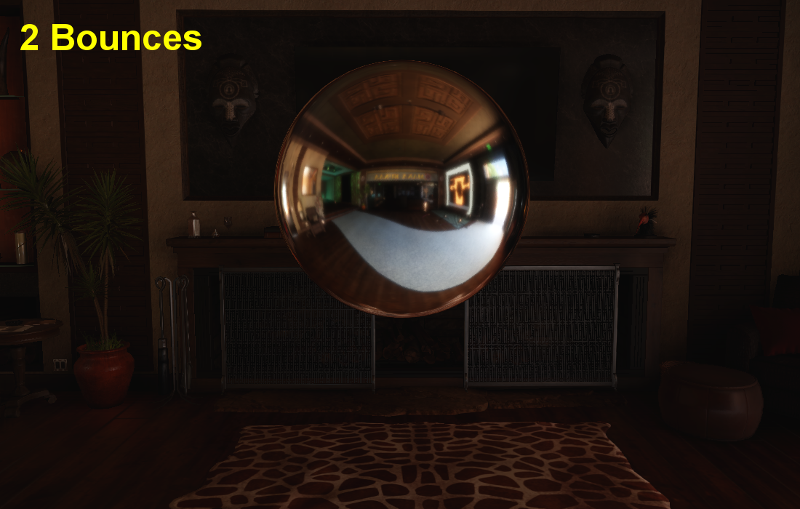
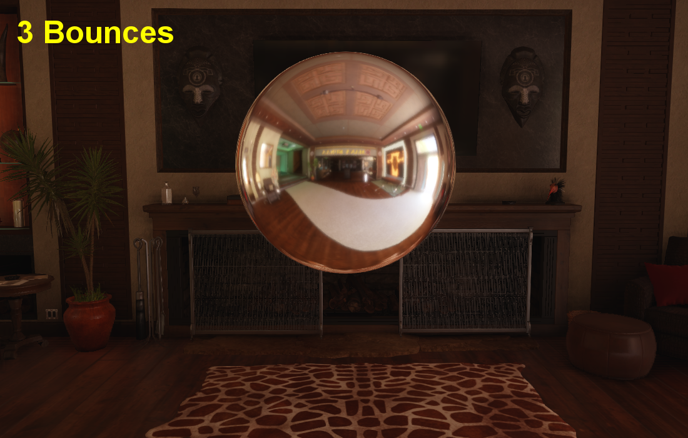
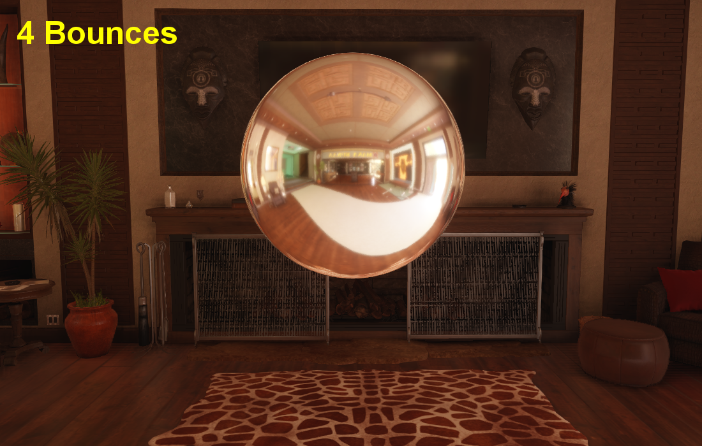
Biggest Benefit
Hardware rendering
Re-render to get bounces
Only have to ray-trace and re-project once
Notes:
Perhaps the biggest benefit to this is we can leverage the hardware rendering of the scene, through the real engine rendering pipeline to produce the color data. We can get more light bounces by re-rendering with the data calculated so far and re-sampling. Since the geometry isn’t changing we only have to do one raycast at the beginning and remember where our samples are coming from. That means additional bounces take a fraction of the time the first bounce takes.
The next question is how do we store this data in the irradiance volume.

Slide 24
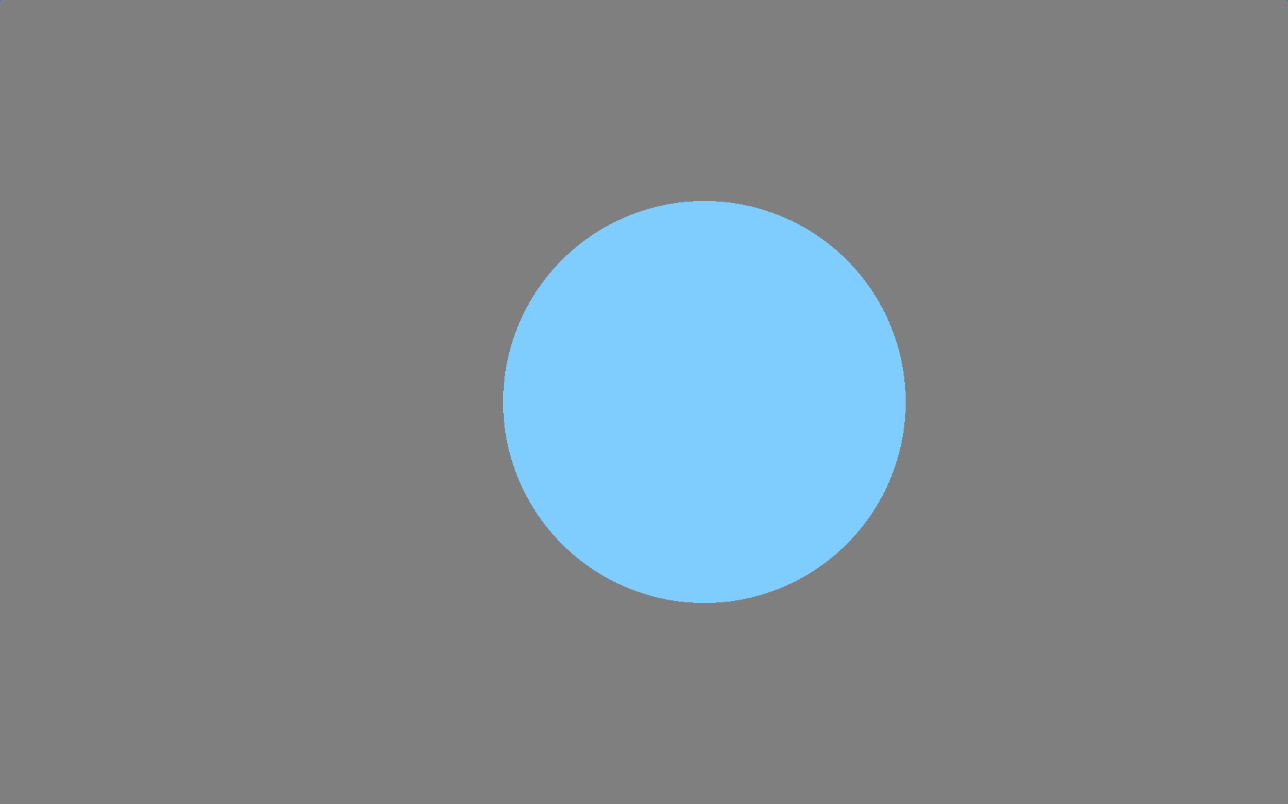
Texture Encoding
Flat Color?
Notes:
Of course we started with a flat color, which was obviously inadequate because it completely lacks directionality and therefore definition of surface.

Slide 25
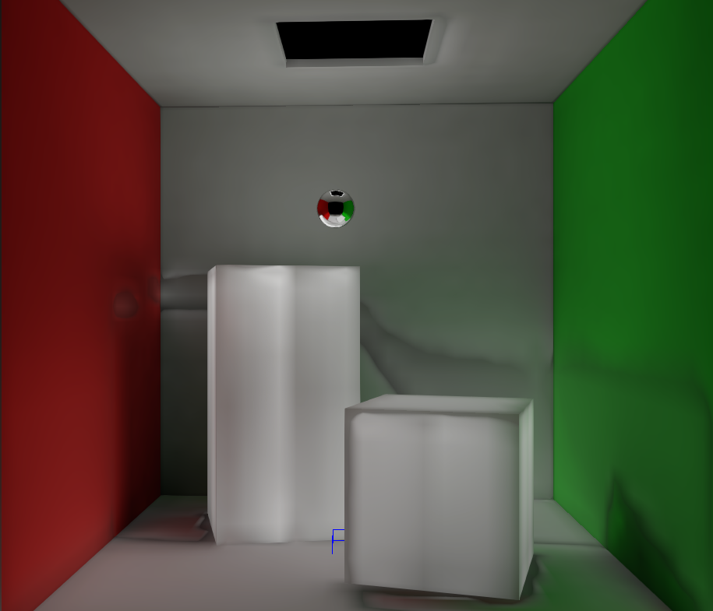
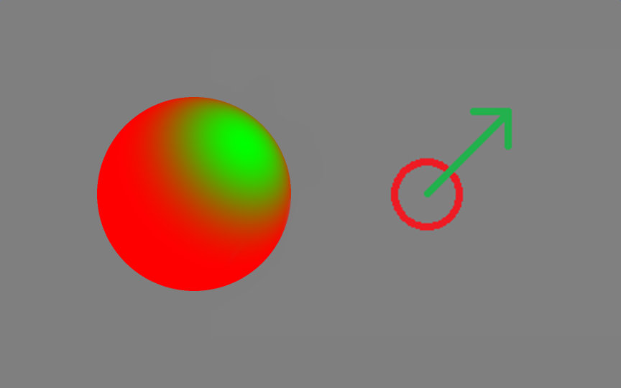
Texture Encoding
Ambient / Highlight / Direction?
Notes:
Next we tried the same format we used for light maps, known as ambient / highlight / direction. This is where a base color is stored as well as a highlight color and the direction it’s coming from. No only is there the issue that this doesn’t have much detail, and the entire back hemisphere of normal is a flat color,
Also there’s a serious artifact when the direction changes dramatically from one voxel to the next, resulting in discontinuities that look like water stains. This can be solved by doing neighbor samples separately and blending after evaluating the normal, but we liked out performance boost from just using hardware trilinear filtering. We also tried solving this by smoothing out changes in the direction, but it lost too much detail.

Slide 26
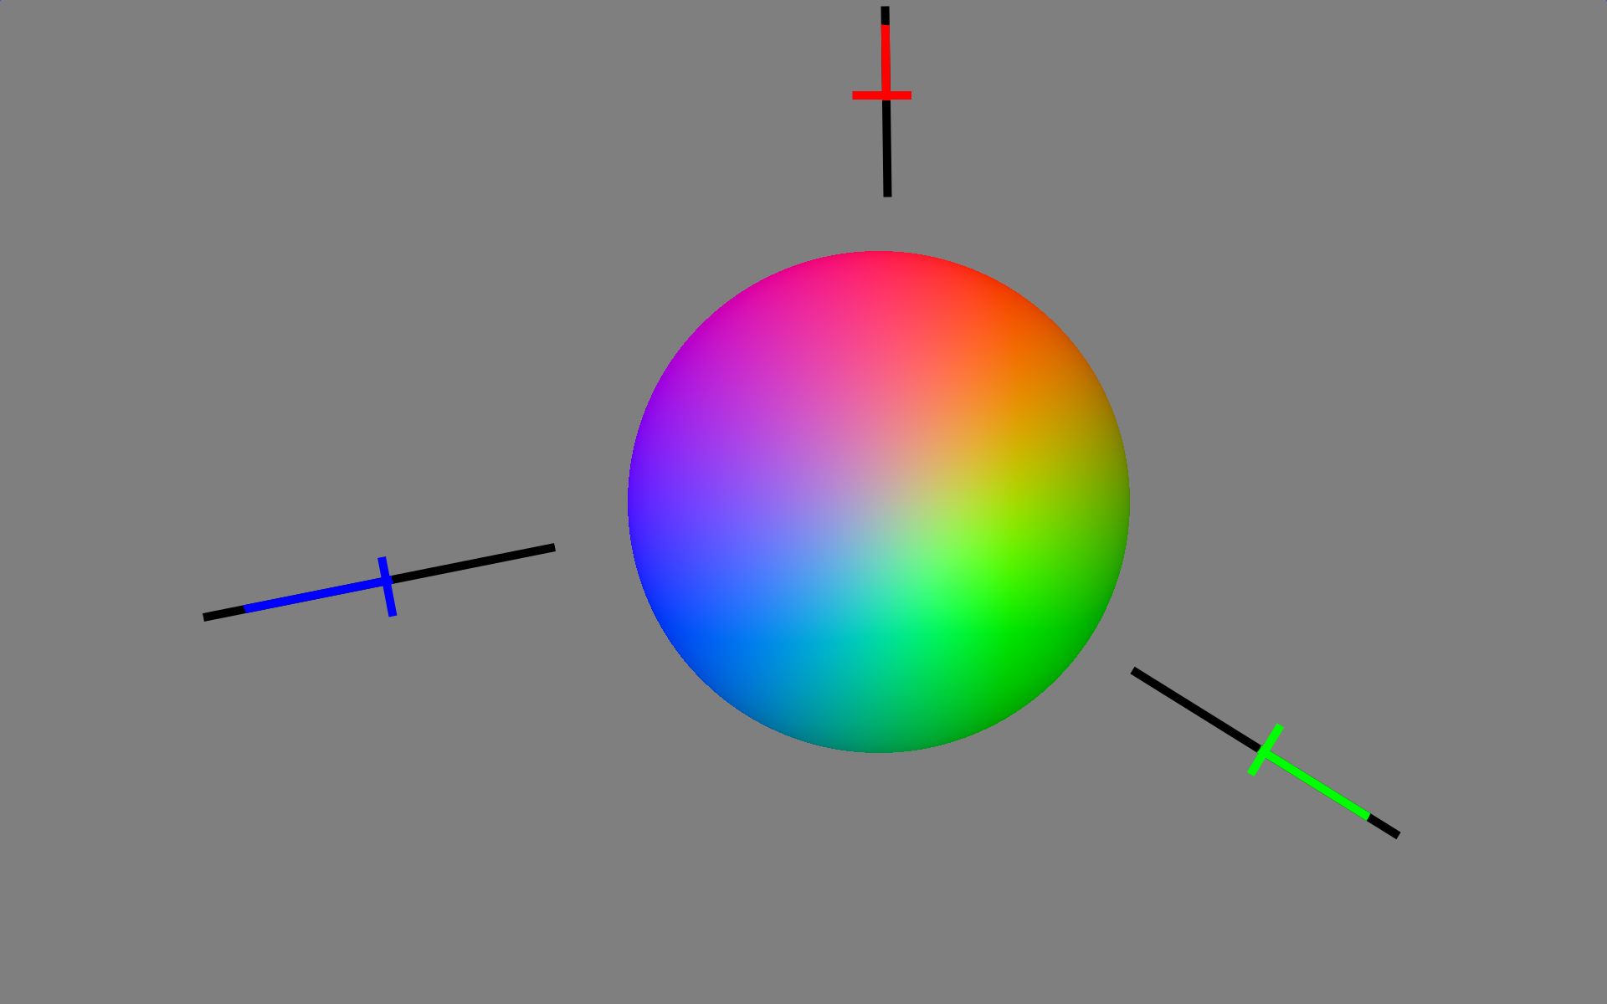
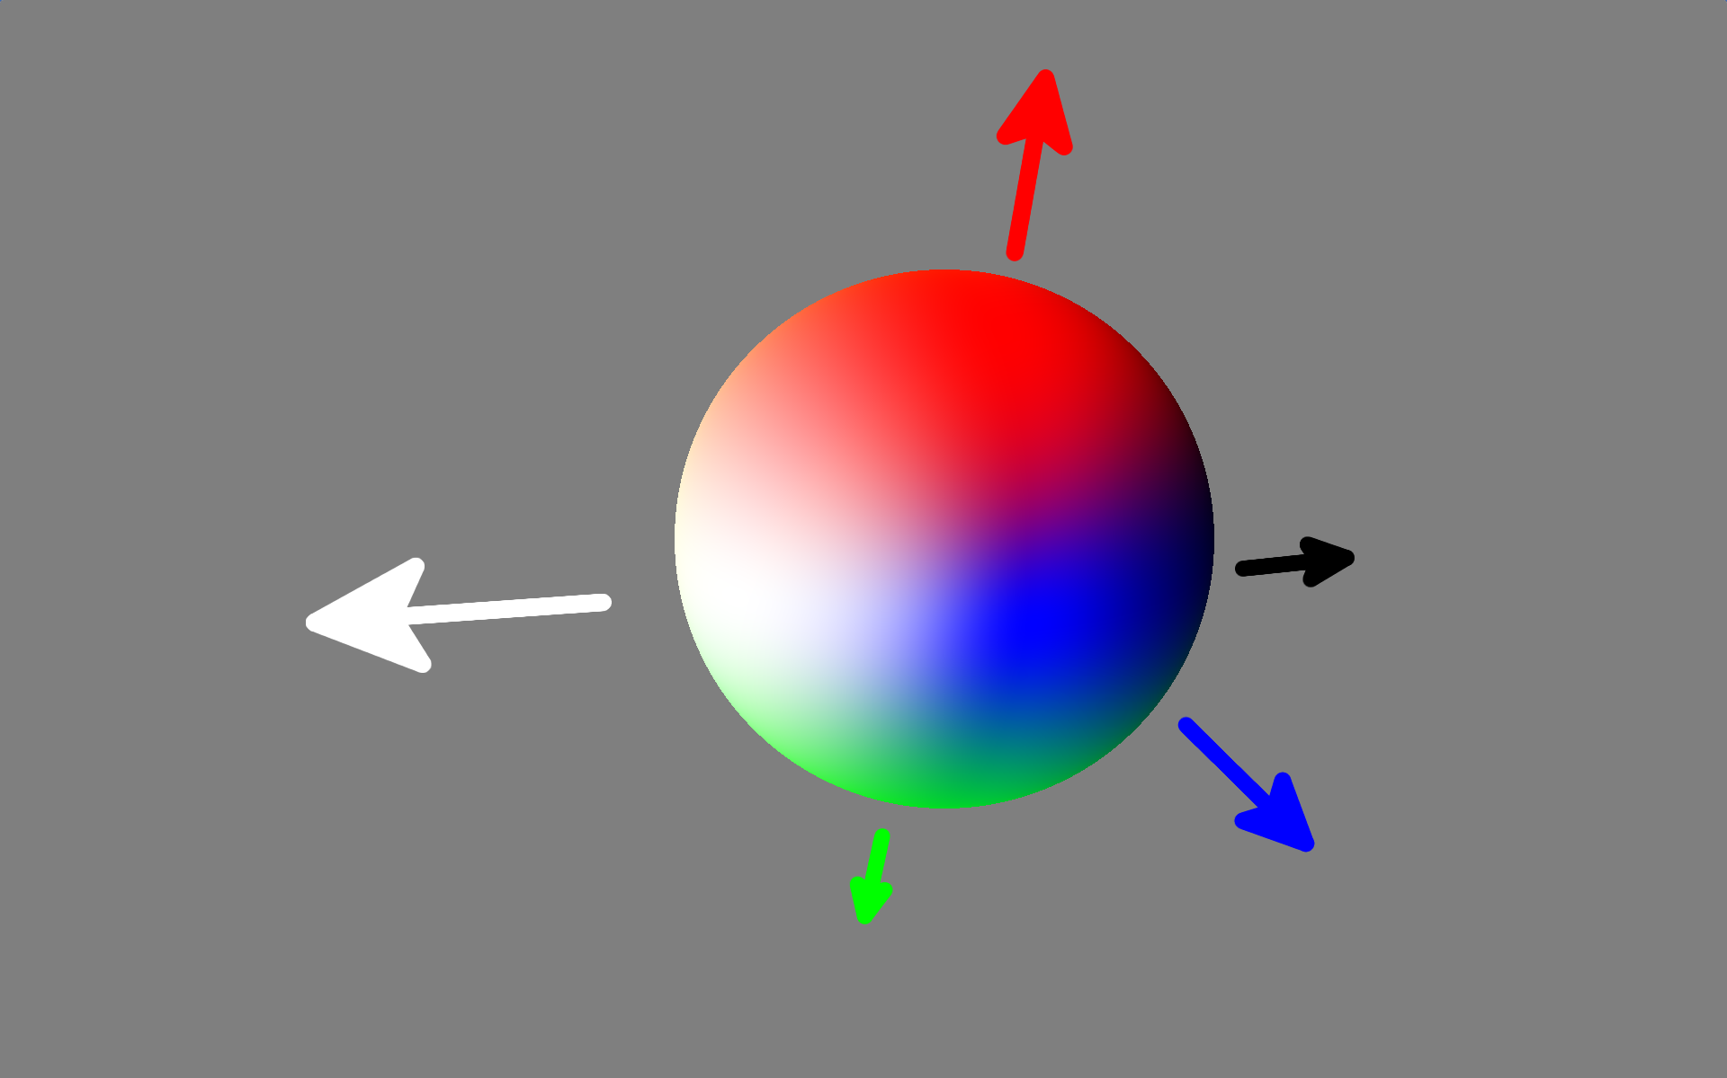
Texture Encoding
Second Order Spherical Harmonic?
Notes:
The next format we tried was second-order spherical harmonic, which is a four-component spherical harmonic. This lets you bend the colors back and forth along each axis and also control the amount overall. But if you have a bright spot coming from opposite directions and nowhere else, for example, it can’t represent this. If we were to go up an order for a third-order SH, that would be nine whole texture samples, which we didn’t like the sound of at all.

Slide 27
Texture Encoding
Ambient Cube! ^{[MCTAGGART04]}
  BC6H Compressed
Notes:
So we finally went for ambient cube, which is Valve’s format that stores a separate color for each direction on each Cartesian axis. We realized that although this is six colors, you only ever need to sample three of them at a time, since you’re either pointing positive or negative and not both. So it’s actually cheaper than SH4 with more precision.

Slide 28
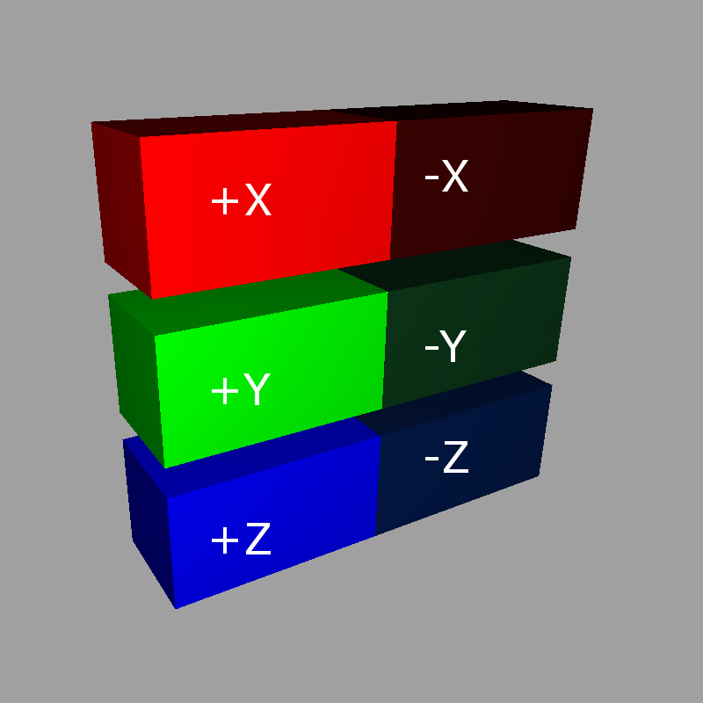
Volume Texture Layout
Notes:
This is how we store the results. Three separate volume textures for X, Y, and Z with the positive and negative side-by-side. We just need to adjust the W position to the back half for negative facing normals.

Slide 29
Performance Benefits
Only 3 samples
Hardware trilinear filtering
Evaluation:
color[n] = normal² ∙ float3( Xsample[n], Ysample[n], Zsample[n] )
color = xVolume.SampleLevel( coord ) * normal.x * normal.x +
yVolume.SampleLevel( coord ) * normal.y * normal.y +
zVolume.SampleLevel( coord ) * normal.z * normal.z;
Notes:
This is great because it’s super cheap in the runtime. We only take three texture samples per pixel and use the built-in trilinear filtering. Evaluation of the color is as simple as squaring the normal and dotting it with the samples for each component.

Slide 30
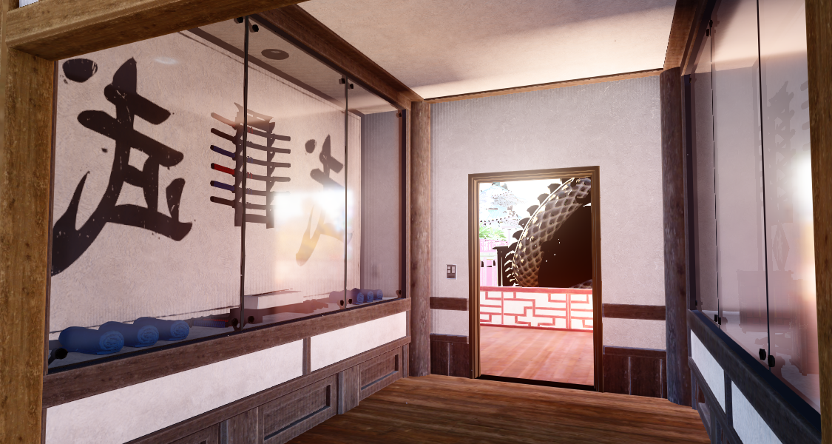
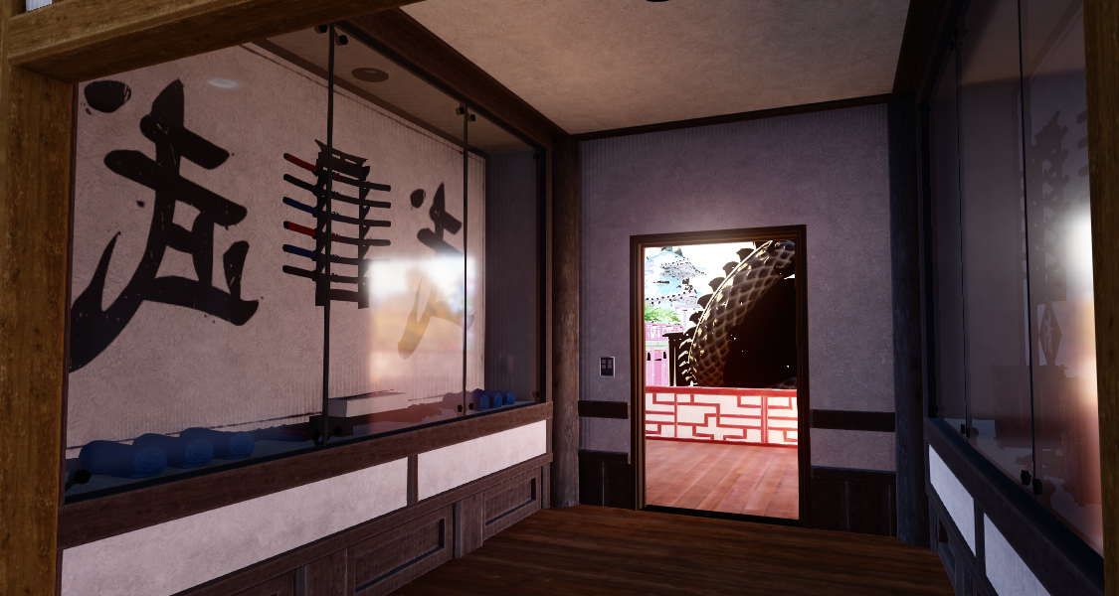
Light Leaking Is A Problem
Notes:
The big thing we’re missing with this format is any way to deal with light leaking. In this image you can see that light is leaking through the wall around the door, causing the wall to glow and bright splotches on the ceiling. This is caused by voxels on the outside of the wall blending with voxels on the inside and carrying light through the wall that shouldn’t be there.

Slide 31
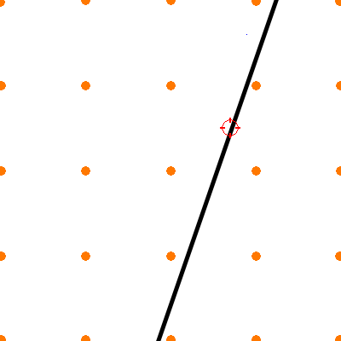
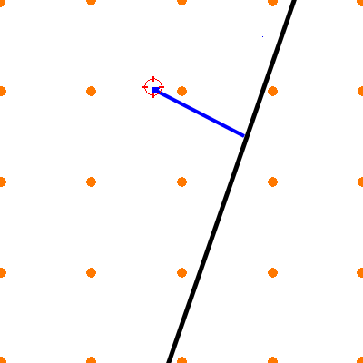
Common Approach
Adjust trilinear
Based on normal
^{[SILVENNOINEN15]}
Our approach needs
to be more reliable
Notes:
A common approach that has been suggested in the past, including at a talk by Silvennoinen at Remedy in this course last year, is to adjust sample positions to prevent filtering based on surface normals or other clues. We tried a similar approach, where the normal adjusted the lookup coordinate in the volume texture. The problem is, surfaces near outside walls that are facing outward can still pick up outdoor lighting. This might seem acceptable, but in our case since we’re propagating multiple bounces, this outdoor light can bounce off of the details inside the room onto the wall and then spread throughout the room. So what it comes down to is our lighting has to be 100% leak-proof. And it would also be nice to avoid additional shader logic around samples or manual filtering.

Slide 32
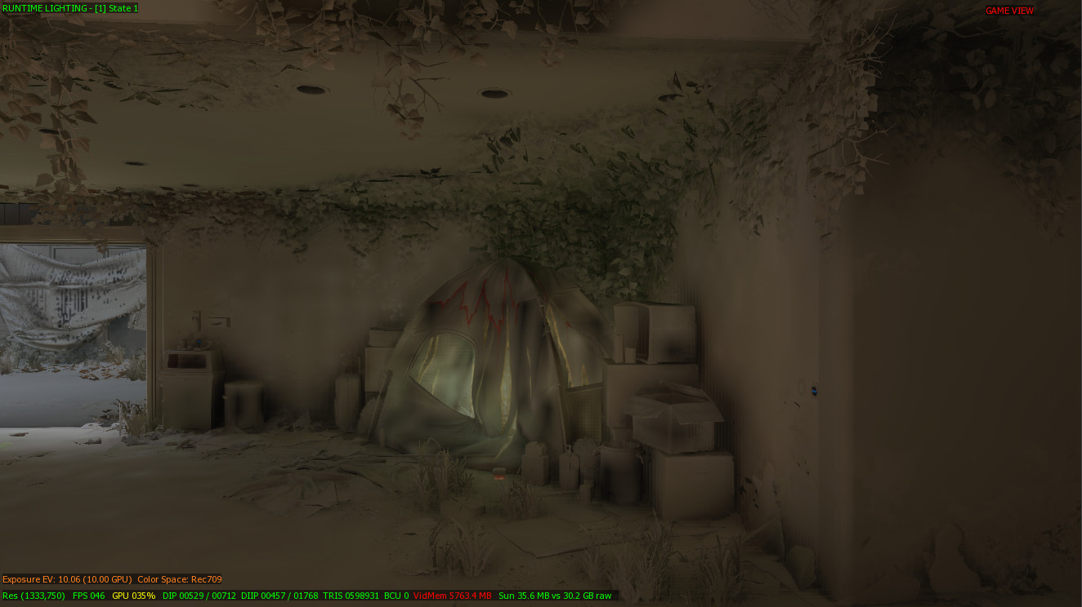
More Voxel Data
Planes
Signed
distance field
Bad artifacts
Notes:
We also tried encoding dividing planes at each voxel. In implementing this we realized that if we wanted to maintain our use of built-in trilinear filtering, then using a signed distance field is the same as using planes to define a smooth surface. So we tried both of these. However what we found is that occasionally when there’s a detail on the wall or in the corner the determination of exactly where to place the plane could be slightly off. The result was unsightly black splotches on the wall or among details.

Slide 33
Solve With Shaping
Notes:
So we finally came up with our solution.
Let the lighting artists fix it. We let them place the volume edges precisely in the world, and thereby the job of defining the correct planes falls to them.

Slide 34
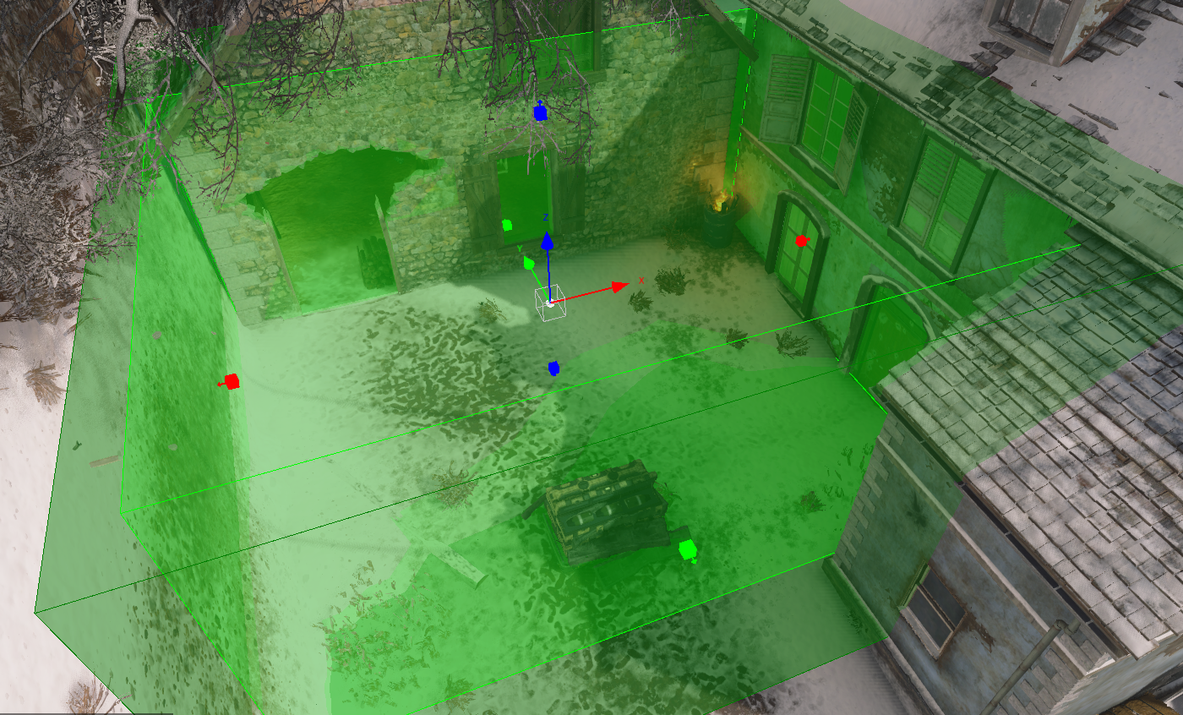
Click To Size Boxes
Notes:
We started by letting them place boxes and providing them the tools to snap these to world geometry easily. These boxes define a clip shape for the GI volumes. Each face of the box gets a feather distance that attenuates the GI, which is why we call them attenuation volumes.

Slide 35
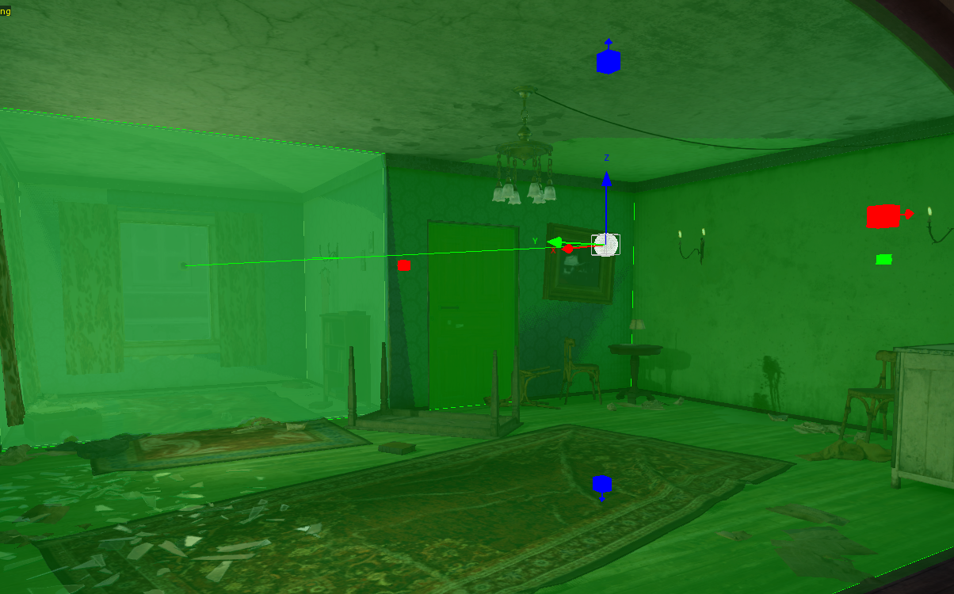
Click To Add Boxes
Auto-parent
on creation
Notes:
We extended this to unions of boxes to create more complex attenuation shapes.

Slide 36
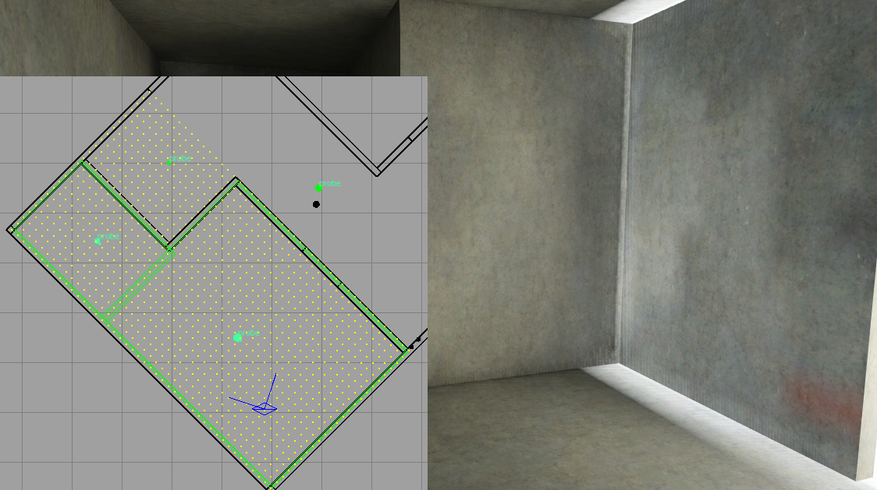
Voxels Near Walls
Notes:
There is a small problem where our volume texture is still a box, so we have to avoid pulling data from voxels that are outside the attenuation shape.

Slide 37
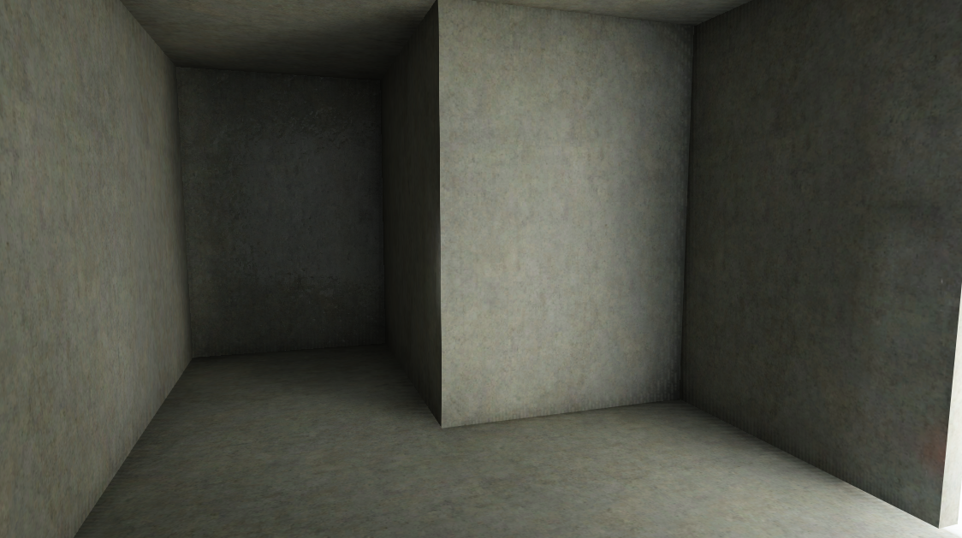
Consider Backfaces
Notes:
We solved this by simply ignoring voxels outside the shape at bake time, and pulling over the color from valid voxels instead. At runtime no special processing is required. We also used backfaces to recognize invalid voxels, as well as dummy geometry that is present in our levels called “caulk” which should never be visible from the play space. If a voxel sees a backface or caulk, skip it.

Slide 38
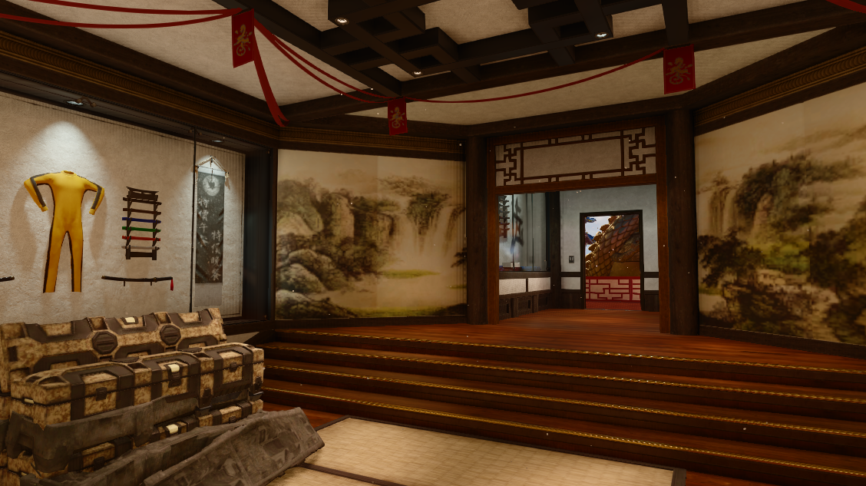
Complex Room Shapes
Notes:
Then we end up with complicated rooms like this one that are hard to fill with boxes.

Slide 39
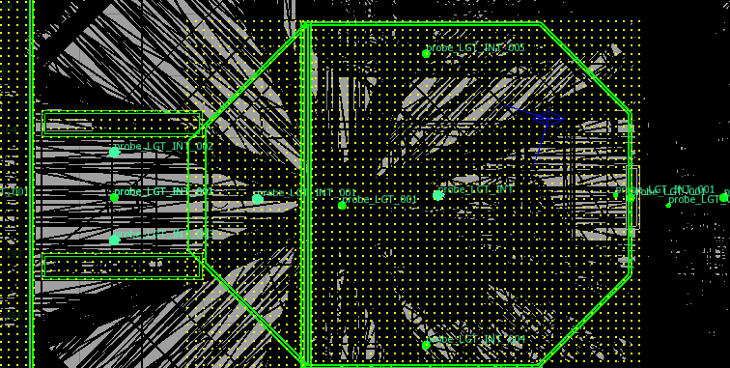
Solution: Convex Shapes
Notes:
So we added support for multi-sided convex attenuation shapes.

Slide 40
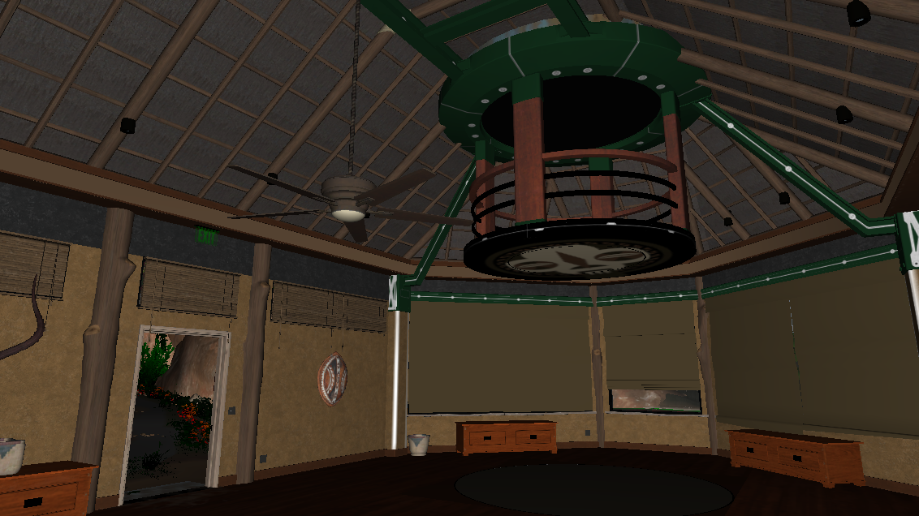
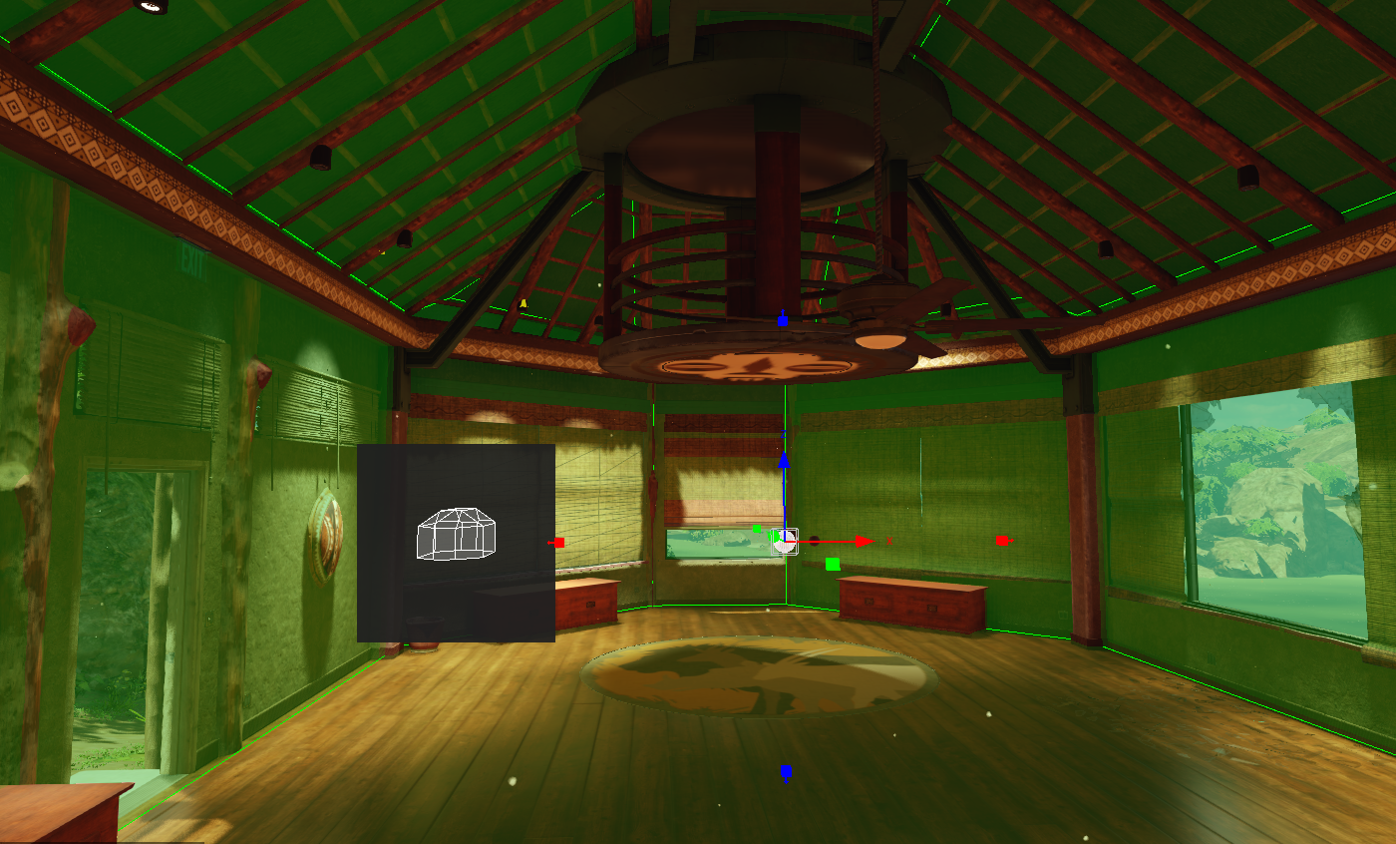
Multiface Volumes
Click to add and remove faces.
Notes:
The trick is providing artists with tools to build these complex shapes that don’t suck. Simply modelling these shapes from scratch to match pre-existing geometry would be painful.
So we gave them a simple interface where they can construct a shape just by clicking walls to add and remove faces. Then they can push and pull faces from the inside or out. The little minimap in the lower-left corner helps them visualize their work. This room is easily matched with a volume in under a minute.

Slide 41
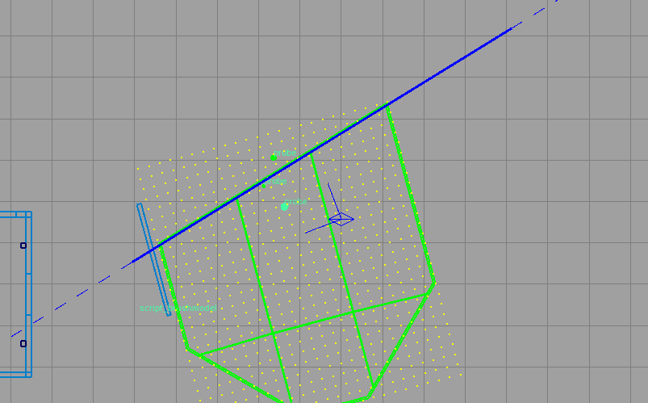
Multiface Volume Editing
Drag / Cut / Slice / Rotate
Notes:
Obviously we’ve given plenty of tools for dealing with these in 2D and 3D including dragging and rotating faces, slicing shapes, and splitting them.

Slide 42
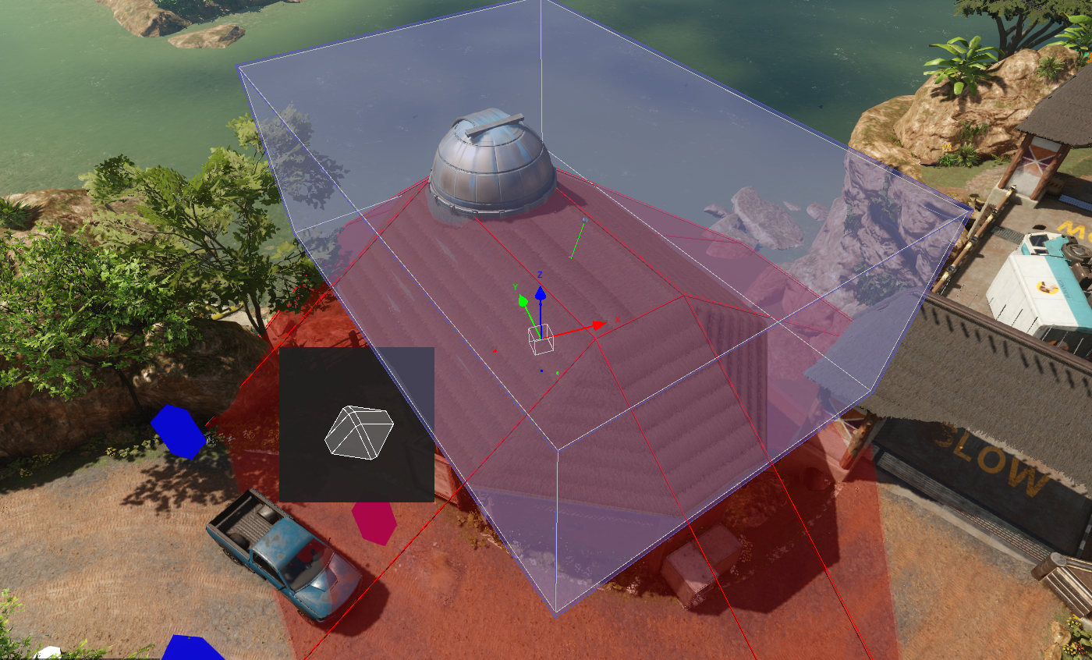
Subtract Shapes
CSG add
Then subtract
Notes:
These convex shapes of course can be unioned together just like the boxes. And to further extend it we added the ability to flag shapes as “subtracting.” In this picture the red shape is subtracting a chunk out of the bottom of the box. This allows simple CSG operations. There isn’t a hierarchy of operations, just unions then subtracts, for shader and tool simplicity. But it’s plenty powerful.

Slide 43
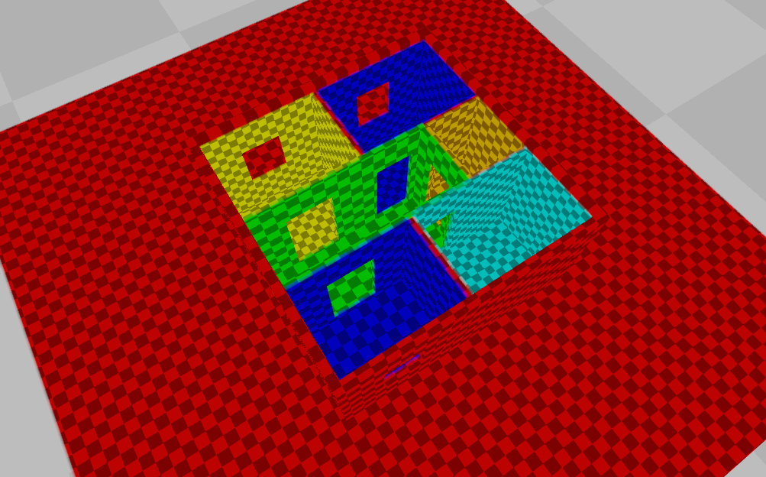
Override Volumes
Like priority
Only two levels.
Notes:
And one final trick is to flag some volumes as “override” volumes. It’s like a volume priority, but with only two priorities, again for simplicity. In this case there’s a large outside probe in red overlapping the building, and all the interior probes are flagged to override it.

Slide 44
Runtime Implementation
Cull against volume AABB’s to build a list of volumes
Per pixel calculate attenuation on visible volumes
  Convex hull CSG
  Groups of six planes either extended, combined or subtracted
Notes:
So here’s how it works when we go to render with these. We cull against the bounding boxes of the volumes on the CPU to decide which ones to shade.
Then for each pixel we calculate the contribution of the probe based on its attenuation volume.
We group the planes into blocks of six which define shapes to either extend the previous group, combine with the groups so far, or subtract from the groups so far.
Here’s an example.

Slide 45
Example GI Volume
struct PlaneGroup
{
float4 planes[6]; // Groups of six planes.
bool subtractive; // Per group, specifies whether it adds or subtracts.
bool finished; // Per group, whether it should be combined with the previous.
}
struct GIvolume
{
PlaneGroup *groups;
}
// Blends, or “feather”, are pre-multiplied into the plane definition.
planes[i].xyz = planeNormal;
planes[i].w = planeOffset;
planes[i] /= blendWidth; // Blend width is a scalar for how wide the blend is.
Notes:
This is how a given volume’s attenuation shape might be defined in code. There are a variable number of groups of six planes.
Each group is flagged to extend, combine, or subtract from what has come before.
A nice optimization of this data format is the feather at the edges of the volume can be pre-multiplied into the plane definitions, so there’s no extra math necessary to calculate the feather other than a “saturate” in the shader.

Slide 46
Group Size?
[6]+[6+6+…?
[6]+[4+4+...?
[4]+[4+4+…?
[8]+[2+2+…?
Notes:
Of course some shapes won’t have a multiple of six planes, so there will be dummy planes in there that don’t affect the shape. We do this just to avoid extra branching in the shader.
We chose six rather arbitrarily, because many volumes are still boxes and will have exactly six. We could have done any number, or even had a mandatory first group that’s a different size than the rest. The actual data stored in the level will define what’s best here.

Slide 47
Shader Example
attenuation = 0;
groupAtten = 1;
for ( int group = 0; group < numGroups; group++)
{
groupAtten *= saturate( dot( planes[group][0].xyz, pos ) + planes[group][0].w );
groupAtten *= saturate( dot( planes[group][1].xyz, pos ) + planes[group][1].w );
groupAtten *= saturate( dot( planes[group][2].xyz, pos ) + planes[group][2].w );
groupAtten *= saturate( dot( planes[group][3].xyz, pos ) + planes[group][3].w );
groupAtten *= saturate( dot( planes[group][4].xyz, pos ) + planes[group][4].w );
groupAtten *= saturate( dot( planes[group][5].xyz, pos ) + planes[group][5].w );
if( finished[group] )
{
if( subtractive[group] )
attenuation = max( attenuation, groupAtten );
else
attenuation *= 1.0f - groupAtten;
groupAtten = 1;
}
}
return saturate( attenuation );
Notes:
And here is potential shader code for evaluating the groups of planes. The plane evaluations are inverted to save a little math, and all multiplied against each other. Groups flagged to extend will allow the code to just continue on to the next group. To combine with previous groups, the result of this group is inverted and multiplied against previous groups. To subtract, the “max” is taken.

Slide 48
Why Not K-DOPs?
X
KDOP – k-sided Discrete Oriented Polytope
Pairs of planes or slabs
Instead of individual planes
Notes:
At this point you might be asking yourself why we didn’t use KDOPs, which are the same as convex hulls except that they’re specified as pairs of parallel planes to save computation when the planes happen to be parallel. The answer is, we didn’t want to restrict the authoring to parallel planes, because accuracy in the attenuation was paramount. So we let the artists use the tool without any hint of restriction, then just adjusted the data and shader after the fact to see if KDOPs would be an optimization. In most cases they were a very minor one, but in some they were far more expensive, so we didn’t use them.

Slide 49
Runtime Implementation
Sample three ambient cube values depending on normal
Blend results between all volumes
Notes:
Once the attenuation is calculated, the color is sampled as described earlier, and the colors for all contributing probes are blended together based on their attenuation.

Slide 50
Challenges
Notes:
So now that you have the whole picture, I still need to mention some challenges we had to overcome to make this approach a success.

Slide 51
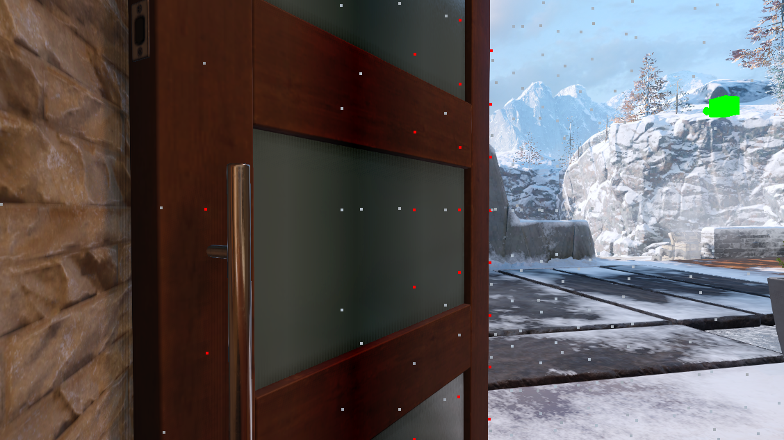
Problem: Geo Within Voxels
Notes:
The first is the problem of voxels that fall within geometry that lies inside of a volume. In this example there are several points that have landed inside of or right next to the door model, resulting in odd stripes on the door.

Slide 52
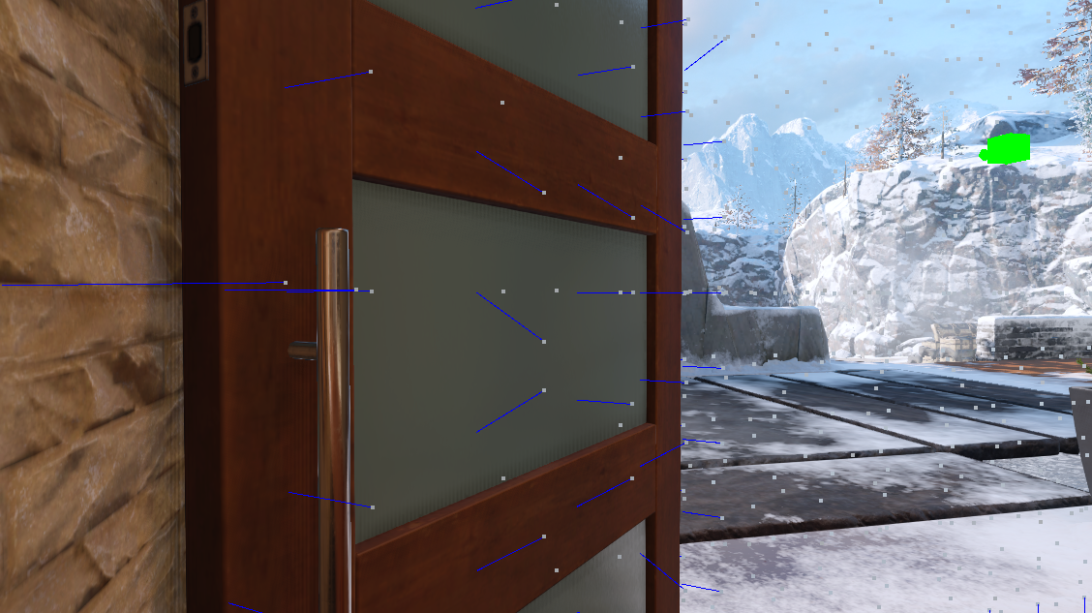
Solution: Smart Centers
Notes:
Our first attempt to solve this was to push sample points for all voxels out away from geometry in the scene before sampling. This happens to solve the issue in this case and goes a long way. But there’s still a potential issue of light leaking from one side to the other of these smaller details. Our attenuation volumes solve leaking on the macro scale, but it would be unreasonable to place new volumes in all of these cases.

Slide 53
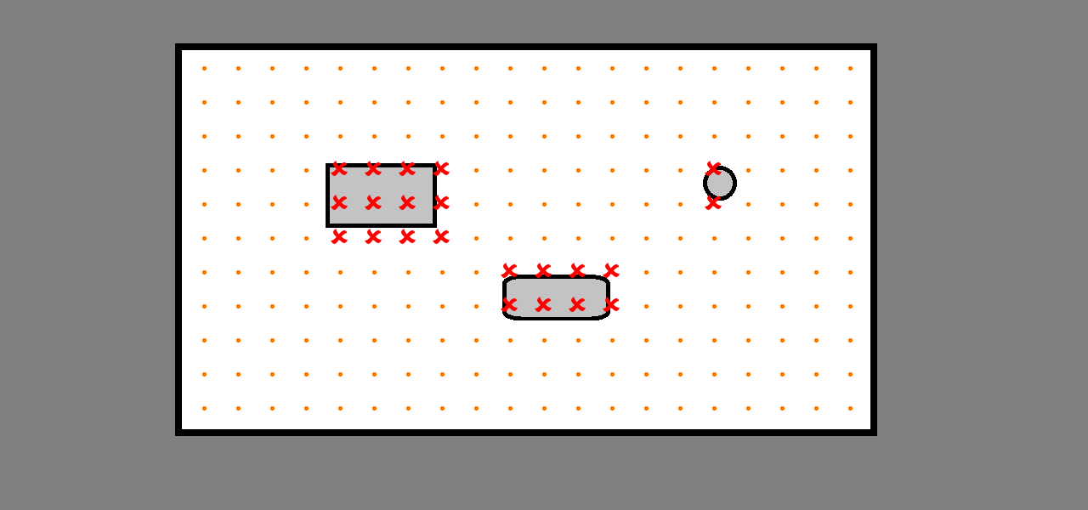
Invalidate Near Geometry
Notes:
The ultimate solution was to not even calculate the samples that lie near geometry. We have an in-painting pass that runs through and fills in color gradients across all the skipped voxels. The allows a nice smooth blend from the light side to the dark side of an object and prevents splotchy artifacts.

Slide 54
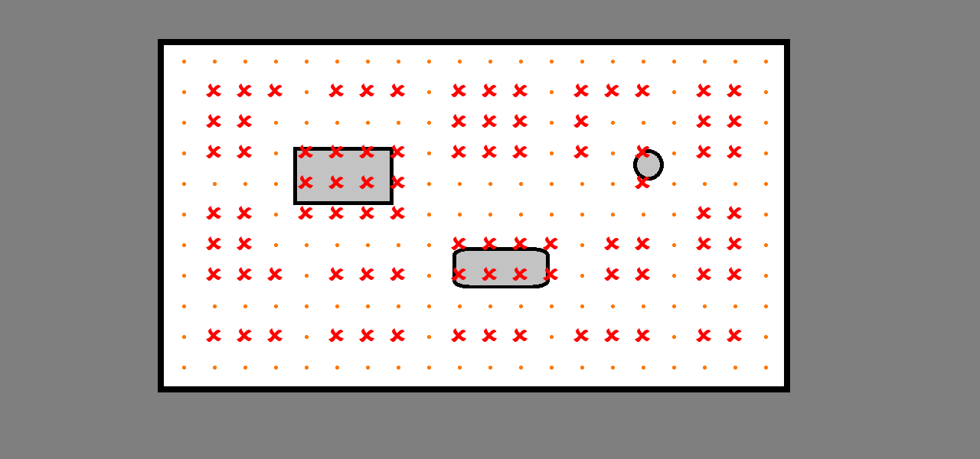
Empty Space Skip
Notes:
This brings up another optimization we made. Other approaches to irradiance volumes, including the one mentioned earlier from Remedy, make use of a sparse octree or other sparse data structure to reduce the amount of data processed in low detail areas, such as the open space in the middle of a room. We didn’t do this because we were enjoying the performance benefits of very simple sampling in the shader, and because we can easily afford the extra texture memory on modern hardware. But we did like the idea of saving bake time by not processing these. So we simply skip some of them when baking and let the in-painting process fill them in, doing just the corner of every three-cube. So we bake as little as 1/27th of the voxels in open space. This saves bake time, but does not affect performance or memory at runtime.

Slide 55

Problem: Seams
Notes:
The next problem we ran into was visible lighting seams between the volumes. This was reduced somewhat by using color data from neighbor probes, so at least the voxels on either side of the seam have the same visibility data. But this can still happen in some situations, and even the difference in voxel distribution can cause a perceived seam.

Slide 56

Solution: Volume Smoothing
Notes:
We tried implementing a feature which automatically smooths color gradients across these seems, using gradient domain reconstruction. It’s a harder task that you might think to identify which voxels to smooth, since smoothing through walls is exactly what you DON’T want. Once we got it working we found it often interferes with the look of the scene. So it’s available to the lighting artists when they want it, but they often solve the problem in other ways.

Slide 57

Careful Lighting Artistry
Notes:
The solutions are not only simple, but often occur as part of natural level design. Material changes, detailed textures, nearby bright lights, and door trim can all help hide subtle seems that might otherwise stand out in an unrealistic test level.

Slide 58

Auto Volumes?
“Do-Everything Button”
Notes:
The most obvious problem with this approach is it takes work to fill out a level with probes and volumes. Of course we’ve given the artists as many tools as we can think of to do this accurately, but we’re experimenting with even more. We have an “Auto-Volume” tool. Point at the middle of a floor and it fires and bunch of rays and stuff and sets up the volume for you automatically. It works perfectly in many cases, suck as the example above. If we could get it to work everywhere, we wouldn’t need to hand-place volumes at all. I don’t think we’ll get it to that point, but if it works 80% of the time, that’s a big time savings.

Slide 59


Debug Tools
Volume Blending And Density
Volume Overdraw Per Tile
Notes:
We’re also provided a suite of debugging tools to help the artists understand what’s happening. Such as the ones below that show voxel density and culling overlap.
Probe blends
Probe density
Probe overdraw
Static probe view
Voxel visibility view
Probe points color coding (yellow = inpainted, red = invalid)
Probe counts
Probe geometry tracking
Probe report
Voxel debugging
Lighting influence

Slide 60

Reflections
Notes:
One thing I haven’t touched on yet is reflections. Many other volumetric techniques suggest encoding reflection probe visibility into the irradiance volume data. But we found that reflection leaking can cause just as severe artifacts as diffuse bounce leaking. Luckily we already have a solution for that. And because of the way our pipeline originally worked, our irradiance volumes were already tied to specific reflection probes. Although the bounce GI data no longer comes from a single probe for any given volume, we retained the association so that reflections from that one probe would only apply within that volume.

Slide 61

Reflection Planes
[LAGARDE12]
Notes:
Our reflection cubemaps are then parallaxed against arbitrary planes to fit the space correctly. Since many volumes are already matched to the walls around them, the reflection planes can just be assumed to be the edges of the volume and no further work by lighting artists is required. In cases where they don’t look correct, the reflection planes can be manually specified, shown here by the colored lines.

Slide 62

Clever Artistry
Notes:
Of course artists are always here to help use cover the artifacts. In this example an artist has adjust the reflection plane to an arbitrary location to help the incorrect reflection line up with the objects in the scene based on his knowledge of where the player will be standing.

Slide 63
Reflection Plane Parallax
float reflectionMip = ( 1 – gloss ) * numMips;
// as things get rougher “fade off” parallax correction
// by pushing out intersection planes
float minDist = saturate( ( reflectionMip – 2.5 ) / ( numMips – 2.5 ) ) * 100;
distanceToPlane = max( abs( distanceToPlane ), minDist );
float intersectionDist = abs( distanceToPlane / -dot( direction, plane.xyz ) );
Notes:
We had to make some modifications to the basic implementation to improve quality in certain situations. In this hypothetical code snippet, we start by calculating the mip in the cube map that represents the gloss of the surface we’re lighting. Then we use that calculation to fade out the parallax correction at lower gloss levels.

Slide 64

Parallax Fade Out
Notes:
The reason we need to do this is the parallax correction can cause changes in the tightness of the details visible in the reflection map. For example, in this image, the voxel right next to the cube map sees light coming from an appropriate range of angles given it’s gloss value. But the voxel further away would see a tighter portion of the cube map if the reflections were parallaxed. This is of course correct for a reflective surface, but for low-gloss surfaces it causes the perception of more detail in the specular, and therefor makes the surface look more reflective than it should.

Slide 65

Reflection Brightness Correction
[LAZAROV13]
Notes:
Then we brightness correct the reflection based on the GI sample to make it look more correct. This is all to make reflections that are very bright not show up in very dark areas where they’re likely occluded and we just don’t have sufficient parallax proxy information to capture the occlusion. This is better than simply multiplying the reflection by the sampled luminance. In the image here, a simple multiplication is present, but there are still very bright reflections on the left side rock wall, making it appear shiny and out of place, when in fact the reflections should be occluded.

Slide 66

Reflection Brightness Correction
Notes:
Here the better math is used and the specularity fits the scene much more believably.

Slide 67
Brightness Correction
float maximumSpecValue = max3( 1.26816,
9.13681 * exp2( 6.85741 - 2 * mip ) * nDotV,
9.70809 * exp2( 7.085 - mip - 0.403181 * mip²) * nDotV );
Max specular brightness is just a guess based on angle and gloss
The light mostly probably came from a certain direction and area
This defines a cone of a certain size
Actual numbers determined experimentally
We know the diffuse light is a function of what’s in the specular map
Assume a maximum specular brightness that created this diffuse brightness
Adjust the sampled specular against the theoretical maximum
float adjustedMaxSpec = diffuseGILum * maximumSpecValue;
float3 specLum = luminance( cubeMapSample );
float3 reflection = cubeMapSample *
adjustedMaxSpec / ( adjustedMaxSpec + speculum );
Notes:
The code for this looks complex, but it’s simple in concept.
2. We know the diffuse light is a function of what’s in the specular map
Assume a maximum specular brightness that created this diffuse brightness
Adjust the sampled specular against the theoretical maximum
1. Max specular brightness is just a guess based on angle and gloss
The light mostly probably came from a certain direction and area
This defines a cone of a certain size
Actual numbers determined experimentally

Slide 68
Pros:
As good or better quality than light maps
Notes:
The advantages of this technique.
Always at least as good, or better, than light maps.
[ Our de facto volume resolution was one voxel per 8 inches cubed, but the artists had control over this and it could vary up or down. ]

Slide 69
Pros:
Less than 2ms for reflections and GI
Notes:
Adds less than 2ms to our deferred lighting shader in most cases for all GI related computation. This is not necessarily an accurate number, since the GI is part of our deferred shader which is complex and highly optimized, simply commenting out the code is not a fair test.
[ Our overall budget for the deferred shader was 4ms, which included tile-based classification, culling, reflections, GI, and lights. ]

Slide 70
Pros:
Works on all geometry
Notes:
It works, not only on all physical geometry, including moving meshes, but also on particles and volumetrics.

Slide 71
Pros:
Less baking time with incremental baking
Notes:
Bakes have gone down from around 8 hours for a shipping quality light bake to 1 or 2 hours at worst. But we can do a lower quality bake, that’s still good enough to verify lighting work, in just 5 or 10 minutes. And because the probes and volumes are discrete objects, artists can select to bake only the room or area they are working in and see the bounce lighting update in a few seconds.
[ Quality level affects how many rays are cast when accumulating voxel data, and nothing else. That means no major effect on brightness, runtime performance, or memory usage, only bake time and aliasing artifacts. ]

Slide 72
Pros:
Baking is done in editor
Notes:
All baking is done in-editor, where the lighting is done, and is rendered the same way it is rendered in game. This cuts the feedback and iteration loop for lighting artists down from hours to seconds.

Slide 73
Pros:
Moving and changing GI
Notes:
Again, because probes and volumes are discrete objects, we can do neat tricks with them. Like attaching them to moving objects, like when you have lighting for the inside of a train that you want to move with you. Or we can swap them out in chunks when the lighting environment changes, like when a wall is destroyed and light spills into the room.

Slide 74
Pros:
Loose connection between light and geo
Notes:
Lightmaps were tied closely to the geometry, since they relied on world UV’s. So as soon as a level was modified, lighting would go back to a broken state until it was rebuilt. But with GI volumes, builders can make modifications to levels and the lighting still looks reasonable without a light bake to hold them over until a lighting artist has a chance to revisit the level.

Slide 75
Cons:
Takes set up time
Notes:
In summary, the downsides are:
Setting up a level for the first time can take some time. Maybe two days for a large one, but at least this only has to be done once.

Slide 76
Cons:
Training is hard
Notes:
Artists have to be trained on the tools to work with volumes, which is something they likely don’t have experience with.

Slide 77
Cons:
Either lower resolution
or more memory use in game
Notes:
Volumes obviously contain more data than light maps, so you either need to use more memory or lower resolution and quality. We obvious chose to match or beat quality in all cases.
[ In the example given earlier, the GI volume data resulted in 50.5Mb of texture data, plus an additional 77Mb of reflection probe data. This represents a medium-sized amount of data relative to other maps. Some maps could reach up to 50% more data in individual chunks, but anything larger than that would stream as separate blocks of data. ]

Slide 78
Cons:
Need beefy dev machines
(48Gb RAM and 12Gb VRAM)
Notes:
You need a pretty impressive development machine if you’re going to be baking lighting all the time. Our lighting artists have 20-core machines with 48Gb of RAM and Titan X video cards. Otherwise you’ll be running out of memory and your bakes can take much longer. Of course, passing the bake off to a render farm is an option, but we keep them local most of the time so artists can iterate.

Slide 79
Cons:
Development challenges
Notes:
Custom solutions had to be made to fix speckling and leaking problems. While we’ve solved these, a different game might have different problems that need to be solved.

Slide 80
Special Thanks
Treyarch:
Dimitar Lazarov – Original Idea
Kevin Myers – Baking Code
Everyone Else at Treyarch
Activision Central Tech:
Peter-Pike Sloan – Lots of Math
Josiah Manson – Light Bake Features
Angelo Pesce – Reflection Solutions
Notes:
Special thanks to my co-developers.

Slide 81
References
^{[DROBOT13]} DROBOT, M., 2013. Lighting Killzone: Shadow Fall, Digital Dragons
^{[TATARCHUCK05]} TATARCHUK, N., 2005. Irradiance Volumes for Games, GDC Europe
^{[BUEHLER01]} BUEHLER, C., BOSSE, M., MCMILLAN, L., GORTLER, S., COHEN, M., 2001. Unstructured Lumigraph Rendering, SIGGRAPH
^{[MCTAGGART04]} MCTAGGART, G., 2004. Half-Life 2 / Valve Source Shading, Game Developers Conference
^{[SILVENNOINEN15]} SILVENNOINEN, A., TIMONEN, V., 2015. Multi-Scale Global Illumination in Quantum Break, SIGGRAPH
^{[LAGARDE12]} LAGARDE, S., ZANUTTINI, A., 2012. Local Image-based Lighting With Parallax-corrected Cubemaps, SIGGRAPH
^{[LAZAROV13]} LAZAROV, D., 2013. Getting More Physical in Call of Duty: Black Ops II, SIGGRAPH

