Slide 1
THE DEVIL IS IN THE DETAILS IDTECH 666
Tiago Sousa Lead Renderer Programmer
Jean Geffroy Senior Engine Programmer
Notes:
Hi everyone
I’m Tiago Sousa, Lead Renderer Programmer at id Software – and my (very French) colleague and co-speaker is Jean Geffroy, Senior Engine Programmer at id.
Lets begin !

Slide 2
Initial Requirements
Performance: 60hz @ 1080p
Speed up art workflow
Multi-platform scalability
KISS
Minimalistic code
No shader permutations insanity: ~100 shaders, ~350 pipe states
Next Gen Visuals
HDR, PBR
Dynamic and unified lighting, shadows and reflections
Good anti-aliasing and VFX
Notes:
In the latest id Tech iteration, there was a big amount of updates/changes. But, for today, our focus is Rendering of course.
For sake of time, we will focus on couple interesting topics, albeit there are many areas that were updated.
Our main goal, was from the start 60hz at 1080p across all platforms, all this while aiming at a high quality visual bar.
For this new iteration and given our relatively short development time, we had to pick our fights careful, has there was a substantial catchup todo, we tried as much as possible mitigate potential time consuming work – tl;dr keep it simple.
One thing I’m particularly happy, is that we have a fairly minimal amount of shaders due to careful design. About 100 unique shaders. Could actually be less if some tidy up.
Other very important goal was where could we help art doing their job, how to save their precious time and where could we speedup their workflow;

Slide 3
Anatomy of a Frame
Frame | Cost
Shadow Caching | ~3.0 ms
Pre-Z | ~0.5 ms
Opaque Forward Passes Prepare cluster data Textures composite, compute lighting Output: L-Buffer, thin G-Buffer, feedback UAV | ~6.5 ms
Deferred Passes Reflections, AO, fog, final composite | ~2.0 ms
Transparency Particles light caching, particles / VFX, glass | ~1.5 ms
Post-Process ( Async ) | ~2.5 ms
Notes:
At a high level a frame in DOOM looks something as this
We do a Hybrid approach, by using opaque passes and deferred for a nice quality / performance ratio.
Using Forward also has some auto-magic benefits for quality ( which we will talk soon ) and things like MSAA.
As you might have guessed, being Forward forces us to prepare all lighting and shading data ahead of time as much as possible.
. That means things like the data structure used to index into things like Light sources, are prepared ahead of time.
. Shadows are other obvious case. We do quite some work keeping costs down here, resorting to things like caching and smart composite to mitigate costs when update required.
For the deferred stage, we output the minimal data required for doing things like reflections, specular occlusion and so on.
I mention approximated times has times are always variable. For example posts can grow when DOF is enabled or some game related Post Process – albeit posts run in Async on consoles and Vulkan.
Or the usual Particles, where we can get cases with some heavy overdraw.

Slide 4
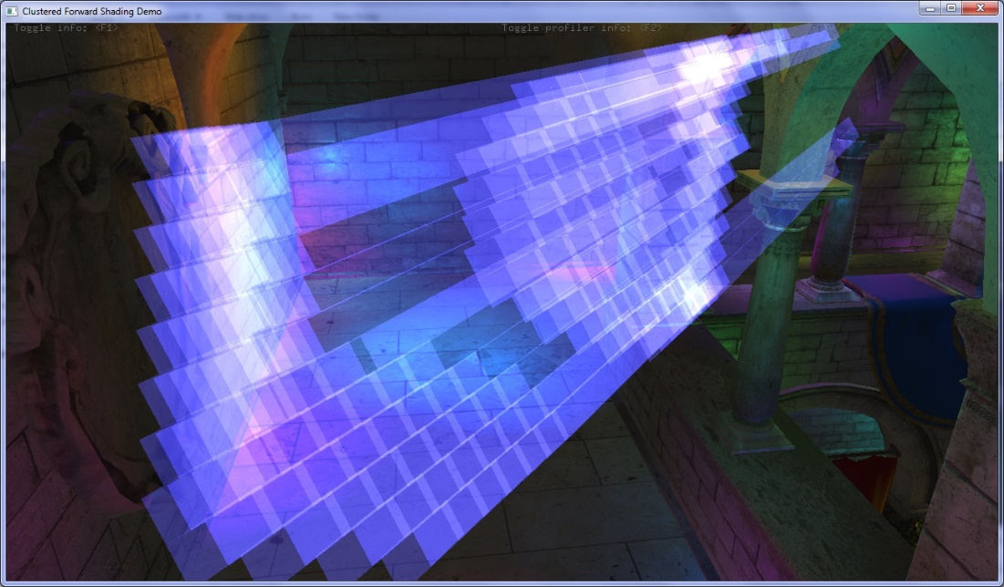
Data Structure for Lighting & Shading
A derivation from
“Clustered Deferred and Forward Shading” _{[Olson12]}
“Practical Clustered Shading” _{[Person13]}
Just works ™
Transparent surfaces
No need for extra passes or work
Independent from depth buffer
No false positives across depth discontinuities
More Just Works ™ in next slides
Olson12
Notes:
A derivation from
“Clustered Deferred and Forward Shading”, Ola Olson et Al.
“Practical Clustered Shading”, Emil Person
Just works ™
Works implicitly on transparent surfaces
Independent from depth buffer
No false positives along depth

Slide 5
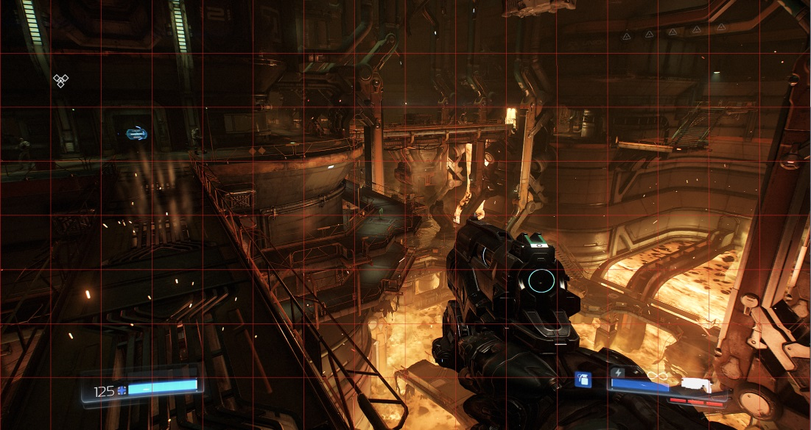
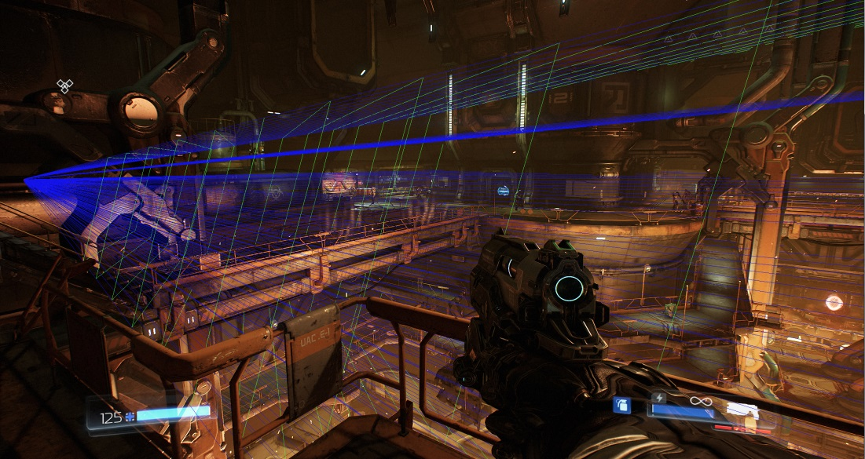
Preparing Clustered Structure
Frustum shaped voxelization / rasterization process
Done on CPU, 1 job per depth slice
Logarithmical depth distribution
Extended near plane and far plane
$ZSlice={Near}_{z}×{( \frac{{Far}_{z}}{{Near}_{z}})}^{\frac{slice}{num slices}}$
Voxelize each item
An item can be: light, environment probe or a decal
Item shape is: OBB or a frustum ( projector )
Rasterization bounded by screen space min_{xy} max_{xy} and
depth bounds

Slide 6
Preparing Clustered Structure
Refinement done in clip space
A cell in clip space is an AABB
N Planes vs cell AABB
OBB is 6 planes, frustum is 5 planes
Same code for all volumes
SIMD
//Pseudo-code - 1 job per depth slice ( if any item )
for ( y = MinY; y < MaxY; ++y ) {
for ( x = MinX; x < MaxX; ++x ) {
intersects = N planes vs cell AABB
if ( intersects ) {
Register item
}
}
}
Notes:
Important to mention: If volume intersecting view frustum, we perform frustum clipping, which increases number of planes

Slide 7
Preparing Clustered Structure
Structures
Offset list:
64 bits x Grid Dim X x Grid Dim Y x Grid Dim Z
Item list:
32 bits x 256 x Worst case ( Grid Dim X x Avg Grid Dim Y x Grid Dim Z )
Offset List, per element
Offset into item list, and light / decal / probe count
Item List, per element
12 bits: Index into light list
12 bits: Index into decal list
8 bits: Index into probe list
Grid resolution is fairly low res: 16 x 8 x 24
False positives: Early out mitigates + item list reads are uniform ( GCN )

Slide 8
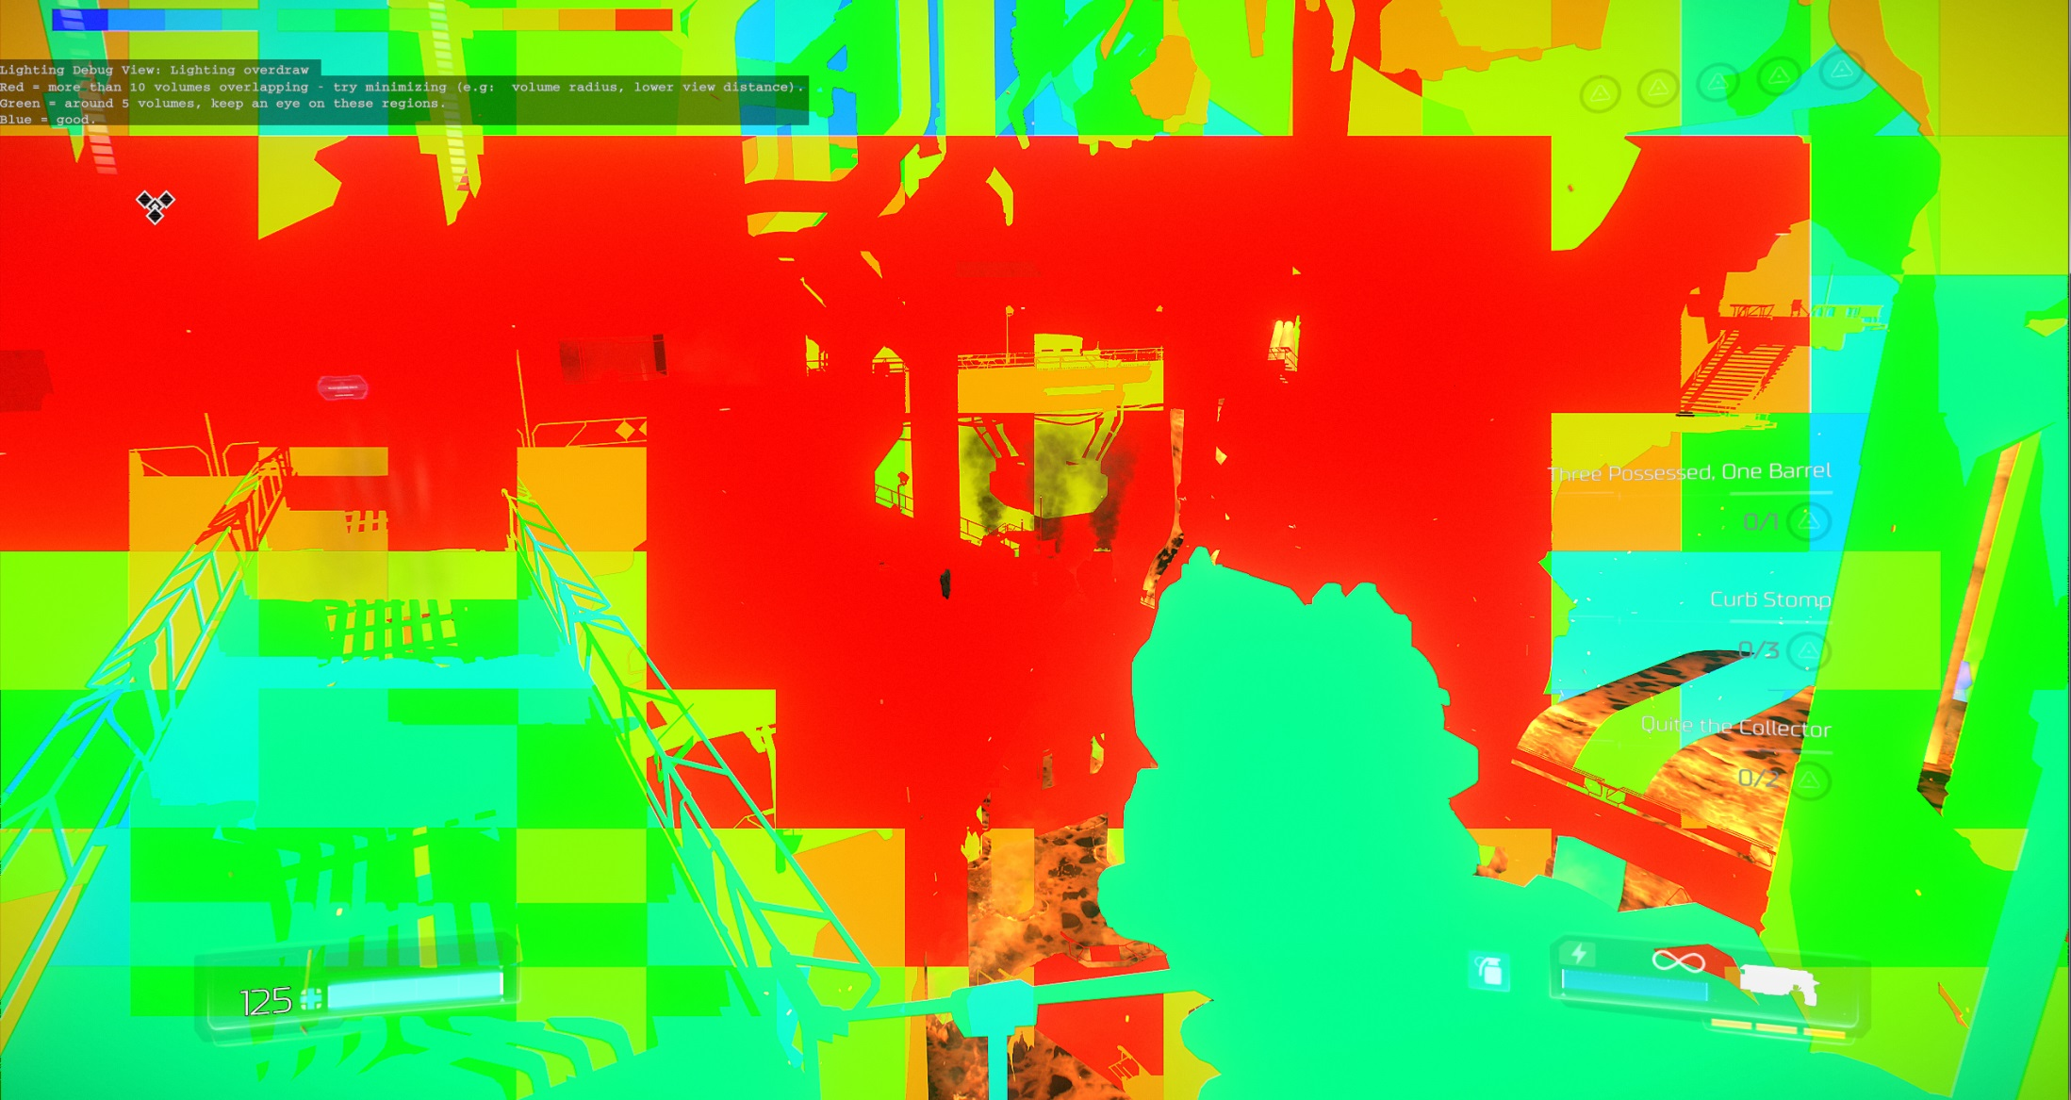
Preparing Clustered Structure
Hotspot:
~300 light sources
~1.2k decals
Notes:
Can be better / improved – perf was quite ok already, ship it

Slide 9
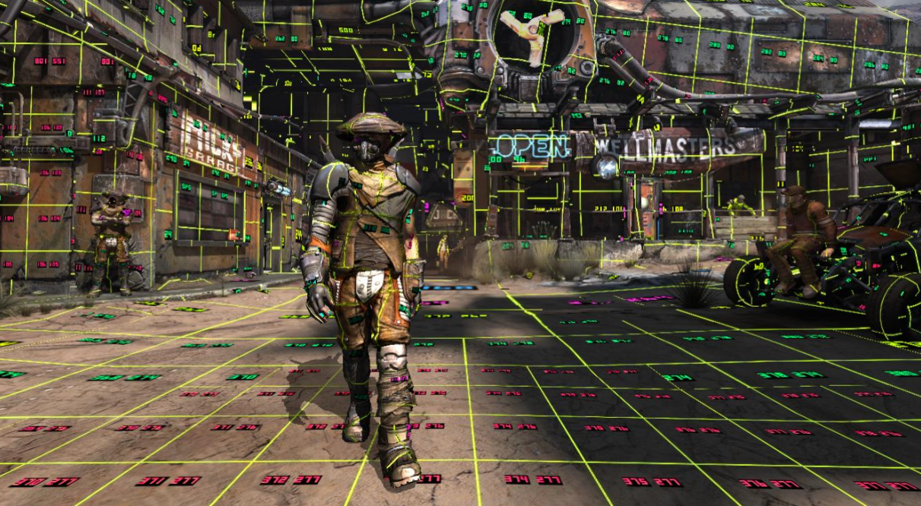
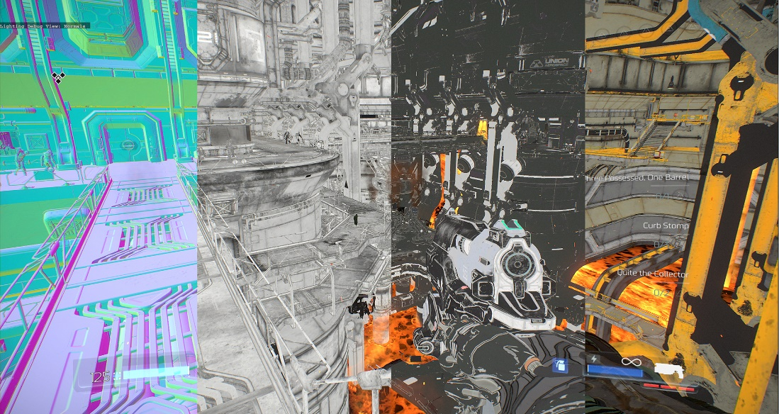
Detailing the World
Virtual-Texturing_{[10]} updates
Albedo, Specular, Smoothness, Normals, HDR Lightmap
HW sRGB support
Baked Toksvig_{[11,12,13,14]} into smoothness for specular anti-aliasing
Feedback buffer UAV output directly to final resolution
Async compute transcoding
Cost mostly irrelevant
Design flaws still present
E.g. Reactive texture streaming = texture popping
Notes:
Mega-Texture was still used in this project, some relevant updates
Albedo, Specular, Smoothness, Normals, HDR Lightmap
Allows dynamic lighting
Fairly packed, BC3 page files ( an atlas )
HW sRGB support
Improved mipmap generation
Baked Toksvig into smoothness for specular anti-aliasing
Feedback buffer UAV output directly to final resolution
Async compute transcoding
Old CPU transcoding ran slow on new consoles
Cost is now mostly irrelevant
Old design troubles still present
Overall, low texture quality
Reactive texture streaming = texture popping
Opaque geometry only
Page borders artefacts, low quality filtering, etc
Extra costs due to dependent lookups
HDPhoto / BC compression artefacts

Slide 10
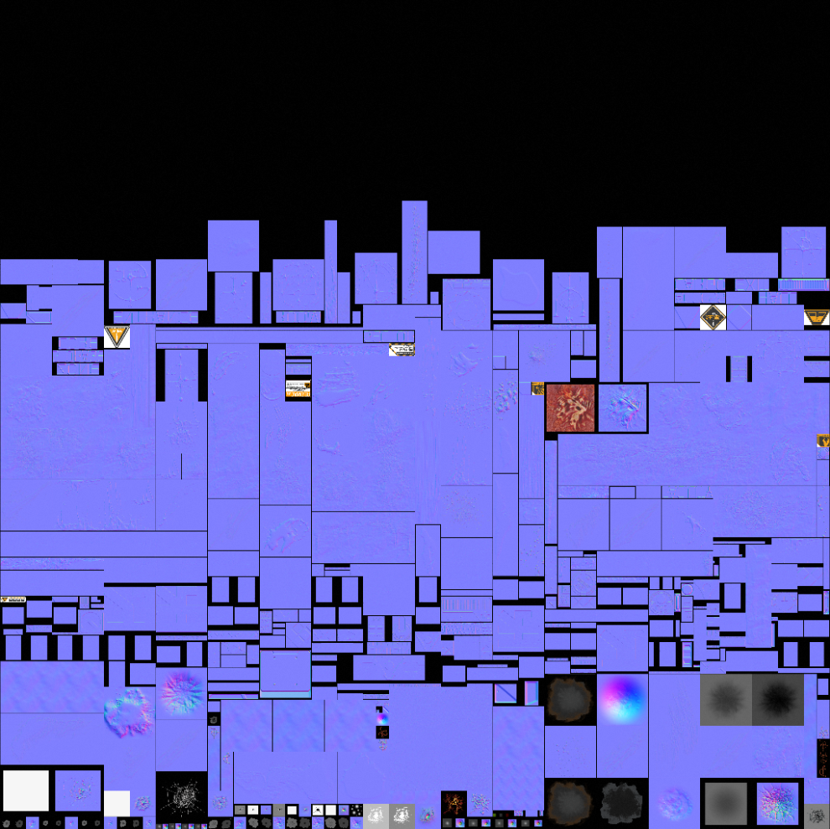
Detailing the World
Decals embedded with geometry rasterization
Realtime replacement to Mega-Texture “Stamping”
Faster workflow / Less disk storage
Just Works ™
Normal map blending
Linear correct blending for all channels
Mipmapping / Anisotropy *
Transparency
Sorting
0 drawcalls
8k x 8k decal atlas
BC7
Decal Atlas
Notes:
Who here ever implemented deferred/geometry decals ? Raise your hands…
How fun was it dealing with all the trouble cases ?
*Have to compute your own derivatives, but just works across geometry edges and depth discontinuities

Slide 11
Detailing the World
Box Projected
$e0$ , $e1$, e₂ is OBB normalized extents, p is position
Indexing into decal atlas
Per decal: Scale & bias parameter. E.g.
M_{decalProj}= M_{scale} $∙$ M_{decal}⁻¹
M_{scale}=$\left|\begin{matrix}\frac{0.5}{sizeX} & 0 & 0 & 0.5 \\ 0 & \frac{0.5}{sizeY} & 0 & 0.5 \\ 0 & 0 & \frac{0.5}{sizeZ} & 0.5 \\ 0 & 0 & 0 & 1\end{matrix}\right|$
$e$₂
$e$₁
M_{decal} =$\left|\begin{matrix}e0x & e1x & \text{e}2x & \text{p}x \\ e0y & e1y & \text{e}2y & \text{p}y \\ e0z & e1z & \text{e}2z & \text{p}z \\ 0 & 0 & 0 & 1\end{matrix}\right|$
p
$e$₀
const float4 albedo = tex2Dgrad( decalsAtlas, uv.xy * scaleBias.xy + scaleBias.zw, uvDDX, uvDDY );
Notes:
Some math recap
Relevant to mention: we don’t concatenate scale and bias into matrix, as we rely on normalized uv coordinates for fragment clipping

Slide 12
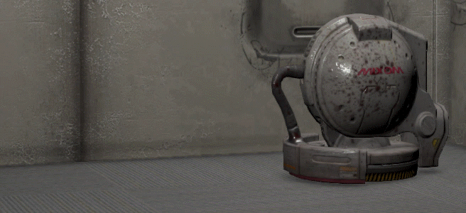
Detailing the World
Manually placed by artists
Including blending setup
A generalization for “Blend Layers”
Limited to 4k per view frustum
Generally 1k or less visible
Lodding
Art setups max view distance
Player quality settings affect view distance as well
Works on dynamic non-deformable geometry
Apply object transformation to decal
Notes:
Limited to 4k per view frustum
Lodding
Art setups max view distance
Quality settings affect view distance as well
Works on non-deformable geometry
Apply object transformation to decal

Slide 13
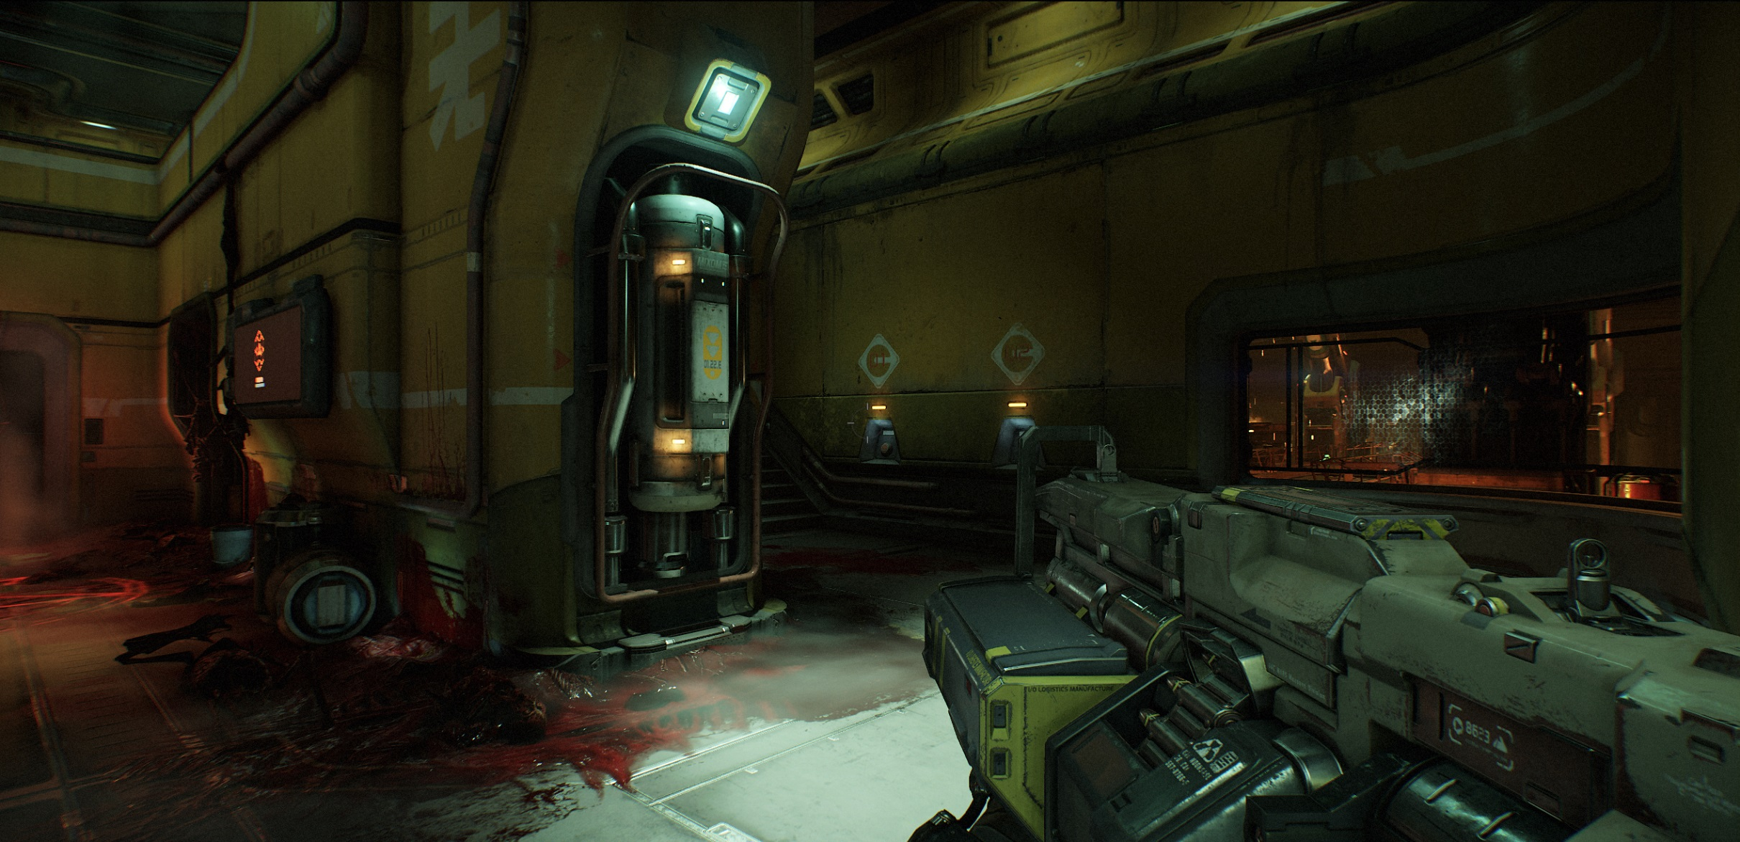
Detailing the World
Notes:
Some results

Slide 14
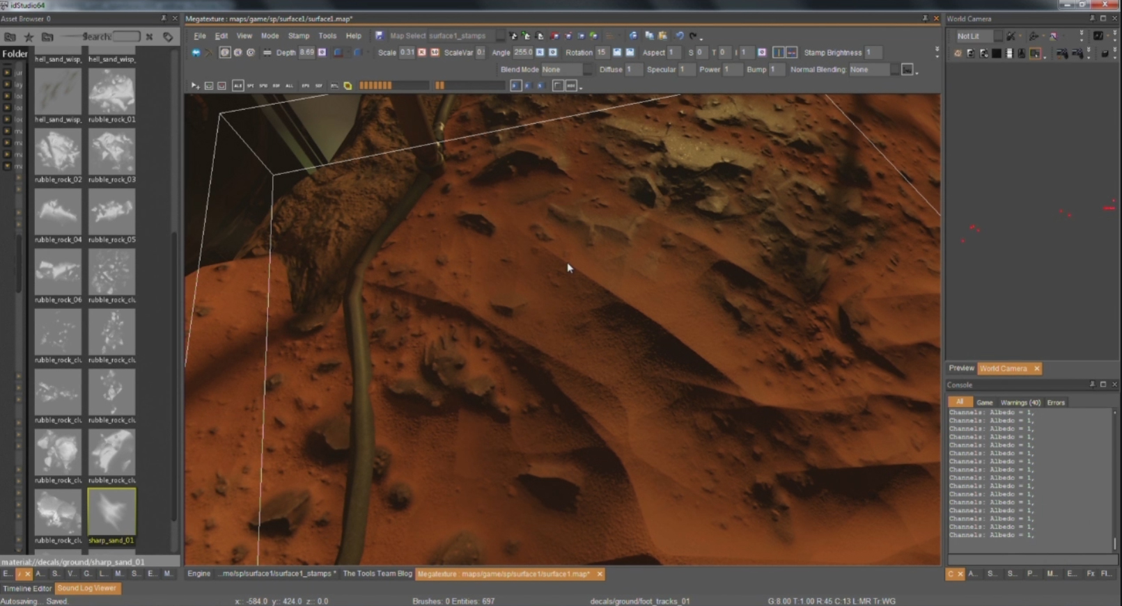
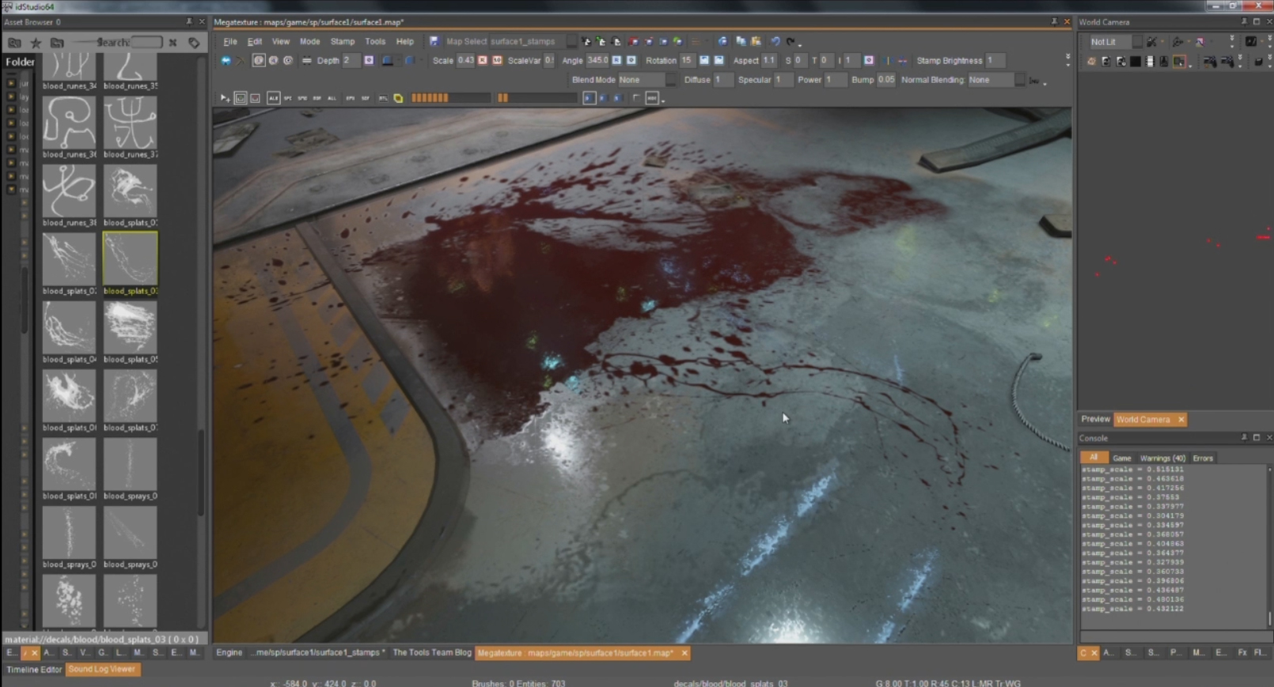
Detailing the World
Notes:
Some results – this type of details are usually approximated in a relatively brute force way with multiple layers (per drawcall), on our case the cost is proportional to screen coverage

Slide 15
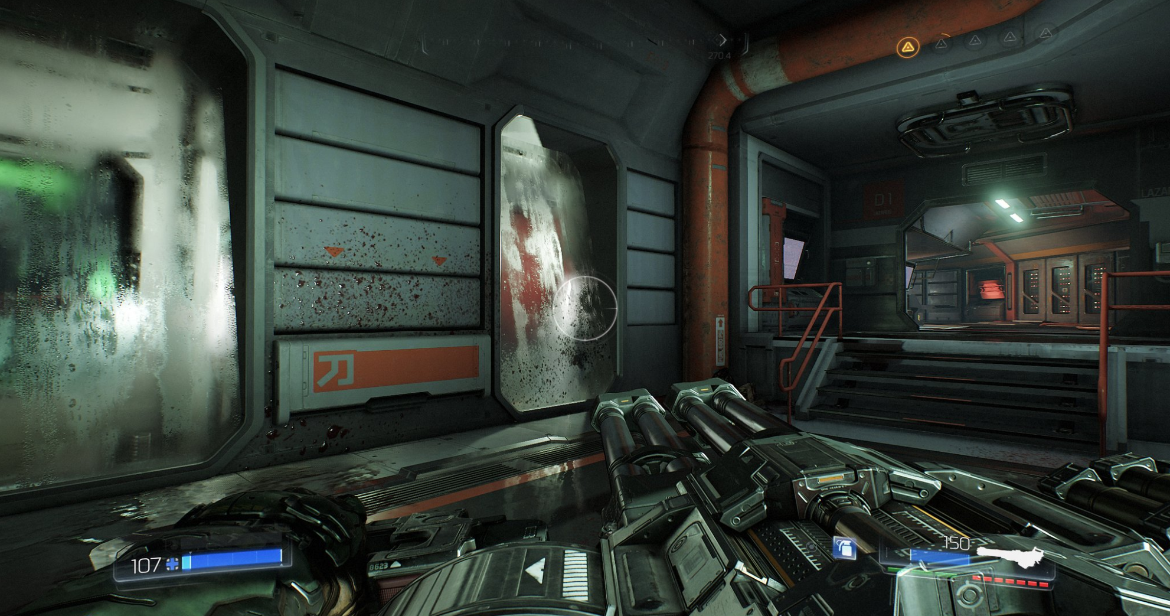
Detailing the World
Notes:
Glass is another good example: the haze / condensation / blood – is all decaling modifying surface properties.

Slide 16
Lighting
Single / unified lighting code path
For opaque passes, deferred, transparents and decoupled particle lighting ( slides 23-27 )
No shader permutations insanity
Static / coherent branching is pretty good this days – use it !
Same shader for all static geometry
Less context switches
Components
Diffuse indirect lighting: Lightmap for static geometry, irradiance volumes for dynamics
Specular indirect lighting: Reflections ( environment probes, SSR, specular occlusion )
Dynamic: Lights & shadows

Slide 17
Lighting
//Pseudocode
ComputeLighting( inputs, outputs ) {
Read & Pack base textures
for each decal in cell {
early out fragment check
Read textures
Blend results
}
for each light in cell {
early out fragment check
Compute BRDF / Apply Shadows
Accumulate lighting
}
}

Slide 18
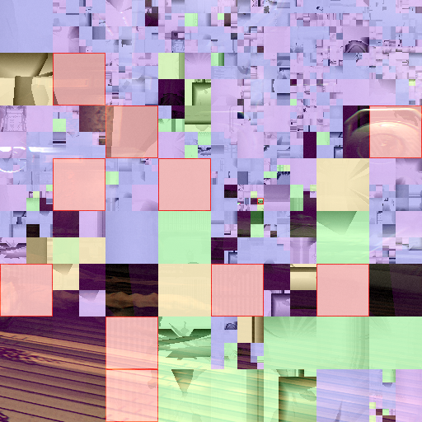
Lighting
Shadows are cached / packed into an Atlas
PC: 8k x 8k atlas ( high spec ), 32 bit
Consoles: 8k x 4k, 16 bit
Variable resolution based on distance
Time slicing also based on distance
Optimized mesh for static geometry
Light doesn’t move?
Cache static geometry shadow map
No updates inside frustum ? Ship it
Update? Composite dynamic geometry with cached result
Can still animate ( e.g. flicker )
Art setup / Quality settings affect all above
Shadow Atlas
Notes:
Shadows are cached ahead of time into an Atlas
PC: 8k x 8k atlas ( high spec ), 32 bit
Consoles: 8k x 4k, 16 bit
Variable resolution based on distance
Time slicing also based on distance
Optimized mesh for static geometry
Light mostly static ?
Cache static geometry shadow map
No updates ? Ship it
Updates ? Composite dynamic geometry with cached result
Art setup and quality settings affects all
Resolution, time sliccing, etc

Slide 19
Lighting
Index into shadow frustum projection matrix
Same PCF lookup code for all light types
Less VGPR pressure
This includes directional lights cascades
Dither used between cascades
Single cascade lookup
Attempted VSM and derivatives
All with several artefacts
Conceptually has good potential for Forward
Eg. decouple filtering frequency from rasterization
Shadow Atlas
Notes:
Index into shadow frustum projection matrix
Then scale / bias into atlas
Same PCF lookup code for all light types
Less VGPR pressure
This includes directional lights cascades
Dither used between cascades
Single cascade lookup
Attempted VSM and derivatives
All with several artefacts
Conceptually has good potential for Forward
Eg. decouple filtering frequency from rasterization

Slide 20
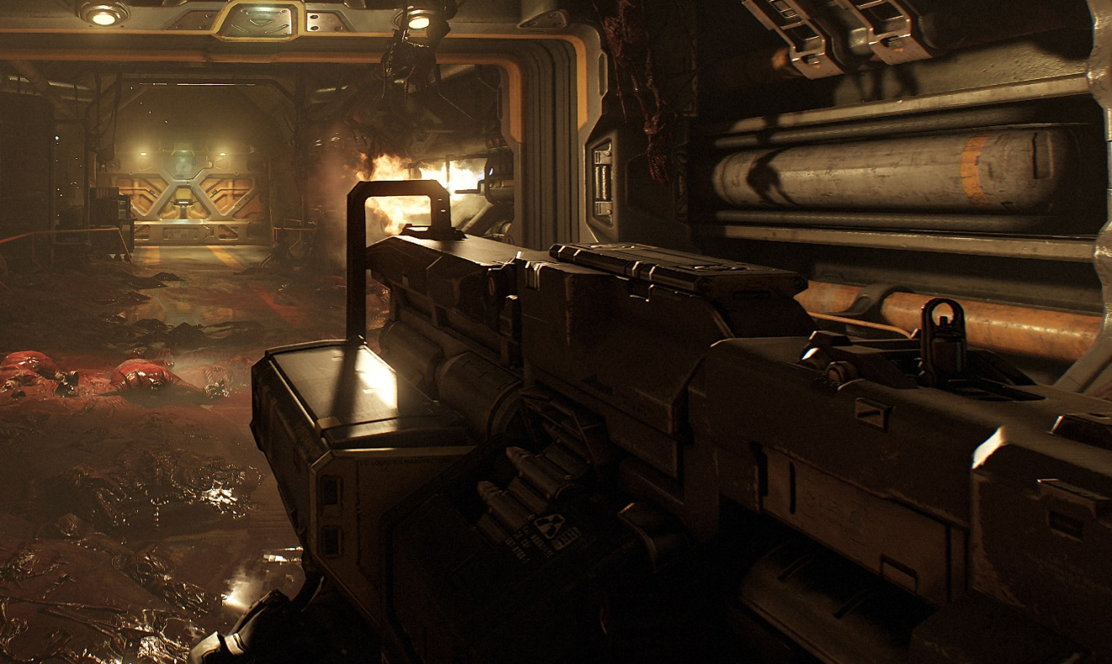
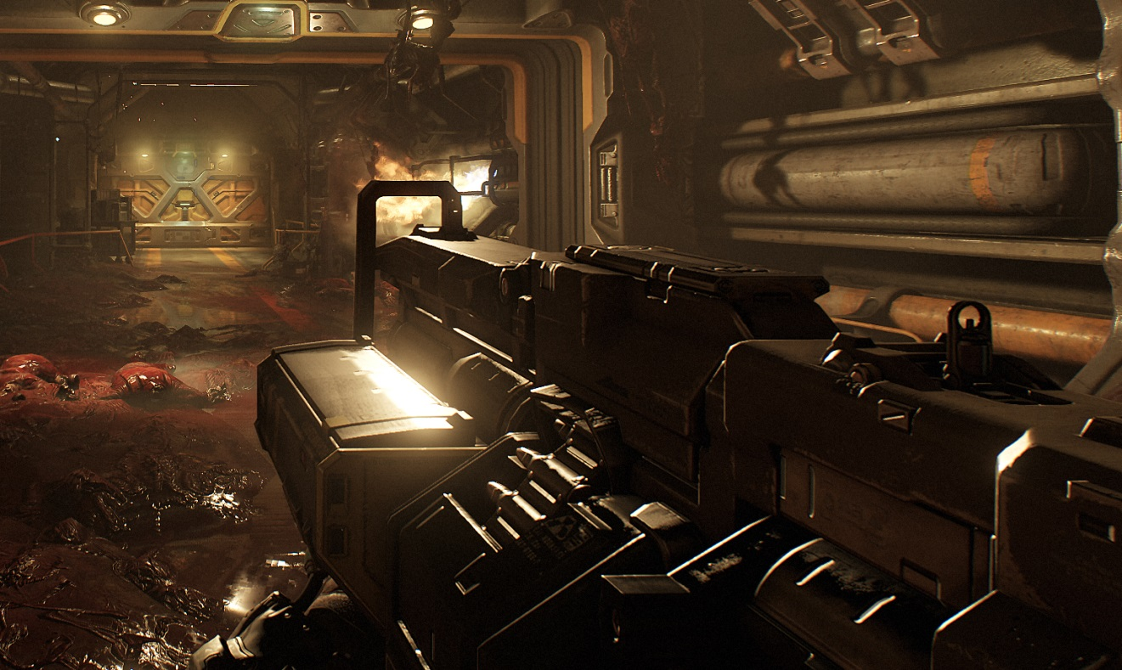
Lighting
First person arms self-shadows
Dedicated atlas portion. Disabled on consoles to save atlas space
First Person Self-Shadows: On
First Person Self-Shadows: Off
(Notice light leaking)
Notes:
First person arms self-shadows.
Dedicated atlas portion.

Slide 21
Lighting
Keep an eye on VGPR pressure
Pack data that has long lifetime. e.g: float4 for an HDR color ⬄ uint, RGBE encoded
Minimize register lifetime
Minimize nested loops / worst case path
Minimize branches
56 VGPRS on consoles ( PS4 )
Higher on PC due to compiler inefficiency ☹ ( @ AMD compiler team, pretty plz fix - throwing perf out )
For future: half precision support will help
Nvidia: use UBOs / Constant Buffer ( required partitioning buffers = more / ugly code )
AMD: Prefer SSBOs / UAVs
Notes:
Dynamics Indirect lighting
Irradiance Probes approximation
SH 2 encoded
Volume texture

Slide 22
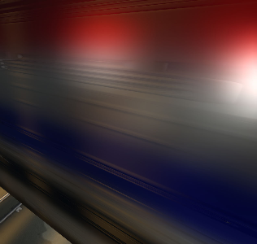
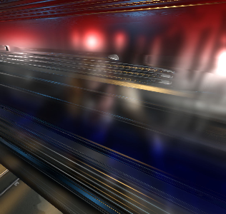
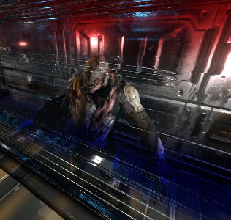
Transparents
Rough glass approximation
Top mip is half res, 4 mips total
Gaussian kernel ( approximate GGX lobe )
Blend mips based on surface smoothness
Refraction transfers limited to 2 per frame for performance
Surface parameterization / variation via decals
Glass Roughness Variation
Notes:
Transparents are generally FX from game team

Slide 23
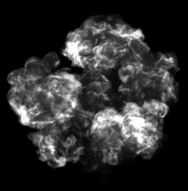
Particle Lighting
Per-vertex ?
No higher frequency details ( e.g. shadows )
Per-vertex + tessellation _{[Jansen11]}
Requires large subdivision level
Not good for GCN / Consoles
Per-pixel ?
That's a lot of pixels / costly
Mixed resolution rendering ?
Nguyen04 ? Problematic with sorting
Aliasing MSAA target ? Platform specific
Per Vertex
Tessellation
Per-Pixel*

Slide 24
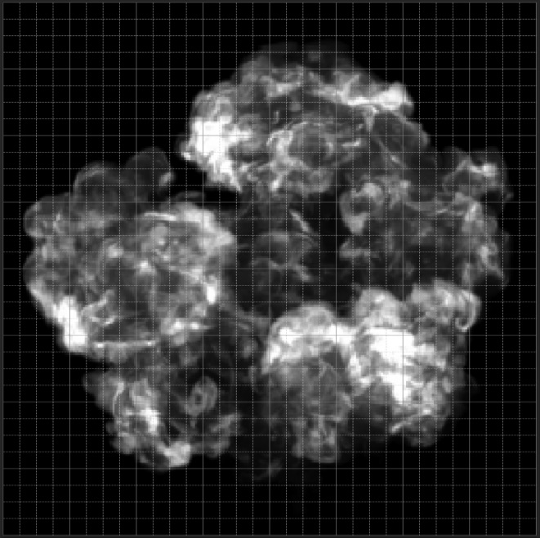
Decoupled Particle Lighting
Observation
Particles are generally low frequency / low res
Maybe render a quad per particle and cache lighting result ?
Decouples lighting frequency from screen resolution = Profit
Lighting performance independent from screen resolution
Adaptive resolution heuristic depending on screen size / distance
E.g. 32x32, 16x16, 8x8
Exact same lighting code path
Final particle is still full res
Loads lighting result with a Bicubic kernel.
Adaptive resolution
Notes:
Observation
Particles are generally low frequency / low res
Maybe render a quad per particle and cache lighting result ?
Similar to Texel / Object space Shading ( amd ), but lighting only
Decouples lighting frequency from screen resolution = Profit
Lighting performance independent from screen resolution
Adaptive resolution heuristic depending on screen size / distance
E.g. 32x32, 16x16, 8x8
Exact same lighting code path
Final particle is still full res
Loads lighting result with a Bicubic kernel.

Slide 25
Decoupled Particle Lighting
//Pseudocode – Particle shading becomes something like this
Particles( inputs, outputs ) {
…
const float3 lighting = tex2D( particleAtlas, inputs.texcoord );
result = lighting * inputs.albedo;
…
}

Slide 26
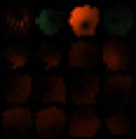
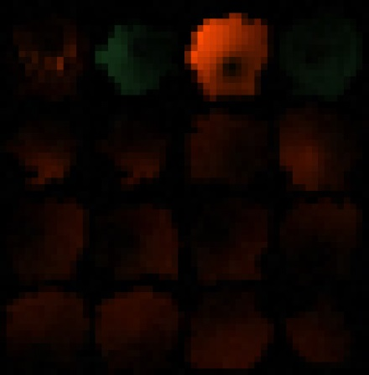
Decoupled Particle Lighting
4k x 4k particle light atlas
Size varies per-platform / quality settings
R11G11B10_FLOAT
Dedicated atlas regions per-particle resolution
Some waste, but worked fine – ship it
Fairly performant: ~0.1 ms
Worst cases up to ~1 ms
Still couple orders magnitude faster
Good candidate for Async Compute
Particle Light Atlas

Slide 27
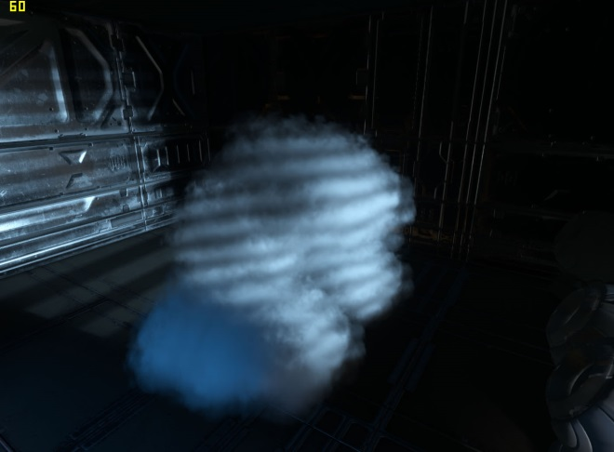
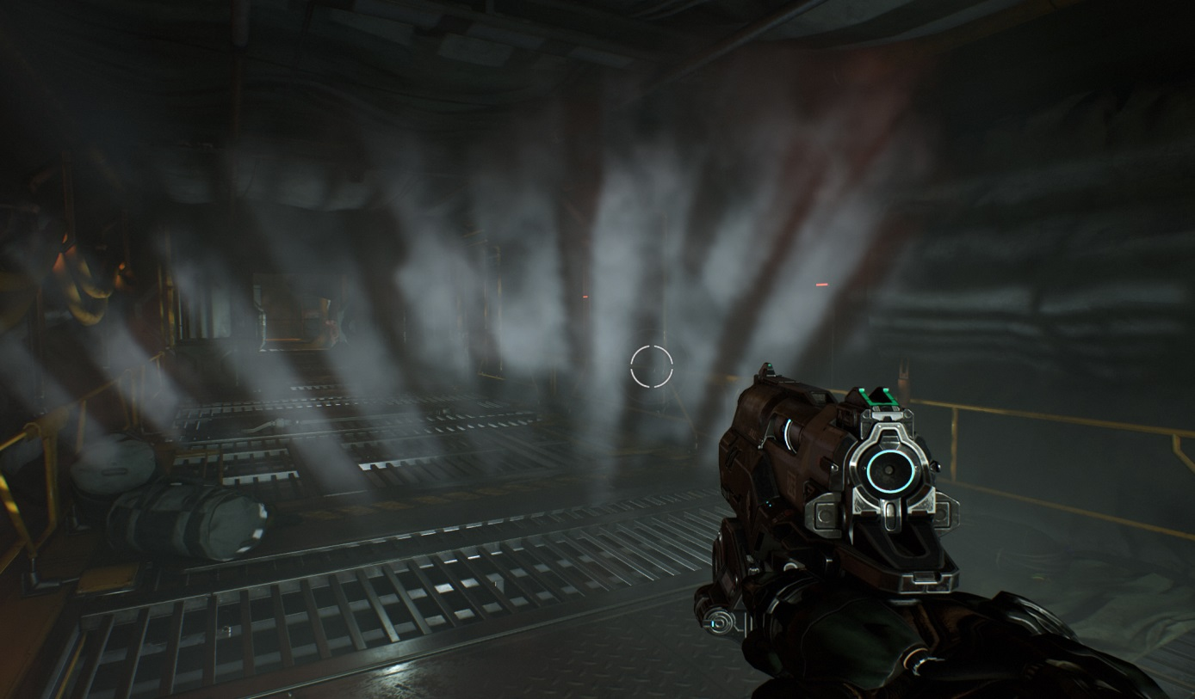
Decoupled Particle Lighting
Results

Slide 28
Post-Process
[Sousa13]
Notes:
I’m asked frequently about the post processing on DOOM / idTech – fyi it’s essentially my 2013 Siggraph lecture

Slide 29
Optimizing Data Fetching ( GCN )
GCN scalar unit for non-divergent operations
Great for speeding up data fetching
Save some VGPRs
Coherent branching
Fewer instructions (SMEM: 64 Bytes, VMEM: 16 Bytes)
Clustered shading use case
Each pixel fetches lights/decals from its belonging cell
Divergent by nature, but worth analyzing
Notes:
The GCN architectures features a scalar unit that can be leveraged by shader code to share some work within a wavefront. In particular, it can be really interesting to fetch data through this scalar unit rather than through vector memory operations. This has a few benefits. More data can be fetched at once (64 bytes vs 16 bytes). The data can be stored in SGPRs, thus potentially saving some precious VGPRs. Finally, since the data is scalar at this point, branching is guaranteed to be non-divergent, meaning that both code paths do not have to executed. This can be a powerful lever to speed up some rendering passes.
Something to bear in mind when writing code using scalar data fetching is that we can expect VGPR savings only if this is the main code path instead of a fast path that can only be dynamically enabled. If multiple paths can be executed, register pressure cannot be lowered.
Let’s have a look at how we can leverage this scalar unit for our main opaque pass, which takes about half of the GPU frame duration.

Slide 30
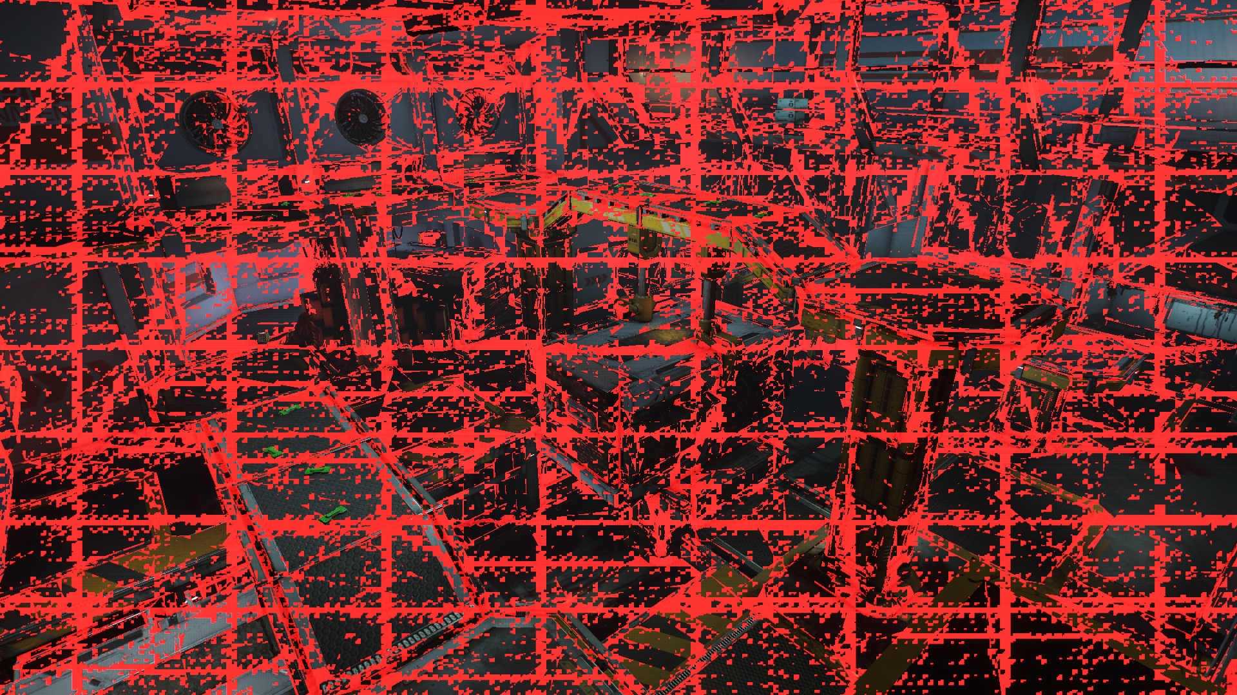
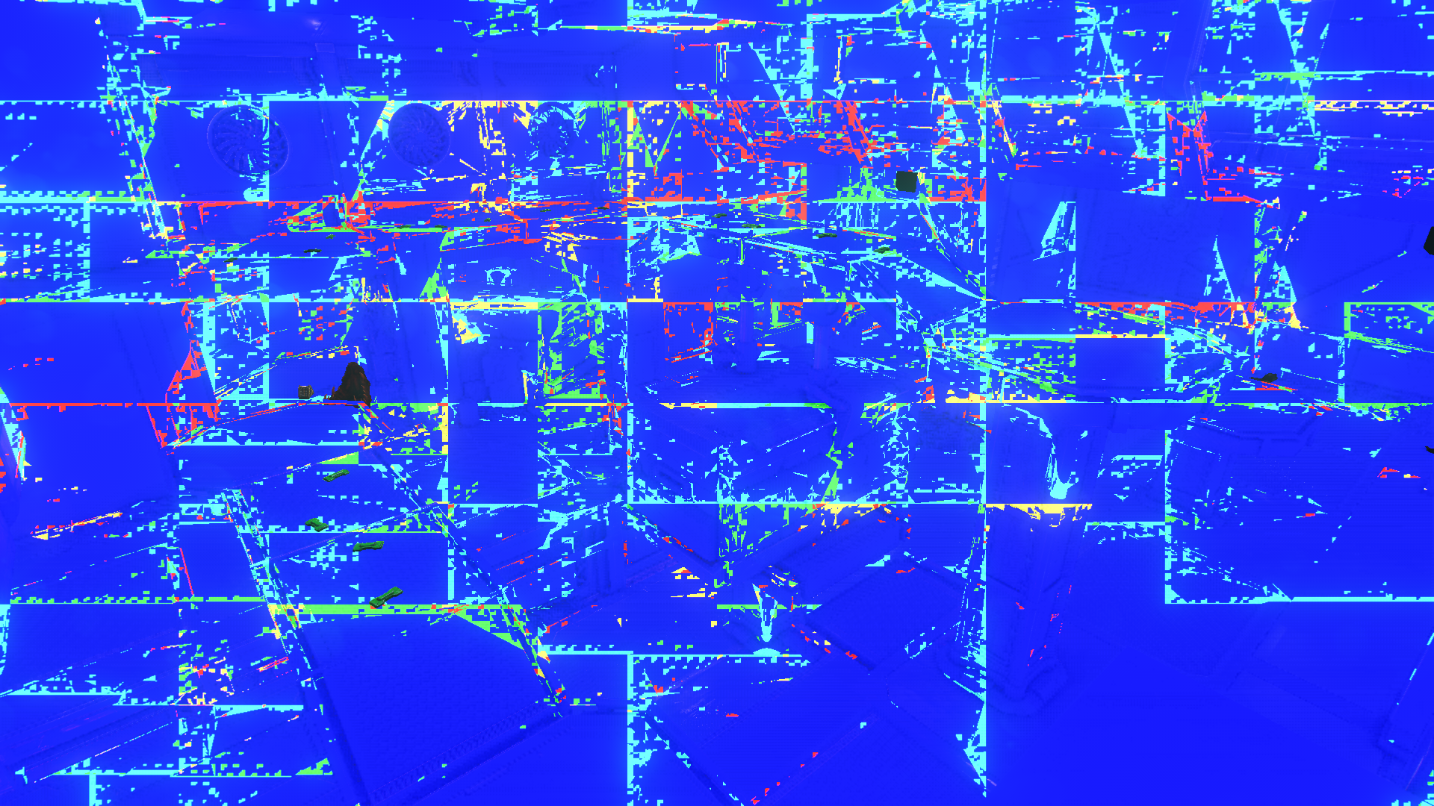
Clustered Lighting Access Patterns
Notes:
This is a pretty standard arena featured in Doom. Let’s have a look at access patterns for our clustered forward shading.
In green, we can see all the waves that only access one node from the cluster. This covers the majority of the screen, and naturally matches the setup of the cluster cells. We can easily exploit this to speed up how we fetch data. Let’s focus now on those wavefronts that are reading from different cells.
We can see that those, in red, still cover an important part of the screen. However, this isn’t telling the whole story. Let’s look more in depth at the actual lighting data that’s being fetched from those cells.
What we’re looking at now is how much data is being shared across all threads within a wavefront. In blue wavefronts, all threads are accessing the exact same light and decal data. Red waves have 5 or more items that aren’t being access by every single thread. As we can see here, the vast majority of cluster data, meaning lights and decals, are being accessed in a very coherent manner within one wavefront. Even when touching multiple cells, the content of those cells is mostly identical, and that’s a property we should try and leverage.

Slide 31
Analyzing the Data
Most wavefronts only access one cell
Nearby cells share most of their content
Threads mostly fetch the same data
Per-thread cell data fetching not optimal
Not leveraging this data convergence
Possible scalar iteration over merged cell content
Don’t have all threads independently fetch the exact same data
Notes:
We’ve seen that with a clustered lighting approach, most wavefronts only touch one cell. This is mostly independent from geometric complexity. But the interesting part is that even when touching multiple cells, most of the actual lighting data is still shared, because lights and decals often overlap across multiple cells within the cluster. Overall, threads within a given wavefront mostly end up fetching the exact same data.
This means that independently fetching this data per thread is clearly not optimal, since we’re not exploiting this convergence at all. What we could do instead is serialize the way we’re gathering the data so that we can use the scalar unit.

Slide 32
Leveraging Access Patterns
Data: Sorted array of item (light/decal) IDs per cell
Same structure for lights and decals processing
Each thread potentially accessing a different node
Each thread independently iterating on those arrays
Scalar loads: Serialize iteration
Compute smallest item ID value across all threads
ds_swizzle_b32 / minInvocationsNonUniformAMD
Process item for threads matching selected index
Uniform index -> scalar instructions
Matching threads move to next index
Divergent
Thread X | A | B | D
Thread Y | B | C | E
Thread Z | A | C | D | E
Serial
Scalar | A | B | C | D | E
Notes:
First, let’s review our setup. Every cell within the cluster stores a sorted list of light and decal offsets. By the very nature of the algorithm, every thread within a wave will potentially be accessing a different cell, and therefore end up iterating on those sorted arrays independently from the other threads.
What we want to do is serialize this iteration. In a simplified example where 3 threads are independently iterating over [A, B, C], [B, C, E] and [A, C, D, E], we could instead serially iterate over [A, B, C, D, E]. In total, we’d be running more iterations of our lighting loop, but fetching data would then be significantly faster, and we’d potentially save quite a few registers in the process.
The way we do this is by having each thread maintain an index within the light/decal ID array it’s iterating on. We then compute the smallest item ID across all threads (using a combination of swizzle and readlane instructions). The resulting light/decal ID is then uniform (the value is the same for all threads). We can therefore fetch the content through the scalar unit and then process the item. Threads that were referring to this item (i.e. their divergent value is the same as the wave min value) then increment their local index and move to the next item. This ultimately guarantees that all items are processed exactly once and in order.

Slide 33
Special Paths
Fast path if touching only one cell _{[Fuller15]}
Avoid computing smallest item ID, not cheap on GCN 1 & 2
Some additional (minor) scalar fetches and operations
Serialization assumes locality between threads
Can be significantly slower if touching too many cells
Disabled for particle lighting atlas generation
Opaque render pass, PS4 @ 1080p
Default: 8.9ms
Serialized iteration only: 6.7ms
Single cell fast path only: 7.2ms
Serialized iteration + fast path : 6.2ms
Notes:
The approach just discussed provides a significant boost in most cases, but there are some refinements we can do on top.
First of all, if only one cell is accessed by an entire wavefront, we can use a dedicated fast path. By doing so, we can avoid computing the smallest item ID, which isn’t cheap on 1 & 2. We can also use scalar operations to fetch cell content. This fast path will not result in any VGPR reduction since it has to live with the other path we just described, but can still result in an additional performance increase for those wavefronts touching only one cell.
Also, it is worth noticing that the main reason this scalar approach works is because most of the data that’s been accessed by a wave is shared by all threads, because of their locality. If for some reason threads become spread apart too much in world space, this could actually seriously hurt performance. This typically isn’t something to worry about for an opaque pass, but with the decoupled approach we use for particle lighting, it became an issue, since samples could be pretty far apart from each other. In that case, sticking to divergent fetches was actually faster.
Overall, using those optimizations approach, we were able to get a 30% speedup on the opaque pass at 1080p on PS4. Using the fast path alone results in a significant boost already, but doesn’t increase occupancy. Using the scalar iteration on the merged cell content allows us to get rid of the divergent code path altogether, thus saving some more registers and gaining us an extra wavefront.

Slide 34
Dynamic Resolution Scaling
Adapt resolution based on GPU load
Mostly 100% on PS4, more aggressive scaling on Xbox
Render in same target, adjust viewport size
Intrusive: requires extra shader code
Only option on OpenGL
Future: alias multiple render targets
Possible on consoles and Vulkan
TAA can accumulate samples from different resolutions
Upsample in async compute

Slide 35
Async Post Processing
Shadow & depth passes barely use compute units
Fixed graphics pipeline heavy
Opaque pass not 100% busy either
Overlap them with post processing
Render GUI in premultiplied alpha buffer on GFX queue
Post process / AA / upsample / compose UI on compute queue
Overlap with shadows / depth / opaque of frame N+1
Present from compute queue if available
Potentially lower latency

Slide 36
GCN Wave Limits Tuning
Setup different limits for each pass
Disable late alloc for high pixel/triangle ratio
Restrict allocation for async compute
Avoid stealing all compute units
Mitigate cache thrashing
Worth fine tweaking before shipping
Saved up to 1.5ms in some scenes in DOOM!
Notes:
To conclude, I’d like to share a couple of common sense tips. GCN lets you setup some limits on how wavefronts are being scheduled. This is something that’s definitely worth spending a bit of time with during the later stages of a project. There’s no reason not to frequently update those limits. We’ve found out for instance that disabling vertex shader parameter cache late allocation during static geometry rendering, where each triangle is potentially yielding a significant number of pixels was beneficial.
If using async compute, those limits should definitely be tweaked again. Assigning too many or too little wavefronts to an async compute task can result in an effective serialization of the task. Using async compute can in general result in more frequent thrashing of GPU caches. Restricting the number of waves allowed to be in-flight, or locking a task to only a subset of the compute units can mitigate this.
Overall, by fine-tuning wave limits throughout the whole frame, as opposed to sticking to the default values, we were able to save up to 1.5ms in some scenes on Doom.

Slide 37
GCN Register Usage
Think globally about register and LDS allocation
Do not always aim for divisors of 256
Bear in mind concurrent vertex / async compute shaders
Fine tweaking to find sweet spot
Example: DOOM opaque pass
GFX queue: 56 VGPRs for PS, 24 for VS
Compute queue: 32 VGPRs for upsample CS
4PS + 1CS/VS or 3PS + 2CS + 1VS
Saves 0.7ms compared to a 64 VGPRs version
Notes:
One last thing that’s worth spending a bit of time fine tuning is register allocation. VGPRs in particular are extremely precious, and will most of the time control the maximum occupancy a shader can have. Aiming for strict divisors of 256 when optimizing register pressure of a given shader, might not always give the best results, contrary to one’s original intuition. It is important to bear in mind that a given shader will often not run in complete isolation. Some PS waves will likely run in parallel with some VS waves of the matching or subsequent draw calls. Also, if you’re using async compute, there’s going to be some more contention on those registers. It can therefore be beneficial to aim for other values when it comes to register allocation. As an example, in Doom we aimed to 56 VGPRs for our opaque pass PS, and 24 VGPRs for the matching VS. This allowed us to have more waves in flight overall compared to a naïve 64VGPR solution, which would have prevented anything from running in parallel with 4 PS waves. Overall, this saves more than half a millisecond.

Slide 38
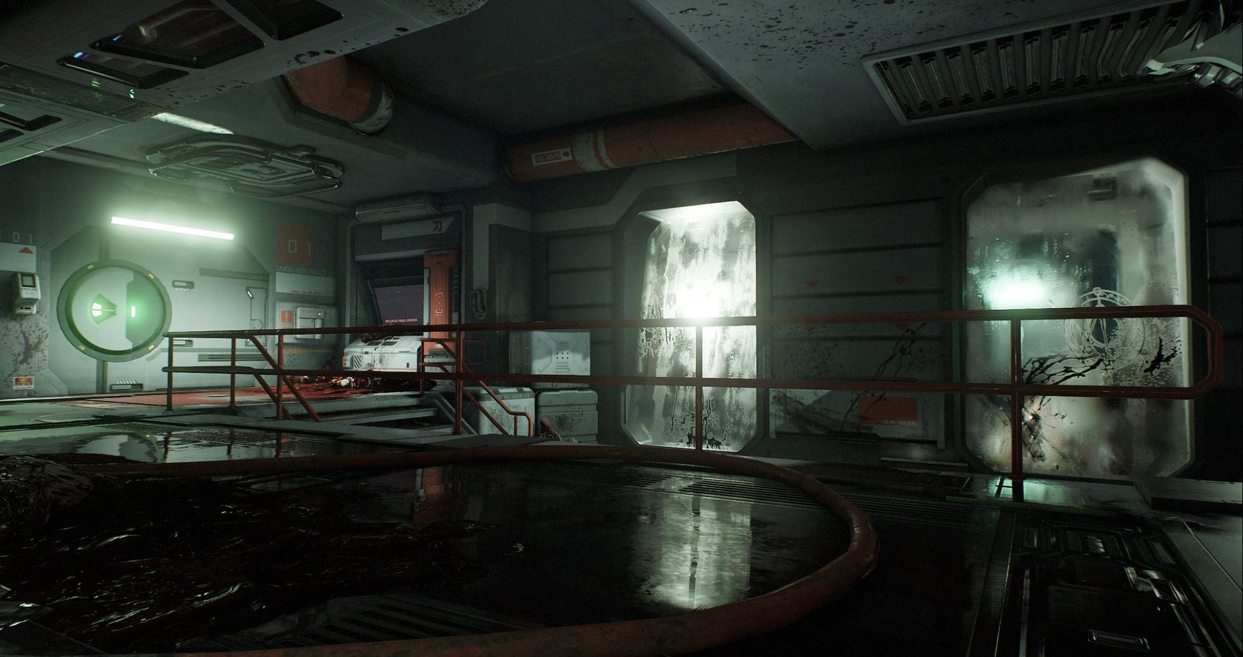
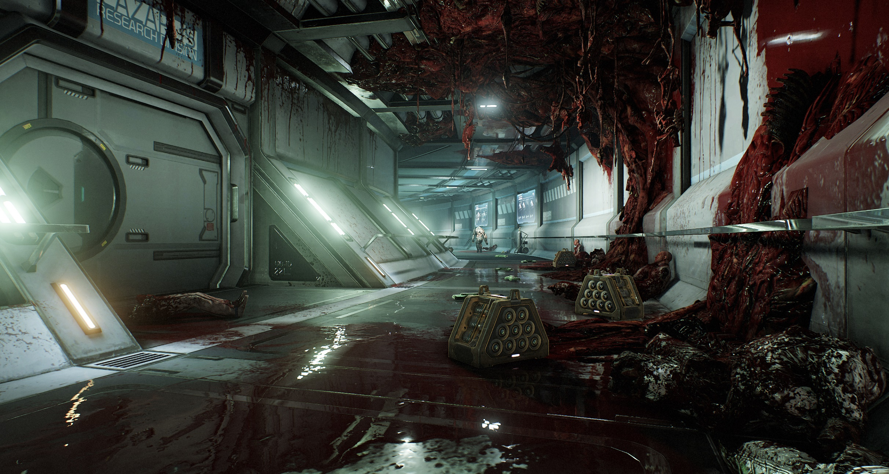
Notes:
Some results

Slide 39
What’s next ?
Decoupling frequency of costs = Profit
Improve
Texture quality
Global illumination
Overall detail
Workflows
etc
Notes:
Decoupling frequency of costs = Profit
Room for improvements on our side
Texture quality
Global illumination
Overall detail
Workflows
etc
Room for improvement on IHVs side
Profiling tools in general are about 1 decade behind what we have on consoles
AMD: please fix your shader compiler
Can we get Barycentric coordinates on all HW exposed?
Sampler Rect
Better filtering

Slide 40
Special Thanks
Code
Robert Duffy, Billy Khan, Jim Kejllin, Allen Bogue, Sean Flemming, Darin Mcneil, Axel Gneiting, Michael Kopietz, Magnus Högdahl, Bogdan Coroi, Ivo Zoltan Frey, Johnmichael Quinlan, Greg Hodges
Art
Tony Garza, Lear Darocy, Timothee Yeremian, Jason Martin, Efgeni Bischoff, Felix Leyendecker, Philip Bailey, Gregor Kopka, Pontus Wahlin, Brett Paton
Entire id Software team
Natalya Tatarchuk

Slide 41
We are Hiring !
Various openings across Zenimax studios
Please visit https://jobs.zenimax.com

Slide 42
Thank you
Tiago Sousa
tiago.sousa@idsoftware.com
Twitter: @idSoftwareTiago
Jean Geffroy
Jean.geffroy@idsoftware.com

Slide 43
References
[1] “Clustered Deferred and Forward Shading”, Ola Olson et al., HPG 2012
[2] “Practical Clustered Shading”, Emil Person, Siggraph 2013
[3] “CryENGINE 3 Graphics Gems”, Tiago Sousa, Siggraph 2013
[4] “Fast Rendering of Opacity Mapped Particles using DirectX11”, Jon Jansen, Louis Bavoil, Nvidia Whitepaper 2011
[5] “Fire in the Vulkan Demo”, H Nguyen, GPU Gems, 2004
[6] “Lost Planet Tech Overview”, http://game.watch.impress.co.jp/docs/20070131/3dlp.htm
[7] “GPU Best Practices (Part 2)”, Martin Fuller, Xfest 2015
[8] “Southern Island Series Instruction Set Architecture”, Reference Guide, 2012
[9] “GCN Shader Extensions for Direct3D and Vulkan”, Matthaeus Chajdas, GPUOpen.com, 2016
[10] “id Tech 5 Challenges”, J.M.P. van Waveren, Siggraph, 2009
[11] “Mipmapping Normal Maps”, Toksvig M, 2004
[12] “Real-Time Rendering, 3rd Edition”, Moller et al., 2008
[13] “Physically-based lighting in Call of Duty: Black Ops”, Dimitar Lazarov, Siggraph 2011
[14] “Specular Showdown in the Wild West”, Stephen Hill, 2011

Slide 44
Bonus Slides

Slide 45
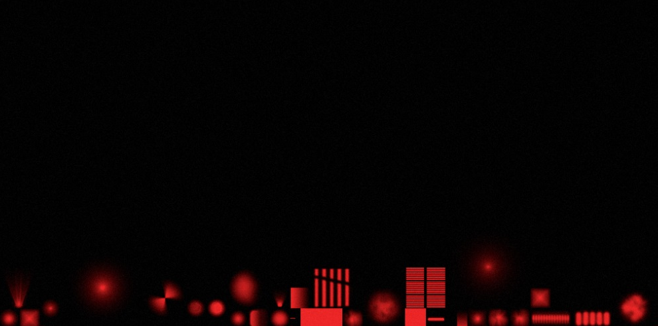
Lighting
Light types
Point, projector, directional ( no explicit sun ), area ( quad, disk, sphere )
IBL ( environment probe )
Light shape
Most lights are OBBs: Acts as implicit “clip volume” to help art preventing light leaking
Projector is a pyramid
Attenuation / Projectors
Uses art driven texture at this point
Stored in an atlas, similar indexing as decals
Art sometimes uses for faking shadows
BC4
Environment Probes
Cube map array, index via probe ID
Fixed resolution, 128 x 128
BC6H
Projector Atlas

Slide 46
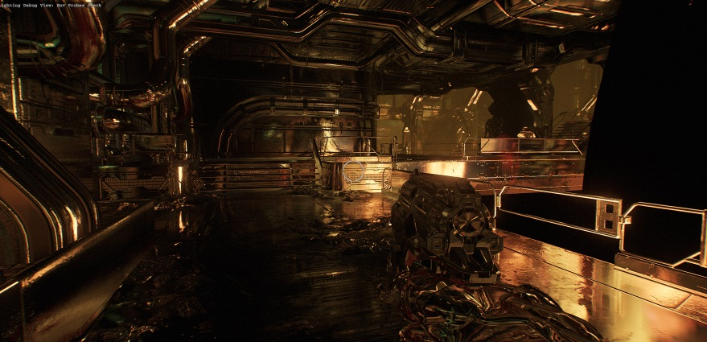
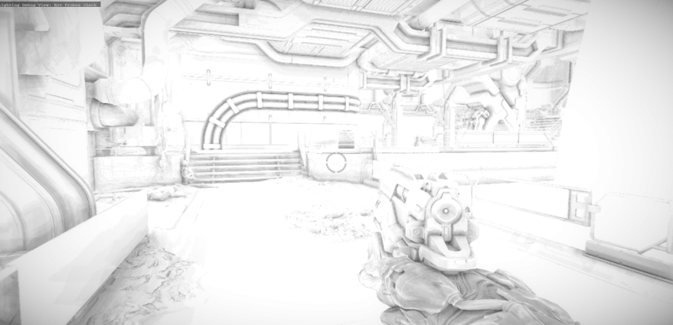
Deferred Passes
Wanted dynamic and performant AO & reflections
Decoupling passes helps mitigate VGPR pressure
2 extra targets during forward opaque passes
Specular & smoothness: RGBA8
Normals: R16G16F
Allows compositing probes with realtime reflections
Final Composite
SSR, environment probes, AO / specular occlusion , fog
Notes:
Take best from both worlds
Performance & Screen Space Approx. from Deferred
Simplicity & unified from Forward.
No fat render targets used on idTech. Not GCN / console friendly
Normals also used for GPU Particles
Main Lighting Buffer: R11G11B10F

