Slide 1
Sampling Methods for Real-time Volume Rendering
Huw Bowles Daniel Zimmermann
SIGGRAPH 2015 Advances in Real-Time Rendering in Games
Notes:
Today we’re going to discuss real-time volume rendering, and propose some concrete improvements over the state of the art.
Advances course web site: http://advances.realtimerendering.com/s2015/index.html
Source code (runnable unity 5 project): https://github.com/huwb/volsample
Shadertoy implementation of forward pinning and adaptive sampling: https://www.shadertoy.com/view/XdfXzn
Adaptive sampling diagram shader: https://www.shadertoy.com/view/llXSD7

Slide 2
Volume Rendering
Ray march – sample volume at regular intervals and integrate lighting
Notes:
What does volume rendering involve? Well we’re going to walk along each pixel ray and integrate lighting from the volume.
We don’t need to discuss this in more detail – the techniques we present are orthogonal to the particular raymarch algorithm/implementation. We’re only concerned with how these samples are placed.
(This is the typical real-time approach. The visibility is evaluated in lock step with the lighting for maximum efficiency.)

Slide 3
Volume Rendering
Notes:
So we can achieve high quality results with a small number of samples. This image was rendered with just 32 samples.
So.. what’s the catch?

Slide 4
Volume Rendering
Notes:
The catch is this only works for stationary or slow moving cameras. Here the camera is moving forwards at a only moderate speed, and there is strong aliasing appearing as a flickering/boiling effect.

Slide 5
Volume Rendering
Volume under-sampled in depth
Sample count low due to expense of shading
We assume low sample counts and concern ourselves with making best possible use of a limited number of samples
Notes:
This is happening because the volume is under-sampled in depth.
Sample count low due to the expense of shading. Instead of doing one shading computation per pixel, we are doing multiple.
In our research we take low sample counts as a constraint and ask if there’s anything we can do to reduce the aliasing?

Slide 6
TALK OVERVIEW
We will manipulate sample layout and motion to substantially reduce error
We will also describe how to adaptively sample depth to render a large range while maintaining quality near viewer
Notes:
We’re going to show that we can manipulate the sample layout and motion to dramatically reduce aliasing.
As mentioned, our ideas are completely independent of the particular rendering algorithm/implementation.

Slide 7
Pinning – Forward Motion
Notes:
To understand the aliasing issue, we’ll study the following diagram. This is a top down view of the camera frustum. Rays march up the screen and sample the volume. The horizontal lines represent the collection of samples for all the pixel rays and we will refer to these as sample slices.
The problem is that as the camera moves, the samples slices move through the volume along the undersampled direction.
We’re going to introduce a family of methods that combat the motion of samples in the volume. We’re going to refer to them collectively as Pinning, as if to pin the samples in place in the volume.

Slide 8
Pinning – Forward Motion
Notes:
Fix is really simple. Instead of sampling at fixed distances from the camera, we slide the samples backwards to compensate for camera motion.
As a result the slices are completely stationary in the world, and the render is completely stable.

Slide 9
Pinning – Forward Motion
Integrate camera forward motion
Adjust ray march start distance
Simple, free, easy to implement
Notes:
“Free” means a line or two of shader code.
It really is that simple.
But what about other kinds of motion?

Slide 10
Pinning – STRAFING Motion
Notes:
Strafing first
No noticeable error because samples move along the sample slices, which are densely sampled (by pixels).

Slide 11
Pinning – Rotational Motion
Notes:
However now we run into trouble under camera rotation. There is noticeable aliasing at the sides of the view.

Slide 12
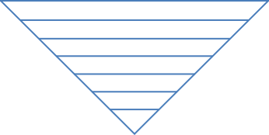
Pinning – Rotational Motion
Problem – samples move perpendicular to slice
Notes:
For samples at the sides of the frustum, there is a significant component of the sample motion that is off-sample-slice.
There IS a way to fix this immediate problem. We can scale the rays to get this curved layout. Now the sample slices lay on the rotational isolines. The sample motion is parallel to the slice and the aliasing disappears.

Slide 13
Pinning – Rotational Motion

Slide 14
Pinning – Rotational Motion
Samples need to move parallel to slice!
Notes:
To quickly recap, as this is an important concept for this talk. Sample motion parallel to the slide – good!

Slide 15
Pinning – Rotational Motion
Samples need to move parallel to slice!
Notes:
Sample motion off slice – bad!

Slide 16
Pinning – Rotational Motion
Can address rotation or strafing
Could adjust dynamically, but changing curvature moves samples
Fixed in-between configuration may work
Notes:
Unfortunately we can adopt a rotation-friendly layout or a strafing-friendly layout but seemingly not both.
We spent some time looking at dynamically computing an optimal curvature (details in additional slides), but the very act of changing the curvature causes samples to move in the world and results in aliasing!
We did find a fixed in-between configuration can work well for some simple camera motions, and is worth trying as a first step, particularly as it’s relatively fast and easy to try.
But for more general camera motion, such as in an interactive application where the camera is user controlled and not constrained in any way, we weren’t able to find a satisfactory solution.

Slide 17
Pinning – General Motion
Can we find a more general approach?
As discussed, sample motion not in line with sample slice produces aliasing
Can we constrain motion of samples to lie on slice?

Slide 18
Pinning – General Motion
Notes:
The following animation shows our new approach. Here we introduce two red spheres which will act as our pins – they are there only to provide a stationary visual reference point.
First strafing – all good
Then camera rotates, show how sample slice changes
Keep rotating
Go back to strafe
Show with stationary reference point how samples maintain slice

Slide 19
PINNING – GENERAL MOTION
Notes:
And now we can see this in motion.

Slide 20
Pinning – General Motion
Previously: single curvature parameter
Instead vary ray scales freely across the screen
We are doing this flatland 2D (not full 3D)
Notes:
Previously we had a single curvature param which would scale down rays at the sides of the view frustum.
Now we generalise this so the scale is free, and we use this to hold the sample slice stationary.
(We had 100 floats, it worked with less but it the computations were inexpensive and O(N) so we could easily afford this many samples.)
Regarding flatland 2D, we think it can be generalised to full 3D, see the notes on the github page for some more details: https://github.com/huwb/volsample

Slide 21
Pinning – General Motion
Advection
Notes:
How to we achieve this?
We call this process advection, because we’re advecting the ray scales in such a way that when the camera moves, the sample slice stays stationary.

Slide 22
Pinning – General Motion
Advection
!
Notes:
There isn’t a closed form solution as the scales are data driven, and in addition there can be folds/multiple solutions.
(Could use a scatter instead of a gather. For example you rasterize the line in the new view (in software) and resolve overlaps manually, or splat the values across (although this can be tricky in terms of filtering).)

Slide 23
Pinning – General Motion
Need to search
Fixed Point Iteration (FPI)
Define forward mapping – how the sample slice will transform
FPI inverts it quickly and cleanly
We used FPI in a very similar manner in the past and investigated its behaviour, see the references for our paper Iterative Image Warping
Notes:
So we need to use some kind of search.
We used fixed point iteration – a very simple yet stable solver.
It only requires that you define the forward mapping – how the camera slice will transform with the camera motion
For each scale value that we’re trying to compute, use FPI to invert the mapping to find the previous scale value.
Its really useful for these kinds of tasks, we wrote a paper about this, see the references.
For more info about this, see the notes on the github page https://github.com/huwb/volsample and the comments in the code.

Slide 24
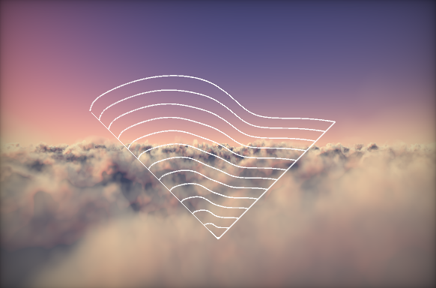
Pinning – General Motion
Advection
Notes:
So just to look at the advection again. Here we show a number of sample slices. When we move the camera to the left, the ray scales will advect to the right, keeping the sample slices stationary in the world

Slide 25
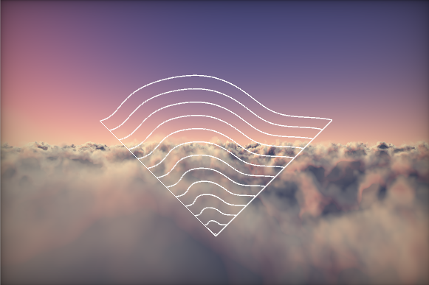
Pinning – General Motion
Advection
Notes:
After advection, sample slices adjusted to compensate/remove camera motion.

Slide 26
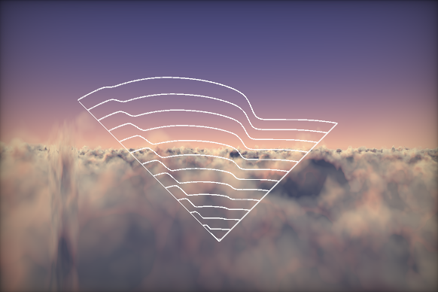
Pinning – General Motion
High gradients produce pinching in render
Manually relax these each frame
Notes:
What issues do we see with this? Firstly, we want to avoid high gradients in the scales. These gradients mean neighbouring rays are scaled differently, which results in a visual pinch in the render.

Slide 27
PINNING – GENERAL MOTION
Notes:
To address this we perform a gradient relaxation, which looks as follows.
Note that we are breaking our rule of stationary sample slices. This can cause aliasing, so there is a tradeoff to be found here. Camera motion can help to mask aliasing, so we ramped down the relaxation process when the camera is stationary.

Slide 28
Pinning – General Motion
Notes:
Another issue is twisting of the sample slices. This can occur when the camera orbits the place where our advection computation is performed.
Note that the algorithm is working perfectly well here – it’s keeping the sample slice stationary. However this conflicts with our other goals, such as not having high gradients.

Slide 29
Pinning – General Motion
Notes:
Addressed by clamping the scales
Get some aliasing. This Feels like a fundamental problem, but there might be a better solution.

Slide 30
Pinning – General Motion
Advection is radius dependent
We found computing near and far scales worked well
Notes:
We found that we don’t need to do it for every single sample slice – computing a near and far ray scale and then interpolating during ray march worked really well.

Slide 31
Pinning – Summary
Pinning forward motion is free and improves results dramatically
Choosing a fixed sample curvature may work in particular scenarios
For a more powerful method, the advection-based sampling is best suited

Slide 32
Adaptive Sampling
Next we look at supporting arbitrary sample distributions
Want to support sample pinning
Notes:
So in the second part of our talk, we look at supporting arbitrary sampling distributions.
Note that we want to support everything we’ve discussed so far.

Slide 33
Adaptive Sampling
Uniform sampling can be inefficient
Either short range
… or low resolution near viewer
Desired: detail near viewer + range

Slide 34
Adaptive Sampling
Use 1/z curve for sample density
A primary cue for depth/volume is parallax, which falls off as 1/z
Notes:
We define a density curve which dictates the sampling density – high near the viewer and low in the distance. We use a curve like 1/z which seems well matched to projection

Slide 35
Adaptive Sampling
Needs to support forward motion sample pinning
Notes:
The tricky problem is we need to support forward sample pinning.

Slide 36
Adaptive Sampling
Needs to support sample pinning
Easy for uniform
Notes:
Uniform

Slide 37
Adaptive Sampling
Needs to support sample pinning
Easy for uniform
But what about adaptive?
?
Notes:
Adaptive

Slide 38
Adaptive Sampling
Notes:
Here is our usual sample layout diagram with adaptive sampling. You can observe that, while the samples slices are moving toward the viewer, we still maintain a sparse sampling in the far field and a dense sampling near the viewer.

Slide 39
Adaptive Sampling
Notes:
Shader: https://www.shadertoy.com/view/llXSD7
(BEFORE PLAYING VID)
To see how this sampling works we can study the following diagram, which is captured from an actual implementation of the sampling on shadertoy, see the slide notes for a link to the shader.
The density curve is shown in red. And the possible sample positions are the black lines.
We’ve drawn these lines in such a way that intersecting the density curve with the lines produces our sampling. So you can see that there are dense samples on the left and sparse on the right.
If the curve is near the end of the black line, the sample is faded out.
Now why would we want to go to all this trouble to get the sample positions?
(PLAY VID)
Well if we animate the sample positions – i.e. move the ray march steps forwards or backwards as we do for the forward pinning – we can see that the samples move as desired .. AND … the density remains distributed as 1/z

Slide 40
Adaptive Sampling
Walk along power-of-2 positions, blend in samples based on density curve
Apply pinning scale afterwards
Supports all the techniques we’ve discussed so far
Compute on CPU and pass in to the shader
Notes:
…
So this supports everything we presented earlier – we’re simply switching out the uniform ray march for an adaptive one
We do this once for all rays, and end up with sample slice distances and weights. We can compute these on the CPU and pass in to the shader
(Sadly at time of writing Unity doesn’t support passing arrays in to shader, so we implemented the sampling algorithm directly in the shader code in our implementation. It could have also been done by writing the sample distances to a texture and sampling them in the shader.)

Slide 41
Adaptive Sampling
Non-uniform distribution of samples
Temporally coherent
No samples popping in/out
Complete determinism
Compute during raymarch?
Notes:
…
…
The sampling algorithm could be computed while raymarching, which raises interesting questions about realtime per-pixel importance sampling. We leave this to future work.

Slide 42
RESULTS
Notes:
we threw together a test camera animation which turned out to be a very challenging test case.
You can see the two advection lines – the two places at which we compute the advection.

Slide 43
COMBINING EVERYTHING – NAIIVE RAYMARCH

Slide 44
COMBINING EVERYTHING – FORWARD PINNING

Slide 45
COMBINING EVERYTHING – FULL PINNING
Notes:
We can still see some aliasing if we stare at it.
We think this can be further improved with more time to settle the implementation and polish, or perhaps with further research.
Also this this is a challenging camera animation. And clouds are completely stationary – having motion would likely help mask aliasing.
Generally though the improvement is dramatic over naiive sampling.

Slide 46
Summary
We introduce a number of practical improvements to standard ray marching
Our Pinning approaches take advantage of unused degrees of freedom in the sampling to dramatically reduce aliasing
We introduce a general sampling algorithm that enables non-uniform sampling
Our approaches are orthogonal to the raymarching algorithm and easily retrofitted

Slide 47
References
Bowles H., Mitchell K., Sumner R., Moore J., Gross M., Iterative Image Warping, Proceedings of EUROGRAPHICS 2012
Notes:
This was the fixed point iteration reference
Advances course web site: http://advances.realtimerendering.com/s2015/index.html
Source code (runnable unity 5 project): https://github.com/huwb/volsample
Shadertoy implementation of forward pinning and adaptive sampling: https://www.shadertoy.com/view/XdfXzn
Adaptive sampling diagram shader: https://www.shadertoy.com/view/llXSD7

Slide 48
ACKNOWLEDGEMENTS
Our test scene draws heavily from two Shadertoy shaders:
Clouds by iq
Cloud Ten by nimitz
For the conversations and support
patapom, Hale Harding, Tom Williams, Jim Callin
Shadertoy + community for the inspiration
Natalya Tatarchuk for this course!

Slide 49
Resources
Advances course web site: http://advances.realtimerendering.com/s2015/index.html
Full source code (runnable unity 5 project): https://github.com/huwb/volsample
ShaderToy implementation of forward pinning and adaptive sampling: https://www.shadertoy.com/view/XdfXzn
Adaptive sampling diagram shader: https://www.shadertoy.com/view/llXSD7

Slide 50
THANKS!
Questions?
We would love to hear from you!
Huw Bowles – huw@studiogobo.com Shadertoy: huwb
Daniel Zimmermann – daniel.zimmermann@studiogobo.com

Slide 51
Dynamic layout curvature
As mentioned , it’s possible to dynamically compute the curvature of the layout instead of using advection
We spent some time looking at this. We posed it as an optimisation which was locally convex and smooth. Additionally we could find very solid initial guesses
However the problem was that changing this parameter caused samples to move and therefore aliasing
If you’re interested in going down this path contact us and we’ll provide details of where we got to

