Slide 1
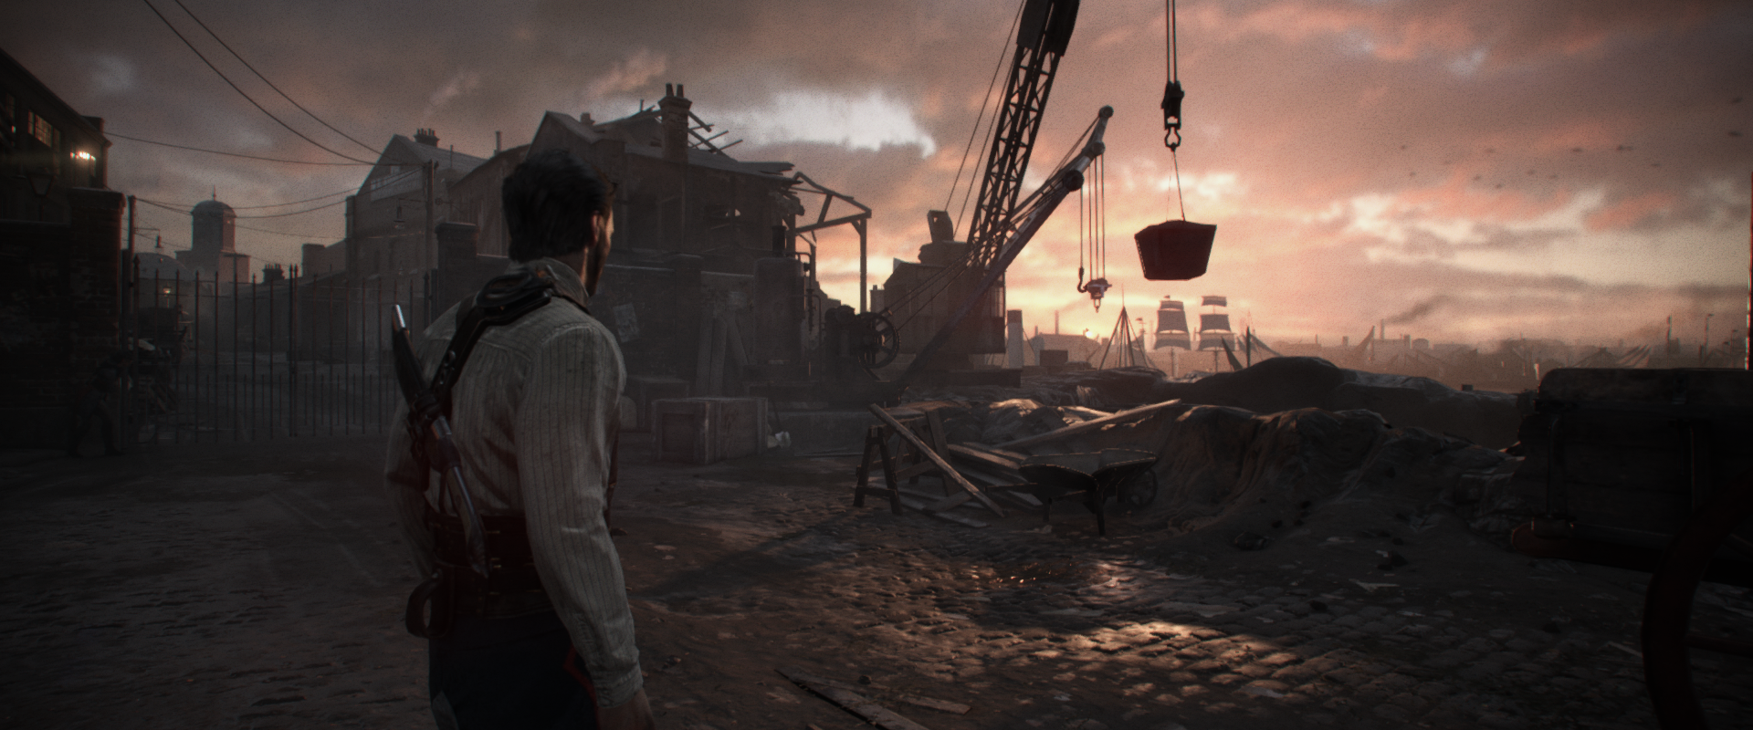
Rendering The Alternate History of The Order: 1886
Matt Pettineo – Ready At Dawn Studios
Advances in Realtime Rendering In Games 2015
Notes:
Welcome to the talk! We’re going to cover antialiasing, shadows, and decals.

Slide 2
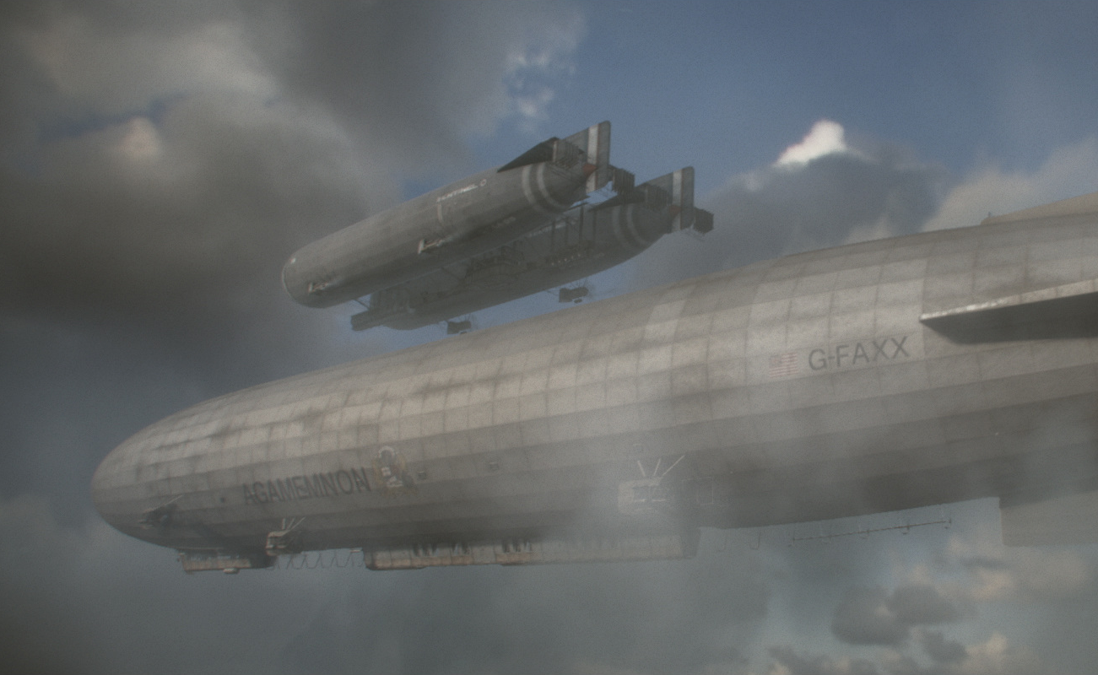
Overview
Shipped February 2015
Alternate history 1886
New engine
Tech focus points:
Materials and shading
Characters (and lycans!)
Image quality and stability
Notes:
Before we get into the interesting topics, I want to give a little bit of context by going over some basics. As you may or may not know, The Order: 1886 is a third-person action adventure game that shipped exclusively for the PlayStation 4 back in February of this year. The game is set in alternate history version of London, 1886, and consequently takes some liberty with the technology that was available at the time. We shipped the game on a brand new version of our in-house engine, which is now the 4th iteration of our technology. For this particular game we had a few key areas that we felt deserved extra attention. The first was our material and shading model, which we covered in-depth during a talk from SIGGRAPH 2013. The second was our characters, since they would be heavily featured in the game’s cinematics. These characters also included werewolves (AKA lycans), which brought some of their own unique challenges. Finally, we really wanted to nail the image quality and stability aspect of the game, since we felt that it would really help sell the game’s particular aesthetic.

Slide 3
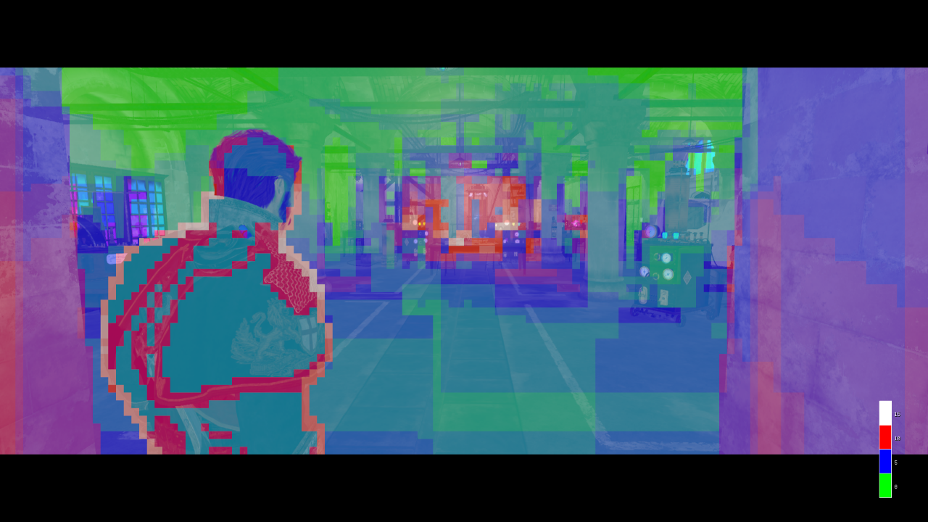
Forward+ Renderer
Depth prepass
Also vertex normal and velocity
Compute per-tile lists
Culled using depth buffer
Separate list for transparents
Async compute -> mostly free
Cheaper MSAA
Notes:
For this particular title, we used a “Tiled Forward” setup that’s often referred to as “Forward+” in other material. To give a really quick overview, we use a compute shader to bin lights into 2D tiles, and then spit out a list of lights for each tile. Then during the main forward pass, the pixel shader walks the list and applies each light one by one. We had used depth prepass for several reasons, the biggest of which was to ensure that we didn’t have any overdraw in the main pass. But during production it turned out to have a depth buffer for various other passes, like our hybrid decals and AO volumes. It’s also handy for Z culling lights during in the tiled lighting compute shader, which gives you a more efficient list of lights.
On the right is an image of one of our in-game debug visualizers, in this case showing how many lights are in each screen-space tile. You might have trouble seeing it, but there’s a legend in the bottom-right corner showing what the colors mean. Green is 0, blue is 5 lights, red is 10 lights, and white is 15 lights. This scene has a fairly typical complexity for the game, where you have mostly around 5 lights with some areas getting to 10 or above

Slide 4
Forward+ Renderer
Generated per-material pixel shaders
Fully compiler-optimized material + lighting pipeline
Harder to hand-optimize optimize all cases
Some GPR problems, fixed before shipping
Function of parameters used by lighting
Had some help from Sony compiler team
Notes:
One of the nice things about using a forward rendering approach is that the compiler has access to your full material and lighting pipeline, which lets it optimize both components using knowledge of the other. So at least in theory you can get some nice optimizations as a result. We helped this along by analyzing textures and automatically replacing constant channels with hard-coded constants, which let those constant values propagate all the way into the lighting phase. One thing everybody asks me about is whether or not we had issues with VGPR pressure due to doing everything in one gigantic pixel shader. Without getting into too many hardware-specific details, I’ll just say that we definitely had a few issues with some of our more complicated shaders. In particular our materials that made use of blending our cloth BRDF with a GGX BRDF had some occupancy problems, since they had so many parameters used for the lighting phase. But ultimately we were able to work through it by making some tools to track these problem shaders, and by also getting some fantastic help from Sony’s compiler team.

Slide 5
GPU Performance Breakdown
Pass | Time (ms)
Prepass | 2.2 - 3.4
Hybrid Decals | 0.0 - 0.5
Occlusion Volumes (async) | 0.5 - 1.0
Lighting Lists (async) | 1.0 – 1.1
Shadows | 2.3 – 5.1
Opaques | 6.7 – 9.0
Transparents | 1.5 – 9.5
Particles and Volumetrics | 2.0 – 2.5
Full Screen FX | 3.0 – 3.5
UI | 0.0 – 0.5
Hair ☹
Notes:
To finish up the engine overview, here’s a table showing the GPU performance breakdown for our game. As you’d expect, we usually spend most of our time in the main opaque pass due to the expensive pixel shaders. Some of these are marked “async”, which means we used async compute to execute these tasks in parallel with draw calls.
You might notice this number right here (click), which has a pretty high upper bound. That comes from cinematics where the character’s hair took up a large portion of the screen. Our hair was rendered as layers of transparent geometry with full dynamic lighting, and so the cost could get really high during close-ups.

Slide 6
Antialiasing
Notes:
Now for the first topic, I’m going to talk about the antialiasing techniques that we used The Order. But before I get into details, I want to step back a bit and give some background material that helps to show some of the reasoning behind our particular decisions.

Slide 7
Antialiasing - Goals
What do we want from AA in 2015?
Good screenshots?
We can do that already
Temporally stable output
Much harder!
Major difference between VFX and games
Kill the flicker!
Notes:
So first of all, what do we even want out of antialiasing in 2015? Video games have a lot of sources of aliasing that manifest in various ways, and as a result there’s a lot of different approaches depending on what specifically you’re looking to fix. For the past 5 years or so we’ve mainly focused on removing the jagged “stair step” artifacts that happen as a result of rasterization, which we’ve done by using morphological techniques like FXAA and SMAA. These do a great job of producing clean-looking still images, but due to their nature they’re really not all that great for improving the temporal stability of a game. For us, this is the area we really wanted to focus on. If you compare offline CG and real-time graphics, the flickering and crawling that plague current games is one the most easily-noticeable differences. We really wanted to address that problem, and our choices reflect that.

Slide 8
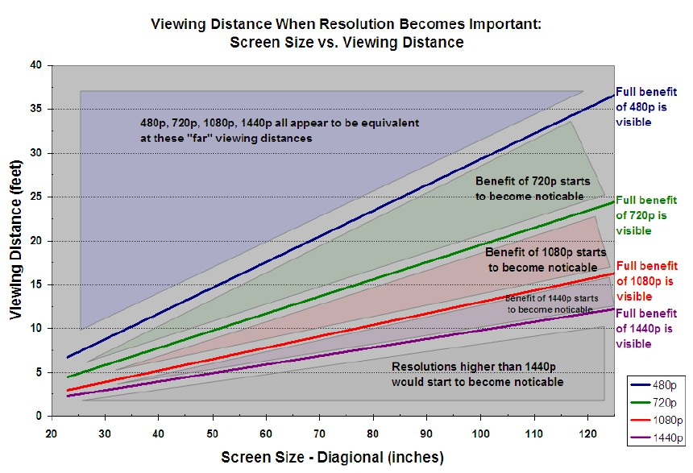
Isn’t 1080p + PostAA “Good Enough?”
Not for us
Flickering still noticeable
Our eyes are good at noticing it
We still need image stability!
Notes:
One argument I’ve heard in the past is that 1080p with post-processing AA is “good enough” for most viewing configurations, and that aliasing shouldn’t be noticeable to most viewers. I’ve occasionally seen charts like these trotted out as evidence, since many people view from a range where the difference between 720p and 1080p is just starting to be noticeable. For typical recorded content that might be true, but I would argue that games are different. In the games industry we are pros at aliasing, and we’re always finding new ways to make it worse. The flickering that results from this perfect storm of undersampling will typically produce a ton pixel-level flickering, and our eyes are actually pretty good at picking up those rapid changes. So I think it’s fair to stay that we still need to find better ways of improving our image stability at our current target resolutions.

Slide 9
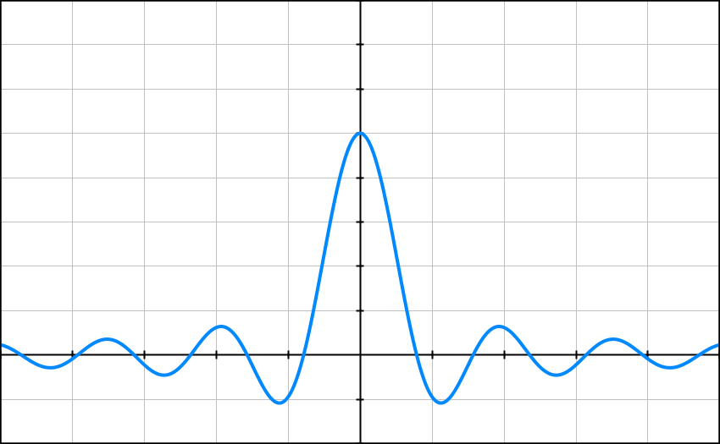
What Causes Flickering?
High-frequency signals
Undersampling
Spatial and temporal!
Moving sample points
Bad filtering
Need to consider frequency response
Can introduce postaliasing
Notes:
So what exactly causes all of this flickering anyway? We know that it’s caused by aliasing, but causes aliasing in the first place? The first ingredient in aliasing stew is high-frequency signals. Signals that change rapidly relative to how often you sample them are always going to be prone to undersampling, which is the second incredient. The third ingredient is moving sample points. When sample points move relative to a signal, the undersampling causes features to be missed entirely by the discrete samples. As the sample points move those features will pop in and out when they get picked up by our sample points, which leads to the dreaded flickering. The final ingredient for flickering is poor filtering. With filtering it’s possible to attenuate high frequencies before they cause problems, but different filters have different attenuation properties. One way to understand this response is to look at the frequency domain representation of a filter, which tells you which frequencies it attenuates and which ones it allows through. The box filter actually translates to a sinc filter in the frequency domain, which has an infinite frequency response. This essentially means it can allow all-frequency signals through, which may be prone to flickering.

Slide 10
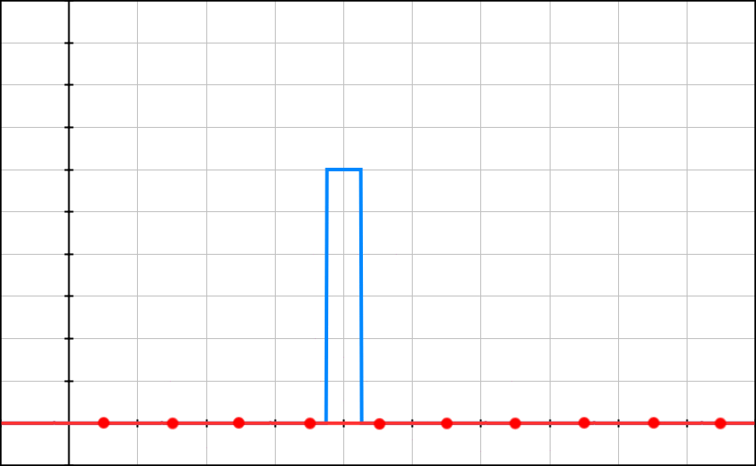
Anatomy of a Flicker
Notes:
Here’s a quick little animation that demonstrates how flickering typically occurs. The blue line is a signal that we’re sampling, which in this case is a pair of step functions. The red dots are our sample points, and the red line is the reconstructed signal with a box filter applied. If it helps, you can think of this like a 1D display where the red dots are pixels and the red line is the output to the display. What you should notice here is that the blue signal is changing too rapidly for our sample points, which means that the sample points sometimes miss the signal entirely. This leads to red outputs rapidly moving up and down as time elapses, which is exactly what we’re trying to prevent. Another key observation to make here is that when sample points move, the signals rate of change in a spatial sense has a direct result on the output’s rate of change in the time domain.

Slide 11
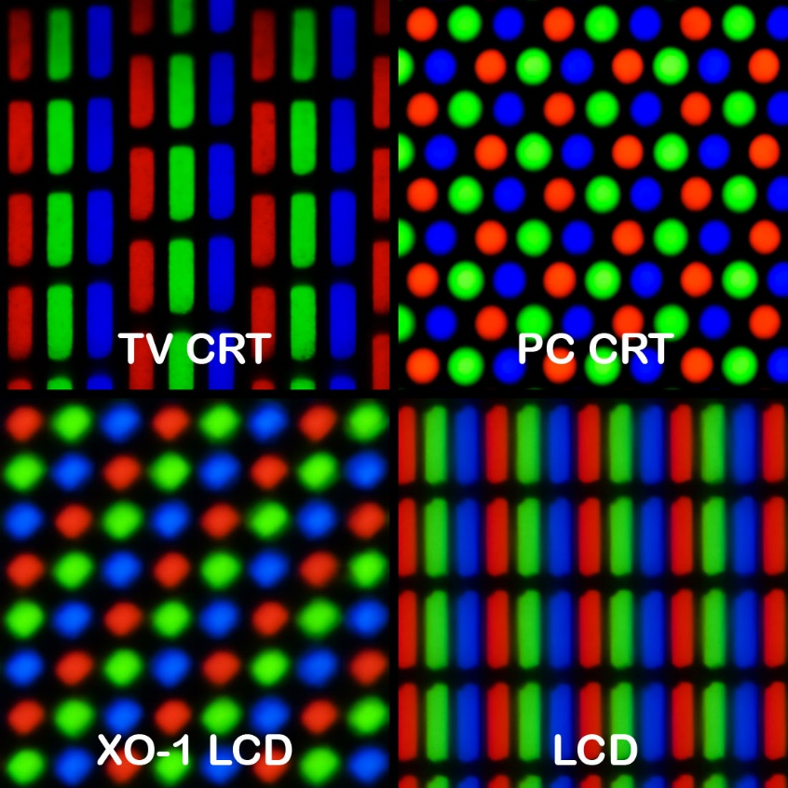
Reconstruction Filters
Important part of resampling
Downscaling and upscaling
Oversampling
Shapes your output
Affects gradients
Affects perceived detail
Affects aliasing
Don’t always get to choose!
Displays
Notes:
So I mentioned earlier that filtering is closely tied to aliasing, and this is usually due to reconstruction filters. We use a reconstruction filter whenever we resample something, which basically means that we want to go from one sample rate to another. The classic case is upscaling or downscaling an image. You essentially have a grid of pixel colors, and you want to end up with another grid with a different size. To compute the values of the new points you use the old ones, with a reconstruction filter applied. The filter you choose is really important, because it shapes your result by affecting the gradients between your new sample points. Filters that attenuate higher frequencies will result in lower gradients, which should make sense intuitively. Naturally that extends Sometimes you don’t get to choose your reconstruction filter, because it’s something inherent to the system as a whole. One example of this is a display. We don’t typically think of it this way, but a display is taking a discretely-sampled signal and converting it to a continuous signal. You can get an idea of what sort of filter is being used by looking at the actual physical patterns on the display, like you can see here in this image from Wikipedia. The common use of rectangular pixel patterns in LCD displays is one of the reasons why we sometimes think of a pixel as a “little square”, even though Alvy Ray Smith insists that we don’t.

Slide 12
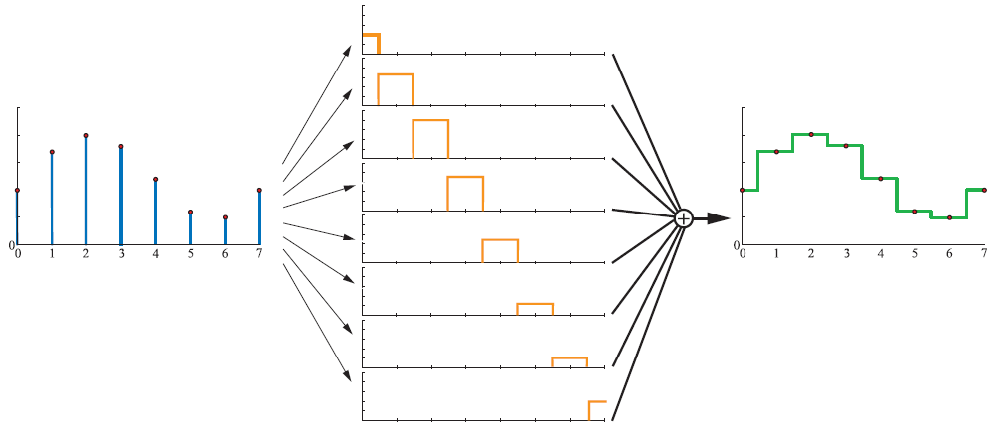
Reconstruction Filters - Box
From Real-Time Rendering 3rd Edition
Notes:
To visualize how reconstruction filters can shape your output, I really like these images from Real-Time Rendering 3rd edition. On the left you have discretely sampled signal, and the middle is a box filter applied to every individual sample. The final reconstructed signal on the right is obtained by summing all of the boxes from the middle. You can see really clearly how the resulting reconstruction has taken on the shape of the filter that was used. Because of the infinite frequency response of the box filter, you end up with reconstruction that’s not even C0 continuous.

Slide 13
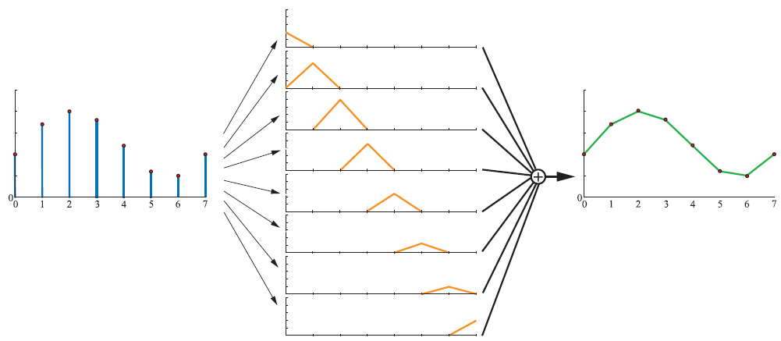
Reconstruction Filters - Triangle
From Real-Time Rendering 3rd Edition
Notes:
Here’s the same diagram but with a triangle filter. The triangle filter is a little smoother than a box filter, and as a result the reconstruction is at least continuous. But there are still abrupt changes in the first derivative.

Slide 14
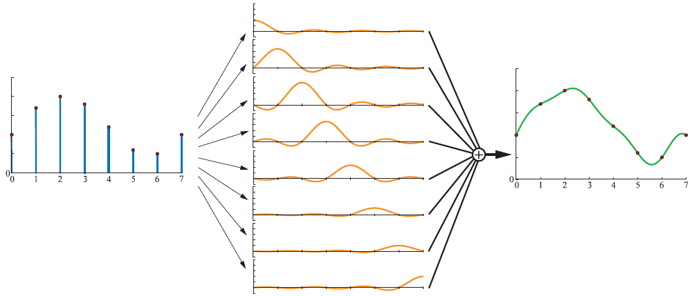
Reconstruction Filters - Sinc
From Real-Time Rendering 3rd Edition
Notes:
Finally we have a sinc filter. The sinc filter is really smooth, and this shows in the resulting reconstruction. It also has negative lobes, which leads to overshooting and undershooting of the original signal. This is normally called “ringing”, and is common in image resizing.

Slide 15
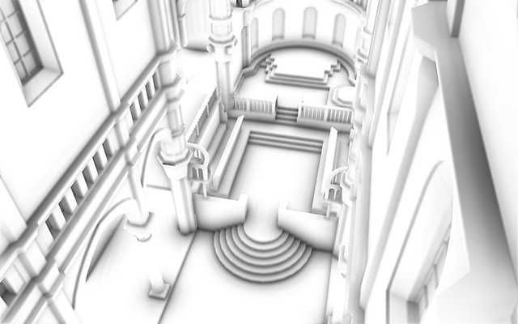
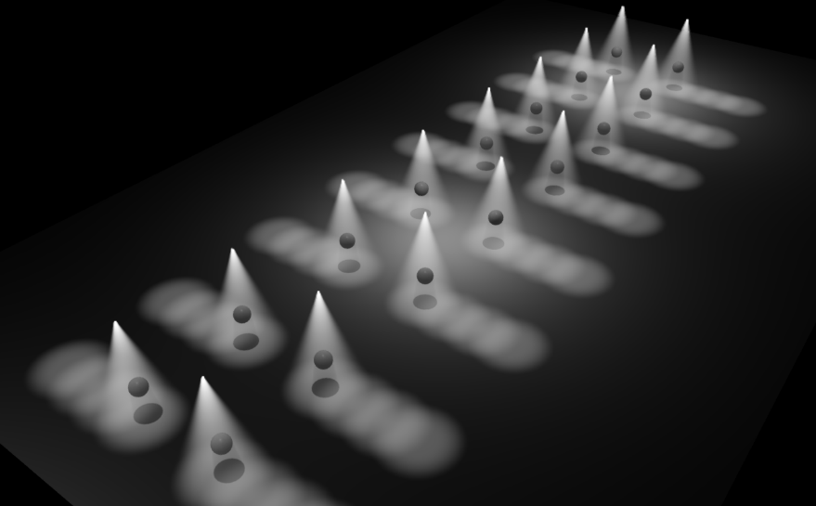
Sources of Aliasing
Rasterization
Specular
Shadows
Textures
SSAO
Post-FX
Do you sample something?
You’re probably aliasing
Notes:
So now that we understand aliasing and filtering a little better, what are the main sources of aliasing in games? Rasterization and specular are probably the two that immediately come to mind. They’re easily the worst offenders, and result in the most noticeable artifacts. But we also have things like shadows, textures, SSAO, and post-processing where undersampling is common. Unfortunately this list could probably go on forever, since we undersample all kinds of things in graphics. (click) For now, we’re just going to worry about the first two, since they’re the main culprits at the moment.

Slide 16
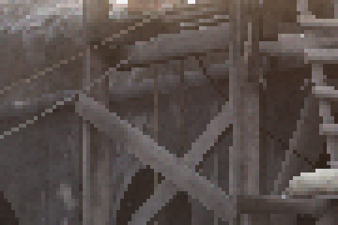
Geometric Aliasing
Geometry undersampled by rasterizer
Often very high-frequency
Can’t prefilter triangles
Rasterizer is a step function
Binary – on/off
Ugly stair-step patterns
Temporal artifacts as camera moves
Changing coverage = Flicker!
Can oversample with MSAA
Notes:
We’ve been dealing with geometric aliasing forever, so we’re probably all familiar with it. If you think about it from a sampling point of view, the problem is pretty obvious: we render everything with triangles, which are inherently high frequency. In fact their 2D projections technically have infinite frequency, due to the discontinuities at the edges. This means we’re technically always going to undersample to some extent, and all we can do is hope that we sample enough that the aliasing isn’t noticeable. The undersampling is made worse by the binary behavior of the rasterize, which essentially applies a step function to the per-pixel coverage test. This “on or off” behavior is what gives use the ugly stair-step pattern that we refer to as “jaggies”. And of course since we’re undersampling a high-frequency signal, whenever the sample points move relative to the geometry we’ll end up with temporal flickering as pixels turn on and off. Note that when I say that the sample points “move”, this can mean that either the camera moves or that the geometry itself moves. There’s really not difference from a sampling point of view, either way you’ll get flickering.
The only bright spot here is that GPU’s have a limited ability to oversample during rasterization, via MSAA.

Slide 17
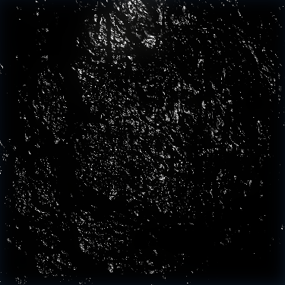
Specular Aliasing
Low-roughness = very high frequency
Moving sample points will flicker
Made worse by undersampled geometry + normal maps
Can be prefiltered
See LEAN/CLEAN/Toksvig [Hill12]
Difficult to account for all sources of normal variation
You should definitely do this!
Notes:
With specular aliasing it’s a similar story. We point sample specular lighting per-pixel, and that signal can be very high frequency depending on the roughness of the surface. The problem is compounded by noisy normal maps, which cause the specular to change even more rapidly. Another compounding factor is geometry, which also contributes to noisy specular when it’s undersampled. The good news for specular is that you can prefilter to a certain extent, which is something that’s been getting a lot attention over the past few years with techniques like LEAN, CLEAN, Toksvig, and their precomputed variants. You should definitely, absolutely use these for your game, no matter what antialiasing you apply afterwards! Fixing aliasing problems early is almost always more effective than trying to fix it after you’ve already undersampled something. For the order we actually used a precomputed version of Frequency Domain Normal Maps, which you can read about in our course notes from SIGGRAPH 2013.

Slide 18
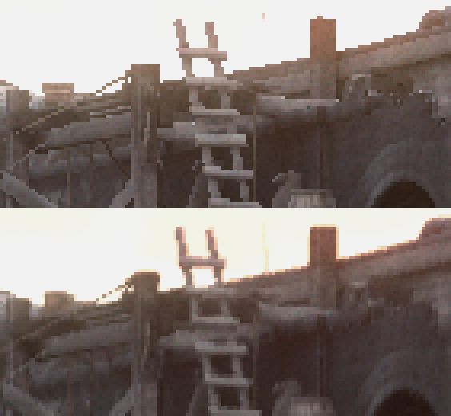
Antialiasing in The Order
EQAA
2x fragments, 4x coverage
Quality vs. performance/memory
Custom resolve
Higher-order filtering
Trade some detail for stability
Temporal AA
Further reduce flickering
Integrate with MSAA resolve
Notes:
Now that the background is out of the way, it’s time to talk about what we used in The Order to combat aliasing. In the end the tools we used weren’t particularly novel or exotic, but it was still important to choose the right ingredients.
The first component was EQAA, which is a variant of MSAA available on AMD GPU’s. Like Nvidia’s CSAA, it essentially lets you decouple MSAA fragment storage from coverage computations so that you can more finely tune the balance between quality and performance/memory. For The Order we used 2 color fragments and 4 coverage samples, which puts the raw quality somewhere between 2x and 4x MSAA if you’re using a standard hardware resolve.
To increase stability, we wrote a custom resolve shader that uses a wider, higher-order reconstruction filter instead of the typical box filter that’s used in hardware. This essentially let us smooth out the signal a bit while resampling, in order to give a result that was more stable under motion.
Finally, we combined our resolve pass with a fairly standard temporal antialiasing component. This is done primarily to reduce flickering from shader aliasing, by tracking and reprojecting surface samples from previous frames.

Slide 19
MSAA for Intermediate Passes
Deferred Decals
Accumulate to non-MSAA RT
Low-res transparents and AO
Upscale per depth subsample, composite once
Alpha test
Test per depth subsample, or use A2C
Depth of field
Use smallest CoC from all subsamples
Notes:
These days it’s pretty hard to get MSAA working properly in a modern engine, as I’m sure you all know. It’s fairly standard to have lots of intermediate passes using various deferred techniques, and The Order was no exception. Using MSAA for these passes tends to be difficult and expensive, and so we tried to find compromises whenever it was reasonable to do so. One major example of that was for our hybrid deferred decals, which uses depth buffer projection to accumulate results to a render target. For these decals we accumulated to a non-MSAA render target, which is easy to do on hardware like the PS4 that supports decoupled sample rates for depth targets and render targets. This let us avoid the cost of an additional resolve, but as a result there are artifacts when the decals are occluded by other geometry. Fortunately the deferred decals were almost always small on screen, so this wasn’t much of an issue. For upscaling our low-res transparent and AO passes, we performed the upscale per depth sub-sample, averaged the results, and then composited with the full resolution image. This is not at all the same as compositing per-sample and then resolving after, but it was a enough tradeoff that we made for performance and memory. For alpha test, we exposed options to the artists to let them enable antialiasing. They could either cause the shader to perform the alpha test per-subsample and output the appropriate coverage mask, or they could use alpha to coverage to 4-level transparency.

Slide 20
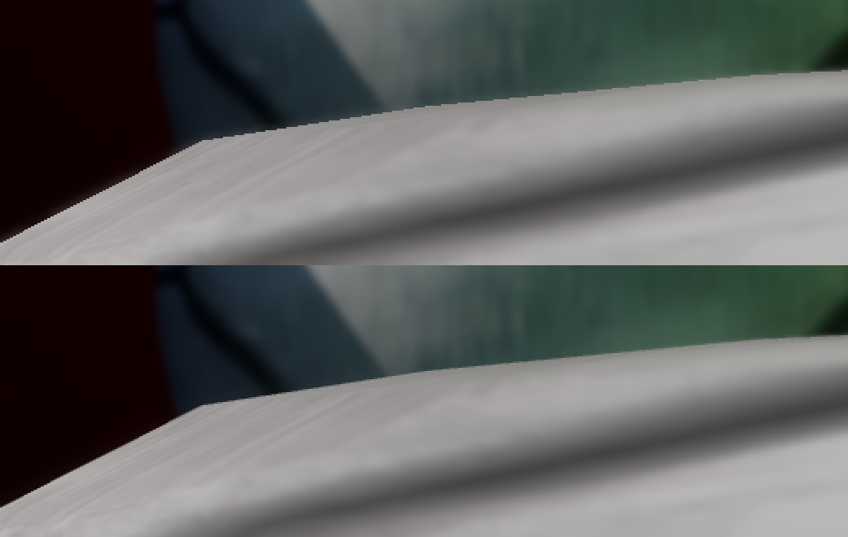
Depth of Field with MSAA
CoC from 1st depth sample
Min CoC from all depth samples
Notes:
Once common issue with MSAA is depth of field reintroducing aliasing. It happens when the depth of field effect only uses one of the depth subsamples. You can see an example of this in the top image, where a jagged edge is visible even though MSAA is used. To get around this we used a simple trick, which was to sample all depth subsamples and choose the sample with the smallest CoC. This causes in-focus pixels to retain the edge gradation.

Slide 21
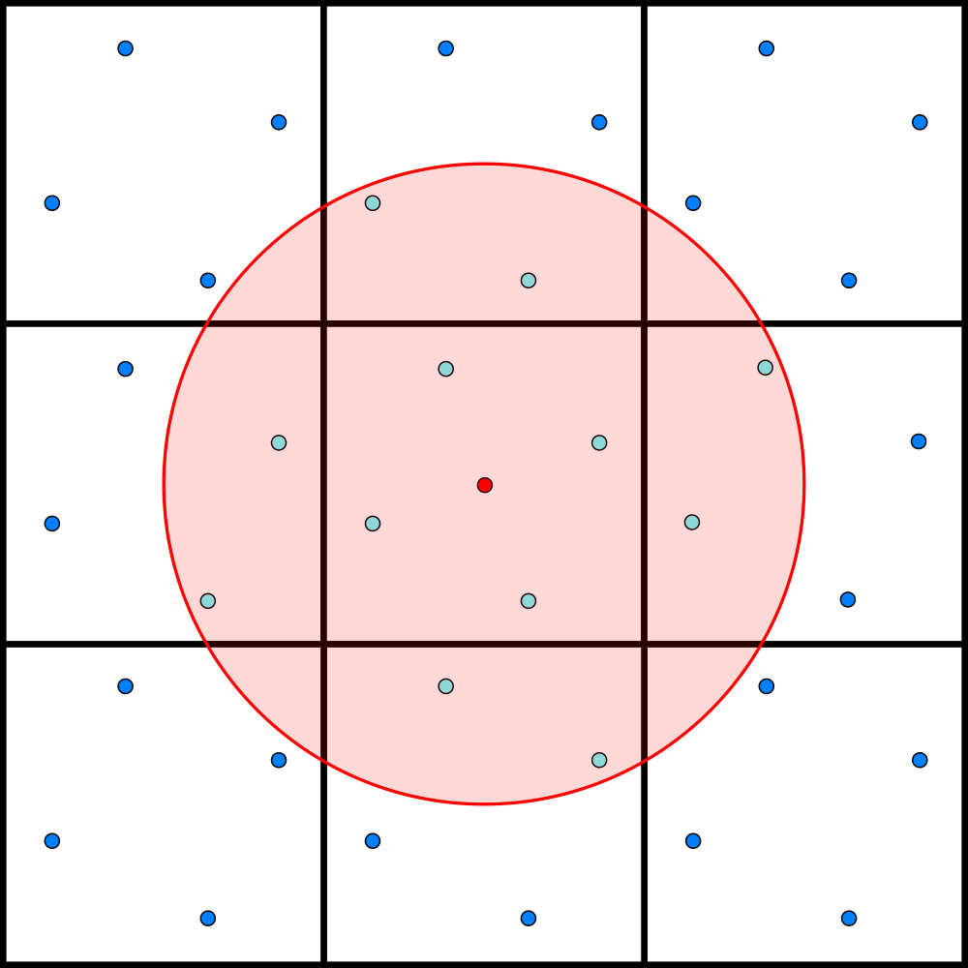
MSAA Custom Resolve
Compute shader instead of HW resolve
Sample color fragments and coverage samples
2-pixel-wide cubic filter [Mitchell88]
Covers subset of neighboring pixels
No negative lobes – too much ringing with HDR
See my blog post:
http://mynameismjp.wordpress.com/2012/10/28/msaa-resolve-filters/
Notes:
Like I mentioned earlier, we didn’t use a standard hardware MSAA resolve for The Order. There’s a few reasons why we did this, but the most relevant reason is that writing our own shader lets us use a custom reconstruction filter instead of being stuck with the standard box filter that’s used by the default resolve. There’s of course many possible filters you can use, such as a triangle, Gaussian, Catmull Rom, and the various Bicubic kernels. For The Order I went with a cubic filter, since a cubic is pretty smooth and you can make it hit zero at a specified distance. In our case the filter was exactly two pixels wide, as shown in the image to the right. The red dot in center represents the center of pixel being resolved, and the blue dots are subsamples. The red circle represents the effective footprint of the filter kernel, and all of the light blue dots are the subsamples with non-zero weights. The wider footprint and smoother filter results in more attenuation than a standard resolve, but we tried to tailor the filter function as well as the width in order to keep the cost down, and to also ensure that we didn’t blur away too much detail during the resolve. We also stayed away from reconstruction filters that have negative lobes, like Mitchell or Catmull Rom. Negative lobes can be useful in standard image processing, since the resulting ringing has the effect of increasing perceived sharpness. However it really doesn’t work very well at all when you’re working with HDR images that have arbitrary intensity ranges. A few years ago I wrote a blog post examining the behavior of many different reconstruction filters when used for MSAA resolve, which you can read if you’re interested.

Slide 22
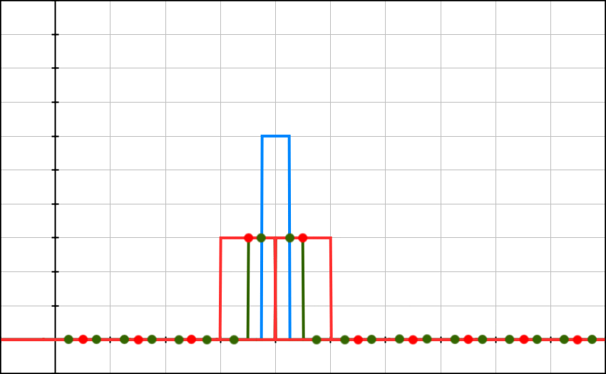
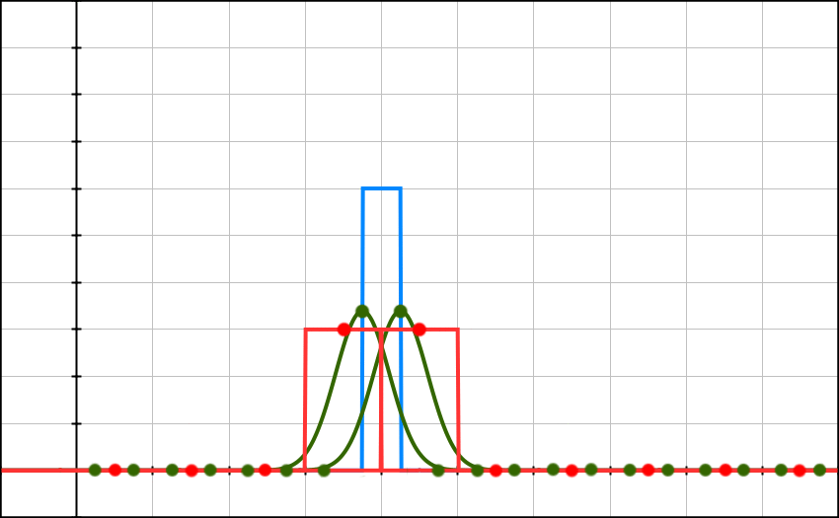
Why Wide Filtering?
Point Sampling
Box Filtered Oversampling
Wide Guassian Filtering
Notes:
To illustrate why we would want to choose a wider, smoother reconstruction filter, let’s look at some animations that show how a high frequency signal responds to different sampling and filtering patterns. (click) First, we have the point sampling example that I showed before, where we end up with flickering due to the signal being too narrow for our sample points to pick up. (click)
Now we have another animation showing an example of oversampling, with a box filter used for reconstruction. This is basically your standard MSAA case: we now have two subsamples within the footprint of our “pixel”, and the reconstruction filter works by averaging the values from the two subsamples. With this case we now have better stability compared to the first approach, although there are still somewhat-rapid changes as the signal slides over our sample points. (click)
Finally, we have an example using the same amount of oversampling, but with a wider Gaussian reconstruction filter. This animation (hopefully) illustrates how using a smoother, wider filter actually translates into smoother transitions in the time domain, which gives us better stability.

Slide 23
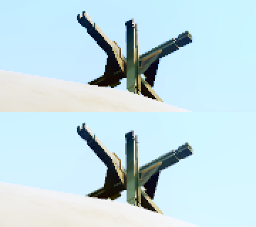
MSAA with HDR
Non-linear tone mapping
“Kills” AA in extreme cases
Clamp is especially bad!
Need to tonemap after postFX
Post-processing needs HDR
Expensive solution [Persson08]:
Post-process at MSAA resolution
Resolve right after tone mapping
Notes:
Another major motivation for using a custom resolve is to get better behavior with HDR. I’m sure most of you know this by now, but a standard MSAA resolve is almost useless once you start using a greater intensity range for your render target. The problem is that filtering your HDR values and then tone mapping the result does not give you the same thing as if you tone mapped the subsamples and then resolved, since tone mapping is typically a non-linear operation. The end result is that you don’t get visible gradiation at your geometry edges, which makes it look like you don’t have MSAA at all. You really want to perform the resolve in a space that’s close to your display space, so that the resulting gradiations have a percetually small differences between them.
The first time that I saw this problem brought up was by Emil Persson back in 2008, in one of the ShaderX books. Back then the ability access subsample through DirectX was brand new, and he suggested using it to apply tone mapping to each subsample during the resolve, so that you get the perceptually-correct result from filtering. This certainly works, but the problem is that we now have long post-processing chains that require HDR every step of the way. Effects like lens flares, depth of field, and motion blur really need linear HDR buffers for the effect to look right, which means tone mapping is typically the last step in your post processing chain. This makes combining tone mapping and resolves an expensive proposition, since you would essentially have to keep your MSAA information through your whole post chain.

Slide 24
MSAA with HDR
Cheap Solution:
Tone map subsamples, resolve, then invert tone mapping
Complex operators are not trivial to invert
Even cheaper:
Approximate tone mapping with simple operator (Reinhard)
Basically weight samples by 1 / (1 + Luminance)
Bonus: suppress small highlights for less flickering
See [Karis14] and [Karis12]
Notes:
An alternative, cheaper solution is to try to resolve in tone mapped space, and then reverse the tone mapping operation to back into linear scene space. I first saw this proposed a few years ago by Andrew Lauritzen on the Beyond3D forums, and I’m honestly not sure if anyone has used this approach in a shipping game. Either way I’ve tried it and it definitely works, with the only major issue being that many tone mapping operators might not be trivial to invert. For those cases you probably need to come up with some approximation of the inverse. You also want to make sure that your tone mapping operator doesn’t have a clamp in it, since a clamp is destructive and absolutely not invertable.
What’s even cheaper is to not use the real tone mapping operator at all, and just approximate it with one that’s trivally invertable. The basic Reinhard operator is a good choice, since it’s so simple. It also only operates on luminance and not color, which is good for our purposes. Brian Karis actually suggested this approach for temporal AA filtering during his talk from last year’s advances talk, so I would encourage you to read through that as well as his blog post for additional details. But the short version is that it basically boils down to weighting each subsample by the inverse of its luminance. If you think about it a different way, this actually has the nice property of weighting relatively brighter samples lower than darker samples. This effectively helps suppress small subpixel highlights, which keeps them from flickering as much.

Slide 25
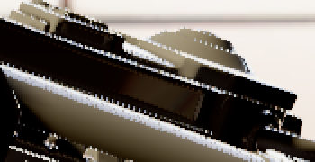
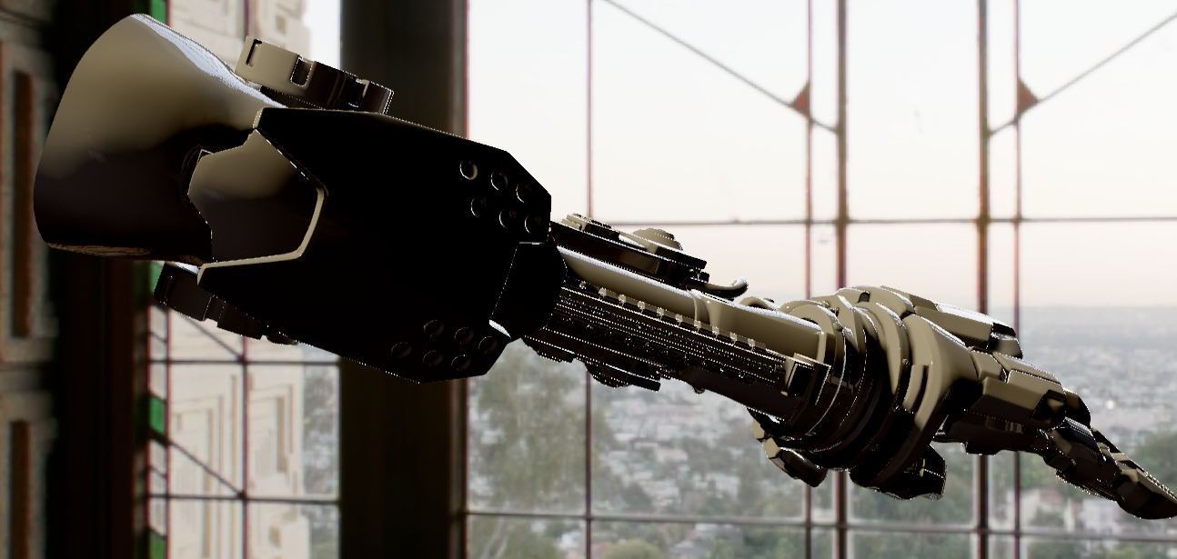
MSAA with HDR
Notes:
To show you what I’m talking about, here’s an image of a high-poly model that was rendered with 4xMSAA using a standard hardware resolve. The edge quality really isn’t great, and you can see a lot of specular aliasing towards the center of the mesh that manifests as singular bright pixels. Now if I switch to an image that was resolved with an inverse luminance filter…

Slide 26
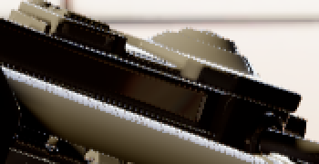
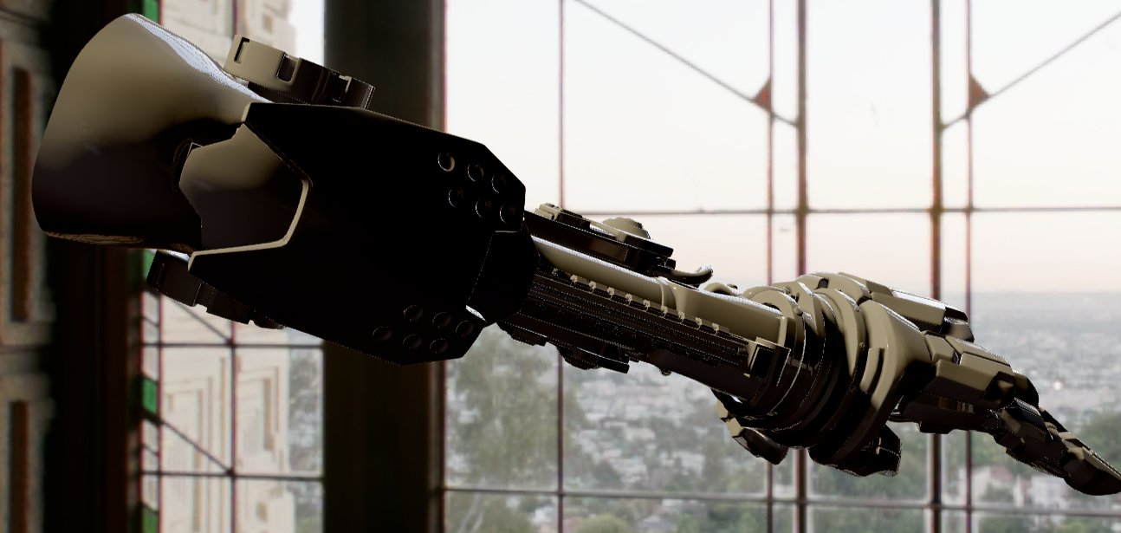
Inverse Luminance Filter
Notes:
…we not only get better edge quality, but we’ve suppressed a lot of the specular aliasing. (Switch back and forth a few times to show the difference)

Slide 27
MSAA with HDR
Need to account for exposure!
Don’t want to overdarken highlights
Better matches final tone mapping step
Can still offset exposure by 1 or 2 stops
Balance overdarkening vs. suppressing highlights
Notes:
One catch here is that you really want to account for exposure when you’re doing this. Normally with tone mapping the curve is fixed, and you apply exposure to make sure that the relevant part of your dynamic range ends up getting mapped to your displayable range. So if you don’t do this during your resolve, you’ll get weird results that come from not actually matching your final tone mapping step. If your dynamic range is really high, this can actually manifest as overdarkening of your highlights. Trust me when I say that you really don’t want your specular showing up as totally black pixels! Fortunately this is easy to fix: just apply exposure to your luminance value before calculating a weight from it. If you still want to retain some highlight suppression, you can offset the exposure value by 1 or 2 stops before applying it to your luminance. This lets you balance suppression against overdarkening so that you can find the right sweet spot.

Slide 28
Inverse Luminance Filter
Notes:
So to show you what I’m talking about, let’s go back to this image of scene resolved with an inverse luminance filter. At this current intensity range things don’t look so bad. But if we bring everything up by 10 stops…(click)

Slide 29
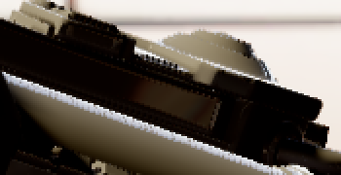
Inverse Luminance Filter – Exposure +10
Notes:
…suddenly all of our highlights disappear! This clearly isn’t what we wanted. However if we take exposure into account with a small offset of 2 stops…(click)

Slide 30
Fixed Inverse Luminance Filter – Exposure +10
Notes:
…then things are back to normal.

Slide 31
Resolve Filter Sample Code
float3 sample = InputTexture.Load(uint2(samplePos), subSampleIdx).xyz;
float weight = Filter(sampleDist); // Bicubic, Gaussian, etc.
float sampleLum = Luminance(sample);
sampleLum *= exposure * exp2(ExposureOffset); // ExposureOffset ~= -2.0
weight *= 1.0f / (1.0f + sampleLum);
sum += sample * weight;
totalWeight += weight;
Notes:
Just to lay everything out clearly, here’s some sample code for weighting a single subsample during a resolve operation. Basically we apply both our reconstruction filter as well as our inverse luminance filter, and keep track of the summed weight. That summed weight is then used at then to normalize the result.

Slide 32
Temporal AA
Primary goal: reduce specular flickering
Prefiltering wasn’t enough
Major inspirations:
TXAA
SMAA 1TX [Sousa13]
Dust 514 [Malan12]
Killzone: Shadow Fall [Valient14]
Notes:
The final component of our antialiasing was a temporal antialiasing implementation. At first I was fairly skeptical of temporal techniques, but I ended up pursuing it as means of reducing the flickering that manifested from undersampled specular shading. As I mentioned earlier we prefiltered our specular by way adjusting roughness maps to account for normal map variation, but there was still quite a bit of aliasing that occurred as the result of further perturbing surface normal as well as from very thin geometry. What we ended up shipping with was heavily based on the work presented by Tiago Sousa and Hugh Malan, who both gave fantastic presentations as part of this course. Brian Karis also gave a very in-depth presentation last year, although it happened after we already finalized our tech for The Order. Our implementation doesn’t really add anything new on top of what was previously presented, and so I don’t want to dwell on the topic for this talk . I would recommend consulting these presentations if you’d like to see the full details, and you can also look at the code sample that I’ll be linking to if you just want to see how I implemented it.

Slide 33
Temporal AA
Accumulate multiple samples
Exponential moving average
Reproject previous frame using velocity buffer
Weight and clamp using neighborhood min/max
Min/max computed during MSAA resolve
No jittering
Didn’t have time to fully integrate
Camera was always moving anyway
Notes:
So like I said we didn’t do anything novel here compared to what has already been presented. Like SMAA 1TX, we used an exponential moving average to accumulate each new sample into a render target, and we used a velocity buffer to reproject previous samples into their current position. To weight the new sample we used the local color neighborhood to reject or accept based on the intensity range of the local neighborhood.
Since we did temporal as part of the MSAA resolve, we were able to integrate the min/max computation into the filtering step, since we were already visiting neighboring pixels. This let us make us of unfiltered subsample data for these computations, which gave us better quality than using bilinear samples.
We also didn’t make use of any jittering in our implementation. One reason for this was that I simply didn’t have the time to properly integrate it in our rendering pipeline, since a lot of things need to be aware of the jittering in order to avoid artifacts. Another reason was that jittering only really helps when the camera is perfectly still, by artificially causing your sample points to move around so that you have more data to work with. In our game the camera is always moving anyway. Even if you just put the controller down the camera has a little but of sway to it, and that was enough sample point movement to give the temporal AA something to work with. However this is definitely something that I intend to revisit in the future once I have some more time. In particular I think there are some interesting opportunities to make use of programmable MSAA subsample positions in conjunction with temporal AA.

Slide 34
Post-AA Sharpening
“Soft” look from wide resolve
Consistent with the visual style
Definitely not for everybody
Some gameplay implications
Can add sharpening filter post AA
Unsharp mask is really simple
Don’t go too crazy!
Notes:
So between the MSAA resolve and the temporal filtering, I’m sure plenty of you have concerns about the resulting image being too soft. And this is certainly true, at least to an extent. Using a wider, softer filter is going to remove some of your high frequencies and the image that you get out of it definitely won’t have defined pixel edges. But then again, that’s kind of the point. Whether or not this is acceptable to you really depends on the art style of your game. For us it was pretty consistent with the look and feel that we were aiming for, and we were happy have a softer look as long as it was more stable. But for certain styles it might be a non-starter, and that’s fine. It’s also good to think about the gameplay implications before going nuts with filtering, in case your game relies on certain small details being clearly visible to the player. If you really want to, it’s pretty easy to add a sharpening filtering after you’re applied antialiasing. An unsharp mask is a really simple shader, and doesn’t add much cost. I don’t really recommend it, but it might be a useful option for some.

Slide 35
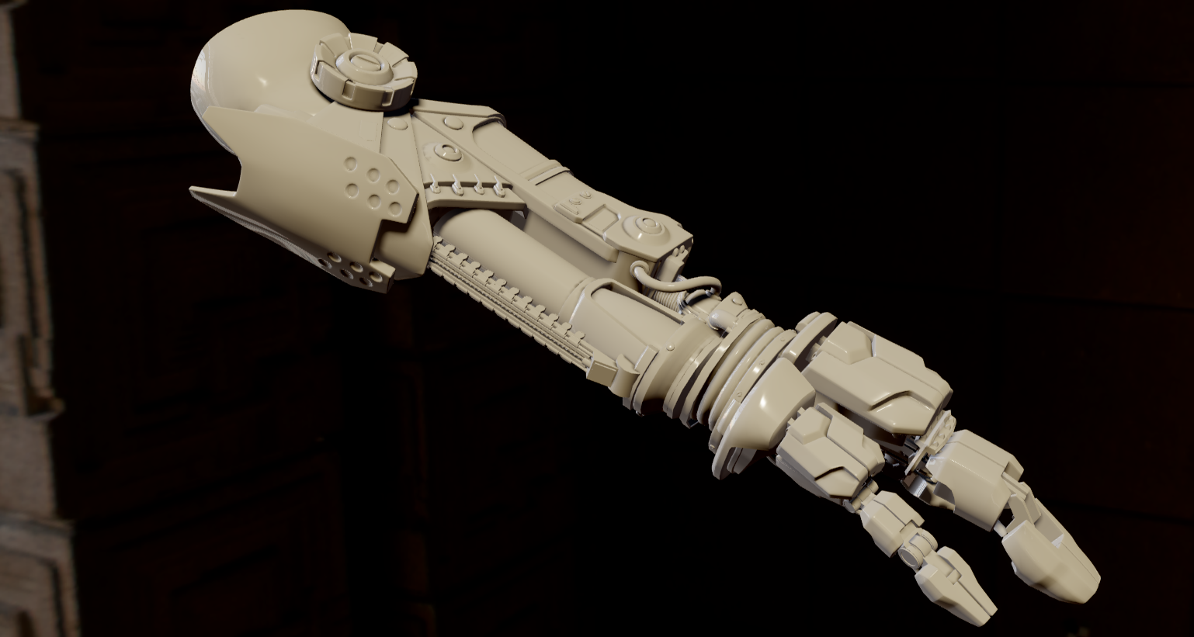
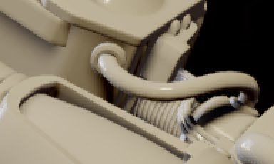
Sharpening = 0.0
Notes:
Here’s a quick comparison showing how sharpening can affect the final result. This image was generated with 4xMSAA, using filtering similar to what we used for The Order. If we enable sharpening at half strength…(click)

Slide 36
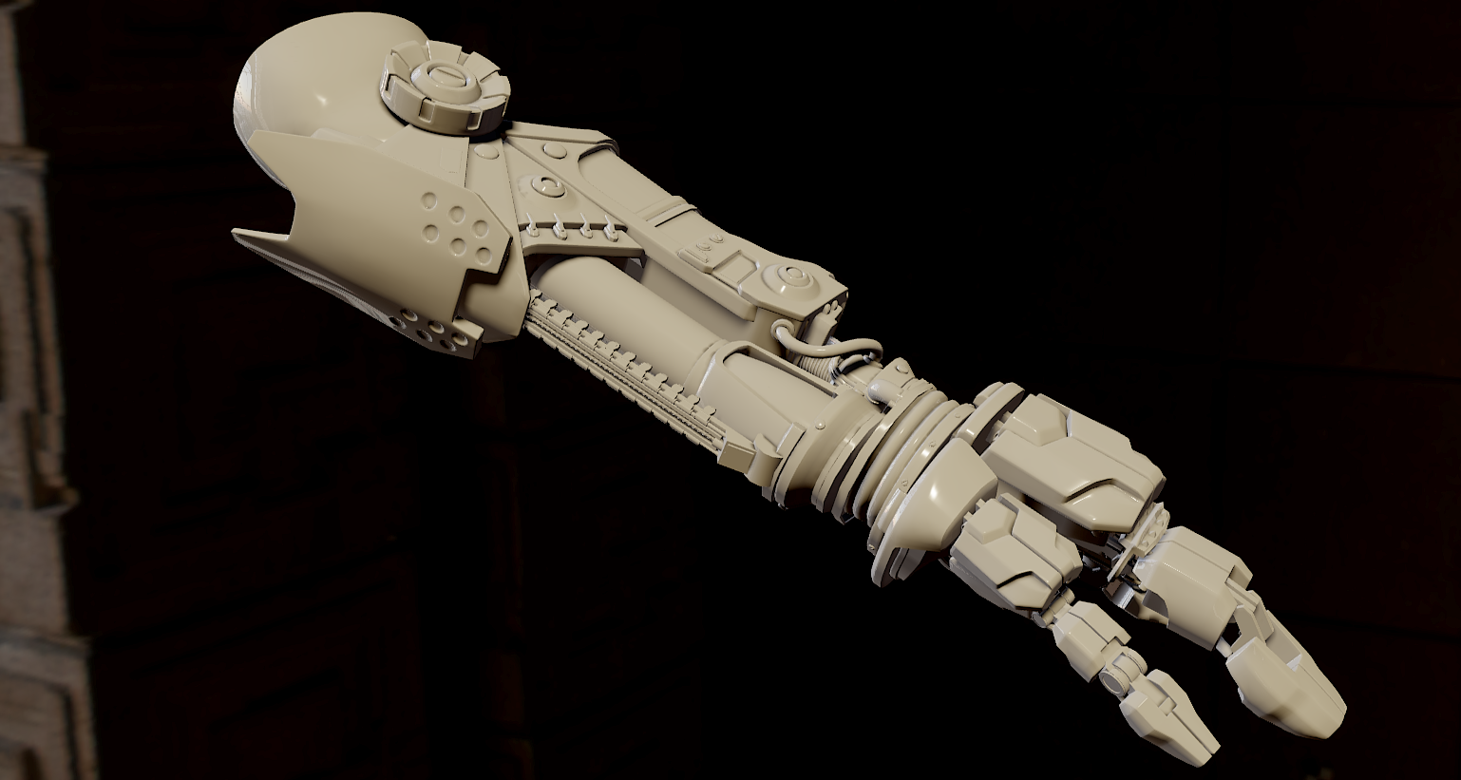
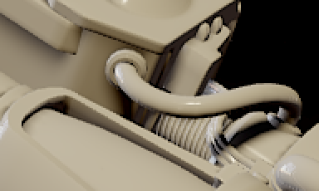
Sharpening = 0.5
Notes:
…the image will now appear sharper with more contrast. However the edge gradiation starts to suffer. If we increase the sharpening to full strength…(click)

Slide 37
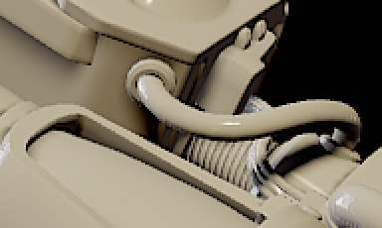
Sharpening = 1.0
Notes:
There’s even more constrast, and even worse edge quality. (flip back and forth again)

Slide 38
AA Performance in The Order
Color Fragments | Coverage Samples | Resolve Type | Temporal AA Enabled | Main Pass (ms) | Transparents (ms) | Resolve (ms) | Total (ms)
1 | 1 | HW | N/A | 7.35 | 0.62 | N/A | 15.7
2 | 2 | HW | N/A | 7.90 | 0.68 | 0.50 | 17.1
2 | 2 | Custom | False | 7.90 | 0.68 | 0.41 | 17.1
2 | 2 | Custom | True | 7.90 | 0.68 | 0.78 | 17.4
2 | 4 | HW | N/A | 8.40 | 0.72 | 0.50 | 17.7
2 | 4 | Custom | False | 8.40 | 0.72 | 0.61 | 17.8
2 | 4 | Custom | True | 8.40 | 0.72 | 1.02 | 18.2
4 | 4 | HW | N/A | 8.55 | 0.72 | 0.56 | 19.0
4 | 4 | Custom | False | 8.55 | 0.72 | 0.63 | 19.1
4 | 4 | Custom | True | 8.55 | 0.72 | 1.03 | 19.5
Notes:
To give you an idea of how much the antialiasing cost us, here’s a table of GPU timings from the PS4. (click) The row circled in red is what we shipped with. If you do the math, it ended up costing about 2.5ms for this particular scene.

Slide 39
AA Memory Overhead in The Order
Color Fragments | Coverage Samples | Color Target (MB) | Depth Buffer (MB)
1 | 1 | 12.187 | 7.125
2 | 2 | 26.141 | 13.25
2 | 4 | 26.141 | 13.25
4 | 4 | 50.515 | 26.375
Notes:
As for memory, here’s how much it cost us for our main render target and depth buffer, which were sized at 1920x800. (click) Once again, the red box is what we shipped with. For our forward rendering setup it was only an additional 20 megabytes, which wasn’t bad at all for our target hardware.

Slide 40
The Order: No AA
Notes:
To give you an idea of how well the antialiasing works in motion, I captured some videos straight off the PS4. (start video) This first video shows the game with no antialiasing whatsoever, with most post processing disabled. Unfortunately it’s a bit compressed since I was unable to get a lossless capture from my dev kit, but even with the compression there’s still visible flickering if you look at some of the thin geometry in the distance. In particularly the railroad tracks get undersampled really badly, as does the crane that’s off in the distance.

Slide 41
The Order: With AA
Notes:
This video was captured with full antialiasing enabled. Hopefully you can see how much smoother everything is compared to the video that I just showed you.

Slide 42
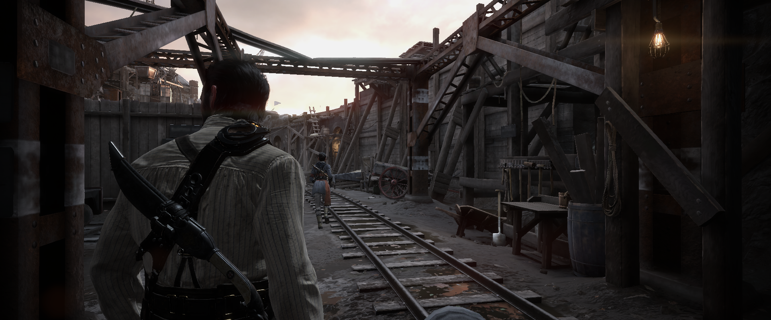
The Order – No AA
Notes:
Finally, I took some uncompressed still captures so that you can compare the edge quality between the two. This one has no antialiasing…(click)

Slide 43
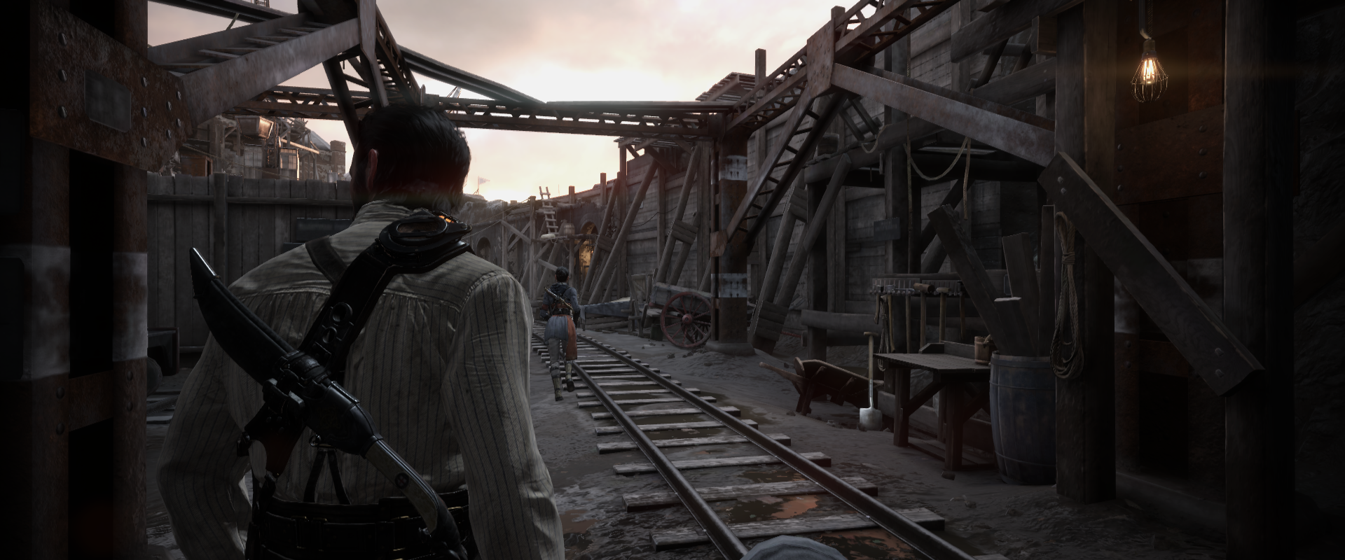
The Order – Full AA
Notes:
…and this one has full antialiasing.

Slide 44
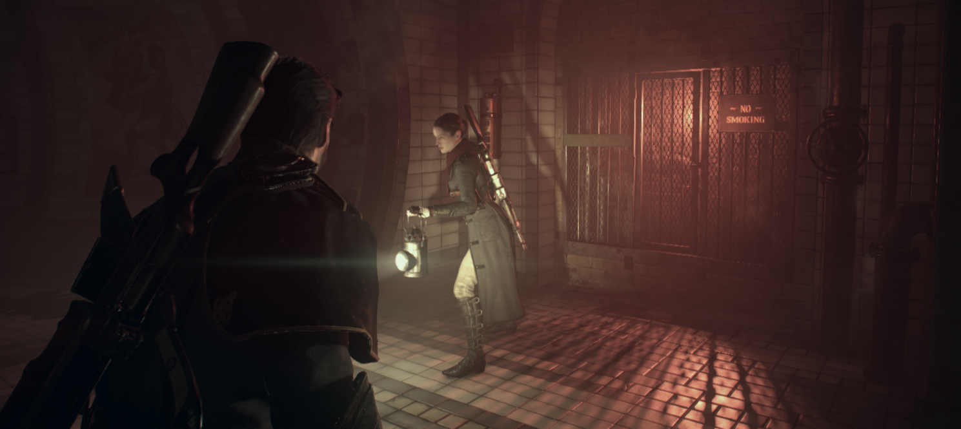
Shadows
Notes:
Now I want to shift gears a bit and talk about the shadow tech that we used for The Order. Like a lot of things in our engine, we used a combination of low-tech and high-tech solutions to get the look that we want. This here is an image taken from an underground section of the Whitechapel area.

Slide 45
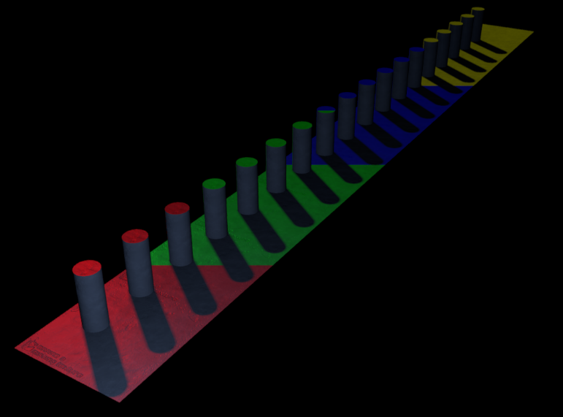
Shadow Basics
16 spot light shadow casters
1 directional light with 4 cascades
Tools supported 2 directional lights
Keep it simple:
1 texture array for spotlights, 1 for cascades
Sampled in forward pass
Cached spotlight shadows
Throttle updates based on distance
Don’t regenerate if nothing moved
Notes:
Just to touch on the basics really quickly, we supported a maximum of 16 shadow-casting spotlights per frame as well as 1 shadow-casting directional light. For shadow map storage we took a really simple approach, and just stored all 16 shadow maps in the 16 slices of a 2D texture array. That texture array was then sampled directly by the forward pixel shaders, so there wasn’t any deferred shadowing or anything like that. One simple thing that we did for performance was we would try to cache shadows whenever we could, and throttle the updates for shadow casters that were far away from the camera. I suspect that this is fairly common on newer hardware now that we have more memory available.

Slide 46
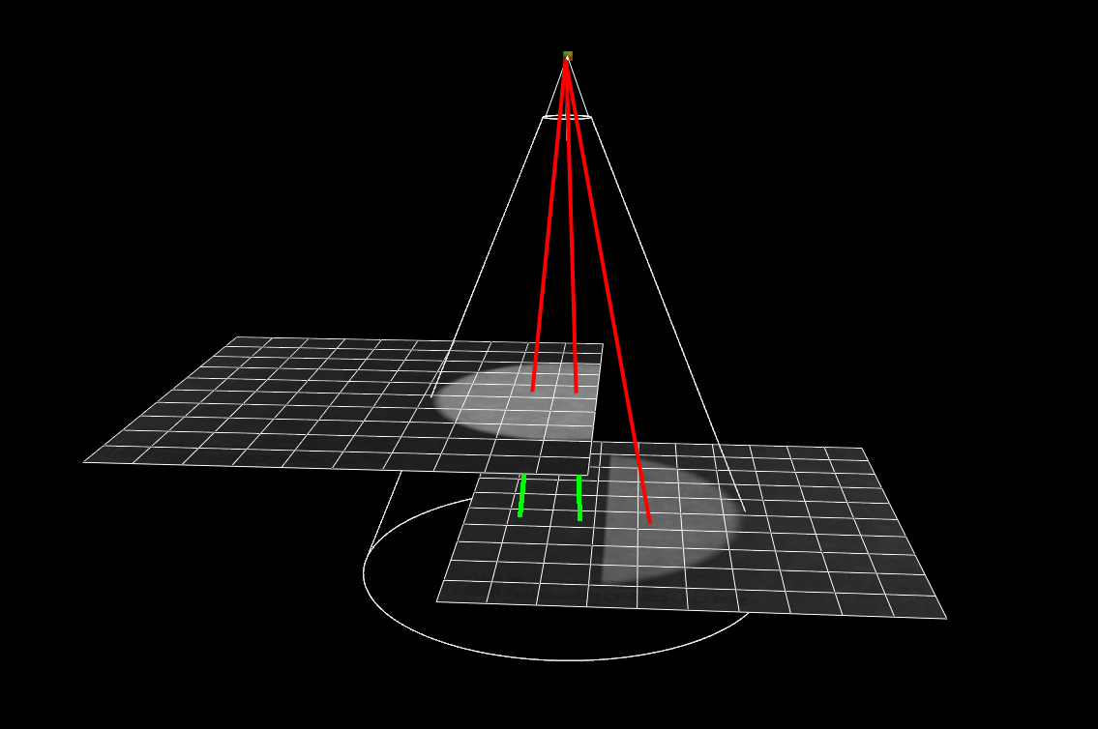
Precomputed Shadow Visibility
Extension of system used for primary visibility
Precomputed during level build
For non-moving lights only
For spotlights:
Rasterize mesh ID’s from light POV
Use stencil to mark casters (count >=2)
Notes:
One important performance aspect for shadows is culling meshes that are totally occluded by other meshes, so that you only have to rasterize the minimal set of shadow casters needed. Some games use really fancy runtime techniques for this, but we instead made use of our precomputed visibility system, whose roots go all the back to the Daxter days. For spotlights in particular, all we do is rasterize mesh ID’s from the light’s point of view so that we can figure out the set of meshes that are actually visible to the light source. Then to get the final set of shadow casters, we use stencil to increment every time the rasterizer touches a pixel. We then only look at mesh ID’s from pixels where the stencil count is greater than or equal to 2, since that means that this particular pixel is casting a shadow onto another mesh. And just to clarify this all done offline, and only for static light sources. It obviously doesn’t work if the light moves.

Slide 47
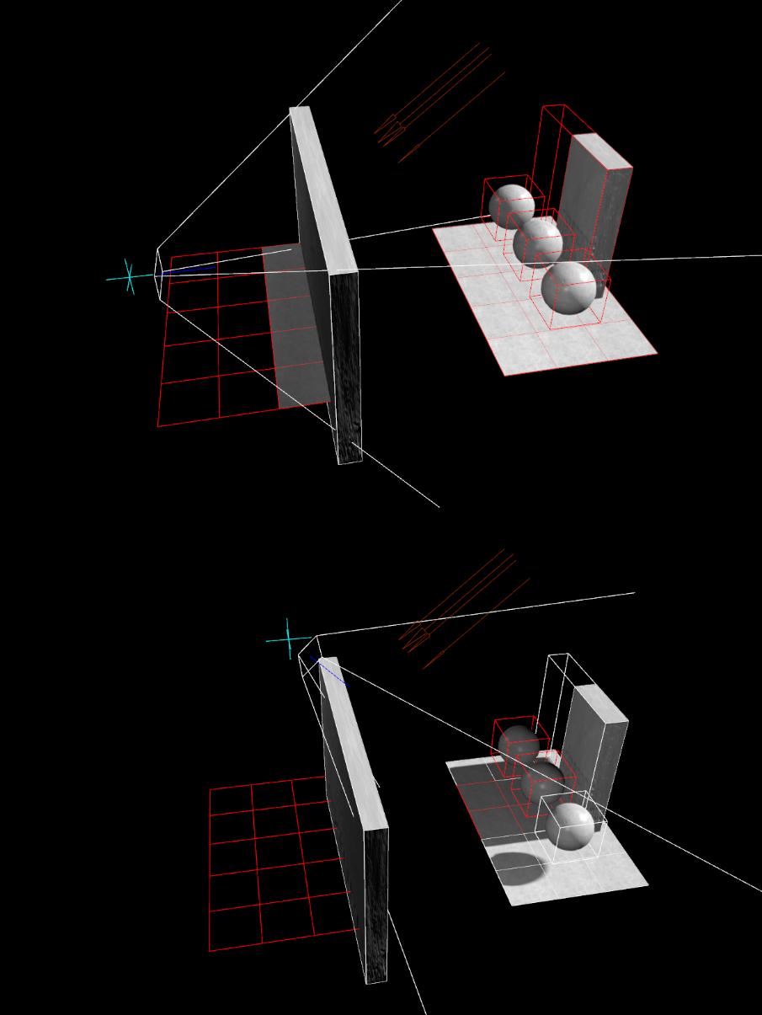
Precomputed Shadow Visibility
For directional lights:
Split level into NxN tiles in light space
Determine potential shadow casters
For each camera sample point:
Render camera-visible meshes
Render potential shadow casters
If stencil >=2, add to final shadow visibility list
Notes:
We did something similar for directional lights, although it was more complicated due to their global nature. For the first pass, we use the same approach as spotlights to figure out the set of potential shadow casters. Since the light is global, we do that by chunking up the level into NxN tiles according to a minimum resolution threshold and then we do the test for every tile. To reduce the necessary set of shadow casters even further, we try to determine the set of shadow casters that will cast shadows that would actually be visible according to the camera’s point of view. This way if some mesh is casting a shadow on the other side of a wall or outside a building, we don’t need to bother rasterizing that mesh. To do that we once again use stencil to mark pixels where shadow casters overlap with meshes visible to current camera sector, and then add casters to the list if the stencil is greater than or equal to 2.

Slide 48
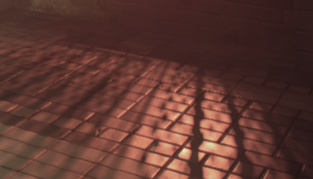
EVSM
Used EVSM for all shadows
Pros:
No bias! Less noodling
HW filtering (trilinear, anisotropic)
Pre-filtering is a good fit for forward rendering
Helped reduce GPR pressure
Works great with caching
Notes:
For filtering, we actually used exponential variance shadow maps for everything, which are essentially a variant of variance shadow maps where leaking is reduced by applying an exponential warp. Variance shadow maps and their derivatives still aren’t very popular in games, which I would assume is due to concerns about leaking artifacts as well as performance costs from high-precision storage formats. However I would say that they worked out pretty well for our specific use cases, and so they’re definitely a viable option.
Perhaps the single greatest benefit of EVSM is you don’t have the typical biasing issues that you have with standard shadow maps and PCF. With EVSM you just pick one bias factor, and you can use it for everything. This was definitely a major motivator for me, since I was really keen to save our lighting artists from having to constantly tweak bias settings.
Next on the list is hardware filtering, which is already a well-known benefit. Typically in games we use shadow filtering as means to reduce aliasing from rasterizing the depth map, but there can also be aliasing from undersampling the shadow map itself. This can happen easily if you have high-resolution shadow maps, or if the shadow is projected onto a surface that’s nearly perpendicular to the viewing direction. Mipmaps help fix the flickering from this undersampling, and anisotropic filtering lets you fix the flickering while still retaining shadow definition.
For us in particular, the ability to prefilter the shadow map was actually a pretty big benefit. Our pixel shaders are pretty monstrous, since they have the full material and lighting pipeline all in one place. Being able to remove filtering made the shader less complicated, and also helped reduce GPR pressure from unrolled PCF loops. Prefiltering also worked really well with our shadow caching system, which was a nice coincidence. By filtering and then saving the results, we would effectively amortize the conversion and filtering costs across multiple frames.

Slide 49
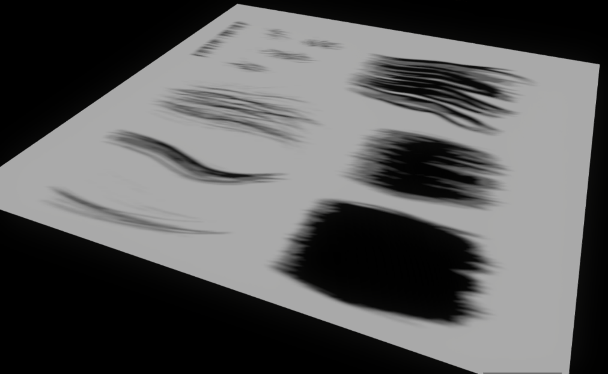
EVSM
Filtering/conversion pipelined with rasterization
Async compute (thanks Tobias!)
Used depth metadata to skip “flat” depth tiles
4xMSAA during depth rendering
Double effective resolution
512x512 for spotlights, 1024x1024 cascades
A2C for 3-bit translucent shadows
Notes:
To further reduce the costs of conversion and filtering, we implemented them as compute shaders that were executed on the async pipes of the GPU. By doing this, we could overlap the conversion and filtering with the depth buffer rasterization that was occurring for the next shadow map in the list. This idea actually came from Tobias Berghoff, GPU psychiatrist, so he deserves the credit for that one. As an additional optimization, were also able to leverage depth buffer metadata to detect “flat” tiles in the depth buffer. For these tiles the depth value is constant, so we could early out the entire wavefront and skip the cost of sampling and converting the depth buffer.
One thing I really like about EVSM is that you can use MSAA during depth buffer rasterization. This lets you get higher effective resolution with lower memory and performance cost, and also lets you make use of a superior rotated grid sampling pattern. We ended up using 4xMSAA, with 512x512 render targets for spotlights and 1024x1024 targets for the each directional light cascade. This gave us an effective resolution of 1k for the spotlights and 2kx2k for the cascades. One added bonus that came from MSAA was that we could use alpha-to-coverage to get a 3-bit translucency approximation. We used this for hair to reduce the harshness of the shadows, for a slightly more realistic look.

Slide 50
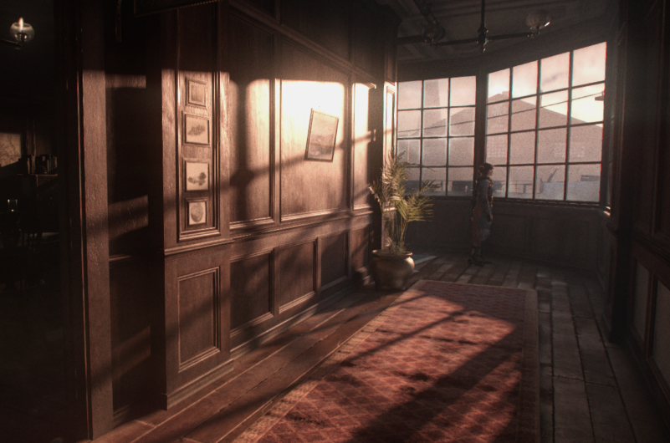
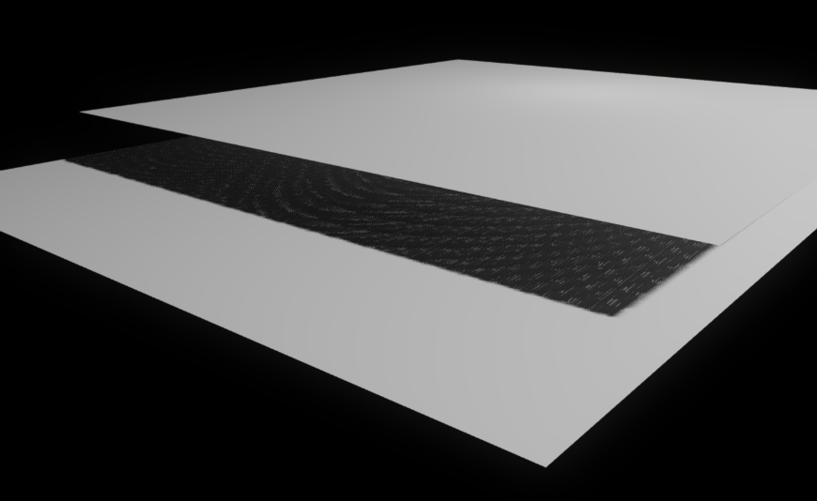
EVSM
Cons:
Used 16-bit for performance reasons ☹
Leaking more prevalent
Less aggressive exponential warp
Precision issues for large depth ranges
Manually constrained spotlight min/max distance
Pre-filtering still expensive
~0.5ms for 1024x1024 with max filtering
Async softens the blow
Notes:
Obviously there’s some downsides to EVSM, and we definitely ran into a few. Most of them stemmed from the fact that we ended up dropping down to 16 bit precision for our EVSM render targets, as opposed to using full 32-bit precision. With 16 bit you can’t use as aggressive of an exponential warp for reducing light bleeding, and so we had some bleeding artifacts in extreme cases. Fortunately these cases weren’t too prevalent in our, and most of the time they could be worked around by simple tweaks to the scene geometry. In some cases we also added additional occlude-only geometry that was rendered into the shadow map but not into the main camera, and these could be used to fix artifacts as well as make things cheaper.
With 16-bit we also had some precision issues in certain places. These mainly came out when the depth range of shadow caster was very large, and the distance between the occlude and receiver was very small. For the most part we avoided these issues by just making sure that the light’s near and far planes were as tight as possible, which is also something you want to do for performance reasons.
And of course there is definitely a cost to conversion and filtering, which certainly weren’t free. Our usage of async compute helped softened the blow, but it was still a cost that we had to account for. In the worst cases it could get up to 0.5ms per cascade with maximum filtering. On the bright side, we could at least account for the filter cost separate from the cost of pixel shading in the main pass.

Slide 51
EVSM - Leaking
Notes:
Here’s a picture showing one of the few places in the game where leaking was easily visible. (click) The areas in the red boxes are it happens. In this case the leaking is being caused by window grills overlapping with other scene geometry.

Slide 52
EVSM – Precision Issues
Notes:
Here we have an example of 16-bit precision issues. (click) If you look at the close-up view, you can see the artifacts pretty clearly.

Slide 53
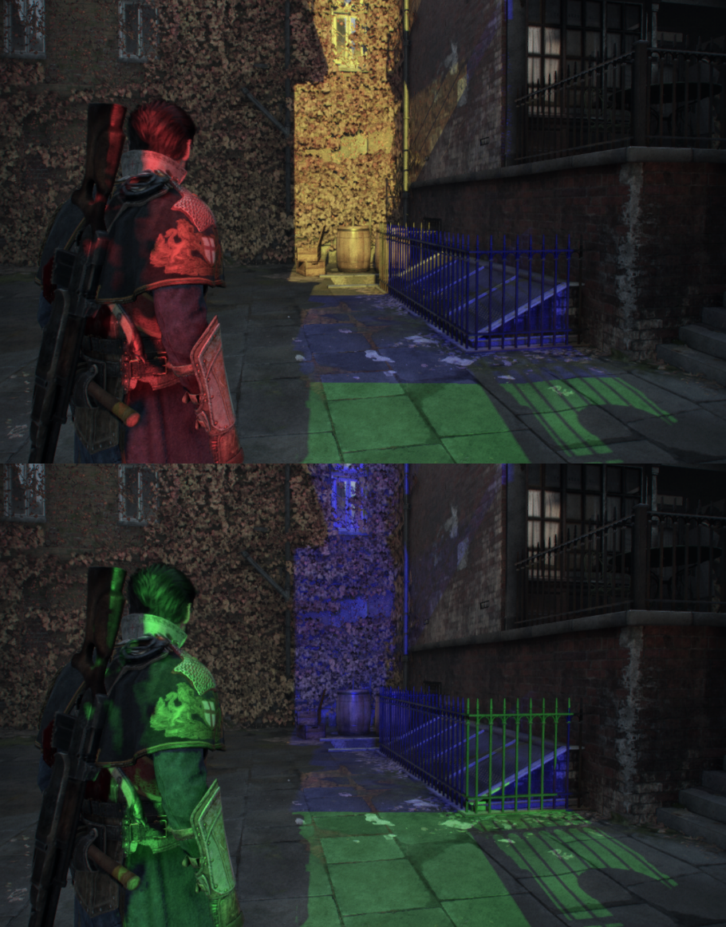
SDSM
SDSM-style analysis for cascades
Analyze depth buffer
Constrain cascades based on visible surfaces
Computed min/max view space XYZ
Single pass with optimized atomics
Ideally compute AABB in light space per-cascade
Notes:
One of the big art requests I had from this game was to have directional light shadows that were easy to work with. Early on in the project we had a more standard cascaded shadow map setup, where control over the cascade partitions was manually controlled by the lighting artists. They were pretty unhappy with this setup, and asked me to look into something that could required less manual intervention to achieve good results. To help them out, I implemented a simplified version of Sample Distribution Shadow Maps into our engine. In case you’re not familiar, the basic idea is that you analyze your depth buffer and use the data to tightly fit your cascade bounds to the set of visible surfaces. The original implementation has a few approaches, some of which require multiple passes in order to achieve the best quality. We ended up using a simplified single-pass approach, where a compute shader computed an axis-aligned bounding box in view space using the depth buffer. This data was then used to constrain the light-space bounding volumes that were used to compute the final cascade partitions. Ideally you would want to transform every depth buffer position into light space and additional constrain your cascades based on the resulting AABB, but in my opinion you get most of the benefit by fitting your cascades to the minimum and maximum visible depth of the scene.

Slide 54
SDSM
Shipped with 1 frame of lag on readback
Planned a GPU path, ran out of time
“Time warp” trick to reduce artifacts:
Compute velocity for each pixel
Predict next frame position
Expand AABB to cover next frame position
Wasn’t stable!
Really need to revisit
Notes:
One of main issues with SDSM is that if you want to do all of your cascade setup on the CPU, then you need to somehow read back the results of your depth buffer analysis. Reading back the data while you’re still submitting is really bad for performance, because you’ll introduce a big hole where the GPU just idles waiting for more commands to be submitted. Waiting a frame or two for the results fixes that’s the performance problem, but then you end up issues when the camera or scene geometry moves around and the cascade bounds need to be increased. Another way to avoid the readback is to use a GPU-driven approach, where the GPU sets up the cascades, culls meshes, and submits the necessary geometry. I had originally planned on implementing this for The Order, but unfortunately it kept getting pushed back until I no longer had time to do it before shipping.
Ultimately we ended up just shipping with one frame of latency on the readback. To reduce the artifacts, we used a simple “time warp” trick during the depth buffer analysis. Basically, we would use the previous view/projection matrix to compute a pixel’s position in the previous frame, and then use that to compute the instantaneous velocity. We would then use that velocity to predict the pixel’s position in the next frame, and then expand the bounds of the AABB to accommodate it.
One really negative point of using SDSM was that it wasn’t always temporally stable, which is pretty funny considering how much I was going on about stability earlier in this presentation. The instability comes from the fact that the cascades could grow or shrink rapidly from one frame to the next. In a lot of cases it’s not much of an issues, since SDSM can make sure that you get sub-pixel shadow resolution and so filtering takes care of it. But for extreme cases where the shadow map resolution is inadequate, the rapid changes are very noticeable. You also can’t use typical cascade stabilization techniques with SDSM, since they require using fixed cascade bounds. Unfortunately our directional lights didn’t really get fully integrated in the game until very late in the project, and so I didn’t really have time to notice the problem and do something about it. If we’re going to continue using SDSM in future projects, then I really need to revisit the issue of stability and see if it can be improved.

Slide 55
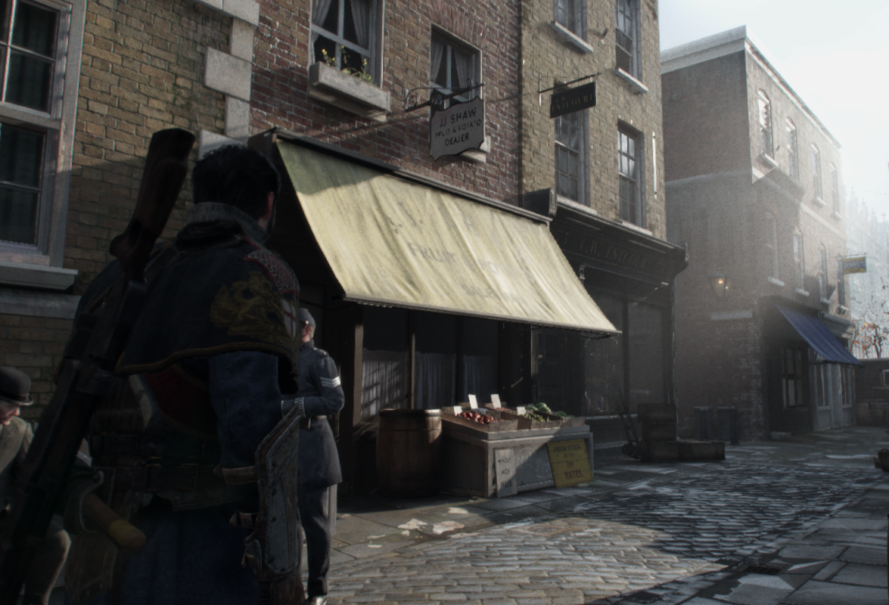
SDSM Disabled
Notes:
To see what kind of impact SDSM had on our game, here’s an image from Mayfair with SDSM disabled. You might not notice all of the aliasing artifacts, but if I switch to an image with SDSM enabled…(click)

Slide 56
SDSM Enabled
Notes:
…you can see all of the places where the shadows improve considerably. (switch back and forth) If you look closely, you can see that the places where it really helps are some of the worst-case situations for shadow maps. For this shot the light is nearly parallel with the brick surfaces in front of the player, and some of the occluders are very close to the wall. Without SDSM those areas undersample very badly, but with SDSM we have enough resolution for those small occluders to have nice shadows.

Slide 57
Acknowledgements
Timothy Lottes
Andrew Lauritzen
Brian Karis
Dave Neubelt
Jamie Hayes
Natalya Tatarchuk

Slide 58
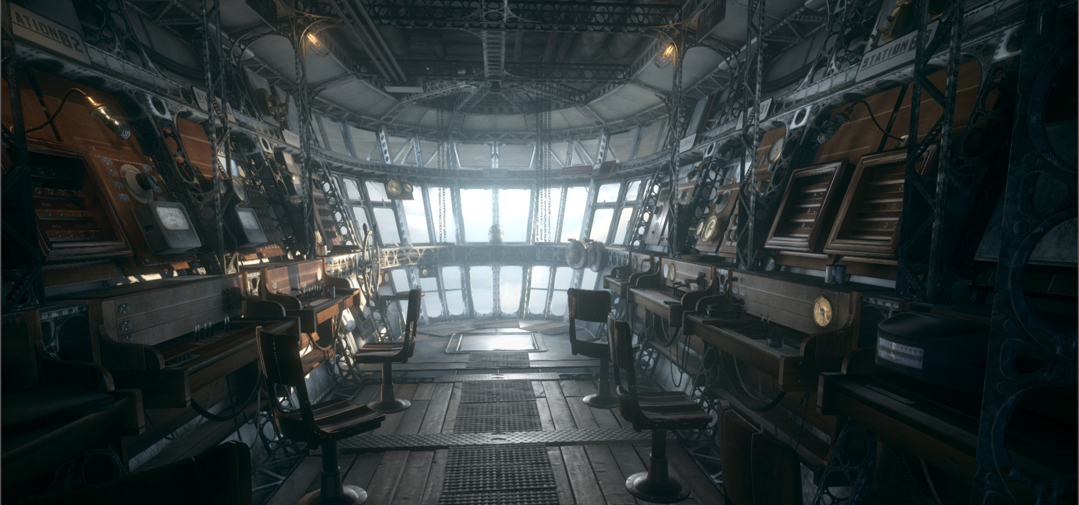
Questions?
Contact info:
matt@readyatdawn.com
@mynameismjp
http://mynameismjp.wordpress.com/
Antialiasing sample code:
http://github.com/TheRealMJP/MSAAFilter
Slides available at www.readyatdawn.com

Slide 59
References
[Drobot14] Hybrid Reconstruction Anti Aliasing
[Karis12] Tone Mapping [Karis14] High Quality Temporal Supersampling
[Kim12] Screen Space Decals in Warhammer 40,000: Space Marine
[Hill12] Rock-Solid Shading: Image Stability Without Sacrificing Detail
[Malan12] Real-Time Global Illumination and Reflections in Dust 514
[Mikkelson10] Bump Mapping Unparameterized Surfaces on the GPU
[Mitchell88] Reconstruction Filters in Computer Graphics
[Neubelt13] Crafting a Next-Gen Material Pipeline for The Order: 1886
[Valient14] Taking Killzone Shadow Fall Image Quality into the Next Generation
[Sousa13] Graphics Gems from CryEngine 3
[Persson08] Custom Resolve
[Pettineo12] Experimenting With Reconstruction Filters For MSAA Resolve

Slide 60
Bonus Slides

Slide 61
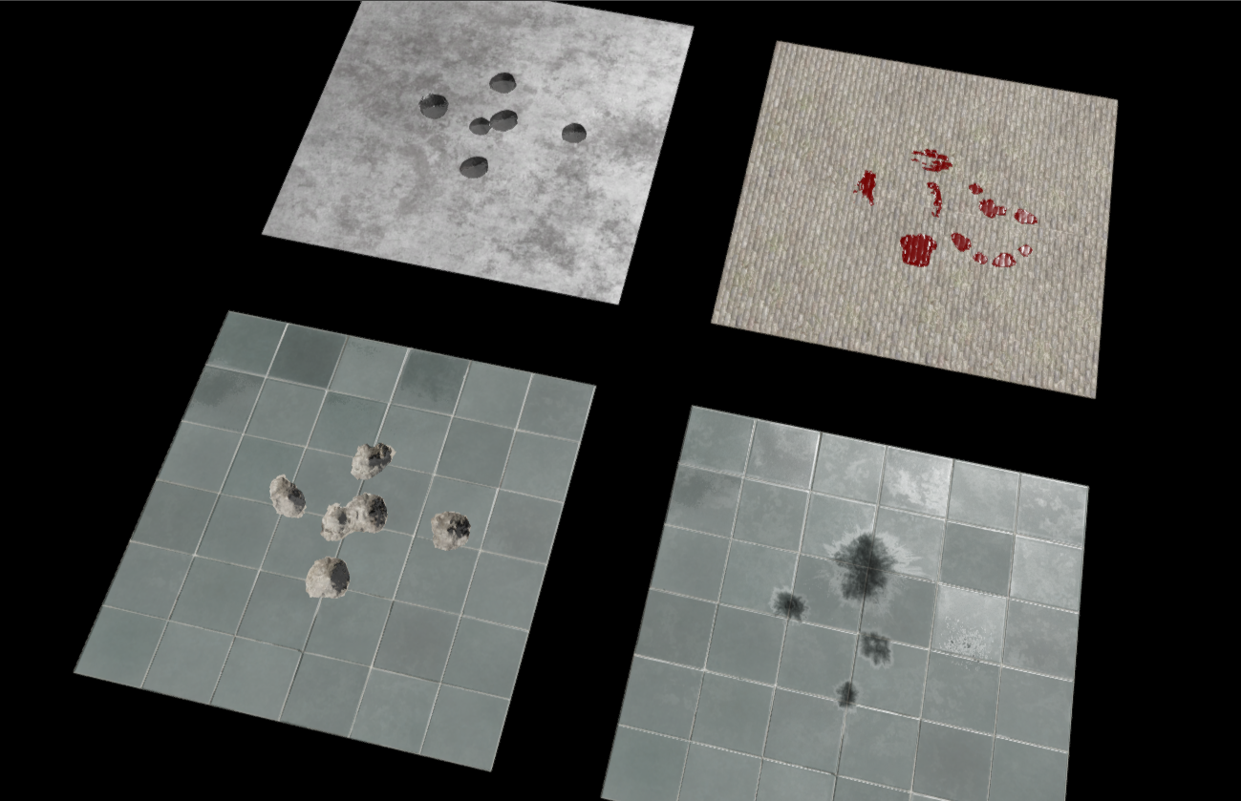
Decals
Notes:
Finally, I just want to briefly talk about our decal technology of the game. This image is showing a few examples of our deferred decal system, which I’ll get to in a minute.

Slide 62
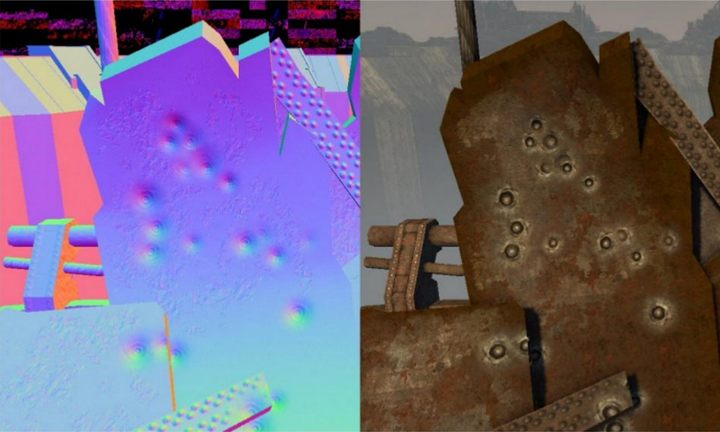
Decals Overview
Popular technique: G-Buffer blending [Kim12]
Modify material properties before lighting
Works well with projective decals
We have no G-Buffer!
What do we do?
From Screen Space Decals in Warhammer 40,000: Space Marine
Notes:
Currently the state-of-the-art for decals is to use projectors that modify your G-Buffer properties before lighting, usually though some form of alpha blending. This is a pretty nice way of doing it, since by modifying the properties you can avoid paying the cost of lighting both the underlying surface and decal. But for our game we had no G-Buffer, so what do we do instead?

Slide 63
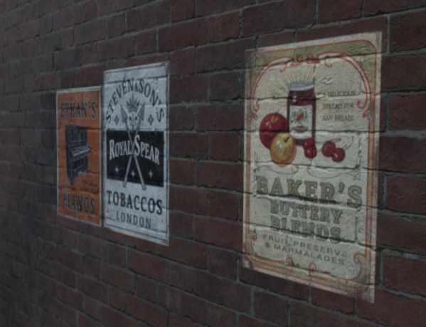
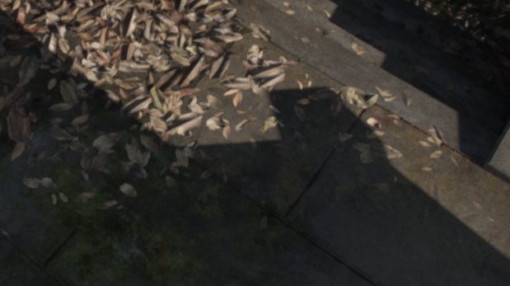
Traditional Decals
General case: old-school decals
Render with transparent blending
Fully lit
Pixel shader overdraw! ☹
Static decals only
Hand-authored geo
Blend with underlying normal
Static opaque geo writes normal to MRT1 during main pass
Notes:
For general-case decals that required arbitrary materials, we fell back to a really low-tech solution. The environment artists had to manually author and place decal geometry throughout the level, and then they would get rendered in a special pass right after the opaque geometry. They were essentially rendered as standard transparent geometry with alpha blending, which meant that we had to pay the cost of lighting both the decal as well as the surface underneath it. The only nice feature that they got for this was that they could sample the normal of the opaque surface underneath the decal, and blend that with the decal’s surface normal. With this they could do things like the posters in the pictures to the right, where the brick normal is visible through the decal. To do this I had to have all opaque geometry write out their per-pixel normal to a second render target, which I wasn’t super happy about. Fortunately the added cost was pretty minimal, since I could make it a non-MSAA target on PS4.

Slide 64
Hybrid Decals
Special cases: hybrid approach
Craters, blood, and scorch marks
Deferred pass to accumulate
Use depth for projection
Additive blend into fp16 render target
Main forward pass reads decal buffer, modifies material properties
R | G | B | A
Crater layer blend | Crater height | Blood amount | Scorch amount
Notes:
For special cases, we came up with a hybrid system that was used heavily throughout the game. These decals worked by using a deferred pass right after our depth prepass, where we rendered projector volumes for each decal. The pixel shader for these volumes would sample the depth buffer to project their textures, and they would additively blend their results into a 16-bit render target. The values that were accumulated in this render target corresponded to specific decal effects, whose meaning was hard-coded into the engine. The first two channels were used for “crater” decals, which were mainly used for added small scale damage from bullets and other weapons. The blue channel was used for blood accumulation, and the alpha channel was used for scorch accumulation. During the main forward pass, the pixel shader would then read in this render target based on screen position, and make the appropriate modifications to the material properties before they were passed n to the lighting phase..

Slide 65
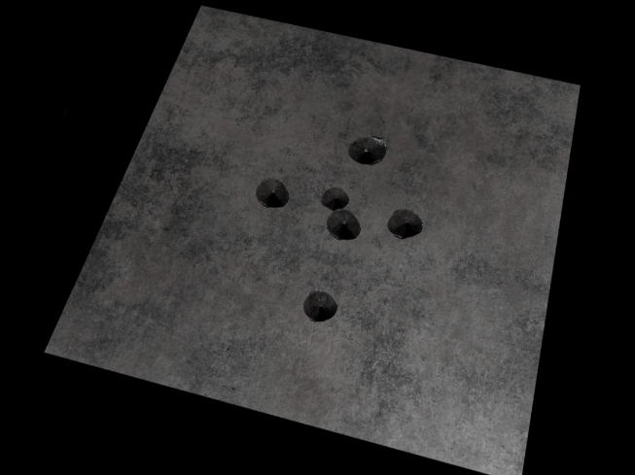
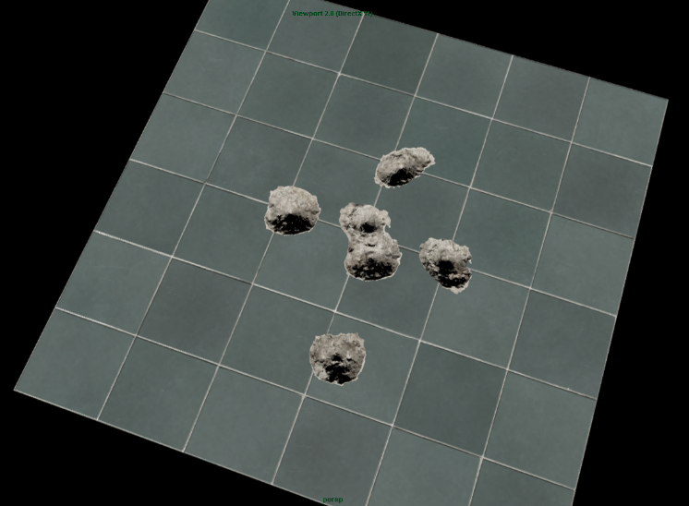
Hybrid Decals - Crater
Primarily used for bullet impacts
R channel triggers layer blending
Full set of properties for damage layer
Material determines the look
G channel treated as height map
Perturb normal using height derivatives
See [Mikkelson10]
Notes:
So like I mentioned before, the first decal type was used creating small craters and other impact effects from bullets. The value from the first channel was used to drive runtime layer blending in the material, so that the material could blend in properties corresponding to a damaged state of that material. So for instance in the ceramic tile case on the right, the damage layer has the look of the concrete and grout that’s underneath the tile. So effectively, the material almost totally controls how it responds to bullet impact, as opposed to that information coming from the decal itself. So for instance if you look at the metal surface in the upper right, you can see that it has a very different material response to the impacts.
To provide the actual cratered look to the surface, the second decal channel was essentially treated as an accumulated height value. The derivatives of this value were used to perturb the surface normal, just like you would if you were applying bump mapping from a height map. For information on how to do this, you can consult Morten Mikkelson’s paper entitled “Bump Mapping Unparametrized Surfaces on the GPU”.

Slide 66
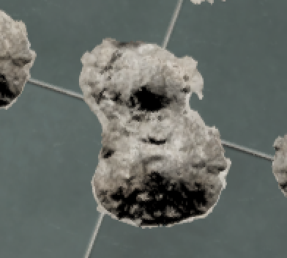
Hybrid Decals - Crater
Notes:
So here’s a closer view of the crater decals on the ceramic tile material. If you look closely at the area in the middle (click), you’ll see that there’s actually two overlapping decals here. That’s one advantage of using an accumulation approach: you can have overlapping decals, and they just naturally pile up without any seams.

Slide 67
Hybrid Decals - Blood
Blend in blood surface properties
Red diffuse, smooth specular, smooth normal
Adjust blend factor using height map
Accumulate more in cracks
Use derivatives to round off edges
Gives blood a “pooled” look
Notes:
Blood works in a similar way to the crater decals. The material reads in the accumulated blood amount, and modifies its material properties accordingly. For blood, this typically means blending in red diffuse, smooth specular, and smooth normals. To make it look more like blood, we use the screen-space derivatives of the blood channel to give a slight beveled look at the edges, which helps give the blood more of a “pooled” look. We also expose controls that allow the blood to the blended based on the material’s height map, which allows the blood to accumulate more in cracks between bricks.

Slide 68
Hybrid Decals - Blood
Notes:
Here’s a better view of the blood decals. If I zoom in on this part here (click), you can start to make out some of the edge beveling and pooling that I was talking about earlier. Also if I zoom in on this part (click), you can see how the decals can overlap nicely without any issues.

Slide 69
Hybrid Decals - Scorching
Simple: just blends in scorch properties
Black diffuse,
Very rough specular
Notes:
Our final type of specialized decal was used for scorching effects from grenades, shotguns, and explosions. This decal was dead simple: wherever it was accumulated, we would blend scorch properties onto the base material properties. This usually meant black diffuse, and very rough specular.

Slide 70
Hybrid Decals
Pros:
Pretty cheap to accumulate (only 1 RT)
Full control over crater properties
All properties can accumulate
No issues with overlapping decals
Cons:
Very limiting
Forward pixel shaders more complicated
Needs logic and properties for decals
Notes:
Looking back, one of the nice things about the hybrid decals was that they were very cheap to accumulate. They were only blending into a single render target instead of a full G-Buffer, so we didn’t have to worry about bandwidth issues. It was also nice that the materials had full control over how they responded to the craters and other decal types, which was occasionally useful for creating specialized looks. And I already mentioned how the decals accumulate, which means you don’t get any issues where the decals overlap. On the flip size, the very obvious downside here is that these decals were super specific and not at all flexible. For generalized decals they had to fallback to the old-school decals, which were expensive and more difficult to author. Another downside is that all of the logic for responding to the decal types had to go into forward pixel shader, which made them even more complicated.

Slide 71
Hybrid Decals – Future Work
More flexible decal types
Arbitrary projective decals
Use dynamic indexing into bindless texture arrays
Object-space accumulation
See [Star Citizen GDC 2015]
Notes:
For future, I’d definitely like to take a stab at implementing a system that can handle more arbitrary materials. One possible avenue for this would be to build up a list of decals in screen-space tiles, just like we do for lighting. Then the main pass could walk the list, and blend in the material properties from the decals. To fetch the properties from the appropriate textures, you could possibly use dynamic indexing into bindless texture arrays.
Another aspect I’d like to consider would be accumulating decals in object space, which would be nice for applying them to characters. This was something that was actually presented earlier this year at GDC by the Star Citizen developers, who alos used a similar accumulation system for the damage effects on their ships.

