Slide 2
GPU-Driven Rendering Pipelines
SIGGRAPH 2015: Advances in Real-Time Rendering in Games
Ulrich Haar, Lead Programmer 3D, Ubisoft Montreal
Sebastian Aaltonen, Senior Lead Programmer, RedLynx a Ubisoft Studio
Notes:
Hi, my name is Ulrich Haar and I will talk about the GPU-Driven rendering pipeline we developed for Assassin’s Creed Unity at Ubisoft Montreal. Sebastian Aaltonen will then talk about a related GPU-Driven rendering pipeline they developed at RedLynx another Ubisoft studio. As my talk is the first part, I will cover a few subjects that are shared between our and RedLynx’s pipeline. Sebastian will then talk about the specifics of their approach in the second part.

Slide 3
Topics
Motivation
Mesh Cluster Rendering
Rendering Pipeline Overview
Occlusion Depth Generation
Results and future work
Notes:
I will start with the motivation and history for both RedLynx and Ubisoft Montreal to develop this kind of GPU-driven rendering pipeline, then do a brief introduction to the mesh cluster rendering that is used in both pipelines. After that I will give a detailed overview of the rendering pipeline on ACU and finish with an overview of occlusion depth generation techniques used and some results.

Slide 4
GPU-Driven Rendering?
GPU controls what objects are actually rendered
“draw scene” GPU-command
n viewports/frustums
GPU determines (sub-)object visibility
No CPU/GPU roundtrip
Prior work [SBOT08]
Notes:
GPU-Driven Rendering: What do we really mean by this?
The most important aspect for us is that we shift control over which objects actually get rendered and to what viewport from the CPU to the GPU, so that the GPU could ideally render a full scene without the CPU ever touching any of the objects. The broad rationale for this is that as scenes and algorithm scale, the GPU is more efficient to cull the massive amount of objects and it has zero latency visibility information available.
As you will see, for a game like AC with its technology that slowly evolved over time, we are still quite far from this ideal state.

Slide 5
Motivation (RedLynx)
Modular construction using in-game level editor
High draw distance. Background built from small objects.
No baked lighting. Lots of draw calls from shadow maps.
CPU used for physics simulation and visual scripting
Notes:
RedLynx games focus heavily on user generated content (UGC). Levels are built from small pieces, including the backgrounds. Draw distance is high.
Levels are downloaded from a server. Limited level size makes baked lighting impossible. Shadow map rendering amplifies the draw call count roughly by a factor of three.
Physics simulation and visual scripting system consume a lot of CPU time.
---
Background info:
RedLynx started prototyping GPU-driven rendering already on Xbox 360 using programmable vertex fetch and memexport. Due to the hardware limitiations the performance trade-off was not acceptable at that time.
Merge-Instancing [Persson, 2012] was a starting point for RedLynx research. This technique used Xbox 360 programmable vertex fetch to merge meshes together on fly in vertex shader. No vertex or index data replication in memory was needed to render multiple different meshes at once. This technique emulates index buffering in the vertex shader, forcing the vertex shader to run 3 times per triangle. Post vertex cache is not used, causing a big performance hit.

Slide 6
Motivation Assassin’s Creed Unity
Massive amounts of geometry: architecture
Notes:
For Assassin’s Creed Unity the same approach was a very good fit, but for somewhat different reasons.
Assassin’s Creed Unity was the first Assassin’s Creed built entirely for the new generation of hardware and this meant that the artists massively increased the amount of geometry to model a realistic Paris.

Slide 7
Motivation Assassin’s Creed Unity
Massive amounts of geometry: seamless interiors
Notes:
At the same time Unity was the first Assassin’s Creed that had to deal with seamless interior spaces adding even more geometry to be processed.

Slide 8
Motivation Assassin’s Creed Unity
Massive amounts of geometry: crowds
Notes:
And more numerous and more detailed crowd characters added further pressure to the rendering pipeline.

Slide 9
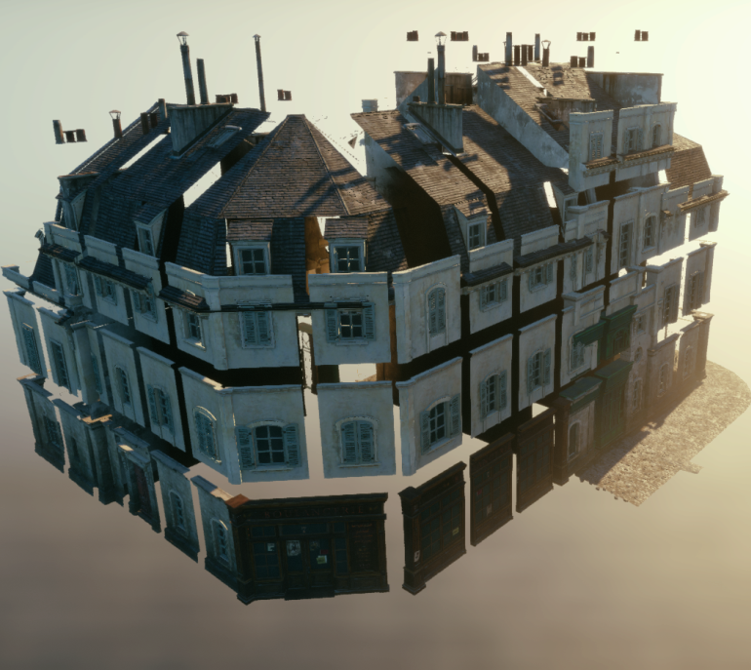
Motivation Assassin’s Creed Unity
Modular construction (partially automated)
~10x instances compared to previous Assassin’s Creed games
CPU scarcest resource on consoles
Notes:
To be able to create such a large play area the first pass of city construction was also partially automated using hundreds of reusable building modules to create a wide variety of house blocks.
A naive one module – one drawcall approach would have led to >50000 drawcalls. Even instancing per mesh would still have required more than 15000 drawcalls.
On consoles the CPU was also showing to be the scarcest resource, so we had to reduce the CPU cost of rendering compared to previous Assassin’s Creed despite the much higher instance count by using more aggressive batching, while at the same time reducing the geometry pressure with more effective culling.
Fortunately this is exactly what mesh cluster rendering makes possible.

Slide 10
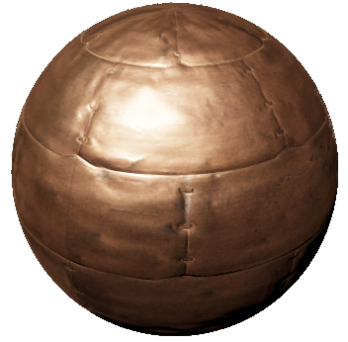
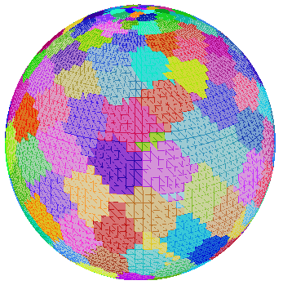
Mesh Cluster Rendering
Fixed topology (64 vertex strip)
Split & rearrange all meshes to fit fixed topology (insert degenerate triangles)
Fetch vertices manually in VS from shared buffer [Riccio13]
DrawInstancedIndirect
GPU culling outputs cluster list
& drawcall args
Notes:
Mesh cluster rendering allows much more aggressive batching while it increases culling granularity at the same time.
Because the GPU index fetch is not programmable, the only way to render different meshes efficiently with a single drawcall using instances, is to enforce a shared topology between all meshes. We chose the good old friend ”vertex strip” as this fixed topology and split all meshes into clusters of 64 vertex strips, so 62 triangles per cluster.
Other topologies for example 32 quads could have been used with a fixed index buffer. But whatever the choosen fixed topology, degenerate vertices must be inserted to make an arbitrary mesh fit the topology (for example 4 vertices between strips ) and pad the end of each mesh to a full cluster.
Post edit we run a post process on a mesh that builds triangle strips from the mesh and then uses a greedy algorithm to build local clusters from these strips.
As we want to fetch different vertices for each cluster we cannot rely on the fixed function vertex fetch but instead need to fetch all data manually using the vertex and instance id.
This way we can render an arbitray number of meshes using one call to DrawInstancedIndirect. The arguments and a stream of cluster information is generated by a GPU compute job that performs culling per cluster.
--------------------------------
For stripped rendering every necessary strip cut adds 4 redundant vertices and 4 redundant triangles (relevant for memory, vertex shading cost and max triangle throughput)
We split our meshes to fixed size 64 vertex (= 62 triangle) instances.
Use a greedy offline clustering algorithm.
Fetching vertex and instance data is O(1).
Bonus: DirectX 11 DrawInstancedIndirect adds a free strip cut after each instance ☺
Programmable vertex fetch is not available on PC.
We read vertices using a Shader Resource View (SRV). Vertex data is stored in SoA layout. This improves GPU latency hiding. Outperforms hardware vertex buffers on GCN.

Slide 11
Mesh Cluster Rendering
Arbitrary number of meshes in single drawcall
GPU-culled by cluster bounds [Greene93] [Shopf08] [Hill11]
Faster vertex fetch
Cluster depth sorting
Notes:
This does not only allow us to batch much more aggressively, but also allows more fine grained GPU frustum and occlusion culling.
As GPU occlusion culling against a depth mip chain looses accuracy with larger object bounds, while beeing very efficient with large numbers of object, this is a good fit.
I will not go into more detail on GPU occlusion culling here, but I recommend the excellent references.
It is also interesting to note, that more fine grained culling does not only cull more vertices, but also prevents some potential overdraw as in the image on the right. It also helps artists as they don’t have to worry about object sizes anymore to manually manage effective culling.
Additionally the manual vertex fetch is actually slightly faster than the automatic one and this approach could also allow cluster depth sorting which can reduce overdraw similiar to a depth pre-pass.

Slide 12
Mesh Cluster Rendering (ACU)
Problems with triangle strips:
Memory increase due to degenerate triangles
Non-deterministic cluster order
MultiDrawIndexedInstancedIndirect:
One (sub-)drawcall per instance
64 triangles per cluster
Requires appending index buffer on the fly
Notes:
While the stripped triangle instance rendering approach to mesh cluster rendering works well on all current platforms, for Assassin’s Creed Unity we changed to a different approach shortly before shipping. This was done mostly to help reduce memory and fix the non-deterministic cluster order that led to z-fighting with improperly aligned building modules.
Other approaches like a manual index buffer and cluster depth sorting could have fixed these problems as well, but instead we opted to use a similar mesh cluster rendering approach using indexed geometry batching with the newly available MultiDrawIndexedInstancedIndirect. For this approach we optimise the mesh with a traditional vertex cache optimiser that favours mesh locality and then split them into uniform 64 triangle clusters.
The simplest approach would have been to use one cluster per sub-drawcall, but this would have required larger clusters to be efficient on the GPU. Instead we chose one sub-drawcall to render one object instance or one mesh and transform. This allows a deterministic instance order and variable cluster sizes. We use 64 triangle clusters for static meshes and full mesh clusters for deformed meshes, where we could not determine the per cluster bounds easily anyways.
This approach requires us to append a per instance index buffer on the fly which adds additional GPU cost, but also allows us to efficiently cull some backfacing triangles.
------------------------------------------
Memory: Overall the memory for meshes increased by almost the factor 2. We could have used a manual index buffer to reduce memory at the cost of another indirection in the vertex shader.
Order: In our case non-deterministic render order would lead to z-fighting between different modules that were not aligned/quantized perfectly.
Geometry only rendering in the shadow and visibility pass was limited by the triangle throughput and vertex wave launch rate.
One drawcall per instance results in:
* Deterministic instance order
* Appending index buffer allows cheap triangle culling
* Same pipeline feasible on PC using individual drawcalls
* Supports variable cluster size
We used 64 triangles per cluster for fast index compaction when the indices get appended into a dynamic index buffer. Note that 64 triangles per cluster does not mean we get 64 vertex threads but overall the vertex wave occupancy was still quite high (~60).
Using MultiDrawIndirect also allowed us to use full mesh clusters for dynamic meshes that do not benefit from smaller clusters as we cannot determine the culling bounds dynamically (e.g. skinned meshes)

Slide 13
Rendering Pipeline Overview
COARSE FRUSTUM CULLING
- CPU
BUILD BATCH HASH UPDATE INSTANCE GPU DATA
- GPU
BATCH DRAWCALLS
INSTANCE CULLING (FRUSTUM/OCCLUSION)
CLUSTER CHUNK EXPANSION
CLUSTER CULLING (FRUSTUM/OCCLUSION/TRIANGLE BACKFACE)
INDEX BUFFER COMPACTION
MULTI-DRAW
Notes:
This is an overview of the rendering pipeline. On the CPU side, we still perform very coarse frustum culling and then batch all un-culled objects together by material. On the GPU we start with per-instance frustum and occlusion culling. Then we perfrom a cluster expansion step before we cull clusters against the frustum and occlusion depth. Some backfacing triangles are then culled during compaction of the index buffer, which is then used by the multi-drawcall. All deformed objects just bypass the cluster specific parts of the pipeline.

Slide 14
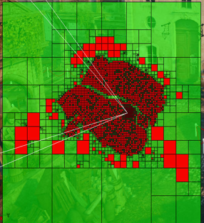
Rendering pipeline overview
CPU quad tree culling
Per instance data:
E.g. transform, LOD factor...
Updated in GPU ring buffer
Persistent for static instances
Drawcall hash build on non-instanced data:
E.g. material, renderstate, …
Drawcalls merged based on hash
Notes:
As mentioned before on the CPU we perform very coarse quad tree culling.
We then update all the per instance data like transform etc. in a gpu ring buffer for dynamic objects and build a hash of all the non-gpu-instancable data.
Drawcalls are then merged based on this hash and a stream of instances is built for the GPU part of the pipeline.
-----------------------------------------------
Granularity of objects in the quadtree varies based on data.
* Houses
* Large meshes
* some individual meshes
* small dynamic meshes like characters
We update the instancable data in the ring buffer (or another section of that buffer for static objects) and then build a list of 8 offsets per instance. These 8 offsets contain all the pointers to the different data necessary to render the instance. Like vertex buffer location, extents, transform etc.
Drawcalls are sorted by distance before merging. Obviously sorting by bounds does not give perfect depth sorting, but much better than after merging.
The order of instances within one drawcall retains the original drawcall order so that as we batch more we will again approach the original front-to-back order.
Due to the limitations of the legacy tech we ended up quite far from the ideal CPU goal « draw scene »-command. Instead we still need to touch even static objects on CPU and can only draw objects with the same material together.

Slide 15
Rendering Pipeline Overview
INSTANCE CULLING (FRUSTUM/OCCLUSION)
…
Instance0
Instance1
Instance2
Instance3
Transform
Bounds
Mesh
This stream of instances contains a list of offsets into a GPU-buffer per instance that allows the GPU to access information like transform, instance bounds etc.
CLUSTER CHUNK EXPANSION
CLUSTER CULLING (FRUSTUM/OCCLUSION/TRIANGLE BACKFACE)
INDEX BUFFER COMPACTION
MULTI-DRAW
Notes:
This stream of instances contains a list of offsets into a GPU-buffer per instance that allows the GPU to access information like transform, instance bounds etc.

Slide 16
Rendering Pipeline Overview
INSTANCE CULLING (FRUSTUM/OCCLUSION)
…
Instance0
Instance1
Instance2
Instance3
…
Chunk1_0
Chunk2_0
Chunk2_1
Chunk2_2
Instance Idx
Chunk Idx
CLUSTER CHUNK EXPANSION
CLUSTER CULLING (FRUSTUM/OCCLUSION/TRIANGLE BACKFACE)
INDEX BUFFER COMPACTION
MULTI-DRAW
Notes:
The GPU then uses this information to frustum and occlusion cull the instance stream. For all instances that pass culling a list of cluster chunks is emitted.

Slide 17
Rendering Pipeline Overview
INSTANCE CULLING (FRUSTUM/OCCLUSION)
CLUSTER CHUNK EXPANSION
…
Chunk1_0
Chunk2_0
Chunk2_1
Chunk2_2
…
…
Cluster1_0
Cluster1_1
Cluster2_0
Cluster2_1
Cluster2_64
Instance Idx
Cluster Idx
CLUSTER CULLING (FRUSTUM/OCCLUSION/TRIANGLE BACKFACE)
INDEX BUFFER COMPACTION
MULTI-DRAW
Notes:
We use the intermediate step of cluster chunk expansion (instead of direct cluster expansion) because the number of clusters per mesh varies dramatically (1-1000). Immediate cluster export would often be very unbalanced between GPU threads within a wavefront. Each cluster chunk instead exports a maximum of 64 clusters.

Slide 18
Rendering Pipeline Overview
INSTANCE CULLING (FRUSTUM/OCCLUSION)
CLUSTER CHUNK EXPANSION
CLUSTER CULLING (FRUSTUM/OCCLUSION/TRIANGLE BACKFACE)
…
…
Cluster1_0
Cluster1_1
Cluster2_0
Cluster2_1
Cluster2_64
…
…
Index1_1
Index2_1
Index2_64
Triangle Mask
Read/Write Offsets
INDEX BUFFER COMPACTION
MULTI-DRAW
Notes:
The cluster culling step then uses the instance transform and each individual cluster’s bounds to cull the clusters against the frustum and occlusion. For each cluster we also fetch a view dependent triangle mask for pre-baked triangle backface culling. Clusters that pass culling, export an index compaction job that consist of the triangle mask and the index read and write offsets. These offsets are determined using atomic operations on the associated instance drawcall primtive count.

Slide 19
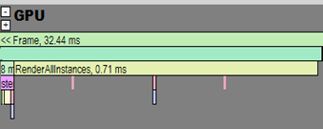
Rendering Pipeline Overview
INSTANCE CULLING (FRUSTUM/OCCLUSION)
CLUSTER CHUNK EXPANSION
CLUSTER CULLING (FRUSTUM/OCCLUSION/TRIANGLE BACKFACE)
INDEX BUFFER COMPACTION
…
…
INDEX COMPACTION
Index1_1
Index2_1
Index2_64
Instance0
Instance1
Instance2
…
1
Compacted index buffer
0
1
0
0
1
2
MULTI-DRAW
Notes:
Index compaction for all unculled clusters then happens into a dynamic index buffer.
Space in this compacted index buffer is allocated on CPU, so the full (unculled) amount of indices must be allocated for each mesh instance.
As the compacted index buffer is quite small (8mb) this means that one renderpass cannot fit completely into the buffer. Large passes are split up, so that index buffer compaction and multi-draw rendering can be interleaved.

Slide 20
Rendering Pipeline Overview
INSTANCE CULLING (FRUSTUM/OCCLUSION)
CLUSTER CHUNK EXPANSION
CLUSTER CULLING (FRUSTUM/OCCLUSION/TRIANGLE BACKFACE)
INDEX BUFFER COMPACTION
…
…
Index1_1
Index2_1
Index2_64
…
0
1
0
1
0
1
2
1
1
64
3
8
MULTI-DRAW
Notes:
At this point index compaction removes triangles culled by per cluster culling and triangle backface culling. Within each index compaction compute job one wavefront handles one cluster and each thread handles one triangle completely independent of the other threads and wavefronts. Based on the triangle mask and input-/output offsets emitted by the cluster culling step each thread calculates the output write position into the dynamic index buffer independently and copies 3 triangle indices. This step takes 5-10% of geometry rendering.

Slide 21
Rendering Pipeline Overview
INSTANCE CULLING (FRUSTUM/OCCLUSION)
CLUSTER CHUNK EXPANSION
CLUSTER CULLING (FRUSTUM/OCCLUSION/TRIANGLE BACKFACE)
INDEX BUFFER COMPACTION
MULTI-DRAW
Drawcall 0
Drawcall 1
Drawcall 2
…
0
1
0
1
0
1
2
1
1
64
3
8
Notes:
We then use one MultiDrawIndexInstancedIndirect call per batch to render groups of drawcalls generated using the atomic operations during cluster culling.

Slide 22
Static Triangle Backface Culling
Bake triangle visibility for pixel frustums of cluster centered cubemap
Cubemap lookup based on camera
Fetch 64 bits for visibility of all triangles in cluster
Notes:
As mentioned earlier cluster culling also fetches a view dependent triangle mask to determine the number of visibile triangles within a cluster.
The idea exploited here is that we can bake visibility of triangles within a cluster for all pixel frustums of a cluster centered cubemap.
For example if the camera is within the yellow pixel’s frustum for the shown cluster, we can fetch the precomputed visibility for the green triangle just based on the camera and cluster position, without any access to the actual geometry. In the same way we can fetch the visibility of all 64 triangles in the cluster at once and then use bitcount on this mask to determine the number of visible triangles that we need to allocated output space for.

Slide 23
Static Triangle Backface Culling
Notes:
Another view of the same principle. The box is the cluster extents, the line segments with arrow represent the triangle and orientation. The darker area on the right is the yellow cubemap pixel’s frustum.
Visibility of each triangle within a cluster for one cubemap pixel is calculated by intersecting the triangle’s half space with the polyhedron defined by the frustum through the pixel. If the camera is within the cluster bounds itself, all triangles are treated as visibile.

Slide 24
Static Triangle Backface Culling
Only one pixel per cubemap face (6 bits per triangle)
Pixel frustum is cut at distance to increase culling efficiency (possible false positives at oblique angles)
10-30% triangles culled
Notes:
On ACU we only used one pixel per cubemap face or 6bits per triangle for memory reasons. This gives less effective culling than is possible with a higher pixel count. We cut the cubemap pixel frustum at a quite aggressive distance to increase this a bit but this can lead to false positives at oblique angles. In total this resulted in about 10-30% of triangles culled for all rigid geometry.

Slide 25
Occlusion Depth Generation
Notes:
Obviously GPU occlusion culling can only be effective with good occlusion depth to test the (sub-)object’s visibility against. Here is a fairly typical (but certainly not worst-case) scene from Assassin’s Creed Unity to give you an overview of how we generate the different types of occlusion depths.

Slide 26
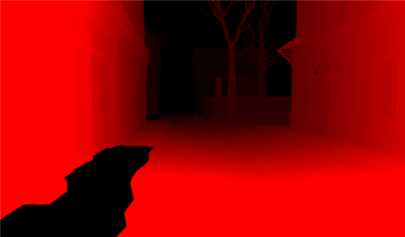
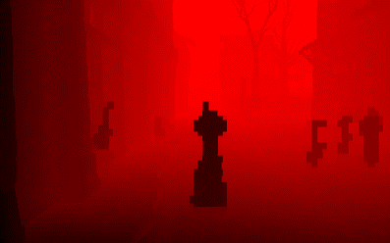
Occlusion Depth Generation
Depth pre-pass with best occluders
Rendered in full resolution for High-Z and Early-Z
Downsampled to 512x256
Combined with reprojection of last frame’s depth
Depth hierarchy for GPU culling
Hierarchy
Notes:
We start with a depth pre-pass rendering of the n best occluders. This serves both as occlusion depth for the GPU culling and also to prime H-TILE and depth for early-z for the actual rendering. This helps as we can lose some front-to-back ordering due to the more general batching.
This is then max-downsampled to 512x256 and combined with a reprojection of a 1/16 low resolution version of last frame’s depth.
--------------------------
Occluders are selected based on bounding volume and artist set flags. Of these occluder meshes the 300 nearest to the camera are chosen, of triangle count and surface area.
We tried different heuristics (merged screen-space projected size) but due to time constraints shipped with the simple distance heuristic.
Meshes with alpha-tested geometry are rejected during the occlusion depth rendering.
No occlusion culling is performed during this pass, although it would be possible to reproject last frame’s depth first and use that as occlusion culling depth for the occlusion depth generation pass.

Slide 27
Occlusion Depth Generation
300 best occluders (~600us)
Rendered in full resolution for High-Z and Early-Z
Downsampled to 512x256 (100us)
Combined with reprojection of last frame’s depth (50us)
Depth hierarchy for GPU culling (50us)
(*PS4 performance )
Hierarchy
Notes:
This is just a cheap way to fill holes in our occlusion depth pre-pass.
Holes can be from objects that are rejected as occluders, bad occluder selection or alpha-tested geometry.
The reprojection fills these holes reliably when the camera is static but also produces holes when the camera is moving at the screen borders or due to parallax rejection.
False occlusion is possible from large moving objects in the last frame’s depth. We reject occluders near the camera during reprojection to avoid this in most cases.
Finally we generate a mip-hierarchy for GPU culling.

Slide 28
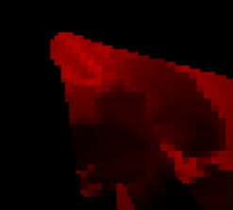
Shadow Occlusion Depth Generation
For each cascade
Camera depth reprojection (~70us)
Combine with shadow depth reprojection (10us)
Depth hierarchy for GPU culling (30us)
Notes:
We also generate a 64x64 low resolution occlusion depth for each cascade of the cascaded shadowmap.
The first step is to generate occlusion depth based on possible shadow receivers obtained by reprojection into light space of the camera depth. A bit more detail on this in the next slides.
This is then combined with a low resolution, reprojected version of last frame’s shadowmap. Again this step could introduce false positives from large fast moving occluders, but we did not have these in the game.
The downsampled shadowmap from last frame is available as the downsample is shared with the generation of the exponential shadowmap for fog

Slide 29
Camera Depth Reprojection
Notes:
Camera depth reprojection aims at removing shadow casters that cannot have any visible shadow receivers. In this example scene all shadow casters in the courtyard of the house block in front of the player cannot contribute to the image as the courtyard itself is occluded by the front of the building.

Slide 30
Camera Depth Reprojection
Notes:
I hope a schematic can make this a bit clearer.
Yellow arrows show the sun direction
Red lines show the extents of one shadow map cascade
Red objects are shadow casters that cannot have a valid receiver as all possible receivers are hidden by the ground and blue objects.

Slide 31
Camera Depth Reprojection
Notes:
Now the bright yellow area marks the horizon created by the foreground objects, below which shadow receivers are invisible. Every shadow caster further away (in light space) than this horizon can be culled.
The depth in light space (aka in the direction of the yellow arrows) of the red line on top of the yellow area is what we need to compute to use for occlusion culling.

Slide 32
Camera Depth Reprojection
Notes:
If we render a cube for each pixel in the camera depth, extruded from the near plane to the value of the camera depth we get these yellow cubes.

Slide 33
Camera Depth Reprojection
Notes:
Now you can see that the green line, which is the max depth rendering of those cubes in light space, is the same as the red line mentioned earlier.
Obviously it would be too many cubes to render one for each pixel of the camera depth image. Instead we render one cube for each 16x16 tile of the camera depth and use the maximum depth per tile. Then the green line becomes a conservative approximation of the red line.
When rendering the cubes in light space it is important to pad them to a minimum size of one pixel and also account for the maximum shadow filter size.
-----------------------
Note that when there aren’t any transparent shadow receivers it would be possible to extrude the cubes not from the camera near plane but from the min-depth per tile. Under these conditions the far plane could be rejected during the max downsampling as well. This produces much tighter cube rendering.
When rendering the cubes it is important to output depth directly in the pixel shader and use a texcoord interpolator to derive the pixel depth instead of the depth provided by the fixed function pipeline as this is too imprecise for triangles that are almost parallel with the light direction.

Slide 34
Camera Depth Reprojection
Light Space Reprojection
Notes:
Camera depth reprojection in light space for the example scene.

Slide 35
Camera Depth Reprojection
Reprojection “shadow” of the building

Slide 36
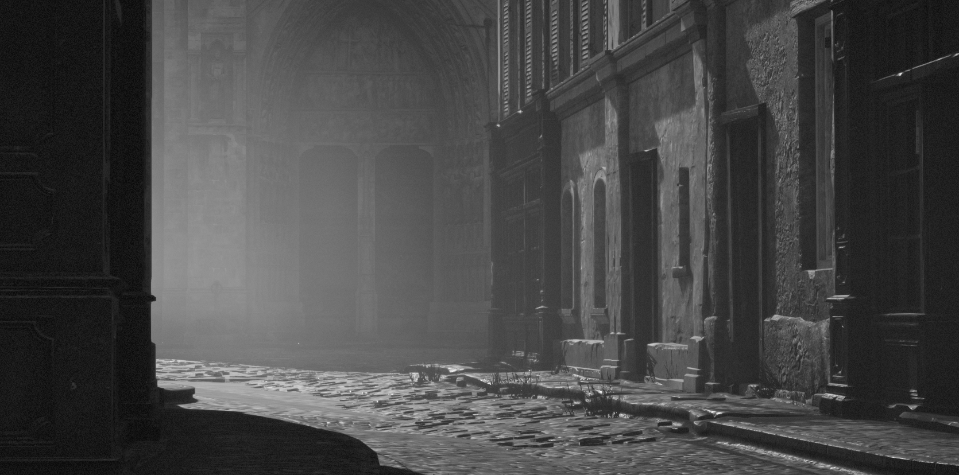
Camera Depth Reprojection
Similar to [Silvennoinen12]
But, mask not effective because of fog:
Cannot use min-depth
Cannot exclude far-plane
64x64 pixel reprojection
Could pre-process depth to remove redundant overdraw
Notes:
Similiar to [Silvennoinen2012] but we produce a depth buffer, not a mask. As we cannot use the min-depth for each tile and have to include the far distance, a mask would lead to much lower culling efficiency.
As we are using exponential shadowmaps for the volumetric fog we would have to account for a very shadow large filter.
Instead we fill holes created by the shadow caster culling during the generation of the exponential shadowmap with the reprojected camera depth. The idea here is that the horizon is most likely a better approximation of the unculled shadowmap than the far plane. Especially as for exponential shadowmaps large values (like the far plane) dominate the values in the filter region.

Slide 37
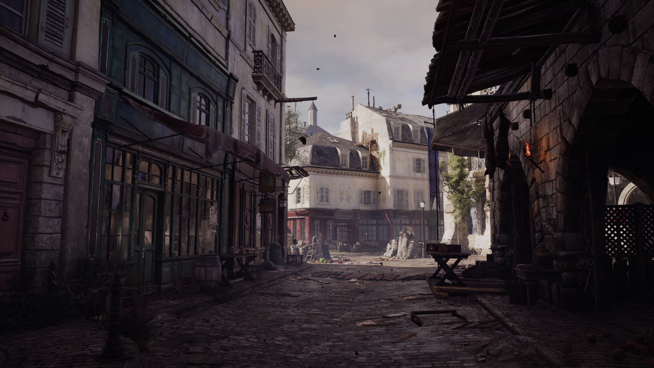
Results
CPU:
1-2 Orders of magnitude less drawcalls
~75% of previous AC, with ~10x objects
GPU:
20-40% triangles culled (backface + cluster bounds)
Only small overall gain: <10% of geometry rendering
30-80% shadow triangles culled
Work in progress:
More GPU-driven for static objects
More batch friendly data
Notes:
And now a quick overview of the results for Assassin’s Creed Unity. We achieved the main goal, which was to reduce the CPU cost per object compared to previous ACs even though we would have liked to do even better, but due to some legacy features like CPU driven LOD transitions, even completely static geometry still needed more CPU work than necessary.
On the GPU we achieved significantly more effective culling, but this translates to only a small gain overall for the geometry rendering. We also had to move the gpu pipeline to async compute to remove the cost from the many stalls required for dependent compute jobs and compute jobs. For many passes the compute jobs of the gpu pipeline also do not completely fill the gpu, wasting time if not done in parallel with rendering.
Shadow occlusion culling saves a significant amount of shadow rendering time (1-3 ms reliably with our data)

Slide 38
Future
Bindless textures
GPU-driven vs. DX12/Vulkan
Notes:
In the future use of bindless textures will allow us to further reduce the number of drawcalls significantly. Apart from the CPU benefits this will also help with the problem of increased GPU overdraw due to the unpredictable drawing order of batched meshes. As the number of drawcalls becomes very low, the drawing order will once again approach the order sorted by object center camera distance. With a very low number of drawcalls actual cluster camera distance sorting could become feasible.
As DX12/Vulkan reduces the cost per individual drawcall significantly, the biggest immediate benefit of a GPU-driven rendering pipeline (given the rendering algorithms and data used in ACU) would be reduced. Whether this kind of pipeline provides a benefit under DX12/Vulkan will depend on the data and rendering algorithms that are used going forward.
The next part of the talk will show some of the very interesting possibilities.
---------------------------------
GPU-driven still has advantages:
- With DX12 (especially on PC), the CPU still doesn't have low latency access to GPU depth buffer --> CPU cannot cull shadows based on visible pixels.
- CPU is still bad at culling 100k+ objects at sub-object granularity (= more than a million visibility tests per frustum).
- GPU driven culling is more power efficient. Reduced power usage increases CPU & GPU clocks -> runs faster.
- Reference: Modified Intel DirectX 12 asteroids demo with ExecuteIndirect. Runs faster on Intel GPU and has much lower CPU usage.
With more control over async compute we hope to move the non-rendering part of the GPU-driven pipeline into async compute to remove all pipeline bubbles due to many small synchronous compute jobs (e.g. the compute jobs to generate the compute arguments for the next indirect compute job). We do already run other GPU-tasks in parallel during geometry only rendering (shadow, visibility), but do to the very coarse load balancing between async and graphics pipeline, the async compute jobs do not fully utilise the GPU during bubbles in the graphics pipe.

Slide 39
RedLynx Topics
Virtual Texturing in GPU-Driven Rendering
Virtual Deferred Texturing
MSAA Trick
Two-Phase Occlusion Culling
Virtual Shadow Mapping
Notes:
Hi, my name is Sebastian Aaltonen. I work as a Senior Lead programmer at RedLynx. We have been a part of Ubisoft for almost four years now.
Today I am going to be talking about GPU-driven rendering. Our core technology is similar to Montreal’s since we have been sharing lots of ideas.
In my part of the presentation I am going to focus on the differences between our technologies.
Virtual texturing is the biggest difference. It combines perfectly with GPU-driven rendering, allowing us to reduce the draw call count to the bare minimum.
Deferred texturing is not a new idea. When combined with virtual texturing and GPU-driven rendering, it starts to make a lot of sense.
I will be talking about our implementation details and our optimized G-buffer layout, including an important optimization, we call the ”MSAA Trick”.
Our occlusion culling differs from the AC: Unity culling system. Our studio’s UGC (user generated content) focus mandates slightly different technical choices.
We have a different shadow mapping pipeline as well. It is based on the same principles as our virtual texturing system.

Slide 40
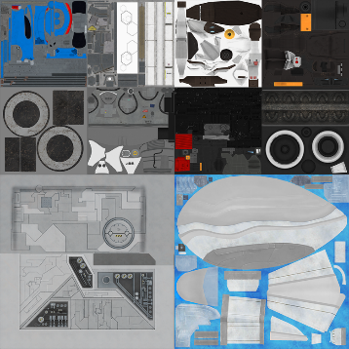
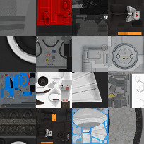
Virtual Texturing
Key idea: Keep only the visible texture data in memory [Hall99]
Virtual 256k² texel atlas
128² texel pages
8k² texture page cache
5 slice texture array: Albedo, specular, roughness, normal, etc.
DXT compressed (BC5 / BC3)
Notes:
RedLynx has been using virtual texturing for 5 years now. We have shipped two games with it, Trials Evolution and Trials Fusion.
The key idea in virtual texturing is to keep only the visible set of texture data in memory.
This is accomplished by splitting the textures to small tiles, called pages.
Page ID pass gives us exact information about the page and mip level accessed by each pixel in the screen. This data is loaded to a constant size (LRU) cache.
Our implementation is based on 256k^2 virtual address space. All our textures are fit to this single big atlas.
We split the big virtual atlas to 128x128 texel pages.
At runtime we have a 8k texture atlas for storing the currently resident pages.
Our texture cache has five array slices to store all the material properties we need: albedo, specular, roughness, normal, and so on. The texture cache is DXT compressed.

Slide 41
GPU-Driven Rendering with VT
Virtual texturing is the biggest difference between our and AC: Unity’s renderer
Key feature: All texture data is available at once, using just a single texture binding
No need to batch by textures!
Notes:
Virtual texturing is the biggest difference between the GPU-driven pipelines of RedLynx and Ubisoft Montreal.
Virtual texturing combines very well with GPU-driven rendering.
It provides access to all the visible texture data using just a single texture binding.
This is a key feature for GPU-driven rendering, as it allows the GPU to efficiently fetch data from any amount of textures in a single draw call.
This means that we do not need to batch by textures anymore.

Slide 42
Single Draw Call Rendering
Viewport = single draw call (x2)
Dynamic branching for different vertex animation types
Fast on modern GPUs (+2% cost)
Cluster depth sorting provides gain similar to depth prepass
Cheap OIT with inverse sort
Notes:
As Ulrich described earlier, the GPU-driven pipeline has access to all the mesh data at once.
With virtual texturing we also have access to all the texture data at once, meaning that we can render the whole scene using just a single draw call.
We handle different vertex animation types by branching in the shader. With modern GPUs this is fast. We have measured around 2% extra rendering cost with 3 different complex animation types, including skinning.
Rendering everything in a single draw call brings us some advantages. We can depth sort the clusters of the whole scene and render all the geometry front to back at cluster granularity. This provides similar reduction of overdraw than depth prepass but without requiring a costly extra rendering pass.
This pipeline can also be used to render transparencies in inverse depth order. Cluster granularity sorting provides cheap OIT approximation that works correctly in most cases.

Slide 43
Additional VT Advantages
Complex material blends and decal rendering results are stored to VT page cache
Data reuse amortizes costs over hundreds of frames
Constant memory footprint, regardless of texture resolution and the number of assets
Notes:
Virtual texturing has also other important advantages over competing solutions, such as bindless textures.
We store complex material blending results and decal rendering results into the virtual texture cache.
Caching amortizes the cost of these bandwidth heavy operations over hundreds of frames.
This makes it possible for our level designers to place a lot of decals and use a lot material variety in their levels, while still maintaining the 60 fps locked frame rate.
Virtual texturing provides us constant memory footprint for texture data, regardless of the number of texture assets and the resolution of textures used.
Our level designers do not need to care about texture memory budget, making their life easier.
This is especially important for user generated content, as we can’t assume that the players have technical knowledge.

Slide 44
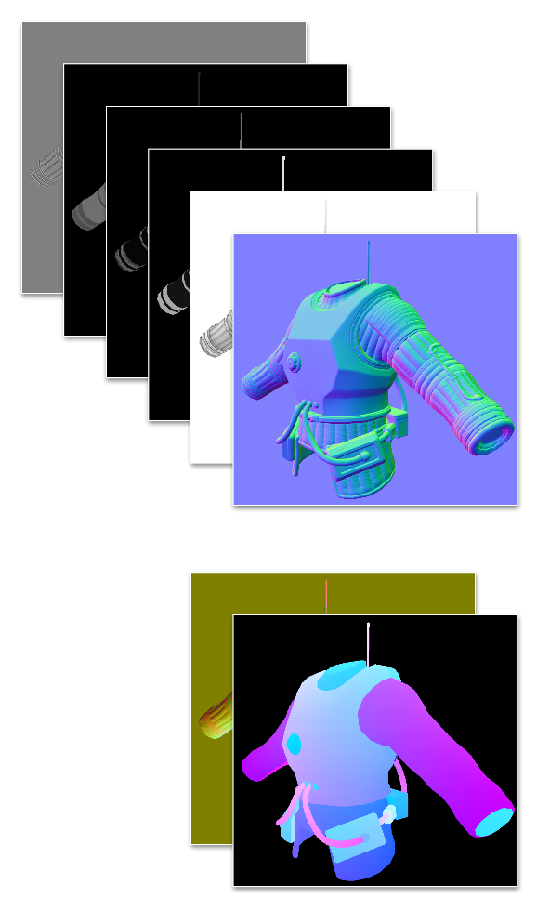
Virtual Deferred Texturing
Old Idea: Store UVs to the G-buffer instead of texels [Auf.07]
Key feature: VT page cache atlas contains all the currently visible texture data
16+16 bit UV to the 8k² texture atlas gives us 8 x 8 subpixel filtering precision
height
albedo
roughness
specular
ambient
normal
tangent frame
UV
Notes:
Deferred texturing is not a new idea. The first reference I found was a forum post from 2007 (http://www.gamedev.net/topic/471781-deferred-texture-mapping/). As far as I know, this technique has not been used in any shipped game yet. The reason being that there has been many open issues in implementing the per pixel texture store and fetch in an efficient and robust manner.
Nathan Reed’s blog post from last year (http://www.reedbeta.com/blog/2014/03/25/deferred-texturing/) proposes solutions to these problems. However the proposed solutions increase the G-buffer storage to 144 bits assuming you need important features such as anisotropic filtering. This is not a win compared to traditional deferred rendering.
A key feature in our pipeline is that we have all the potentially visible texture data loaded into our 8k texture atlas.
UV coordinate to this atlas is enough to represent any potentially visible texel.
The dimensions of the cache are drastically smaller than the big 256k virtual texture. This allows us to use a 16+16 bit UV presentation.
This provides 8 x 8 subpixel precision for texture filtering. In practice this is enough for good quality.

Slide 45
Gradients and Tangent Frame
Calculate pixel gradients in screen space. UV distance used to detect neighbors.
No neighbors found → bilinear
Tangent frame stored as a 32 bit quaternion [Frykholm09]
Implicit mip and material id from VT. Page = UV.xy / 128.
height
albedo
roughness
specular
ambient
normal
tangent frame
UV
Notes:
UV and depth alone are not enough to render modern games. You need gradients for anisotropic filtering and tangent frame for lighting.
Gradients take a lot of space, so we don’t want to store them. Luckily for us, we have a G-buffer filled with UV coordinates, allowing us to calculate the gradients in screen space. Gradient calculation works well for continuous surfaces, but breaks at discontinuities. To solve this problem, we compare the neighbor pixel from both negative and positive x and y side, and take the ones with smaller UV differences. This gives priority to the neighbor belonging to the same surface.
If the UV distance of the selected neighbor is more than N texels, where N is the anisotropy level, we know that the neighbor search failed. In this case we revert back to bilinear filtering. This case occurs most frequently in subpixel thin geometry. This is not a problem in practice, since the slightly increased texture blur from bilinear filtering is not easy to see in one pixel wide features.
We store tangent frame as 32 bit normalized quaternion. The 2 bit alpha channel is used to store the major axis index.
Virtual texturing provides us per page properties, such as mip, material id and colorize color for free. We don’t need to store this data to the G-buffer.
Page index can be simply calculated from the UV by dividing it by 128.

Slide 46
Recap & Advantages
64 bits. Full fill rate. No MRT.
Overdraw is dirt cheap
Texturing deferred to lighting CS
Quad efficiency less important
Virtual texturing page ID pass is no longer needed
height
albedo
roughness
specular
ambient
normal
tangent frame
UV
Notes:
Recap:
Total 64 bits per pixel. Full fill rate on modern GPUs, such as GCN. Multiple render targets are not needed.
Overdraw is cheap, since all texture sampling and most ALU is deferred to the lighting compute shader.
Quad efficiency doesn’t matter as much, as all the heavy work is done in the lighting compute shader. This means that high-poly content runs faster.
Deferred texturing combines very well with virtual texturing. The UV buffer functions as a page ID pass.
If some pixels have a gradient vector with length below 0.5, we know that more detailed texture page needs to be loaded to this area.

Slide 47
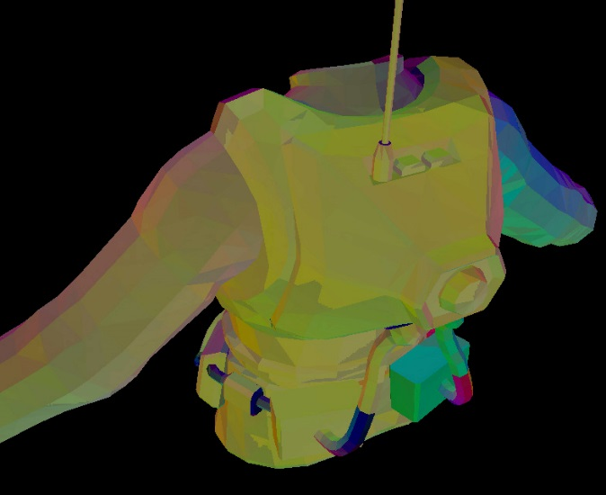
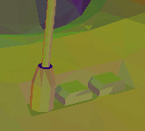
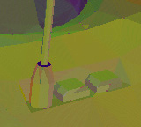
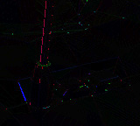
Gradient reconstruction quality
Ground truth
Reconstructed
Difference (x4)
Notes:
Here are some comparison screenshots showing the gradient reconstruction quality. As you can see, the results are very close to ground truth.

Slide 48
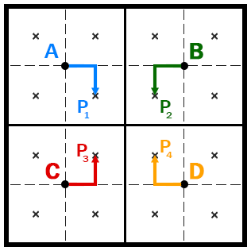
MSAA Trick
Key Observation: UV and tangent can be interpolated
Idea: Render the scene at 2x2 lower resolution (540p) with ordered grid 4xMSAA pattern
Use Texture2DMS.Load() to read each sample separately in the lighting compute shader
$$P_{1}=A+\frac{1}{4}\vec{AB}+\frac{1}{4}\vec{AC}$$
$$P_{2}=B+\frac{1}{4}\vec{BA}+\frac{1}{4}\vec{BD}$$
$$P_{3}=C+\frac{1}{4}\vec{CA}+\frac{1}{4}\vec{CD}$$
$$P_{4}=D+\frac{1}{4}\vec{DC}+\frac{1}{4}\vec{DB}$$
Notes:
We have developed an additional optimization over the virtual deferred texturing pipeline. We call it the MSAA trick.
The key observation leading to this research was that both UV and tangent can be interpolated across triangle surfaces with no quality loss.
This led to an idea to store the G-buffer at lower resolution and interpolate the missing data.
We render at 2x2 lower resolution using MSAA.
We can use GCN programmable sampling patterns to create an ordered grid that matches the higher resolution pixel centers.
Lighting compute shader loads each individual MSAA sample of the G-buffer using the multisample load instruction.

Slide 49
1080p Reconstruction
Reconstruct 1080p into LDS
Edge pixels are perfectly reconstructed. MSAA runs the pixel shader for both sides.
Interpolate the inner pixels’ UV and tangent
Quality is excellent. Differences are hard to spot.
$$P_{1}=A+\frac{1}{4}\vec{AB}+\frac{1}{4}\vec{AC}$$
$$P_{2}=B+\frac{1}{4}\vec{BA}+\frac{1}{4}\vec{BD}$$
$$P_{3}=C+\frac{1}{4}\vec{CA}+\frac{1}{4}\vec{CD}$$
$$P_{4}=D+\frac{1}{4}\vec{DC}+\frac{1}{4}\vec{DB}$$
Notes:
We reconstruct the 1080p G-buffer at the beginning of the lighting compute shader, using the fast LDS memory to store the temporary reconstructed result.
SIMD lane swizzles can also be used on consoles to speed up this step.
MSAA hardware runs the pixel shader and stores the results multiple times for pixels that cover multiple triangles.
For our purpose, it is important to notice that this guarantees that sample frequency data is available for both sides of the triangle edges.
This allows us to reconstruct the edge pixels at native resolution.
As MSAA handles the triangle edges, we only need to do trivial interpolation inside the triangles to reconstruct 1080p UV and tangent.
However the interpolation is not perspective correct, producing minor differences compared to native rendering.

Slide 50
8xMSAA Trick Benchmark
128 bpp G-Buffer
One pixel is a 2x2 tile of ”2xMSAA pixels”
Xbox One: 1080p + MSAA + 60 fps ☺
 | 2xMSAA | MSAA trick | Reduction
G-buffer rendering time | 3.03 ms | 2.06 ms | -32%
Pixel shader waves | 83016 | 36969 | -55%
DRAM memory traffic ESRAM (18 MB partial) | 76.3 MB 15.0 MB | 60.9 MB 29.1 MB | -20%
Notes:
This benchmark uses a 128 bits per pixel G-buffer layout and packs four 2xMSAA pixels into a single 8xMSAA pixel. Quality matches 2xMSAA.
Pixel shader waves are roughly cut by half and the rendering time is roughly cut by one third.
DRAM accesses are also reduced, as we can fit the most accessed MSAA subsample plane completely to ESRAM.

Slide 51
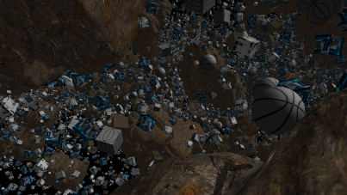
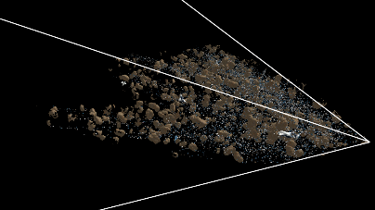
Two-Phase Occlusion Culling
No extra occlusion pass with low poly proxy geometry
Precise WYSIWYG occlusion
Based on depth buffer data
Depth pyramid generated from HTILE min/max buffer
O(1) occlusion test (gather4)
Notes:
I will be talking about our occlusion culling next. Our culling pipeline differs a bit from the AC: Unity pipeline described by Ulrich.
The biggest difference is that we do not perform an extra occlusion geometry pass. We wanted to stay away from a coarse occlusion pass, because our content needs pixel perfect occlusion.
We don’t have big structural objects. All the big level structures are build by the users from small separate objects that can be freely placed. A wall built from a pile of random objects would contain a lot of small holes, if low polygon conservative occlusion proxies were used. The performance would be bad, and the player would not understand why.
Instead we base our occlusion culling on actual G-buffer depth data. We generate a depth pyramid from the depth buffer. Pyramid is generated from the GCN HTILE min/max depth buffer. This makes the pyramid generation roughly 12x faster compared to naive full resolution recursive down sample.
Our occlusion test uses a single gather4 sample instruction to get all four samples at once that cover the object.

Slide 52
Two-Phase Occlusion Culling
First
phase
Down-
sample
Second
phase
1st phase
Cull objects & clusters using last frame’s depth pyramid
Render visible objects
2nd phase
Refresh depth pyramid
Test culled objects & clusters
Render false negatives
Object culling
Draw
Cluster culling
Depth sort clusters
Object list
Occluded objects
Obj. occlusion culling
Occluded clusters
Clu. occlusion
culling
Depth sort clusters
Draw
Notes:
We split our culling and rendering to two phases.
We first perform viewport culling and occlusion culling for objects using the last frame’s depth pyramid. This can be considered as an occlusion hint.
For passed objects, we perform cluster granularity viewport, back-face and occlusion tests, and emit cluster ids to an append buffer for rendering.
In the second phase, we first refresh the depth pyramid with the newly rendered partial frame.
For all the objects and clusters that passed the other tests, but failed the occlusion tests, we perform the occlusion test again.
False negatives are rendered to produce a perfect image.
This culling method would not be possible without GPU-driven rendering, since it requires low latency access to the data generated by the GPU in the previous step.
A CPU round trip in the middle of the frame would badly stall the GPU.

Slide 53
Benchmark
“Torture” unit test scene
250,000 separate moving objects
1 GB of mesh data (10k+ meshes)
8k² texture cache atlas
DirectX 11 code path
64 vertex clusters (strips)
No ExecuteIndirect / MultiDrawIndirect
Only two DrawInstancedIndirect calls
Notes:
In this torture test, we render 250,000 separate moving objects. This kind of sparse object cloud would be a nightmare for existing more coarse occlusion culling systems.
To ensure that the GPU L2 cache will not hold all the mesh data, we randomly populate the scene with 1 GB of different meshes.
In this benchmark we used the DirectX 11 code path, with 64 vertex stripped clusters. MultiDrawIndirect would not benefit a scene with such a high count of low polygon objects.
Textures are sampled in the lighting shader from the 8k^2 texture cache, as described in the previous slides.
We use two draw calls to render this scene.

Slide 54
Benchmark Results
Xbox One, 1080p
GPU time | 1st phase | 2nd phase
Object culling + LOD | 0.28 ms | 0.26 ms
Cluster culling | 0.09 ms | 0.04 ms
Draw (G-buffer) | 1.60 ms | < 0.01 ms
Pyramid generation | 0.06 ms
Total | 2.3 ms
CPU time: 0.2 milliseconds (single Jaguar CPU core)
Notes:
As you can see from the results, the GPU-driven culling and setup steps are very fast. In total these steps use less than 0.5 milliseconds of GPU time.
I must emphasize that this is not lost GPU time. The cluster granularity culling shaves off more GPU cycles from the G-buffer step than the whole GPU-driven pipeline consumes.
In our previous game, Trials Fusion, we used 50% of our total CPU time for these same tasks. Now our total rendering CPU cost is just 0.2 milliseconds on a single CPU core.
This allows the game play programmers to create much more lifelike dynamic environments with more sophisticated physics and destruction.

Slide 55
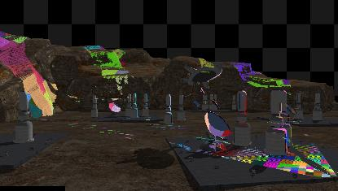
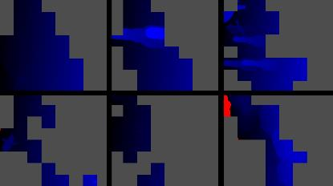
Virtual Shadow Mapping
128k² virtual shadow map
256² texel pages
Identify needed shadow pages from the z-buffer [Fernando01].
Cull shadow pages with the GPU-driven pipeline.
Render all pages at once.
Notes:
We have chosen a bit different approach for our shadow mapping compared to the Ubisoft Montreal team.
In 2001 Fernando described a technique they called Adaptive Shadow Maps.
This technique split the shadow map to small tiles and rendered those tiles at different resolution based on distance.
The biggest problem with this technique was that it required the GPU to send the depth buffer data to the CPU in the middle of the frame.
CPU analyzed the depth buffer, updated the culling structures and performed draw calls for the needed shadow pages. This stalled the GPU, resulting in less than stellar performance.
GPU-driven culling solves the issues in virtual shadow mapping performance.
We do not need a CPU roundtrip in the middle of the frame, and our cluster granularity culling removes most of the vertex processing overhead at the page edges.
DirectX 12 extends render target array index to vertex shader, allowing us to sidestep the geometry shader. This allows us to efficiently render all the shadow pages at once.

Slide 56
VTSM Quality and Performance
Close to 1:1 shadow-to-screen resolution in all areas
Measured: Up to 3.5x faster than SDSM [Lauritzen10] in complex “sparse” scenes
Virtual SM slightly slower than SDSM & CSM in simple scenes
Notes:
Virtual shadow mapping produces an image that has minimal amount of under- and oversampling.
Resolution of the shadow map closely matches the screen resolution in all areas.
Performance is very good, especially in complex scenes. We have measured up to 3.5x advantage over SDSM in the previously shown object cloud test scene.
In simple scenes virtual shadow mapping is slightly slower than SDSM and cascaded shadow mapping in general, but it provides higher quality.
Further optimizations, such as data reuse by XOR hashing page contents will make virtual shadow mapping even faster.

Slide 57
GPU-Driven Rendering + DX12
NEW DX12 (PC) FEATURES
ExecuteIndirect
Asynchronous Compute
VS RT index (GS bypass)
Resource management
Explicit multiadapter
Tiled resources + bindless
Conservative raster + ROV
FEATURES IN OTHER APIs
Custom MSAA patterns
GPU side dispatch
SIMD lane swizzles
Ordered atomics
SV_Barycentric to PS
Exposed CSAA/EQAA samples
Shading language with templates
Notes:
We like DirectX 12 a lot. Lots of new features for graphics rendering and a new manual resource management model that matches console development better.
DirectCompute however didn’t get much improvements. There are some important features supported by other PC compute APIs that are missing.
There are some missing graphics features compared to next gen consoles as well. Hopefully we will get these features in feature level 12_3.

Slide 58
References
[SBOT08] Shopf, J., Barczak, J., Oat, C., Tatarchuk, N. March of the Froblins: simulation and rendering massive crowds of intelligent and detailed creatures on GPU, SIGGRAPH 2008.
[Persson12] Merge-Instancing, SIGGRAPH 2012.
[Greene93] Hierarchical Z-buffer visibility, SIGGRAPH 1993.
[Hill11] Practical, Dynamic Visibility for Games, GPU Pro 2, 2011.
[Decoret05] N-Buffers for efficient depth map query, Computer Graphics Forum, Volume 24, Number 3, 2005.
[Zhang97] Visibility Culling using Hierarchical Occlusion Maps, SIGGRAPH 1997.
[Riccio13] Introducing the Programmable Vertex Pulling Rendering Pipeline, GPU Pro 4, 2013.
[Silvennoinen12] Chasing Shadows, GDMag Feb/2012.
[Hall99] Virtual Textures, Texture Management in Silicon, 1999.
[Aufderheide07] Deferred Texture mapping?, 2007.
[Reed14] Deferred Texturing, 2014.
[Frykholm09] The BitSquid low level animation system, 2009.
[Fernando01] Adaptive Shadow Maps, SIGGRAPH 2001.
[Lauritzen10] Sample Distribution Shadow Maps, SIGGRAPH 2010.
Notes:
March of the Froblins: simulation and rendering massive crowds of intelligent and detailed creatures on GPU

Slide 59
Acknowledgements
Stephen Hill
Roland Kindermann
Jussi Knuuttila
Jalal Eddine El Mansouri
Tiago Rodrigues
Lionel Berenguier
Stephen McAuley
Ivan Nevraev

Slide 60
GPU-Driven Rendering Pipelines Ulrich Haar, Lead Programmer 3D Ubisoft Montreal Sebastian Aaltonen, Senior Lead Programmer RedLynx, a Ubisoft Studio
.

