Slide 1


Slide 2
Stochastic Screen-Space Reflections
Tomasz Stachowiak Electronic Arts / Frostbite
Yasin Uludag Electronic Arts / DICE

Slide 3
Agenda
Motivation and requirements
Previous work
Core algorithm
Secret sauce

Slide 4
Motivation and requirements

Slide 5
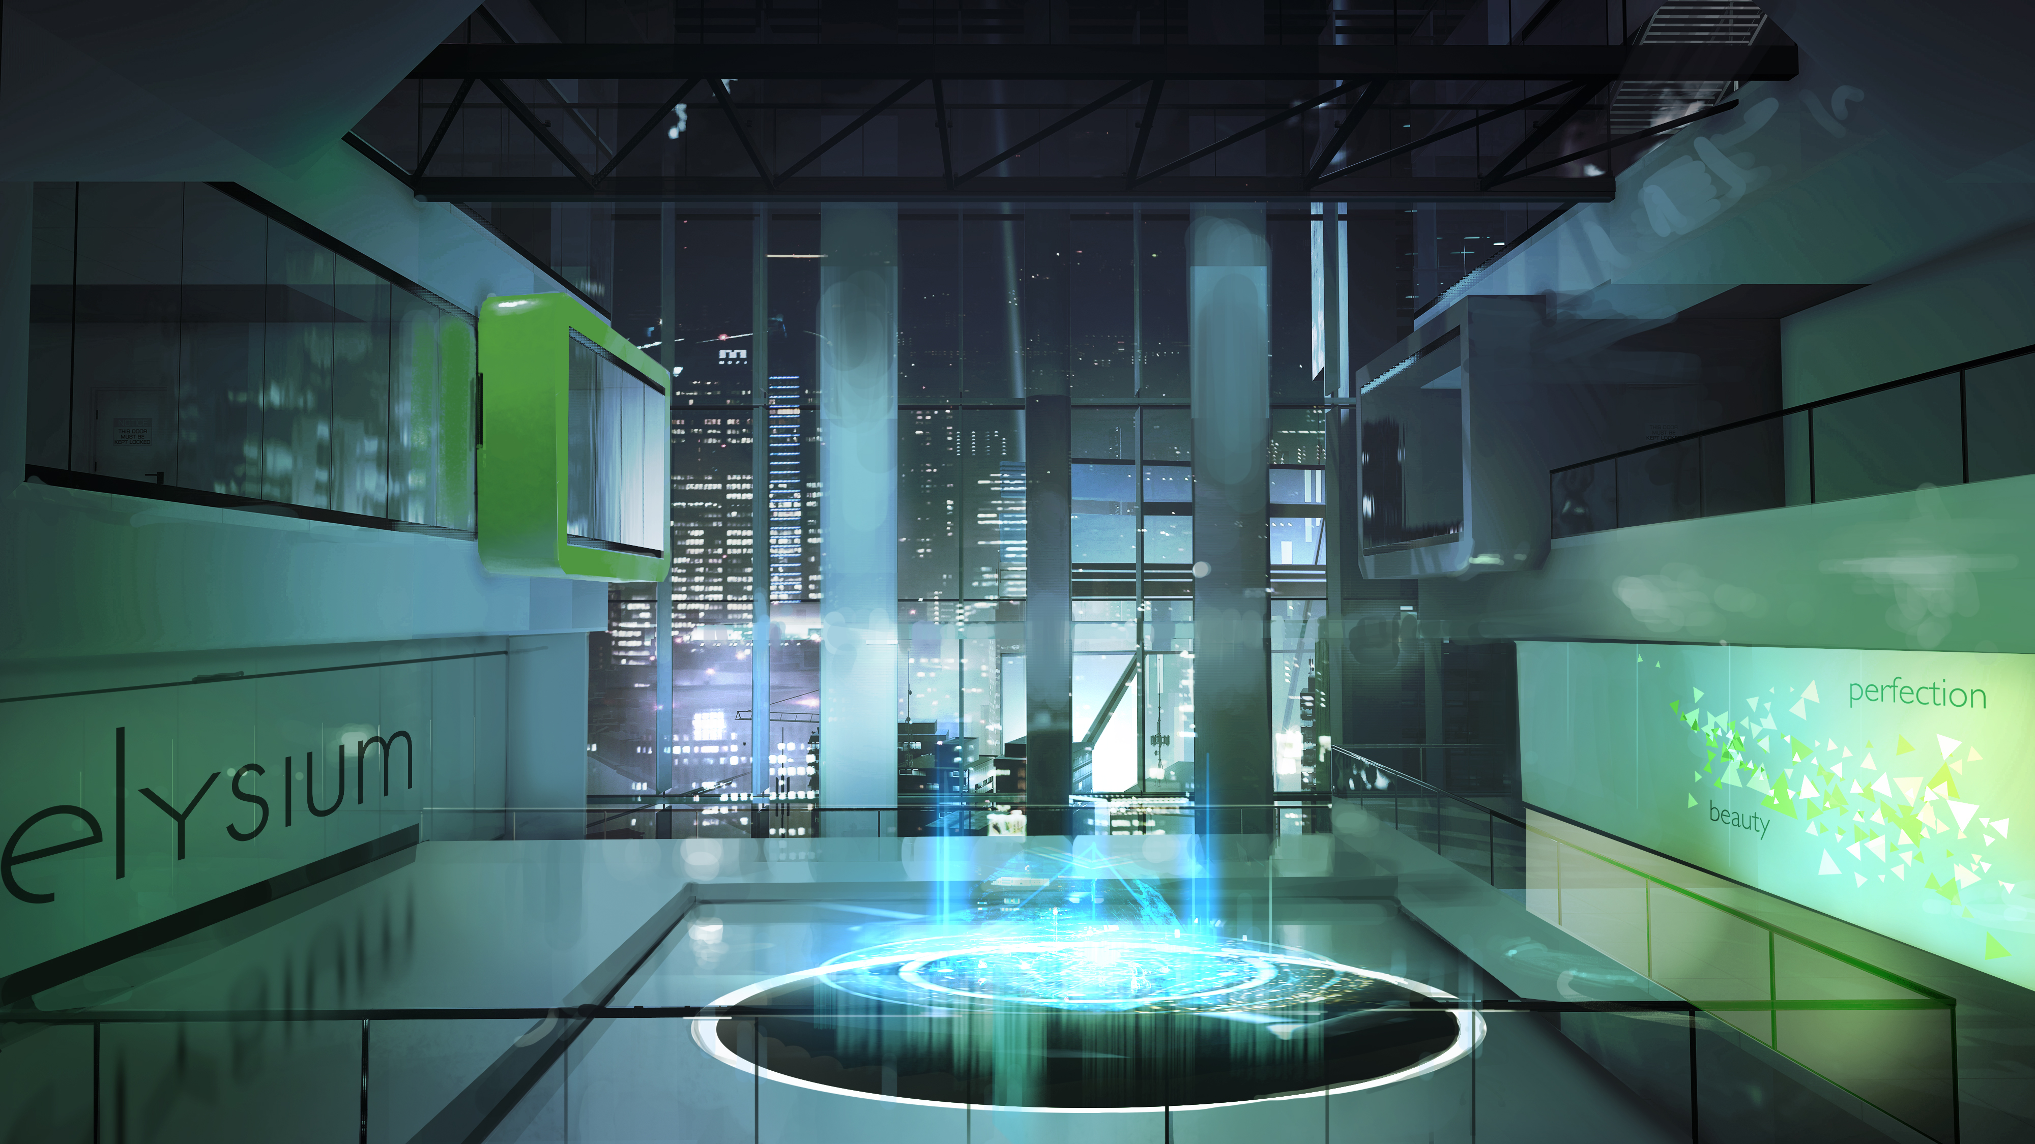
Motivation
Mirror’s Edge Catalyst concept art (DICE)
Notes:
Here’s a concept art piece from Mirror’s Edge Catalyst. As you can see, pretty much everything here is reflective. It is worth noting that while the surfaces are generally smooth, not all reflections are mirror-like. Notice the stretched reflection on the left, and the blurry reflections in the walls on the right.

Slide 6
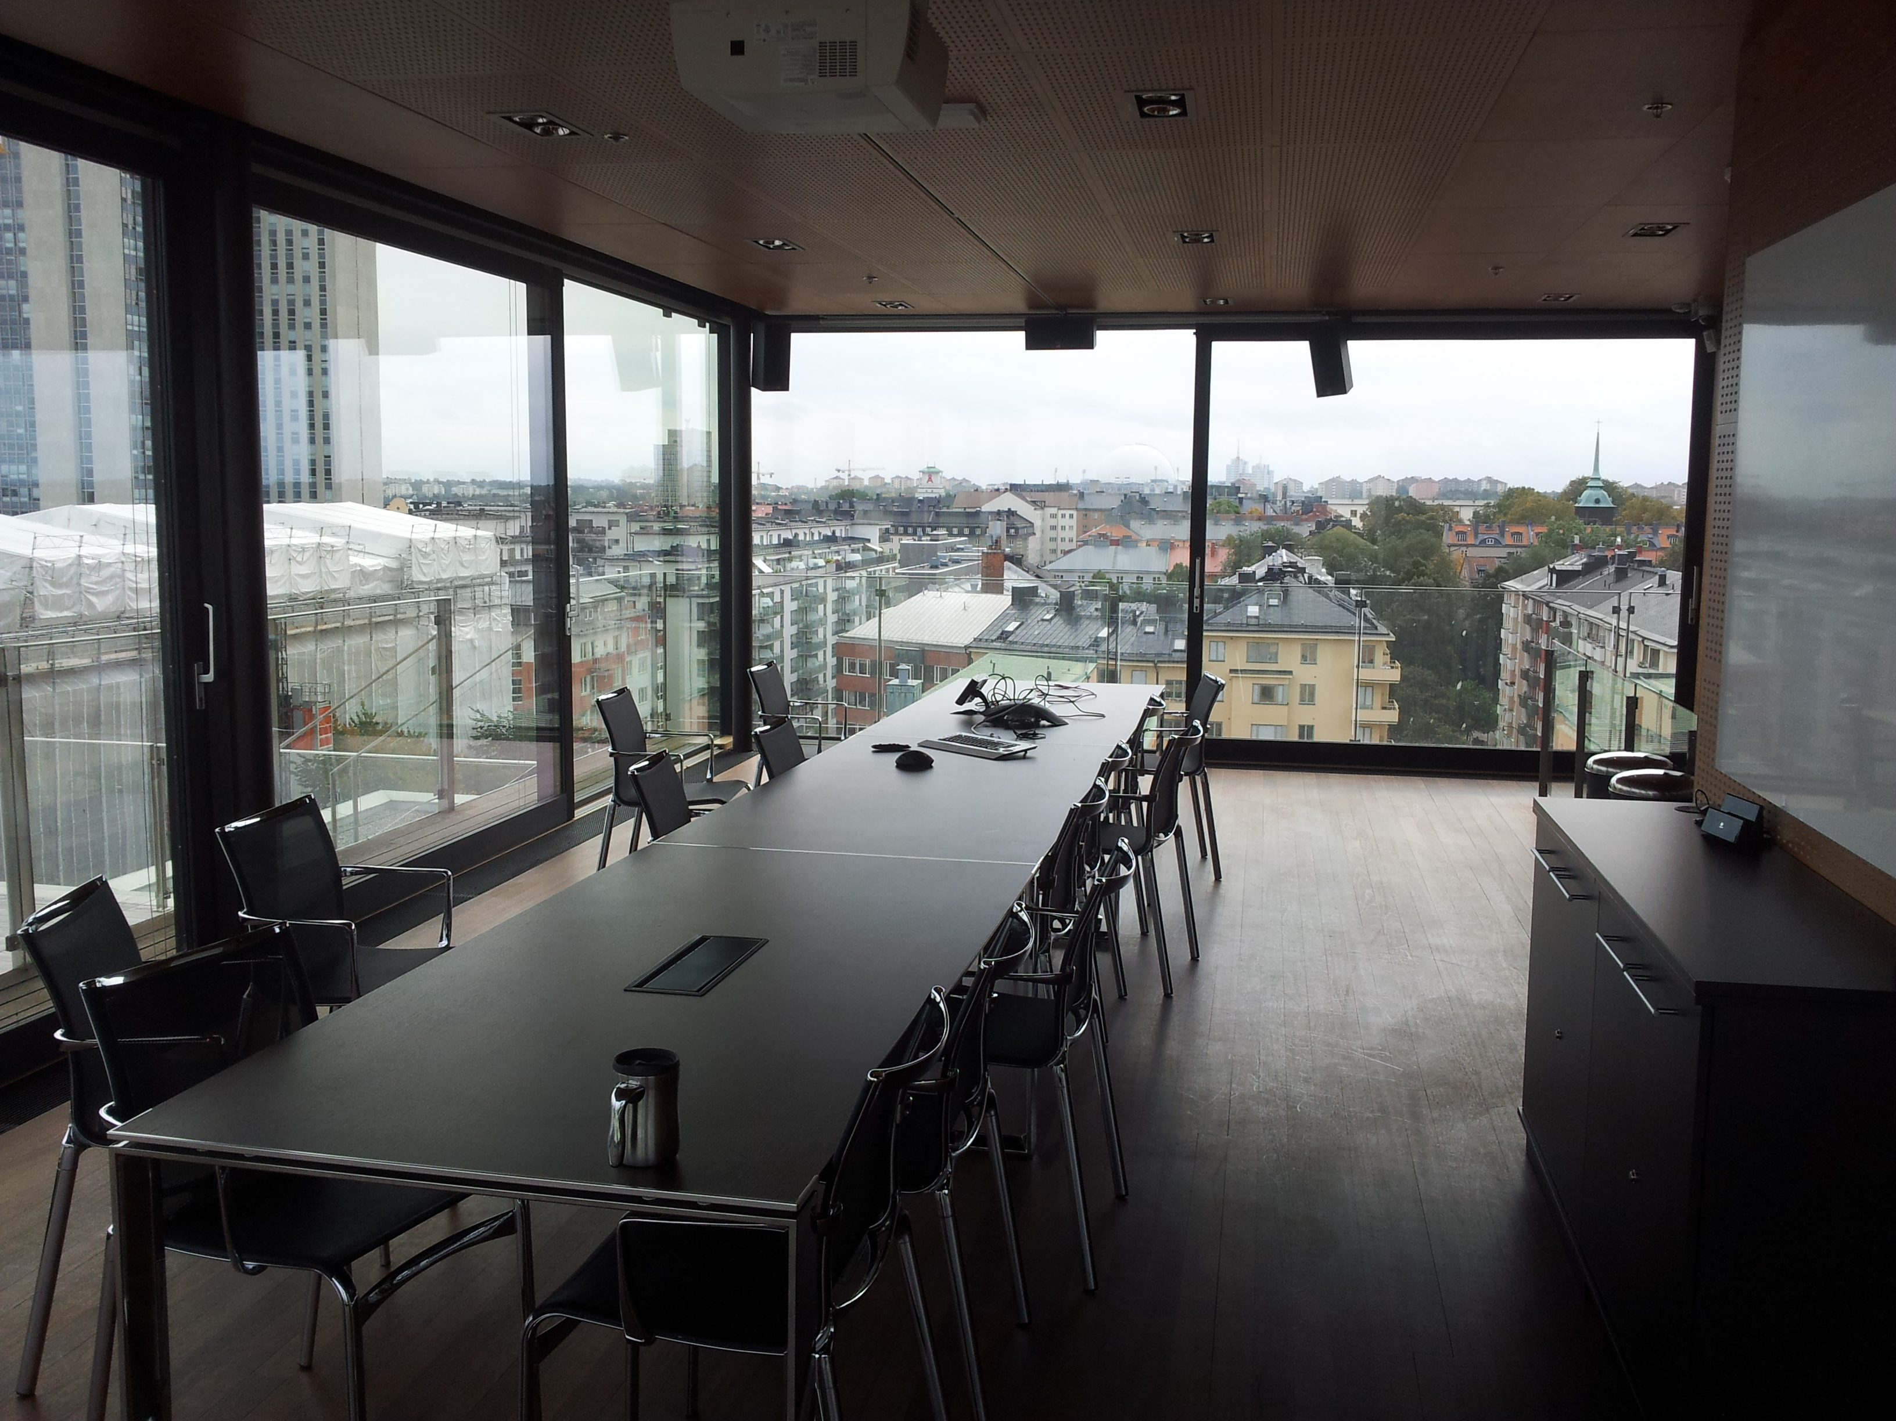
Motivation
Notes:
Here we have a photograph of one of our conference rooms at Frostbite. Interestingly, when looking at this picture, you don’t perceive reflections per se; instead we see some shadowing of the outdoor light. This highlights an important feature of SSR which is often underplayed. It provides specular occlusion for local and distant reflections. Additionally, in this scene, there are plenty of rougher reflections, as well as variations in the reflectivity, especially on the floor. Take notice also how the reflections become sharper as they approach the contact points of the surfaces they reflect in, for example the chair legs.

Slide 7
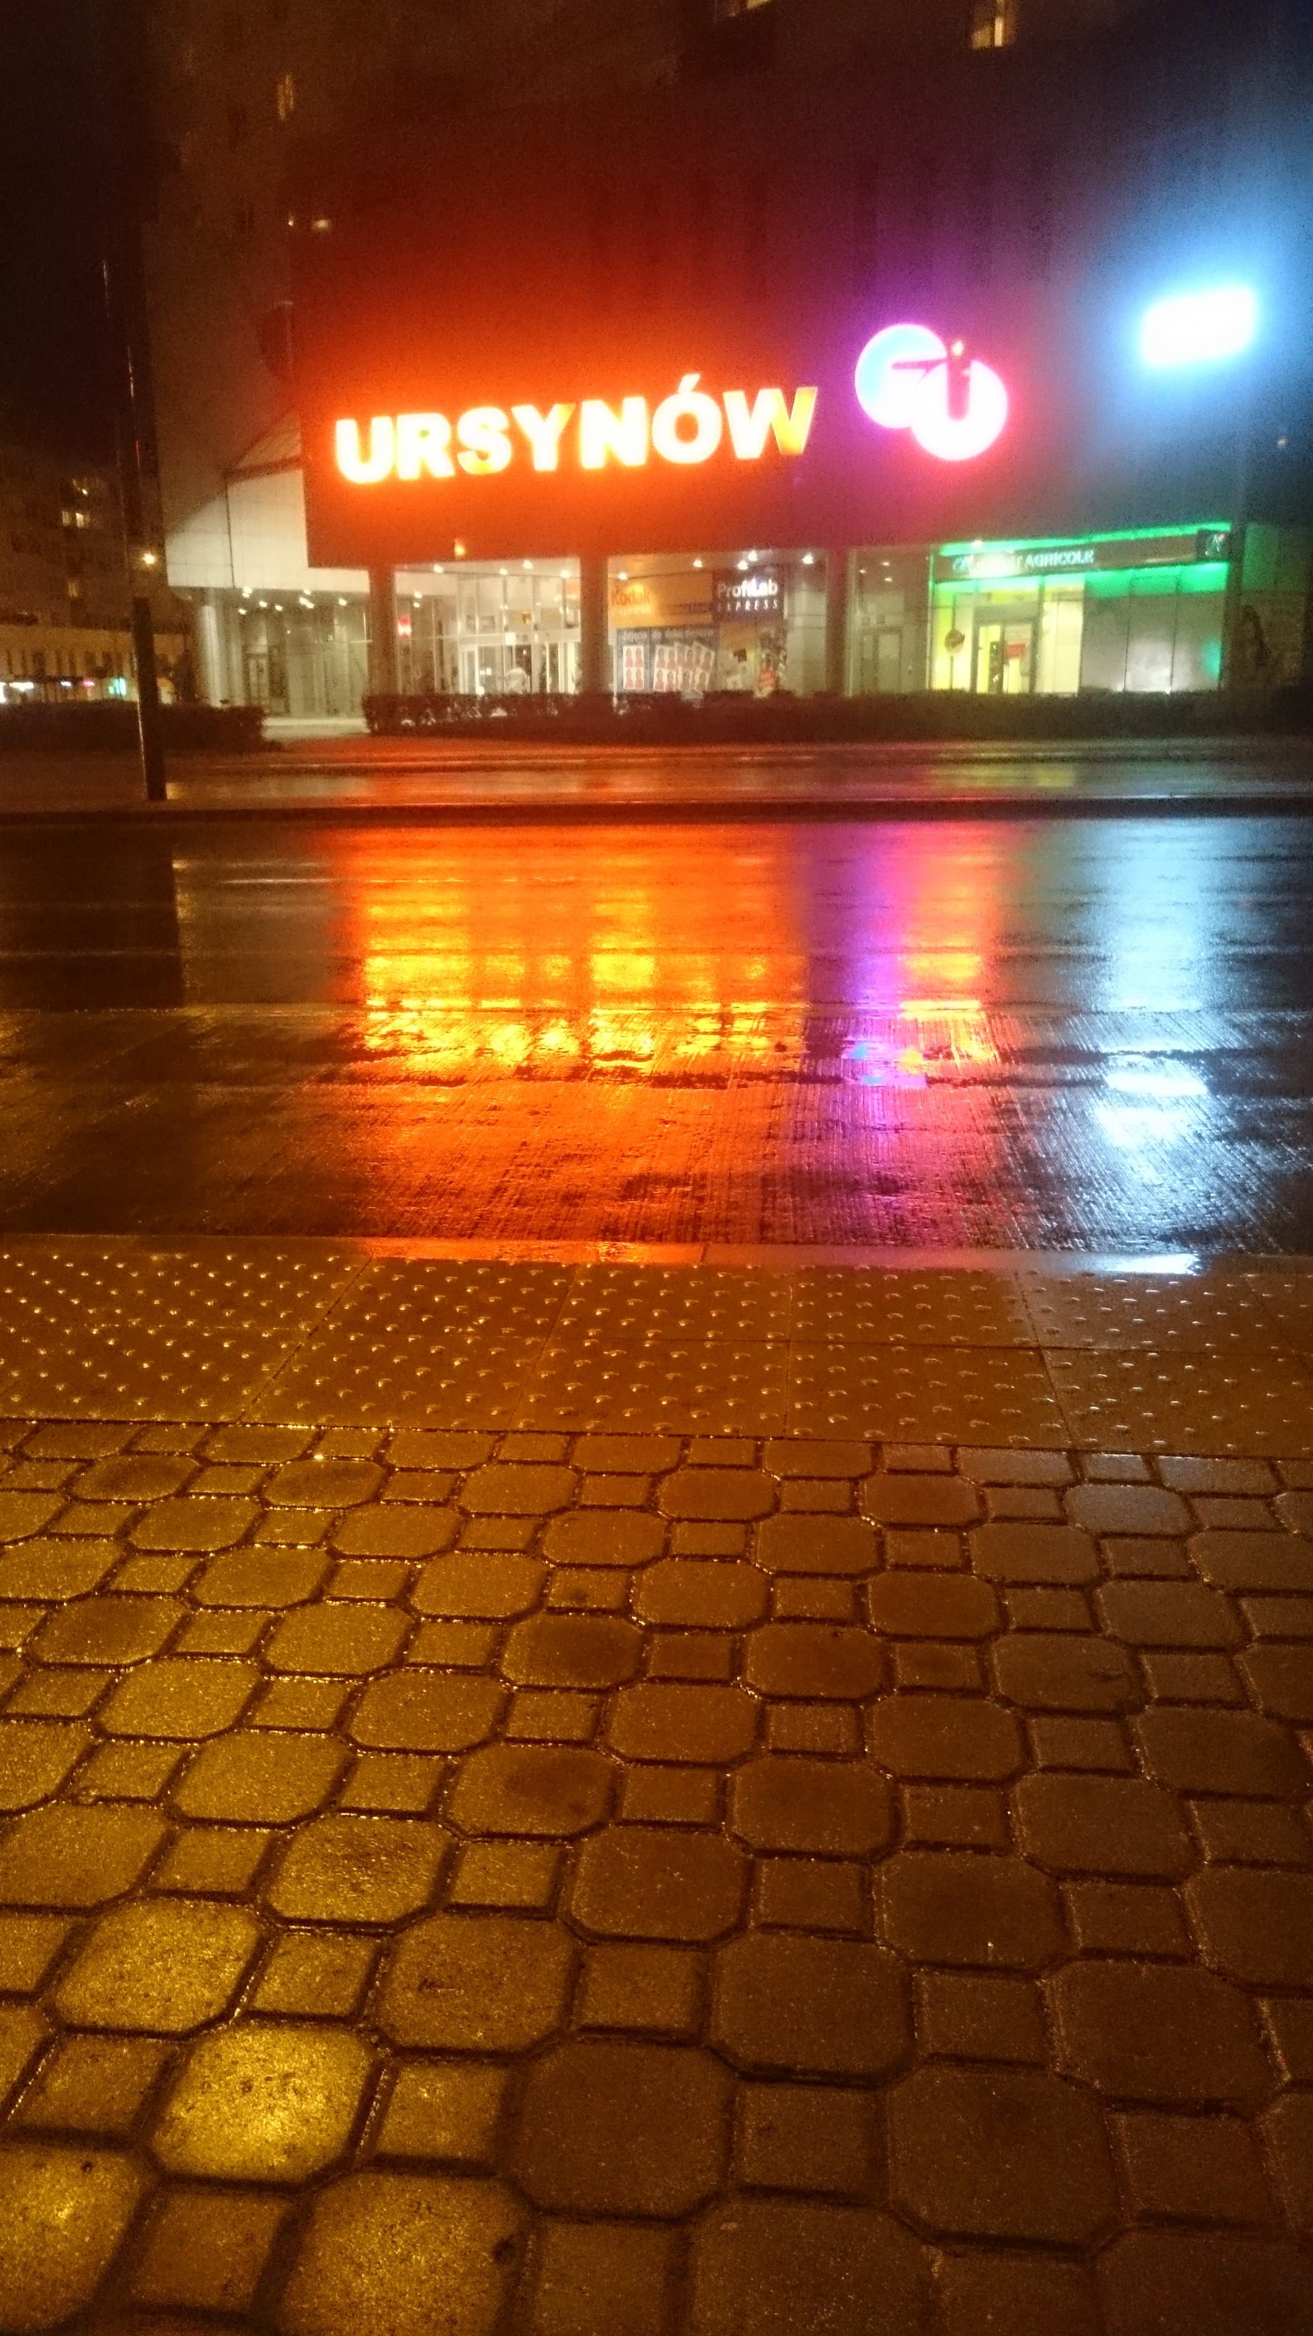
Motivation
Notes:
This photo represents something that you might see quite often in a racing game. But it also highlights a few important features we would like to support. The reflections stretch vertically; there is also high frequency variation in surface roughness and normals.

Slide 8
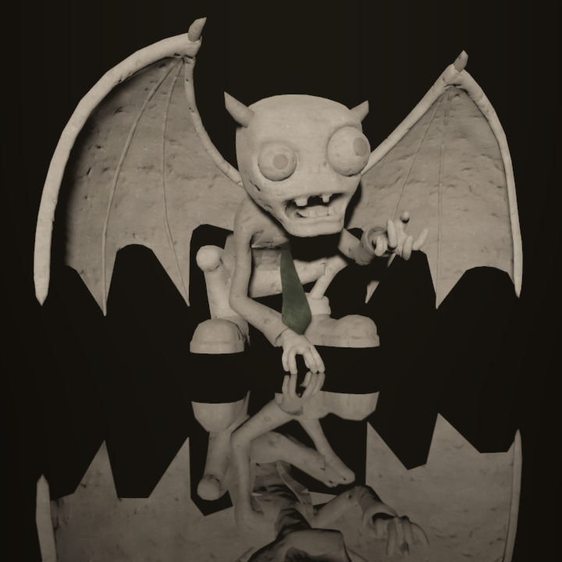
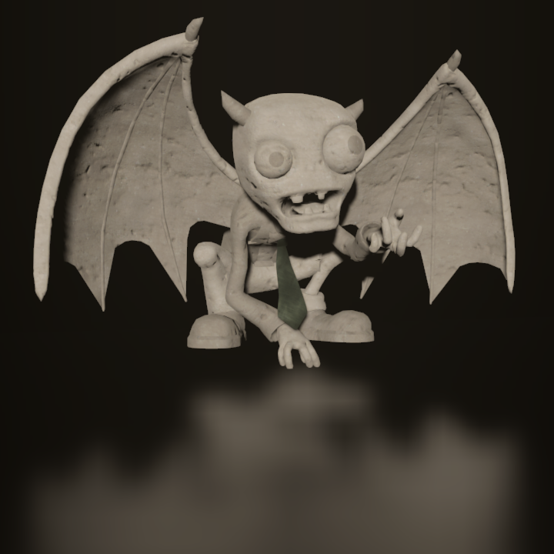
Our requirements
Sharp and blurry reflections
Contact hardening
Specular elongation
Per-pixel roughness and normal
Notes:
So now we can formulate a set of requirements that we would like to have for our SSR. First of all, it should support sharp and blurry reflections.
But those aren’t realistic blurry reflections…

Slide 9

Our requirements
Sharp and blurry reflections
Contact hardening
Specular elongation
Per-pixel roughness and normal
Notes:
… we would like them to sharpen as they come in contact with the reflecting surface.

Slide 10
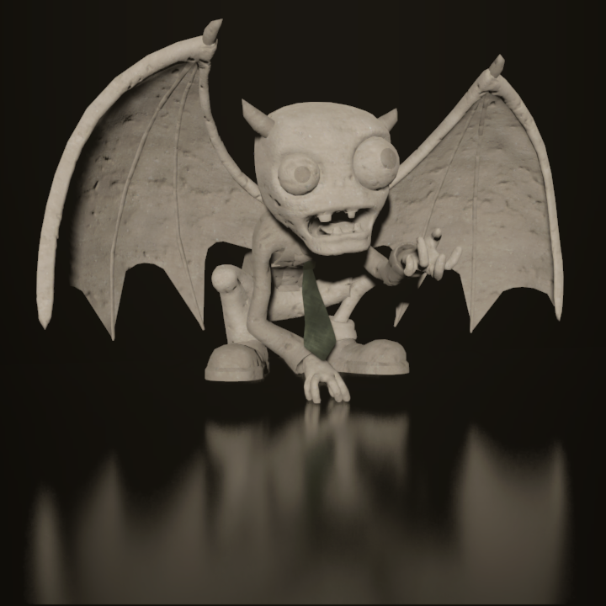
Our requirements
Sharp and blurry reflections
Contact hardening
Specular elongation
Per-pixel roughness and normal
Notes:
They should also stretch vertically. If you’re using a microfacet BRDF, your analytical lights do this already. SSR should also exhibit this physical phenomenon, as it’s important for realism.

Slide 11
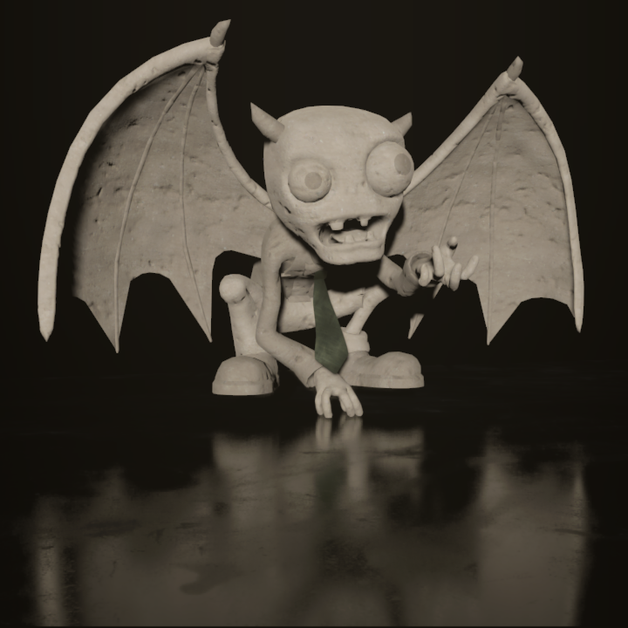

Our requirements
Sharp and blurry reflections
Contact hardening
Specular elongation
Per-pixel roughness and normal
Notes:
Finally, we would like to support per-pixel normal and roughness variation.

Slide 12
Previous work
Notes:
Let’s take a look at a few SSR techniques, and see if and how they fulfill the requirements we want here. We don’t have the time to go through all techniques presented so far, so we will mostly look at the methods which inspired our work.

Slide 13
Previous work
Basic mirror-only SSR
  Shoot rays from G-Buffer
    Normals just work
  Raymarch depth
  Return color at hit point
    Final lighting of last frame
    Reprojected
Notes:
Let’s start with a quick refresher of the basic SSR algorithm. There were a few publications detailing a possible implementation, so I won’t go into much detail. If you’d like to cover those basics more, check out Morgan McGuire and Michael Mara’s paper, for example [McGuire14].
Anyway, the basic algorithm only works with mirror-like reflections, so ray generation is trivial. We just take the G-Buffer’s depth and normals, and calculate the mirror directions. Then we ray-march the same depth buffer using any algorithm, for example by taking constant-sized steps in screen-space. When we intersect a surface, we must fetch the color at the intersection. There are a few options here, but the most popular one is re-projecting the previous frame’s final lighting, and returning that.

Slide 14
Previous work
Killzone Shadow Fall [Valient14]
Notes:
Killzone Shadow Fall had an interesting approach for glossy SSR, similar to Image Space Gathering. They would first generate a sharp reflection image...
… for all the pixels on the screen.
And then they would create a blur pyramid of this sharp reflection, and choose the blurriness based on surface roughness. This guarantees that there are no discontinuities, although there could be other artifacts. For one, it isn’t clear what level of blurriness should correspond to roughness value.

Slide 15
Previous work
Killzone Shadow Fall [Valient14]
???
Notes:
And then there’s the problem of normals. Meaning, they basically disappear on rougher surfaces, as the blur is not feature-aware.

Slide 16
Previous work
Killzone Shadow Fall [Valient14]
☹
No hardening
Notes:
Plus there’s the lack of contact hardening, as the blurriness is only derived from roughness, not object proximity.

Slide 17
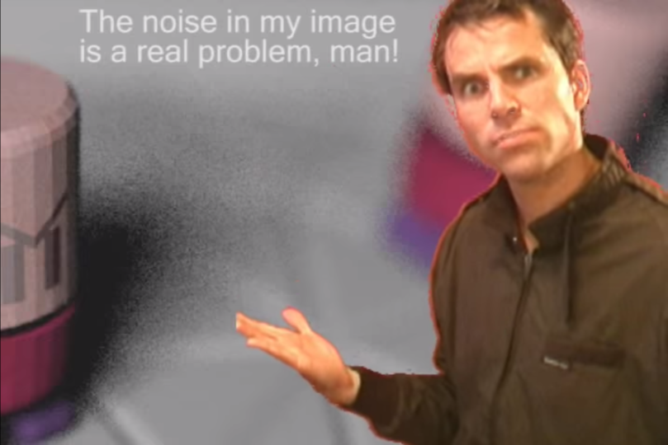
Previous work
Filtered Importance Sampling
Notes:
An approach which does satisfy all the requirements is importance sampling, with or without filtering. Instead of blurring a sharp reflection, this approach produces a blurry reflection by stochastically sampling the directions. For a rough surface, the directions will be more dispersed, and for a smooth surfaces, they will go in a narrow beam. The filtered variant uses a pre-blurred color buffer to sample from.
The only problem with this approach is that unless you use a lot of rays, it will be very noisy.

Slide 18
Our approach
Notes:
Our approach takes ideas from both filtered importance sampling, and the Killzone approach. We stochastically shoot rays, but also perform filtering in the image space, although with a pretty fancy kernel.

Slide 19
Our approach
BRDF importance sampling
Notes:
We begin by importance sampling directions from surfaces, but shoot only very few rays, even as low as just one per pixel.

Slide 20
Our approach
Hit point reuse across neighbors
Notes:
The major difference is that instead of returning the colors immediately, we barely store the intersection points.
Then we have a ‘resolve’ pass, which reuses those intersection points across neighboring pixels.

Slide 21
Our approach
Prefiltered samples
Weighed by each BRDF
Notes:
During the reuse, we calculate the desired blur level of each sample, using an approximate cone fit, and taking the reflection distance into account.
We carefully weigh the contributions by each pixel’s BRDF, and that way we avoid normal smearing, over-blurring, and we retain sharp contact points.

Slide 22
Our approach - screenshots
Notes:
Here’s a few screenshots of the results. I’ll show a video later as well.

Slide 23
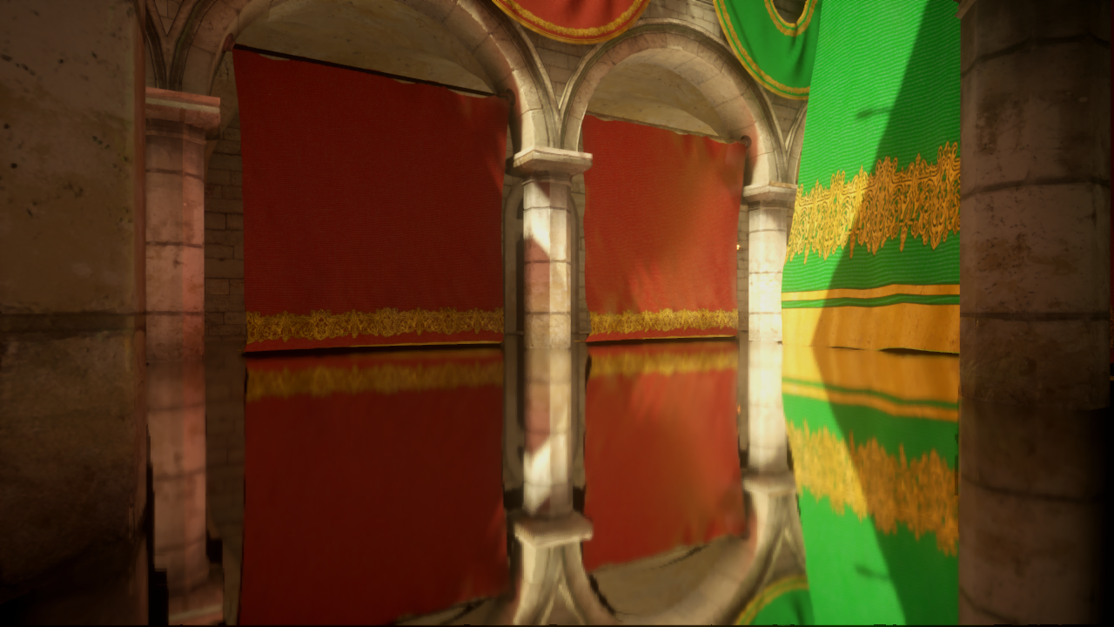
High smoothness

Slide 24
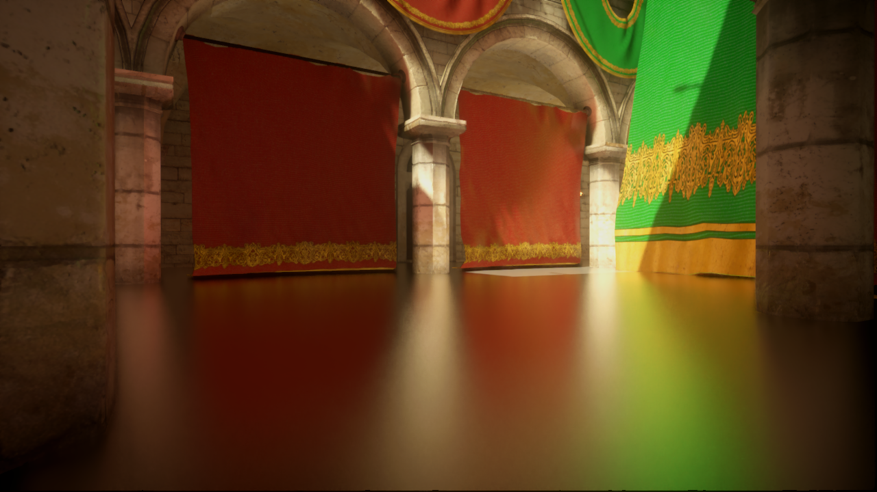
Medium smoothness

Slide 25
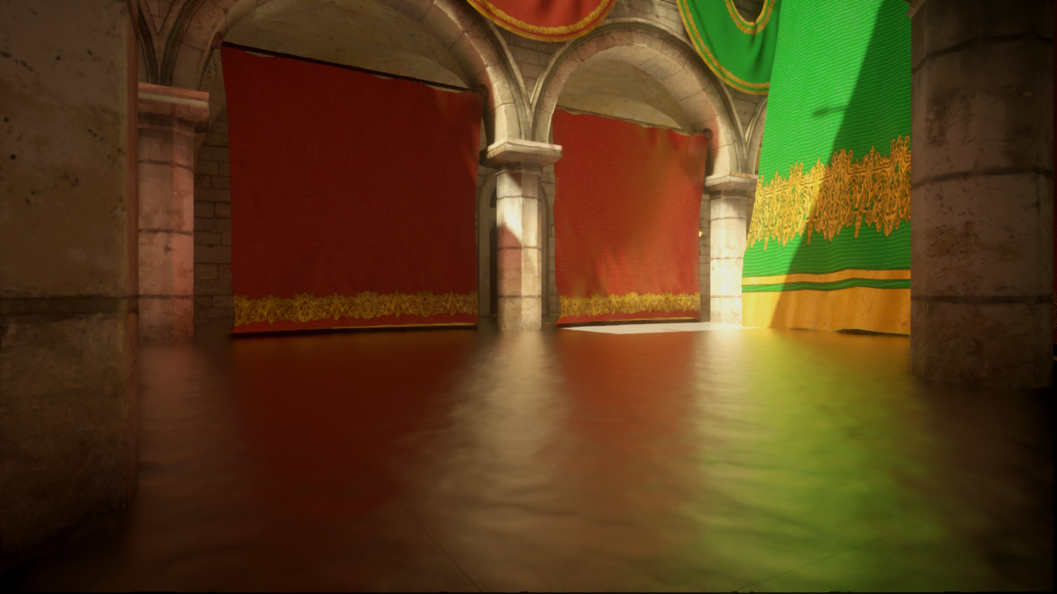
Medium smoothness + normals

Slide 26
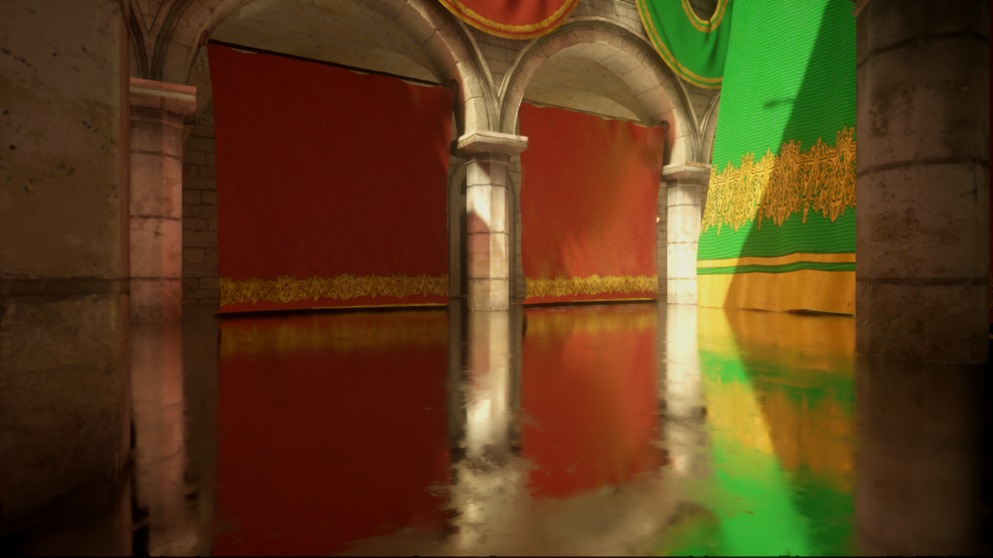
Variable smoothness

Slide 27
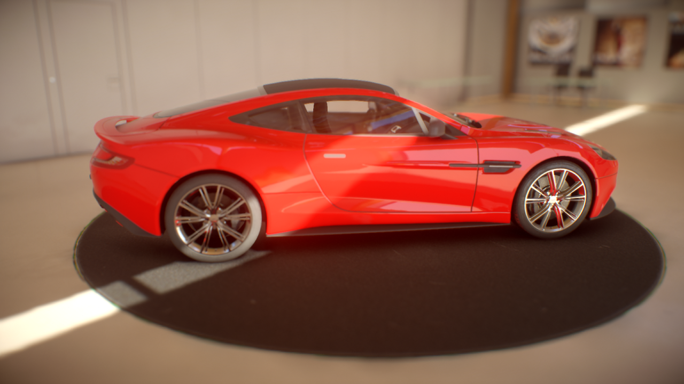
Smooth + rough; complex surfaces
SSR Off

Slide 28
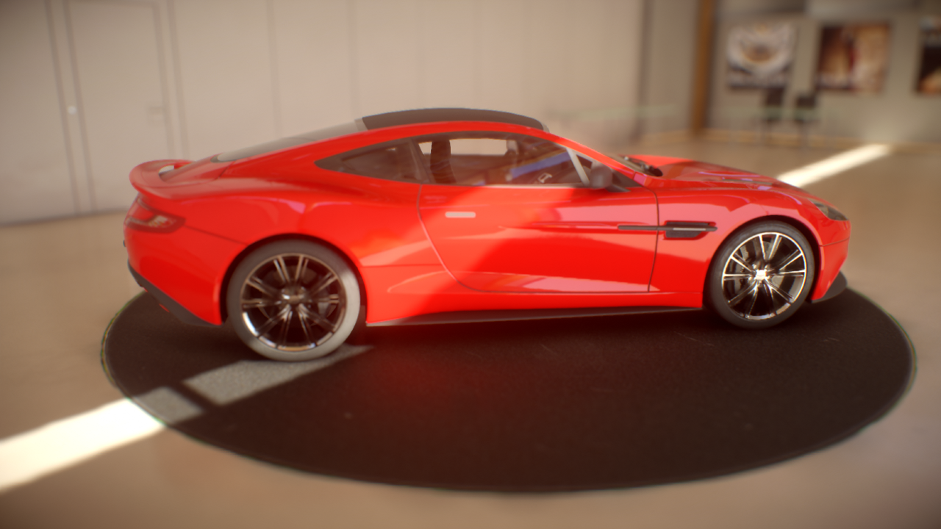
Smooth + rough; complex surfaces
SSR On

Slide 29
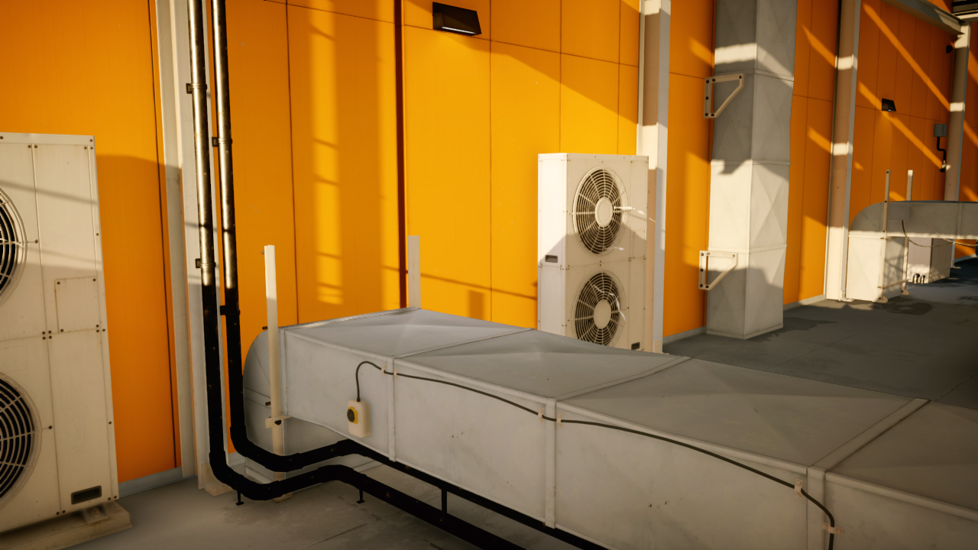
Mirror’s Edge Catalyst
SSR Off Fallback Off

Slide 30
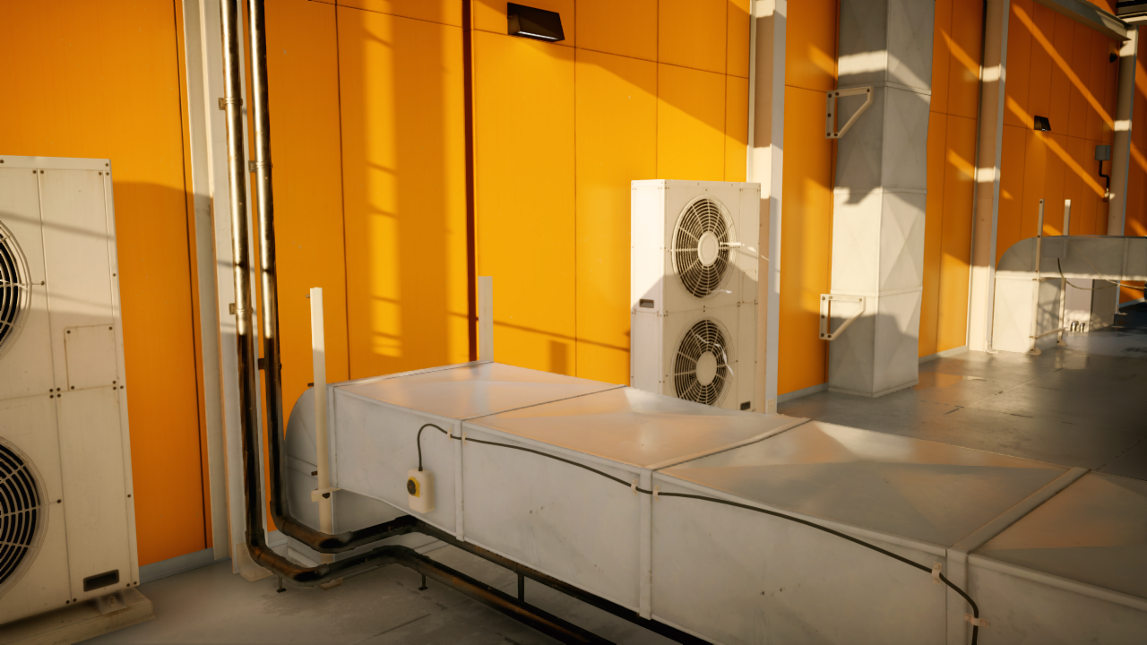
Mirror’s Edge Catalyst
SSR On Fallback Off

Slide 31
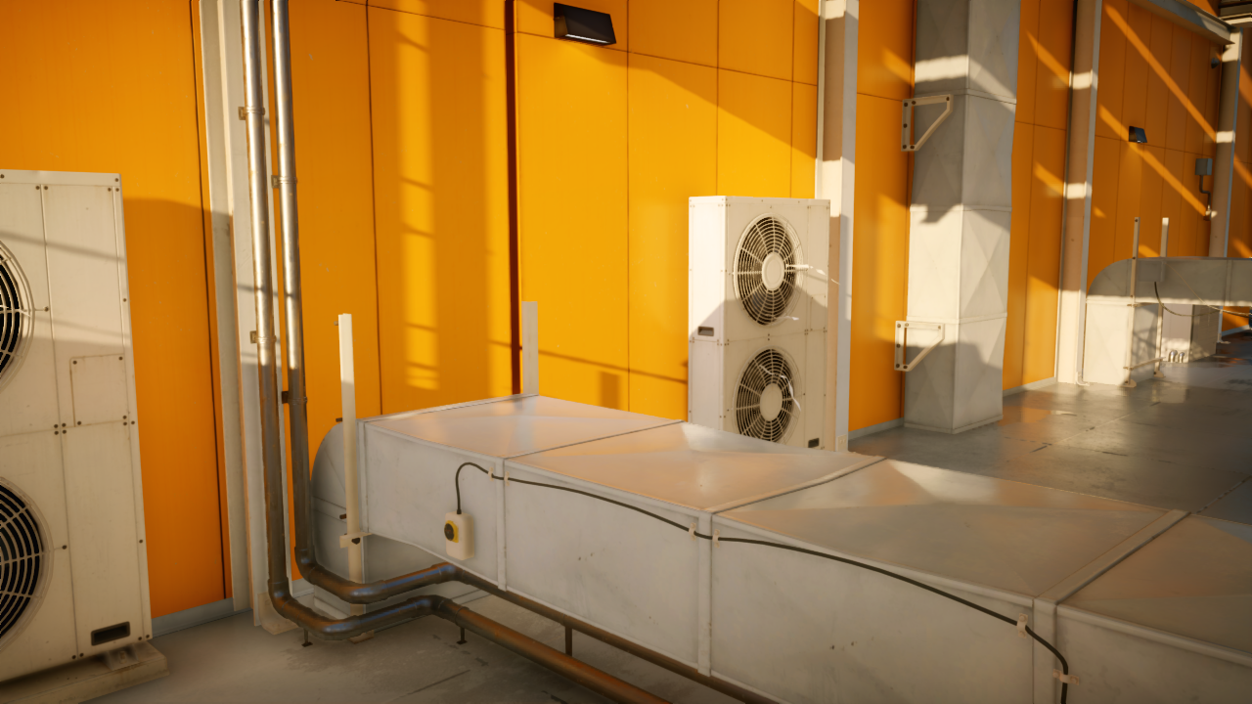
Mirror’s Edge Catalyst
SSR On Fallback On

Slide 32
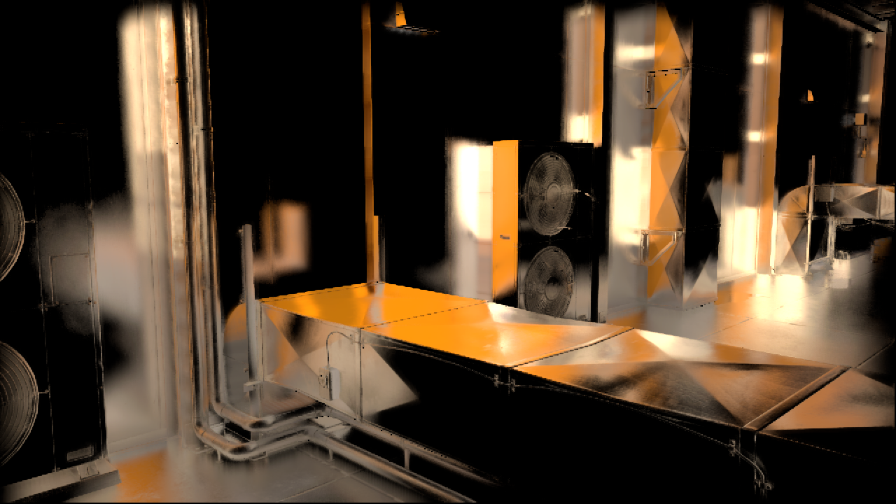
Mirror’s Edge Catalyst
SSR only; no AA

Slide 33
Algorithm breakdown
Tile classification
Ray allocation
Cheap raytracing
HQ raytracing
Color resolve
Temporal filter
Notes:
Now that you (hopefully) liked the results, let’s take a look at the break-down of our algorithm.
We begin by classifying which areas of the screen need reflections, and estimating how much work we need to spend in each tile.
Then we adaptively allocate rays, and importance sample them.
Next, we perform the ray-tracing in two flavors.
After all the ray-tracing is done, we resolve the colors via a ray-reuse filter.
Finally, we reproject the previous frame’s results, and blend the results. This temporal filter significantly reduces noise.

Slide 34
Tile-based classification
Split screen in tiles
Shoot tracer rays at 1/8th resolution
Estimate tile importance
  Hit anything at all?
  Perceptual variance of hit values
Allocate ray count per tile
  Between user-specified min and max
Notes:
Diving deeper, let’s take a closer look at all the steps.
The first one is tile-based classification. We subdivide the screen into square tiles, and we estimate for each tile how many rays we need for it. We let the user specify a min and max number of rays that should be shot per pixel, and this pass decides on a value between the min and max. To do so, we actually trace some rays for each tile, and guesstimate the perceptual variance of the reflection. This catches stark contrasts in the image, and allocates work where the reflection is estimated to be more noisy. We also approximately skip tiles from further calculations if none of the generated rays hit anything.

Slide 35
Ray classification
Classify each pixel based on roughness
Expensive rays
  Hierarchical raytracing
  Exact intersection
Cheap rays
  Simple linear march
  May skip thin objects
Notes:
Once we know which tiles need SSR, we launch an indirect compute pass which decides what kind of ray-tracing is needed for each pixel. We have two ray-tracing algorithms.
There’s the super precise hierarchical Z tracer, which gives exact intersection points. We use this one on smooth surfaces, as for mirror-like reflections we would like the intersection points to be as precise as possible.
For rough reflections, we cheat and use a low quality linear marcher, as the result will be heavily filtered anyway, and exact intersection points aren’t that important.

Slide 36
Hierarchical tracing
Stackless ray walk of min-Z pyramid
mip = 0;
while (level > -1)
step through current cell;
if (above Z plane) ++level;
if (below Z plane) --level;
Notes:
Just a quick note about the hierarchical tracing. A description of it is in Yasin’s article in GPU Pro 5 [Uludag14] and a few other publications [Pearce15] [Hermanns15], but it’s probably good to mention it here as well. The idea is quite simple. We have a min-z pyramid, which is basically a quad-tree.

Slide 37
Hierarchical tracing
Stackless ray walk of min-Z pyramid
mip = 0;
while (level > -1)
step through current cell;
if (above Z plane) ++level;
if (below Z plane) --level;
Notes:
We start at the most refined level of the hierarchy. Regardless of which level we are in at a given moment, we step the ray to the edge of the cell, or until the intersectoin with the Z plane in the cell. If we don’t hit the Z plane, we move to a coarser level.

Slide 38
Hierarchical tracing
Stackless ray walk of min-Z pyramid
mip = 0;
while (level > -1)
step through current cell;
if (above Z plane) ++level;
if (below Z plane) --level;
Notes:
This provides efficient empty space skipping

Slide 39
Hierarchical tracing
Stackless ray walk of min-Z pyramid
mip = 0;
while (level > -1)
step through current cell;
if (above Z plane) ++level;
if (below Z plane) --level;
Notes:
Once we find an intersection with a Z plane, we move to a finer level in the hierarchy.

Slide 40
Hierarchical tracing
Stackless ray walk of min-Z pyramid
mip = 0;
while (level > -1)
step through current cell;
if (above Z plane) ++level;
if (below Z plane) --level;
Notes:
… again.

Slide 41
Hierarchical tracing
Stackless ray walk of min-Z pyramid
mip = 0;
while (level > -1)
step through current cell;
if (above Z plane) ++level;
if (below Z plane) --level;
Notes:
… and again.

Slide 42
Hierarchical tracing
Stackless ray walk of min-Z pyramid
mip = 0;
while (level > -1)
step through current cell;
if (above Z plane) ++level;
if (below Z plane) --level;
Notes:
Once we hit the Z plane at the coarsest level, we have found the intersection.

Slide 43

Importance sampling refresher
probability
Variance reduction for Monte Carlo
Given a target function to integrate…
Find a probability distribution function we can sample
  As close as possible to target
Generate samples according to PDF
Calculate mean function / PDF
Notes:
I have mentioned importance sampling before, but you may not be intrinsically familiar with the concept.
It is a variance reduction technique for Monte Carlo integration.
Suppose that we want to integrate this function; we need to have a probability distribution from which we can generate samples. It should be as close as possible to the original function that we’re integrating.
We generate samples from the PDF, and for each one we calculate the ratio of the function value to the value of the PDF. As the number of samples increases, the average of those values approaches the value of our integrand.

Slide 44
BRDF importance sampling
Any BRDF
  We use GGX
Every ray is sacred, every ray is great…
  Make them count!
  Low discrepancy Halton sequence
  Some rays go under the surface
    We re-generate them
    Could try Distribution of Visible Normals
    [Heitz14]
Notes:
We use importance sampling of the BRDF in order to generate ray directions. Any BRDF can be used here; we happen to worship GGX.
Now, we can’t generate lousy rays. Ray-tracing is expensive, so we spend some extra effort to generate very nice rays. As a bare minimum, we use a Halton sampler, with the values pre-calculated on the CPU side.
Now, the classic way for importance sampling BRDFs works by generating half-angle vectors, and reflecting them off the microfacet normal. This results in some rays actually pointing below the surface. We can’t use those, so we re-generate them a few times until we get nice ones. The extra cost is actually negligible here.
One could go even further, and importance sample from the Distribution of Visible Normals, as proposed by Eric Heitz and Eugene D’Eon. This will probably considerably reduce the noise, and is certainly future work for us.

Slide 45
Ray reuse
Neighboring pixels shoot useful rays
  Visibility might be different
  We assume it’s the same
Reuse intersection results
Notes:
Once we’ve performed all the ray-tracing, it’s time to calculate the colors of our picture.
The simplest way is to look-up the colors at the intersections of each pixel’s rays. But then we would need plenty of rays per pixel to achieve a noise-free result.
Most of the time however, we can steal some rays from neighboring pixels. Usually the surface properties will be similar, and visibility is almost always the same. Therefore we pretend the neighboring rays were shot from the local pixel, and use their intersection points.

Slide 46
Ray reuse
Weigh by local BRDF
Divide by original PDF
  Returned by ray-trace along with hit-point
Neighbors can have vastly different properties
Spikes in BRDF/PDF ratio
  Worse results than without reuse :(
Notes:
Of course we can’t just arbitrarily reuse the intersection points. We still need to be careful to produce the correct result. All the rays’ contributions need to be correctly weighed by the current pixel’s BRDF, and divided by the PDF that they were sampled from.
… and then it turns out that we have been overly optimistic. The neighboring probability distributions can be quite different from the BRDF values at the local pixel, causing pretty big spikes in the f over pdf ratio.

Slide 47
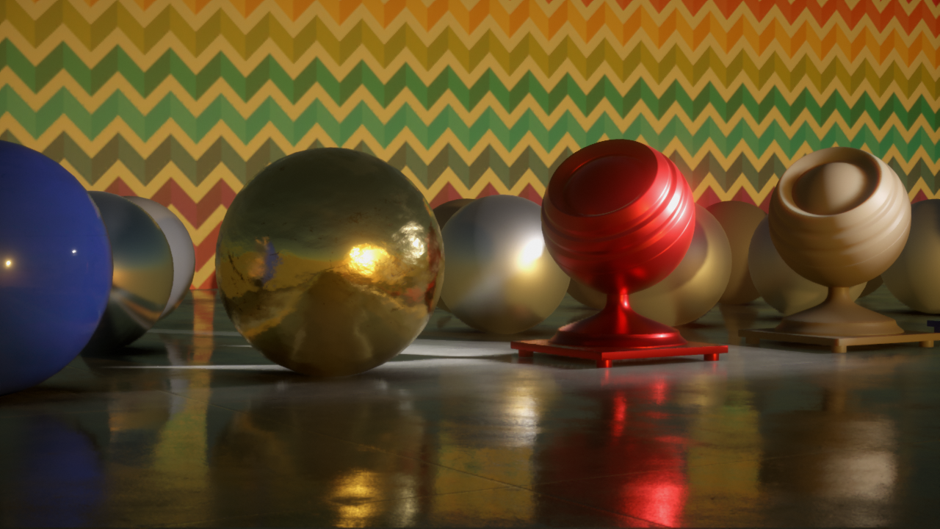
Ray reuse test scene
Notes:
Let’s take a look at an example scene, where there’s roughness and normal variation.

Slide 48
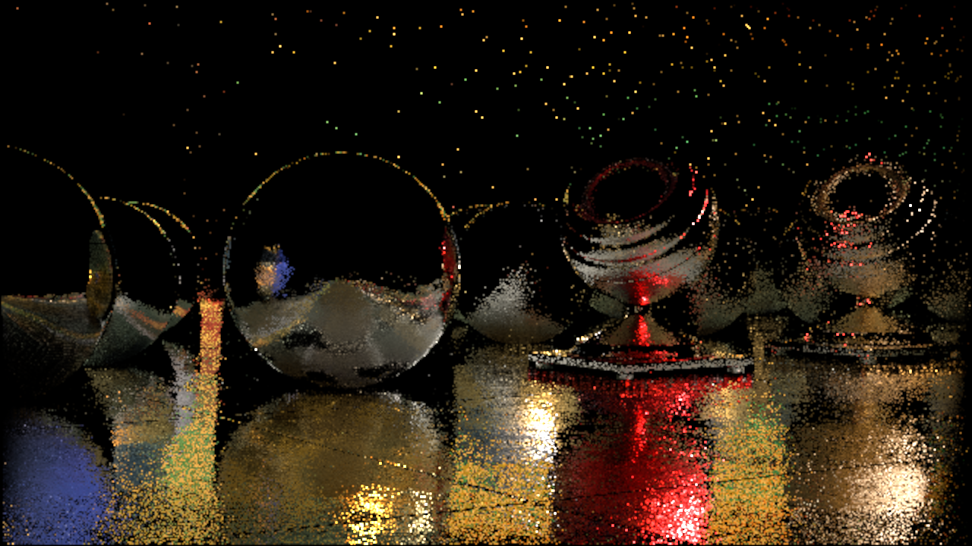
1 ray, 1 resolve sample half-resolution
Notes:
Here’s just the reflections, calculated with one ray per pixel at half-res, and without any ray reuse.

Slide 49
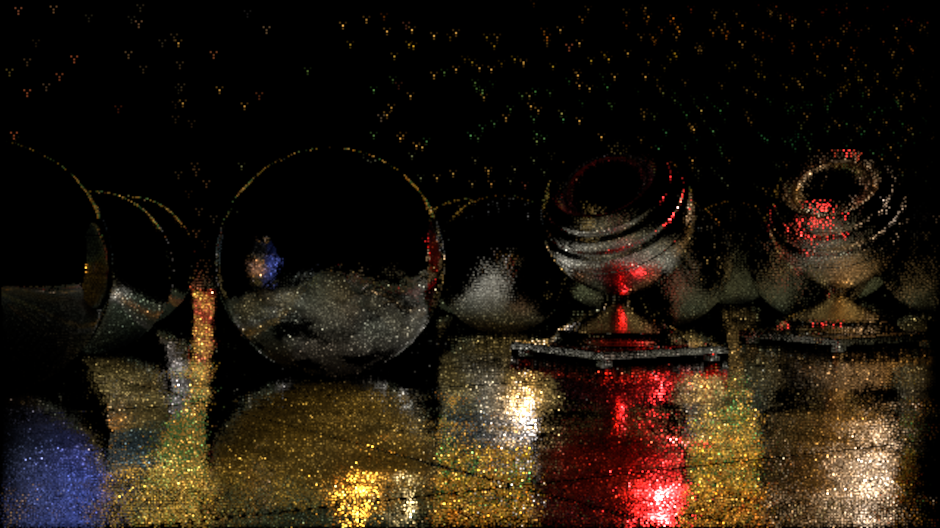
1 ray, 4 resolve samples
half-resolution
Notes:
And here we use four rays in the resolve pass. A few surfaces became smoother, but we have plenty of high intensity speckles everywhere ground. Overall, this is a worse result than without any ray reuse.

Slide 50


Variance reduction
This is what we’re solving
Where
  f_{s} is the BRDF
  L_{i} is the incident radiance
  We integrate over hemisphere
  We skip emitted light (L_{e}) in the formulation
Variance!
Notes:
We can solve that, but we must first take a step back and take a look at what exactly we’re trying to solve here.
This is a version of the scattering integral, with the emitted light removed for brevity. The reflection’s value is determined by a hemi-spherical integral of the incident radiance weighed by the BRDF.
Here, the BRDF and cosine term divided by the PDF value is the source of variance. After summing up all the samples, spikes in those ratios result in pixels with overly bright or dark colors.

Slide 51

Mul and div by the same factor
Notes:
We attack the variance problem directly, as will become obvious in a few moments. We take the original scattering equation, and we multiply its numerator and denominator by the same value. As long as it’s not zero, that’s an identity transformation.

Slide 52

… pre-integrate one of them
Notes:
We then replace one of the integrals with a constant which we can pre-calculate offline. Chances are that you are already calculating this value in your engine; it happens to be the same thing which we normally use for the split integral formulation for image based lighting. See for example Brian Karis’s presentation in the Physically Based Rendering course from 2013 [Karis13].

Slide 53

… and do the rest with Monte Carlo.
Notes:
And finally, we calculate the remaining bit with Monte Carlo quadrature.

Slide 54
Same thing in Simple English
BRDF-weighted image contributions
Normalization of BRDF weights
Pre-integrated BRDF
Notes:
Here’s the same thing again, with some annotations. What this basically boils down to is a weighted sum. The BRDF over PDF values are weights, and divide the result by their sum at the end.

Slide 55
… and pseudocode
result = 0.0
weightSum = 0.0
for pixel in neighborhood:
weight = localBrdf(pixel.hit) / pixel.hitPdf
result += color(pixel.hit) * weight
weightSum += weight
result /= weightSum
Notes:
The code ends up being super simple too.

Slide 56
1 ray, 1 resolve sample
no normalization
half-resolution
Notes:
Here we have the same pictures again. First, without ray reuse.

Slide 57
1 ray, 4 resolve samples
no normalization
half-resolution
Notes:
Now with ray reuse again, without the new variance reduction trick.

Slide 58
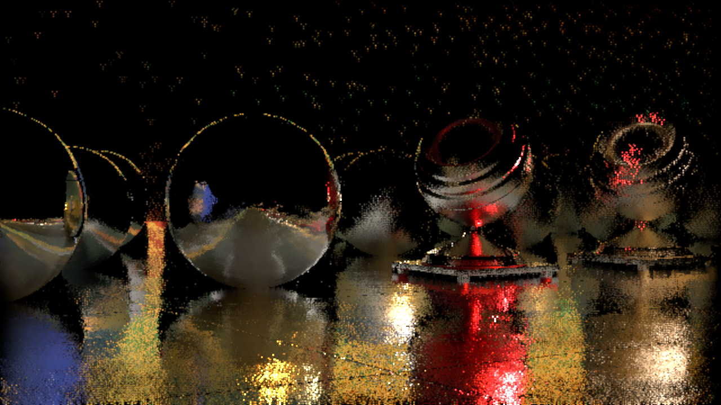
1 ray, 4 resolve samples
with normalization
half-resolution
Notes:
And now with the variance reduction. Much saner now.

Slide 59
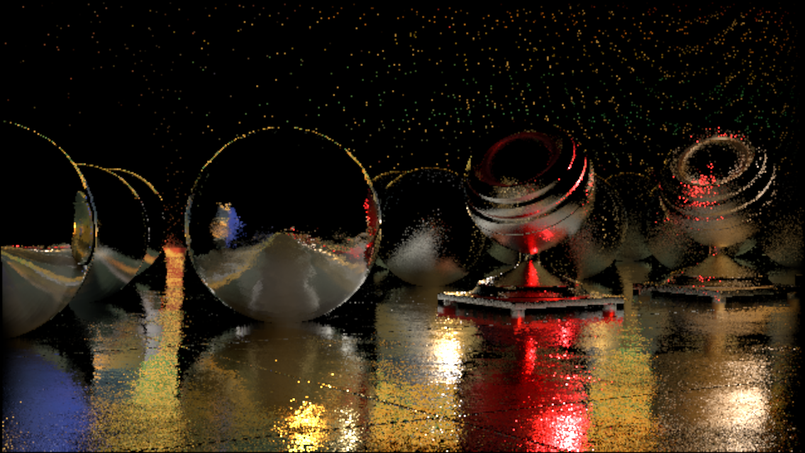
4 rays, 1 resolve sample
with normalization
half-resolution
Notes:
For a comparison, this is without ray reuse, but with four rays /traced/ per pixel. It looks a bit nicer due to more uniform noise distribution, but otherwise variance is pretty similar.

Slide 60
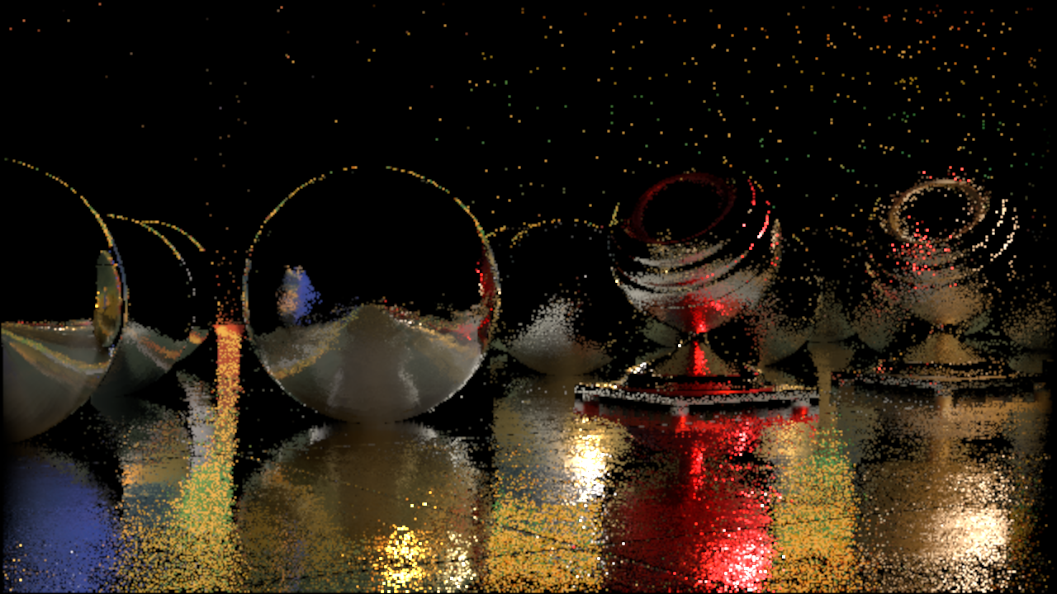
1 ray, 1 resolve sample
with normalization
half-resolution
Notes:
Just one ray and no reuse again.

Slide 61
1 ray, 4 resolve samples
with normalization
half-resolution
Notes:
And now with the variance reduction. Much saner now.

Slide 62

4 rays, 4 resolve samples
with normalization
half-resolution
Notes:
Another image; here we trace 4 rays per pixel, and use 4 samples to resolve. So 16 color values integrated, with only four rays traced per pixel. It’s starting to look nice, but looks like it will be still too expensive to get a noise-free result.

Slide 63
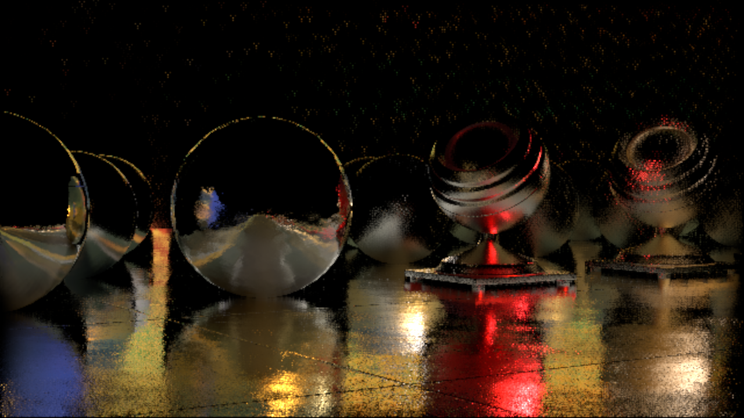
1 ray, 4 resolve samples
with normalization and temporal filter
half-resolution
Notes:
… which is why we use everyone’s favorite technique in the recent days, which is temporal filtering. We get a similar result to the previous image, except here we still only trace one ray per pixel.

Slide 64
Sparse raytracing
Raytrace at a reduced resolution
Reuse multiple rays at full-res
  Unique blend of rays for every pixel
    Automatic from BRDF
  Per-pixel normals and roughness preserved
Weight normalization fixes gaps
Notes:
The weight re-normalization allows us to do one more neat thing. What we’re doing is saying “The BRDF weights *must* integrate to one”, even if we have poorly fitting rays. Thing is, we will usually find some rays in the neighbors which we can use. Even if the given pixel didn’t trace any rays for itself. What this enables us to do, is sparse ray-tracing. We don’t need to shoot rays for every pixel, we just need to resolve at full resolution. We will find *some* rays which will suit us anyway. And we will properly weigh them by the full-res BRDF.

Slide 65
1 ray, 4 resolve samples
with normalization and temporal filter
half-res trace; half-res resolve
Notes:
Here’s the last image again. This is a half-resolution result.

Slide 66

1 ray, 4 resolve samples
with normalization and temporal filter
half-res trace; full-res resolve
Notes:
… and here with a full-res resolve. We’re still ray-tracing at half-res, but we get full-res detail.
Noise is lower here as well, as our temporal filter is designed with the full-res resolve in mind.

Slide 67
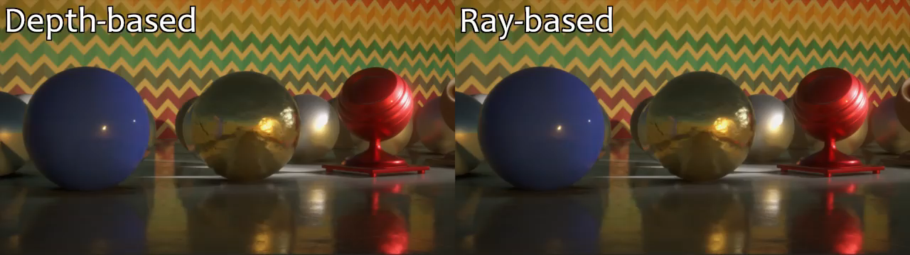
Temporal reprojection
Reprojection along G-Buffer depth ‘smears’
Add reflection depth
  Average from local rays
  Proper reflection parallax
Notes:
I mentioned temporal reprojection, so let’s have a quick look at it now. The idea is simple: given a pixel’s 3D coordinate, check where it was in the previous frame, project it, and we have the texcoord to sample.
… except when we move the viewport, reflections exhibit parallax. That is, the reflected objects move according to their depth, not the depth of the surface which reflects them. Attempting to reproject reflections using the closer depth results in smearing. So we calculate the average depth of the reflected objects, and reproject using that. This results in much reduced smearing.

Slide 68
Importance sampling bias
probability
Lots of noise from BRDF tail
Shift samples toward mirror direction
  Still need accurate PDF values
Truncated distribution sampling
  float2 u = halton(sampleIdx);
  u.x = lerp(u.x, 1.0, bias);
  importanceSample(u);
Different normalization constant
  Our variance reduction re-normalizes!
☹
☺
angle
Notes:
We are actually quite nasty with our importance sampling. We bias it quite a bit. It is difficult to eliminate all the noise without using a crazy number of samples. A lot of it comes from the tail of the BRDF, especially for distributions like GGX. Which is why we shift the generated samples toward the mirror direction. In a fancy way, because we still need accurate PDF values for importance sampling.
It’s actually quite easy to sample a ‘truncated distribution’ when using the inversion method…
… we just offset the pseudo-random value used to generate the offset from the mirror direction.
This has the effect of redistributing the samples from the ‘truncated’ region proportionally in the ‘untruncated’ region of the function. The PDF values are the same except for a constant scale factor… and we don’t need to calculate it, since our variance reduction scheme re-normalizes all the constant factors anyway.

Slide 69
Filtered importance sampling
Pre-filter image pyramid
Estimate footprint of a cone at intersection
No actual cone tracing
Mip determined by log function fit
  Roughness
  Distance to hit
  Elongation
Notes:
Another variance reduction technique we use is filtered importance sampling. I have already covered the ‘importance sampling’ bit, so the filtering part is quite easy to add. Instead of fetching the high frequency color buffer for our reflections, we use appropriately pre-blurred versions of it. We pretend that the rays we trace are cones, and we estimate their footprint at intersection points. From that, we get the mip level of a pre-blurred image pyramid to use.

Slide 70
Filter bias
Counter sampling bias with filter bias
  Same parameter
  Tuned for similar look across the range
Improves performance
  Better spatial coherency
  Smaller mips
Notes:
The sampling of pre-blurred image levels can be biased to produce blurrier reflections than necessary. This is useful to counter the bias in importance sampling, which over-sharpens reflections. We wire the two together, such that we end up with a single ‘bias’ parameter, which goes from “pure unbiased Monte Carlo” to tracing in the mirror direction, and taking all reflection blurriness from the filter.
Increasing the bias results in improved performance in two ways. The ray-tracing becomes more coherent, and we sample smaller color mips. Pushing it *too* high is not desirable however, as we introduce some discontinuities and leaks, since proximity in screen-space doesn’t necessarily mean proximity in the reflection. Increasing the bias also reduces the desirable elongation effect.

Slide 71
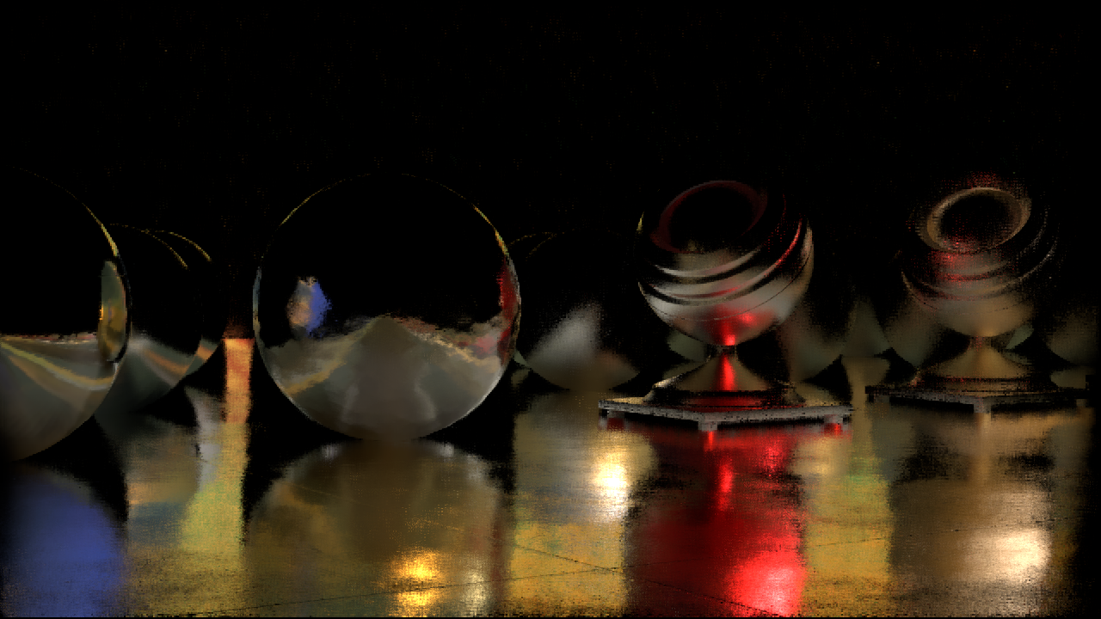
Bias 0.0
Notes:
Here’s our scene with a bias of zero.

Slide 72

Bias 0.7
Notes:
And again with 0.7. Some of the reflections changed slightly, but that is mostly due to the temporal filter’s neighborhood clamping. Otherwise the look of the image is similar, yet the noise is reduced, and the performance is improved.

Slide 73
Multi-pixel resolve
Resolve four pixels at a time
  Using the same rays
Four running color and weight sums
  Four times the VGPRs
    Two-three waves enough in practice
Same four color buffer UVs
  Different mips :(
  Find min and max mips, interpolate samples
  Two color samples instead of four :)
Notes:
Remember the full-res color resolve? We actually run it four pixels at a time, and reuse the same rays for all four pixels. It becomes more VGPR heavy, but lets us save some memory bandwidth, so it’s a win in practice. We only need to fetch the ray data once for all four pixels, and we also calculate the hit point screen-space coordinates once, as they are the same.
The thing which doesn’t necessarily have to be the same however is the mip level of the color buffer to fetch for each pixel. The pixels can have four different roughness values, and therefore should use different pre-filtered images. Here we use a similar trick as the DXT format uses for color compression. We find the min and max anchor mip levels for the four pixels, and we interpolate between them. That way we take only two color buffer samples instead of four.

Slide 74
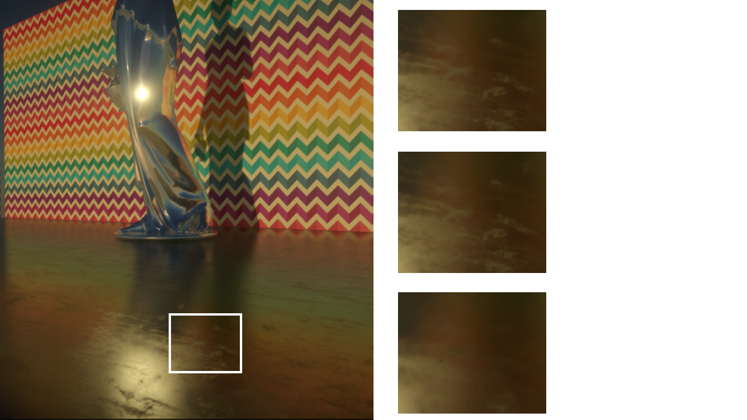
Mip anchor interpolation
4 mip fetches
2 mip fetches
+ interpolation
1 mip fetch
Notes:
To illustrate that the mip anchor interpolation works, here we have some comparison images. At the bottom, we’se using just one mip level for the four pixels we resolve; this results in a blurry image. Then at the top we have four unique mip levels, which is the reference. In the middle we have the result of interpolation. As you can see, the difference is barely noticable.

Slide 75
Performance
PS4 timings (Frostbite testbed)
  1600 x 900; all pixels reflective
  HQ rays for “Disney” roughness < 20%
  Bias 0.7
  All passes use compute, can run async.
Resolve samples | Rays / half-res pixel | Effective samples/pixel | Tile classify | Rayalloc | Linear trace | Hi-Z trace | Resolve | Temporal | Total
4 | 1 | 4 | 0.16ms | 0.24ms | 0.20ms | 0.37ms | 0.81ms | 0.30ms | 2.19ms
4 | 2 | 8 | 0.16ms | 0.34ms | 0.34ms | 0.65ms | 1.46ms | 0.30ms | 3.34ms
1 | 4 | 4 | 0.16ms | 1.06ms | 0.61ms | 0.91ms | 0.91ms | 0.33ms | 4.41ms
Notes:
Here’s a quick slide with performance on the PS4. As you can see, the ray reuse scheme allows us to quite efficiently reduce the ray tracing cost.

Slide 76
Video

Slide 77
Conclusion
All requirements fulfilled
  Accuracy, per-pixel normal, roughness, etc.
Tiny bright highlights still result in noise
  Can we detect and sample them more?
  Adaptive Multiple Importance Sampling?
  Track variance and blur where it’s high?

Slide 78

Thanks!
Questions?
  tomasz.stachowiak@frostbite.com
  @h3r2tic
By the way, we’re hiring!

Slide 79
References
[Heitz14] Eric Heitz, Eugene D'Eon "Importance Sampling Microfacet-Based BSDFs using the Distribution of Visible Normals" https://hal.inria.fr/hal-00996995
[Hermanns15] Lukas Hermanns "Screen space cone tracing for glossy reflections" http://publica.fraunhofer.de/documents/N-336466.html
[Karis13] Brian Karis "Real Shading in Unreal Engine 4" http://blog.selfshadow.com/publications/s2013-shading-course/
[Karis14] Brian Karis "High-quality Temporal Supersampling" http://advances.realtimerendering.com/s2014/
[McGuire14] Morgan McGuire, Michael Mara "Efficient GPU Screen-Space Ray Tracing" http://jcgt.org/published/0003/04/04/
[Pearce15] William Pearce "Screen Space Glossy Reflections" http://roar11.com/2015/07/screen-space-glossy-reflections/
[Tokuyoshi15] Yusuke Tokuyoshi "Specular Lobe-Aware Filtering and Upsampling for Interactive Indirect Illumination" http://www.jp.square-enix.com/info/library/
[Uludag14] Yasin Uludag "Hi-Z Screen-Space Cone-Traced Reflections" GPU Pro 5
[Valient14] Michal Valient "Reflections And Volumetrics Of Killzone Shadow Fall" http://advances.realtimerendering.com/s2014/

Slide 80
Bonus slides

Slide 81
Previous work
Lobe-aware filtering
[Tokuyoshi15]
No hardening :(
Notes:
One can try to filter the importance sampling noise. Similarly to how the Killzone approach blurs mirror-like reflections in screen-space, we can filter the noisy reflections. Only we need a smarter filter, which respects surface details. Yusuke Tokuyoshi has recently published a really cool paper about lobe-aware filtering [Tokuyoshi15], which produces great results. He uses it to de-noise path-tracing and real-time cone tracing.
An image is first rendered using importance sampling.
Then the filtering process compares the similarity of outgoing specular lobes through the use of fitted spherical gaussians. The similarity acts as a weight in a bilateral filter.
This approach fits almost all the bills, except contact hardening. The lobe similarity does not take object proximity into account, therefore we lose sharp contacts between objects.

Slide 82
Previous work
Hi-Z Cone Tracing [Uludag14]
Notes:
Yasin Uludag published a screen-space cone tracing algorithm in GPU Pro 5, which ticks many of the boxes on our list of requirements; everything except elongation.
// See also [Pearce15] and [Hermanns15]
The algorithm starts by tracing a ray, not a cone.
Once the ray hits something, the algorithm pretends it was a cone, and samples a pre-filtered color buffer. The contribution is weighed by a calculated coverage of the pre-filtered area.
It then marches forward and accumulates more samples, until full coverage is obtained.

Slide 83

Previous work
Can’t trace this
Hi-Z Cone Tracing [Uludag14]
???
Notes:
The trouble is with the coverage calculation, and with tracing following the first hit. The depth buffer only contains the first visible surface, so we don’t acutally know the thickness of objects. We can do some guesswork, or assume a constant thickness. But the algorithm still won’t know whether it just hit a solid wall, and should stop, or whether the thing it hit was a thin surface, and it should continue. The cone trace after the first hit can’t be performed accurately either since we can’t trace behind objects. We would need to perform depth peeling, or have other information about the scene structure.
Overall, in simple scenes the algorithm produces great results, but it can produce discontinuities and artifacts which are difficult to get rid of.

Slide 84
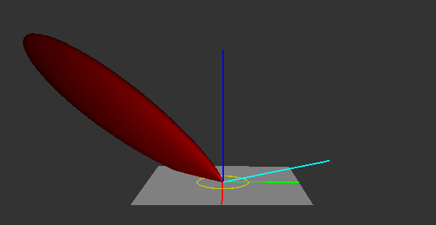
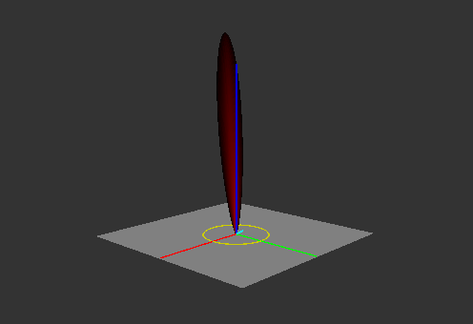
Overblurring at grazing angles
Cones poorly fit specular lobes at grazing angles
Lobes become anisotropic in shape
Cone fit to wider (azimuthal) angle over-blurs
Fit it to polar angle
  Effectively: shrink the cone at grazing angles

Slide 85
Filter shrinking due to elongation
Found a close fit in Mathematica
Also came up with an ad-hoc one
Ad-hoc close enough in testing
specularConeTangent *=
lerp(saturate(NdotV * 2.0), 1.0, sqrt(roughness));

Slide 86
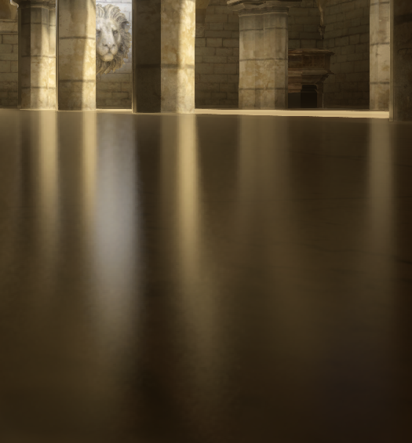
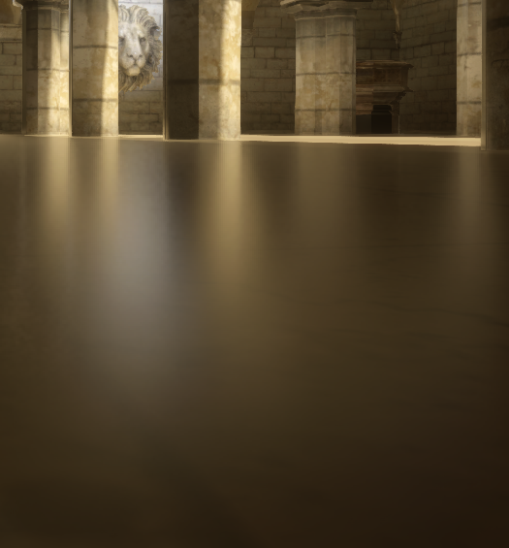
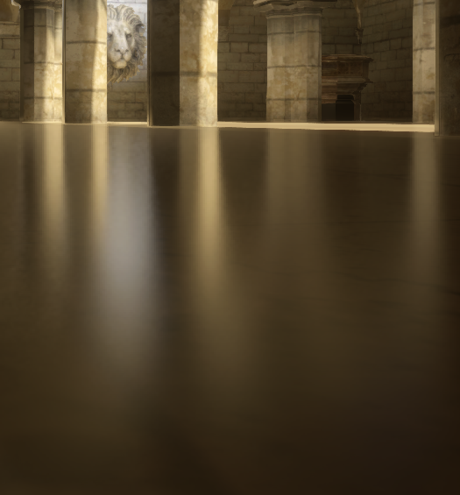
Filter shrinking due to elongation
No filter
Naive filter
Adjusted filter

Slide 87
Pre-integrated FG note
Remember this?
Multiply by FG after temporal
  We do it when applying SSR to the screen
Reduces smearing and noise
Notes:
Just a quick note about the pre-integrated FG term that I’d mentioned before. It is much better to multiply by it after the temporal filter, so that the changes in it do not affect the neighborhood clamping. They also don’t need to be re-projected, since the pre-integrated value is noise free anyway.
In our case, we multiply by the FG term in the pass which applies SSR to the screen. Its value is also used for image-based lights, so it effectively costs just one multiply operation.

Slide 88
Multi-pixel resolve jittering
Ray reuse across 2x2 quads == 2x2 noise
  Makes Temporal AA unhappy!
    2x2 blocks look like features, not aliasing
Spread out the target pixels
  Jitter temporally to hide artifacts
Notes:
There’s one more detail to the multi-pixel resolve that I need to mention. We process four pixels at the same time, but those are not the four closest pixels. Doing so would produce half-resolution noise, which doesn’t play well with Temporal AA due to its neighborhood clamping in a 3x3 neighborhood. We actually spread out the pixels such that the distance between them is greater than the TAA window. Every frame we change which four pixels are resolved together, and let TAA resolve that to a smooth hi-resolution image.

Slide 89
Variance reduction for ray reuse
Initial idea: Multiple Importance Sampling
  Treat neighboring pixels as generation strategies
  Accurate, unbiased results
  Expensive
    ALU and VGPR heavy
Notes:
I actually got the idea for ray reuse while reading Eric Veach’s thesis, particularly the bit about multiple importance sampling. The insight I had is that I could treat the neighboring pixels as ray generation strategies. That way, if we get an unlikely ray with a high BRDF over PDF ratio, we can ask the other neighbors “so what’s the chance that /you/ would give me this ray”, and weigh down the contribution of the unlikely one.
The approach worked fine, and produced great result. But it was also too expensive. All the careful weighing was ALU and VGPR hell.

Slide 90
Neighborhood clamping
Similar to Temporal AA
Tuned for some smearing over noise
  Can’t kill all the lag anyway
    Reflection color is from previous frame!
  Expand the color bounding box
Tiled, loaded from LDS
Notes:
To reduce temporal smearing and lag, we use neighborhood clamping. This is similar to the temporal anti-aliasing algorithm from Brian Karis [Karis14], but it’s tuned a bit differently. The values here are generally much more noisy, so the color bounding box clipping can’t be exact like in TAA. It turns out that we can’t remove all the reprojection lag anyway, since the reflection color buffer we sample in the resolve pass is from the previous frame. With that in mind, if we give some slack to the neighborhood clamping, it will only marginally increase the lag and smearing.

Slide 91
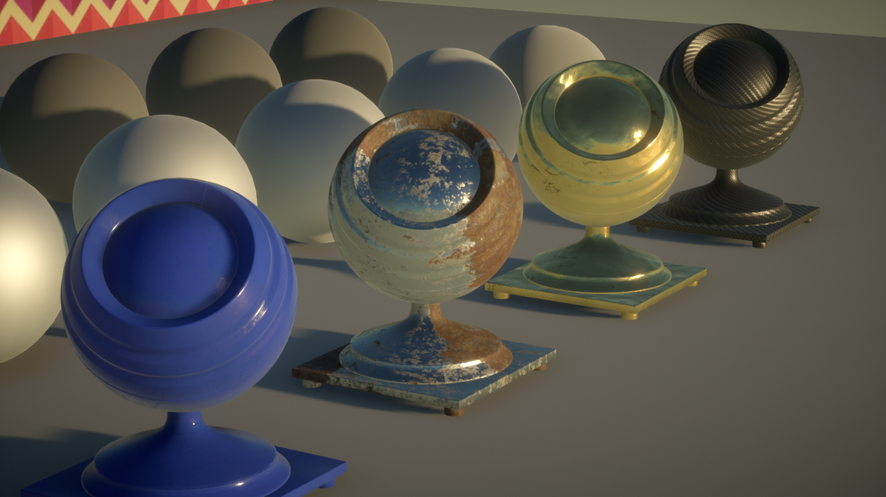
Common materials
SSR Off

Slide 92
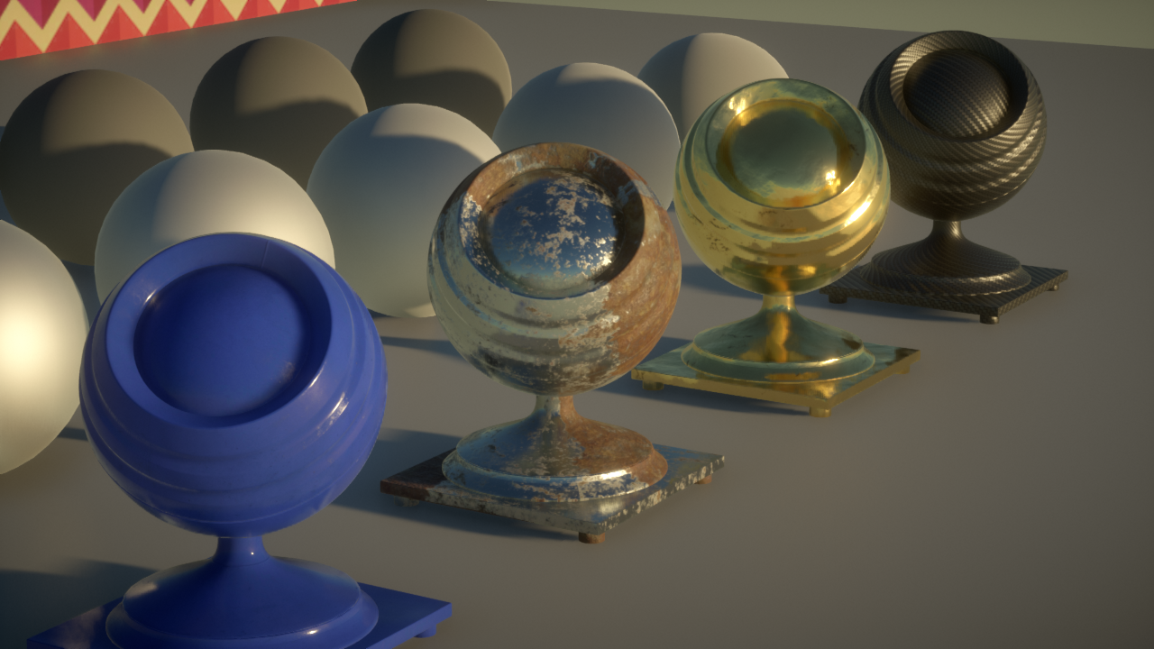
Common materials
SSR On

