Slide 1
Real-time lighting via Light Linked List
8/07/2014
Abdul Bezrati
Notes:
-Introduce yourself: Name, current position etc…

Slide 2
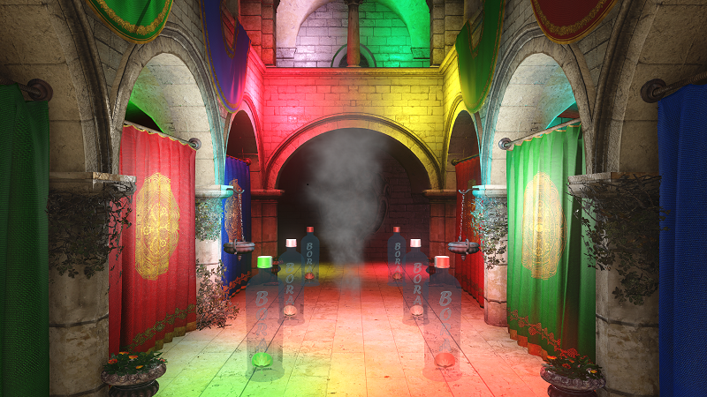
Old: Deferred Lighting
Notes:
-Our old custom engine uses deferred lighting.

Slide 3
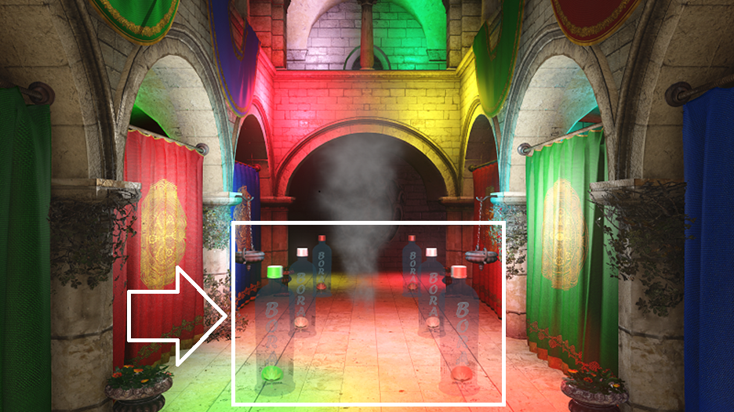
Old: Deferred Lighting
Notes:
No translucent geometry lighting

Slide 4
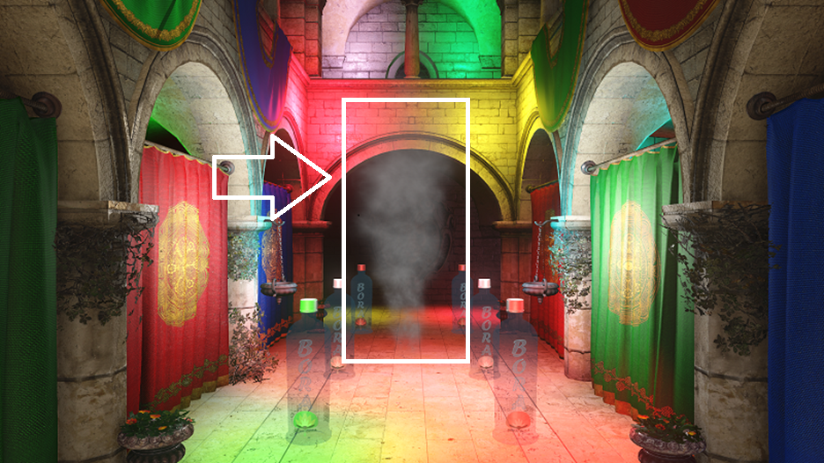
Old: Deferred Lighting
Notes:
No lighting on FX

Slide 5
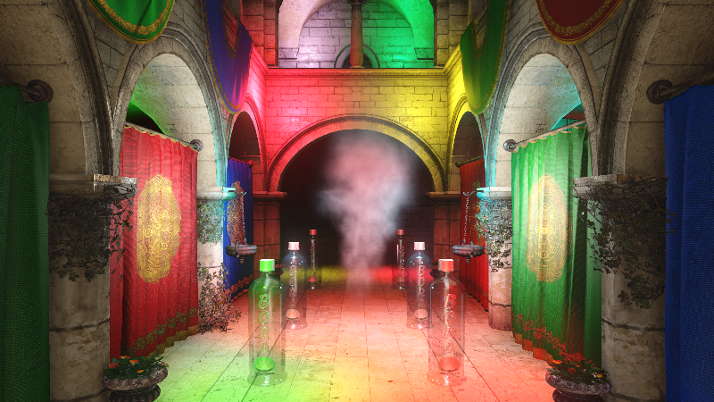
New: Light Linked List
Notes:
-Next gen!

Slide 6
Deferred Lighting
GBufferr
Fill Light Buffers
Light GBuffer
Alpha
Notes:
Traditional deferred lighting
Alpha is either non-lit or uses a different approach.

Slide 7
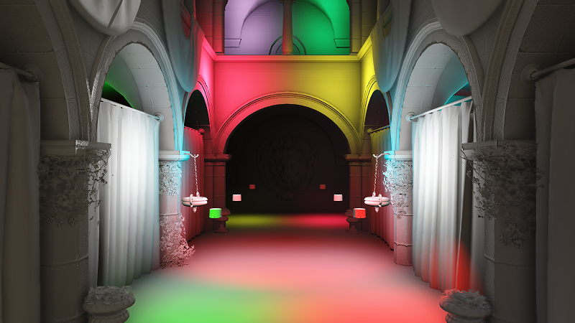
Diffuse Lighting
Notes:
-Deferred Lighting: Diffuse Light Buffer

Slide 8
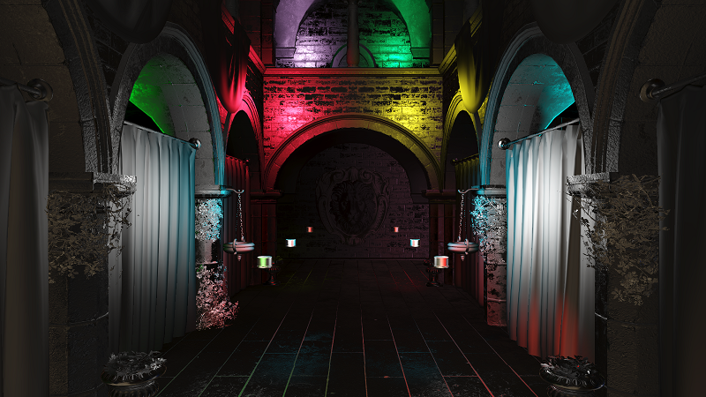
Specular Lighting
Notes:
-Deferred Lighting: Specular Light Buffer

Slide 9
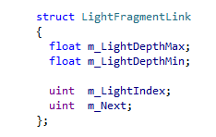
New approach
Store lights in a per-pixel linked list.
Notes:
Each pixel on screen stores only the lights it overlaps.
Store Min and Max depth in camera space.
The light index into a global array.
The link or index to the next fragment.

Slide 10
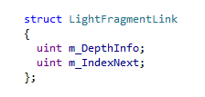
Compressed Fragment
Notes:
-Convert depth into FP16 and pack into u32
-Use 8 bits for light indices and 24 bits for linked element indices.
-Maximum light count per frame is 256 which is plenty for the type of games we are making.
-Size was reduced from 16 bytes to 8 bytes per element.

Slide 11
Resolution
Lower resolutions are better:
One quarter, one eighth etc…
Notes:
Better because less memory is required.
Less GPU bandwidth
We have experienced with 1 quarter but one eighth was the sweet spot

Slide 12
Memory Cost
4 Buffers at one eighth resolution:
2 RWByteAddressBuffer
1 RWStructuredBuffer
1 Depth Buffer (optional)
Pre-allocate average 40 Lights per pixel.
Total cost:
900P: ~7.25 megs
1080P: ~10.15 megs
Notes:
4 Buffers: 2 ByteAddressBuffers, 1 depth buffer and 1 structured buffer.
4 megs less than deferred lighting using R11G11B10 at the same resolution.
Average not a maximum!

Slide 13
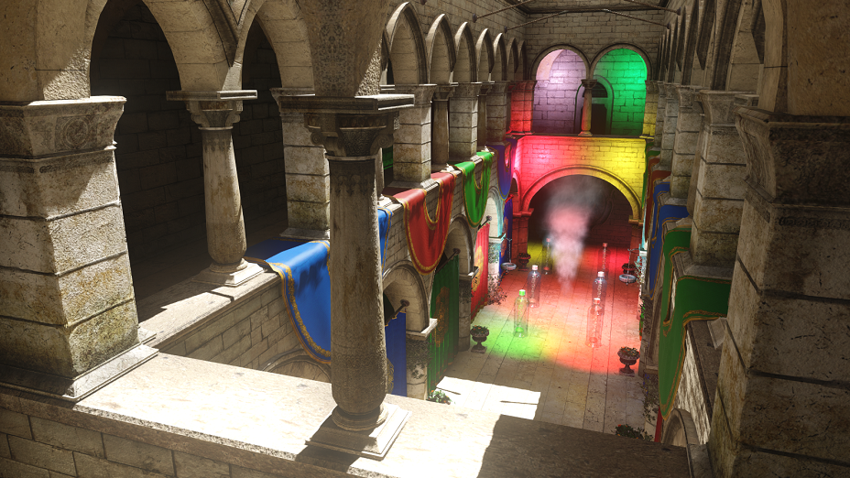
Notes:
LLL Debug View A

Slide 14
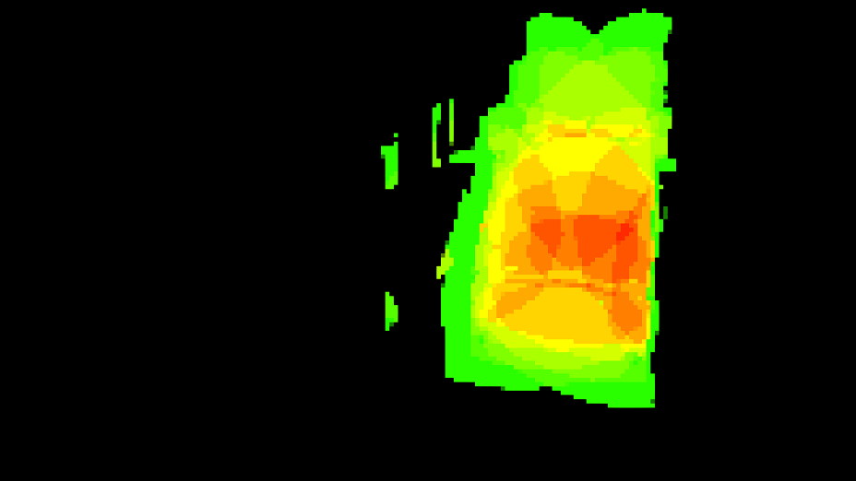
Notes:
LLL Debug View B:
Notice the reduced resolution (aliasing).
Using a reduced resolution not only speeds up the generation and access to the LLL but also saves memory.
The more lights a pixel overlaps the more its color shifts to red.
Black pixels overlap no lights.

Slide 15
Insomniac Engine
GBufferr
Fill Linked Listr
Light GBuffer
Custom Materials
Alpha

Slide 16
Insomniac Engine
GBuffer
(fast path)
Fill Linked Listr
Light GBuffer
Custom Materials
Alpha
Notes:
First step:
Gbuffer 90+ % of our materials.
3 render targets: 1 Depth/Stencil + 2 Material Buffers

Slide 17
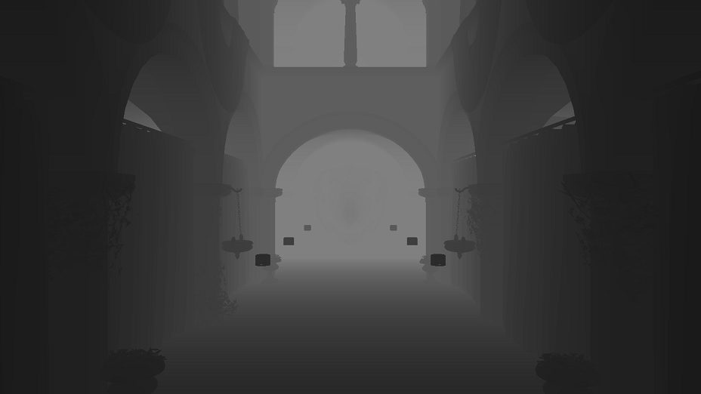
Notes:
Depth buffer: Float32

Slide 18
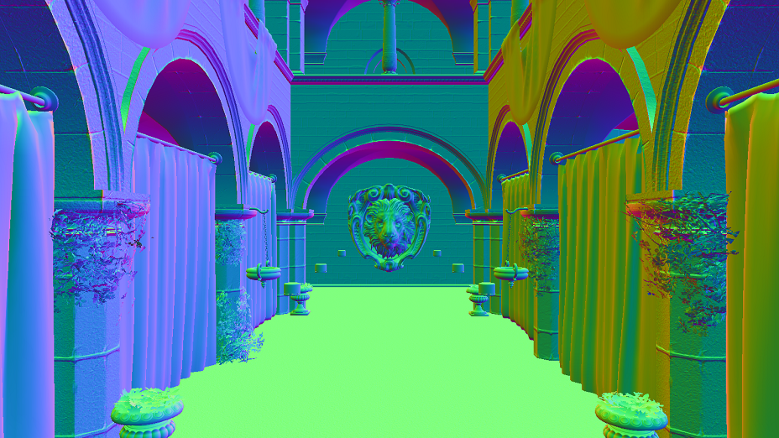
Notes:
MRT 0: Normals in world space, RGB channels.

Slide 19
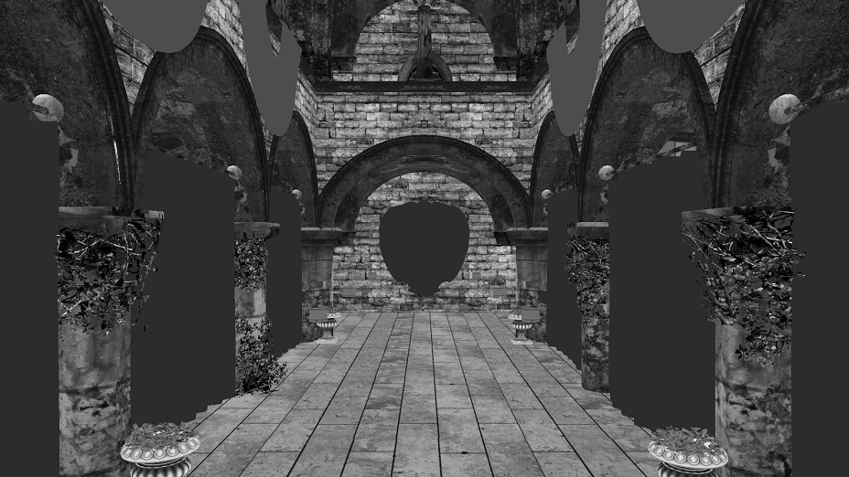
Notes:
MRT0: Glossiness, alpha channel.

Slide 20
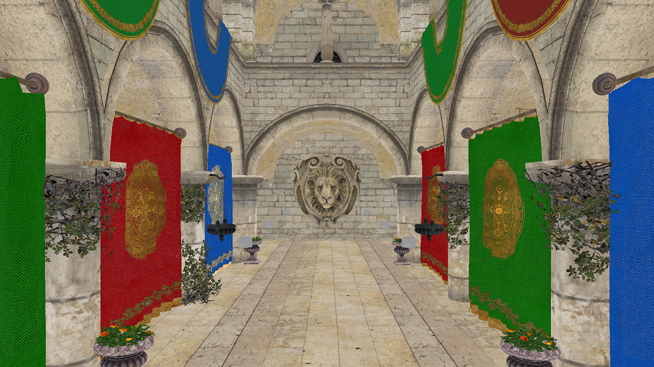
Notes:
MRT1: Diffuse color, RGB channels.

Slide 21
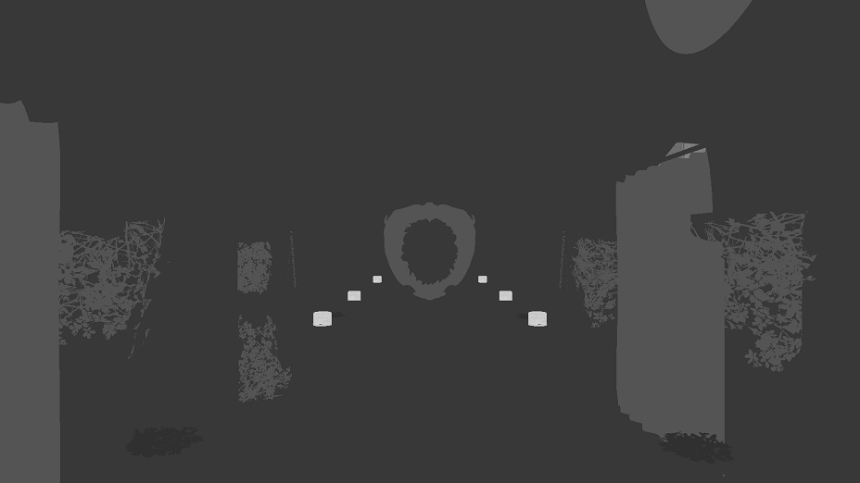
Notes:
MRT1: Specular Reflectance, alpha channel.

Slide 22
Insomniac Engine
GBufferr
Fill Linked List
Light GBuffer
Custom Materials
Alpha
Notes:
Second step:
Fill the light linked list

Slide 23
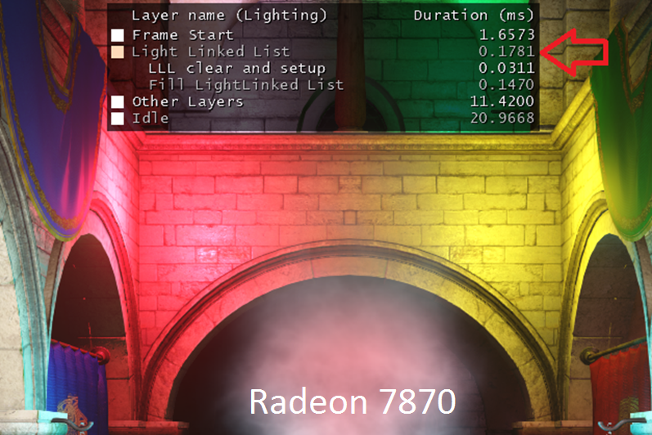
Fill LLL Cost 900P
Notes:
900P
Less than 0.15ms for 16 lights.

Slide 24
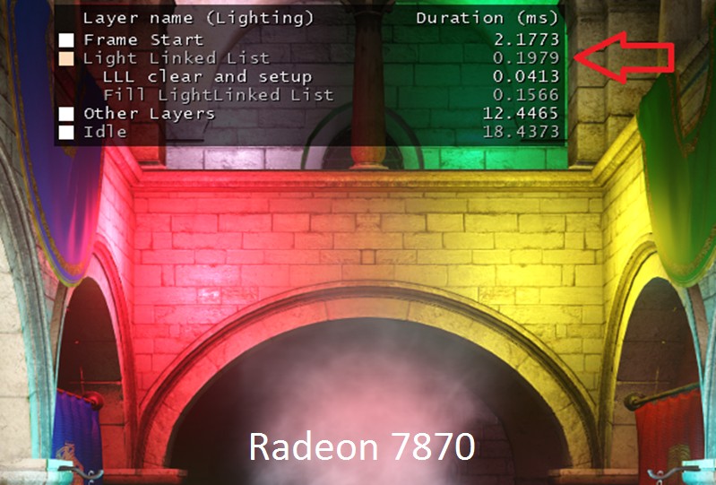
Fill LLL Cost 1080P
Notes:
1080P
Less than 0.16ms for 16 lights.
~10% slower

Slide 25
LLL Depth Buffer
Generate down-sized depth buffer.
Use conservative depth selection.
Use GatherRed.
Notes:
Generate the down-sized depth buffer to match the down-sized resolution.
Gather red to speed up the process.
Not necessary but nice to have, forward engines can skip this

Slide 26
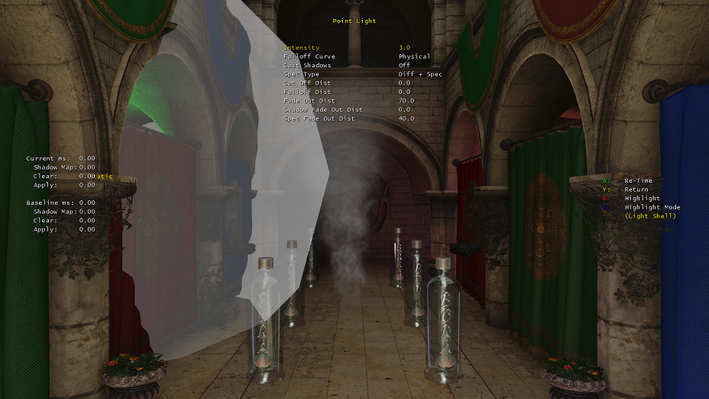
Light Shells
Notes:
-We use triangle soups to represent our lights.
-Low tessellation:
Faster to clip against the near and far frustum clips on the CPU.
-You need to slightly oversize your light shells to account for two things:
- Low tessellation
- Lower rendering resolution; we use half a pixel size to do the scaling.

Slide 27
LLL Shader Steps
Software depth test.
Acquire min and max depth.
Allocate a LLL fragment.
Notes:
One shader that executes three steps:

Slide 28
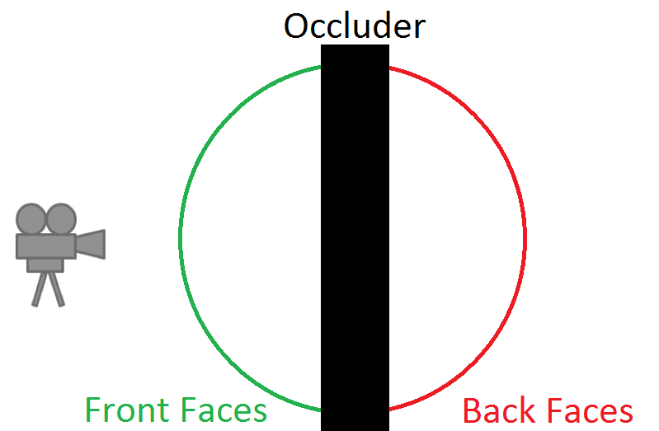
LLL Depth Test
Notes:
Front faces pass the depth test
Back faces fail the depth test
Disable hardware depth culling

Slide 29
LLL Depth Test
Software test front faces.
Notes:
If the front facing geometry fails the depth test then we know that back facing geometry will also fail the test and we skip the current pixel altogether.

Slide 30
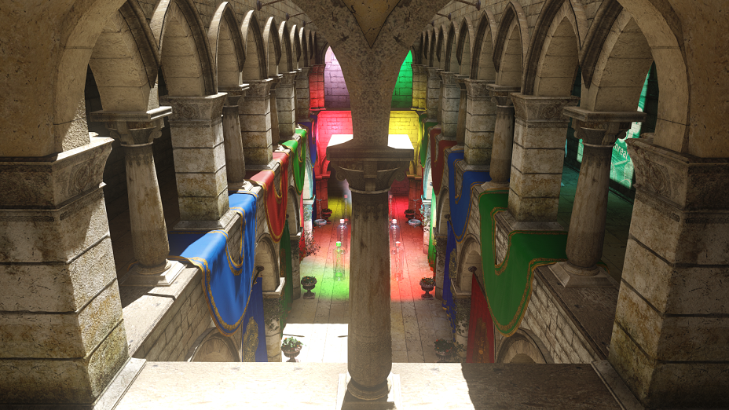
Notes:
Focus on the front pillar.

Slide 31
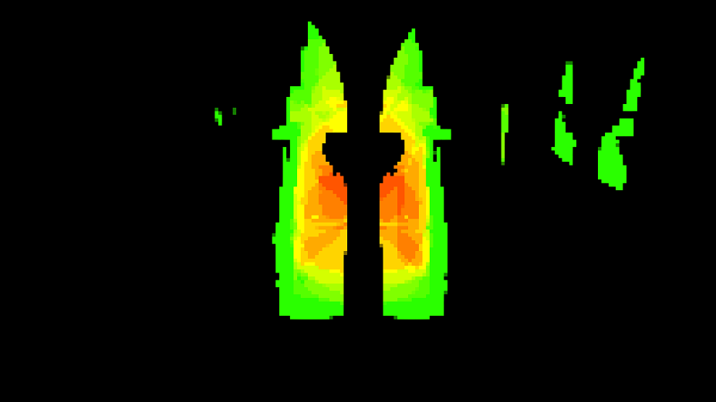
Notes:
Pillar occluded a lot of light fragments

Slide 32
Depth Bounds
Both depths need to come through.
Which depth comes first?
Notes:
Before allocating a linked fragment we need to make sure min and max depth are available.
Min and max depth depends on the front and back faces; which one gets rendered first?
Min comes from front faces.
Max comes from back faces.

Slide 33
Depth Bounds
Bounds RWByteAddressBuffer
Pixel | Pixel | Pixel | Pixel | Pixel | Pixel | Pixel | Pixel
Pixel | Pixel | Pixel | Pixel | Pixel | Pixel | Pixel | Pixel
Pixel | Pixel | Pixel | Pixel | Pixel | Pixel | Pixel | Pixel
Pixel | Pixel | Pixel | Pixel | Pixel | Pixel | Pixel | Pixel
Pixel | Pixel | Pixel | Pixel | Pixel | Pixel | Pixel | Pixel
Pixel | Pixel | Pixel | Pixel | Pixel | Pixel | Pixel | Pixel
Pixel | Pixel | Pixel | Pixel | Pixel | Pixel | Pixel | Pixel
Pixel | Pixel | Pixel | Pixel | Pixel | Pixel | Pixel | Pixel
Notes:
Use a byte address buffer.

Slide 34
Depth Bounds
Encode Depth + ID
16 bits ID
16 bits Depth
Notes:
Encode the depth and the id.

Slide 35
Depth Bounds
Use InterlockedExchange
New Info
Old Info
Pixel | Pixel | Pixel | Pixel | Pixel | Pixel | Pixel | Pixel
Pixel | Pixel | Pixel | Pixel | Pixel | Pixel | Pixel | Pixel
Pixel | Pixel | Pixel | Pixel | Pixel | Pixel | Pixel | Pixel
Pixel | Pixel | Pixel | Pixel | Pixel | Pixel | Pixel | Pixel
Pixel | Pixel | Pixel | Pixel | Pixel | Pixel | Pixel | Pixel
Pixel | Pixel | Pixel | Pixel | Pixel | Pixel | Pixel | Pixel
Pixel | Pixel | Pixel | Pixel | Pixel | Pixel | Pixel | Pixel
Pixel | Pixel | Pixel | Pixel | Pixel | Pixel | Pixel | Pixel
Notes:
Check for id match:

Slide 36
Light Fragment Links
Use a RWStructuredBuffer for storage:
Notes:
-8 bytes per fragment; currently we are allocating an average of 40 fragment per pixel at a resolution that is one eighth of our running game:
8 * 40 * 1600 * 900 * (1/64) = 6.86 megs of memory

Slide 37
Allocate LLL Fragment
Increment current count
Notes:
Do the allocation and make sure we don’t overflow
MaxCount is LLL resolution x average light per pixel

Slide 38
Track Last Entry
StartOffset RWByteAddressBuffer:
InterlockedExachange
New Index
Old Index
Pixel | Pixel | Pixel | Pixel | Pixel | Pixel | Pixel | Pixel
Pixel | Pixel | Pixel | Pixel | Pixel | Pixel | Pixel | Pixel
Pixel | Pixel | Pixel | Pixel | Pixel | Pixel | Pixel | Pixel
Pixel | Pixel | Pixel | Pixel | Pixel | Pixel | Pixel | Pixel
Pixel | Pixel | Pixel | Pixel | Pixel | Pixel | Pixel | Pixel
Pixel | Pixel | Pixel | Pixel | Pixel | Pixel | Pixel | Pixel
Pixel | Pixel | Pixel | Pixel | Pixel | Pixel | Pixel | Pixel
Pixel | Pixel | Pixel | Pixel | Pixel | Pixel | Pixel | Pixel
Notes:
Track the old offset per pixel via the second RWByteAddressBuffer

Slide 39
Light Fragment Encoding
Fill the linked light fragment and store it.
Notes:
-Store the min and max depth into a u32
-Store the global light index and the previous fragment index into a u32

Slide 40
Insomniac Engine
GBufferr
Fill Linked Listr
Light GBuffer
Custom Materials
Alpha

Slide 41
Lighting the GBuffer
Draw full-screen quad
Access the LLL
Apply the light
Notes:
Either a pixel shader + full screen quad or a compute shader

Slide 42
Accessing the SRVs
Fetch the first linked element offset:
The first linked element is encoded in the lower 24 bits.
Notes:
Use screen uvs to generate an index into the offset ByteAddressBuffer

Slide 43
Light Loop
Start the lighting loop:
An element index equal to 0xFFFFFF is invalid.
Notes:
-The lighting loop goes on unless we hit an invalid element index 0xFFFFFF.
-Fetch the current linked element and update the next linked element’s index.

Slide 44
Decoding Light Depth
Decode the light min and max depth.
Compare the light depth.

Slide 45
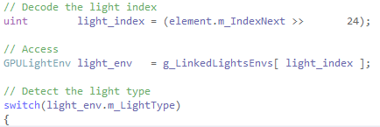
Access Light Info
Fetch the full light information:
Notes:
-Decode the global light index which is stored into the upper 8 bits of the linked elements m_IndexNext member.
-Access the full light environment which is stored into a dynamic structured array.

Slide 46
Insomniac Engine
GBufferr
Fill Linked Listr
Light GBuffer
Custom Materials
Alpha

Slide 47
Custom Materials
Render geometry again.
Access the LLL while rendering.
Notes:
Hair
Skin
Eyes
Soft Alpha Test

Slide 48
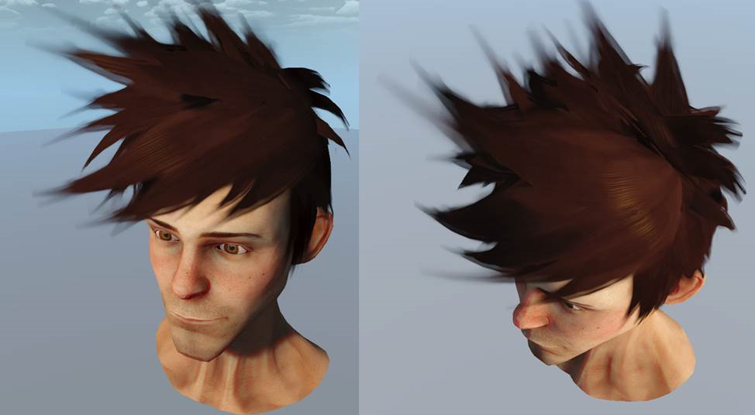
Custom Materials
Notes:
Hair
Skin
Eyes
Soft Alpha Test

Slide 49
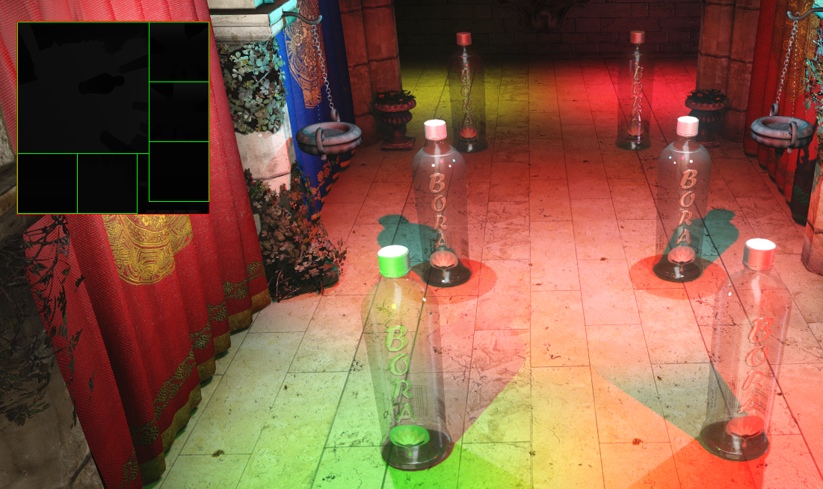
Shadows?
Notes:
Texture Array.
Allocate sub-regions.

Slide 50
Questions?
abezrati@insomniacgames.com

