Slide 1
Hybrid Reconstruction Anti Aliasing
Michal.Drobot 3D @ Far Cry 4

Slide 2
HRAA: Goals
Temporal Stability
High quality Edge Anti Aliasing
Super-sampling comparable to 4x RGSS
Shading cost of 1 sample / pixel
Performance ~1ms on PS4 / X1 @ 1080p resolution

Slide 3
HRAA: Overview
Stable Edge Anti-aliasing
Temporal Super-sampling
Temporal Anti-aliasing

Slide 4
Stable Edge AA
Morphological
SMAA [Jimenez 11]
FXAA [Lottes 09]
Analytical Edge AA
GBAA [Persson 11]
DEAA [Malan 10]
MSAA
EQAA / CSAA
Coverage Based
CRAA
Notes:
Morphological:
Sub-pixel Morhpological Anti-Aliasing [Jimenez 11]
Fast AproXimatte Anti Aliasing [Lottes 09]
Analytical:
Geometric Buffer Anti Aliasing [Persson 11]
Distance to Edge Anti Aliasing [Malan 10]
Multi Sampled Anti Aliasing
Enhanced Quality Anti Aliasing

Slide 5
Morphological
Pros:
Highest perceptual quality is static scenario
Catch All behaviour
Ease of integration
Uses rasterized data

Slide 6
Morphological: Frame A
Notes:
Morphological algorithm rely on rasterized pixel colour / geometric data changes. If those changes do not get ‘rasterized’ AA will be incorrect.
In case of long moving edges, AA will result in wobble effect, where edge will get correctly rasterized only at its unique rasterized positions.
All intermediate edge positions won’t have any effect on AA, unlike Analytical methods.

Slide 7
Morphological: Frame B
Notes:
Morphological algorithm rely on rasterized pixel colour / geometric data changes. If those changes do not get ‘rasterized’ AA will be incorrect.
In case of long moving edges, AA will result in wobble effect, where edge will get correctly rasterized only at its unique rasterized positions.
All intermediate edge positions won’t have any effect on AA, unlike Analytical methods.

Slide 8
Analytical: Frame A
Notes:
Morphological algorithm rely on rasterized pixel colour / geometric data changes. If those changes do not get ‘rasterized’ AA will be incorrect.
In case of long moving edges, AA will result in wobble effect, where edge will get correctly rasterized only at its unique rasterized positions.
All intermediate edge positions won’t have any effect on AA, unlike Analytical methods.

Slide 9
Analytical: Frame B
Notes:
Morphological algorithm rely on rasterized pixel colour / geometric data changes. If those changes do not get ‘rasterized’ AA will be incorrect.
In case of long moving edges, AA will result in wobble effect, where edge will get correctly rasterized only at its unique rasterized positions.
All intermediate edge positions won’t have any effect on AA, unlike Analytical methods.

Slide 10
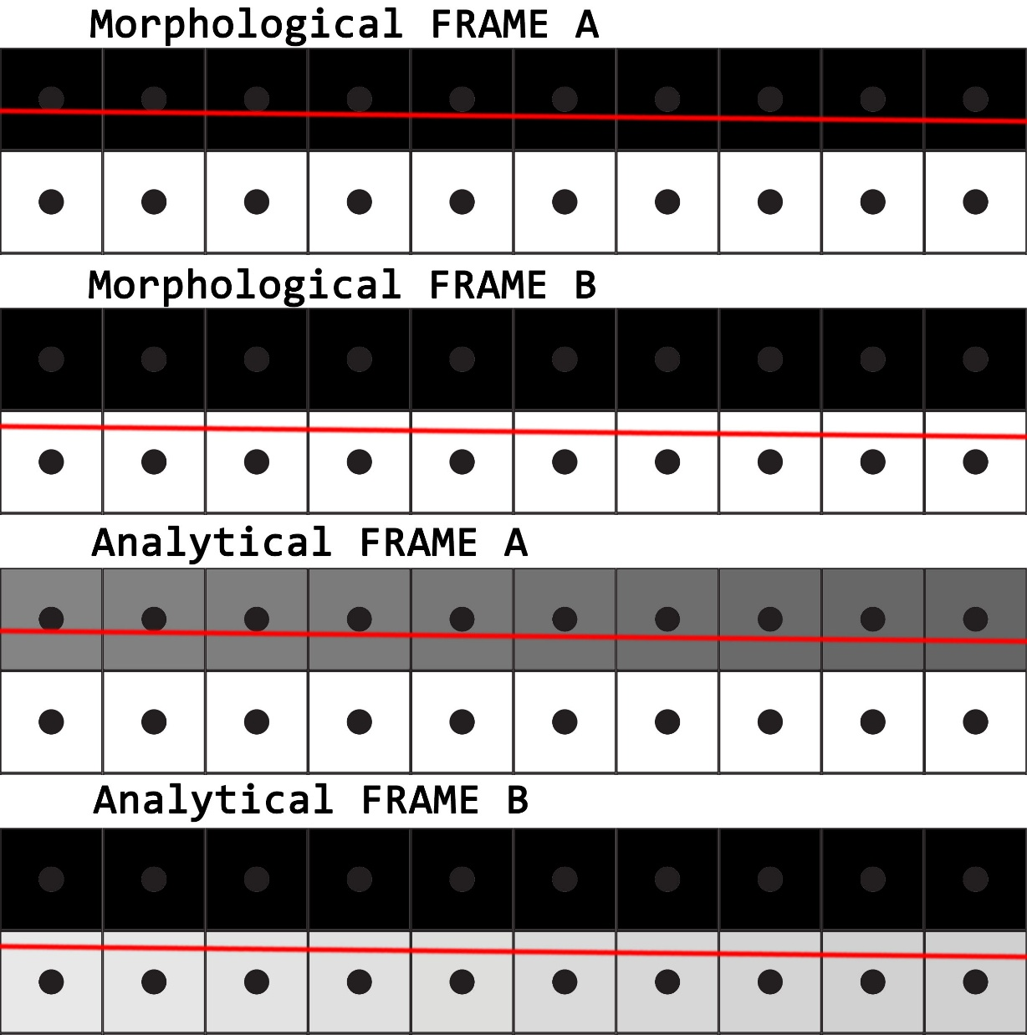
Morphological
Cons:
1.0-1.5 ms @1080p (PS4/X1)
Not temporarily stable
Wobbles under motion
Partially solved
More expensive SMAAx4
Notes:
Morphological algorithm rely on rasterized pixel colour / geometric data changes. If those changes do not get ‘rasterized’ AA will be incorrect.
In case of long moving edges, AA will result in wobble effect, where edge will get correctly rasterized only at its unique rasterized positions.
All intermediate edge positions won’t have any effect on AA, unlike Analytical methods.

Slide 11
Analytical
Pros:
Highest edge quality close to ground truth
Temporarily Stable Extends to Alpha Test (use Signed Distance Fields for best results)
Fast 0.3 ms @1080p (PS4/X1)
Notes:
Image courtesy [Persson 11]

Slide 12
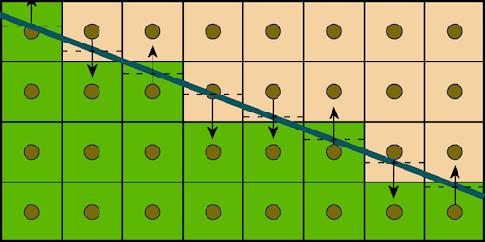
Analytical
D = min3(d0, d1, d2)
Cons:
Complicated integration
Every G-Buffer shader outputs distance to edge
Geometry Shader / Direct Vertex access [Drobot 14]
Suffers from rasterization issues
Rasterization Order Dependant
Content dependent
Overtessellation effectively turns AA off
Does not AA intersecting triangles
d1
d2
d0
Notes:
Note: Performance hit can be negligible on platforms supporting Direct Vertex Access in Pixel Shaders such as AMD GCN. See [Drobot 14]

Slide 13
Analytical: Distance to Vertical Edge

Slide 14
Analytical: Distance to Horizontal Edge

Slide 15
Analytical: No AA

Slide 16
Analytical: AA

Slide 17
Analytical AA
Notes:
Top: Visualization of distance to edge. Color encodes 1bit direction (X, Y). Signed value encodes 4bit distance.
Middle: Result of 1x Centroid rasterization
Bottom: Result of analytical resolve.
Note perfectly anti aliased edge on right side. Middle section shows incorrectly AA edge due to rasterization errors and subpixel triangles (where multiple triangle meet).

Slide 18
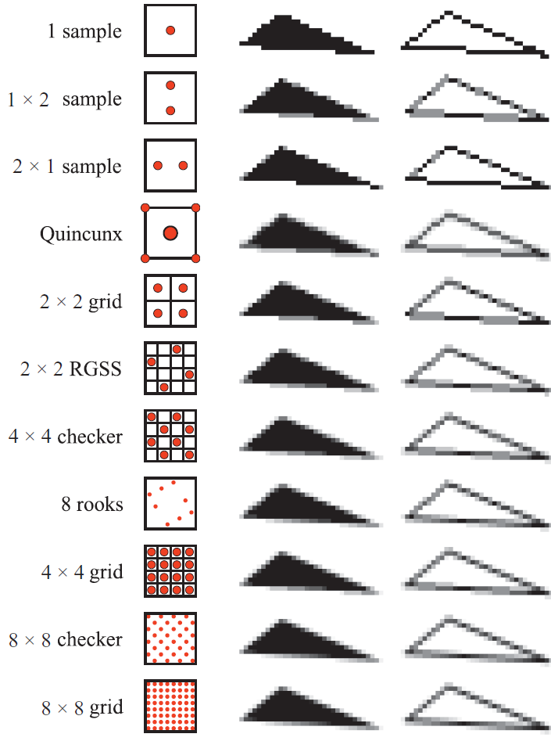
MSAA
Pros:
Converges to ground truth with amount of samples
Resolves sub-pixel issues
Cons:
Memory footprint scales linearly with amount of samples
Mesh rendering time scales with amount of samples
Complex integration with deferred rendering
Notes:
Image courtesy Real-Time Rendering, 3rd Edition, A K Peters 2008

Slide 19
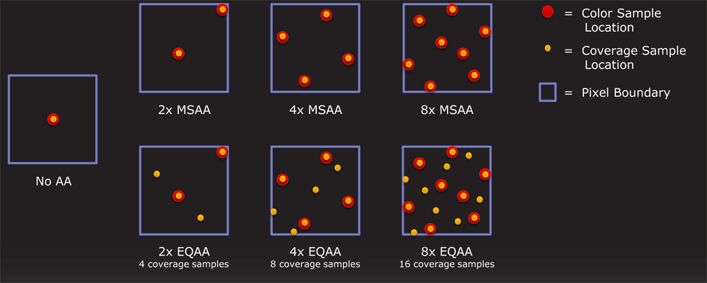
EQAA/CSAA
GPUs can decouple coverage samples from color/depth fragments
MSAA aided by cheap coverage samples = EQAA
Notes:
Image courtesy [AMD 11]

Slide 20
Coverage Reconstruction AA
Use color fragment with additional coverage samples
Minimal cost
Reconstruct final image from coverage
Requires hardware capable of direct Coverage samples access
Following presentation based on AMD GCN architecture
Other IHVs also support coverage sampling
Notes:
Most GPUs are very well optimized for Coverage sampling, unless you want to manually output coverage from Alpha Testing
AMD hardware allows manual access to Coverage pipeline intermediate buffers, thus allowing more complex resolves.

Slide 21
Basic concepts
Fragments
Rasterized values stored in memory
Dictate Buffer Memory Footprint
1-8 in 2^N format
Samples
Rasterizer positions inside a pixel
Set on Rasterizer State Vector
1-16 in 2^N format
Anchors - overlapping with Color/Depth Fragments

Slide 22
Basic concepts : Association Buffers
FMASK
Fragment Compression Buffer associated with Color Buffer
Stores association table between samples and color fragments
For every pixel stores
For every sample
Bit index of associated fragment
( [1,2,4,8,16 samples][1,2,4 bit for color index] + 1 bit for UNKNOWN) per pixel
4-sample/2-fragment = 4 * 2 = 8 bit
8-sample/1-fragment = 8 * 1 = 8 bit
16-sample/8-frag = 16 * 4 = 64 bit

Slide 23
Example : Color/Depth : 2F 4S
Color
Fragments
0
Color / Depth
1
0
2
FMASK
3
3 | 2
2 | 2
1 | 2
0 | 2
1
Notes:
Samples 0 and 1 are anchored – have their own depth fragments for depth testing

Slide 24
Example : Color/Depth : 2F 4S
Color
Fragments
0
1
0
2
FMASK
3
3 | 2
2 | 2
1 | 2
0 | 2
1
Notes:
BLUE triangle hits the ANCHORED SAMPLE 0 – BLUE is added to Color Fragments

Slide 25
Example : Color/Depth : 2F 4S
Color
Fragments
0
1
0
2
FMASK
3
3 | 0
2 | 0
1 | 2
0 | 0
1
Notes:
Samples covered by BLUE triangle gets associated

Slide 26
Example : Color/Depth : 2F 4S
Color
Fragments
0
1
0
2
FMASK
3
3 | 0
2 | 0
1
0 | 0
1
Notes:
Incoming Red Triangle clears sample 1 association

Slide 27
Example : Color/Depth : 2F 4S
Color
Fragments
0
1
0
2
FMASK
3
3 | 0
2 | 0
1 | 1
0 | 0
1
Notes:
New color RED gets added to Fragment Color table. Sample 1 gets association with RED color stored at Color Fragment 1.

Slide 28
Example : Color/Depth : 2F 4S
Color
Fragments
0
1
0
2
FMASK
3
3 | 0
2 | 0
1 | 1
0 | 0
1
Notes:
Incoming Green Triangle will need to clear Sample 1 and 3 association and evict RED or BLUE from Color Fragment Table

Slide 29
Example : Color/Depth : 2F 4S
Color
Fragments
0
1
0
2
FMASK
3
3 | 0
2 | 0
1
0 | 0
1
Notes:
Arbitration rules:
During color eviction from Color Fragment table, Fragment with least priority is removed.
Priority depends on Sample Count associated with Color.
If a tie occurs, lower index has higher priority.

Slide 30
Example : Color/Depth : 2F 4S
Color
Fragments
0
1
0
2
FMASK
3
3 | 1
2 | 0
1 | 1
0 | 0
1
Notes:
GREEN gets added into Color Fragments, Samples 1 and 3 get new associations

Slide 31
Example : Color/Depth : 2F 4S
Color
Fragments
0
1
0
2
FMASK
3
3 | 1
2 | 0
1 | 1
0 | 0
1
Notes:
Sample 3 is unanchored - it has no depth thus can’t be Z –tested.
To avoid color leakage it’s association must be discarded.

Slide 32
Example : Color/Depth : 2F 4S
Color
Fragments
0
1
0
2
FMASK
3
3 | 2
2 | 0
1 | 1
0 | 0
1
Notes:
Sample 3 goes UNKNOWN

Slide 33
Example : Color/Depth : 2F 4S
Color
Fragments
0
1
0
2
FMASK
3
3 | 2
2 | 0
1 | 1
0 | 0
1

Slide 34
Example : Color/Depth : 2F 4S
Color
Fragments
0
1
0
2
FMASK
3
3 | 2
2
1 | 1
0
1
Notes:
BLUE gets evicted. All samples associated with it will be set to UNKNOWN (including 2 not covered by RED triangle)

Slide 35
Example : Color/Depth : 2F 4S
Color
Fragments
0
1
0
2
FMASK
3
3 | 0
2 | 2
1 | 1
0 | 0
1
Notes:
Sample 2 is left UNKNOWN

Slide 36
CRAA Setup
MRT Setup
Color / Depth 1F xS
Pipeline
Gbuffer Render
Lighting
CRAA Resolve
Notes:
Simple setup that has low shading rate 1 shaded sample / pixel
Image reconstruction based on coverage data happens after lighting.

Slide 37
CRAA
FMASK : 1F xS
8 bit
X e {1, 2, 4, 8}
16 bit
X e {16}
Bitwise
0 – Fragment written to color buffer was ‚hit’ by sample
1 – UNKNOWN – sample is associated with other Color Fragment
Immediately know Color Fragment ‚coverage’
(X - Countbits(FMASK[pixel])) / X
Can we infer associations of UNKNOWN samples?
Notes:
Specific case of 1Fragment FMask.
Every sample can only have two states, thus making sampling and recovering information very easy.

Slide 38
8xCRAA: Example
Color
Fragments
FMASK
6
5
0
7 | 1
6 | 1
5 | 1
4 | 1
3 | 1
2 | 1
1 | 1
0 | 1
3
1
0
4
2
7
Notes:
1F xS sampling patterns should be handcrafted.
Sample 0 (depth / color) at center should behave better at reconstruction of sub-pixel details.
Sample 0 at edges / corners should behave better at reconstruction of edges.
Better sampling patterns require more work.

Slide 39
8xCRAA: Example
Color
Fragments
FMASK
6
5
0
7 | 1
6 | 1
5 | 1
4 | 1
3 | 1
2 | 1
1 | 1
0 | 1
3
2
0
4
2
7

Slide 40
8xCRAA: Example
Color
Fragments
FMASK
6
5
0
7 | 1
6 | 1
5 | 1
4 | 1
3 | 1
2 | 1
1 | 1
0 | 1
3
2
0
4
2
7

Slide 41
8xCRAA: Example
Color
Fragments
FMASK
6
5
0
7 | 0
6 | 1
5 | 1
4 | 0
3 | 1
2 | 0
1 | 0
0 | 0
3
1
0
4
2
7

Slide 42
8xCRAA: Example
Color
Fragments
FMASK
6
5
0
7 | 0
6 | 1
5 | 1
4 | 0
3 | 1
2 | 0
1 | 0
0 | 0
3
1
0
4
2
7
Notes:
We see it will end up not being rasterized – thus set Samples to UNKNOWN.
But maybe the neighbour Pixel will get rasterized?

Slide 43
8xCRAA: Example
Color
Fragments
FMASK
6
5
0
7 | 0
6 | 1
5 | 1
4 | 0
3 | 1
2 | 0
1 | 0
0 | 0
Neighbour
Fragments
3
1
U
B
L
R
0
4
2
7
Notes:
GREEN triangle is large enough to get rasterized in pixel neighborhood. We add its color GREEN to current pixel Neighborhood Fragments as UP neighbor.

Slide 44
8xCRAA: Example FMASK
FMASK : 00010110
X = 8
RED Coverage = CountBits(00010110^) / 8 = 5/8
UNKNOWN
Infer them from neighbourhood
We know every Sample position

Slide 45
8xCRAA: Simple Resolve
For every UNKNOWN sample
GetSamplePosition
Treat Sample Pos as vector
Add together
Sum defines an approximate equation of half plane dividing the pixel
Calculate Half Plane direction : Vertical / Horizontal
Calculate Half Plane slope
From Direction and Slope Infer UNKNOWN fragment
Up/Bottom
Left/Right
Resolved Pixel = Color Fragment * Coverage + (1-Coverage) * Inferred Fragment

Slide 46
8xCRAA: Simple Resolve
Color
Fragments
FMASK
6
5
0
7 | 0
6 | 1
5 | 1
4 | 0
3 | 1
2 | 0
1 | 0
0 | 0
Neighbour
Fragments
3
1
U
B
L
R
0
4
2
7
Notes:
We find a half plane dividing the pixel.
Could also use more expensive (at runtime) line fitting between two subsets of samples.

Slide 47
8xCRAA: Simple Resolve
Color
Fragments
FMASK
6
5
0
7 | 0
6 | 1
5 | 1
4 | 0
3 | 1
2 | 0
1 | 0
0 | 0
Neighbour
Fragments
3
1
U
B
L
R
0
4
2
7
Notes:
Infer UNKNOWN sample colors from the other side of derived edge.

Slide 48
8xCRAA : In Practice
8xCRAA
8xCRAA
8xMSAA
Notes:
Top Left : Overview of complex AA scenario using 8xCRAA
Top Right : Line layout for a crop of a complex corner case with multiple triangles intersecting one pixel
Bottom Left: 8xCRAA resolve results
Bottom Right: 8xMSAA resolve results

Slide 49
8xCRAA : In Practice
8xCRAA
8xCRAA
8xMSAA
Notes:
Note: 8xCRAA results are comparable with 8xMSAA apart from pixels that contain multiple triangle intersections.
In that complex case, a single edge estimation can’t correctly resolve the edge.
Visible artifacts are similar to analytical methods.

Slide 50
8xCRAA LUT
What about subpixel artifacts?
Can we eliminate them?
Can we get rid of ALU to be only BW bound?
Solution
Precompute an LUT to store neighbouring pixel weights
Use full neighborhood
Multiple edges / triangles crossing the pixel

Slide 51
8xCRAA LUT : Example
Color
Fragments
FMASK
6
5
0
7 | 1
6 | 1
5 | 1
4 | 1
3 | 1
2 | 1
1 | 1
0 | 1
Neighbour
Fragments
3
1
U
B
L
R
0
4
2
7
Notes:
In that case analytical would blend RED with BLUE

Slide 52
8xCRAA LUT : Example
Color
Fragments
FMASK
6
5
0
7 | 1
6 | 1
5 | 1
4 | 1
3 | 0
2 | 1
1 | 1
0 | 0
Neighbour
Fragments
3
1
U
B
L
R
0
4
2
7
Notes:
In that case analytical would blend RED with BLUE
We need to blend 3 RED with 2 GREEN and 3 BLUE
Only RED got rasterized in current pixel.
Fortunately BLUE and GREEN triangles were big enough to get rasterized in neighborhood (assumption).

Slide 53
8xCRAA LUT : In Practice
CLUT[256]
Every entry stores weights for UP, BOTTOM, LEFT, RIGHT neighbour sample
Weights are 4BIT – as maximum coverage can be 16
LUT is indexed directly by FMASK bit pattern
CLUT for 8S is 512bytes : 256 * 4 * 4
Fits Texture Cache Lines
Once primed lookups are for ‚free’
For Every FMASK entry
Precompute Optimal Neighbourhood Blending Scheme

Slide 54
8xCRAA LUT : Example
Color
Fragments
FMASK
CLUT[01101111]
5
6
U | 2
B | 3
L | 0
R | 0
0
7 | 1
6 | 1
5 | 1
4 | 1
3 | 0
2 | 1
1 | 1
0 | 0
Neighbour
Fragments
3
1
U
B
L
R
0
4
2
7
Notes:
With CLUT we have proper blending of subpixel details

Slide 55
8xCRAA LUT : Example
Color
Fragments
FMASK
CLUT[01101111]
5
6
U | 2
B | 3
L | 0
R | 0
0
7 | 1
6 | 1
5 | 1
4 | 1
3 | 0
2 | 1
1 | 1
0 | 0
Neighbour
Fragments
3
1
U
B
L
R
0
4
2
7
Notes:
Samples 5 and 6 pull data from UP neighbor.
7, 4, 2 pull data from BOTTOM.

Slide 56
8xCRAA LUT : In Practice
Simple resolve
Neighborhood prefetch
FMask read
LUT[FMask] read
Blend
Minimal overhead of coverage sampling
You mileage may vary depending on HW, settings etc.

Slide 57
8xCRAA LUT : In Practice
AA triangle intersections
Sub-pixel quality varies
Better than Analytical methods based on single traingle
Non sub-pixel triangle quality equal to 8xMSAA
Correct resolve assuming all triangles cutting the pixel will rasterize in immediate neighborhood
Common fail case:
Triangle doesn’t rasterize in immediate neighborhood
Notes:
* You mileage may vary depending on HW, settings etc.
Note: It is still possible to get sub-pixel artifacts (similar to Analytical). However, the chance is lower (still not practical with certain content or tessellation).
Correct Coverage resolve requires specific HW modes settings
Check your IHV
For AMD GCN
Compressed Depth Buffer
Depth Testing High Quality Intersections
Z sample interpolation
Front to Back sorting

Slide 58
8xCRAA
8xCRAA LUT
Notes:
Top to bottom:
Edge layout
1x Centroid Rasterization result
8xCRAA (single edge resolve) – fails at pixels cut by multiple edges
8xCRAA LUT – correctly resolves pixels cut by multiple edges, assuming that all triangles cutting the pixel will rasterize in immediate neighborhood.

Slide 59
Temporal Super Sampling
Based on Killzone: Shadow Fall [Valient14]
Use current and previous frame for data (2 samples)
Use N-2 frame for Color flow test
N-1 Sample is valid only if:
Motion flow between frame N and N-1 is coherent
Color flow between frames N and N-2 is coherent
(note N-2 and N have same sub-pixel jitter)
Notes:
Extension of method from Killzone Shadow Fall.
Only two unique frames are used for actual super-sampling.
Motion Flow constraint guarantees dis-occlusion correctness.
Color Flow constraint guarantees color data freshness as well as lack of jitter in stationary position (this is a fail case for exponential buffer Super-sampling where convergence is impossible to due to cumulative weight).

Slide 60
Frame N
Temporarily Stable
Edge Anti-aliasing
Temporal 2x Super-sampled resolve
Frame N-1
Stable Super-sampled Frame
Frame N-2
Notes:
Data flow of current pipeline

Slide 61
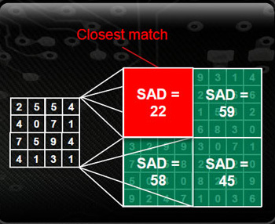
Temporal Super Sampling
Tests use 3x3 neighborhood
Sum of Absolute Differences
For performance reasons => smaller window =>more conservative
GCN provides HW acceleration
SAD
QSAD
MQSAD
Packed LERP
Notes:
For similarity test use SAD or other neighborhood similarity metric.
Also SAD based operations are natively supported in HW on AMD GCN architecture (as a part of HW video acceleration).
See SAD4ShaderInstructions Cap in DX11
See msad4 (hlsl)
GCN allows much more useful operations on packed 8bit values : variations of sad, packed lerp…
Image courtesy of AMD

Slide 62
Temporal Super Sampling
If N-1 sample fails Geometric Metric
Interpolate from N
If N-1 sample fails Color Metric
Limit N-1 sample by N color bounding box
Improves stability
Brings in some new information
Maximize incoming information through advanced sampling patterns

Slide 63
Sampling Patterns : 1x Centroid

Slide 64
Sampling Patterns : 2x Rotated Grid
Notes:
2xRG has 2 unique columns and 2 unique rows.

Slide 65
Sampling Patterns : 2x Quincunx
Notes:
QUINCUNX optimizes the pattern by sharing corner samples with adjacent pixels.
It covers 3 unique rows and 3 unique columns, improving over 2xRG.
It adds a 0.5 radius blur (that is partially recoverable by 0.5 pixel unsharp mask processing).

Slide 66
Sampling Patterns : 4x Rotated Grid
Notes:
4xRG has 4 unique columns and 4 unique rows.

Slide 67
Sampling Patterns : 2x FLIPQUAD
Notes:
FLIPQUAD is a efficient 2 sample / pixel scheme that allows effective 4x Super-sampling by sharing sampling points on pixel boundary edges.
It combines the benefits of QUINCUNX and Rotated Grid patterns.
Covers 4 unique rows and 4 unique columns, improving over 2xRG and QUINCUNX, matching 4xRG
It adds a 0.5 radius blur (that is partially recoverable by 0.5 pixel unsharp mask processing).

Slide 68
Sampling Patterns : Comparison
1x
FLIPQUAD
4xRG
Notes:
Image courtesy [Akenine 03]
We can see FLIPQUAD performing similar to 4xRotated Grid.
It can provide arguably higher quality results.

Slide 69
FLIPQUAD: In Practice
[AMD 13] AMD_framebuffer_sample_positions
2xMSAA – easy setup
Significantly higher quality than QUINCUNX at same cost [Laine 06]
Pattern | E
1x Centroid | >1.0
4x Uniform Grid | 0.698
4x Rotated Grid | 0.439
Quincunx | 0.518
FLIPQUAD | 0.364
Notes:
Lower error estimate E -> closer to 1024 super-sampled reference.
Image courtesy [Laine 06]

Slide 70
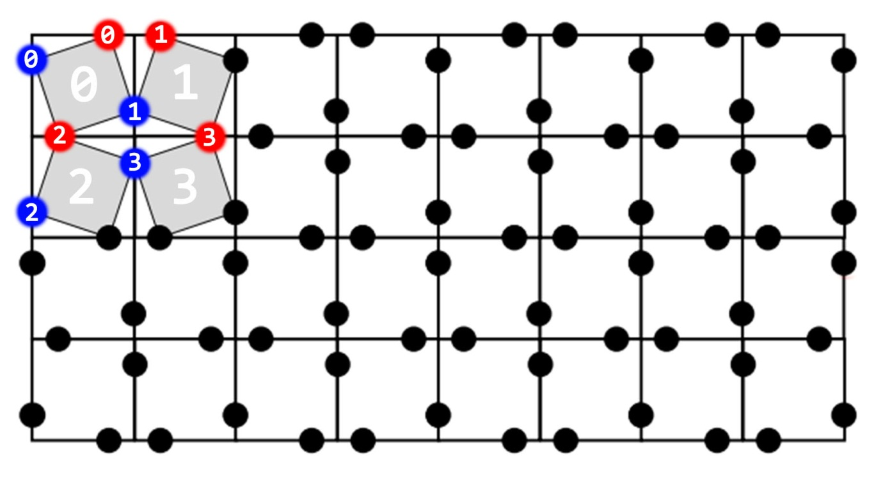
Temporal FLIPQUAD
Split the pattern in half
Frame A (BLUE) renders on part Frame B (RED) second
Needs custom per pixel within quad resolve
Convenient blend on X or Y axis depending on frame
Pixel0 = avg(BLUE(0,1), RED(0,2))

Slide 71
Temporal FLIPQUAD: In Practice
Non uniform rasterization grid may result in filterable ‚jigsaw’ pattern
Notes:
Noise is always contained within a pixel quad, thus easy to filter.

Slide 72
Temporal FLIPQUAD: In Practice
UVs need to be interpolated at SAMPLE positions for super-sampling
Use HLSL interpolator modifiers
sample float2 UV;
Not normalized spatial distances between rasterization samples => wrong derivative calculation
DDX = 1.0
DDY = 1.6
DDX = 0.4
DDY = 1.0
Notes:
Be default all texture coordinates will be interpolated at pixel center or centroid.
In case of our FLIPQUAD pattern we want to benefit from super-sampling, therefore UV should be evaluated at sample positions to match the rasterization grid.
Use HLSL interpolator modifier : sample

Slide 73
Temporal FLIPQUAD: In Practice
Mip map selection needs special care:
Use tex2Dgrad with analytical gradients
Manually average gradients inside quad
Manually pick samples within quad for uniform gradients
Adjust sample order/positions to minimize temporal changes of distances
Default solution

Slide 74
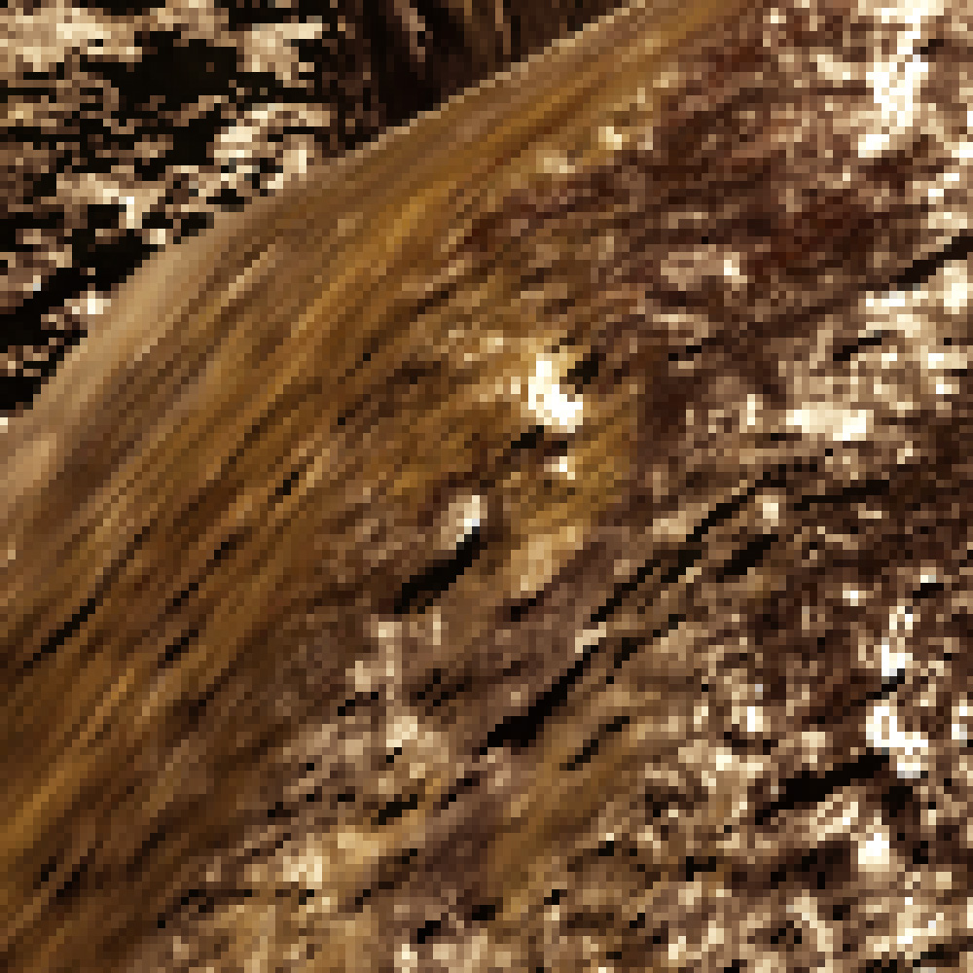
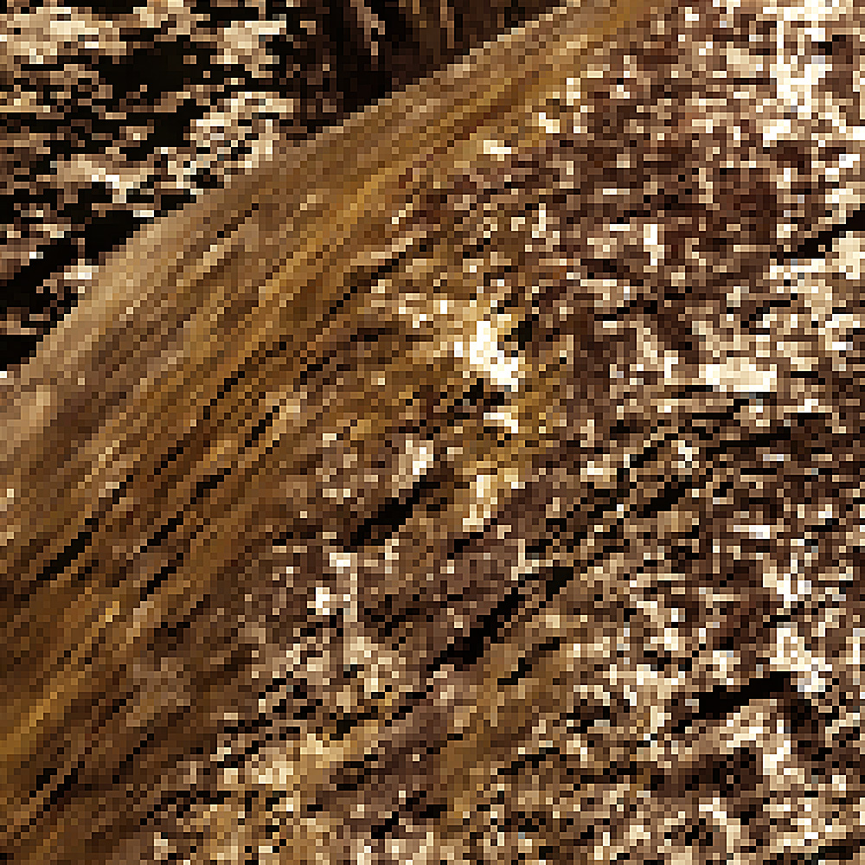
Frame A
Correct Mip

Slide 75
Frame B
Oversharpened
Mip

Slide 76
Frame A
Correct
Mip
Reordered samples

Slide 77
Frame B
Correct
Mip
Reordered samples

Slide 78
Temporal Anti Aliasing
History exponential buffer
Amortize sudden visual changes (flicker)
Accumulate as much new ‘important’ data as possible
Use frequency based acceptance metric
Operate on fresh data neighborhood (3x3 window)
History sample close to mean doesn’t bring new information
History sample further away brings more information
History sample too far might be a fluctuation
Use local minima / maxima for soft bounds

Slide 79
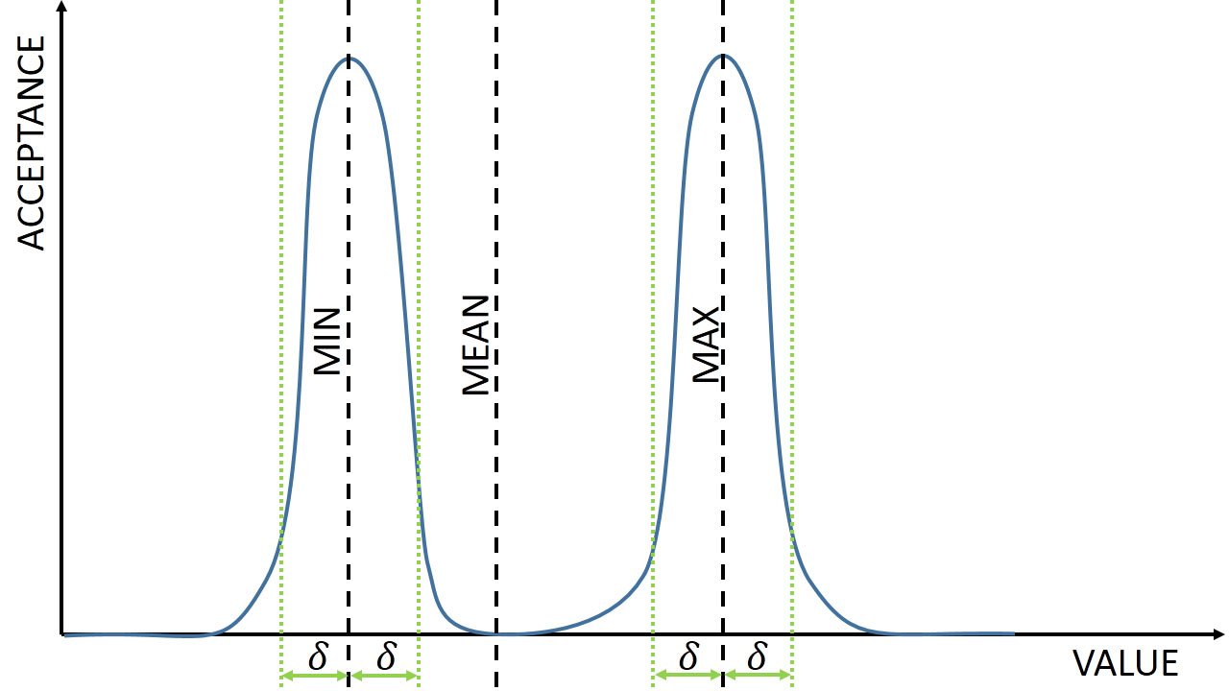
Notes:
Frequency based acceptance metric
Operate on fresh data neighborhood (3x3 window)
History sample close to mean doesn’t bring new information
History sample further away brings more information
History sample too far might be a fluctuation
Local minima / maxima provide soft bounds for exponential weight function.

Slide 80
Frame N
Temporarily Stable
Edge Anti-aliasing
FLIPQUAD Reconstruction
&
Temporal Anti-aliasing
Frame N-1
Stable Super-sampled Frame
Frame N-2
Accumulation History Buffer

Slide 81
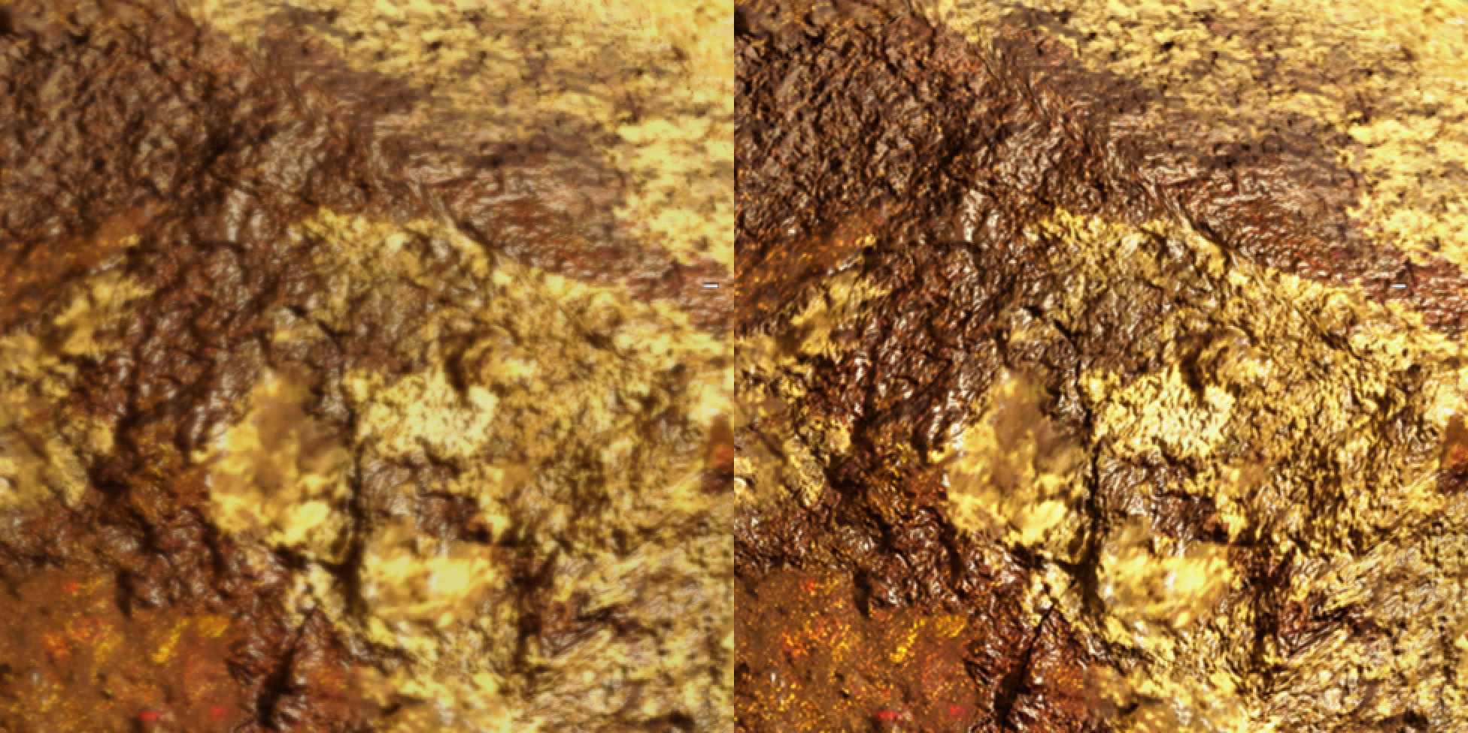
Temporal Anti Aliasing: In Practice
Use exponential history buffer for stabilization
Not robust enough for real sample accumulation (Super-sampling)
Impossible to keep uniform sample weights
With removal of stale data
Convergence impossible
Long history requires a lot of resampling
Leads to numerical diffusion
Overblurring
Notes:
Exponential history buffers are very convenient for image stabilization.
Unfortunately lack of possibility to remove a single sample from history, results in lack of convergence for finite length patterns.
In effect there is a very hard to remove artifact or high contrast details fading in/out – or ‘fizzing’

Slide 82
Higher Order Resampling
Reprojection = resampling problem
Non-fraction offsets result in numerical diffusion
Especially evident in history buffers
Error accumulates over time
Equivalent to problem of advection in discrete fluid simulation
Notes:
Due to grid quantization a value progression over time can be skewed.
Bilinear Sampling can be interpreted as semi-Lagrangian method (1st order). While unconditionally stable, it oversmoothens the results.

Slide 83
2nd Order Resampling: Mac Cormack
Mac Cormack Scheme [Dupont 03]
1 – project value into future N+1
2 – reproject back into N
Reprojected value has double accumulated error of projection method used
3 – correct value by half accumulated error
4 – project corrected value into N+1

Slide 84
2nd Order Resampling : BFCEE
Back Forth Error Correction & Compensation [Selle 07]
1 – project value into future N+1
2 – reproject back into N
Reprojected value has double accumulated error of projection method used
3 – correct projected value by half accumulated error
Notes:
One full projection step is cut in comparison to Mac Cormack.
Unfortunately final value requires memory access to: phi_n, phi_hat_n and phi_hat_n+1

Slide 85
2nd Order Resampling: GPU BFCEE
GPU Optimized BFCEE
1 – project value into future N+1
2 – reproject back into N
Reprojected value has double accumulated error of projection method used
3 – project reprojected value into N+1
Triple accumulated error
4 – correct projected value by half accumulated error between projected and double projected value
Notes:
Projections from N to N+1 are quick to evaluate at shader execution time by UV offsets.
Final value requires only access to phi_hat_hat_n+1 and phi_hat_n+1
Effectively this is equivalent to BFCEE in terms of steps, however memory consumption and bandwidth is cut.
Note:
BFCEE ⬄ GPU BFCEE ⬄ MacCormack only for linear projection functions!

Slide 86
Bilinear : Continuous resampling 30 frames
Shader BFECC: Continuous resampling 30 frames
Use per Sample interpolation mode
super-sampling on texture data
Not normalized spatial distances between rasterization samples => wrong derivative calculation
Mip map selection need special care
tex2Dgrad with analytical gradients
Set sample order to minimize temporal changes of distances
Notes:
This is a result of Exponential History Buffer, resampled over 30 frames. Camera movement speed varied, therefore this can be assumed as average case.
If the relative pixel speed on screen would be exactly 0.5 texel a frame (thus bilinear resampling would always end up doing maximum blur), result would be much worse.

Slide 87
HRAA: Final Implementation
Temporarily Stable Edge Anti-aliasing
SMAA (Normal + Depth + Luma Predicated Thresholding)
CRAA
AEAA (GBAA)
Temporal FLIPQUAD Reconstruction combined with Temporal Anti-aliasing (TAA)
TFQ + TAA

Slide 88
HRAA: FC4 Final Implementation
Temporarily Stable Edge Anti-aliasing
Non obvious choice
SMAA + AEAA on Alpha Test
Most reliable, reasonable performance
CRAA + AEAA on Alpha Test
Best performance, some content issues
Notes:
We are still on the fence with final method we will ship.
If we would live in perfect world with all content having perfect LODs , we would go CRAA.
Otherwise SMAA + AEAA on Alpha Test (this makes the whole pass cheaper and more stable on vegetation that is really important in our use case).

Slide 89
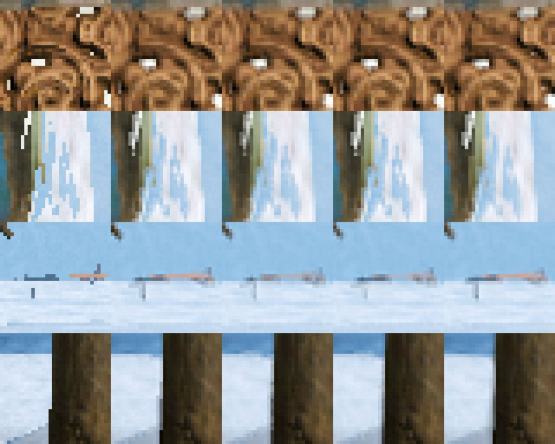
TFQ +
AEAA
TFQ +
CRAA
TFQ + SMAA
1x
TFQ

Slide 90
TFQ +
AEAA
TFQ +
CRAA
TFQ + SMAA
1x
TFQ
Notes:
Note: Reconstruction capabilities of all TFQ based methods.

Slide 91
Single Pass | Timing (ms) | GBuffer Overhead (%)
BFECC Single Value | 0.3 | N/A
Temporal FLIPQUAD (TFQ) | 0.2 | N/A
AEAA | 0.25 | <1% C
8xCRAA | 0.25 | <8% HW/C
SMAA | 0.9 | N/A
TAA | 0.6 | N/A
TFQ + TAA | 0.62 | N/A
Full Method
AEAA(Alpha Test) + 8xCRAA + TFQ + TAA | 0.9 | <3% HW/C
SMAA + TFQ + TAA | 1.4

Slide 92
HRAA: Hi Frequency Recovery
FLIPQUAD BOX resolve kernel
Results in 0.5 blur
Art direction ‘might’ find it objectionable
Super-sampling requires wider, complex kernel to preserve [Burley 07]:
Anti-aliasing
Hi-Frequency details

Slide 93
HRAA: Hi Frequency Recovery
4-tap Sinc kernel can be approximated by:
Box Blur (FLIPQUAD resolve) – 0.5 pixel radius
Unsharp masking – 0.5 pixel radius
“Arguably” reconstruct detail
Will not introduce aliasing as long as it is inside window of reconstrucion blur kernel
All information exusts in various image frequencies
Negative Mip Bias on all textures to match Super-sampled resolution
Adds detail that would get resolved if super-sampled in single frame

Slide 94
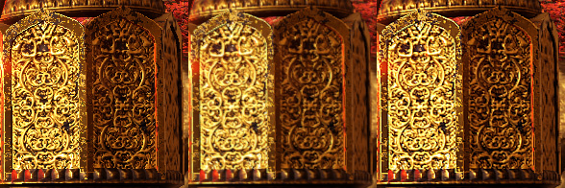
HRAA: Hi Frequency Recovery
1x
FQ
FQ + Unsharp
(oversharpened for effect)

Slide 95
MOVIE

Slide 96
HRAA: Summary
Temporarily Stable
Comparable to 4x RGSS
Cut to fit your needs
Fast
Doesn’t solve all problems – sub-pixel content still problematic
Provides some new ideas and solutions to your AA toolbox

Slide 97
HRAA: Future Direction
Tile based Edge Anti Aliasing
Bigger neighborhood knowledge guarantees less fail cases
More complex Coverage analisys for better LUT
Augment SMAA with Coverage information
Explore more sampling patterns
Upsampling
Partially trade Super Sampling for higher resolution resolve

Slide 98
Q&A
Twitter: @MichalDrobot
hello@drobot.org
More details, samples and pictures
in upcoming GPU Pro 6 article
GO grab it March 2015

Slide 99
References
[Akenine 03] Akenine-Moller T. 2003, “An Extremely Inexpensive Multisampling Scheme”
[AMD 11] AMD 2011, “EQAA Modes for AMD 6900 Series Graphics Cards”
[AMD 13] AMD, Alnasser M., Sellers G. 2013, “AMD_framebuffer_sample_positions”, OpenGL Extension Registry.
[Burley 07] Burley B. 2007, “Filtering in PRMan”, part of “Renderman Repository”.
[Drobot 14] Drobot M. 2014, “Low Level Optimizations for AMD GCN Architecture”, Digital Dragons 2014.
[Dupont 03] Dupont T., Liu Y. 2003, “Back and forth error compensation and correction methods for removing errors induced by uneven gradients of the level set function”,
[Jimenez 11] Jimenez J., Masia B., Echevarria J., Navarro F., Gutiereez D. 2011, “Practical Morphological Anti-Aliasing.”, GPU Pro 2. AK Peters Ltd., 2011.
[Jimenez 12] Jimenez J., Echevarria J., Gutiereez D., Sousa T., 2012, “SMAA : Enhanced Subpixel Morphological Antialiasing.”, EUROGRAPHICS 2012.
[Laine 06] Laine S. and Aila T. 2006, “A Weighted Error Metric and Optimization Method for Antialiasing Patterns”
[Lottes 09] Lottes T. 2009, “FXAA”, NVIDIA Whitepaper Repository.
[Malan 10] Malan H. 2010, “Edge Anti-aliasing by Post-Processing”, GPU Pro 1, 2010
[Persson 11] Persson E. 2011, “Geometric Buffer Antialiasing”. SIGGRAPH 2011.
[Selle 07] Selle A., Fedkiw R., Kim B., Liu Y., Rossignac J. 2007, “An Uncoditionally Stable MacCormack Method”.
[Valient 14] Valient M. 2014, Taking Killzone Shadow Fall Image Quality into the Next Generation”, Game Developer Conference 2014.

Slide 100
Special Thanks
In Random Order
Ubisoft 3D Teams:
Stephen Hill
Urlich Haar
Jeremy Moore
Bartlomiej Wronski
AMD:
Layla Mah
Chris Brennan
Microsoft:
David Cook
MY TURTLE
BEER

