Slide 1
Sand Rendering in Journey
John Edwards
thatgamecompany

Slide 2

Notes:
Here are some pictures of Journey.
To give a little context to the people who haven't played Journey, it's a multiplayer PlaystationNetwork game. One of the things we were trying to do with the game was recreate the experience of hiking in nature, when you encounter someone else on the trail after not having seen anybody for a while. There's a desire to make some sort of connection with that person, to say hello, maybe even to journey with them for a while. You want to acknowledge them on a human level, something that strangely doesn't happen very often in most online video games.
We thought the best environment to encourage this kind of interaction would be a vast and barren desert, and we spent a long time on technology to make the player feel like they were really hiking out in nature, so that when they did eventually encounter another player in the game, they would treat them like another human being.

Slide 3
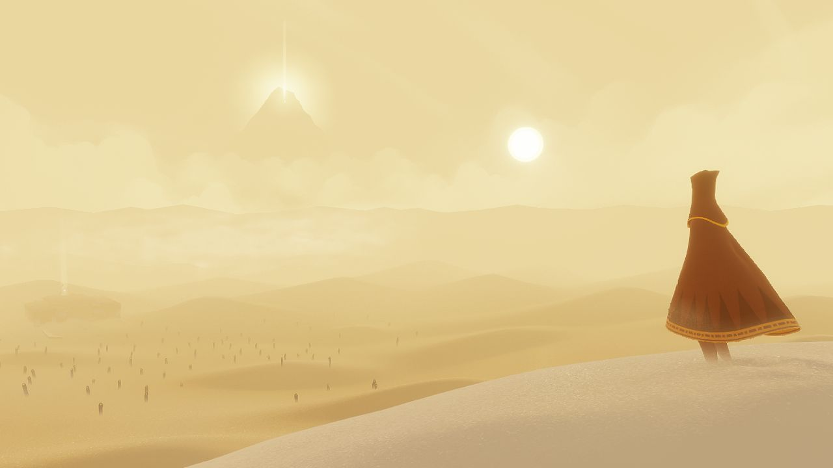

Slide 4
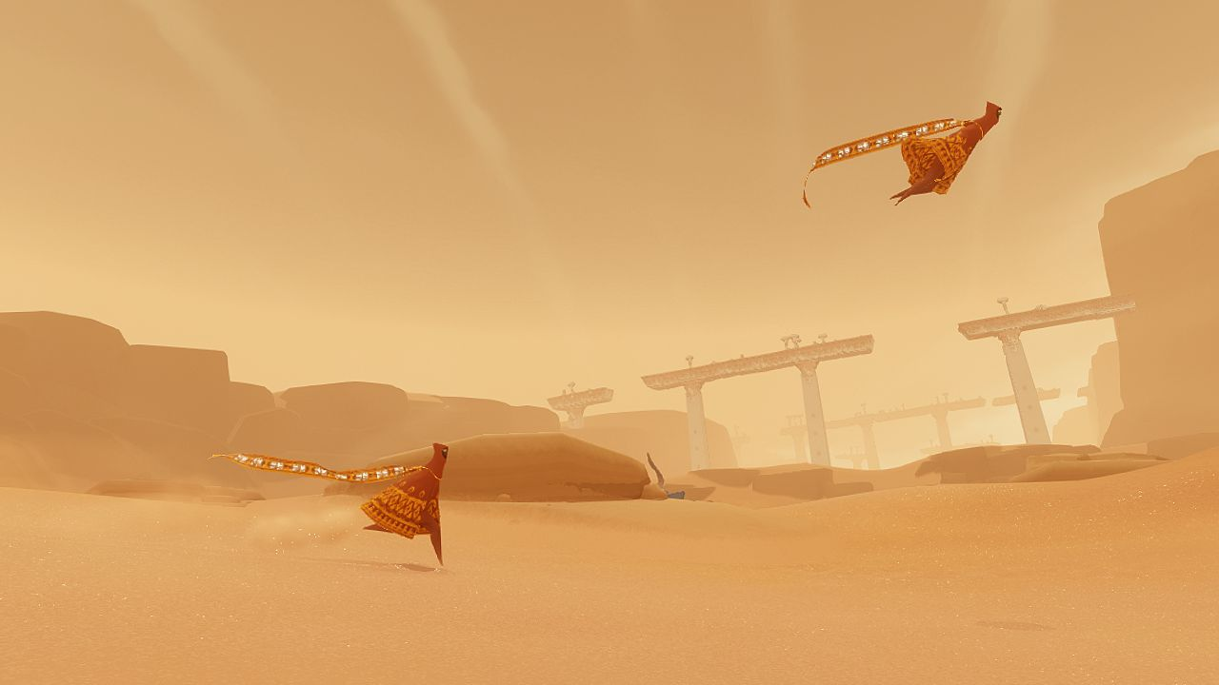

Slide 5
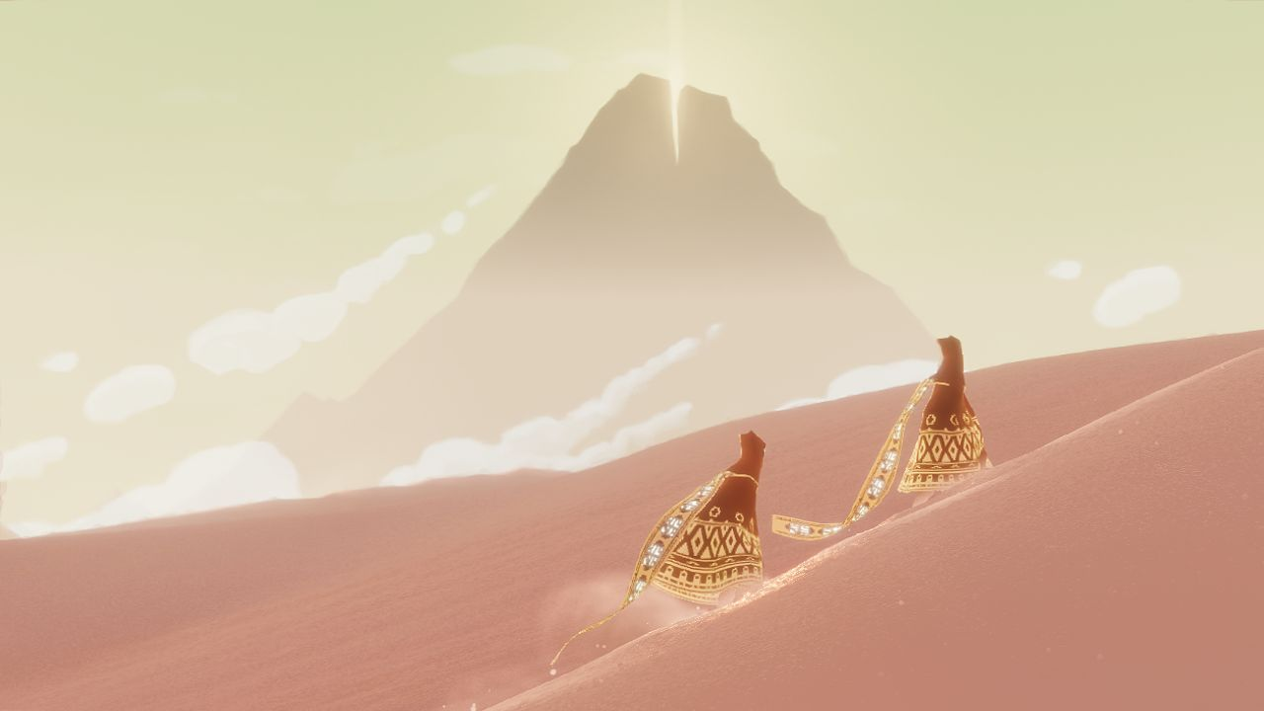

Slide 6
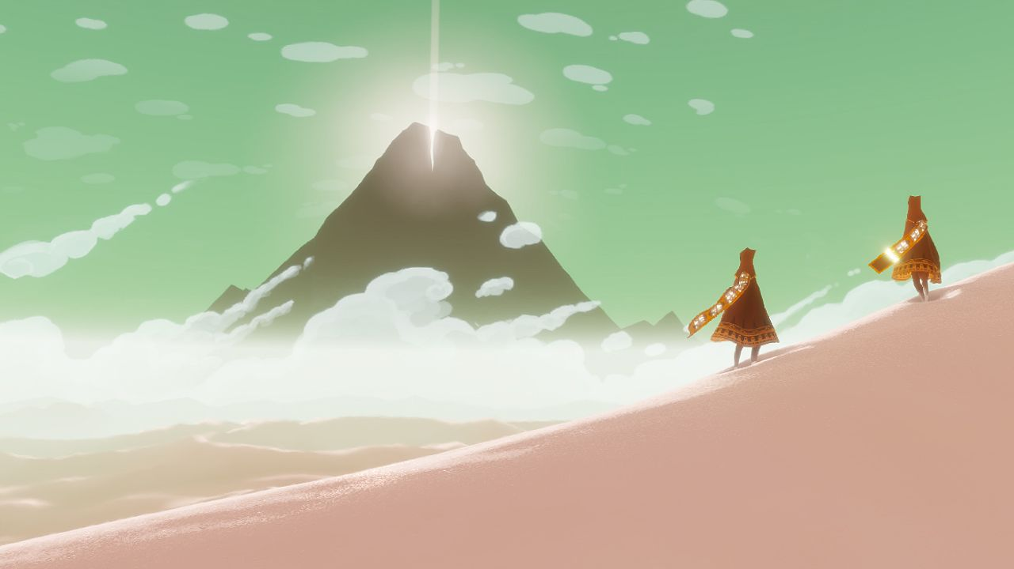

Slide 7
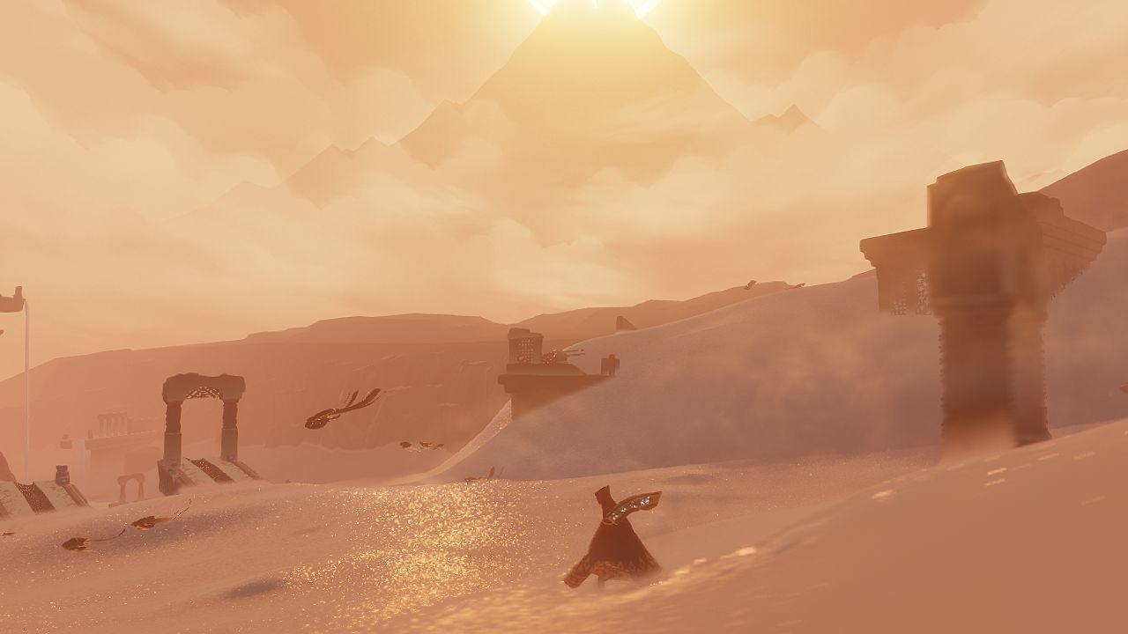

Slide 8
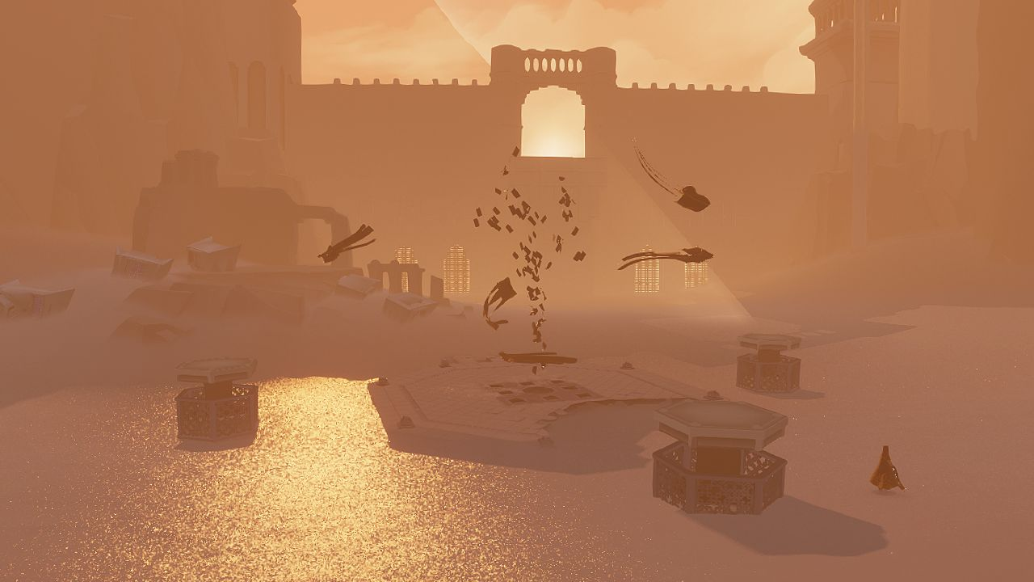

Slide 9
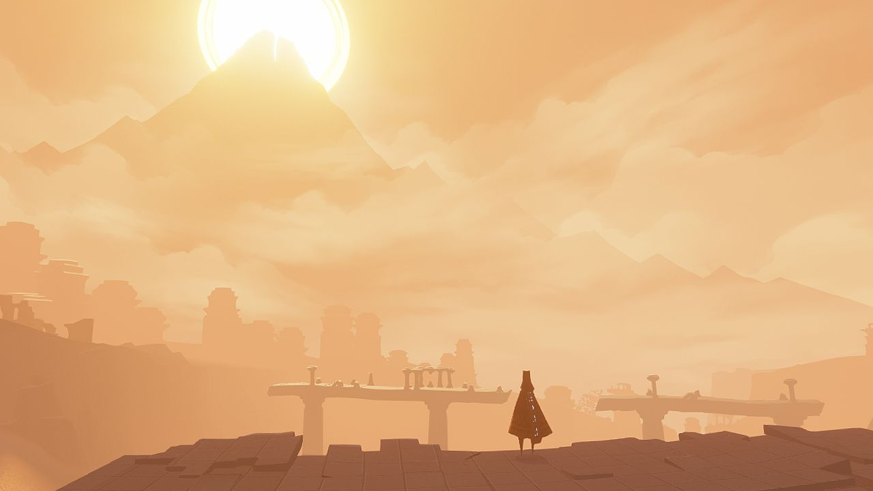

Slide 10
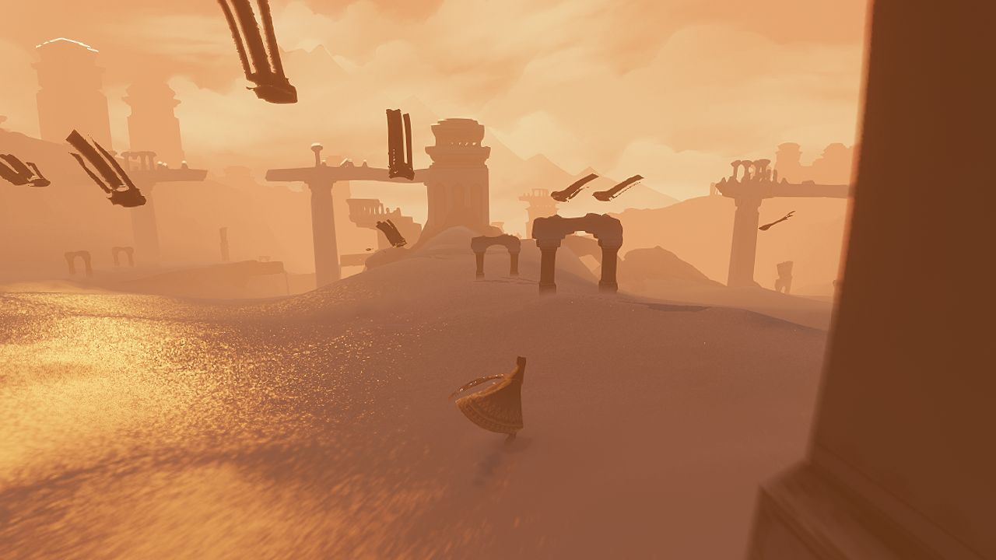

Slide 11
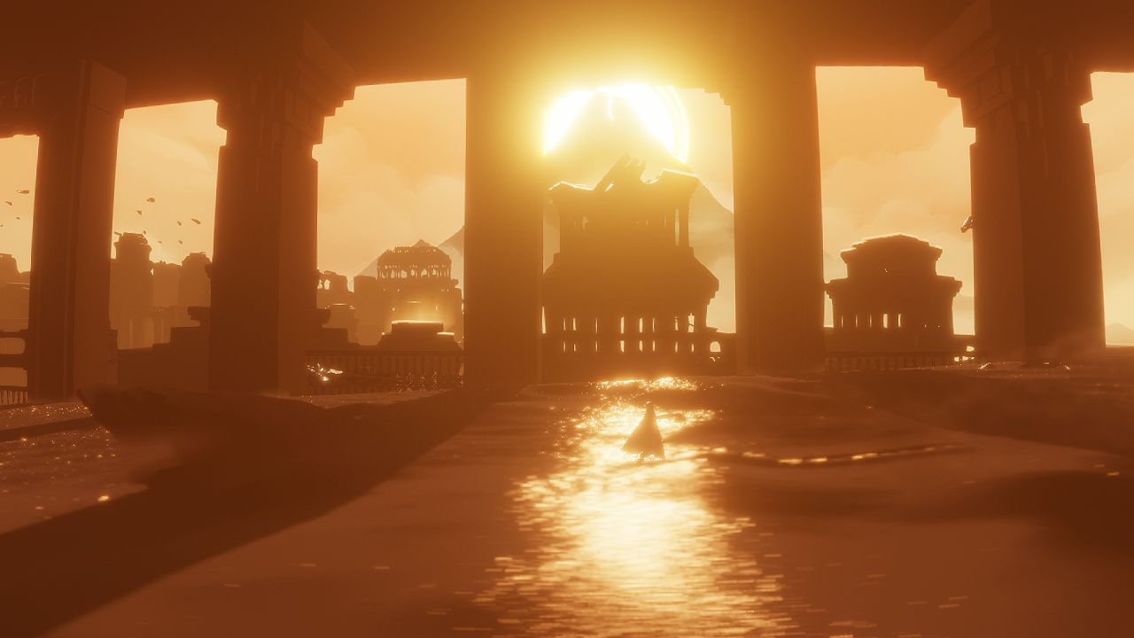

Slide 12
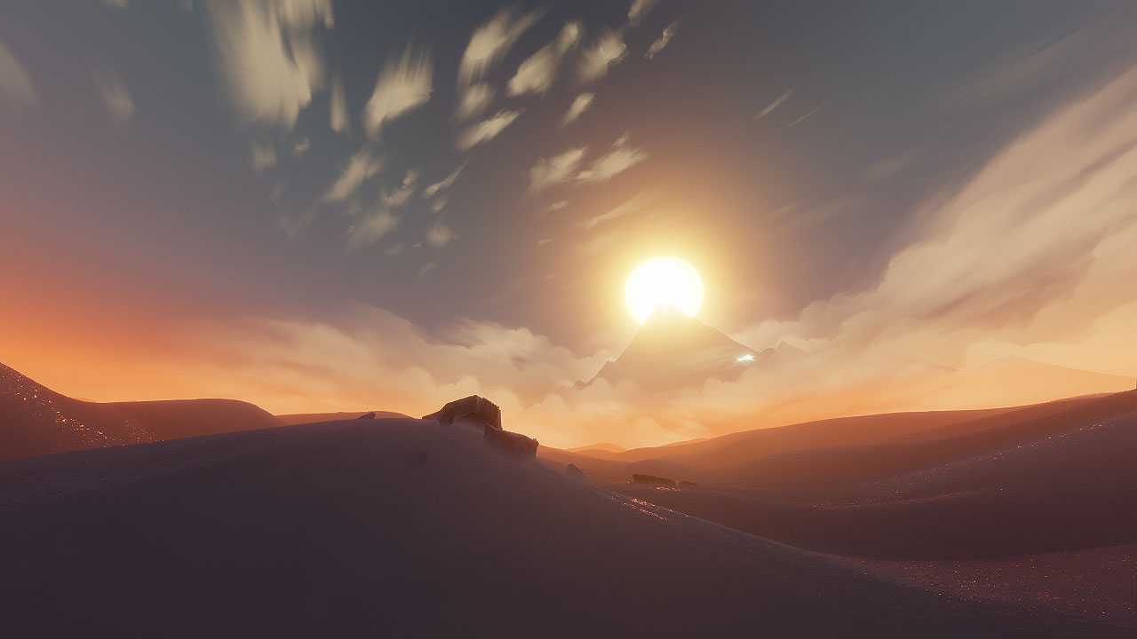

Slide 13
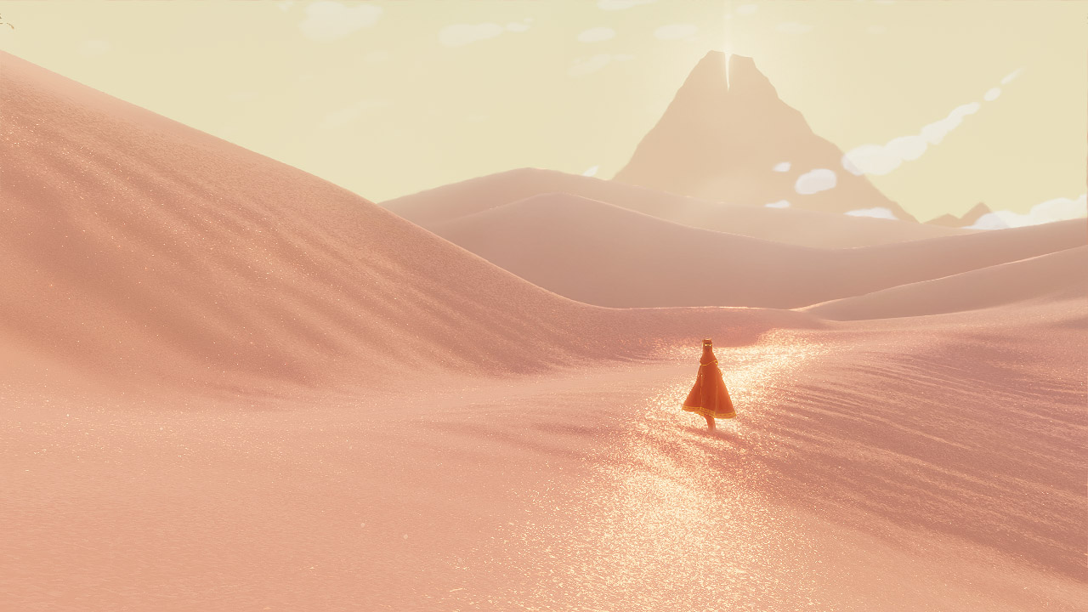
Shipping
Notes:
Here's an image from the final game. I'm going to pull away all the hacks we used to make the sand feel the way it does one by one, and then I'll explain how and why we did each one.

Slide 14
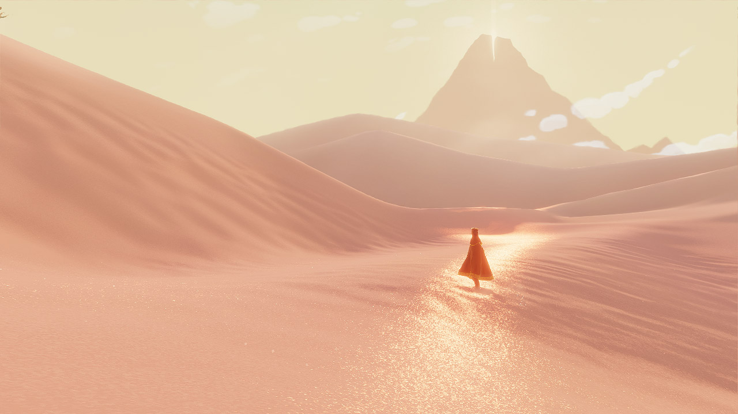
- Sharp mips
Notes:
First is a mipmap detail hack. We used this to get extra sand detail in the distance.

Slide 15
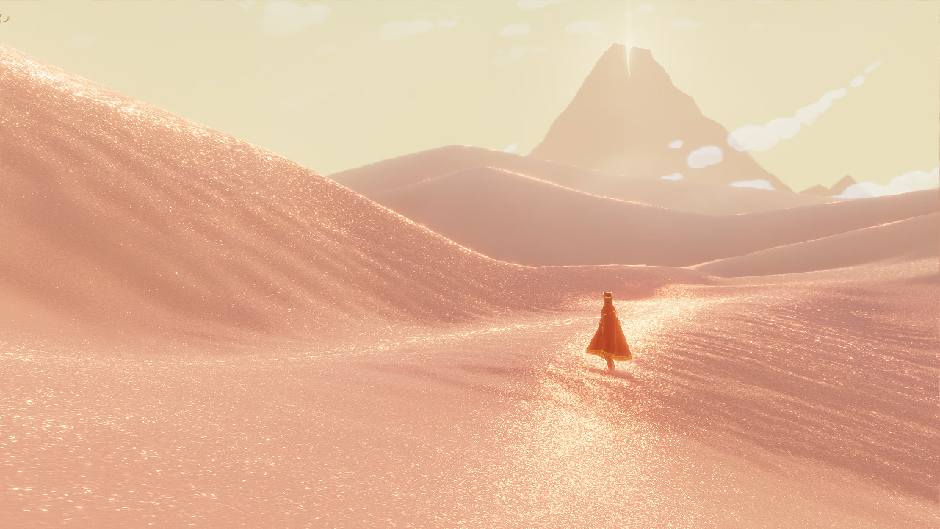
Anisotropic masking
Notes:
Now I'm removing our hack to mask out the regions where the anisotropic filter breaks down.

Slide 16

Glitter specular
Notes:
I'm removing fake specular hack number one.

Slide 17
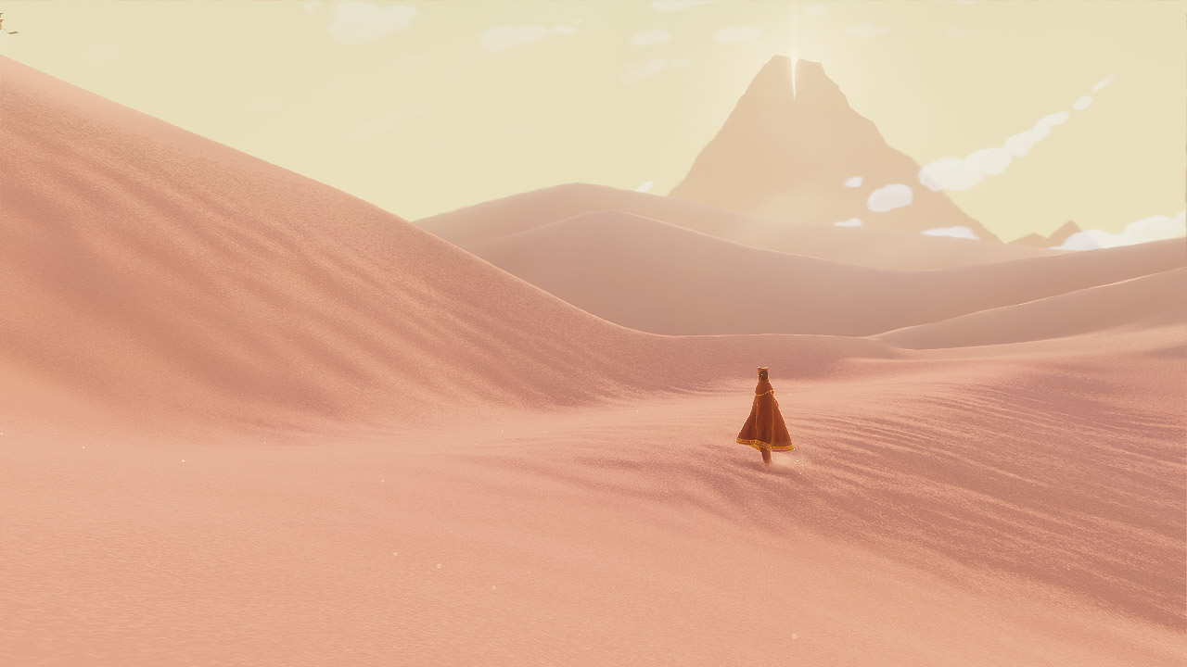
Ocean specular
Notes:
Now I'm removing fake specular hack number two.

Slide 18
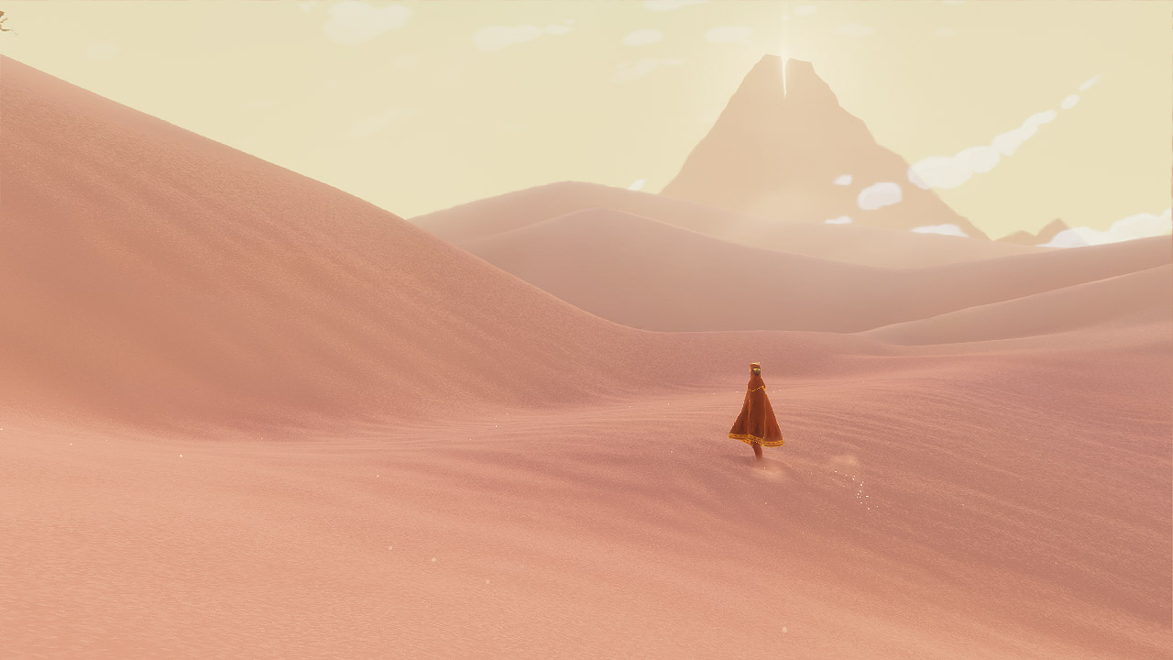
Diffuse contrast
Notes:
Now I'm removing our diffuse lighting hack. So now you see the sand just lit with a Lambert shader.

Slide 19
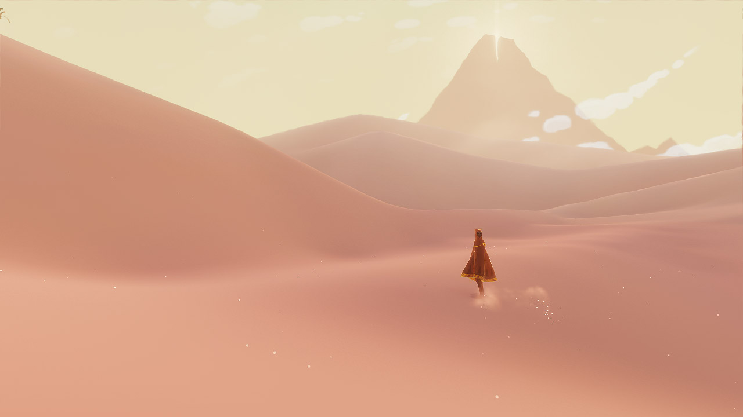
Detail heightmaps
Notes:
And finally removing the geometry detail height maps. This is what Journey would look like if it took place in a giant bowl of pudding.

Slide 20
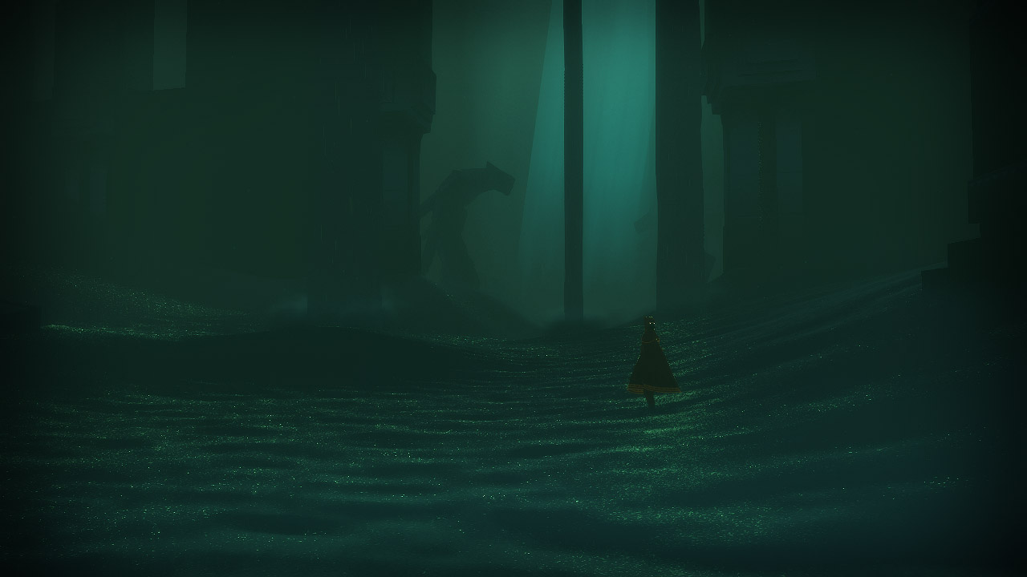
Shipping
Notes:
And here's the same breakdown, again, for a different part of Journey. This is a darker, spookier part, with very glittery sand.

Slide 21
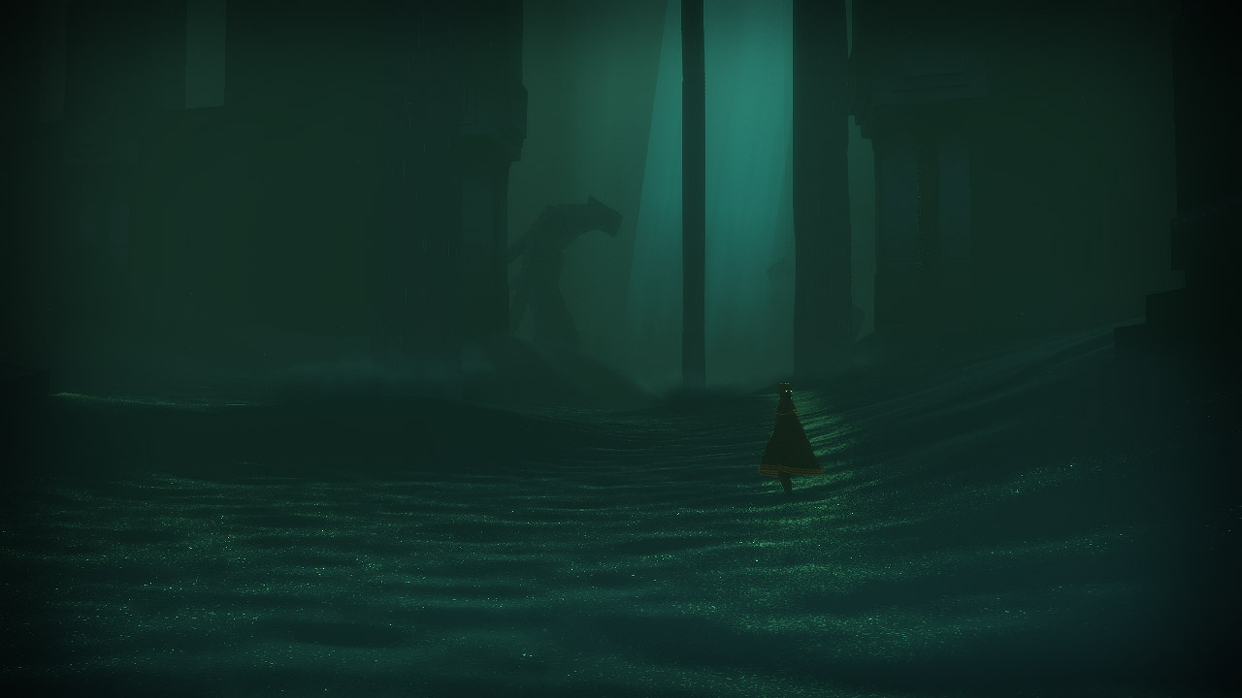
- Sharp mips

Slide 22
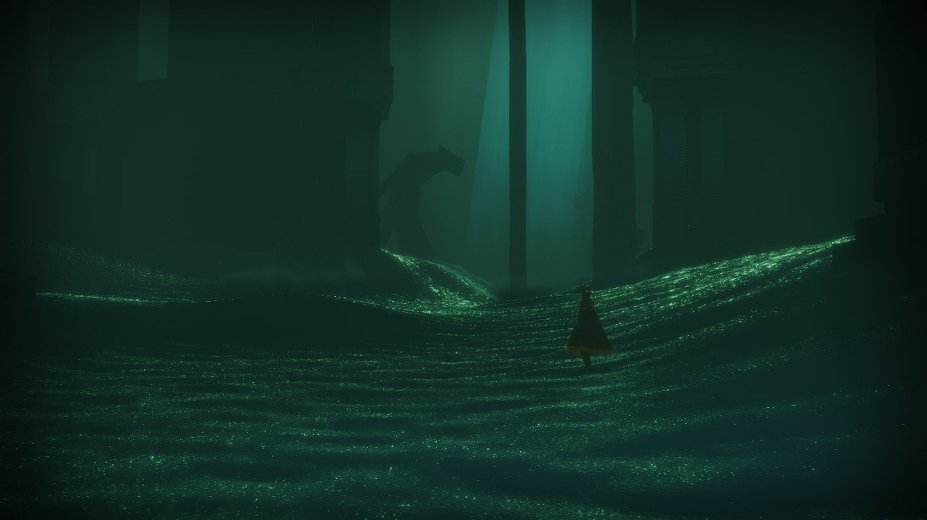
- Anisotropic mask

Slide 23
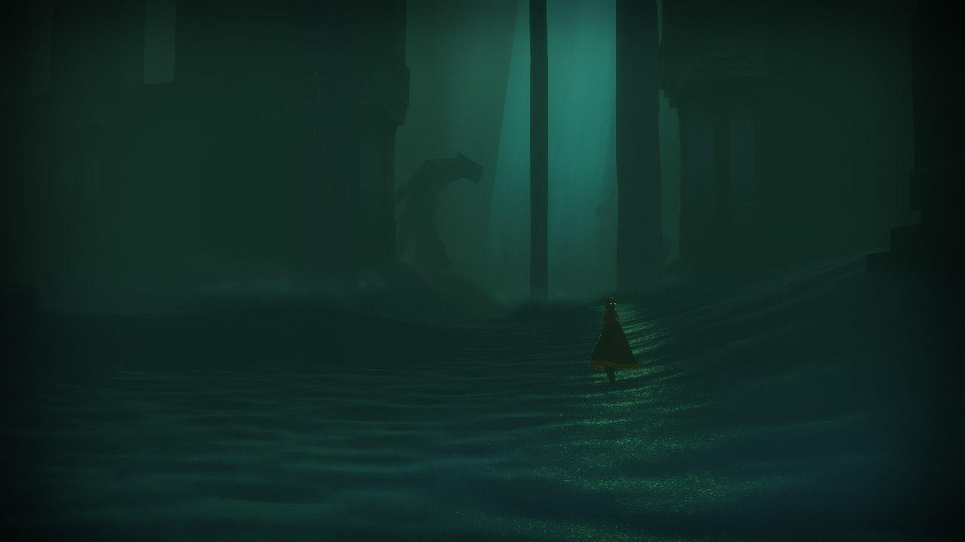
- Glitter specular

Slide 24
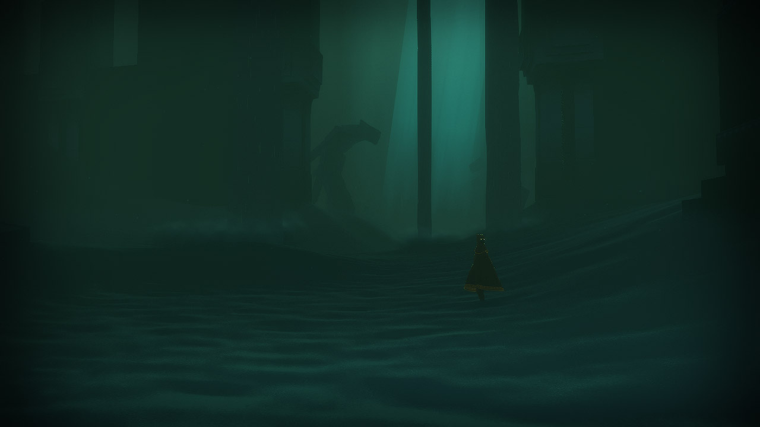
- Ocean specular

Slide 25
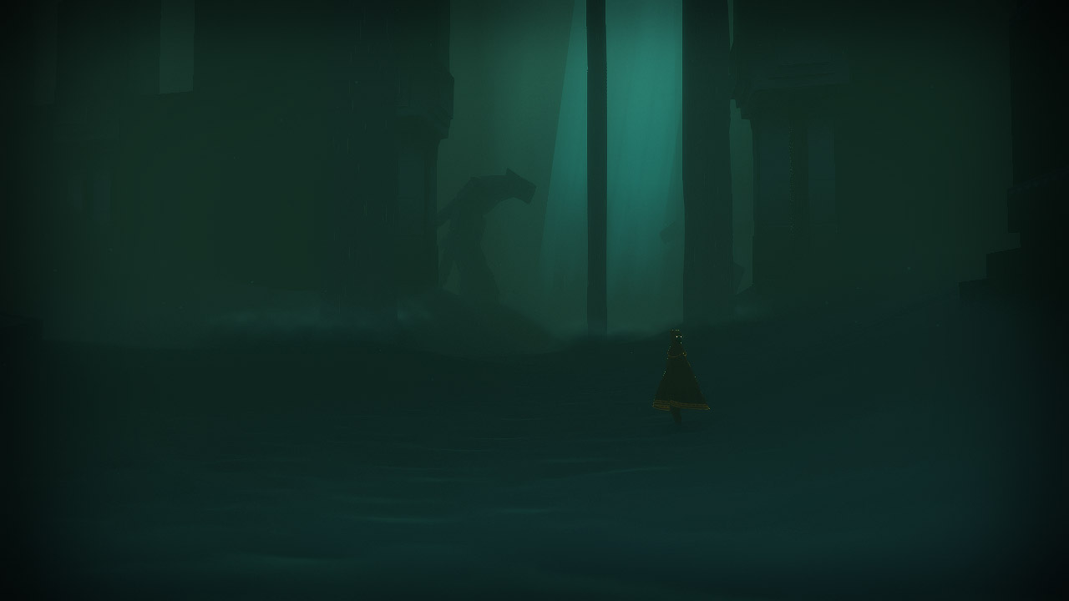
- Diffuse contrast

Slide 26
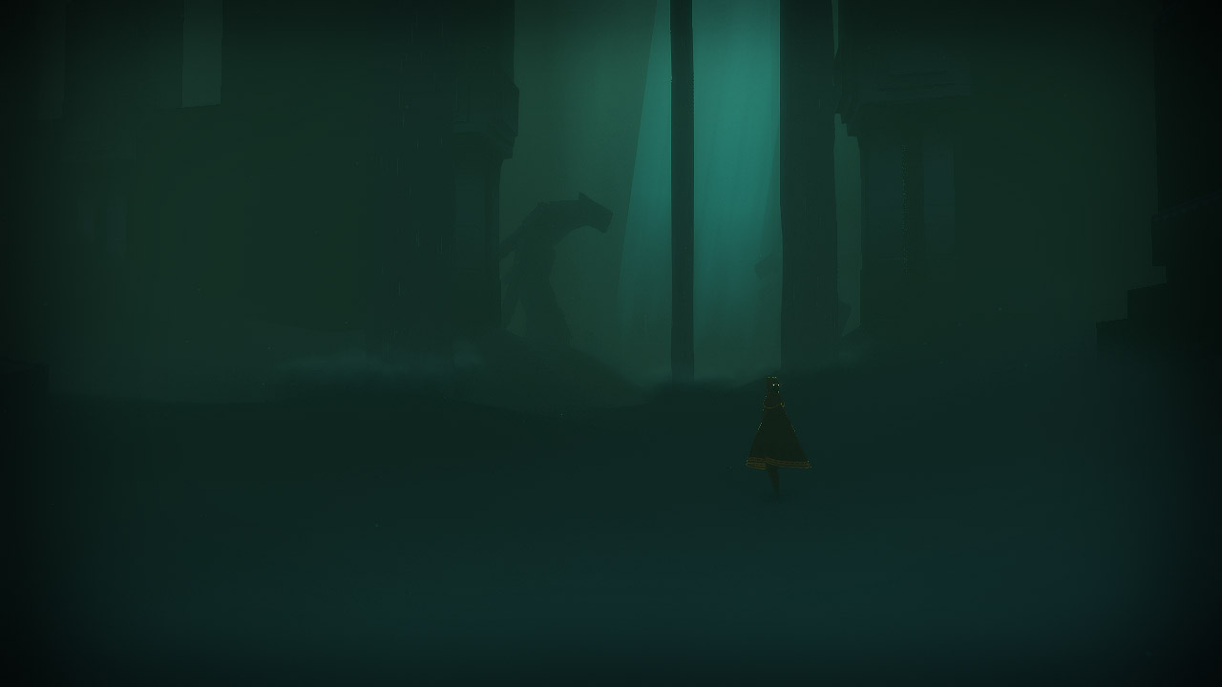
- Detail heightmaps

Slide 27
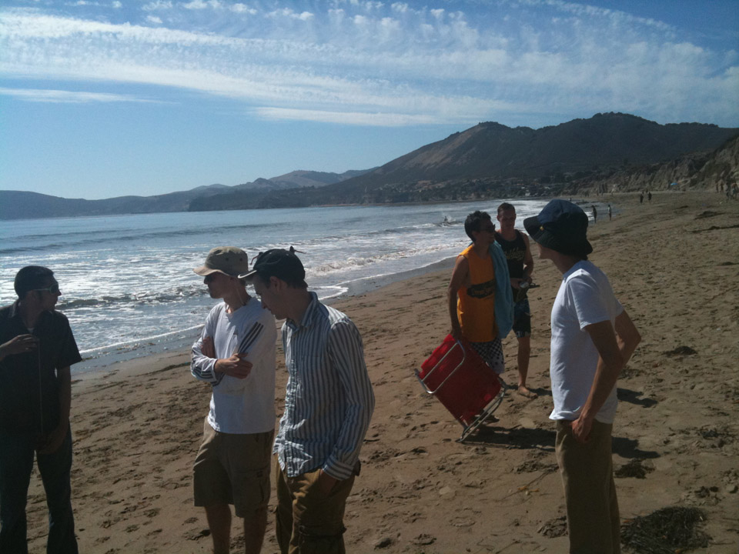
Notes:
Why am I calling most of our effects hacks? To explain, we will now enter the vacation photo portion of the SIGGRAPH presentation ... Don't worry, there's a good reason for this!
Very early on in the project the entire team went up to the Pismo dunes a little ways north of here in California. We spent two days running, sliding and diving through the sand, just getting a feel for it. And that was the inspiration for most of the visual development of the sand. I personally only started to look at reference photos very late in the project, because we were never going for photorealism, but we were trying very hard to convey a realistic feeling to put the players in the mindset of being out in the middle of nature so they'd appreciate each other more when they encountered each other during the journey.

Slide 28
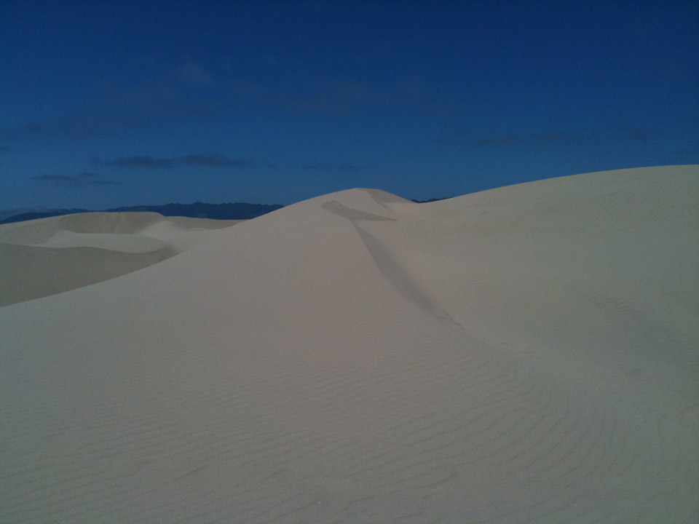

Slide 29
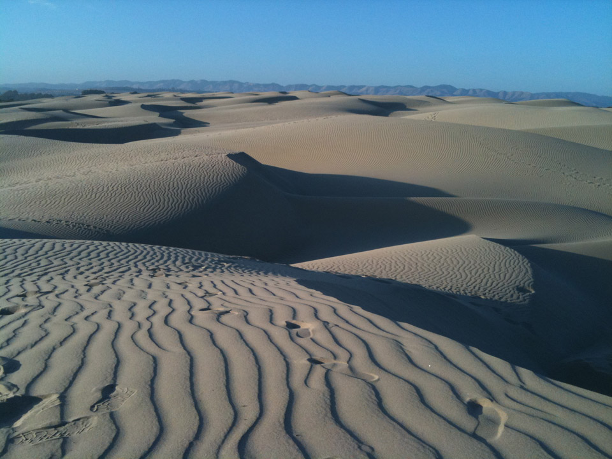

Slide 30
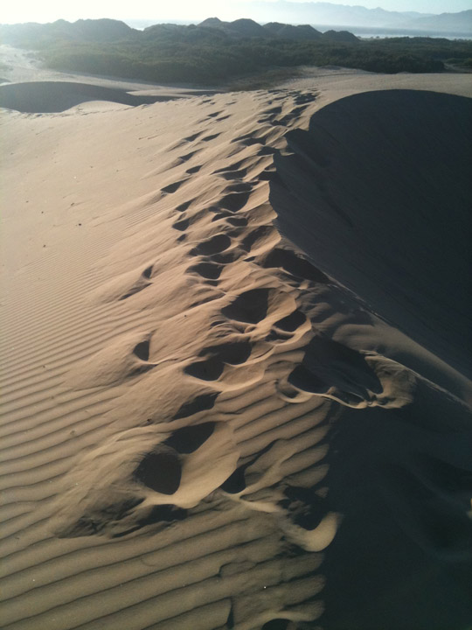

Slide 31
Sharp mips on
Notes:
So, with that in mind, here's our first hack, the detailed mip map. Notice that the sand remains very detailed and grainy far into the distance.

Slide 32
Sharp mips off
Notes:
Here's an image with more normal mip maps. It doesn't feel as sandy, but it's actually probably more photorealistic.

Slide 33
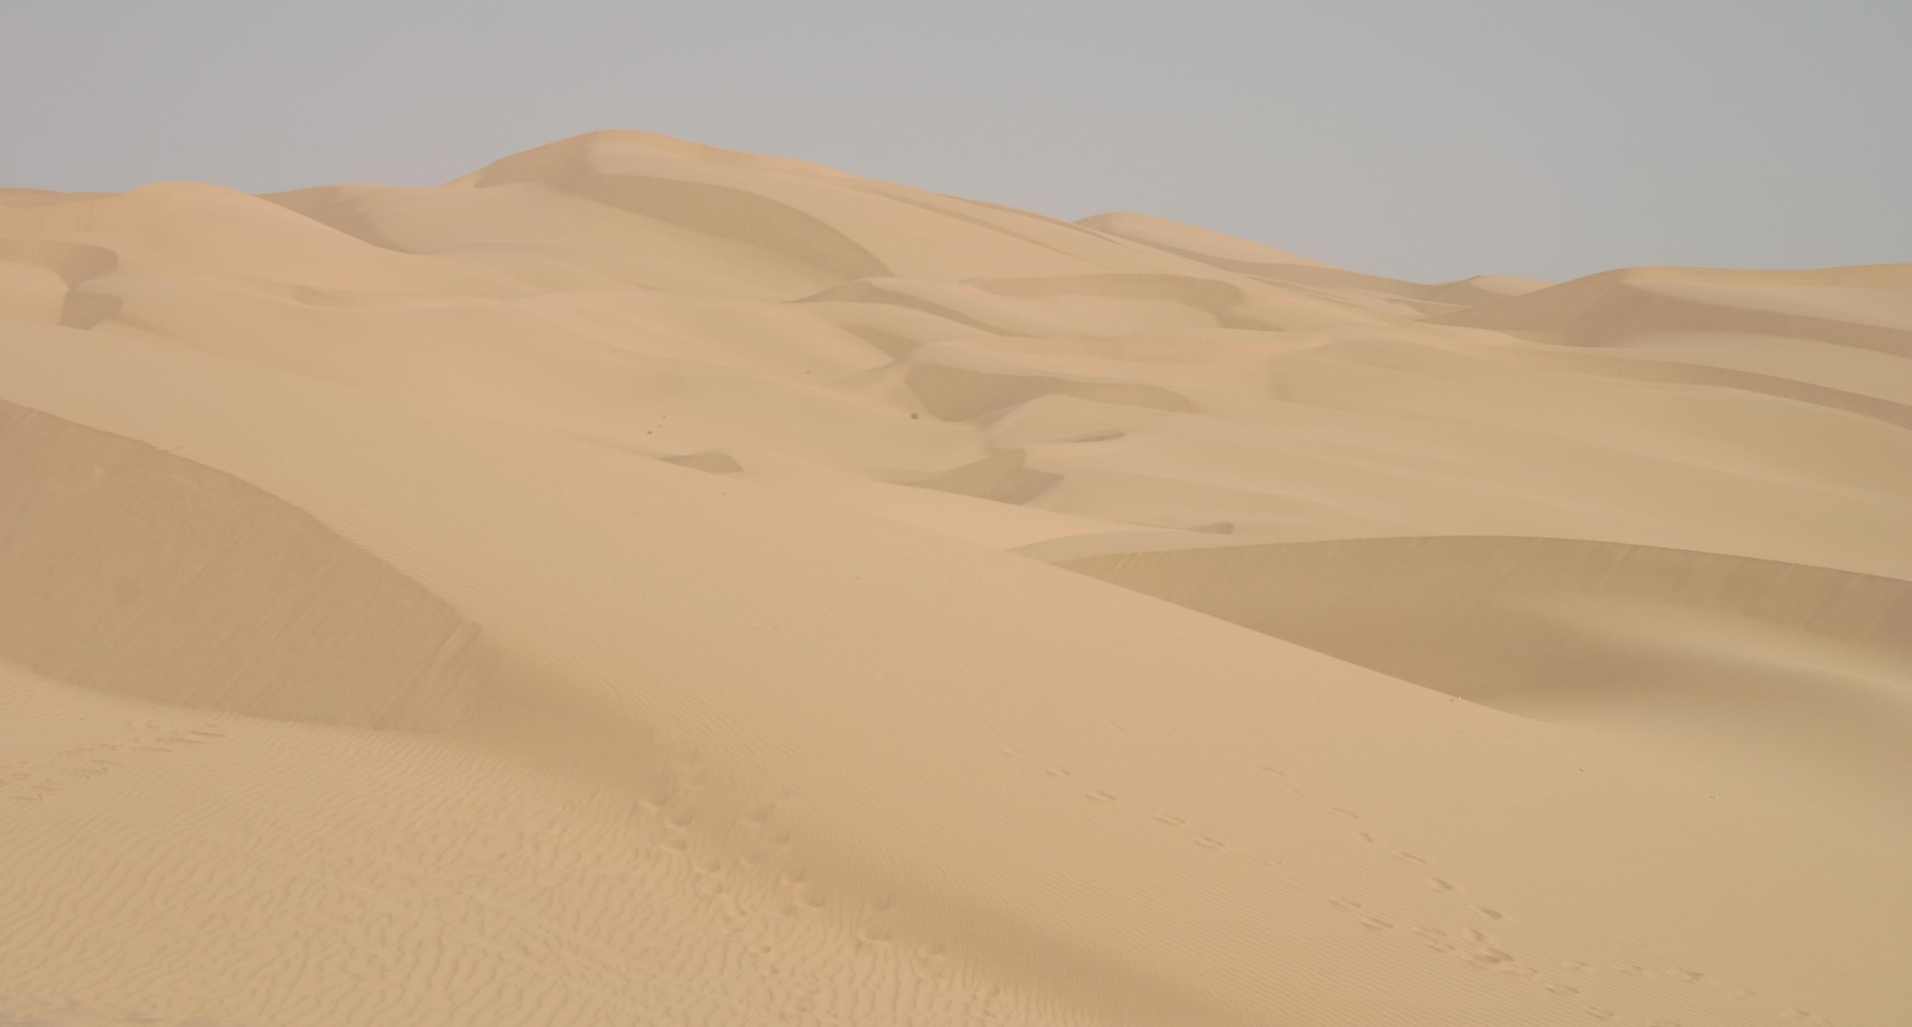
Notes:
Here's a picture of a real sand dune. Or should I say a bland dune! Notice how you can't really see any grains.

Slide 34
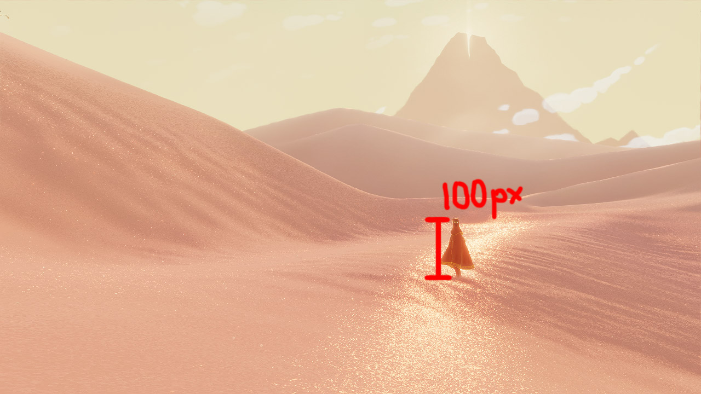
Notes:
We can do a little bit of math to understand why that makes sense.
The character is about 100 pixels tall on screen ...

Slide 35

Notes:
... and assuming the character is 1 meter tall (Journeyers are short ... and they like round numbers), then each pixel by his foot is about 1 square cm.

Slide 36
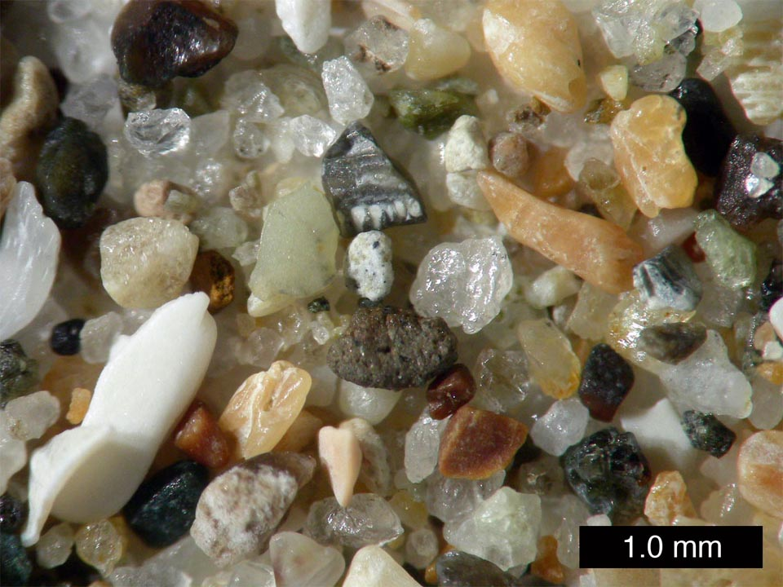
Notes:
Here's a zoomed in picture of actual Pismo sand. Just eyeballing it, it looks like the average grain of sand might be about 0.5 mm.

Slide 37
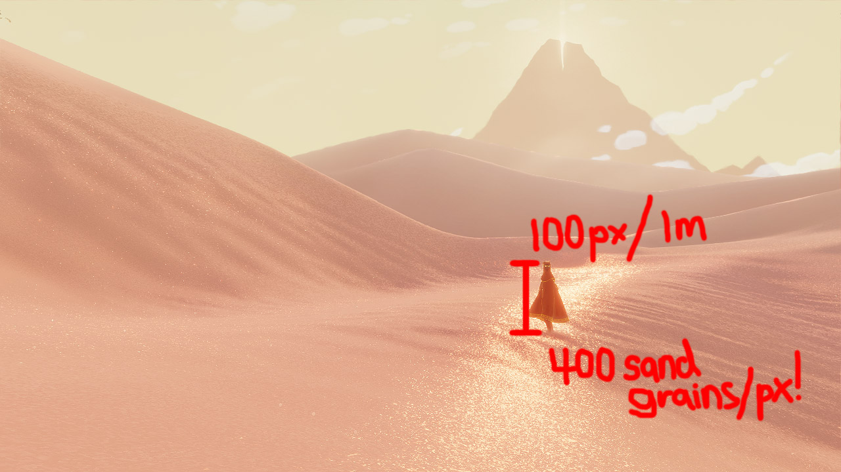
Notes:
That means each pixel by the character's feet contains about 400 grains of sand. For diffuse lighting, at least, all those grains should be averaging together into the smooth, pudding-y consistency we saw in the image of the real sand dune.
The thing is, when you actually go out to the dunes, the very first thing you notice is just how grainy they are. Eyes have more resolution than TVs right now, so you can see more sand grains, but you're also feeling the grains on every part of you, your face, your clothes, and places sand grains were never meant to go. So we tried to render our sand as grainy as possible, which basically meant a different sand grain for every pixel.

Slide 38
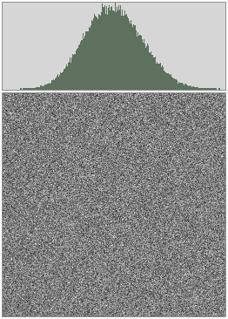
Notes:
Most of the texture of the sand is derived from a simple noise normal map. We generate ours dynamically, but this would work for static normal maps as well. Here's some of our noise with its histogram. More normals point straight up, and fewer and fewer normals point off to the sides.

Slide 39
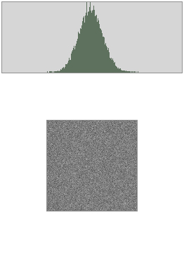
Notes:
Now when you do a simple box downsample for a mipmap, notice the distribution tightens. Your normal map gets weaker.

Slide 40
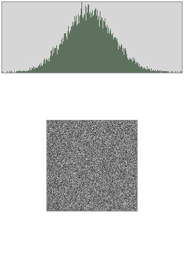
Notes:
But notice how it looks like the histogram is getting exactly half as wide when you downsample. So, if after every downsample you just double the normals, you can preserve the histogram, meaning you preserve the graininess of the texture. I'm not a mathematician, so I don't know if this is exactly true. If any mathematicians want to explain to me how wrong I am, my email is john@thatgamecompany.com, but for everyone else, I think this is a good enough hack for basically preserving the level of graininess as far out into the distance as you want. We disable the doubling on the last few mips, just because it eventually starts to look ridiculous to have sand grains the size of dunes.

Slide 41
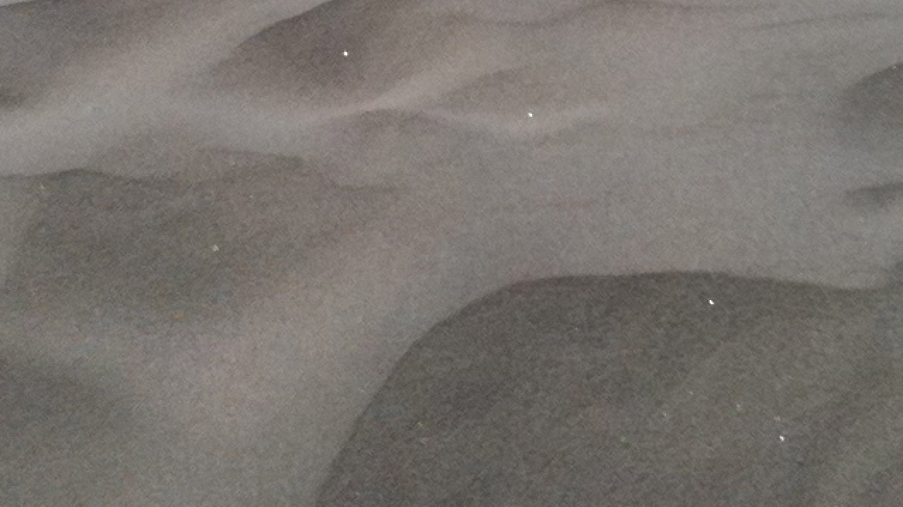
Notes:
Next I want to explain our sparkle specular hack. That's the second thing you notice about sand, by the way. It's very sparkly.

Slide 42
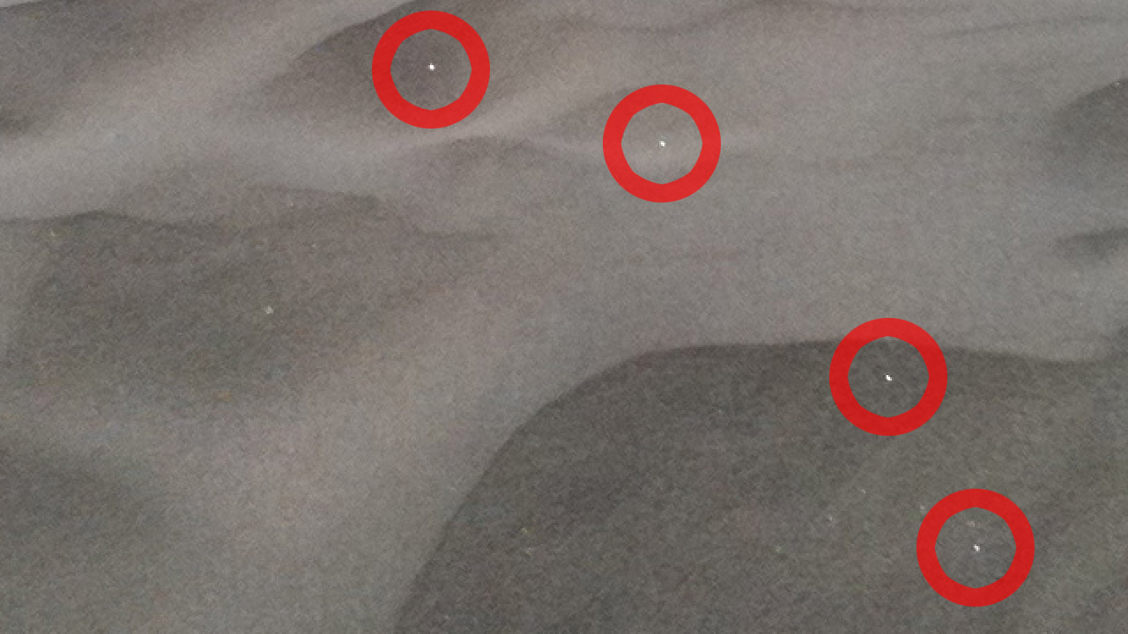
Notes:
Pictures don't pick it up too well, but you can see some glinting grains in this one. And when you're actually out in the dunes, the sparkles are constantly leaping to your eyes.

Slide 43
Glitter on
Notes:
Here are the images with the glitter specular turned on and off.

Slide 44
Glitter off

Slide 45

Glitter on
Notes:
And zoomed in so you can actually see it ...
Glitter specular on ...

Slide 46
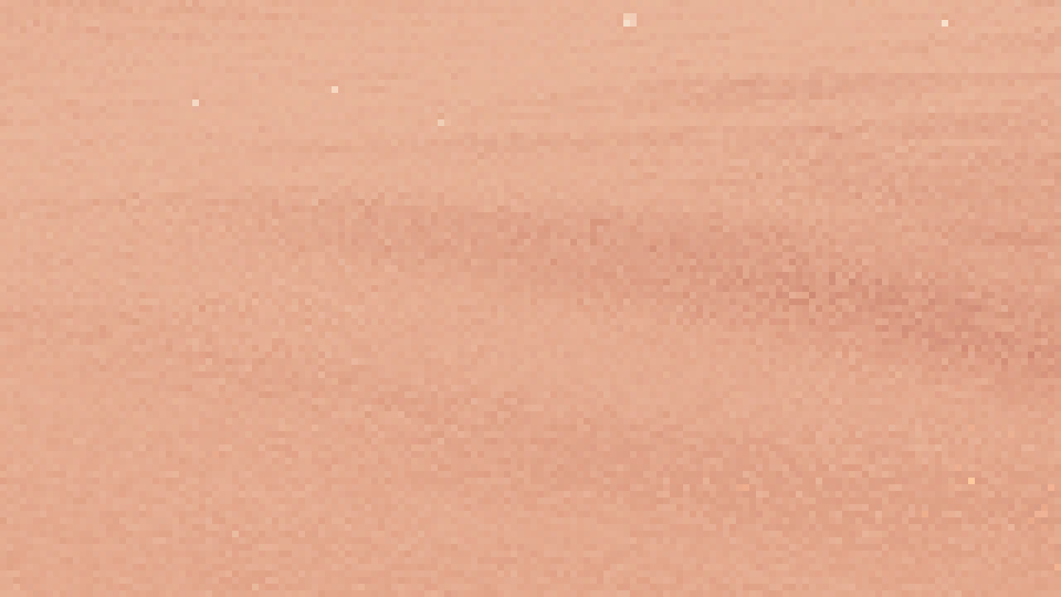
Glitter off
Notes:
… Glitter specular off.
I think the physical cause of the glitter is pretty straightforward. Whenever one of the little mirror-like grains of sand happens to be oriented in just the right way, it will reflect the sun into your eyes. Classic specular reflection.

Slide 47
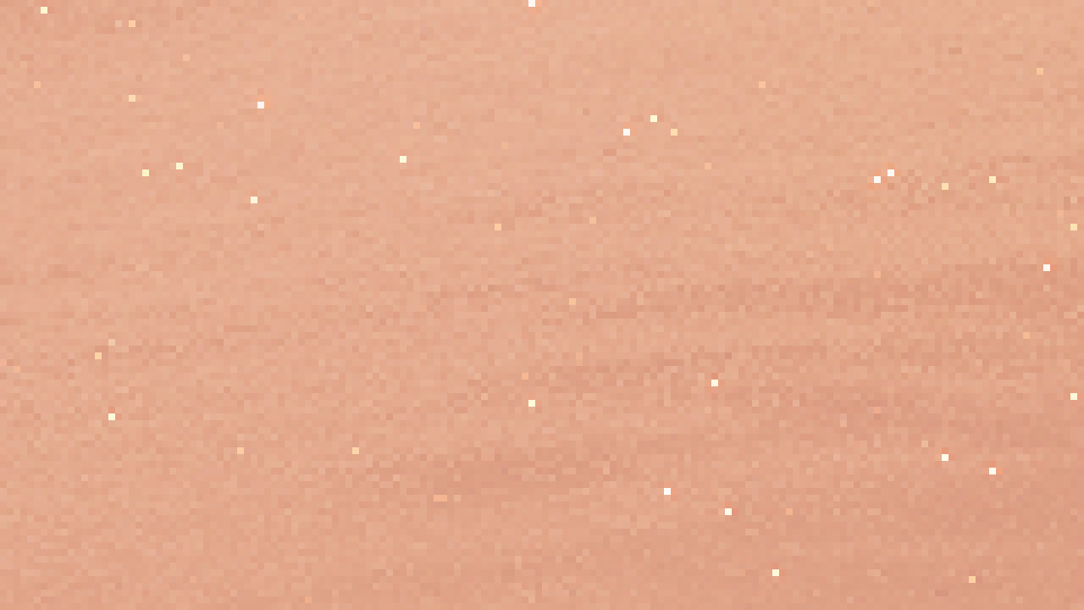
Specular glitter
Notes:
And that's what we tried, at first. Standard specular on a very grainy normal map with a very high specular power. And it actually looked okay in static images. You can see lots of nice little glints.

Slide 48
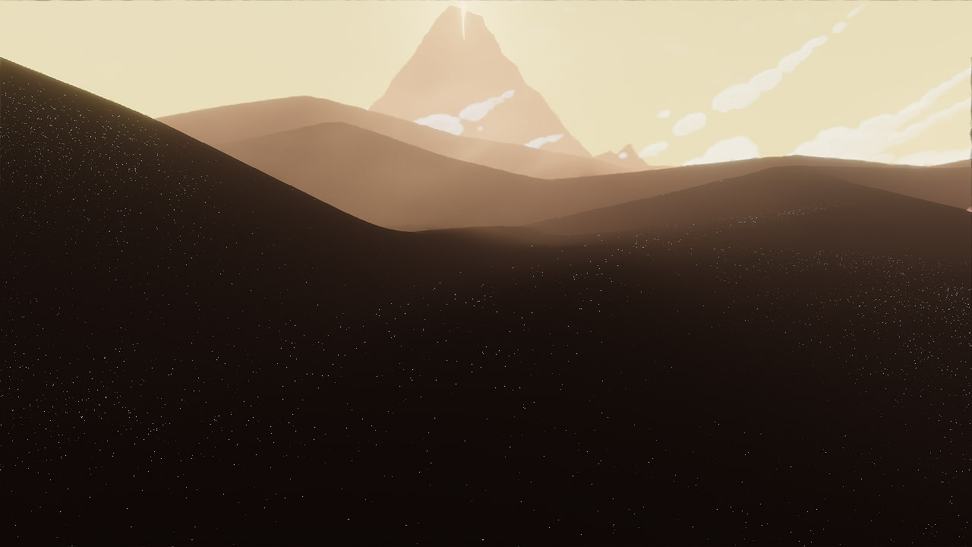
Notes:
[VIDEO]
But we could never control the aliasing in motion. Notice how it looks like you were just clubbed over the head or are about to get a migraine.

Slide 49
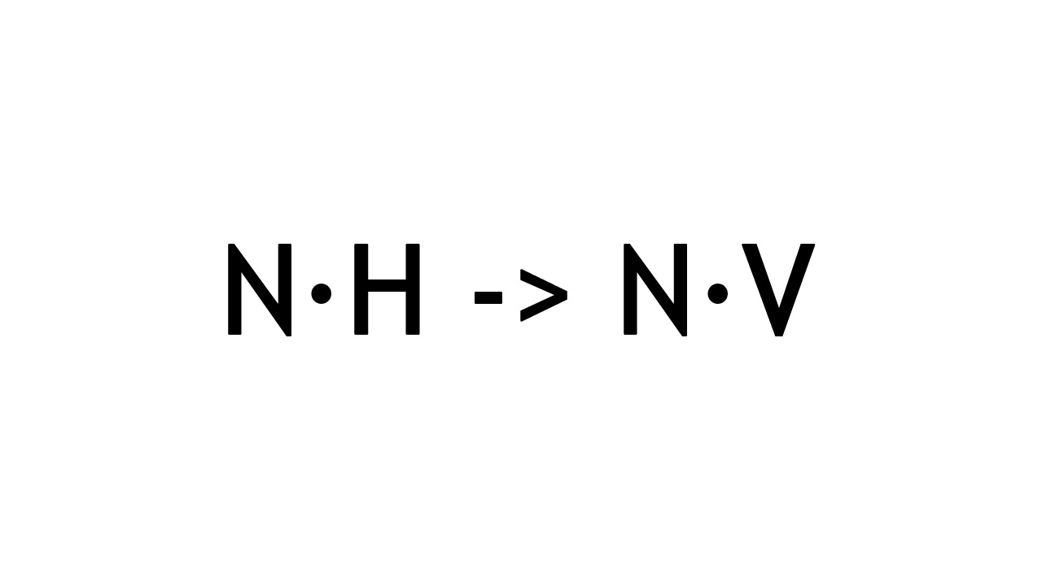
Notes:
So, instead, we used another hack. The main feeling you get from glinting sand specular is that it moves around when you do. In other words, it's view dependant. So instead of using real specular to get the glinting effect, we used the simpler "ambient specular" or "velvet" equation of just normal dot view, and that had a lot less aliasing.

Slide 50
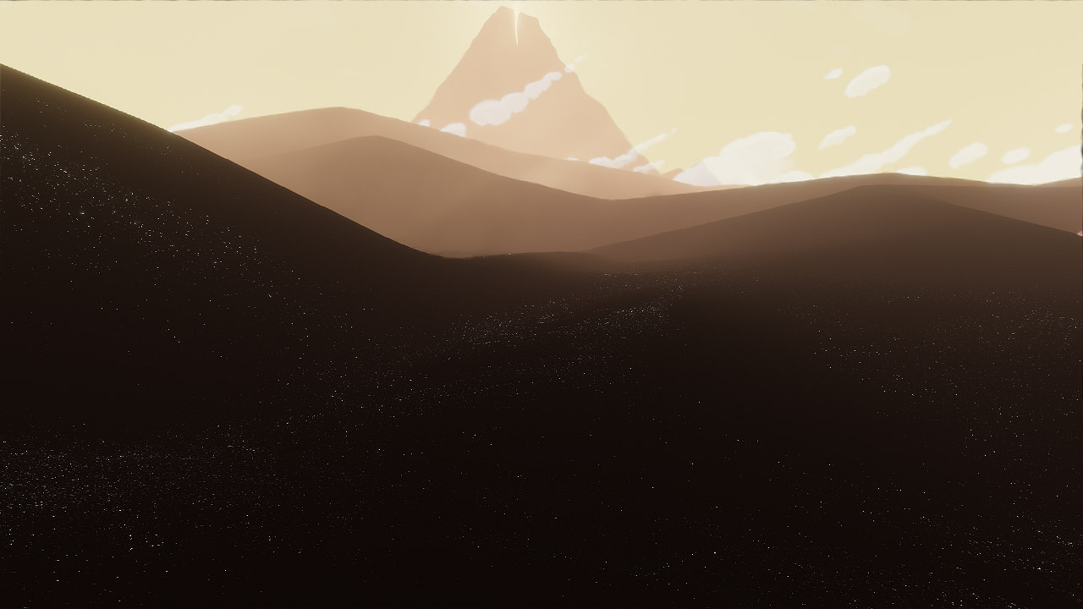
Notes:
[VIDEO]
As you can see in this video.

Slide 51
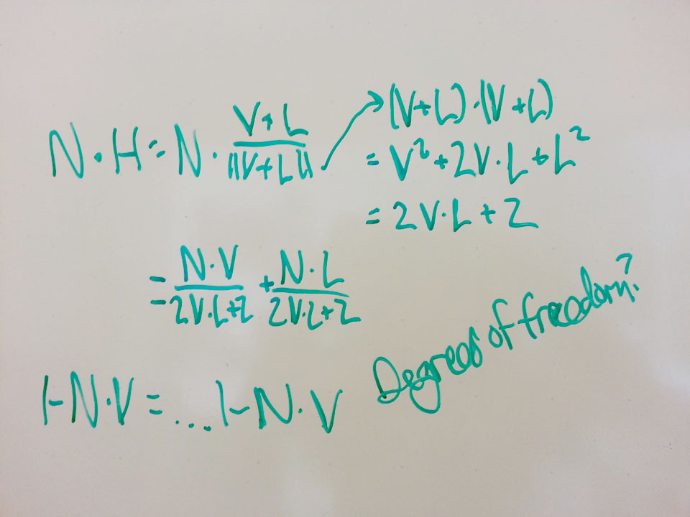
Notes:
As for why that is, here are some equations. They may or may not mean anything. I was never able to figure out why the hack specular worked better. But if any mathematician in the audience wants to tell me, again, my email is john@thatgamecompany.com!

Slide 52
Aniso failure mask off
Notes:
There was a big problem with the last effect ...

Slide 53
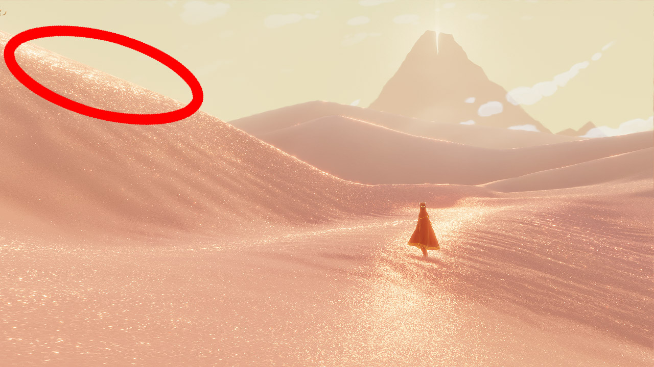
Notes:
... it looked like radioactive oatmeal around the silhouettes of dunes. This was such a big problem, we nearly abandoned the entire effect.
See, Journey uses full 16-tap anisotropic filtering on the sand texture, the maximum the PS3 allows.

Slide 54
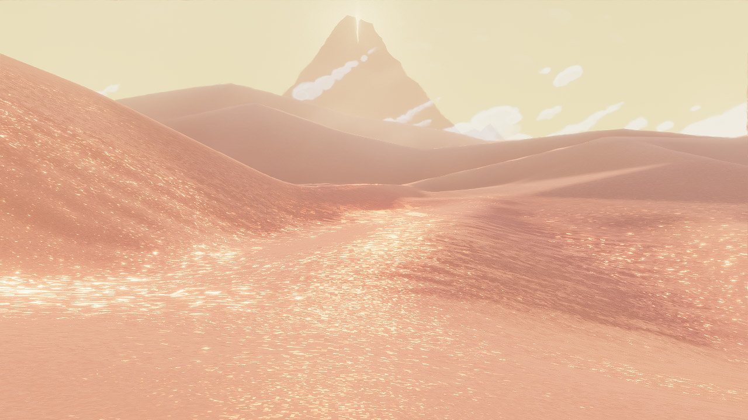
Aniso off
Notes:
The game looks ... quite different without it.

Slide 55
Aniso 16
Notes:
Another comparison of a screenshot with and without aniso-16.

Slide 56
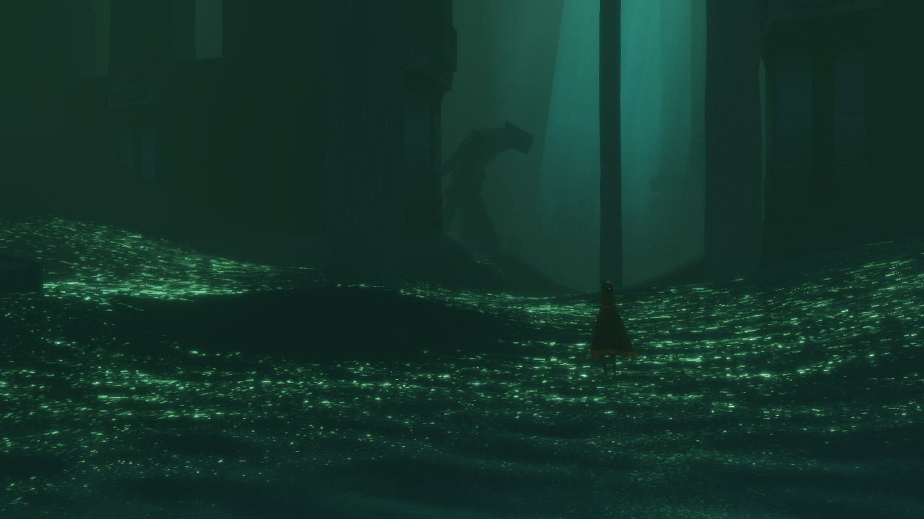
Aniso off
Notes:
I think this illustrates an interesting bit of perceptual psychology, though. It seems like as long as detail is pixel sized (or maybe just uniform), people see it as graininess. So, the pixels by the player's feet don't look like 400-times-too-big sand boulders, they just look like nice grainy sand. But as soon as you can pick out a larger feature, you take its size literally. Make the sand grains one pixel bigger, and all of the sudden you are playing in a rubble heap, not a sand dune.
We spent a long time trying to figure out ways to improve our anisotropic filtering, but never got anywhere. So instead of fixing our problem, we did the mature thing and swept it under the rug. We ended up just masking out the areas where we detected the anisotropic filter failing.

Slide 57

Notes:
Now, there's probably some Cg function that just tells you when your aniso filter is breaking down, but I couldn't find it, so in Journey we just created a texture that, given perfect anisotropic filtering, would have predictable values based on distance from the camera. Here's that texture with its mip chain.

Slide 58
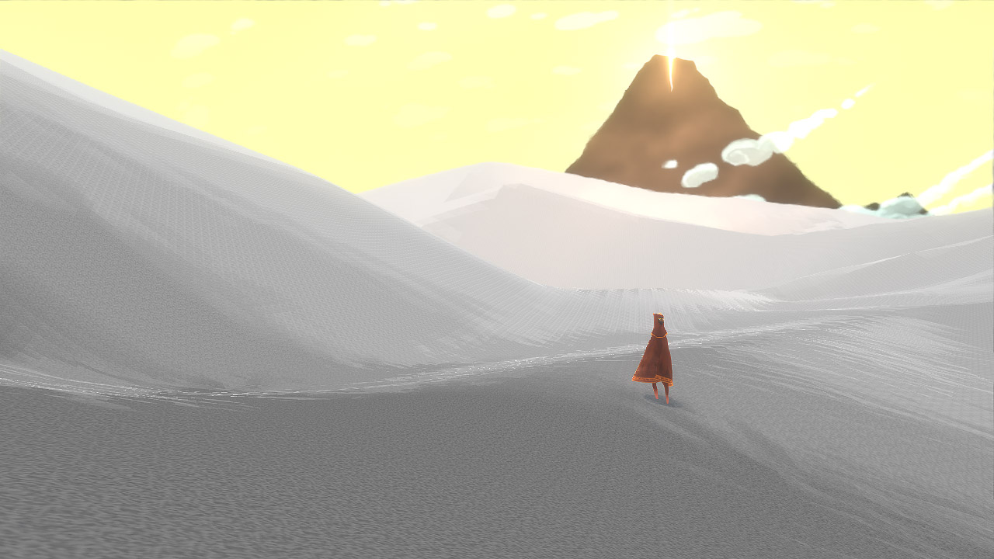
Notes:
Here's a picture of the dunes with just that texture mapped. Notice the dunes are generally darker closer to the camera and lighter farther away. We added some noise for dithering.

Slide 59
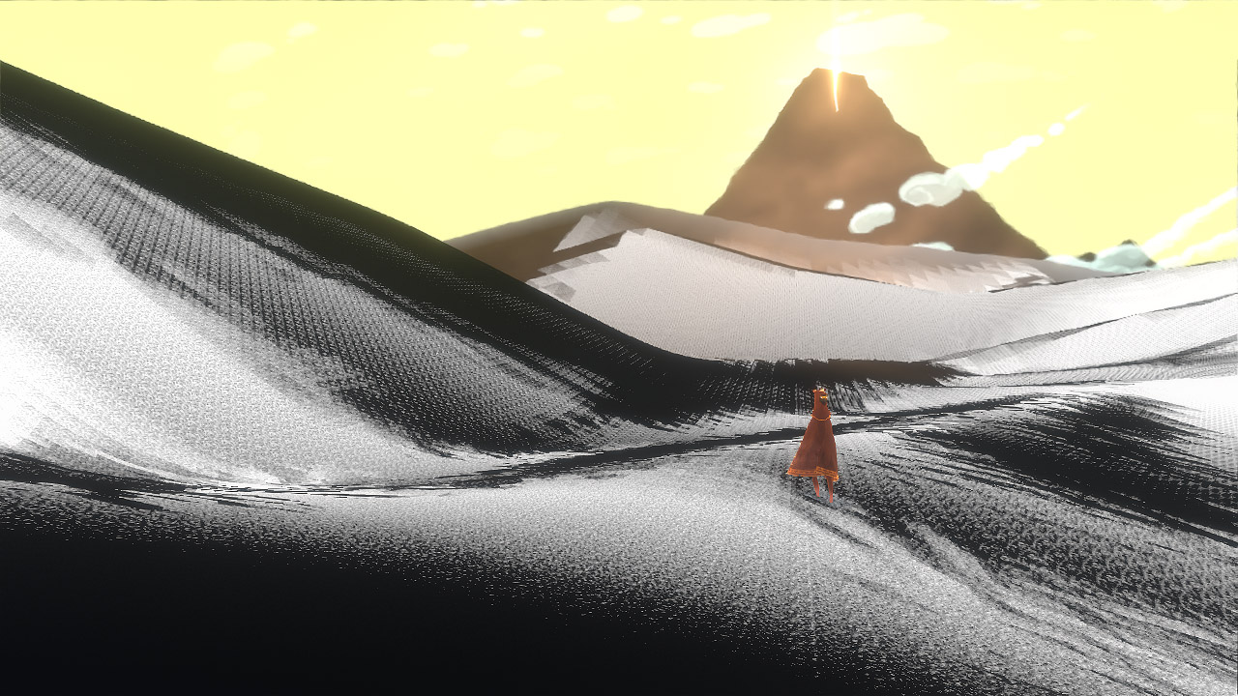
Notes:
And here's an image showing the masked off areas. Anything black is masked off. This fixed our anisotropic filter problem, but notice how much of the screen is masked off. With only sparkles in the white areas, the sand just wasn't sparkly enough.

Slide 60
Specular on
Notes:
So we added more specular ...
We added an ocean-style big column of specular. In this shot you can see it cutting through where the player is standing. This is probably the biggest hack we have, since I've never seen any sand, either in real life or in pictures, behave this way, but it ended up feeling right.

Slide 61
Specular off

Slide 62
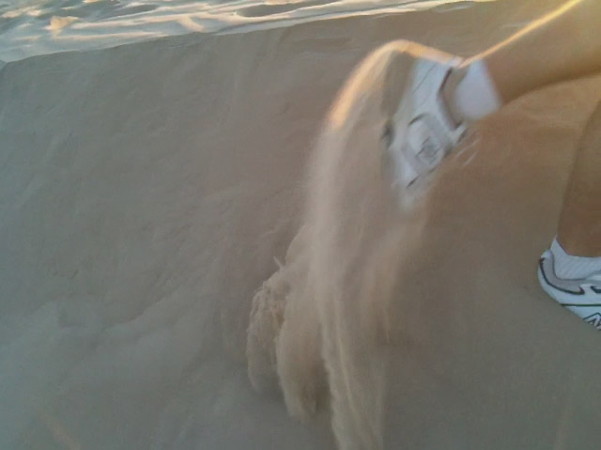
Notes:
I think that's because another property of the feel of sand. Sand, on the Pismo dunes at least, was actually very fluid. Walking out in the Pismo dunes was like walking on a giant ocean of sand.

Slide 63
“ocean of sand”: 41,700
“ocean of lard”: 111,000
Notes:
And we're not the only ones to think of sand that way. The term "ocean of sand" has quite a few hits on Google. Almost half as many as "ocean of lard", so you know it's a popular term.
Also, we added a fluid simulation to the sand, which, again, is totally fake, but it's kind of like the ocean and ended up feeling right in certain scenes.

Slide 64
Shipping diffuse
Notes:
Here's the final real hack. Our modified diffuse shading. Notice how compared to the Lambert shading, our shipping sand is much higher contrast.

Slide 65
Lambert diffuse
Notes:
And it took me a long time to realize this, probably because the Lambert Lobby is so strong in California, but Lambert is actually a pretty bad shader for just about everything. It feels like practically any change you do is an improvement.

Slide 66
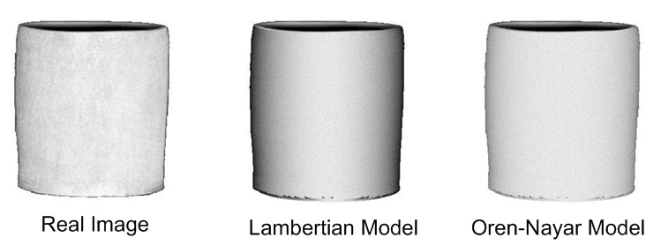
Notes:
There's actually a physically based model for diffuse which is designed for very rough surfaces (like sand) called Oren-Nayar. One of the major properties of this shader is that from many views, the contrast between the light side and the dark side of an object is increased.

Slide 67
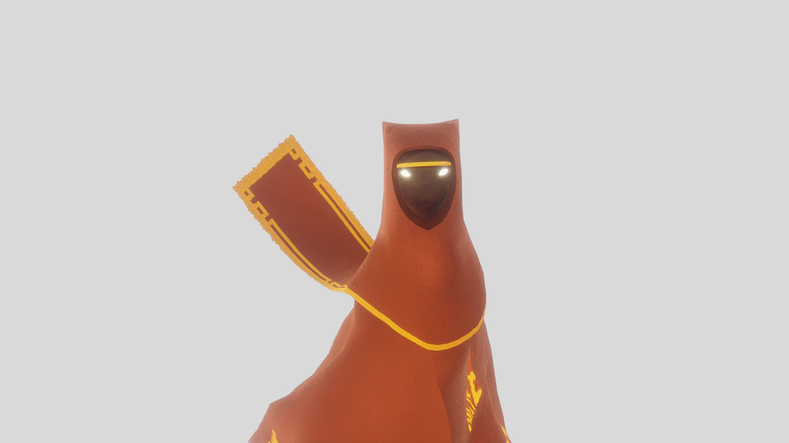
Notes:
And we ended up using a version of it for our cloth.

Slide 68
half OrenNayarDiffuse( half3 light, half3 view, half3 norm, half roughness )
{
half VdotN = dot( view, norm );
half LdotN = dot( light, norm );
half cos_theta_i = LdotN;
half theta_r = acos( VdotN );
half theta_i = acos( cos_theta_i );
half cos_phi_diff = dot( normalize( view - norm * VdotN ),
normalize( light - norm * LdotN ) );
half alpha = max( theta_i, theta_r ) ;
half beta = min( theta_i, theta_r ) ;
half sigma2 = roughness * roughness;
half A = 1.0 - 0.5 * sigma2 / (sigma2 + 0.33);
half B = 0.45 * sigma2 / (sigma2 + 0.09);
return saturate( cos_theta_i ) *
(A + (B * saturate( cos_phi_diff ) * sin(alpha) * tan(beta)));
}
Notes:
It looked pretty good on the dunes, but the problem is, Oren-Nayar ain't cheap, and we didn't want to plaster half the screen with it by putting it on the sand.

Slide 69
void reverse(char* s, int l) {
do {
random_shuffle(s, s + l);
} while (!verify(s));
}
Notes:
So instead of using physical modeling to derive the lighting equation for the sand, we used another method inspired by my favorite way to reverse a string, random shuffle-verify. Keep trying random things until it looks good! Surprisingly effect method for many graphics programming problems, if given enough time.

Slide 70
saturate( dot( N, L ) );
Notes:
So, for the sand, we started with an ugly Lambert.

Slide 71
saturate( 4 * dot( N, L ) );
Notes:
And then threw a 4 in here ...

Slide 72
N.y *= 0.3;
saturate( 4 * dot( N, L ) );
Notes:
And multiplied the y-component of the normal by 0.3.
On the way hand, both of these operations increase contrast, which is in line with Oren-Nayar. But really, there wasn't any motivation for these operations other than the fact that they looked good. That's just the way it works, sometimes, I guess, and maybe it's important to admit that.

Slide 73
Detail heightmaps on
Notes:
And now the final effect I want to talk about, our detail heightmaps.
This one, I'll admit, we only added after looking at reference photos. But it's really important for conveying the feeling of sand. So reference photos can be good, too!

Slide 74
Detail heightmaps off

Slide 75

Notes:
The dunes in Journey were represented by layered heightmaps. For the base, we used a really low resolution artist-generated heightmap. The levels in Journey are quite large, but the heightmaps were only 256x512. But as we streamed the data into the verts on the SPUs, we used B-spline interpolation. B-splines are very smooth. They are second derivative continuous, in fact, so we could use the second derivative for ambient occlusion, incidentally.

Slide 76

Notes:
But to get that extra level of detail that is really characteristic of sand dunes, we always layered on top a detail heightmap. The detail heightmap was generated out of a blend of these 4 tiling textures. For each vertex of the detail heightmap, we chose the X- or the Z-column based on which derivative was greater, and we lerped between the shallow and steep rows based on the total steepness of the terrain.

Slide 77
Special thanks to:
SPU programmer extraordinaire: Martin Middleton
Art Director, Chief shadow requester: Matt Nava
Mathematicians – email john@thatgamecompany.com
Notes:
Okay, that's it. That's sand rendering in Journey

Slide 78

jobs@thatgamecompany.com

