Slide 2
Scalable High Quality Motion Blur and Ambient Occlusion
Michael Bukowski – Vicarious Visions
Padraic Hennessy – Vicarious Visions
Morgan McGuire – Vicarious Visions / Williams College
Brian Osman – Vicarious Visions

Slide 3
Agenda
Designing scalable algorithms
Examples
  Motion blur
  Ambient occlusion
Closing

Slide 4
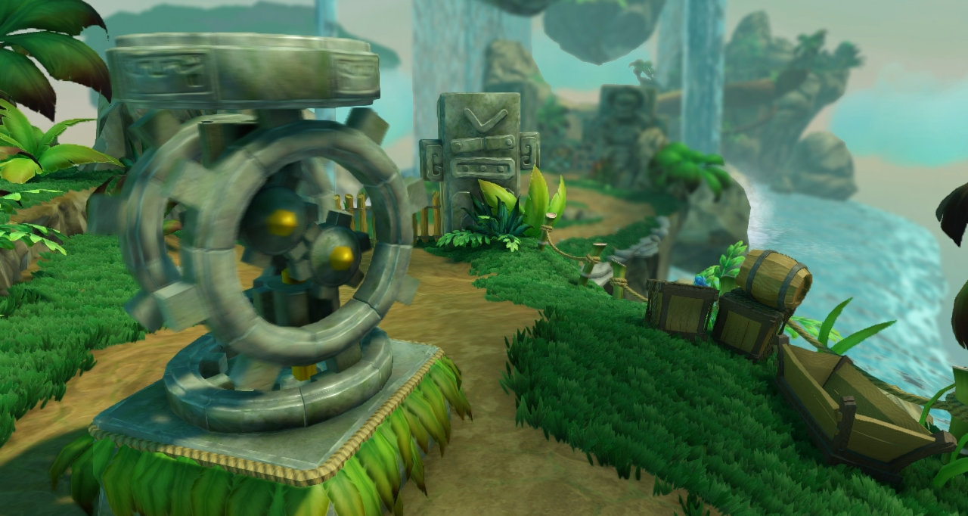

Slide 5
Designing Scalable Algorithms

Slide 6
Why we go for scalable
Ability to share effects across platforms with different performance constraints
Share across games that are going for different art styles
Notes:
At Vicarious Visions we develop on platforms ranging from mobile through console to dx11.
Since we often have two or three projects running at the same time, each on multiple platforms, it is important that we invest in shared technologies.
Just as import as being able to scale in performance, our techniques must also scale in design, giving them the ability to compliment multiple art styles.

Slide 7
Benefits of scalable effects
Visual consistency
Development time savings
Consistent content requirements
“Free” quality gains
Notes:
When talking about scalable effects in the context of one project there are a number of benefits we get:
Visual Consistency – Using the same algorithm on every platform results in similar contributions
The visual consistency means that our artists will get the same results on each platform, saving them the time choice of which platform to optimize for.
Development time savings - designing and implementing robust algorithms take time and effort, we have found that it is worth it to spend more time upfront designing for scalability than to implement 2 algorithms
Consistent Content Requirements – if we find that we need to make some requirements on how assets are authored do support an algorithm we don’t want to have multiple requirements for different platforms
“Free” quality gains – When you have scalability designed into an algorithm you can maintain visual consistency but increase quality as you move to new platforms and performance restrictions are lifted.

Slide 8
We ask ourselves the following
Will it work on platform X?
Where can we change parameters for increased quality?
Where can we change parameters for increased speed?
Does it work if we change the resolution?
Does it depend on a hardware or API feature?
Does it dictate an art style?
Notes:
When we start working on an algorithm we have a mental checklist that we continually measure or ideas against.
An interesting exercise is to think about some algorithms that you currently have in your engine and ask these questions.
If you are a multi-project studio or part of a central tech group the most important of the questions here in terms of scalability is “Does it dictate an art style?” since this will limit the application of the approach.

Slide 9
Potential Scalable Elements
Quality knobs
  Maximum radius
  Sample count
  Clamps on inputs
Resolution independence
  Allow normalized screen units instead of pixels
Modular functions
  Accuracy vs speed
Additional processing
  Additional passes, iterative algorithms
Notes:
Some of the common elements we considered when designing the algorithms were:
Quality knobs – these are simply adjustable parameters that can yield higher quality. All your usual suspects are here like radius, sample counts, adjusting restrictions like clamps
Resolution independence – pretty self explanatory, this one can be hard to do if you perform a lot of bilateral blurs or nearest neighbor sampling
Modular Functions – Especially for lower end hardware we often have to replace some function with and approximation for performance reasons, for the quality improvements it is important to leave the option of going back to the full formula on platforms where you have some cycles to spare.
Additional Processing – This is probably one that hasn’t got much thought on the real-time side of things, but this could give you lots of quality gains if for instance you change a random seed and re-run an algorithm to reduce aliasing or if you design a function that converges on the correct solution each iteration.

Slide 10
Our Process
Design for quality on low end
Extend to high end
Iterate on quality and performance
Ample time between iterations
Performance
High End
Performance
Low End
Notes:
Our process has evolved over the past 2 years into something that we regularly employ now.
Design for the lower end platform using the types of questions asked earlier
Optimize the algorithm for performance and integrate it into the game
We then revisit the higher end platforms and implement there
By performing the optimization in between the low end and high end implementations we give ourselves time to take a step back and re-evaluate our approach, this often leads to major quality and performance gains
4) We take any fundamental improvements made on the higher end platform and integrate them back into the lower end targets
5) Rinse and repeat, often changing project directions and requirements will expose or remove constraints from the design

Slide 11
Agenda
Designing Scalable Algorithms
Examples
  Motion Blur
  Ambient Occlusion
Closing
Notes:
Two of the first algorithms that really helped us develop this process were Motion Blur and Ambient Occlusion. We are going to take a closer look at where those algorithms are at right now.

Slide 12
Motion Blur

Slide 13
Introduction
Convey sense of speed
Reduces strobe artifacts
  Especially important @ 30 fps
Give cinematic feel of a real camera
Notes:
Motion blur is a great effect to invest in to get a more cinematic feel for your games.
This is because motion blur is emulating the non-instantaneous shutter time of actual cameras.
It also helps reduces the strobe effect that happens when you render at frame rates under 60 fps, giving your game a much smoother experience.
Artistically motion blur can be used very effectively to communicate a sense of speed to the player.

Slide 14
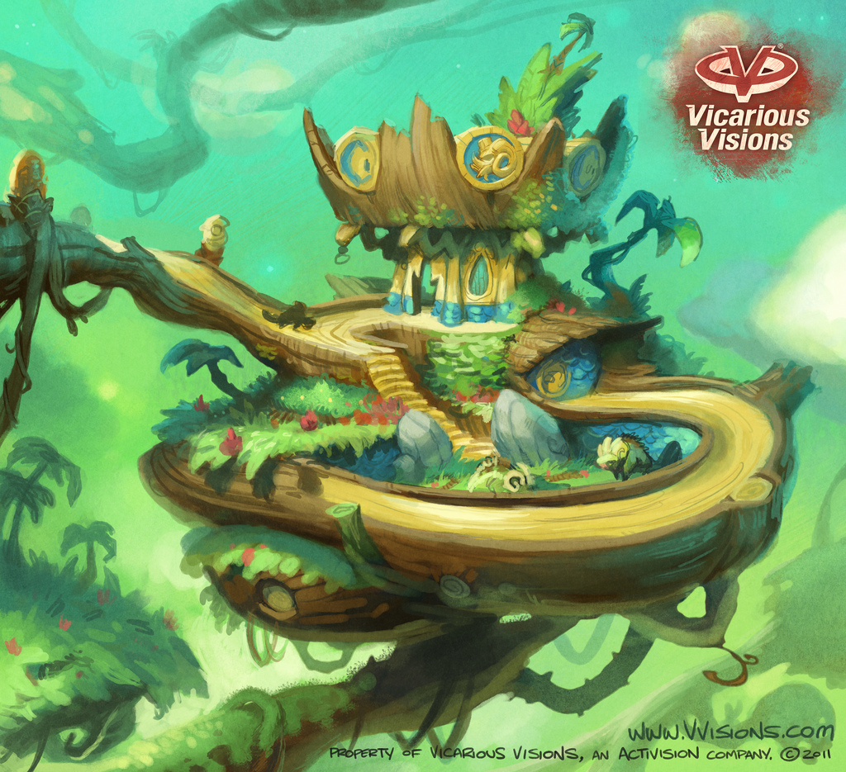
Project Motivations
Highly dynamic characters
Dense organic environments
Lots of scene motion
Notes:
So why did we go for motion blur?
When the concepts for our game started coming in we saw many characters with exaggerated movements, dense “living” environments, and that they would require lots scene motion to sell them. At roughly the same time we decided that we would be targeting 30fps to support more flexibility in our lighting. Deciding to go for motion blur at this point aligned with so many of our project goals that it was an easy call.

Slide 15
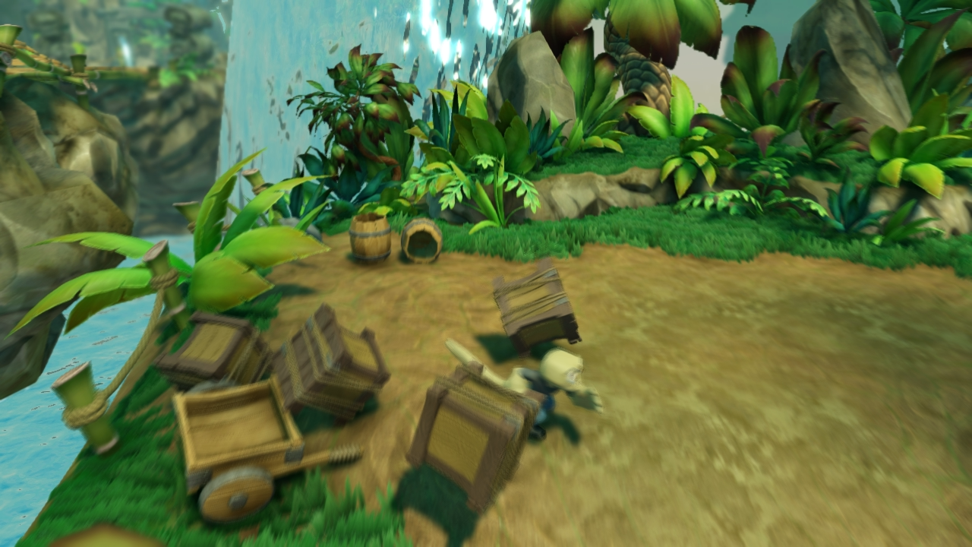
Notes:
Here is just a quick sample of what we were able to achieve with the algorithm I’m about to present

Slide 16
Project Constraints
No asset requirements
Consistent for all geometry types
Independent of scene complexity
Minimal G-buffer encoding
These constraints eliminated most existing techniques
Notes:
When we approached motion blur we decided early that we would impose some restrictions on our solution.
No asset requirements – We wanted to avoid as much as possible imposing new restrictions on the content teams. At this point in the project we had already redesigned our core lighting algorithm, material system, and animation system, we felt that any more requirements would have just slowed down the entire team.
Consistent for all geometry types – This speaks to the robustness of the solution, we didn’t want to handle many different classes of geometry or potentially have visual inconsistencies between two pieces of geo.
Independent of scene complexity – When we started evaluating motion blur we didn’t have a clear picture of where art was going to spend the main scene budget, we wanted to avoid algorithms that didn’t scale well with differing scene complexities
Minimal G-buffer encoding – With our g-buffer layouts we could really only spare 2 channels to encode the velocity and we couldn’t spare any additional space for per-geometry data
Once we had these project constraints we evaluated numerous existing techniques but we found that we couldn’t find one that met our list of restrictions

Slide 17
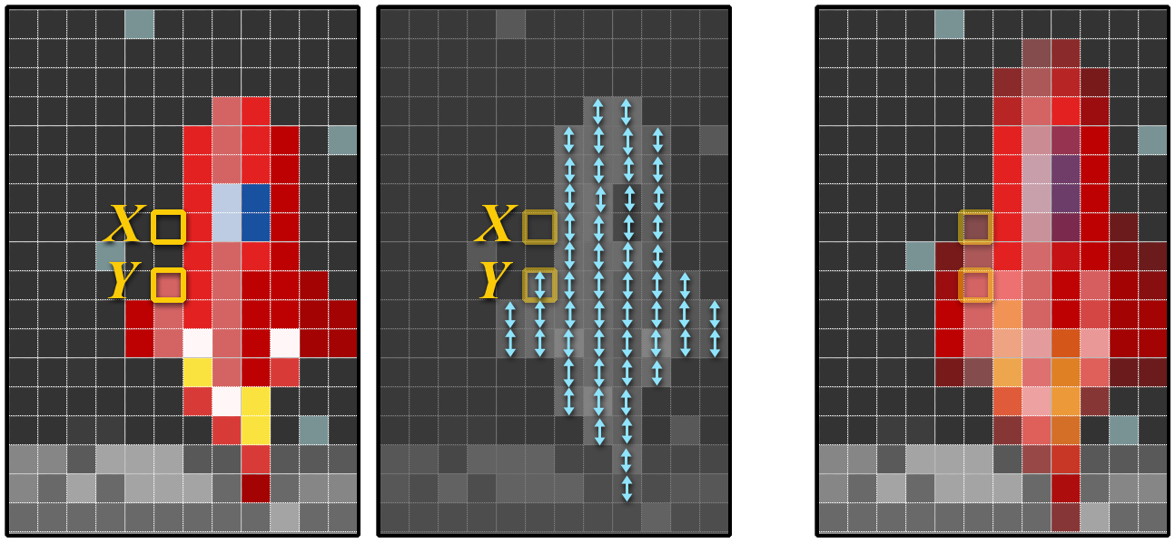
Closer Look At Motion Blur
Input Image + Input Velocity → Final Image
Notes:
If look at what is going on under the good when something is blurring due to motion we can represent it fairly simply.
We have an input image and a velocity at every pixel for objects in that image. We see that the contribution of a pixel is spread out over distance represented by the velocity.
So if I can describe what is happening in 2 sentences why have a talk about how to solve it?

Slide 18
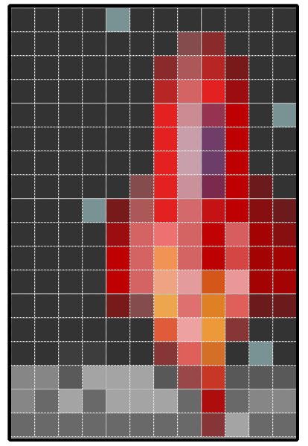
Core Problems
Naturally scatter effect
Need to represent as gather
Objects blur outside their extents
Results in transparent like effect
Notes:
As I just described motion blur it is extremely simple to represent it as a scattering effect. The contribution of a pixel is distributed over the area described by the velocity.
Unfortunately we need to describe motion blur as a gathering effect. Independent of performance we could say that for each pixel loop over the entire image and find what pixels potentially overlap the pixel in question and we should end up with a very similar results. Again this is far to slow work in practice so we have to come up with something to make that portion of the algorithm faster.
Another problem associated with the gather technique is that objects moving no longer have the same silhouette, their shape becomes distorted as they move faster.
To put the icing on the cake, we end up seeing what was originally occluded by the object resulting in a transparent like effect.

Slide 19
Our Approach
Dilate velocity using tiles
  Allowing blurring outside of object boundaries
Sample along dilated velocity
  Scatter → Gather
Mix samples based on velocity and depth
  Background estimation
Notes:
Our approach is three pronged:
Dilate the velocity using screen space tiles : We chose to dilate the velocity using a tile based approach. We found that we could do a large radius dilation efficiently
Sample along dilated velocity : By preprocessing the velocity into the dilated form we have also given our selves the primary direction that we should look in when looking for contributing pixels
Mix samples based on velocity and depth : Finally we combine the samples in an interesting way to simulate background estimation for achieving the transparent aspect of motion blur
When we combine the 3 things mentioned above we get a robust motion blur solution

Slide 20
Walkthrough

Slide 21
Render Velocity
Calculate velocity in screen space
Clamp to max blur
Rescale to 0→1
Notes:
First you will want to render a pretty traditional velocity buffer. You will want to calculate velocity in terms of pixels in this step and then clamp it to the maximum allowable blur, you will see why this is important as the walk through progresses. Finally you will want to take the –max to max velocity and scale it into the 0-1 range so you can store it in 2 channels.

Slide 22
Tile Maximum Velocity
NxN Down-sample
  N = max blur radius
Record maximum by magnitude
Notes:
The first step of the velocity preprocessing is to find the maximum velocity in each tile on the screen. A tile is represented by NxN pixels where N is the maximum allowable blur. As you perform this down sample make sure you account for the remapping of the velocity when testing magnitude.

Slide 23
Neighborhood Maximum Velocity
Input tile maximum results
Apply 3x3 box filter
Find the maximum by magnitude of center and surrounding tiles
Notes:
The second step of the velocity preprocess is to apply a 3x3 box filter on the tile max velocity texture to find the maximum velocity in a particular region. Once this stage is done we now have a conservative map of the regions of influence for some large scale velocities. Finally we can pass this texture on to the reconstruction shader as you will see next.

Slide 24
Neighborhood Maximum Velocity
Input tile maximum results
Apply 3x3 box filter
Find the maximum by magnitude of center and surrounding tiles
Notes:
The second step of the velocity preprocess is to apply a 3x3 box filter on the tile max velocity texture to find the maximum velocity in a particular region. Once this stage is done we now have a conservative map of the regions of influence for some large scale velocities. Finally we can pass this texture on to the reconstruction shader as you will see next.

Slide 25



Reconstruction
Center Depth & Color
Center Velocity
Neighborhood maximum
C
Notes:
Now that we have pre processed our velocity into a W/NxH/N sized buffer it’s time to use the information.
Looking at center sample C we first grab the depth and color of that pixel. Next we grab the high resolution velocity from our source velocity buffer, we hold on to this because we will use it in the comparisons in the next step. Finally we grab the maximum neighborhood velocity this will come in handy as we choose sampling locations in the next step.

Slide 26
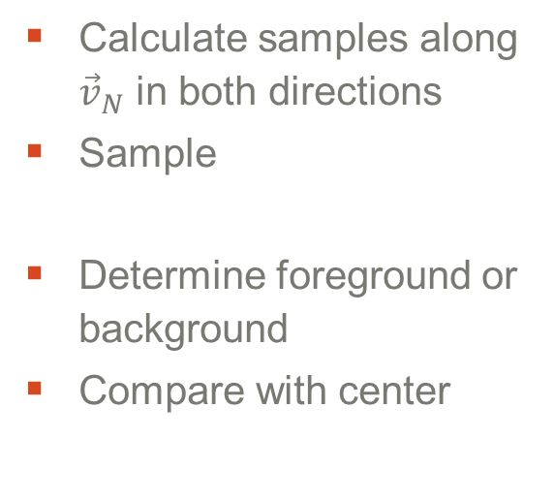

Samples
Calculate samples along ${\vec{v}}_{N}$ in both directions
Sample
Determine foreground or background
Compare with center
S
$$z_{S} ,{Color}_{S} ,{\vec{v}}_{S}$$
S
Notes:
For this step you will want to re-expand the neighborhood velocity back into the –max – max range and then generate some sample points along that vector ( both positive and negative from center ).
At each sample point you will want to get the depth, color, and high resolution velocity. We then compare the depths to see if the sample is in the foreground or background of the center and then apply some comparisons based on that finding.

Slide 27
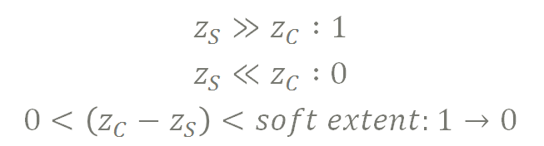
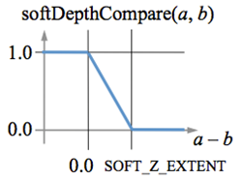
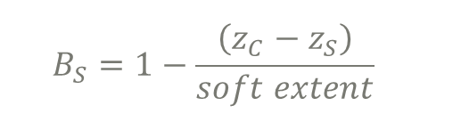
Foreground vs. Background
Desired:
Formula:
C
S
Notes:
To determine the foreground or background of a pixel we just applied a ramped step curve that gave us some intermediate values when the depths were close. If you do anything with soft particles this will look familiar.

Slide 28



Comparison Details
Interesting cases:
Background sample
Potential background estimation
Foreground sample
Potentially moving overtop of the center
Both samples are moving
  aka we want something blurry
Notes:
Right now there are 3 cases that we really care about for the comparisons
Background sample
The background sample case allows us to achieve the transparent effect by potentially treating the sample as an estimate for what is in the background of this pixel.
Foreground sample
The foreground samples case allows us to blur an object past the extents of its own bounds because we allow samples from elsewhere blend overtop of the center.
Both samples moving
This is the general bucket that we just want something blurry because everything is moving. We found that when you get to this point there is so much blurring going on that the eye can’t really depict direction.

Slide 29
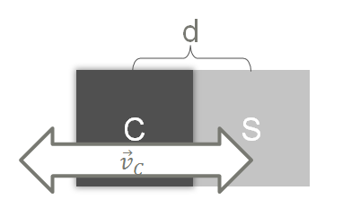

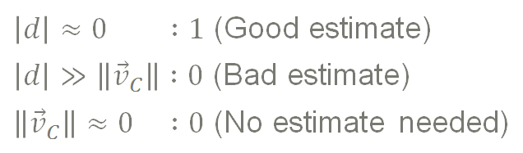
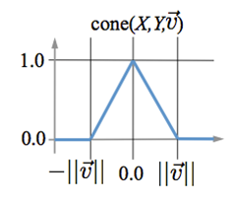
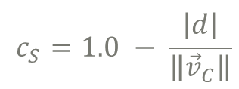
Background Sample
Case:
Desired:
Formula:
Notes:
For the background estimation we only really need to look at the velocity of the center, determining if it needs a background estimate at all, and the pixel distance between the center and the sample to see if it would be feasible that they overlap. We represented this with a cone like fall off. We use the velocity of the center as the denominator because we get less picky about background samples the faster the object is moving.

Slide 30
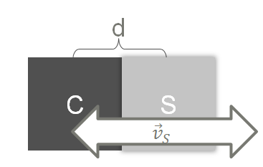

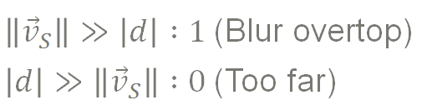
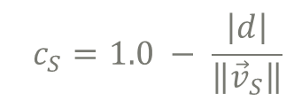
Foreground Sample
Case:
Desired:
Formula:
Notes:
For the second case we want to allow object to blur out of their extents so all we really need to do here is ensure that the samples are overlapping. We apply a simple fall off so we get a nice fade at the ends.

Slide 31
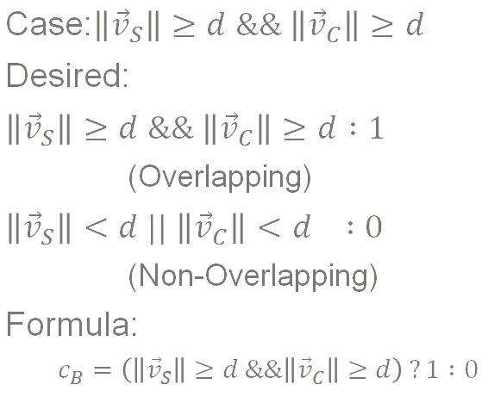
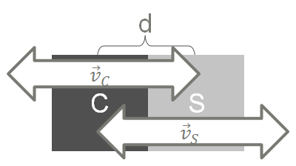
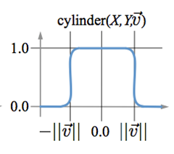
Mutually Blurry Samples
Notes:
The last stage we simple need to validate the samples could feasibly overlap, notice how we don’t check direction just magnitude, we found that the results were better doing this and the incorrect blurring was not noticeable at all.

Slide 32
Final Details
Gather samples
Sum weights from comparisons
Sum color contributions
Normalize for result
Notes:
Finally we can generate the output pixel color. When performing the comparisons we don’t actually treat them as mutually exclusive cases instead we determine the foreground and background weights and use that to weight the first two contributions and for the third we just mix it in. Because we do this we need to renormalize at the end. For the center sample you can fool around with the initial weights, a higher weight will result in less pronounced blur regions and a lower weight will result in a more “thick” looking motion blur.

Slide 33
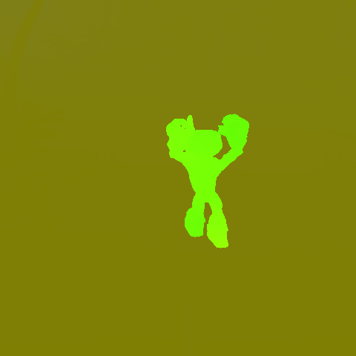
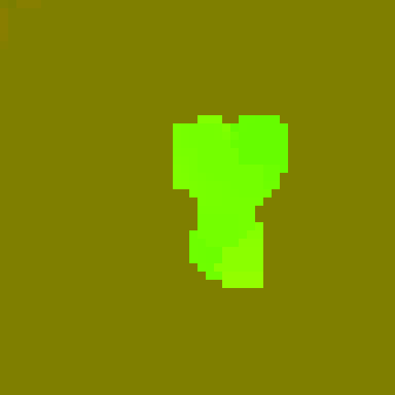
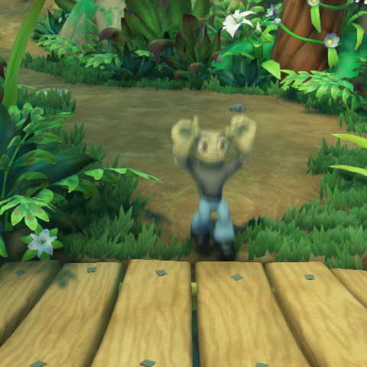
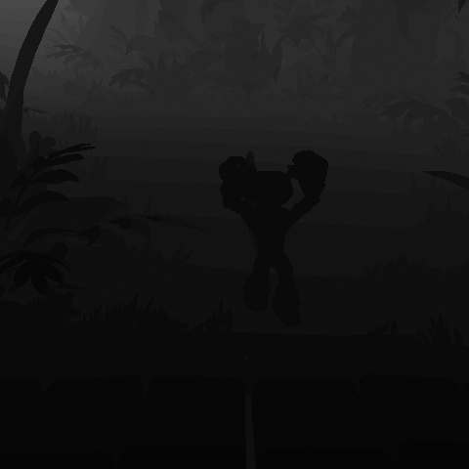

General Flow
Velocity
Dilated Velocity
Color/Depth
Final Result
Notes:
So putting it all together the high level flow we capture velocity depth and color. Then we preprocess the velocity and then finally run the reconstruction using all the source textures and the new processed velocity to produce the final image.

Slide 34
Scalability and Implementation

Slide 35
Scale for Design
Tune relative weights of contributions
Artificial velocity
  Particles
  Full screen masks
  Game events
  Special moves
Notes:
Tune weights - The look of the motionblur is heavily determined by the weights of each of the comparison cases and the initial weight of the center sample. This can lead to a very subtle effect or a way over the top blur.
Artificial velocity – because this algorithm just operates on a normal velocity buffer you can inject any kind of velocity you want into the buffer, this artificial velocity could come from particles, full screen effects, special game events, or even character moves.

Slide 36
Scale for Quality
Change max radius
Increase number of samples
Change comparison functions
Mix in samples along tile max and center velocity
More selective dilate
Notes:
Quality scaling for this algorithm includes some usual suspects like adjusting the maximum radius, increasing the number of samples etc.
But there is also room for other quality improvements such as sampling not only in the direction of the neighborhood velocity but also in the direction of the tile velocity and center velocity.
I feel that you could also swap out the tile based dilate with any other dilation method to achieve different quality results.

Slide 37
Current Gen Implementation
Branch on velocity
7 taps (6 samples + center)
Checkerboard jitter
Packed depth ( velocity = xy, depth = zw )
Max Blur Radius = 10px
Alternate samples between Vc and Vn
Notes:
We found it worth it to pay the branch cost on current gen because we had a lot of scene with not much motion. It would be interesting to change shaders when the engine detects that the camera is moving since that would likely result in more motion make the branch irrelevant
We chose a checker board pattern so that the post process AA would smooth out the motion blur contribution.
Packing the depth into the zw of the velocity texture will save you a ton on the reconstruction phase so you should do it… really… just do it.
We wanted the effect to be relatively subtle so we chose a max blur radius of around 10px at current gen resolutions
Even on current gen we decided to alternate samples between the center and neighbor hood velocity to avoid artifacts at the boundaries of tiles.

Slide 38
DX11 Implementation
Branch on velocity
9 taps (6 samples + center)
4x4 randomized jitter
Packed depth ( velocity = xy, depth = zw )
Max Blur Radius = 18px
Alternate samples between Vc and Vn
Notes:
We kept the branch on velocity since it was much less overhead in DX11
We only increase the sample count slightly because we didn’t see much of a difference when really increasing that number
At a higher resolution we found we could get better results with a 4x4 randomized jitter so we removed the checkerboard
We only increased the radius to maintain visual consistency at the higher resolution.
Once again we alternated samples between the center and neighborhood velocities to avoid tile boundary artifacts

Slide 39
Results

Slide 40
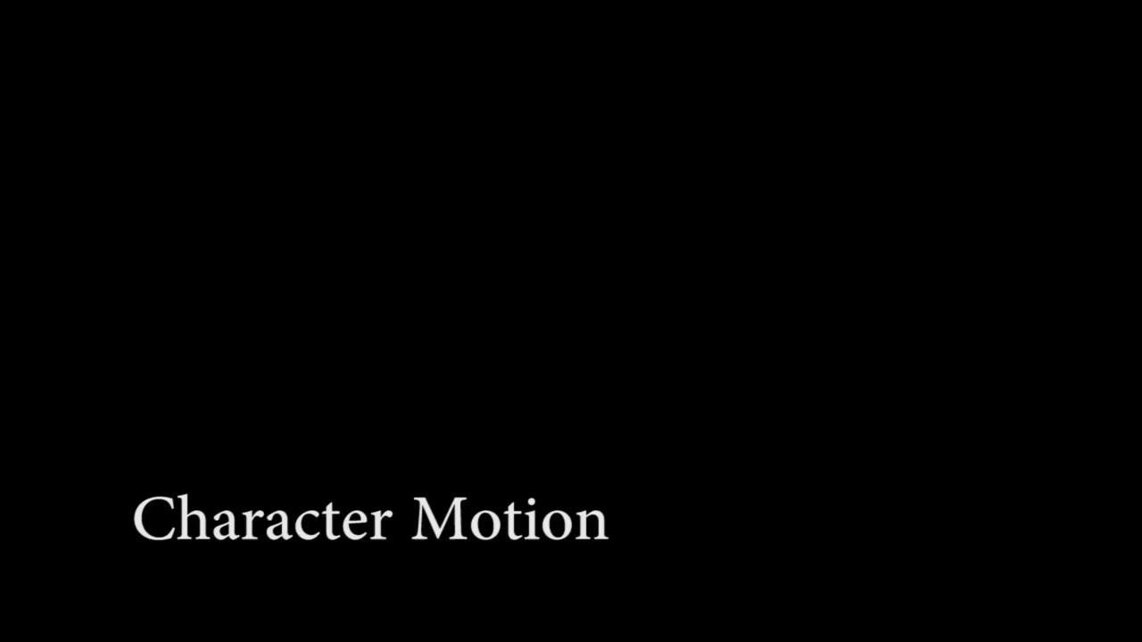
Notes:
This video shows a typical game camera and you can see how the motion blur enhances the characters movements. We have turned up the exposure time so it is more excessive that we normally have to better show the blurring. The game is rendering at 30fps

Slide 41
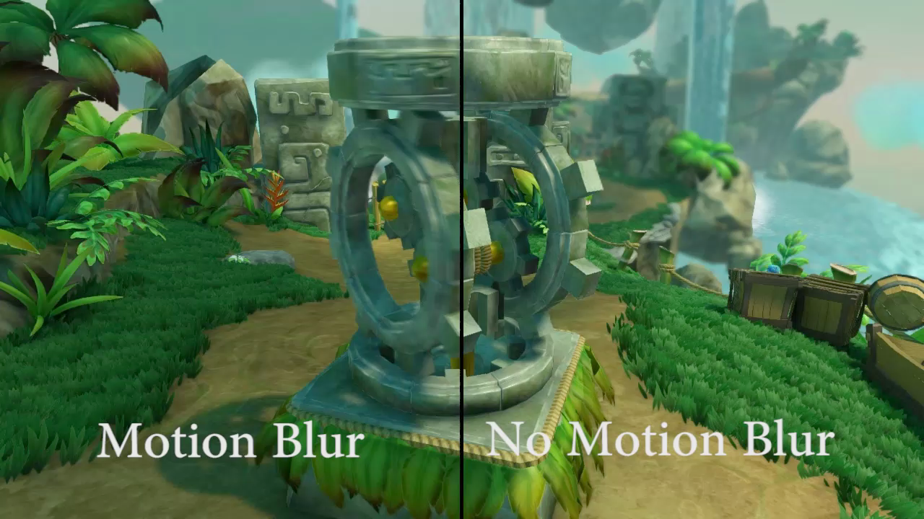
Notes:
This video is more of a comparison of with and without motion blur.
Notice the strobing on the right hand side as well as the perceived lower frame rate.

Slide 42
Agenda
Designing Scalable Algorithms
Examples
  Motion Blur
  Ambient Occlusion

Slide 43
Scalable Ambient Occlusion

Slide 44
Introduction
Greatly benefits lighting in shadow
Contact and crease shadowing
Notes:
AO is a pretty standard effect in rendering at this point. There has been some great work involved in approximating the ambient occlusion GI term. We wanted a solution that could move between platforms for visual consistency so we decided to throw our hat in the ring.

Slide 45
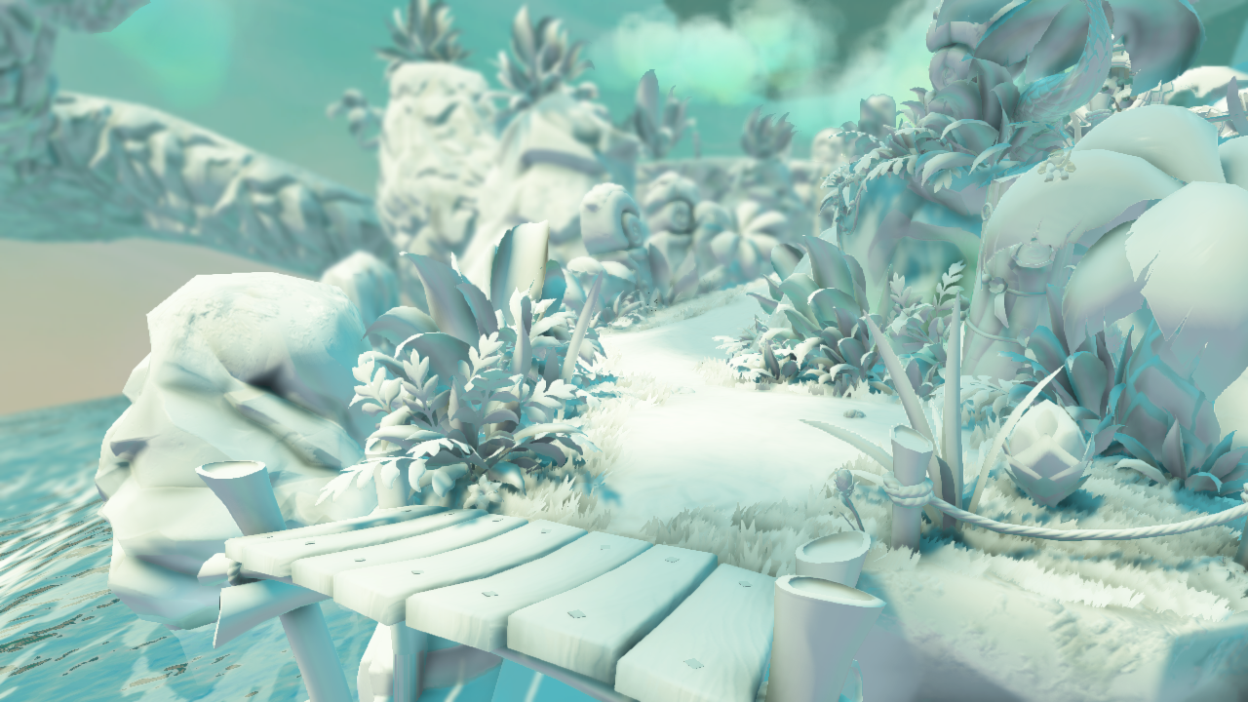
Notes:
Here is the kind of contribution for AO that we can achieve with the algorithm I’m about to present

Slide 46
Project Constraints
Fast
Surface aware
Reduce aliasing
Notes:
Our project constraints for this effect were pretty generic, it needed to be about as fast as our current VO implementation, we wanted it to be more surface aware, and we wanted to reduce aliasing as much as possible.

Slide 47
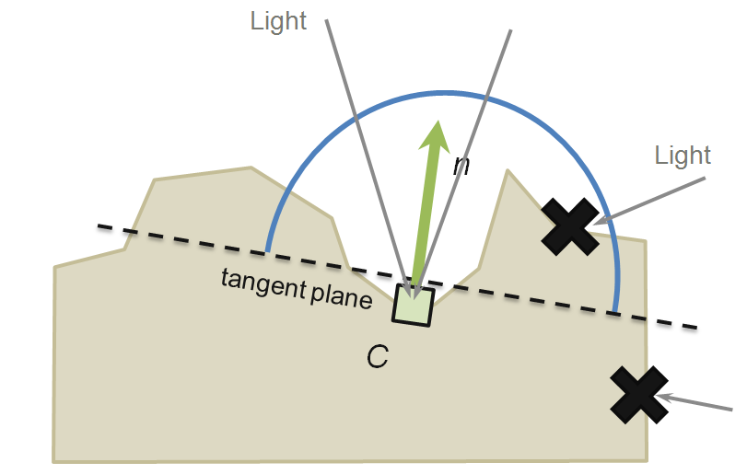
A closer look at AO
Notes:
So I’m sure you have probably seen a slide like this in the past but I’m going to quickly re-iterate the goal with AO.
We basically want to estimate the amount of ambient incoming light that is blocked by the complexity of the geometry.

Slide 48
Core problem
Didn’t want two different algorithms
Wanted visual consistency
Notes:
The core problems in this were much more localized to scalability than motion blur. We just wanted an algorithm that had visual consistency and we didn’t want to support and maintain two separate algorithms
.

Slide 49
Our Approach
Less but higher quality samples
Base contribution on two things:
  Distance of point to center
  Projected length of the sample distance onto the normal
Experiment with falloff function until we liked the results
Notes:
We decided that to keep up in terms of speed with our existing algorithm we would take less samples but make them higher quality
We would base the contributions on the normal of the surface being shaded to get better surface aware behavior
Finally we wanted to get it to a point where we could start manipulating the fall off function to get the exact look we wanted.

Slide 50
Walkthrough

Slide 51
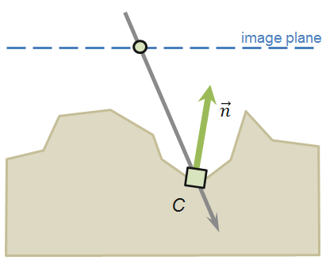
Center
Sample Depth and Normal
Reconstruct Position
Notes:
For the center sample we simply reconstruct the position and normal

Slide 52
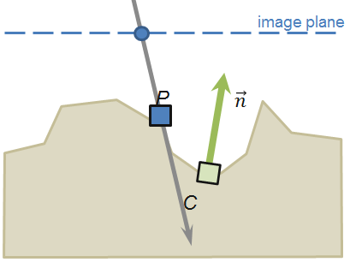
Sample Properties
Choose Sample Location
Sample Depth
Reconstruct Position
Notes:
When gather sample properties we chose to just reconstruct the position of the sample.

Slide 53
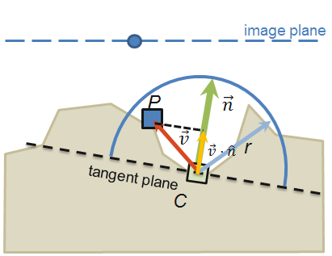
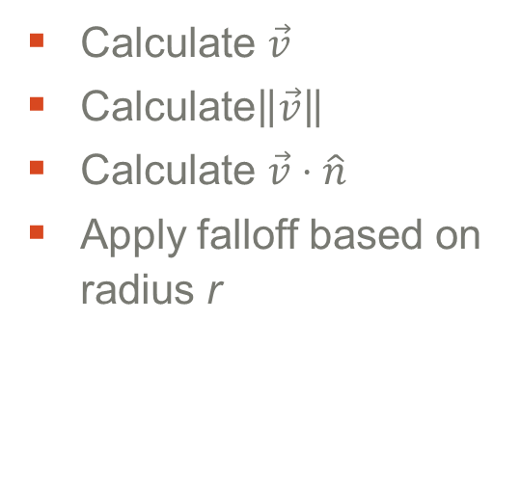
Sample Contribution
Calculate $\vec{v}$
Calculate$\left\|\vec{v}\right\|$
Calculate $\vec{v}⋅\hat{n}$
Apply falloff based on radius r
Notes:
We then calculate the vector between the center and sample points.
We gather information that we can apply in fall off functions by projecting the vector onto the surface normal and getting the length of the vector.

Slide 54
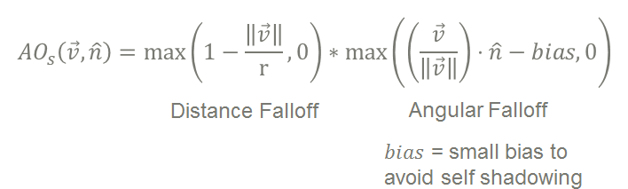
Falloff Function
We use
Try some of your own here!
*See Morgan et al. 12 for more falloff options
Notes:
The last part for the sample is figuring out the contributions of the various parameters. We experimented a lot with this phase and determined that we liked the following function the most.
The distance portion of it is simply a linear fall off
The angular portion is really just a dot product but before normalizing the vector we apply a small bias to avoid self shadowing
You can check out the follow up paper for more falloff options.
The important thing here is that you should try some of your own function here to get the exact look you are going for.

Slide 55
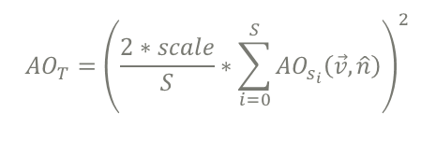

Total Occlusion
Sum Contributions and Normalize
$scale$ = Artist tuned contribution scale
$S$ = Number of samples
Notes:
The last step is to accumulate all the samples and introduce any artistic controls you want before normalizing the contribution.

Slide 56
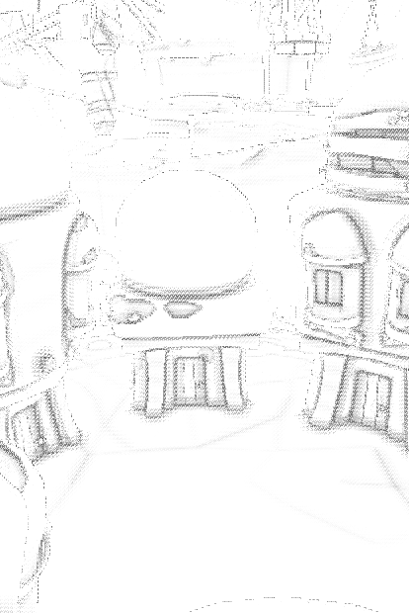
Normals
G-buffer if you got it
Derive from depth otherwise
  Some artifacts
Two different looks for the AO contribution
G-Buffer
Derived
Notes:
For the normals you have a couple options, the first is that you use g-buffer normals. Obviously this only works if you have a g-buffer, if you have a forward rendered engine then you might consider using derived normals from the depth buffer. You get some artifacts but they are lessened when you put the contributions through a blur.

Slide 57
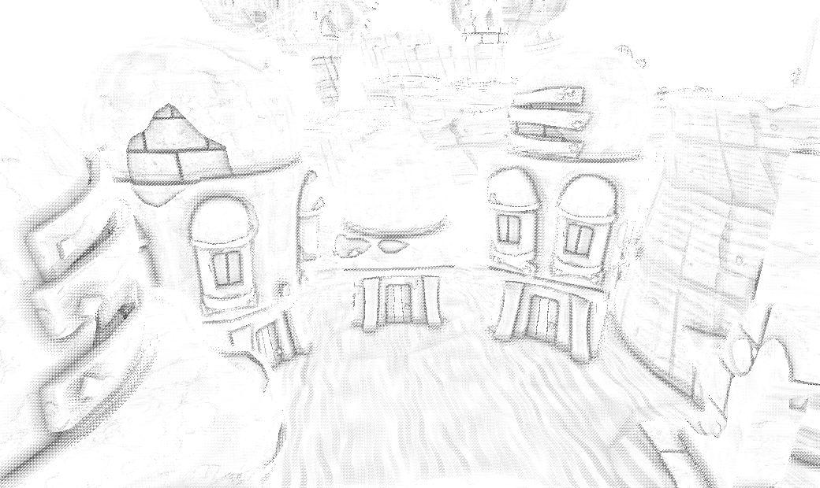
AO Contribution (G-Buffer Normals)

Slide 58
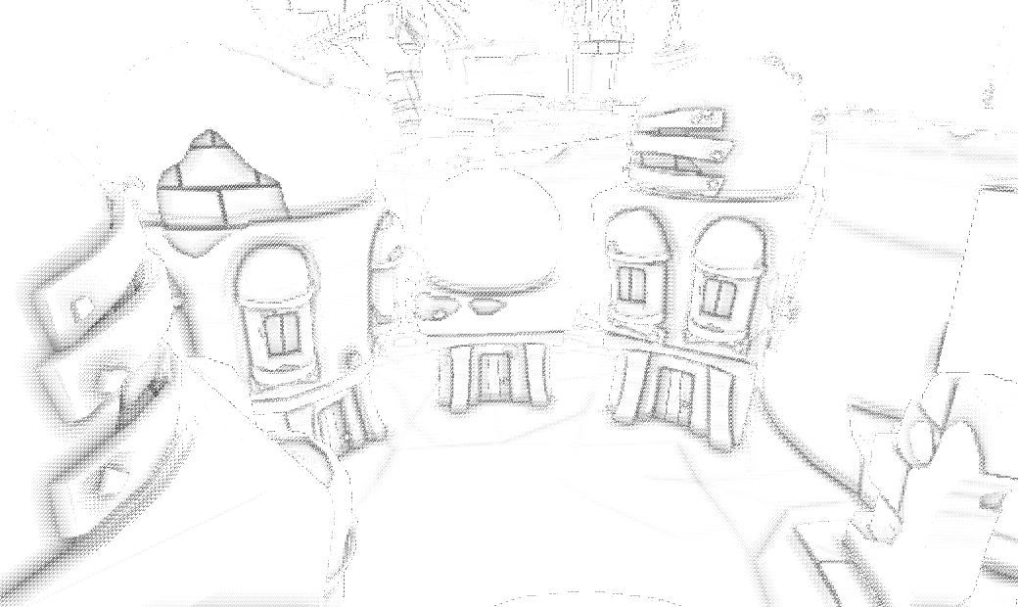
AO Contribution (Derived Normals)

Slide 59
Blur Results
Depth aware bilateral blur
Softens contribution
Wide filter to hide pattern
Combined with shadows to amortize cost
Notes:
To make the ao contribution silky smooth push it through a depth aware bilateral blur. You should make the filter fairly wide to avoid patterns. Even if you pack the depth in the same buffer as the AO you still have an extra channel so you should use it to soften some of your shadows.

Slide 60
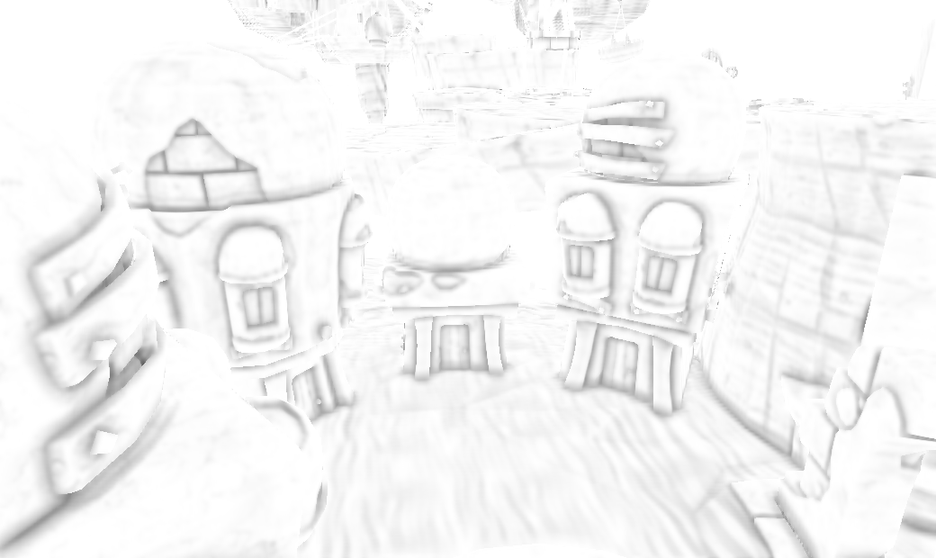
Final AO

Slide 61
Scalability and Implementation

Slide 62
Scale for Design
Increased radius
Change falloff functions
  Emphasize contact shadows
  Wider influence
Change application
  Modulate everything
  Modulate ambient
Notes:
The biggest one here is the fall off functions
Depending on your falloff functions you can favor contact shadows or larger influence and everything inbetween.

Slide 63
Scale for Quality
Increased radius
Increased sample count
Better sampling pattern
Wider blur
Notes:
Because we can apply the same fall off functions just on less samples to the different platforms the quality scalability is really good for this approach. Depending on how wide your blur is it might be more worth it to blur the results better.

Slide 64
Current Gen Implementation
4 taps at full resolution
Sample around a spiral
Rotate around random vector
Use mirrored taps
Clamp Radius to ~20 pixels
Transpose math to calculate all at once
Encode depth in blue/alpha for blur
Notes:
We get pretty great results using only 4 taps at full resolution, to make it fast we use mirrored taps and transpose all the math to compute the 4 samples all at once. Our final shader is about 56 instructions, very comparable with VO.

Slide 65
DX11 Implementation
9 Samples
Procedural spiral sampling pattern
  Introduces some noise
No radius clamp
Mip depth for unclamped radius
Encode depth in blue/alpha for blur
See Morgan et al. 2012 for more performance tips
Notes:
For dx11 we up the samples and sample patterns. We also employ the depth mip trick outline in Morgan et al. to effectively remove the screen space velocity constraint.

Slide 66
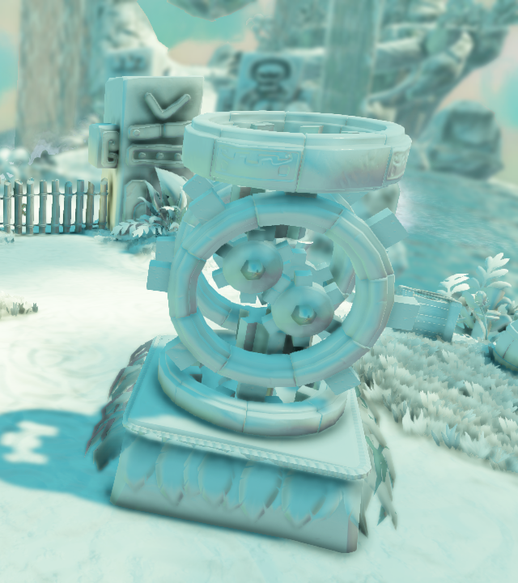
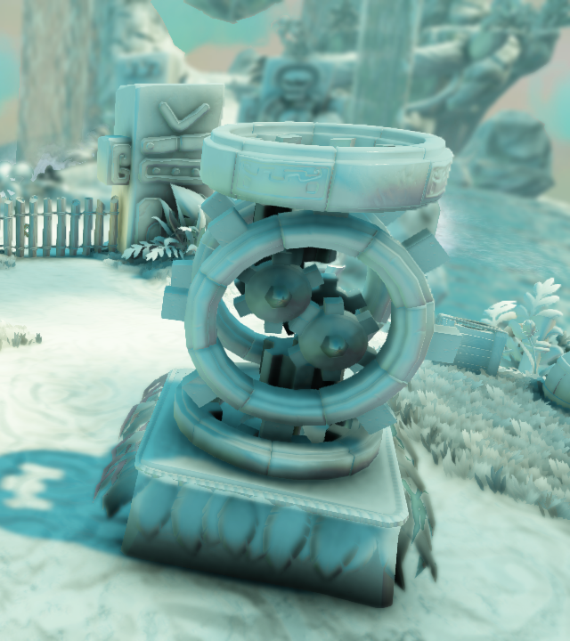
Clamped radius
Current Gen
DX11

Slide 67
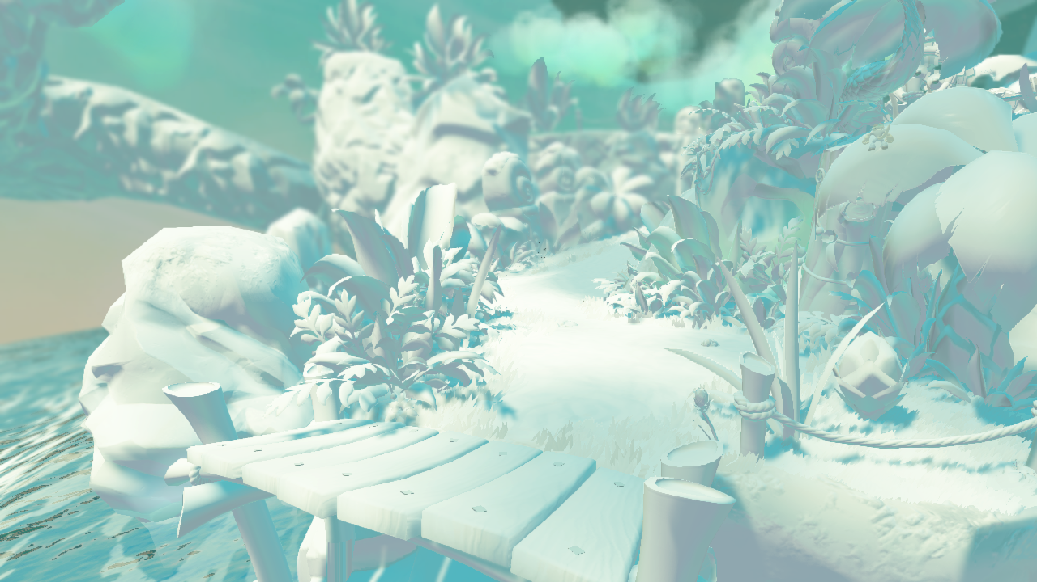

Slide 69
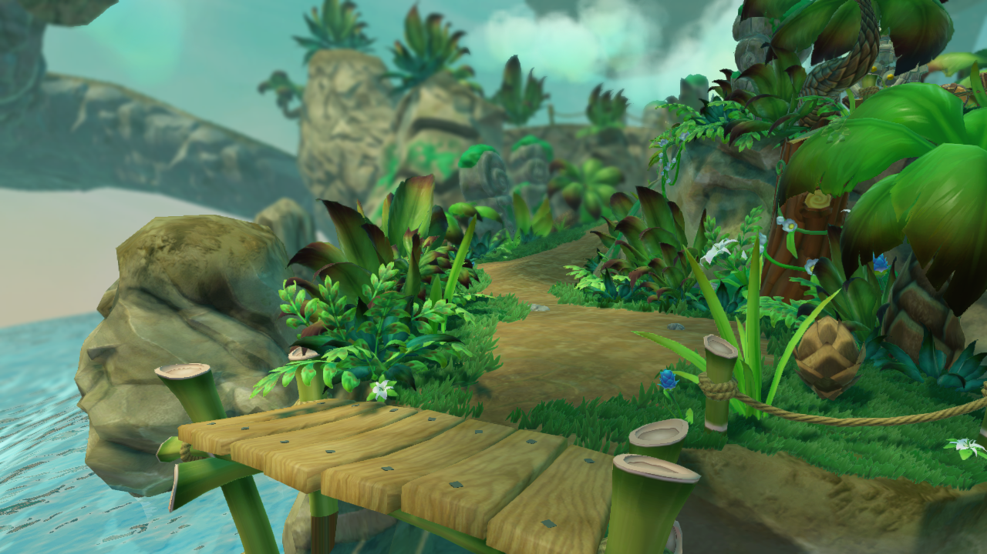

Slide 70
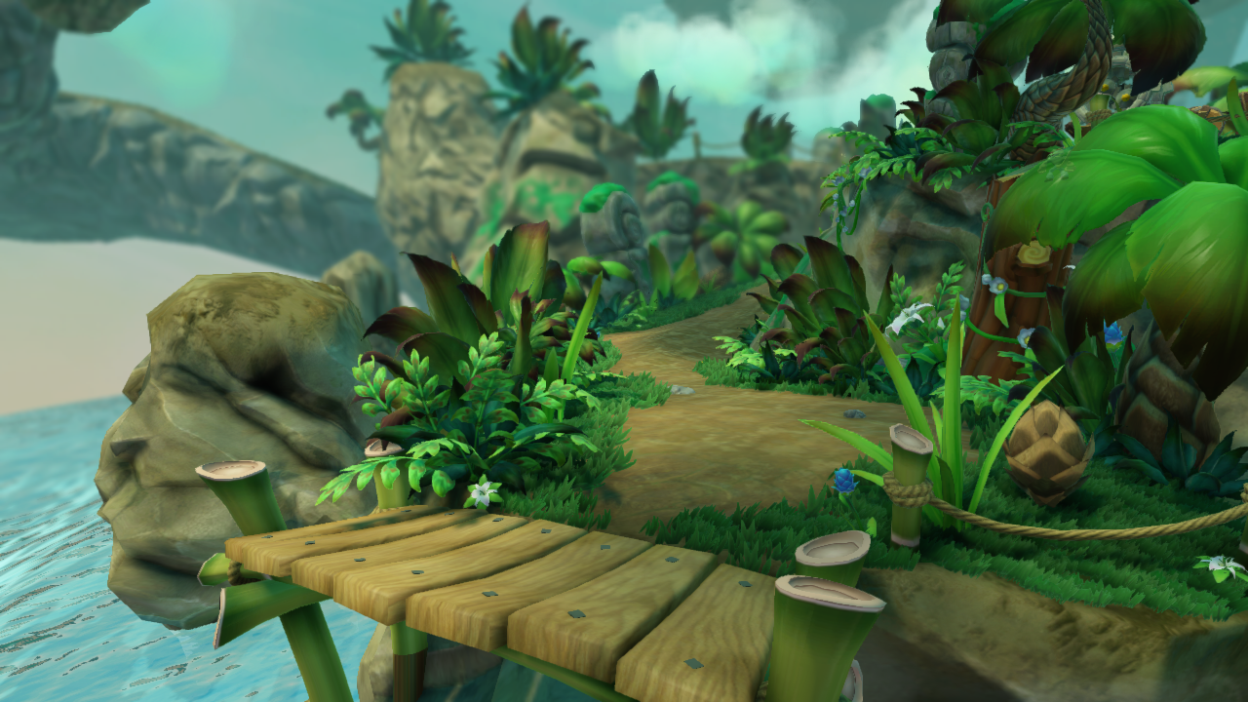

Slide 71
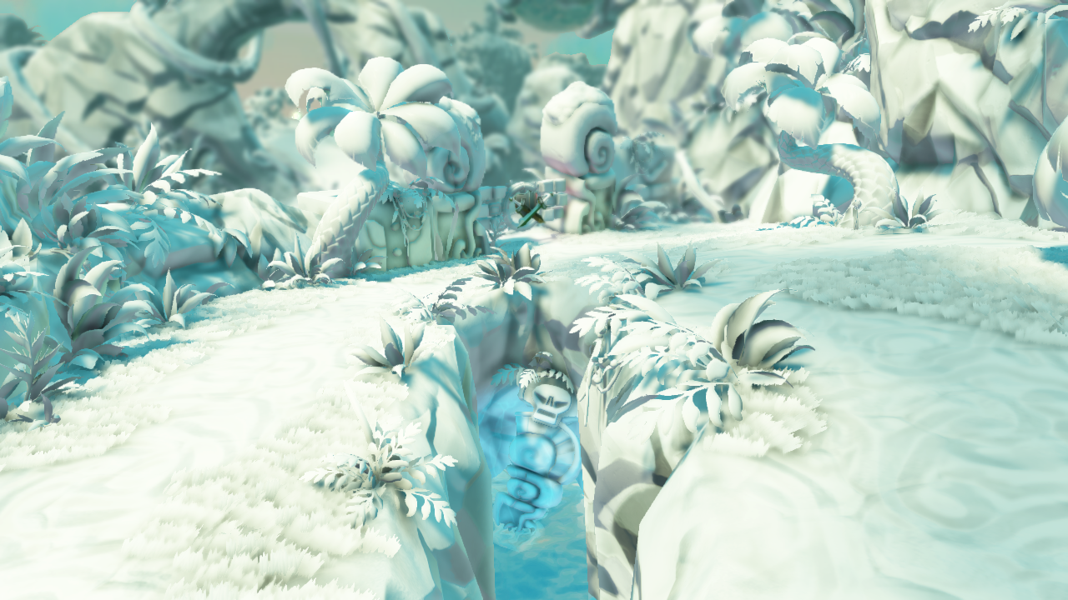

Slide 72
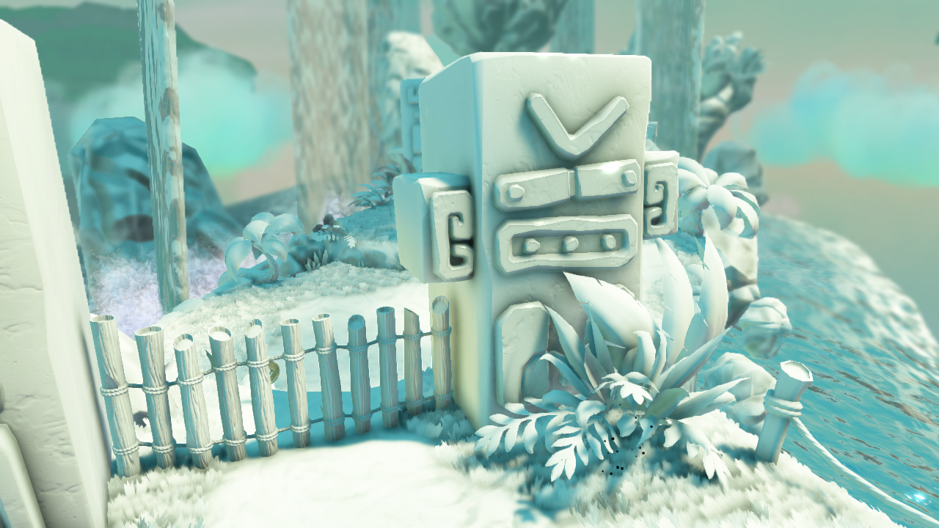

Slide 73
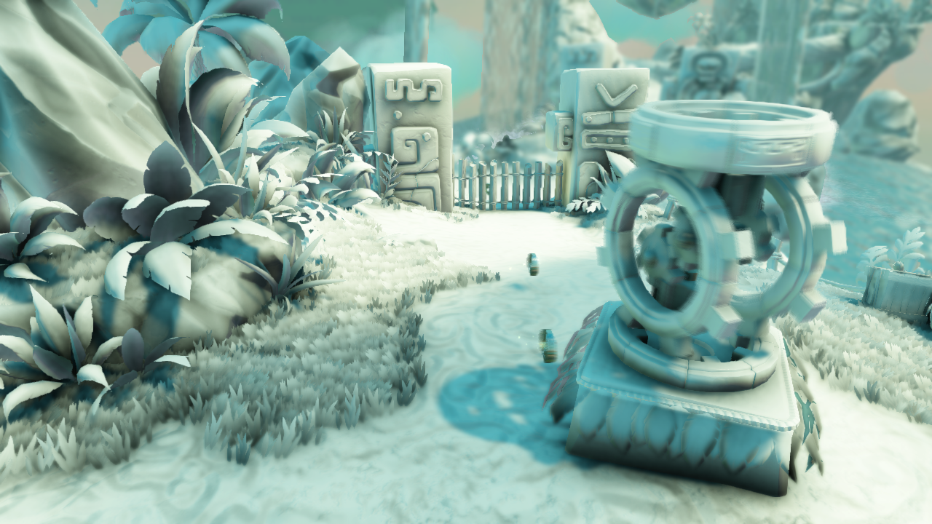

Slide 74
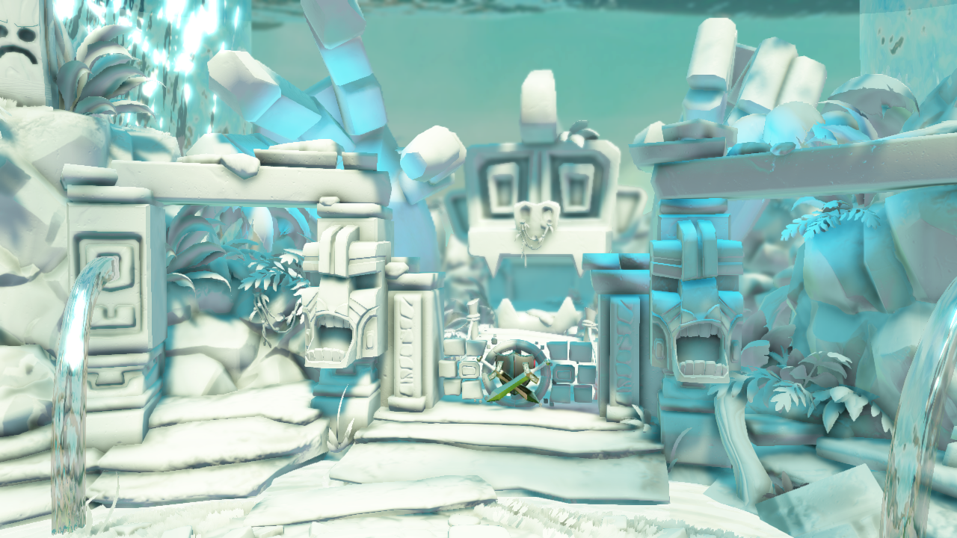

Slide 75
Agenda
Designing Scalable Algorithms
Examples
  Motion Blur
  Ambient Occlusion
Closing

Slide 76
Closing

Slide 77
Closing Remarks
Demonstrated power of scalability
Effects that bridge the gap between current gen and DX11
We have experienced excellent results with this approach

Slide 78
Thanks
Activision
HPG and I3D
Vicarious Visions
Michael Mara and David Luebke – Nvidia
Natalya “Natasha” Tatarchuk

Slide 79
References
Original Papers and Source:
http://www.vvisions.com/research/whitepapers.cfm
http://graphics.cs.williams.edu/papers/
Extension to original AO
http://graphics.cs.williams.edu/papers/SAOHPG12/

Slide 80
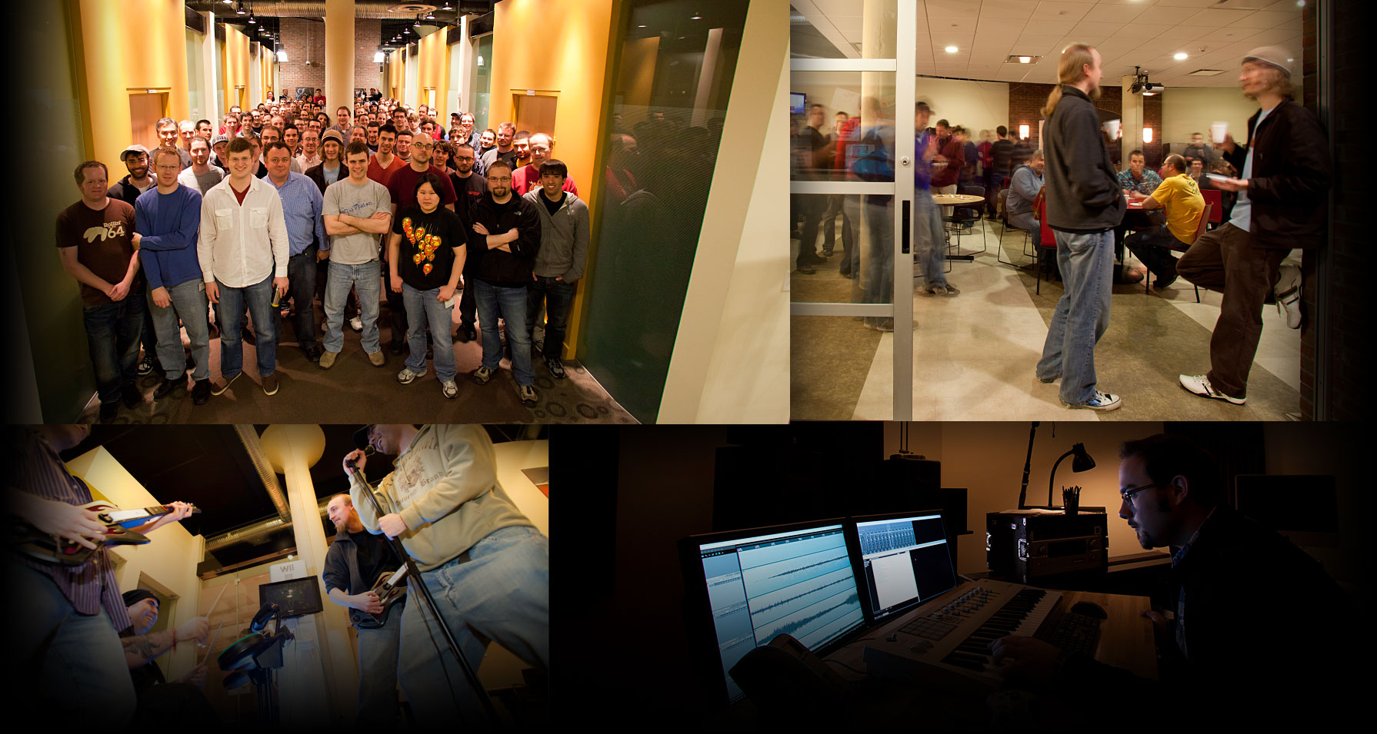

Join our team!
http://www.vvisions.com/work_for_us/

