Slide 2
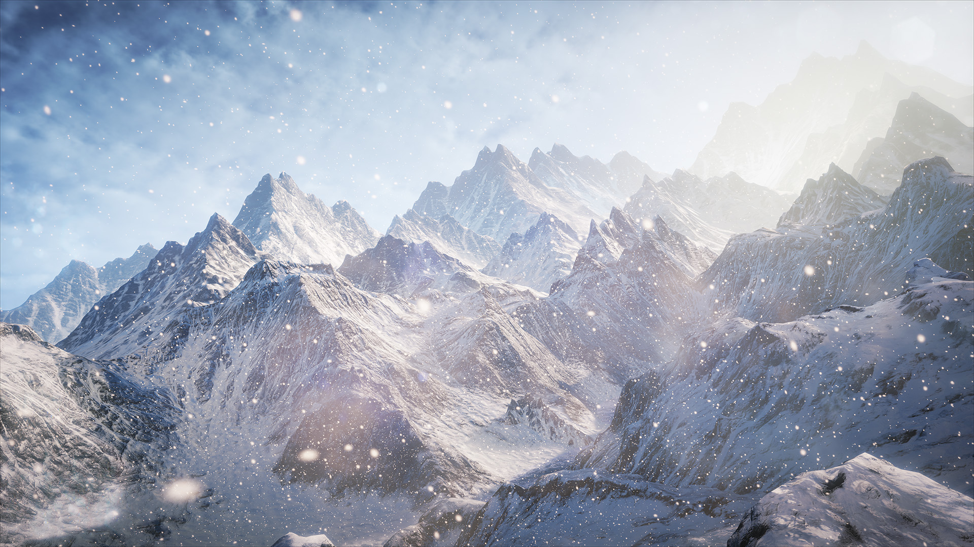
The Technology Behind the “Unreal Engine 4 Elemental demo”
Martin Mittring
Senior Graphics Architect
Martin.Mittring@EpicGames.com
Epic Games, Inc.
Advances in Real-Time Rendering in 3D Graphics and Games Course

Slide 3
Overview
Real-time Demo
Graphical Features
Indirect Lighting
Shading
Post Processing
Particles
Questions
Notes:
Cut from this presentation (for time reasons): Perlin noise, lava through skeletal mesh, FXAA, Upscaling, BokehDOF, Ambient Cube map, Deferred Decals, Bloom, Particle motion blur, BlurGBuffer

Slide 4
Elemental demo
GDC 2012 demo behind closed doors
Demonstrate and drive development of Unreal® Engine 4
NVIDIA® Kepler GK104 (GTX 680)
Direct3D® 11
No preprocessing
Real-time
30 fps
FXAA
1080p at 90%
Notes:
Kepler: NV680
No preprocessing: iteration time
All in editor: iteration time
3 Parts
Non interactive
Interactive
Editor (not shown)
Next: show demo

Slide 5
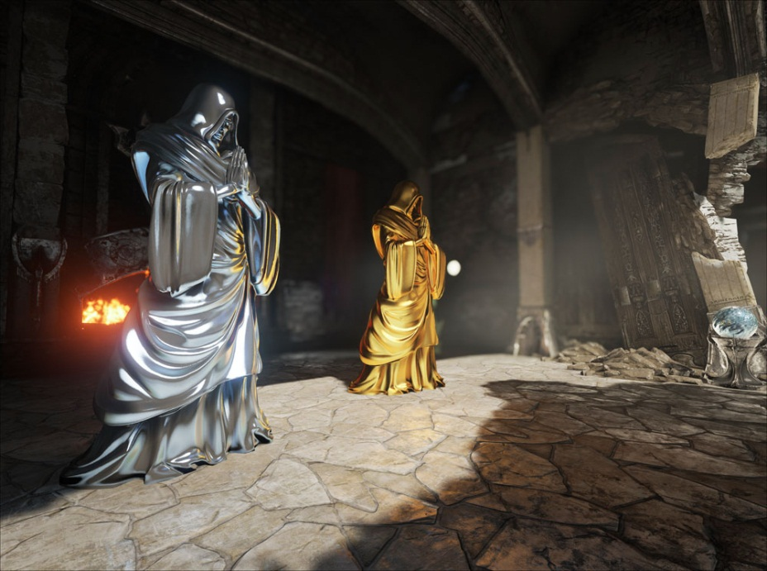
Real-Time Demo
Notes:
Show full non interactive part
Show 5min (until: I’ve been in the editor the whole time) of the interactive part
Interactive demo: showcase dynamic GI (floor reflection, moving objects)

Slide 6
Transition to Unreal Engine 4
Shrink
Removed rarely used features
Unify renderer interface using Direct3D 11 as guidance
Research
Samaritan demo (Direct3D 11, Deferred shading, Tessellation, …)
Elemental demo (Global Illumination, …)
Expand
Bigger changes (Derived Data cache, new Editor UI, …)
Notes:
It was time to make bigger changes
Derived Data cache: Asset compiling to platform specific binary file is stored in network cache, only the first user does the processing

Slide 7
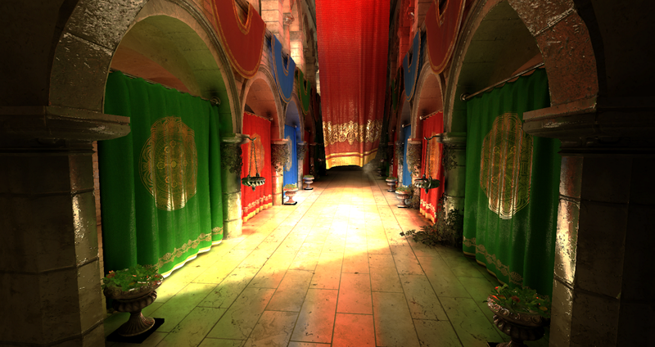
Working on Unreal Engine 4
This caught our attention:
More details:
Beyond Programmable Shading Course
Tuesday, 9 am - 12 pm
Interactive Indirect Illumination and Ambient Occlusion Using Voxel Cone Tracing [Crassin11]
Notes:
We searched for a general real-time GI solution
Cyril did amazing work on multiple voxel topics. This work seems more applicable for game development as low resolution voxel data has reasonable memory requirements.
For more details on Voxel Cone tracing please look at his work, here we stay high level in order to cover other areas as well.
Image provided courtesy of Cyril Crassin
A modified version of the Crytek Sponza model was used

Slide 8
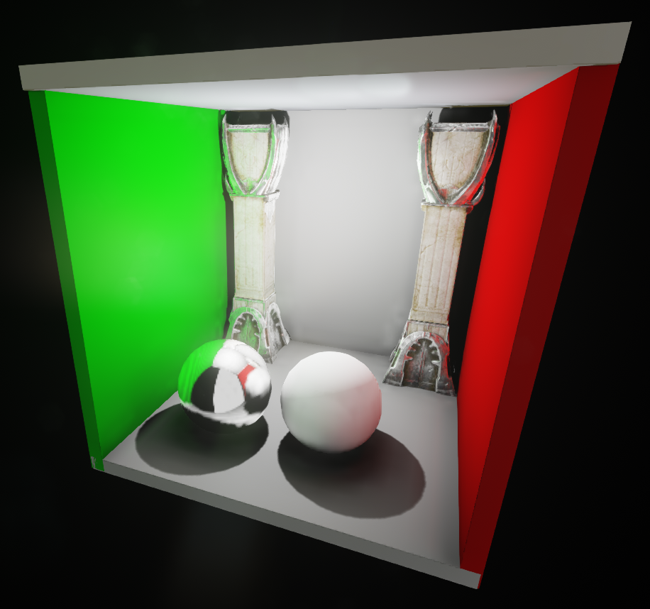
Indirect Lighting

Slide 9
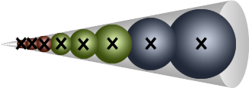
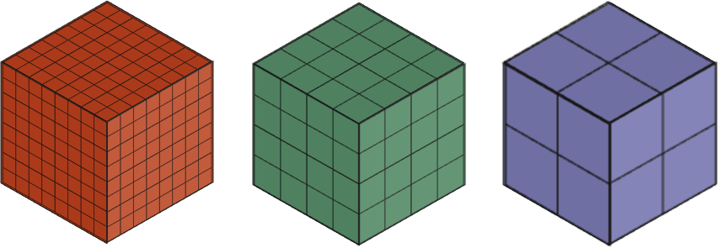
Voxel Cone Tracing Concept
Volume ray casting [Groeller05]
Start with some start bias
Content adaptive step size
Lookup radiance and occlusion
Accumulate light with occlusion
Stop if occluded or far enough
Cone trace
Mip level from local cone width
Progressively increasing step size
Cone
Voxel
Data
Notes:
Accumulate light with occlusion (=Shadows)

Slide 10
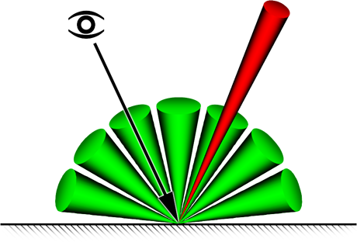
Using Voxel Cone Tracing for GI 1/2
Like “Ray-tracing into a simplified scene”
Diffuse GI:
Multiple directions depending on normal
Opening angle from cone count
Specular Reflections:
Direction from mirrored eye vector
Opening angle from Specular Power
Not as precise as ray-tracing but
Fractional geometry intersection
No noise
Level of detail

Slide 11
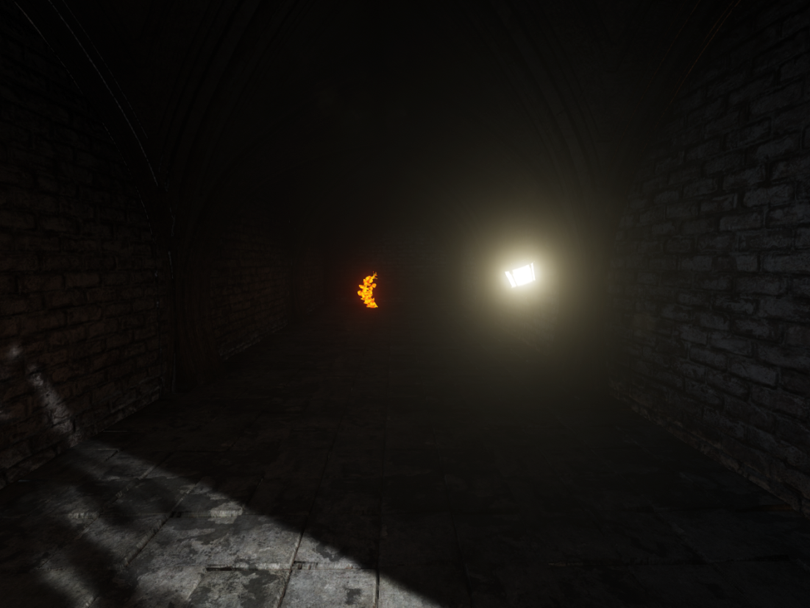
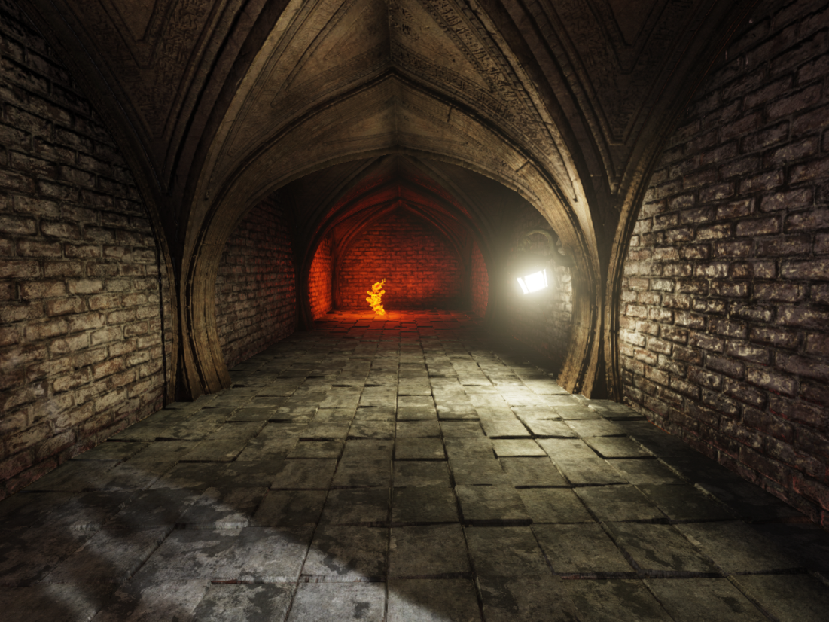
Using Voxel Cone Tracing for GI 2/2
[Crassin11] can be further optimized / approximated
Lower Voxel Resolution
Gather instead of scatter in Voxel Lighting pass
Adaptive sampling, sample reuse
Additional Benefits
Shadowed IBL
Shadowed area lights from emissive materials
VL disabled
VL enabled
Notes:
[Tabellion08]: Shrek2 was rendered with single bounce GI. It’s faster and allows for more artist control.
Gather instead of scatter in Voxel Lighting pass: We iterate through all leaf voxels nearby a light and gather light, [Crassin11] is scattering a large enough number of photons
Fractional geometry intersection vs binary for ray-casting
Area lights from emissive materials: at no extra cost
Blurry shadows: independent of light count and geometry

Slide 12
Voxel Cone Tracing Challenges
Stepping through thin walls
Wide cones show artifacts but narrow cones are slow
Mip maps need to be direction dependent
Creating voxel data from triangle meshes
Run-time memory management
Efficient implementation on GPU hardware
Sparse data structures
Notes:
Stepping through thin walls: voxel data is an approximation and point lookups does further approximation
Narrow cones are slow: we need more cones and traverse more data
Sparse data structures: to save memory and bandwidth
Creating voxel data from triangle meshes: doing that at run-time makes it just harder as it needs to be fast
Sparse data structures: Volume texture would work but memory requirements would make it impractical even for normal sized levels.

Slide 13
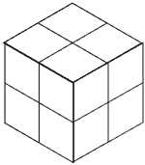
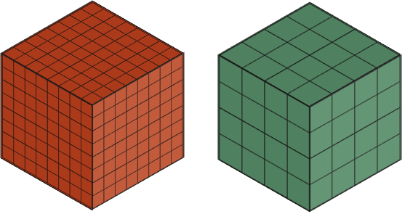
Sparse Voxel Octree
Mapping function allows locally higher resolution
World 3D position <=> Index and local 3D position
Fully maintained on GPU
Index to access render stage specific data
Per node/leaf data
2x2x2 voxel data (placed at octree node corners)
6x 3x3x3 voxel data (like 2x2x2 with additional border)
Notes:
Optimized tree traversal through redundancy
Non sparse 3D grid to skip top levels of the tree

Slide 14
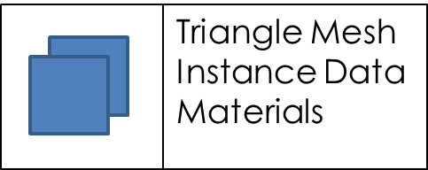
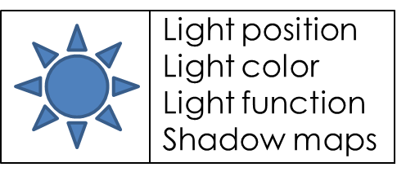
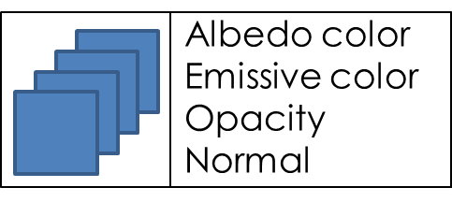
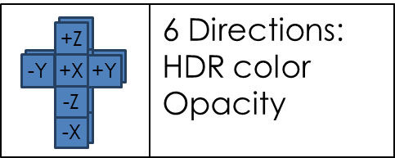
Voxel Lighting Pipeline
Voxelization
Lighting
Filter and Finalize
Voxel
Space
Diffuse
Sampling
Specular
Sampling
on demand
each frame
Screen
Space
Notes:
Voxelization: After level load for all static regions, dynamic objects whenver they move
Lighting: accumulate light and shade
Filtering: Create directionally dependent voxels and mips
Finalize: Create redundant data and copy to volume texture

Slide 15
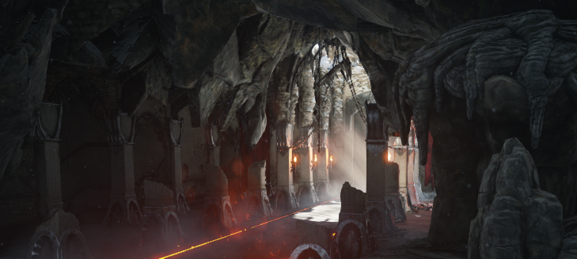
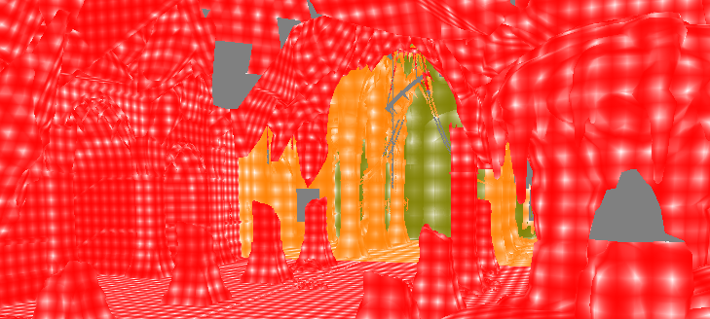
Voxelization 1/2
Create voxel geometry data in a Region
Input: Octree, Triangle Mesh, Instance Data, Materials, Region
Output: Octree, 2x2x2 material attributes, normal
Region revoxelization
Geometry changes
Material changes
Resolution changes
Optimized for few dynamic objects
Revoxelize on demand
Region keeps static voxel data separate
3D Scene
Voxel resolution as color
Notes:
Geometry changes (e.g. bone animation, level load)
Material changes (e.g. animated material)
Resolution changes (e.g. viewer gets closer to the region, can be controlled by designer)
Colors: grey: no voxel data, red: high, yellow: medium, green: low

Slide 16
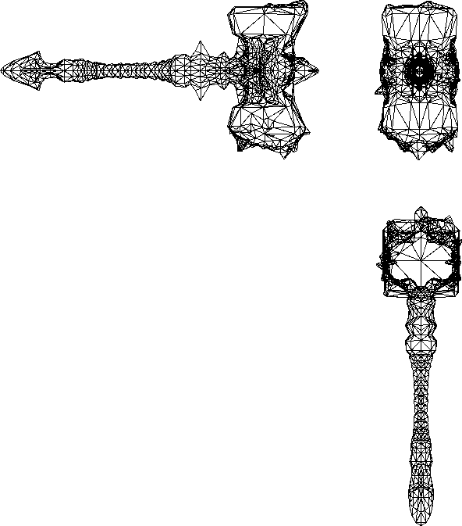
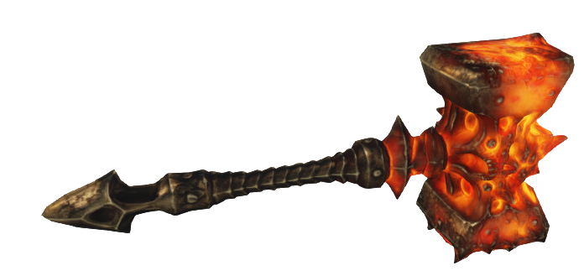
Voxelization 2/2
Pixel shader pass using hardware rasterizer
One rasterization pass per axis (X, Y, Z) to avoid holes
Shader evaluates artist defined material
Output: fragment queue that is processed by following CS
Compute Shader pass
Update octree data structures (in parallel)
Stores voxel data in leaves
2 Pass method
Better occupancy for second pass (2x2 quad)
Shader compile time (reuse CS)
Notes:
Quite fast but
Aliasing especially with animated content
Large updates can be costly

Slide 17
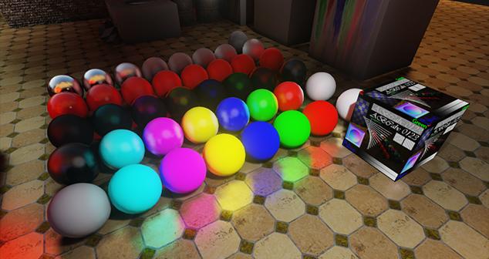
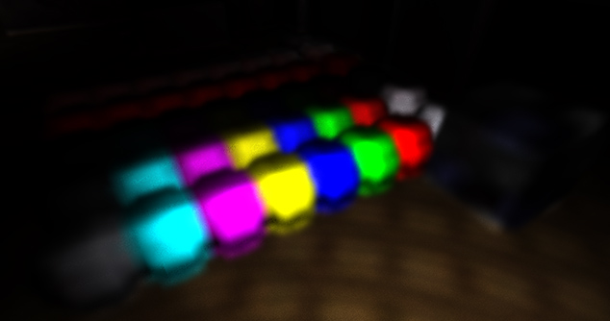
Voxel Lighting
Compute shading and store Radiance
Input: 2x2x2 material attributes, normal
Output: 2x2x2 HDR color and opacity
Accumulate Irradiance and Shade
Add direct light with shadow maps
Add ambient color
Combine with albedo color
Add emissive color
3D Scene
Voxel Lighting Data

Slide 18
Filter Voxels and Finalize
Generate mip-maps, Create redundant border, Compress
Input: 2x2x2 HDR color, occlusion and normal
Output: HDR multiplier, 6 x 3x3x3 LDR color and occlusion
Generate directionally dependent voxel
See view dependent voxels in [Gobbetti05]
At leaf level from voxel normal
At node level from same direction only
Directionally independent
Directionally dependent
Notes:
Generate mip-maps: Generate node data from leaves
[Gobbetti05] is introducing view dependent voxels, here we talk about directionally dependent as we care here about the cone direction
Directionally dependent voxel data required for quality: this is especially true for the lower resolution mips where walls become single voxels
6x because of the 6 directions (a 3d voxel has 3 axis and each has positive and negative direction)

Slide 19
The Cone Trace function
Traverse tree to find node index and node local position
3 tri-linear filtered lookups in 32 bit volume texture to get 3 directions
Weight results based on direction (Ambient Cube [McTaggart04])
Calls SVOLookup() many times
Get all lighting coming from the given direction in a cone
float4 HDRColorAndOcclusion = SVOLookupLevel (float3 Pos, int Mip, float3 Direction)
float4 HDRColorAndOcclusion = SVOConeTrace (float3 Pos, float3 Direction, float ConeAngle)
Notes:
Finally we can build the function that can be used for the Cone Trace

Slide 20
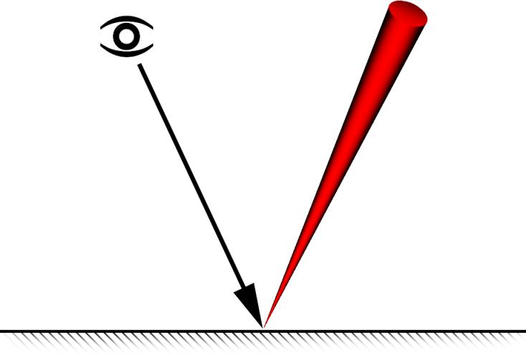
Specular Sampling 1/2
Specular
Per pixel local reflections
Cone angle from Specular Power
Single cone usually sufficient
Complex BRDF possible
Adaptive for better performance
Specular brightness
Depth difference
Normal difference
Half Res
Up-sample in X
Refinement Point Queue
Scatter Specular
Up-sample in Y
Refinement Point Queue
Scatter Specular
Full Res
Notes:
Sampling, first specular as it’s simpler
Single usually sufficient: very low Specular Power has issues
Not adaptive on Output: voxel data usually too low resolution)
Complex BRDF possible: Weights, adjust the cone direction and opening angle, multiple cones
Specular brightness: reject non specular

Slide 21
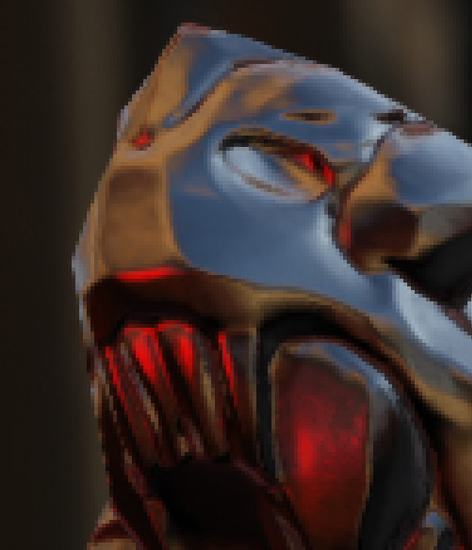
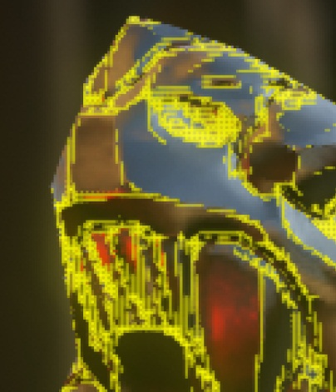
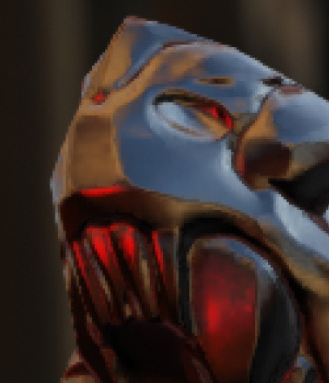
Specular Sampling 2/2
Reference
Half Res
Refinement Point Queue
Adaptive Result
Up-sample pass using Dispatch()
Scatter passes use DispatchIndirect()
uint Pos = 0;
InterlockedAdd(State[STATE_Count], 1, Pos);
InterlockedMax(State[STATE_ThreadGroupCountX], (Pos+63)/64); // saves one pass
RWScratchColors[Pos] = (ThreadId.y << 16) | ThreadId.x;
Notes:
Dispatch() is one method to invoke a compute shader, ThreadGroupCount comes from CPU
DispatchIndirect() is another method where the thread group count can come from the GPU itself
DispatchIndirect is using STATE_ThreadGroupCountX to run a total of STATE_ThreadGroupCountX *64 threads, real amount is limited by STATE_Count, it processes all units in RWScratchColors[]
Next slide: a bit more complex is the diffuse sampling

Slide 22
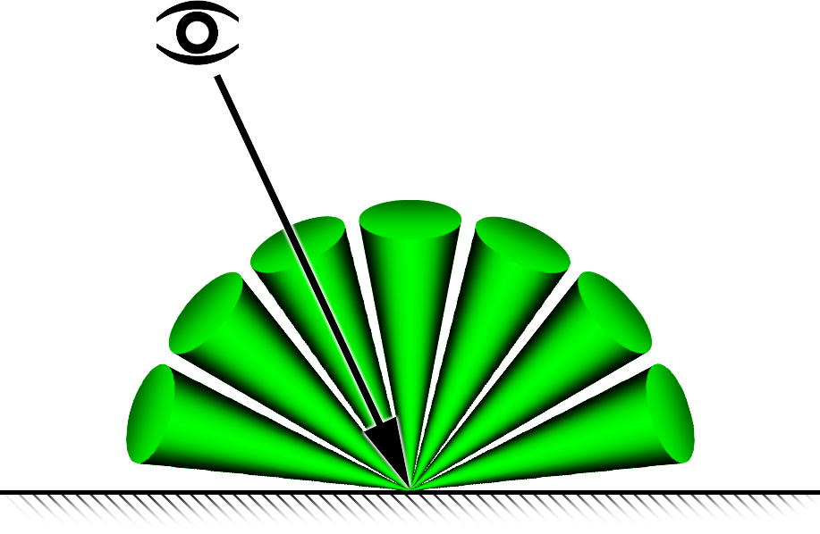
Diffuse Sampling 1/2
Similar to Final Gathering [Jensen02]
Problem:
Few samples for good performance
Enough samples for quality (cone angle)
Well distributed over hemisphere to reduce error
Don’t want noise
Don’t want to blur over normal details
Diffuse is mostly low frequency
Coherency important for efficiency
Notes:
Genetic Algorithm to create good sample sets
Tried reprojection with 2 sample sets
~4.5 cones per pixel

Slide 23
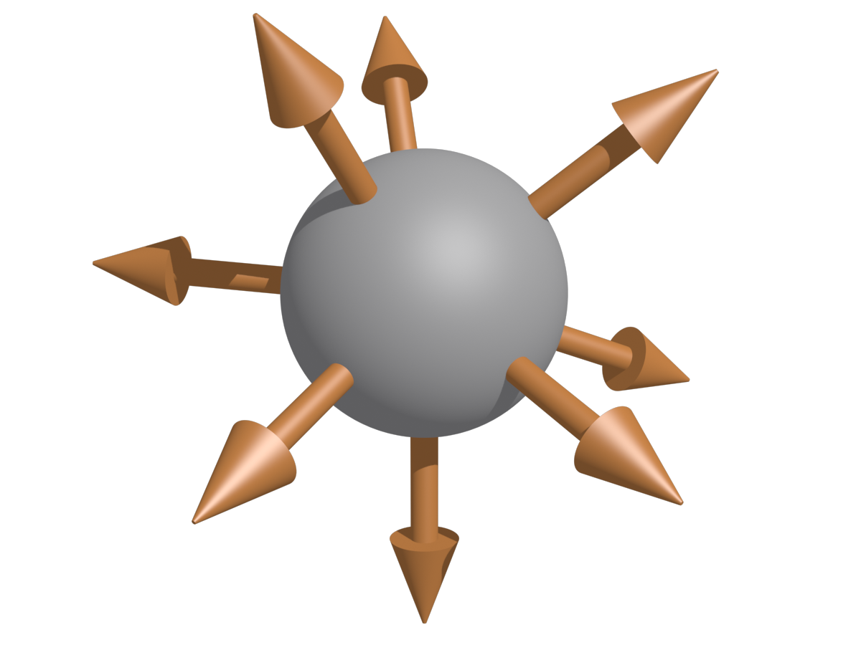
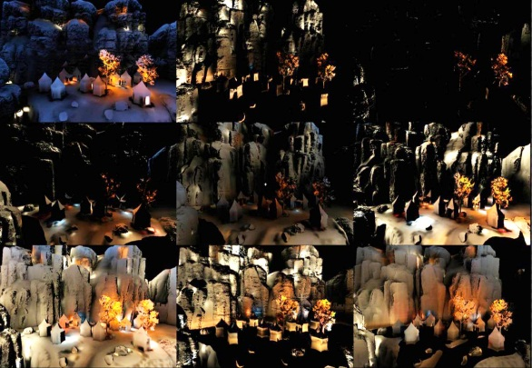
Diffuse Sampling 2/2
Non-interleaved processing of interleaved 3x3 pattern [Segovia06]
9 well distributed cones in world space
Loop over 9 directions, then XY
Reject samples behind surface normal
Output non interleaved
Compositing Pass:
Recombine non interleaved sub images
Weight by normal and depth
5x5 filter to account for missing samples
Multiply with Albedo color
……….
5 | 6 | 4 | 5 | 6 | 4
8 | 9 | 7 | 8 | 9 | 7
2 | 3 | 1 | 2 | 3 | 1
5 | 6 | 4 | 5 | 6 | 4
8 | 9 | 7 | 8 | 9 | 7
2 | 3 | 1 | 2 | 3 | 1
……….
……….
……….
Interleaved
Samples on Sphere
1 | 2 | 3
4 | 5 | 6
7 | 8 | 9
Non Interleaved
Notes:
[Segovia06] Non-interleaved Deferred Shading of Interleaved Sample Patterns
Diffuse is mostly low frequency
Reuse for neighbors with similar normal / position
First explained with interleaved processing, for better coherency we first loop over directions then XY and output non interleaved
Reject samples behind surface normal -> (~ 0.5 cone trace per pixel)
Genetic Algorithm to create good sample sets
Tried reprojection with 2 sample sets
~4.5 cones per pixel
Result is per pixel normal affected

Slide 24
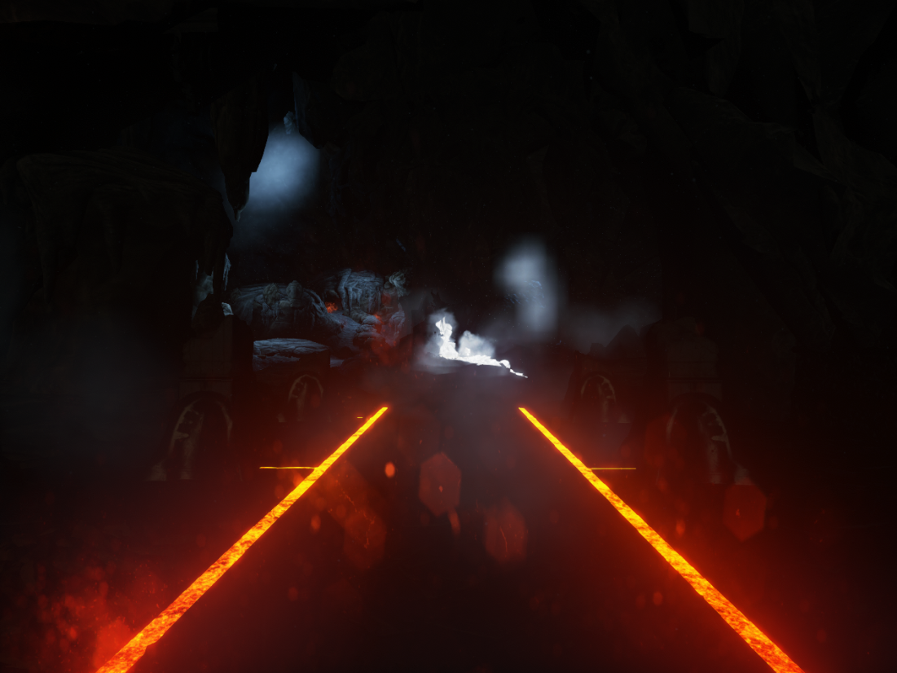
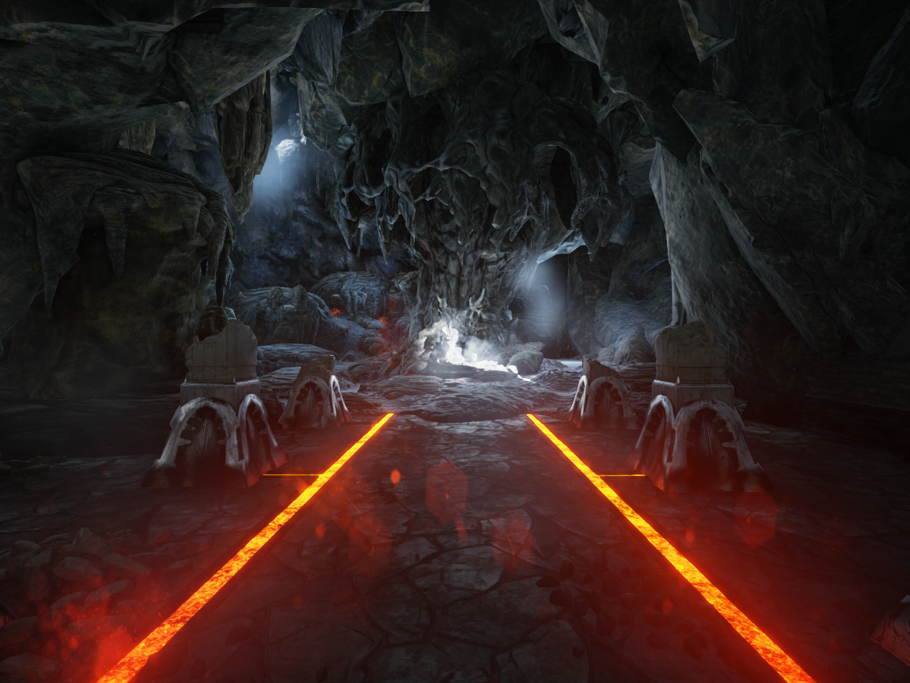
Voxel Lighting Examples 1/3
disabled
enabled

Slide 25
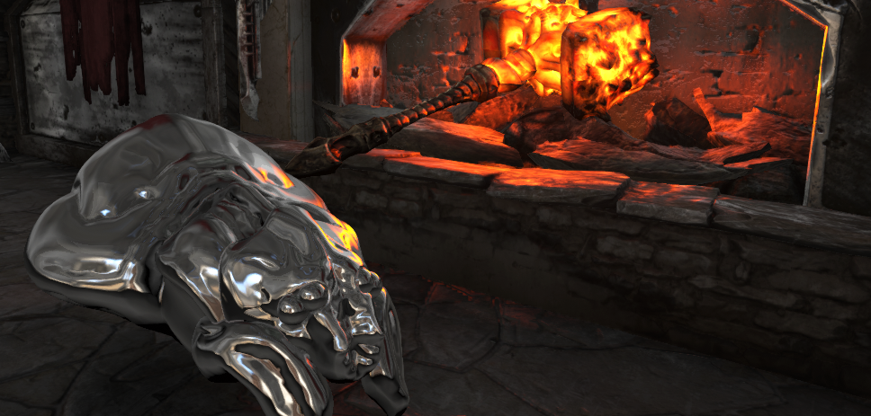
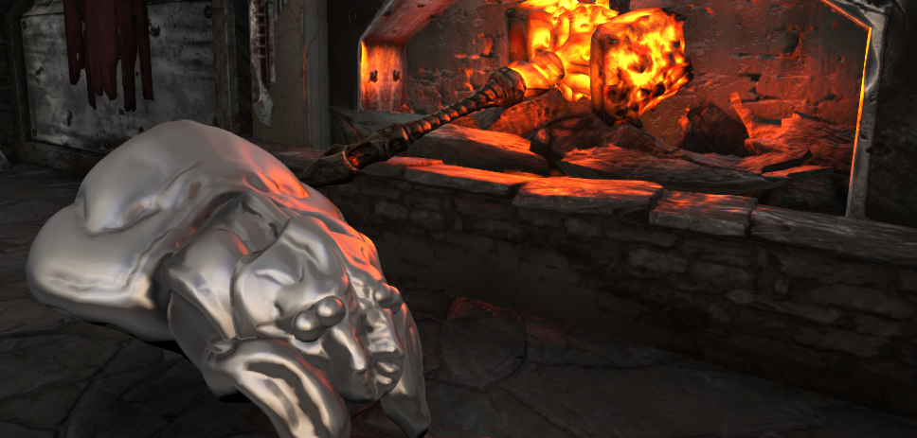
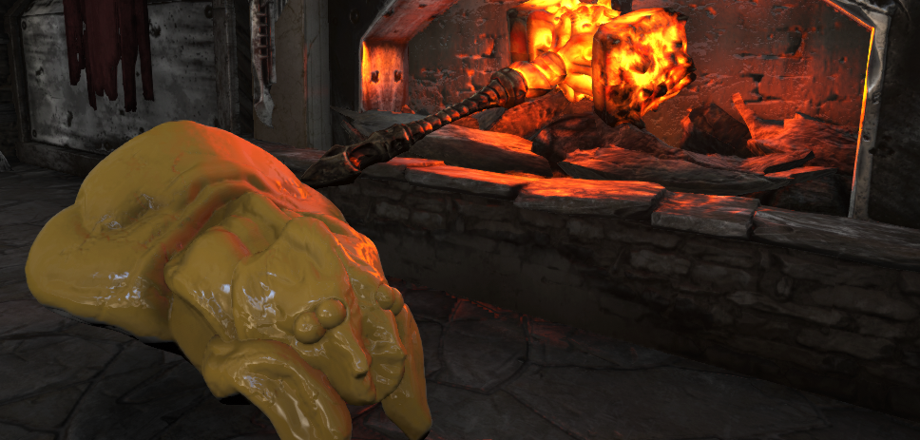
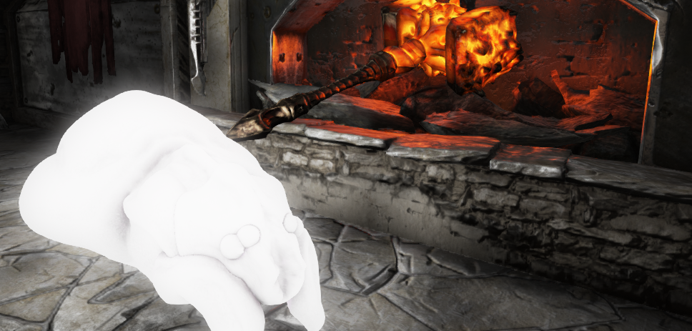
Voxel Lighting Examples 2/3
Notes:
The object is a magnified spider head
Different materials are shown. Notice the emissive material brightens up the environment
Removing the hammer actually also removes the yellow lighting

Slide 26
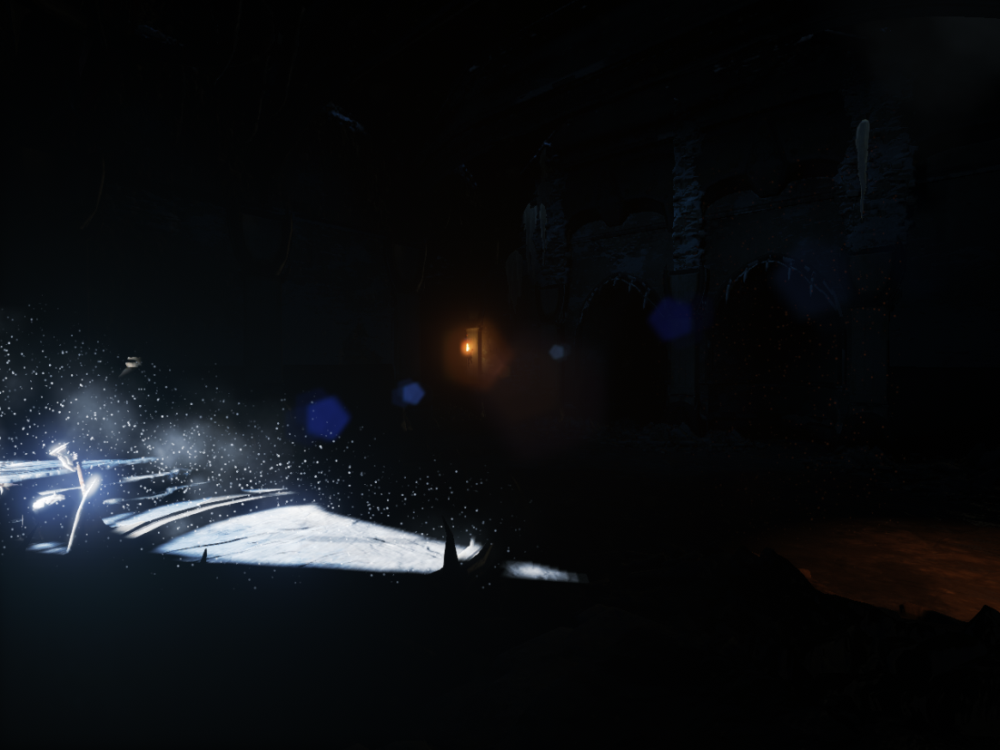
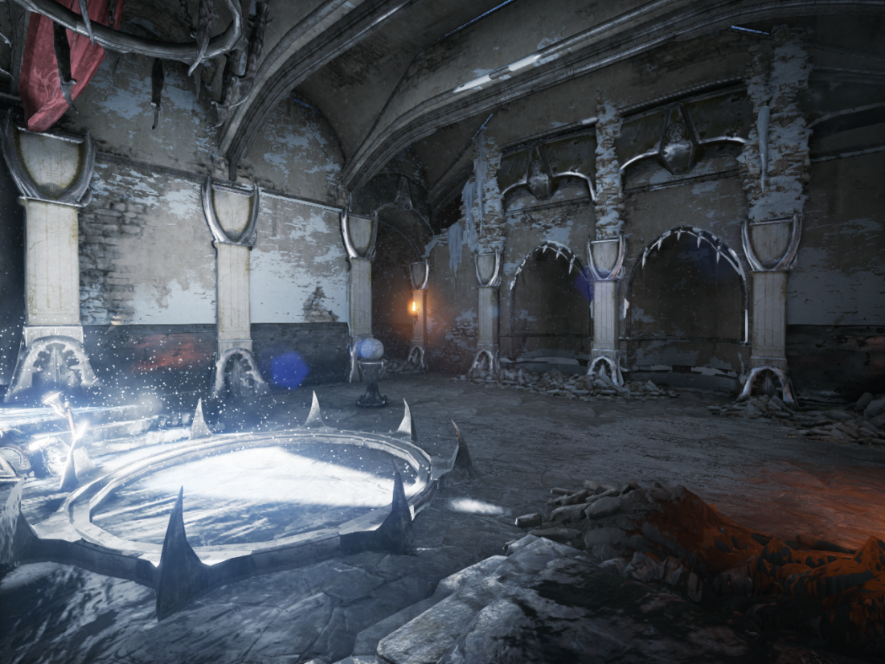
Voxel Lighting Examples 3/3
disabled
enabled

Slide 27
Shading

Slide 28
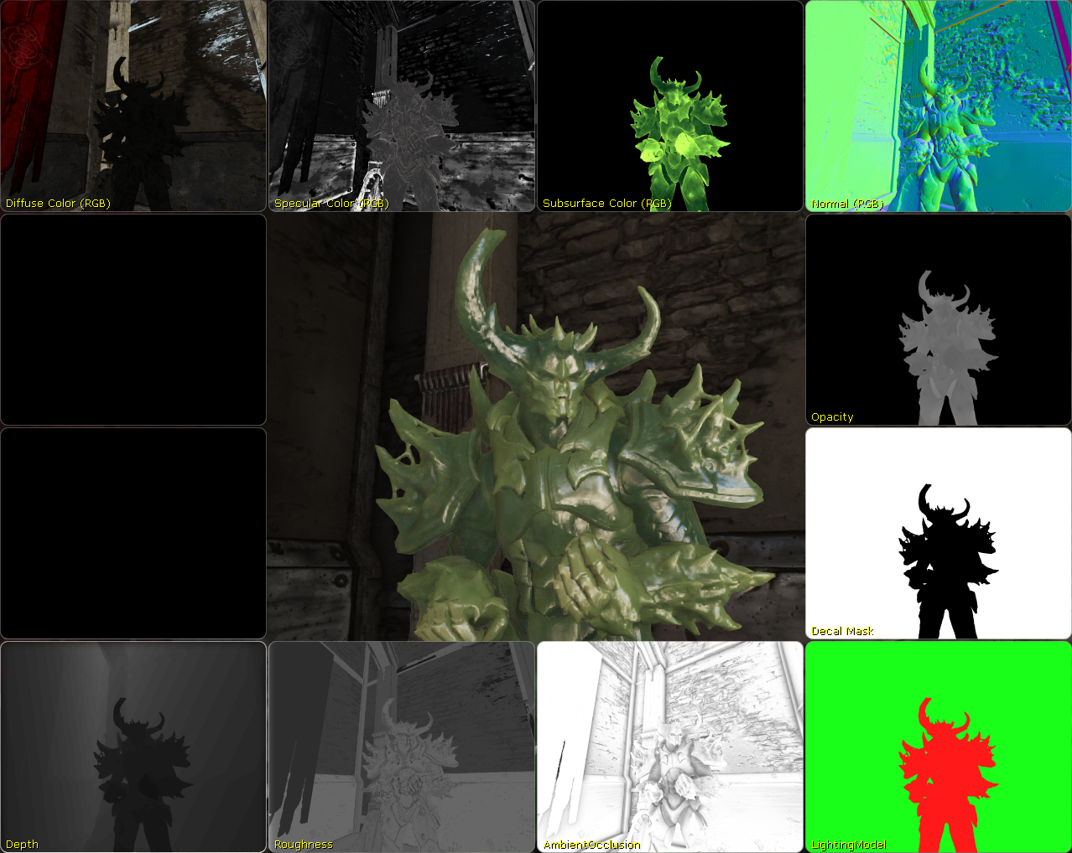

Slide 29
Deferred Shading
Classic deferred shading in PS (one forward pass)
Name | Format | Usage
Depth | D24 | Depth
Stencil | S8 | Stencil masking
SceneColor | R16G16B16A16f | RGB: Emissive and Light Accumulation
GBufferA | R10G10B10A2 | RGB: WS Normal, A: Lighting Model
GBufferB | R8G8B8A8 | RGB: Specular, A: Ambient Occlusion
GBufferC | R8G8B8A8 | RGB: Diffuse, A:Opacity or Decal Mask
GBufferD | R8G8B8A8 | R: Specular Power*, GBA: Subsurface Color
* not in alpha channel because of frame buffer blending limitations

Slide 30
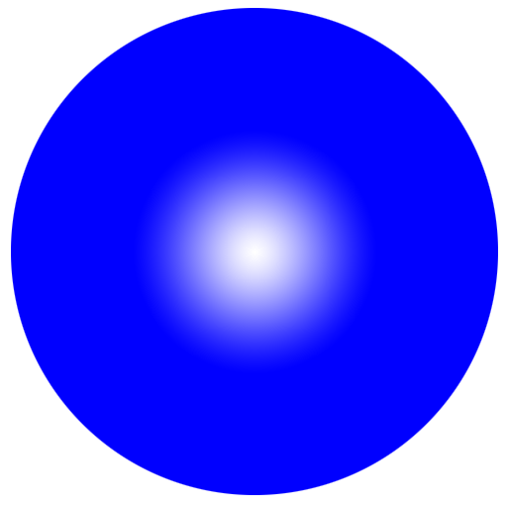
New Specular Power Encoding
Higher Specular Power for IBL
More definition for common values
Tweaked to give pixel sharp reflection on a far sphere of width 1000 pixel
1.0
OldEncode(x): sqrt(x / 500)
OldDecode(x): x * x * 500
Old
0.0
1.0
NewEncode(x): (log2(Value) + 1) / 19
NewDecode(x): exp2(Value * 19 - 1)
New
0.0
Notes:
Human friendly mapping (texture, slider, shader graph)

Slide 31
Gaussian Specular
Gaussian Specular for less aliasing [McKesson12]
Our empirical approximation
Dot = saturate(dot(N, H))
Threshold = 0.04
CosAngle = pow(Threshold, 1 / BlinnPhongSpecularPower)
NormAngle = (Dot - 1) / (CosAngle – 1)
LightSpecular = exp(- NormAngle * NormAngle) * Lambert
Phong
Gaussian
Notes:
Gaussian Specular: less specular aliasing with very hard surfaces

Slide 32
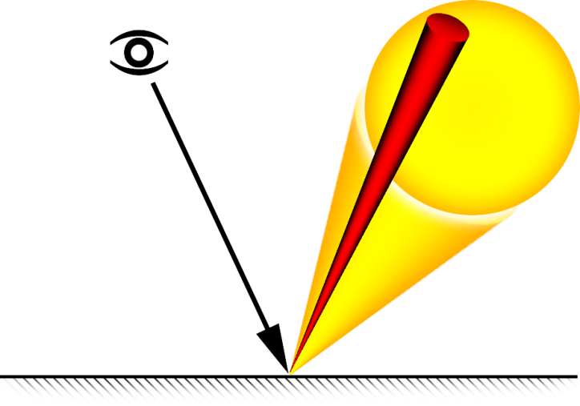
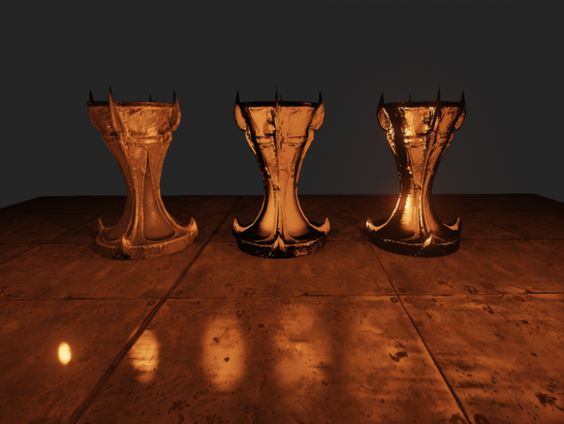
Area Light Specular
Soft Sphere Area Light
Energy conserving (approximation)
LightAreaAngle = atan(AreaLightFraction / LightDistance)
ACos = acos(CosAngle)
CosAngle = cos(ACos + LightAreaAngle)
different radii
SpecularLighting /= pow(ACos + LightAreaAngle, 2) * 10
Notes:
Formulas can be optimized further

Slide 33
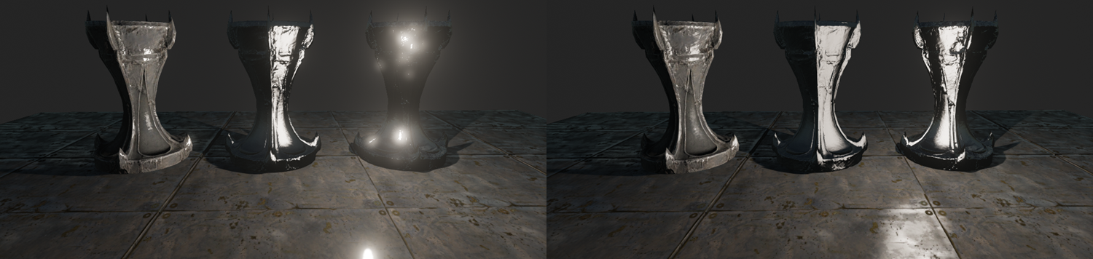
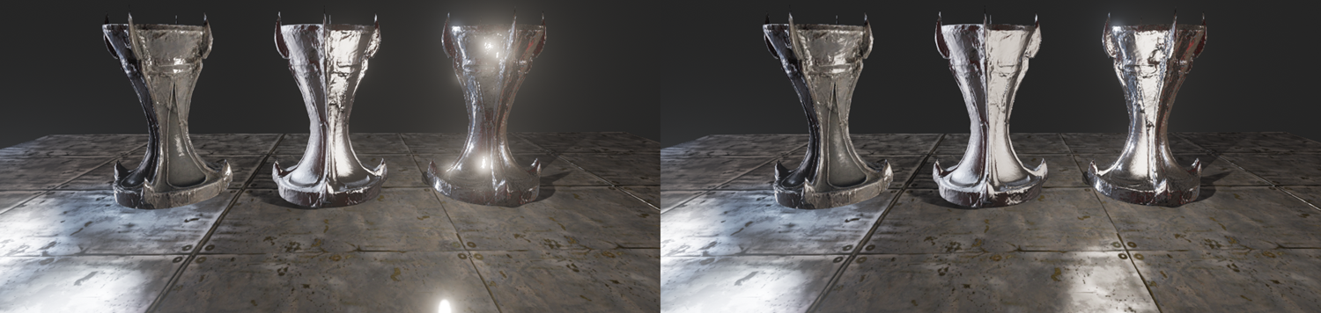
Specular Comparison
Point Light
Area Light
Point Light + IBL
Area Light + IBL

Slide 34
Post Processing

Slide 35
New post processing graph
Graph:
Created each frame
No User Interface
Dependencies define execution order
RT on demand, ref. counting, lazy release
Node:
Many types but fixed function
Multiple inputs and outputs
Defines output texture format
TextureInput Scene Color
DownSample 4 to1
GaussianBlurX
GaussianBlurY
ToneMap HDR to LDR
PostProcessAA
FXAA
UpScale
avg. 4 samples
Example Graph

Slide 36
Screen Space Ambient Occlusion
Classic SSAO [Kajalin09]
Ambient occlusion computed as post process
Only requires z buffer and 3d point samples
Few samples are permutated with small screen aligned pattern
Our technique is based on 2d point samples
Angle based similar to HBAO [Sainz08]
Using GBuffer normal improves quality further
Complements Voxel Lighting with high frequency details

Slide 37
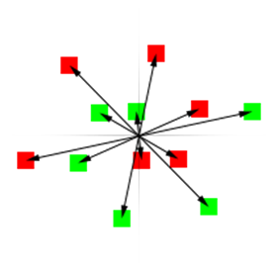
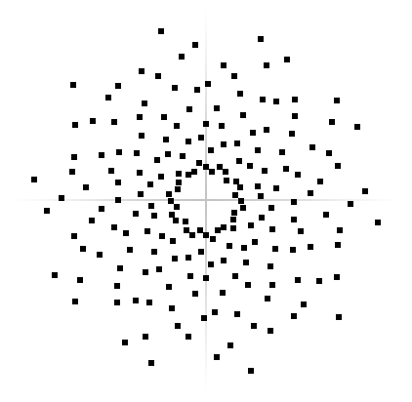
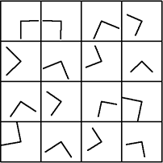
SSAO sampling
We use 6 sample pairs = 12 samples into half res z buffer
16 rotations with scale interleaved in 4x4 pattern
+
=
6 Samples pairs
16 rotations with scale in 4x4 pixel block
192 samples in 4x4 pixel block

Slide 38
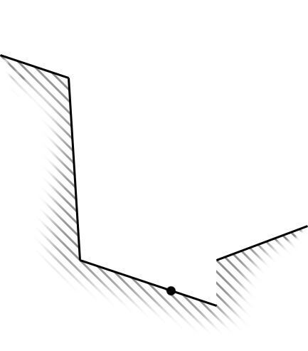
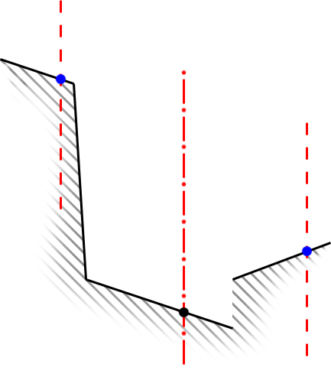
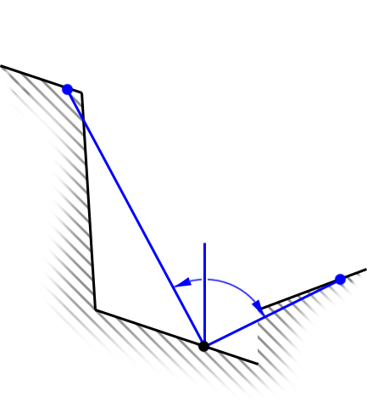
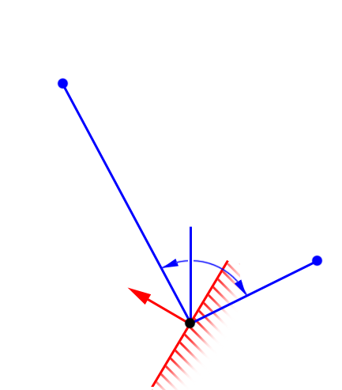
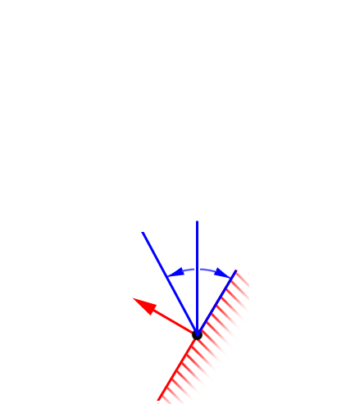
SSAO with per pixel normal
Per pixel normal further restricts angle
A) Given: z buffer in the sample direction
B) Get equi-distant z values from samples
C) AO (so far) = min((angle_left+angle_right)/180,1)
D) Clamp against per pixel normal
E) AO (per pixel normal) = (angle_left+angle_right)/180 AO ~= 1-saturate(dot(VecA,Normal)/length(VecA))
A
B
C
D
E

Slide 39
SSAO Example
SSAO (Depth only)
SSAO with per pixel Normal

Slide 40
SSAO Example Close-up
SSAO (Depth only)
SSAO with per pixel Normal
Notes:
The remaining dither pattern can be removed by a following blurring step – that step should take normal into account as well.
Next: Image Based Lens Flares

Slide 41
Image Based Lens Flares 1/2
Lens flares are out of focus reflections on the camera lens
Image based method
Threshold and blur bright image parts
Scale and mirror image multiple times
Soft mask screen borders
Lens/Bokeh Blur (for out of focus)
Render a textured sprite for each very bright low res pixel
Ideally for each lens reflection with different radius
Notes:
Good:
Pretty
Various quality options
Works on any bright pixel (e.g. emissive, reflection, sky box)
Bad:
Less art control
Can be blurry or aliasing
Performance (usually good)

Slide 42
Image Based Lens Flares 2/2
Source Image with Bloom
IB Lens Flares (without Lens Blur)
Lens Blur Sprite Image
IB Lens Flares (with Lens Blur)

Slide 43
IB Lens Flares Examples
Emissive (Sun)
Emissive (Fire)
Reflections

Slide 44
HDR Histogram [Scheuermann07]
64 Buckets, logarithmic, no atomics
Pass 1: Generate screen local histograms (CS) in parallel
Pass 2: Combine all lines into one
64 Buckets are stored in 16 ARGB
Clear groupshared histograms float[64][16]
Sync
Accumulate histograms in parallel
Sync
Accumulate many Histograms to one float4[16]
Output one Histogram per line in 16 texels
Notes:
Brightness = max(R,G,B)
CS but no Atomics

Slide 45
Eye Adaptation
Compute average brightness from Histogram (blue line)
Consider only bright areas (e.g. >90%)
Reject few very bright areas (very bright emissive, e.g. >98%)
Compute single multiplier for whole view port
Smoothly blend with last frame average (white bar)
Bound in user specified region (green)
Apply in tone mapper (white curve)
Read result in tone mapping VS
Pass to PS as interpolator
Notes:
Fully GPU based, at no point the value is read back to CPU

Slide 46
Particles

Slide 47
GPU accelerated particles
CPU
Spawn particles (arbitrarily complex logic)
Memory management in fixed size buffers (unit: 16 particles)
Emitter management (Index buffer, draw call sorting)
GPU
Motion from Newtonian mechanics (fixed function)
Lighting from non directional volume cascades (3D lookups)
GPU Radix depth sort if required [Merrill11] [Satish09]
Rendering
Additional forces from Vector Fields* (3D lookup)
Particle Curves to modulate particle attributes* (1D lookup)
* See next slides
Notes:
Particle Curves: created by designer, arbitrary complex, get compressed later

Slide 48
Particle Attributes
State-full simulation [Lutz04]
Allows more complex animations
Stored over particle lifetime
Particle Curves: Time Phase and Scale
Name | Format | Usage
Position | R32G32B32A32f | World Space Position*, Time Phase
Velocity | R16G16B16A16f | World Space Velocity, Time Scale
Render Attrib. | R8G8B8A8 | Size, Rotation
Simulation Attrib. | R8G8B8A8 | Drag, Vector Field Scale, Random Seed
Notes:
State-full: Means we simulate one step and use the result of that as next input, this allows more complex motions
Orbit motion to add some per particle noise: Random Seed
Precision far from 0,0,0 wasn’t an issue yet

Slide 49
Particle Curves
Concept
1D Function of time
Artist driven (arbitrary complex)
Implementation
Filtered texture lookup (Piecewise linear, equidistant)
Sample count depends on source curve (error threshold)
Many 1D curves packed into single 2D texture
Name | Format | Usage
Attributes | R8G8B8A8 | Modulate simulation or render attributes

Slide 50
Particle Vector Fields
Per volume attributes
World to Volume matrix
Force scale (accumulate)
Velocity scale (weighted blend)
Affect all particle systems globally or a single system
Per volume element attributes
Can be imported from Maya
Unified interface for many kind of complex motions
Name | Format | Usage
OffsetVector | R16G16B16A16f | Force or Velocity Delta
Notes:
Can import from Maya
Up to 4 Vector Field lookups per particle system

Slide 51
Shadow receiving Translucency

Slide 52
Volumetric direct and indirect lighting

Slide 53
> 1 Million Particles
Notes:
Next:Thanks

Slide 54
Thanks
NVIDIA, AMD
Special thanks to Cyril Crassin and Evan Hart from NVIDIA
Epic
Rendering team: Daniel Wright, Andrew Scheidecker, Nick Penwarden
Everyone that contributed to Unreal Engine 4

Slide 56
Epic Games is hiring
Work on leading game engine
Unreal Engine 3
Upcoming: Unreal Engine 4
Ship successful games
Gear Of War 1-3, Infinity Blade 1-2, …
Upcoming: Fortnite, Infinity Blade: Dungeons
Target many platforms:
Xbox 360, PlayStation 3, PC DX9/11, Mobile, Mac, next gen consoles
Main office in North Carolina
www.EpicGames.com/jobs
Notes:
Beach in 2h drive distance
Outstanding benefits package
Core hours 13:30 to 17:00
Other offices
Salt Lake City, Utah Warsaw, Poland Shanghai, China Seoul, Korea and Yokohama, Japan

Slide 57
References 1/2
[Crassin11] Interactive Indirect Illumination and Ambient Occlusion Using Voxel Cone Tracing Interactive Indirect Illumination Using Voxel Cone Tracing, Sep 2011 http://research.nvidia.com/sites/default/files/publications/GIVoxels-pg2011-authors.pdf
[Kawase04] Practical Implementation of High Dynamic Range Rendering http://www.daionet.gr.jp/~masa/archives/GDC2004/GDC2004_PIoHDRR_SHORT_EN.ppt
[Segovia06] Non-interleaved Deferred Shading of Interleaved Sample Patterns http://liris.cnrs.fr/Documents/Liris-2476.pdf
[Kajalin09] Screen Space Ambient Occlusion ShaderX7 - Advanced Rendering Techniques
[Sainz08] Image-Space Horizon-Based Ambient Occlusion http://www.nvidia.com/object/siggraph-2008-HBAO.html
[Tabellion08] Practical Global Illumination with Irradiance Caching http://cgg.mff.cuni.cz/~jaroslav/papers/2008-irradiance_caching_class/10-EricSlides.pdf
[Toksvig05] Mipmapping normal maps. Journal of Graphics Tools 10, 3, 65–71 ftp://download.nvidia.com/developer/Papers/Mipmapping_Normal_Maps.pdf
[Bruneton11] A Survey of Non-linear Pre-filtering Methods for Efficient and Accurate Surface Shading http://hal.inria.fr/docs/00/58/99/40/PDF/article.pdf
[McKesson12] Gaussian Specular from Learning Modern 3D Graphics Programming http://www.arcsynthesis.org/gltut/Illumination/Tut11%20Gaussian.html http://arcsynthesis.org/gltut/Illumination/Tut11%20On%20Performance.html
[Scheuermann07] Efficient Histogram Generation Using Scattering on GPUs http://developer.amd.com/gpu_assets/GPUHistogramGeneration_I3D07.pdf

Slide 58
References 2/2
[Gobbetti05] Far Voxels: A Multiresolution Framework for Interactive Rendering of Huge Complex 3D Models on Commodity Graphics Platforms http://www.crs4.it/vic/cgi-bin/bib-page.cgi?id='Gobbetti:2005:FV‘
[Mittring11] The Technology Behind the DirectX 11 Unreal Engine "Samaritan" Demo http://udn.epicgames.com/Three/rsrc/Three/DirectX11Rendering/MartinM_GDC11_DX11_presentation.pdf
[Lutz04] Building a Million-Particle System http://www.gamasutra.com/view/feature/130535/building_a_millionparticle_system.php?page=1
[Lutz11] Everything about Particle Effects http://www.2ld.de/gdc2007
[McTaggart04] Half-Life®2 / Valve Source™ Shading http://www2.ati.com/developer/gdc/D3DTutorial10_Half-Life2_Shading.pdf
[Merrill11] High Performance and Scalable Radix Sorting Parallel Processing Letters, vol. 21, no. 2, 2011, pp. 245-272 https://sites.google.com/site/duanemerrill/awards-publications
[Satish09] Designing Efficient Sorting Algorithms for Manycore GPUs IPDPS '09: Proceedings of the 2009 IEEE International Symposium on Parallel & Distributed Processing, 2009 http://mgarland.org/files/papers/gpusort-ipdps09.pdf
[Jensen02] A Practical Guide to Global Illumination using Photon Mapping Siggraph 2002 http://www.cs.princeton.edu/courses/archive/fall02/cs526/papers/course43sig02.pdf
[Groeller05] A Simple and Flexible Volume Rendering Framework for Graphics-Hardware based Raycasting http://cumbia.informatik.uni-stuttgart.de/ger/research/pub/pub2005/vg2005-stegmaier.pdf

Slide 59
Questions?

Slide 60
Bonus slides
Bonus
Slides

Slide 61
Bloom 1/2 [Kawase04]
Goal: Large, high quality, efficient
Down sample:
Blur during downsample avoids aliasing
A = downsample2(FullRes)
B = downsample2(A)
C = downsample2(B)
D = downsample2(C)
E = downsample2(D)
Without blur (1sample):
With blur (4 samples):

Slide 62
Bloom 2/2
Recombine (with increasing resolution):
Blurring while up sampling
Improves quality
Barely affects blur radius
Combine with dirt texture
E’= blur(E,b5) D’= blur(D,b4)+E’ C’= blur(C,b3)+D’ B’= blur(B,b2)+C’ A’= blur(A,b1)+B’
blur(blur(X,a),b) ~= blur(X,max(a,b))
Notes:
Combine with dirt texture: J*const + tex2d(Dirt,ScreenUV)*const

Slide 63
Bloom Example
Bloom with single Gaussian
Bloom with 5 Gaussians and Dirt

Slide 64
GBuffer Blur 1/2
Smart blur:
Average of 5 pixels
Weighted by normal
Weighted by depth difference
Applications:
Reduce aliasing of specular materials (noticeable in motion)
Reduce high frequency dither artifacts in Ambient Occlusion
Can increase performance of with IBL or Voxel Lighting

Slide 65
GBuffer Blur 2/2
Using Gather() where possible (Depth, AO)
Output: SpecularPower, Normal, AmbientOcclusion
Reduce Specular Power [Toksvig05] [Bruneton11]
L = saturate(length(SumNormal) * 1.002)
SpecularPower *= L / (L + SpecularPower * (1 - L))
W
Z
X
Y
Kernel using 5 samples
single Gather
Kernel using 2 Gather

Slide 66
without GBuffer Blur
with GBuffer Blur

Slide 67
SSS Material Example
unshadowed
shadowed
Notes:
SSS: Sub Surface Scattering
Modified PCF lookup – softer for SSS and falloff in the material is different

Slide 68
Auxiliary to the graph
Post Process Volume:
Linearly blends Post process properties
Priority depending on camera position
Soft transitions with Blend Radius
Weight can be controlled remotely
Render Target Pool:
Allocation on demand, reference counting
Deferred release
Tools to look at intermediate Buffers
Notes:
Next SSAO

Slide 69
Voxel Lighting Examples 3/5
disabled
enabled

Slide 71
Voxel Lighting Examples 5/5

