Slide 1


Slide 2


Graphics Gems for Games
Findings from Avalanche Studios
Emil Persson
Senior Graphics Programmer
@_Humus_

Slide 3
Graphics Gems for Games
Particle trimming
Merge-instancing
Phone-wire Anti-Aliasing
Second-Depth Anti-Aliasing

Slide 4
Graphics Gems for Games
Particle trimming

Slide 5
Particle trimming
GPUs increasingly more powerful
  ALU – Through the roof
  TEX – Pretty decent increase
  BW – Kind of sluggish
  ROP – Glacial speed
ROP bound?
  Draw fewer pixels
  ???
  Goto 1
 | 9700 Pro (2002) | HD 2900XT (2007) | HD 7970 (2012) | 10 year speedup
ALU | 33.8 GF/s | 475 GF/s | 3789 GF/s | 112x
TEX | 2.6 GT/s | 11.9 GT/s | 118.4 GT/s | 46x
BW | 19.84 GB/s | 105.6 GB/s | 288 GB/s | 15x
ROP | 2.6 GP/s | 11.9 GP/s | 29.6 GP/s | 11x
Source: Wikipedia [1]
Notes:
ALU and TEX has increased way more than Bandwidth and ROP over the last decade. Modern GPUs have an ALU / ROP ratio 10x larger than a decade ago.
There are very few possible optimization opportunities when you are ROP bound. Simply drawing fewer pixels is generally the only way to go. Another strategy is to make fancier shaders to shift the balance towards the ALU/TEX. However, that might make it prettier more or less for free, but it won’t make it go faster.

Slide 6
Particle trimming
Typical ROP bound cases
  Particles
  Clouds
  Billboards
  GUI elements
Solutions
  Render to low-res render target
  Abuse MSAA
Our solution
  Trim particle polygon to reduce waste
Notes:
There are a number of typically ROP bound cases in real games today. They generally consist of a simple shader, usually little more than just a texture.
There are some tricks that have been employed to various success before, such as rendering to a low-res render target and upscale, which essentially reduces the number of pixels. This may work for low-frequency data, such as a typical particle system. Another approach is to abuse MSAA to improve rasterize throughput. This may not work out if you are already using MSAA for antialiasing.
The solution presented here is to reduce the number of pixels by eliminating waste. This technique can generally be combined with the other two approaches.

Slide 7
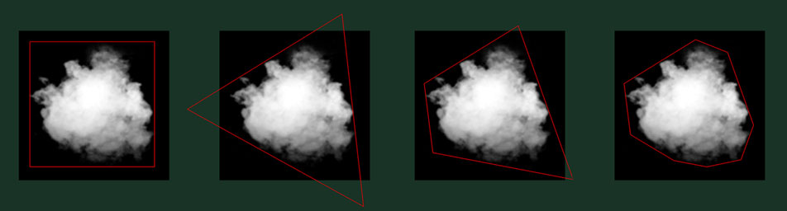
Particle trimming
Common with large alpha=0 areas
  Wasted fillrate
  Adjust particle geometry to minimize waste
  Automated tool [2]
Notes:
A typical particle texture has plenty of area where alpha is zero. Rendering those pixels will be a waste of fillrate as it contributes nothing to the final frame.
Instead of simply drawing a plain quad, a better approach is to use irregular polygons that tightly encloses the ”meat” of the particle. We made a tool that automatically finds an optimal enclosing polygon for a given texture.

Slide 8
Particle trimming
Original | 100%
Tight rect | 69.23%
3 vertices | 70.66%
4 vertices | 60.16%
5 vertices | 55.60%
6 vertices | 53.94%
7 vertices | 52.31%
8 vertices | 51.90%
Huge fillrate savings
  More vertices ⇒ Bigger saving
  Diminishing returns
  Just Cause 2 used 4 for clouds, 8 for particle effects
Notes:
The more vertices you use, the bigger the fillrate saving will be, but there is a diminishing return. Going further than about 8 vertices is usually not really worth it. Even staying with four vertices can provide a substantial performance improvement.
Particles will have to be very small for a smaller vertex count to really pay off from a GPU performance point of view. You’ll rarely be bound by the vertex shader. However, if the particles are generated on the CPU, computing more vertices may be costly. For this reason we stuck with 4 vertices for the clouds in Just Cause 2. However, the particle effects were drawn with GPU generated vertices, so we went all the way to 8 there.

Slide 9
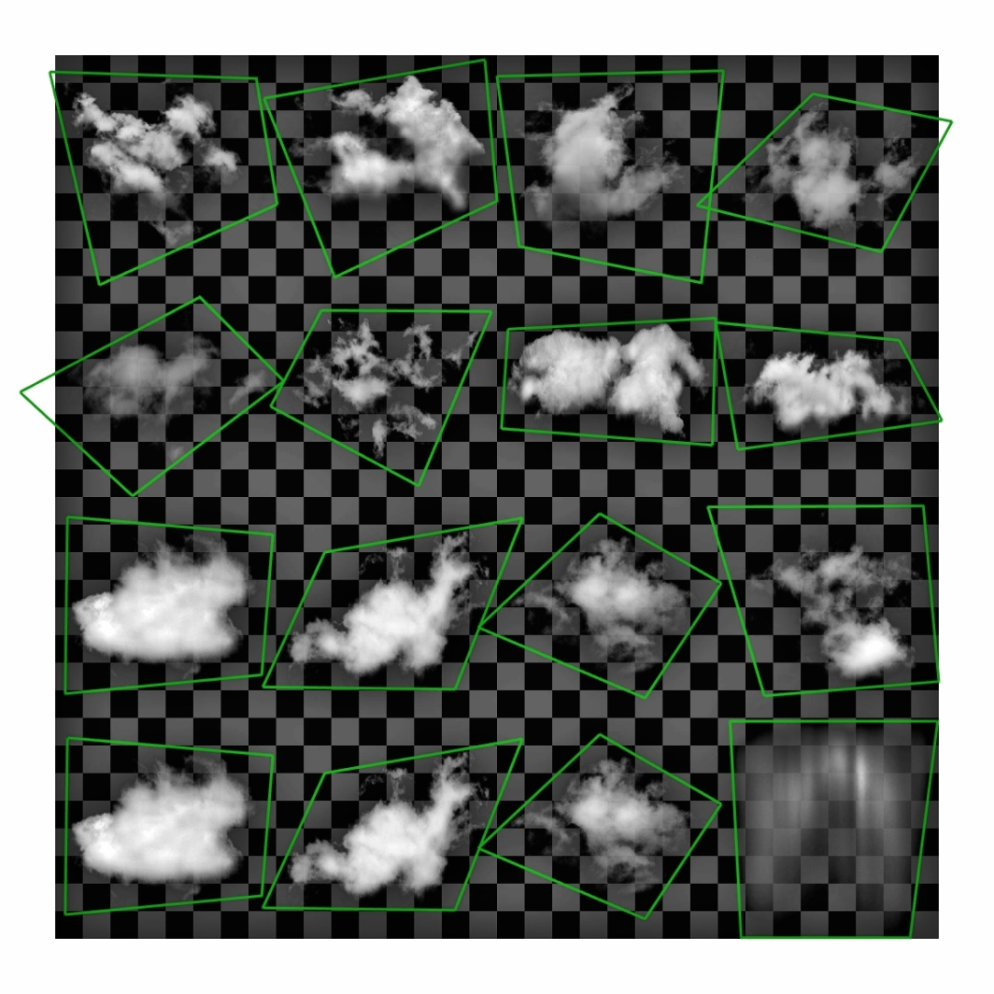
Particle trimming
First attempt: Manual trimming
  Tedious, but proved the concept
  OK for our cloud atlas
    > 2x performance
  Dozens of atlased particle textures
Automatic tool [3]
  Input:
    Texture and Alpha threshold
    Vertex count
  Output:
    Optimized enclosing polygon
Notes:
Before making the tool we tried manual trimming with a rudimentary in-game tweaking system temporarily added to the debug-menu. This was done on the clouds texture atlas. It worked, but was tedious. The large performance benefit motivated expanding this to general particle effects. However, the manual approach did not scale. Instead of a single atlas with 16 tiles we had dozens of textures, some with 64 animation frames. It would be weeks or months of works to do them all manually.
We came up with a tool that given a texture, an alpha threshold, and a target vertex count computed an optimized enclosing polygon. This tool is open-source and available online [3]. We have continued to develop it internally though and integrated it into our pipeline. However, the open-source version is a good start for integrating this technique into your tool chain.

Slide 10
Particle trimming
Algorithm
  Threshold alpha
  Add each solid pixel to convex hull
    Optimize with potential-corner test
  Reduce hull vertex count
    Replace least important edge
    Repeat until max hull vertex count
  Brute-force through all valid edge permutations
    Select smallest area polygon
Notes:
Adding pixels to the convex hull can be quite slow if we are adding every solid pixel. So whenever a pixel is deemed to not be a potential corner pixel, e.g. it is surrounded by other solid pixel and thus completely within solid space, then we simply skip it. This made the construction of the convex hull substantially faster.
The convex hull is typically a fair bit larger than the target vertex count, anything from a few dozen up to hundreds of vertices. To find the most optimal polygon we loop through all permutation of edges in the hull and select the one that results in the smallest area. This is a brute-force approach, so it is important to reduce the search space prior to this selection phase. So we remove vertices from the convex hull, one-by-one, by finding the edge that grows the convex hull the least when removed.

Slide 11

Particle trimming
Original texture

Slide 12

Particle trimming
Thresholded texture

Slide 13
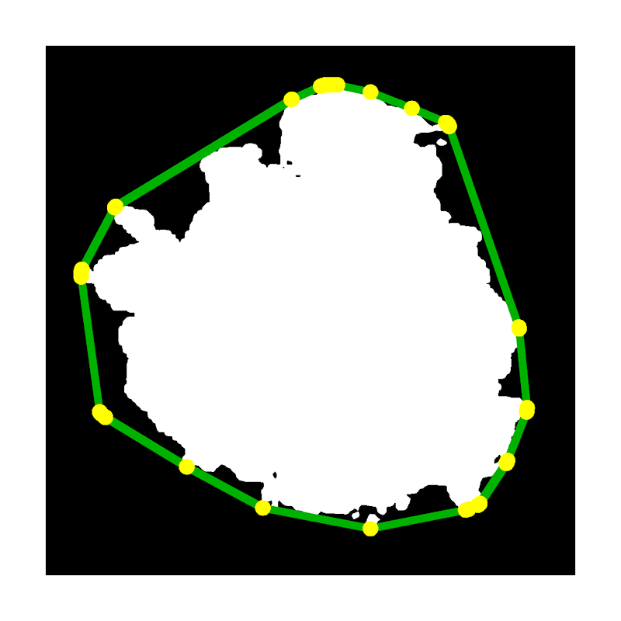
Particle trimming
Convex hull

Slide 14
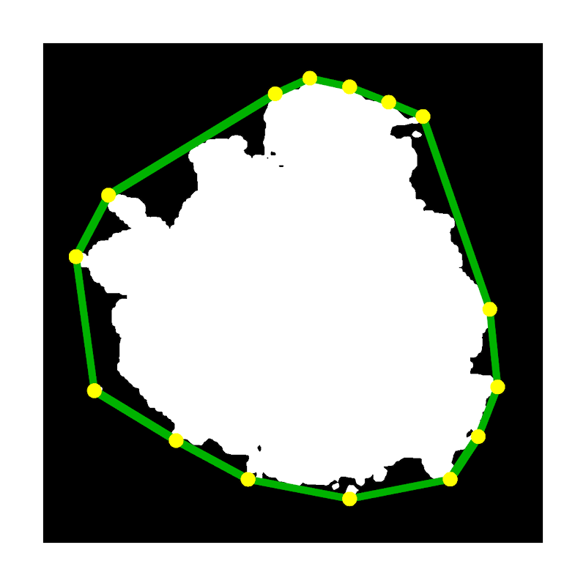
Particle trimming
Reduced convex hull

Slide 15
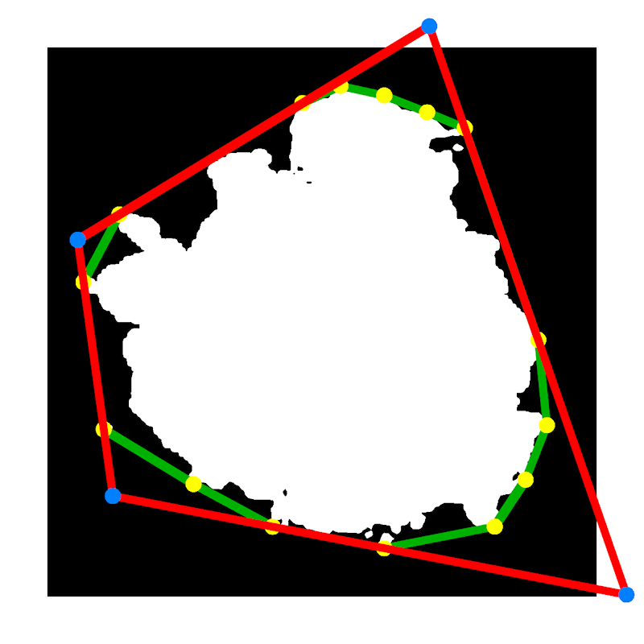
Particle trimming
Final 4 vertex polygon
(60.16%)

Slide 16
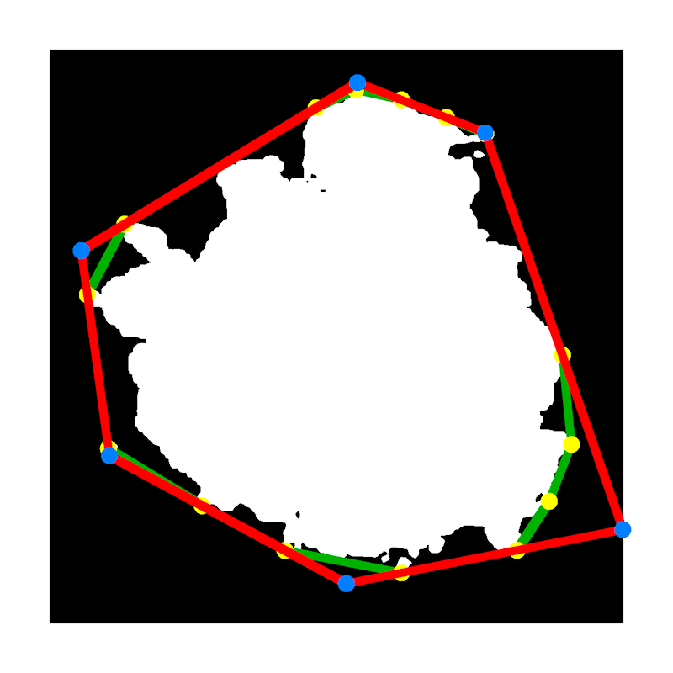
Particle trimming
Final 6 vertex polygon (53.94%)

Slide 17
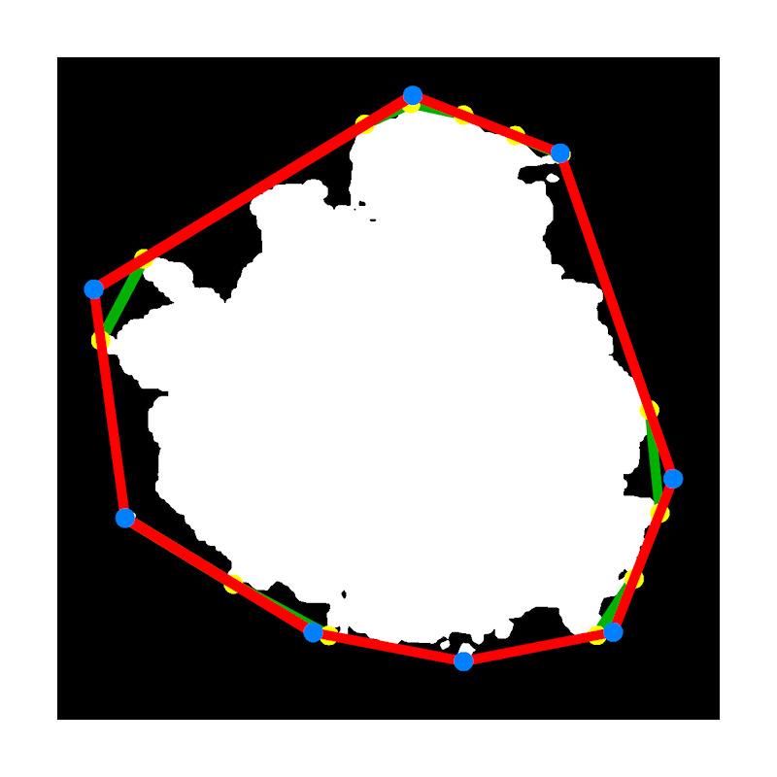
Particle trimming
Final 8 vertex polygon (51.90%)

Slide 18
Particle trimming
Issues
  Polygon extending outside original quad
    No problem for regular textures. Use CLAMP.
    May cut into neighboring atlas tiles …
    Compute all hulls first, reject solutions that intersect another hull.
    Revert to aligned rect if no valid solution remains
  Performance
    Brute-force
    Keep convex hull vertex count reasonably low
  Filtering
    Add all four corners of a pixel (faster), or interpolate subpixel alpha values (accurate)
  Handling ”weird” textures
    I.e. alpha != 0 at texture edge
Notes:
The optimized polygons can sometimes include long sharp wedges that extend outside of the original quad. For a regular texture this is fine, just use CLAMP mode. For texture atlases this could mean that part of the ”meat” from another particle gets included, which produces ugly artifacts. This is generally only a problem in practice for small vertex counts, like 3-5 vertices. In Just Cause 2 we used 8 vertices, so this was not a problem. For the clouds texture that used 4 vertices this was avoided manually as part of the tweaking, which occasionally led to somewhat larger polygons than otherwise necessary. Post-JC2 we have added a proper solution that simply rejects solutions where the resulting polygon would intersect the convex hull of another atlas tile. This typically allows a fair amount of cutting into neighboring quads, but never into the actual particle.

Slide 19
Graphics Gems for Games
Merge-Instancing

Slide 20
Merge-Instancing
Instancing
  One mesh, multiple instances
Merging
  Multiple meshes, one instance of each
  What about: Multiple meshes, multiple instances of each?
    Instancing: Multiple draw-calls
    Merging: Duplication of vertex data
    Merge-Instancing: One draw-call, no vertex duplication
Notes:
When reducing the number of draw calls there are two standard approaches. Multiple instances of a single mesh is typically done with regular instancing. If there are multiple meshes, but a single instance of each, they can be merged into a single vertex and index buffer and drawn with a single draw call. However, sometimes you want to draw multiple meshes, with multiple instances of each, and each with their own transforms or other instance data. With instancing this results in multiple draw calls. With the standard merging approach you need to duplicate the vertex data.
We came up with an approach that combine the benefits of merging and instancing such that you can draw it all with a single draw call without duplicating vertex data. Thus, for the lack of a better name, it can be referred to as Merge-Instancing.

Slide 21
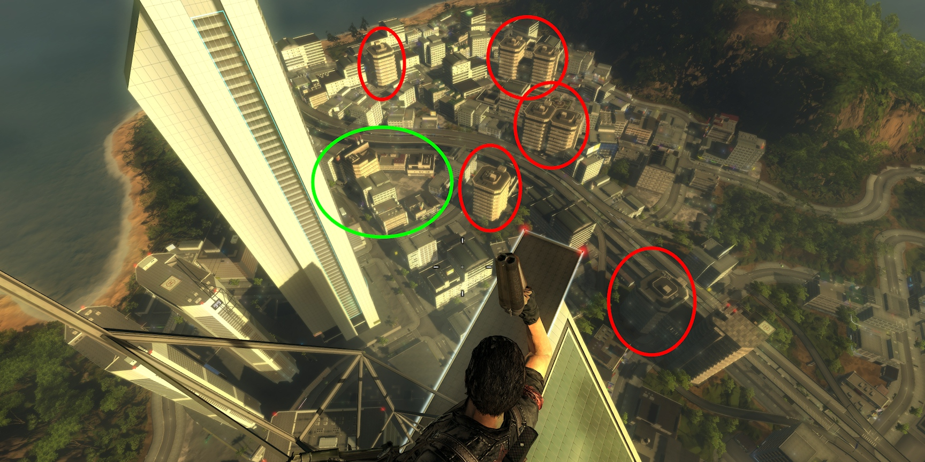
Merge-Instancing
Notes:
In this screenshot from Just Cause 2 you may think that those building in the red circles would be prime candidates for drawing with instancing, considering that they are the same model, just different transforms. However, this means that either they all have to be merged into the same bounding box for culling, which will greatly reduce the effectiveness of culling due to the enormous bounding box required to enclose them all. Alternatively you cull them all individually, which means that you are paying a much higher price in the culling stage, likely to far exceed the benefit of reduced draw call count, besides the complexity of managing multiple instances as a single entity and dynamically generating the instance buffer every frame.
Ideally you want to merge the models in the green circle, because they are close to each other and can easily share a common bounding box and be dealt with as a single instance. Unfortunately, neighboring houses are rarely all of the same mesh, but typically contain a mix of different meshes. Hence the need for this technique.

Slide 22
Merge-Instancing
Instancing
Merge-Instancing
for (int instance = 0; instance < instance_count; instance++)
for (int index = 0; index < index_count; index++)
VertexShader( VertexBuffer[IndexBuffer[index]], InstanceBuffer[instance] );
for (int vertex = 0; vertex < vertex_count; vertex++)
{
int instance = vertex / freq;
int instance_subindex = vertex % freq;
int indexbuffer_offset = InstanceBuffer[instance].IndexOffset;
int index = IndexBuffer[indexbuffer_offset + instance_subindex];
VertexShader( VertexBuffer[index], InstanceBuffer[instance] );
}
Notes:
This is how instancing and merge-instancing compare on a higher level. Instancing just loops over the instances, and for each instance it loops over the mesh indexes and passes the corresponding vertex and instance data to the vertex shader. Here the Input Assembly unit takes care of feeding the vertex shader a nicely packaged set of data in its input attributes.
Merge-Instancing requires that the vertex shader does all the work itself. The only input is the vertex id. So it loops over the total number of vertices for the entire batch, computes which instance it belongs to and where within the instance we are. This is used to fetch the index from the index buffer, the corresponding vertex and of course the instance data. Once the final vertex has been fetched the same vertex shader logic proceeds as normal.

Slide 23
Merge-Instancing
Implemented in Just Cause 2 on Xbox360
  Draw-calls less of a problem on PS3 / PC
Xbox360 HW lends itself to this approach
  No hardware Input Assembly unit
  Vertex shader does vertex fetching
  Accessible through inline assembly
Notes:
For Just Cause 2 we only implemented this on Xbox360. One reason is that it was the only platform that really had much of a problem with draw-calls. The PS3 has a more lightweight API and did not suffer as much when the draw-call count increased. We were also running our rendering code on the SPUs, which further made rendering code run fast. For the PC the sheer amount of raw power compared to the consoles, together with a much more efficient DX10 API, made draw-calls not much a problem.
The other reason is that the Xbox360 API lends itself very well to this technique. It is possible to implement similarly on other platforms, but you may need to jump through some hoops to make it happen and may pay a higher price in performance. However, the Xbox360 GPU does not have a traditional Input Assembly unit. Instead it is the vertex shader itself that does all vertex fetching. Every time you set a new vertex declaration the runtime may have to patch your shader to insert new vertex fetch instructions. The vertex fetch instructions are accessible for general shader development through inline assembly. Consequently there is plenty of flexibility in how to fetch vertices, i.e. it does not have to be done in the typical Input Assembly kind of way. Since we’re not really replacing a fixed function unit with shader logic there is no particular overhead in doing it manually rather than relying on patched shader instructions.

Slide 24
Merge-Instancing
Merging odd sized meshes
  Choose common frequency
  Duplicate instance data as needed
  Pad with degenerate triangles as needed
Example
  Mesh0: 39 vertices, Mesh1: 90 vertices
    Choose frequency = 45
    Pad Mesh0 with 2 degenerate triangles (6 vertices)
    Instances[] = {
      ( Mesh0, InstanceData[0] ),
      ( Mesh1, InstanceData[1] ),
      ( Mesh1 + 45, InstanceData[1] ) }
Notes:
To make this work we have to align meshes on a common frequency. This may also mean we have to insert a few degenerate triangles, depending on the sizes of the meshes involved. For larger meshes we may need to use more than one instance data slot. This is a small amount of data though compared to duplicating vertices. In the example here the second mesh is more than twice as big, so we represent this as two instances, where the first instance points to the first half of the mesh, and the other to the second half of the mesh.

Slide 25
Graphics Gems for Games
Phone-wire Anti-Aliasing

Slide 26
Phone-wire AA
Sources of aliasing
  Geometric edges
    Mostly solved by MSAA
    Post-AA usually works too
    Breaks down with thin geometry
  Shading
    Sort of solved by mipmapping
    Poorly researched / understood
    Few practical techniques for games
    LEAN mapping [4]
Notes:
At one point aliasing was sort of a solved problem, first through mipmapping for the shading and later through MSAA for geometric edges. However, aliasing in games is on the rise again. As shaders get more advanced mipmapping alone does not fully solve the shader aliasing problem. More complex lighting introduces aliasing where the mipmapped textures alone exhibit none. In particular the specular component tends to cause lots of aliasing. This field is poorly researched and only quite few approaches exist to properly deal with the problem. The most notable work here is LEAN mapping. On the geometry side we are getting increasingly denser geometry, and as geometry gets down to the sub-pixel level, MSAA is not always sufficient.

Slide 27
Phone-wire AA
Sources of aliasing
  Geometric edges
    Mostly solved by MSAA
    Post-AA usually works too
    Breaks down with thin geometry
  Shading
    Poorly researched / understood
    Few practical techniques for games
    LEAN mapping
Notes:
This technique takes a stab at solving the thin geometry case, at least for a subset of common content in games exhibiting an aliasing problem, in particular phone-wires.

Slide 28
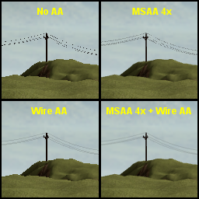
Phone-wire AA
Phone-wires
  Common game content
  Often sub-pixel sized
MSAA helps
  … but not that much
  Breaks at sub-sample size
Idea
  Let’s not be sub-pixel sized!
Notes:
Phone-wires are common in games and highly aliasing prone. They tend to go sub-pixel sized and end up as a set of random disconnected dots flickering in motion. MSAA helps somewhat, but does not fix the problem. It’s just somewhat less objectionable. Essentially it pushes the problem further into the distance, much like a higher resolution would do, but stil completely breaks once you’re down to sub-sample size. The solution is simply to avoid going sub-pixel.

Slide 29
Phone-wire AA
Phone-wires
  Long cylinder shapes
  Defined by center points, normal and radius
Avoid going sub-pixel
  Clamp radius to half-pixel size
  Fade with radius reduction ratio
Notes:
Phone-wires are essentially long cylinder shapes, and for the purpose of this technique they will be represented in the vertex buffer as a center point, a normal and a radius. This is so that we can dynamically adjust the radius of the wire. Note also that this technique works for any cylinder shape, not necessarily only phone-wires. There are other fairly common game content that it also applies to, such as antenna towers, railings, bars etc.
The idea is simple. We avoid going sub-pixel by simply clamping the radius to the width that represents a pixel wide wire at that distance. To simulate the sub-pixel coverage we simply fade it away, for instance, if the actual wire would be half a pixel wide, but we clamp it to a full pixel, then we simply output 0.5 to the alpha and blend.

Slide 30
Phone-wire AA
// Compute view-space w
float w = dot(ViewProj[3], float4(In.Position.xyz, 1.0f));
// Compute what radius a pixel wide wire would have
float pixel_radius = w * PixelScale;
// Clamp radius to pixel size. Fade with reduction in radius vs original.
float radius = max(actual_radius, pixel_radius);
float fade = actual_radius / radius;
// Compute final position
float3 position = In.Position + radius * normalize(In.Normal);
Demo + source available! [5]
Notes:
First we compute the w value, or the view distance. Then the radius corresponding to pixel wide wire is computed. This is just the view distance multiplied with a constant scale factor which can be derived from your projection. Then we do the clamping of the radius and the resulting fade required, and finally compute the vertex position given the center point, normal and final radius. Full source is available online. [5]

Slide 31
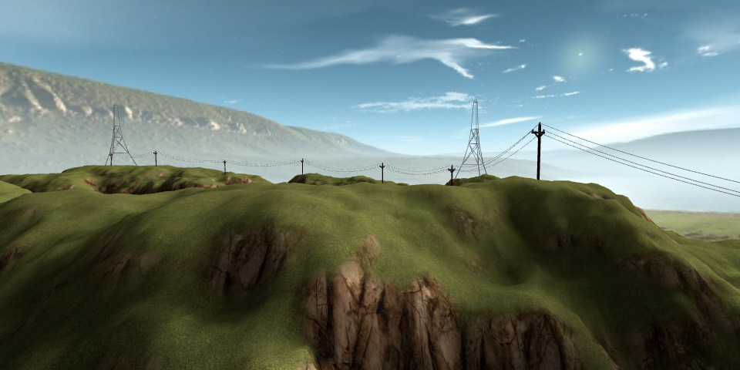
Phone-wire AA off, MSAA 4x
Notes:
This is with only MSAA enabled. As you can see, the quality is far from perfect. The close wires on the right look sort of OK, but in the distance it’s just a mess of random dots.

Slide 32

Phone-wire AA on, MSAA 4x
Notes:
If we enable this technique the wires the clean and smooth, just like we want them. Note though that this technique does nothing for “jaggies”. This technique alone would produce a smooth and fully connected wire, but with your typical stair-stepped pixel edges. Thus we still need a regular antialiasing scheme for dealing with the jaggies, for instance MSAA. It may also work with post-AA techniques, such as MLAA and FXAA, but your mileage may vary. With Phone-wire AA and MSAA used together, we get perfectly aliasing free wires. It should be noted though that it is important that other aspects of the wires are also aliasing free, such as the lighting, otherwise there may still be lighting. In the demo a simple lighting model is used, which is not particularly aliasing prone. For more advanced shading, an approach can be to simply fade away lighting towards a constant color before the wire gets too thin, or from whatever distance aliasing typically becomes visible.

Slide 33
Graphics Gems for Games
Second-Depth Anti-Aliasing

Slide 34
Second-Depth Anti-Aliasing
Filtering AA approaches
  SIGGRAPH 2011 - ”Filtering Approaches for Real-Time Anti-Aliasing” [6]
  Post-AA
    MLAA
    SMAA
    FXAA
    DLAA
  Analytical approaches
    GPAA
    GBAA
    DEAA
    SDAA [7]
Notes:
At Siggraph 2011 there was a course on Filtering Approaches for Real-Time Anti-Aliasing where numerous different techniques and implementations were presented. The techniques can be roughly categorized in two classes: Post-AA techniques and Analytical approaches. Post-AA techniques operate entirely on final pixel buffers that are already available and does not care how the buffer was generated. They are decoupled from the rest of the rendering pipeline, which is a great property. The analytical approaches note that aat least for games the game engine generally has information available that could help the process and provide much more accurate results. Instead of reverse-engineering a pixel-buffer through a bunch of heuristics, they use engine provided data to find the edges through direct computation. The technique here, SDAA, belongs to that latter class of techniques. It should generally be less intrusive on the game engine design than the previous methods.

Slide 35
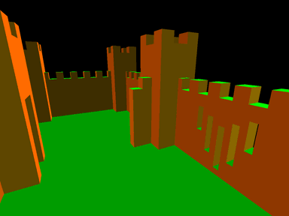
Second-Depth Anti-Aliasing
Depth buffer and second-depth buffer
Depth is linear in screen-space
  Simplifies edge detection
  Enables prediction of original geometry
Two types of edges
  Creases
  Silhouettes
Silhouettes require second-depth buffer
  Do pre-z pass with front-face culling
  Alternatively, output depth to render target for back-facing geometry
Notes:
The key enabler of this technique is that depth values as interpolated by the rasterizer and stored in a depth buffer is linear in screen-space. This property is illustrated with the picture here where ddx(z) and ddy(z) has been outputted directly to the screen. This results in completely flat-shaded surfaces. In other words, the delta from pixel to pixel will be constant within a surface. So edge detection on a depth buffer is merely about finding a discontinuity in the slope. The slopes can also be used to find where the original geometric edge is located.
There are two types of edges, creases and silhouettes. The former only needs the regular depth buffer, but the latter requires the second-depth buffer as well. The easiest way to generate a second-depth buffer is just to use a pre-z pass, but using front-face culling, then copying the results to a texture before proceeding with general scene rendering. If you don’t want a pre-z pass, there are other single-pass options that could work.

Slide 36
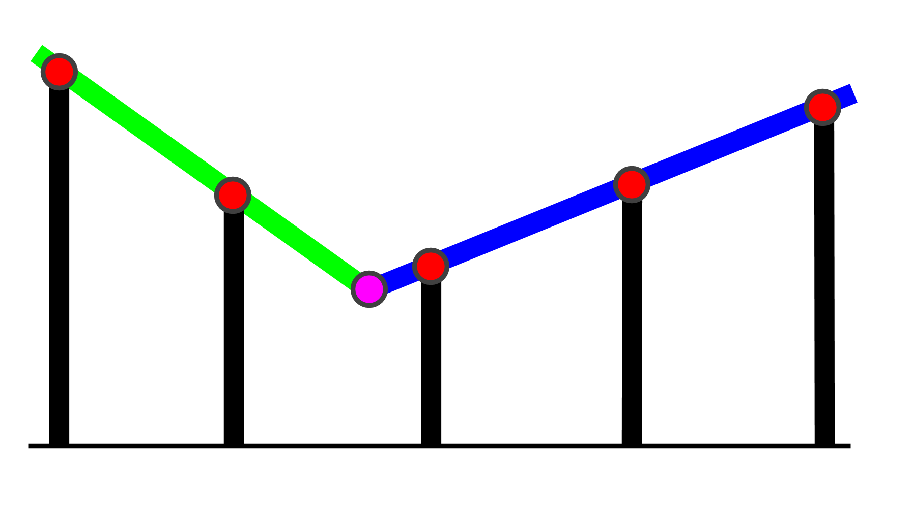
Second-Depth Anti-Aliasing
Attempt crease case first
Look at depth slopes
Compute intersection point
  Valid if distance < one pixel
  Used if distance < half pixel
If invalid, try silhouette
Notes:
When resolving for AA in the end, for each edge pixel we first attempt to resolve it as a crease. This is done by computing the intersection point between the two slopes. If the intersection point lands within a pixel, we have a crease. But we only use it if it’s within half a pixel. The reason for that is that if the edge is further away than that, it is actually not touching this pixel’s area, but belongs to the neighboring pixel in that direction. If the edge cannot be resolved as a crease, we proceed to the silhouette case.

Slide 37
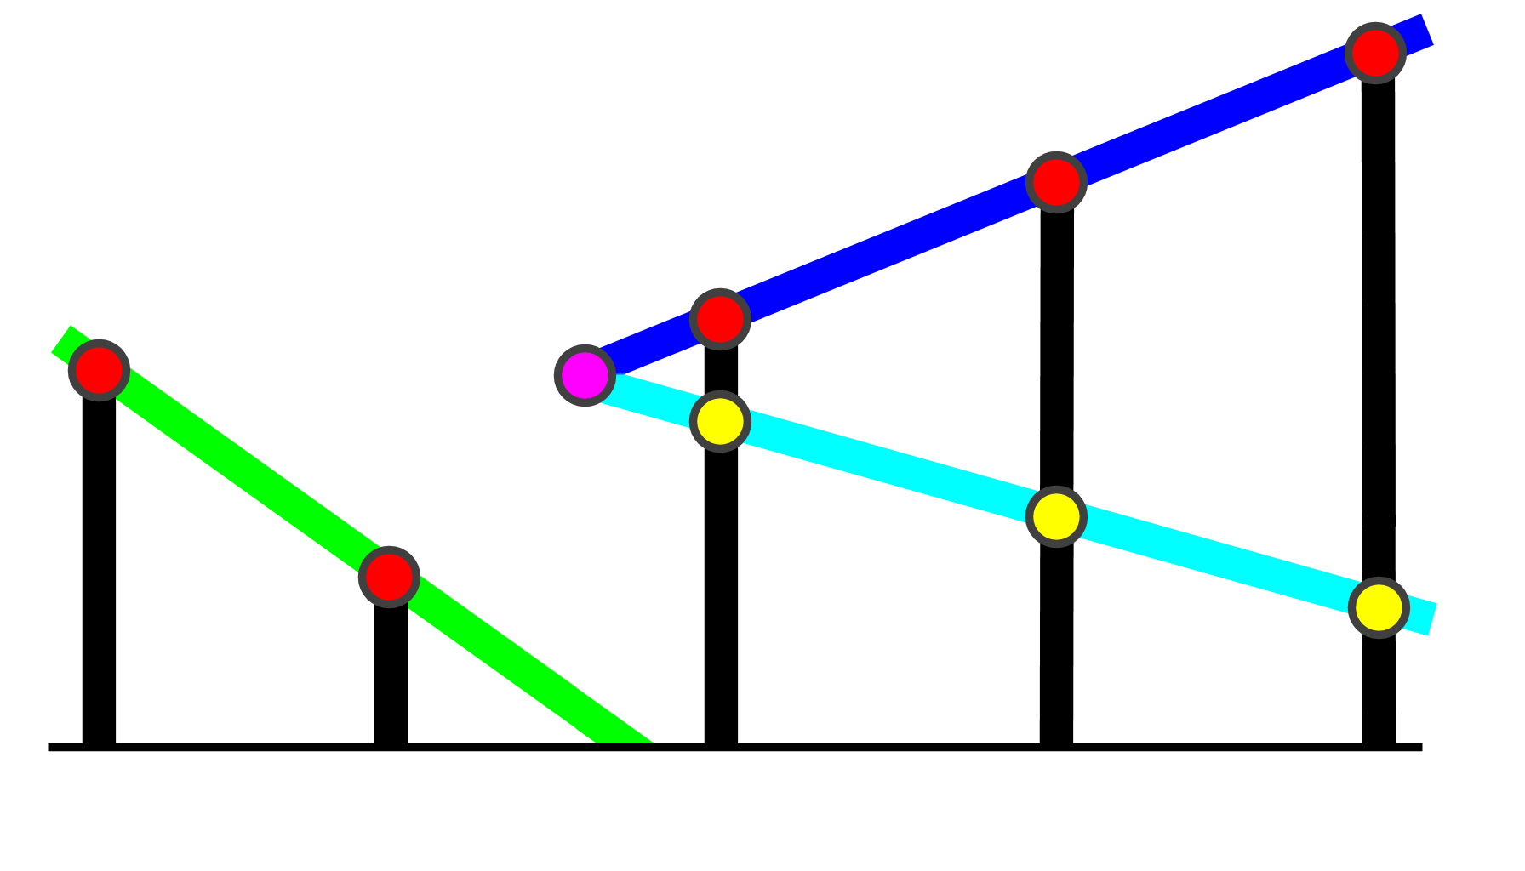
Second-Depth Anti-Aliasing
Try as silhouette
Neighbor depths useless
  Look at second-depths
Compute intersection point
  Used if distance < half pixel
Notes:
For the silhouette case we cannot know where the original geometric edge was by looking at the regular depth buffer alone. In the picture, from the red dots we can only know that the blue surface ends somewhere between the second and third sample, but we cannot know how far it extends over the gap. However, by looking at the depths of the back-facing geometry we can compute the intersection point in the same way as with a crease. Again, if it’s within half a pixel we will use the result.

Slide 38
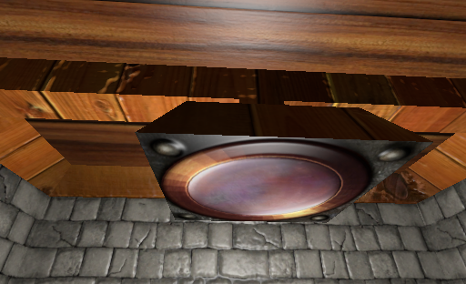
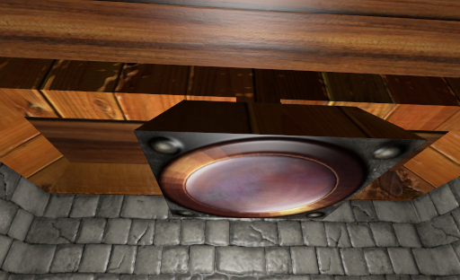


Second-Depth Anti-Aliasing
Results
Demo + source available! [7]
Notes:
This technique can compute the original edge’s position very accurately. As a result, the gradients are very smooth, limited only in the resolution of the underlying color format in the buffer.
This technique is quite sensitive to depth buffer precision. At least a 24bit buffer is required, even for the simple test scene in the demo.

Slide 39
References
[1] http://en.wikipedia.org/wiki/Comparison_of_AMD_graphics_processing_units
[2] http://www.humus.name/index.php?page=News&ID=266
[3] http://www.humus.name/index.php?page=Cool&ID=8
[4] http://www.csee.umbc.edu/~olano/papers/lean/
[5] http://www.humus.name/index.php?page=3D&ID=89
[6] http://iryoku.com/aacourse/
[7] http://www.humus.name/index.php?page=3D&ID=88

Slide 40

This slide has a 16:9 media window
Thank you!
Emil Persson
Avalanche Studios
@_Humus_

