Slide 1



Slide 2
Advances in Real-Time Rendering in Games
Part I
Natalya Tatarchuk
Bungie

Slide 3
Games Are a Unique Medium
Games are about pixels in motion
Don’t forget about input lag
Design and gameplay needs to define what gets exposed to the player
Notes:
Input lag requirements vary for each game genre
How does your feature influence the input lag
The design of your game controls what you need to expose for your features- and what you should focus on. Alex Vlachos will talk in the later part of the day how design of Portal 2 influenced the design of his water flow system – and how the water flow system influenced the game play.

Slide 4
It’s All About the Pipeline
Content longevity and content production efficiency are key
Polish == iteration
Notes:
Successful games are not cheap to produce
Great part of that cost is content generation
Techniques that improve content workflow are crucial
Including offline toolchain techniques
Good IP is alive for ~5 years; great IP – 10+!
This means all assets are likely to be around for just as long
Can’t go through and rework them for big budget titles for every new release
Titles often live for 3-4 years (through out their development cycle). Good IP will be alive for 5 years, great IP – 10! Now the asserts that were created for a particular technique

Slide 5
Course Goals
Latest techniques from the game development community
Focus on practical, production-proven techniques

Slide 6
Course Goals
Share work-in-progress for practical solutions
Share challenges encountered during game development
With the eye toward the future
Inspire new research directions!

Slide 7
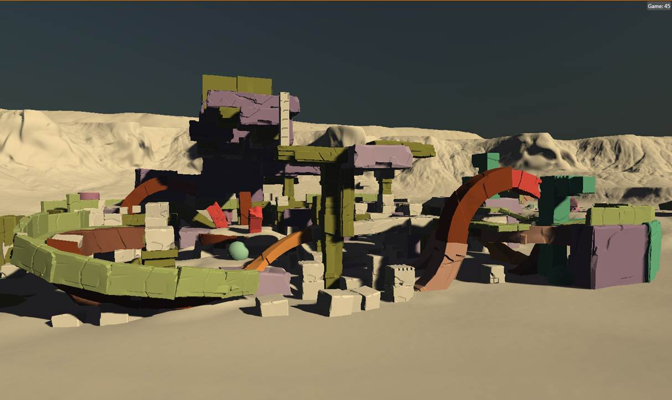
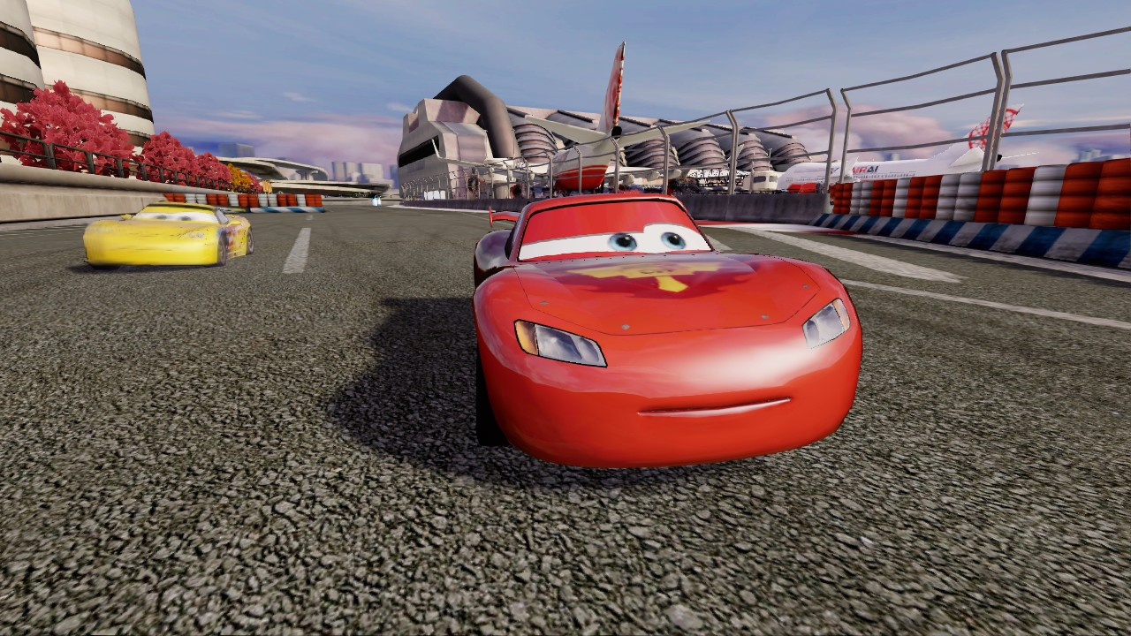
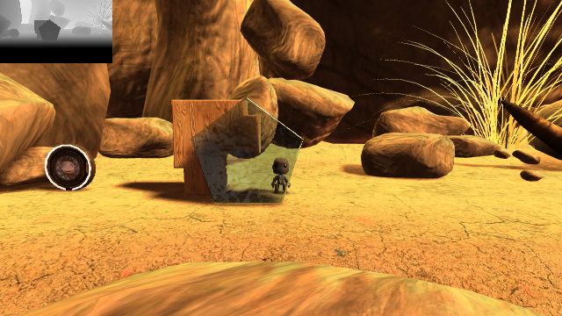
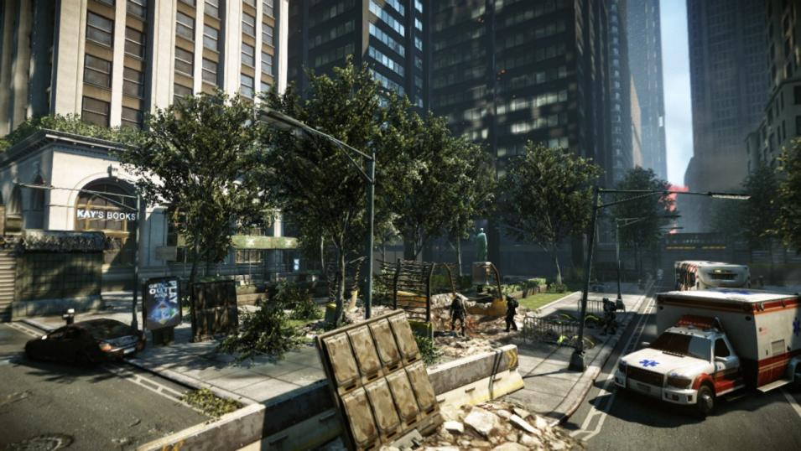
Part I
Monday, August 8th 2011 | 9:00 AM - 12:15 PM | East Hall AB
9:00 ^{am} | Tatarchuk Introduction
9:05 ^{am} | Chen, Silvennoinen, Tatarchuk Making Game Worlds from Polygon Soup: Visibility, Spatial hierarchy and Rendering Challenges
9:50 ^{am} | Hall, C., Hall, R. W., Edwards Rendering in Cars 2
10:30 ^{am} | Evans Two uses of Voxels in LittleBigPlanet2’s graphics engine
11:15 ^{am} | Sousa, Kasyan, Schulz Secrets of CryENGINE 3 Graphics Technology
Notes:
9:00 am Introduction [Tatarchuk] (5 minutes)
9:05 am Making Game Worlds from Polygon Soup: Visibility, Spatial hierarchy and Rendering Challenges [Chen/Silvennoinen/Tatarchuk] (40 minutes)
9:45 am Rendering in Cars 2 [Hall, C., Hall, R. W., Edwards] (45 minutes)
10:30 am Two uses of Voxels in LittleBigPlanet2’s graphics engine [Evans, Kirczenow] (45 minutes)
11:15 am Secrets of CryENGINE 3 Graphics Technology [Sousa, Kasyan, Schulz] (60 minutes)
12:15 pm Close

Slide 8
Part I
Monday, August 8th 2011 | 9:00 AM - 12:15 PM | East Hall AB
9:00 ^{am} | Tatarchuk Introduction
9:05 ^{am} | Chen, Silvennoinen, Tatarchuk Making Game Worlds from Polygon Soup: Visibility, Spatial hierarchy and Rendering Challenges
9:50 ^{am} | Hall, C., Hall, R. W., Edwards Rendering in Cars 2
10:30 ^{am} | Evans Two uses of Voxels in LittleBigPlanet2’s graphics engine
11:15 ^{am} | Sousa, Kasyan, Schulz Secrets of CryENGINE 3 Graphics Technology
Notes:
Folks from Avalanche will talk about various rendering techniques used in Cars 2: The Video Game. Among these, they will discuss work in offloading post-processing onto the Playstation 3's SPU's. This includes using the SPU's to render stereographic 3D images without affecting performance of the game while maintaining full visual quality, resolution, and a full 3d experience for up to 4 players. They will also discuss ways of dealing with potential stereo 3D artifacts and a comparison between SPU and GPU rendering. In addition, they will describe new developments in color precision, post processing effects, and shadows. Lastly they will explain light probes, and the ways they were used for lighting. This includes an overview of probe capture, the volume representation, and ways to make it more artist-controllable.

Slide 9
Part I
Monday, August 8th 2011 | 9:00 AM - 12:15 PM | East Hall AB
9:00 ^{am} | Tatarchuk Introduction
9:05 ^{am} | Chen, Silvennoinen, Tatarchuk Making Game Worlds from Polygon Soup: Visibility, Spatial hierarchy and Rendering Challenges
9:50 ^{am} | Hall, C., Hall, R. W., Edwards Rendering in Cars 2
10:30 ^{am} | Evans Two uses of Voxels in LittleBigPlanet2’s graphics engine
11:15 ^{am} | Sousa, Kasyan, Schulz Secrets of CryENGINE 3 Graphics Technology
Notes:
Tiago Sousa from Crytek will describe an overview of a different method for deferred lighting approach used in CryENGINE 3, along with an in-depth description of the many techniques used to optimize light passes and avoid light leaking, including details regarding rendering of light volumes, platform specific optimizations, stereoscoping 3D rendering and their shadowing techniques.

Slide 10

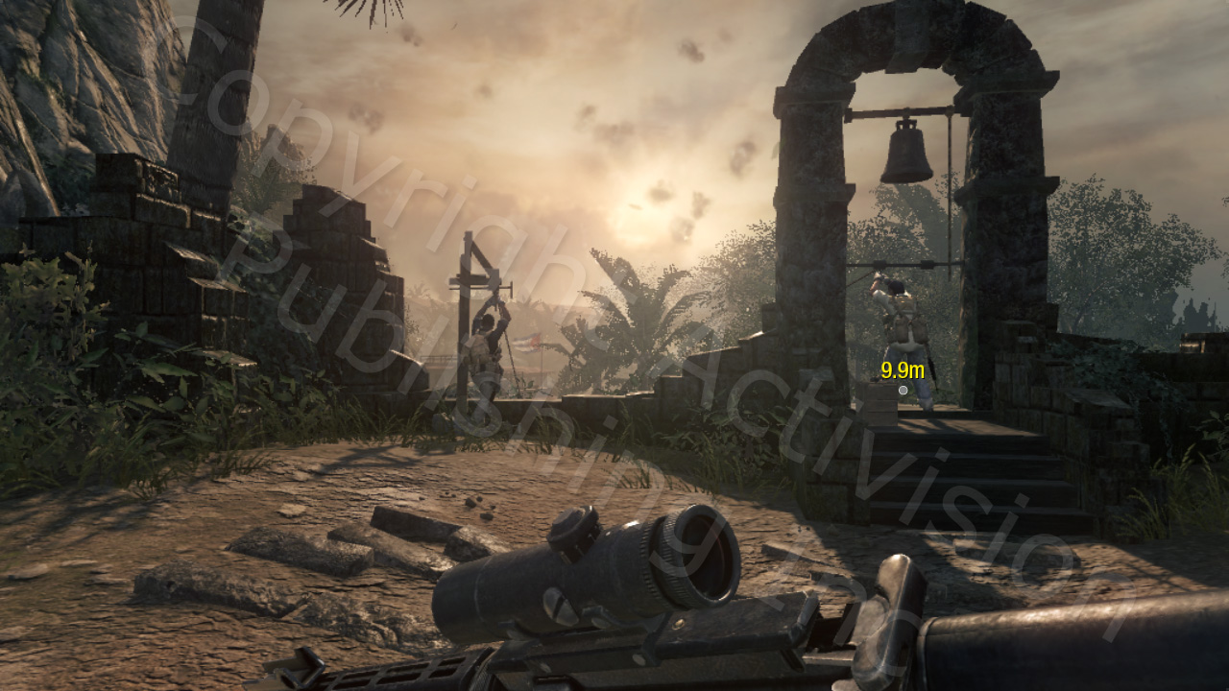
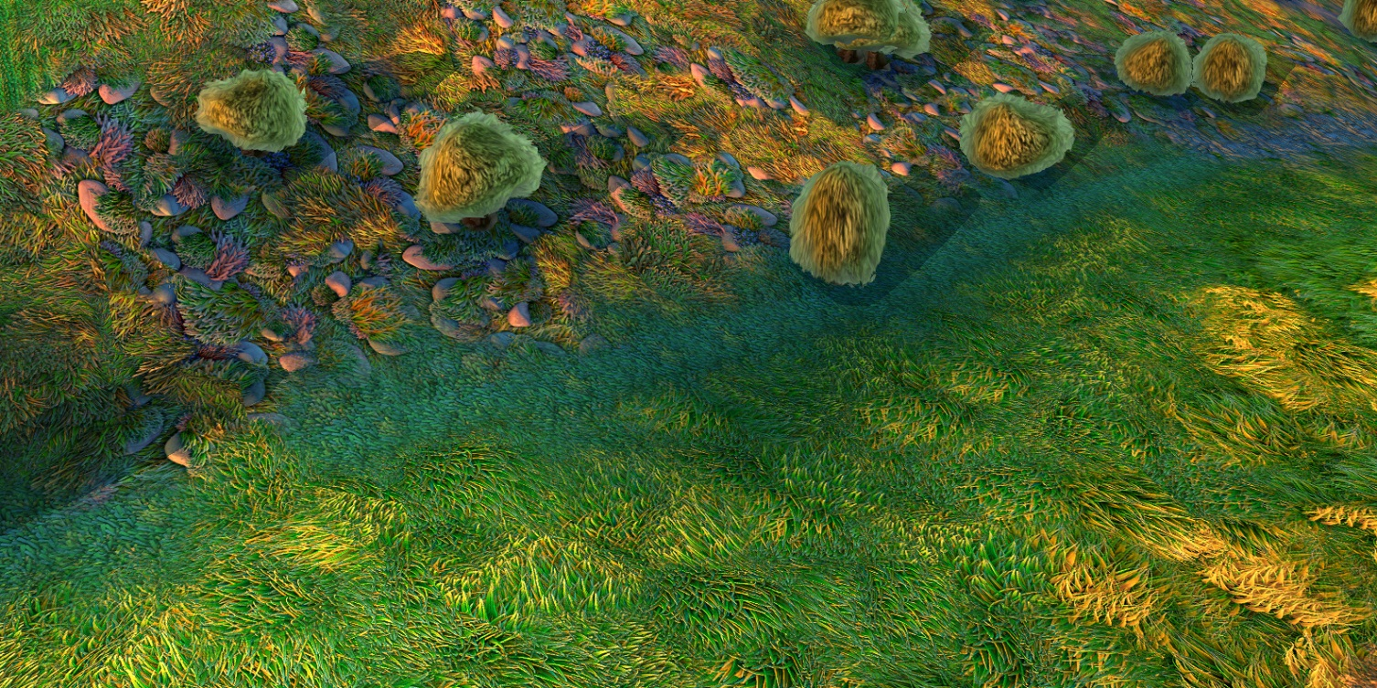
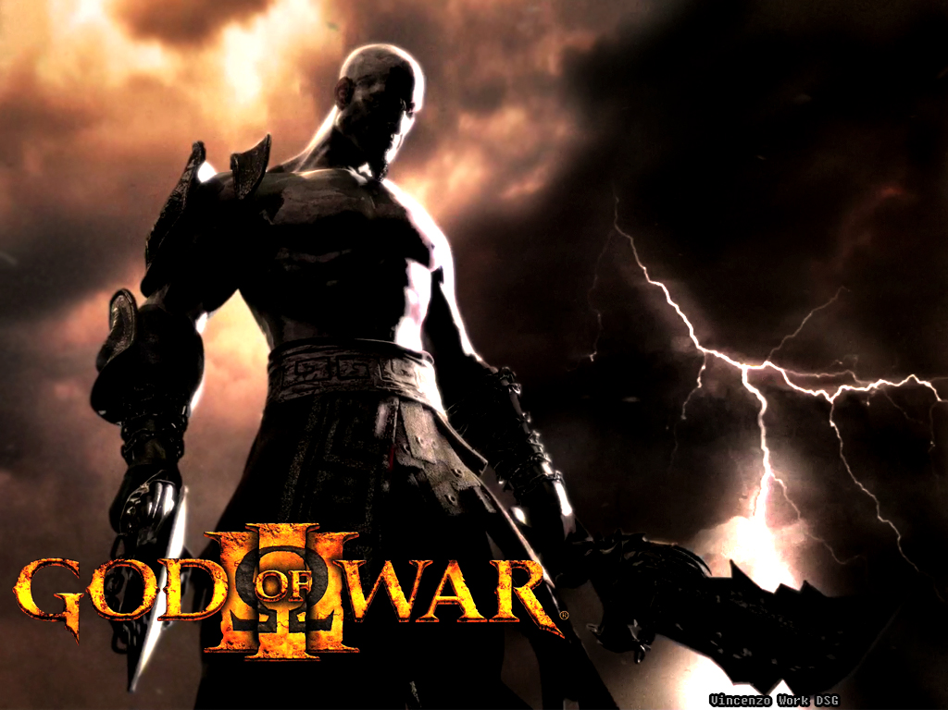
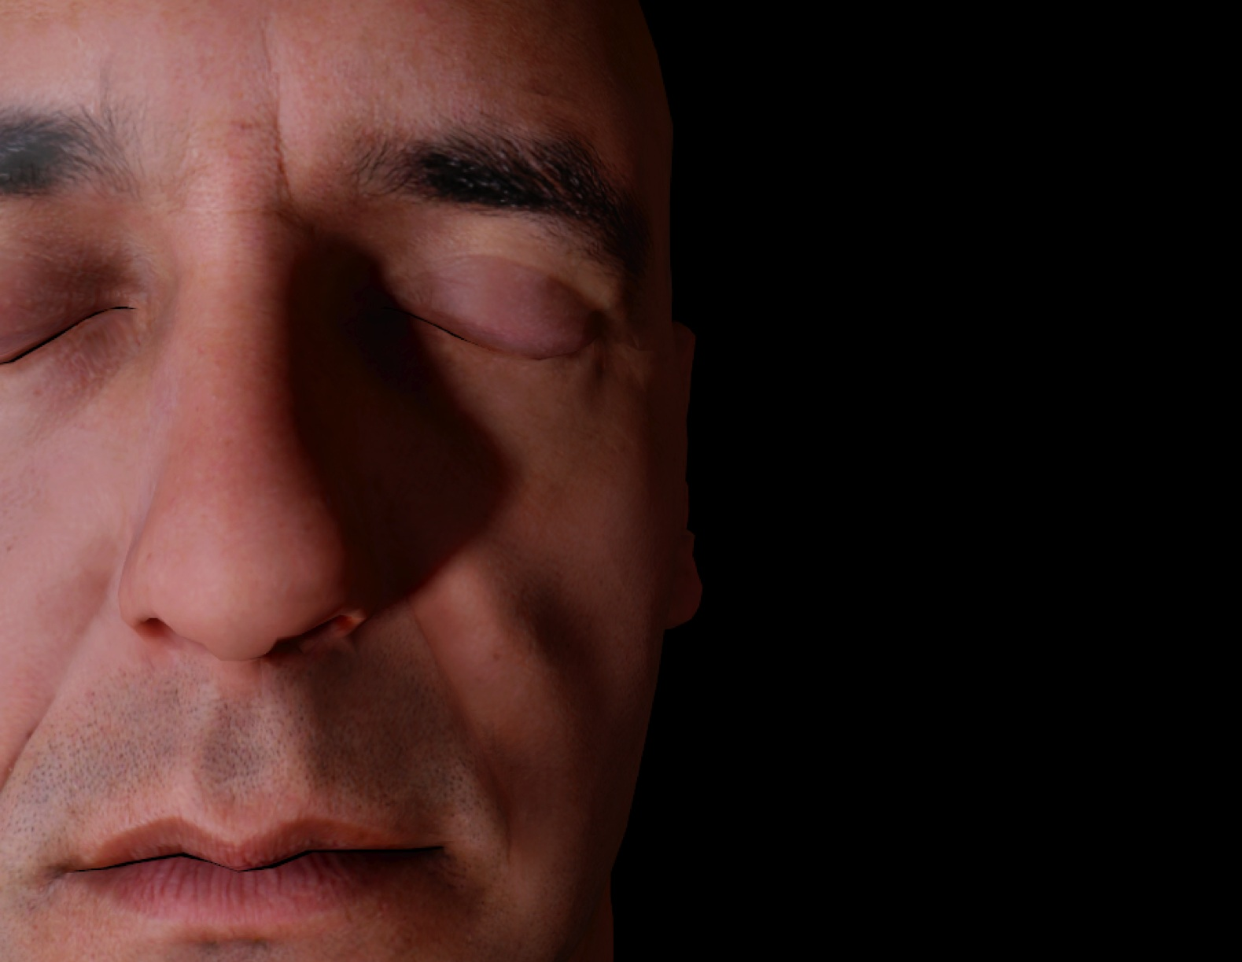
Part II
Monday, August 8th | 2:00 PM - 5:15 PM | East Hall AB
2:00 ^{pm} | White, Barre-Brisebois More Performance Without Quality Compromise: Five Rendering Ideas from Battlefield 3
2:50 ^{pm} | Lazarov Physically-Based Lighting in Call of Duty: Black Ops
3:30 ^{pm} | Malan Real-Time Image Quilting: Arbitrary Material Blends, Invisible Seams, and No Repeats
4:15 ^{pm} | Filippov Dynamic Lighting in God of War 3
4:45 ^{pm} | Penner Pre-Integrated Skin Shading
5:25 ^{pm} | General Q&A, Close
Notes:
2:00pm Welcome! [Tatarchuk] (5 minutes)
2:00pm More Performance Without Quality Compromise: Five Rendering Ideas from Battlefield 3 [White, Barre-Brisebois) (50 minutes)
2:50pm Physically-based lighting in Call of Duty: Black Ops [Lazarov] (40 minutes)
3:30pm Real-time image quilting: Arbitrary material blends, invisible seams, and no repeats [Malan] (45 min)
4:15pm Dynamic lighting in God of War 3 [Filippov] (30 minutes)
4:45pm Pre-Integrated Skin Shading [Penner] (40 minutes)
5:25pm Close

Slide 11
Part II
Monday, August 8th | 2:00 PM - 5:15 PM | East Hall AB
2:00 ^{pm} | White, Barre-Brisebois More Performance Without Quality Compromise: Five Rendering Ideas from Battlefield 3
2:50 ^{pm} | Lazarov Physically-Based Lighting in Call of Duty: Black Ops
3:30 ^{pm} | Malan Real-Time Image Quilting: Arbitrary Material Blends, Invisible Seams, and No Repeats
4:15 ^{pm} | Filippov Dynamic Lighting in God of War 3
4:45 ^{pm} | Penner Pre-Integrated Skin Shading
5:25 ^{pm} | General Q&A, Close
Notes:
In the first lecture in the course John White and Colin Barré-Brisebois will talk about several techniques from the upcoming Battlefield 3 and Need for Speed: The Run titles designed to accelerate the rendering behind these games. The goals of their techniques are to increase performance without visual quality sacrifice. They will focus on chroma sub-sampling for faster full-screen effects, a novel DirectX 9+ scatter-gather approach to bokeh rendering, improved temporally-stable dynamic ambient occlusion, and z-buffer reverse-reload tricks for faster shadow and volumetric deferred lighting.

Slide 12
Part II
Monday, August 8th | 2:00 PM - 5:15 PM | East Hall AB
2:00 ^{pm} | White, Barre-Brisebois More Performance Without Quality Compromise: Five Rendering Ideas from Battlefield 3
2:50 ^{pm} | Lazarov Physically-Based Lighting in Call of Duty: Black Ops
3:30 ^{pm} | Malan Real-Time Image Quilting: Arbitrary Material Blends, Invisible Seams, and No Repeats
4:15 ^{pm} | Filippov Dynamic Lighting in God of War 3
4:45 ^{pm} | Penner Pre-Integrated Skin Shading
5:25 ^{pm} | General Q&A, Close
Notes:
Vassily Fillipov will then give a talk discussing a novel forward lighting approach that was used in God of War 3 to create rich dynamically lit environment with dozens of light sources applied to a single pixel. He will describe how lights were combined using Playstation 3’s SPU architecture to create a single aggregate light for each vertex. He will also describe a new light interpolation approach which improves resulting lighting accuracy and reduces visual errors. Vassily will also describe how the aggregate lights are applied in real-time per pixel on the Playstation 3’s graphics processing unit, the RSX. Complete mathematical explanation of the algorithm will be presented in the talk. Usability constraints, edge cases and ways to reduce artifacts are covered in detail.

Slide 13
Part II
Monday, August 8th | 2:00 PM - 5:15 PM | East Hall AB
2:00 ^{pm} | White, Barre-Brisebois More Performance Without Quality Compromise: Five Rendering Ideas from Battlefield 3
2:50 ^{pm} | Lazarov Physically-Based Lighting in Call of Duty: Black Ops
3:30 ^{pm} | Malan Real-Time Image Quilting: Arbitrary Material Blends, Invisible Seams, and No Repeats
4:15 ^{pm} | Filippov Dynamic Lighting in God of War 3
4:45 ^{pm} | Penner Pre-Integrated Skin Shading
5:25 ^{pm} | General Q&A, Close
Notes:
In the following talk in the course, Hugh Malan will present a method for implementing image quilting in the pixel shader. This technique provides solutions for situations where standard environment texturing has problems: transitions between arbitrary neighbour materials (such as asphalt to earth), localized texture features due to custom geometry (such as rust stains down a wall from a metal structure), and edge effects (such as damage along edges of an arbitrary concrete shape). Production issues will also be covered, including techniques for sharing vertices and substantially reducing vertex size, texture storage options, and implementation issues for PC, Microsoft Xbox 360 and Sony Playstation3.

Slide 14
Part II
Monday, August 8th | 2:00 PM - 5:15 PM | East Hall AB
2:00 ^{pm} | White, Barre-Brisebois More Performance Without Quality Compromise: Five Rendering Ideas from Battlefield 3
2:50 ^{pm} | Lazarov Physically-Based Lighting in Call of Duty: Black Ops
3:30 ^{pm} | Malan Real-Time Image Quilting: Arbitrary Material Blends, Invisible Seams, and No Repeats
4:15 ^{pm} | Filippov Dynamic Lighting in God of War 3
4:45 ^{pm} | Penner Pre-Integrated Skin Shading
5:25 ^{pm} | General Q&A, Close
Notes:
Finally, Eric Penner will describe a technique for rendering realistic skin in games, discussing an approach where rather than gathering neighboring light to simulate subsurface scattering, the effects of scattered light are pre-integrated which allows achieving the non-local effects of subsurface scattering using only locally stored information and a custom shading model.

Slide 15
Slides & Notes
All material will be posted on
http://advances.realtimerendering.com/
Notes:
Raw slides shold be posted this week.

