Slide 1



Slide 2
Pre-integrated Skin Shading
Eric Penner
Notes:
Hi, everybody
I just want to welcome everybody to this beautiful city
And I’m proud to say all the work I’m going to present today was developed here in Vancouver while I was working at Electronic Arts
Of course Murphy’s law says that after I got accepted to present here in my home town, and opportunity came up and I moved to San Francisco.
So I can’t say this is my home town anymore.

Slide 3
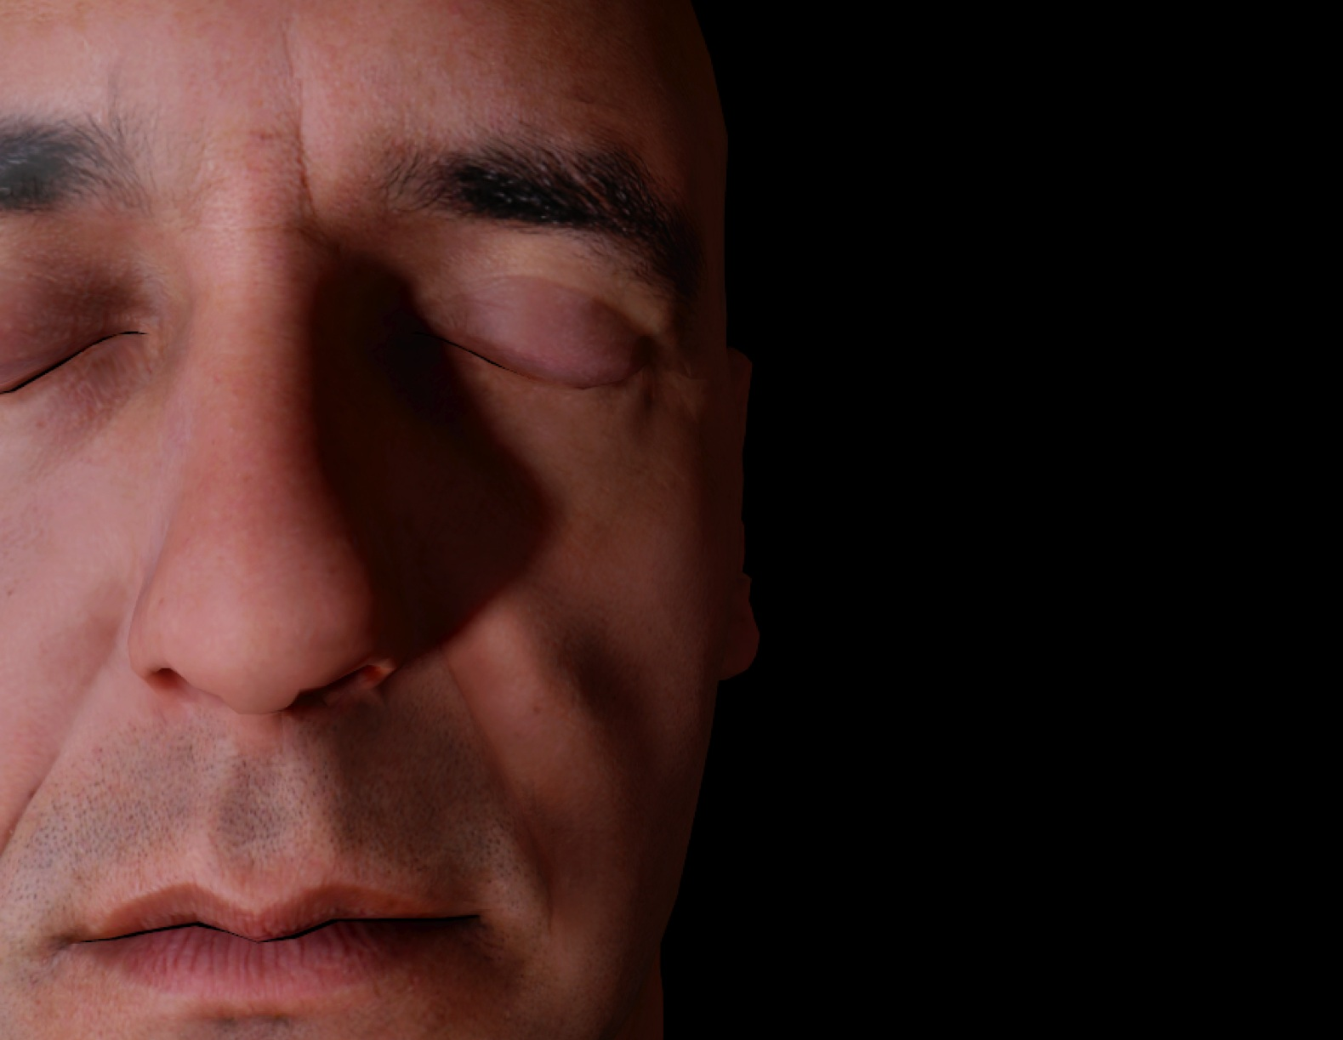
Notes:
Anyway, moving on to what I want to present today:
This image basically sums up what I want to talk about. I want to talk about rendering very realistic characters with nice soft realistic looking skin.
What makes what I’m going to talk about unique is I want to do this purely as a simple shader that you can drop into almost any pipeline.
Also, I think the process of coming up with this approximation occurs a lot in rendering. So I’m going to talk about that a bit.

Slide 4

Overview
Intro to SSS
TSD Approaches to SSS
Our Approach - Pre-Integrated Skin Shading
Extra time? Two Tricks for character shadows
  Masked Variance Shadow Maps
  PCF² using Pixel Quad Messages (16x depth samples)
Notes:
As an overview
I’m going to talk a bit about SSS; The best way of doing this in real-time TSD; A new approach called pre-integrated skin shading; and why tone-mapping is important
Two tricks for character shadow rendering: One that lets you get 16x the depth samples when doing PCF; Improving the quality of variance shadow maps, specifically for character faces

Slide 5
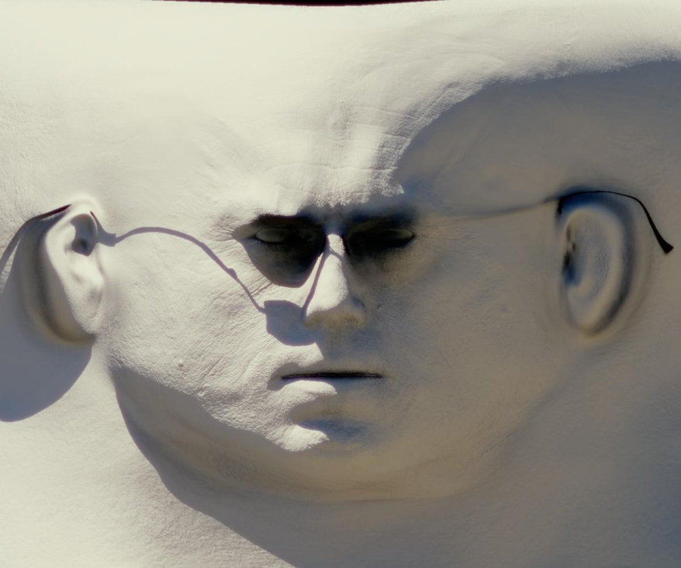
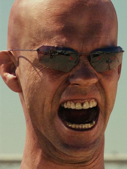
Subsurface Scattering - TSD
Texture Space Diffusion _{(Borshukov et al.)}
Notes:
When people talk about realistic skin rendering they usually mention SSS. The first time people realized we might be able get realistic sub-surface scattering in real-time was around 2003 (Matrix sequels). In those films they realized that because skin has limited scattering distance and limited curvature. They could get away without more expensive techniques (ray-tracing or volumetric scattering simulations). Instead, they gathered incident light in a texture (light map), performed a custom tailored blur to mimic scattering of R/G/B light. This wasn’t real-time, but it was still faster/easier.

Slide 6
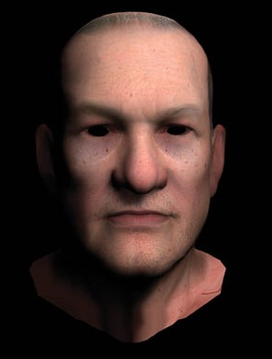
Subsurface Scattering - TSD
Texture Space Diffusion _{(Borshukov et al.)}
Gaussian Blur / Wrap lighting_{(Gosselin/Green)}
Notes:
The first real-time approach applied the basically same technique using a 2-pass gaussian blur

Slide 7
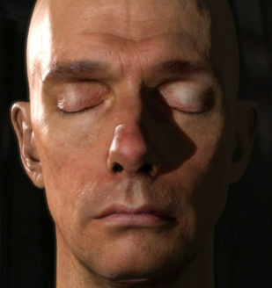
Subsurface Scattering - TSD
Texture Space Diffusion _{(Borshukov et al.)}
Gaussian Blur / Wrap lighting_{(Gosselin/Green)}
Efficient Rendering of Human Skin _{(d’Eon et al.)}
Notes:
And finally we got quality matching offline rendered results in the NVIDIA human head demo

Slide 8
Subsurface Scattering - TSD
NVIDIA Human Head
  Gold standard for quality in real-time
  Helps to have high quality head scan
Notes:
NVIDIA Human Head
Still probably the gold standard for real-time skin rendering

Slide 9
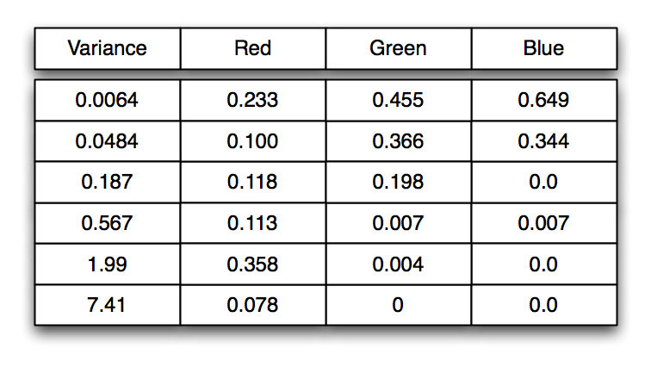
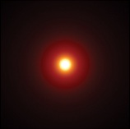
Subsurface Scattering - TSD
GPU Gems 3 - Diffusion Profile
Notes:
What was unique about this approach: Used measured data from real skin, and then fit that data with a sum of gaussians approximation. Could be performed using a set of 2-pass gaussian blurs (which had different weights for R/G/B)

Slide 10
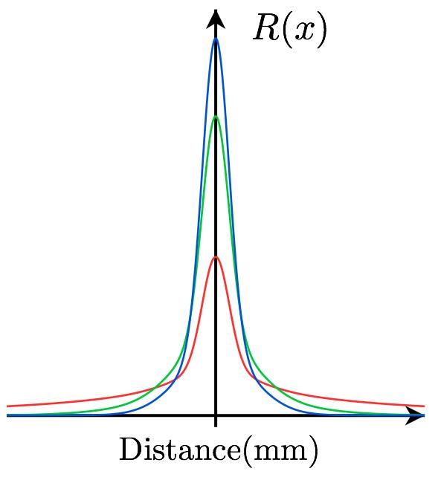
Subsurface Scattering - TSD
GPU Gems 3 - Diffusion Profile

Slide 11
Subsurface Scattering - TSD
NVIDIA Human Head
  Gold standard for quality in real-time
  Lots of 1024² or 2048² maps
  Many Gaussian blur passes
Take Home Messages
  Linear Lighting! Needs Good Spec! (multiple lobes)
  Skin diffusion is not Gaussian (two pass blur isn’t enough)
Notes:
-Main issue is with this technique performance
12 blur passes of big lightmaps
Tough to fit into real-time engine
It had some great other take home messages too though:
Such as performing all lighing calculations in a linear space (not gamma space)
Proposed a great specular model for skin (multiple spec lobes)
Skin diffusion is not a gaussian (so we can’t get the precise look of scattering in skin using a 2 pass gaussian blur)

Slide 12
Fast Subsurface Scattering
Fast Subsurface Scattering
  ShaderX⁷ _{(Hable et al.)}
  Make a custom jittered kernel
  Unique weights for r/g/b
float2 blurJitteredSamples[13] = {
{ 0.000000, 0.000000 },
{ 1.633992, 0.036795 },
{ 0.177801, 1.717593 },
{ -0.194906, 0.091094 },
....
};
float3 blurJitteredWeights[13] = {
{ 0.220441, 0.437000, 0.635000 },
{ 0.076356, 0.064487, 0.039097 },
{ 0.116515, 0.103222, 0.064912 },
{ 0.064844, 0.086388, 0.062272 },
....
};
Notes:
Very nice optimizations of this technique exist
Fast subsurface scattering uses a 12 tap jittered blur kernel
Where each tap gets uniquely weighted for R/G/B

Slide 13
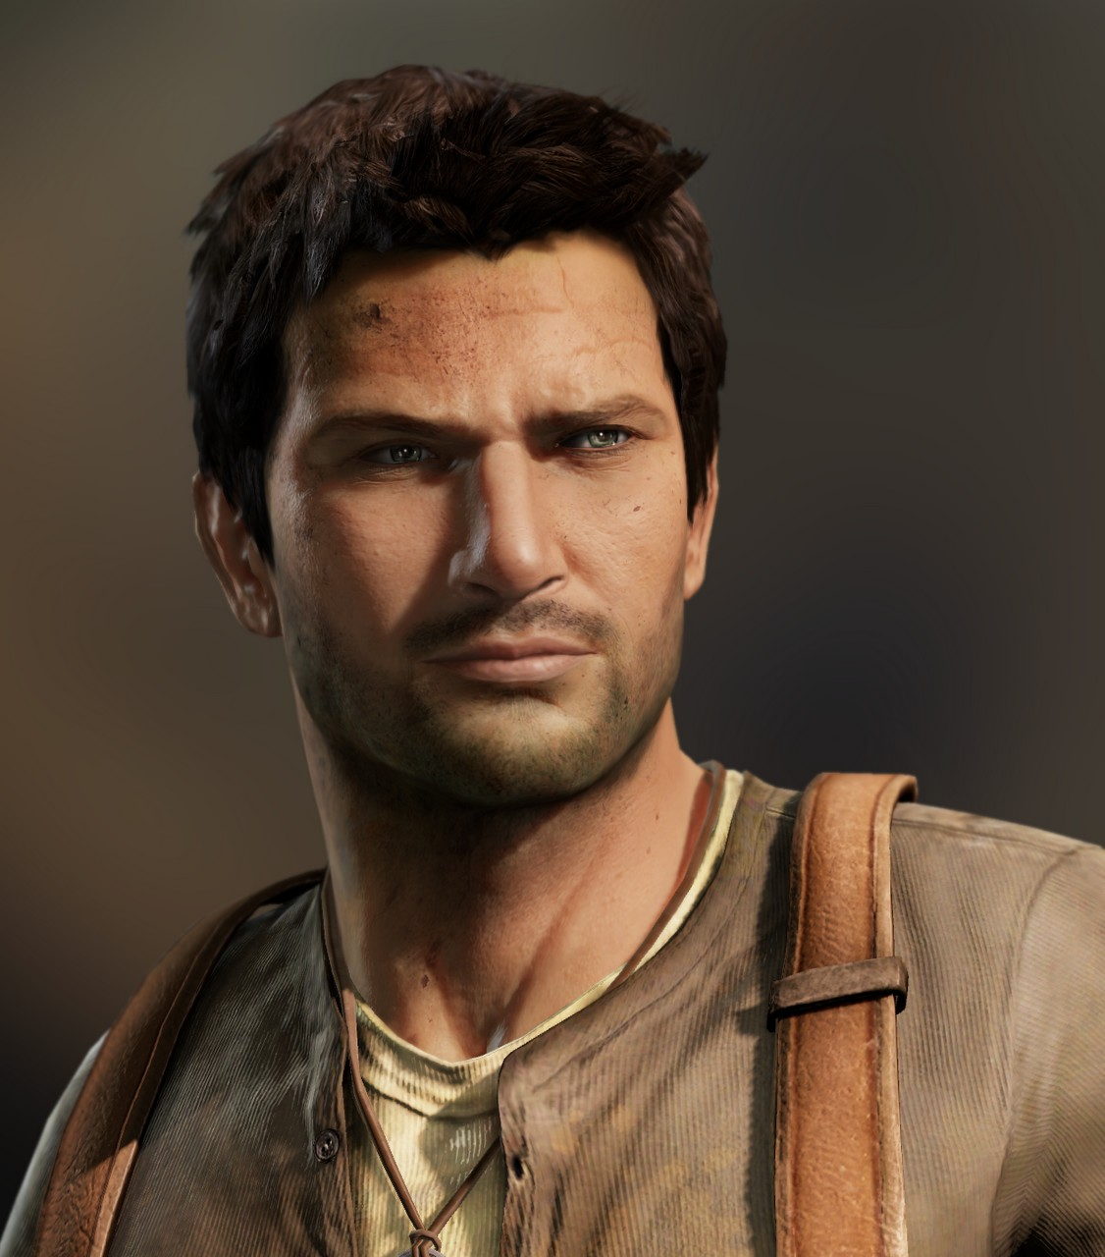
Fast Subsurface Scattering
Fast Subsurface Scattering
  ShaderX⁷ _{(Hable et al.)}
  Make a custom jittered kernel
  Unique weights for r/g/b
_{Uncharted} ₂
Notes:
Uncharted 2 used it. Very nice!

Slide 14
Fast Subsurface Scattering
Remaining Problems
  Much better performance, but still expensive
  Doesn’t scale (10 heads/body-parts = 20 light-maps)
  Seams in UV space
  Light-map resolution
  Banding due to inadequate samples

Slide 15
Screen Space SSS
Screen-Space Subsurface Scattering_{(Jiminez et al.)}
  Do the blur in screen-space
  More scalable, but high fixed cost
  Requires deferred renderer
  Adds many G-buffer channels
  Too many ‘S’s?

Slide 16
Pre-Integrated Skin Shading
Goal: A simple pixel shader
  All inputs stored locally in texture/bump maps (no blur passes)
Key Observation:
  Scattering isn’t visible everywhere
  Occurs near changes in incident light (light gradients)
Strategy:
  Find light gradients and pre-integrate scattering
Notes:
What I thought would be interesting when I looked at skin shading:
Nobody had looked at just how far we can push a standard pixel-shader to rendering sub-surface scattering
Especially if we specifically tailor it for skin
Goal of pre-integrated skin shading is to store all the data we need in vertices/texture maps
No extra blur or diffusion passes

Slide 17

Constant incident light: Do nothing!
Notes:
If we look at what happens in texture space diffusion
- I found there is really only few different cases
One really interesting case is when there is constant incident light
Interestingly in that case we don’t have to do anything!

Slide 18

Small Surface Bumps
Notes:
- Over here, on the other hand, we can see that surface curvature has created a strong diffuse fall-off
We can see that TSD would essentially scatter the light around the surface slightly, depending how curved the surface is
This describes what happens on a big scale…

Slide 19

Small Surface Bumps
Notes:
But once we get into really small features,
- Light won’t just wrap around a little bit, it will actually diffuse right through features like wrinkles and bumps

Slide 20

Shadows
Notes:
And then finally, when shadows fall on the surface, light will scatter into the shadows
- Again, creating that unique look of skin

Slide 21
Three Problems to Solve
Notes:
Since I described the one situation where we don’t have to do anything
We are really left with 3 phenomena to deal with here
If we are going to come anywhere close to TSD

Slide 22
Three Problems to Solve
1.) Surface Curvature
2.) Small Surface Bumps
3.) Shadows

Slide 23
Three Problems to Solve
1.) Surface Curvature
Notes:
Let’s start with the effect of surface curvature

Slide 24
Curvature: Pre-Integrated BRDFs
Diffuse Lambertian fall-off (dot(N,L))
  Causes incident light gradient
Why not bake scattering in modified dot(N,L)?
  Wrap lighting (GPU Gems 1)
  ATI Skin Fall-Off
  Half-Life Fall-Off
Notes:
- Diffuse or lambertian fall-off (basically the N.L in your shader)
Causes an incident light gradient on a surface, when a surface is curved
So one immediately might think, can we just bake the effect of scattering into the N.L calculation
Well, yes and this has been done a few times and its usually known as wrap lighting
GPU gems 1 mentioned this together with TSD
ATI skin fall-off
Half-life-2 wrap lighting

Slide 25
Curvature: Pre-Integrated BRDFs
Problems with wrap lighting?
  Not based on real skin diffusion profiles
  Biggest problem: doesn’t account for curvature/thickness!
Notes:
- What are the real problems with wrap lighting.
Why do people like about texture space diffusion over this technique
Well think there is really two problems
First, these techniques are not based on real measured skin diffusion profiles
Biggest problem, IMO is these techniques don’t account for surface curvature
If we have a big object, light won’t scatter around it nearly as much as it will for a small object

Slide 26
Curvature: Pre-Integrated BRDFs
Problem: Not based on real skin diffusion profile
Solution: Pre-blur diffuse BRDF with skin profile
Notes:
So to address problems:
For the problem of not being based on a real skin diffusion profile
Why don’t we do a full simulation of skin on a diffuse BRDF and see if that gets us better results
And..

Slide 27
Curvature: Pre-Integrated BRDFs
Problem: Not based on real skin diffusion profile
Solution: Pre-blur diffuse BRDF with skin profile
Problem: Doesn’t account for surface curvature
Solution: Parameterize BRDF with curvature
Notes:
- For the problem of not accounting for surface curvature (or the different sizes of objects)
- Why don’t add curvature as an extra parameter to our BRDF

Slide 28
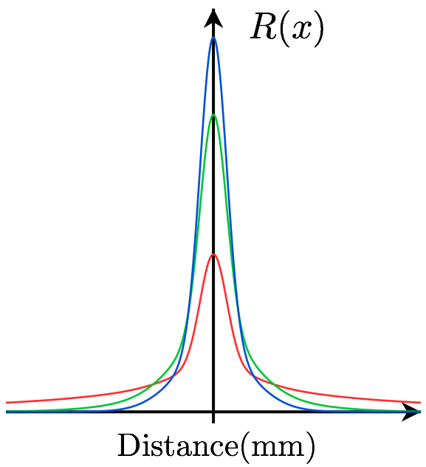
Curvature: Pre-Integrated BRDFs
How do we pre-integrate the diffuse BRDF?
Profile
Notes:
How do we pre-integrate the effect of scattering on a diffuse BRDF?

Slide 29
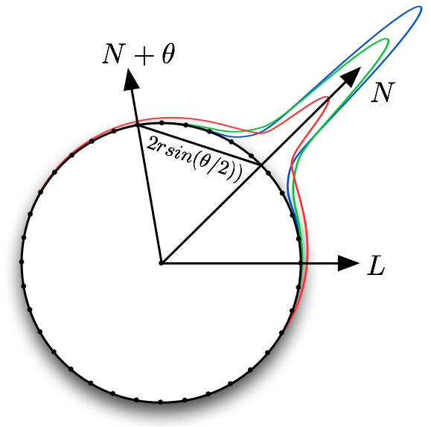
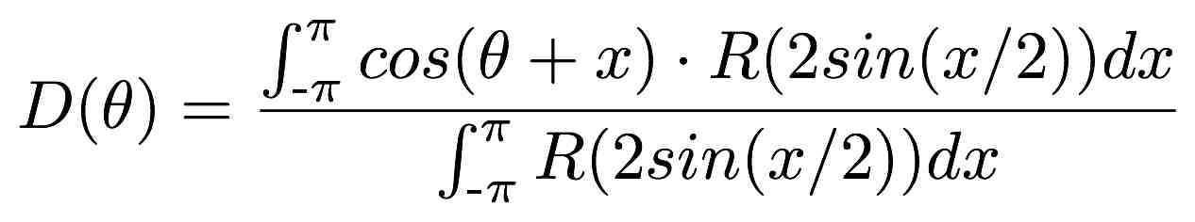
Curvature: Pre-Integrated BRDFs
Integrate all incoming light on a sphere_{(or a ring, it’s easier)}
Profile
Notes:
- We can basically take our regular diffuse light calculation:
And calculate exactly what scattering would look like on a sphere of a particular size (or of a particular curvature)
And we do this by gather all the diffuse light incoming from all points on the sphere (or ring, it’s easier)
We can really use any expensive technique here since we will just record the results.
So basically for each point on our diffuse fall-off (the diagram on the right shows one angle between the normal and the light)
we integrate all the light that would arrive from scattering from the entire sphere
This is expensive, so we record this value so we can use it later

Slide 30
Curvature: Pre-Integrated BRDFs
Let see look at some results!
Notes:
So let’s just compare, just using an accurate profile of skin, to some other approaches that modify the diffuse fall-off to mimic the effect of scattering

Slide 31
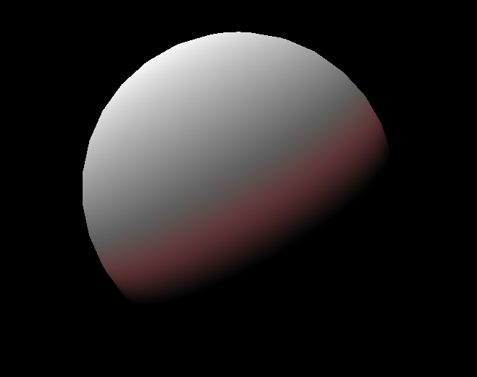
Curvature: Pre-Integrated BRDFs
Wrap Lighting
GPU Gems 1
Gamma space lighting
No tone-mapping
Notes:
The first technique I could find, from GPU gems 1, still used gamma space lighting , no tone-mapping
Basically, just wrapped red light a bit further around

Slide 32
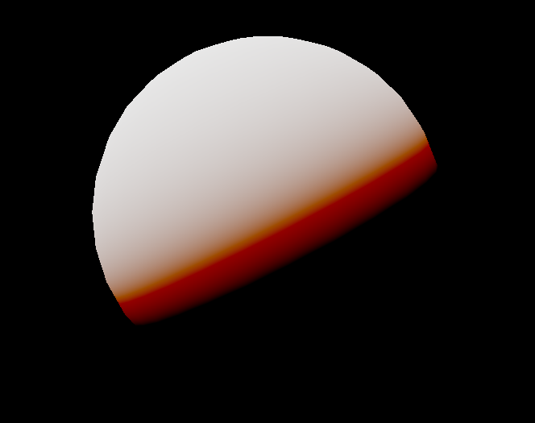
Curvature: Pre-Integrated BRDF
Wrap Lighting
More recent (used today)
Linear lighting
Filming Tone-mapping
Notes:
Here’s another example of wrap lighting
This is using linear lighting and filmic tone-mapping
You can see this technique basically extends red green and blue light further around the sphere, but

Slide 33
Curvature: Pre-Integrated BRDF
Wrap Lighting
More recent (used today)
Linear lighting
Filming Tone-mapping
B/G/R Cutoffs
are clearly visible
Notes:
We can basically clearly the see where the blue green and red cut offs are, so it doesn’t look very natural.

Slide 34
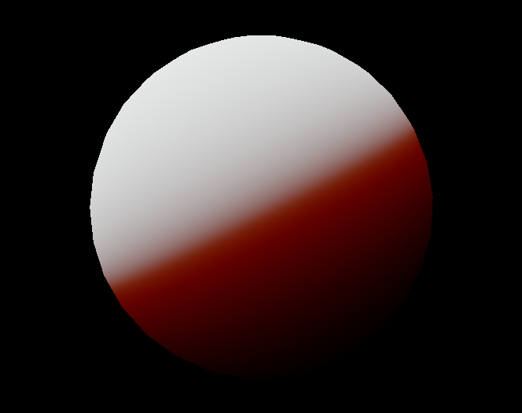
Curvature: Pre-Integrated BRDF
Pre-integrated scattering
Linear lighting
Filmic tone-mapping
Notes:
Now, if we look at the fall-of we get from pre-integration
We can see it should already look a lot more smooth and natural
At this point there shouldn’t be any difference from an offline rendering that uses a volumetric technique
If there is a difference, just use that offline technique. This is pre-computed anyway.

Slide 35
Curvature: Pre-Integrated BRDF
How does curvature help?
Notes:
So the next question is, how is curvature involved in all of this
And how is it going to help

Slide 36
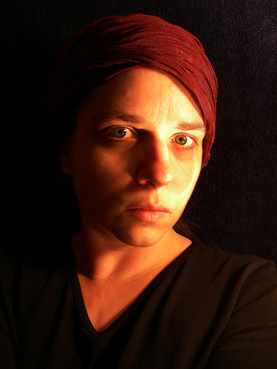
Curvature: Pre-Integrated BRDF
How does curvature help?
Look at nose vs. forehead
Notes:
Well if we look at this photo, for example,
We can see that scattering is a lot more visible on the bridge of the nose
Compared with on the forehead.
This is because the higher curvature on the nose creates stronger incident light gradient,
Which will result in a lot more visible scattering.

Slide 37
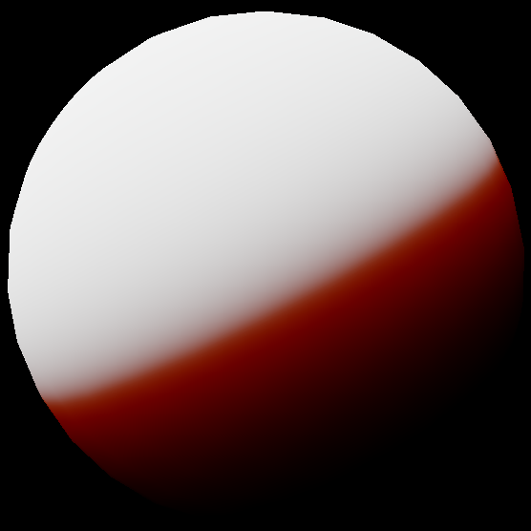
Curvature: Pre-Integrated BRDF
Let’s decrease the size
Notes:
-We showed the effect of scattering on one particular curvature
-So let’s see how this works if we apply it to different sizes
-Let’s decrease the sphere size by a power of two

Slide 38

Curvature: Pre-Integrated BRDF
Let’s decrease the size
Notes:
And again

Slide 39

Curvature: Pre-Integrated BRDF
Light scatters right through.
Now let’s increase size
Notes:
- So at this point light scatters right through because this is just a few millimeters thick.
- Now let’s increase the size by powers of two

Slide 40
Curvature: Pre-Integrated BRDF

Slide 41
Curvature: Pre-Integrated BRDF
Notes:
So now we get less and less visible scattering

Slide 42

Curvature: Pre-Integrated BRDF
Flatter surfaces have less
visible scattering

Slide 43
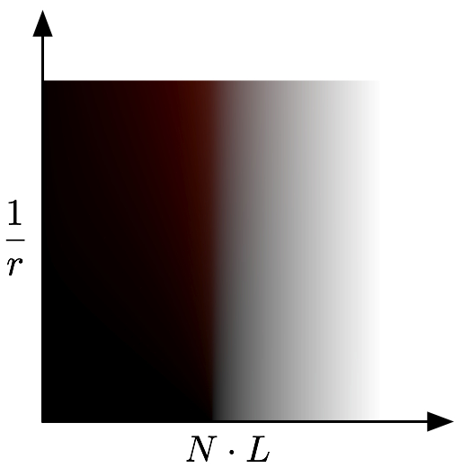
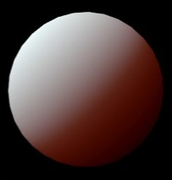

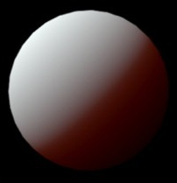
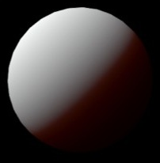
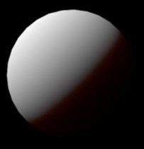
Curvature: Pre-Integrated BRDF
Now bake everything!
Notes:
So, now that we’ve used the accurate skin profile to capture the look of scattering on various surface curvatures
We can store all this data in a simple 2D texture that is parameterized by N.L and curvature

Slide 44
Curvature: Pre-Integrated BRDF
So where do we get curvature (1/radius)
Notes:
So the next question, where do we get an estimate of curvature from.

Slide 45
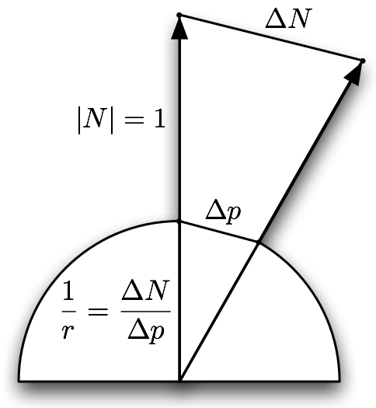
Curvature: Pre-Integrated BRDF
So where do we get curvature (1/radius)
  Similar triangles and derivatives.
Notes:
Well it turns out we can get a first order estimate of curvature by just using a simple similar triangles relationship between the rate of change in our normal vector and the rate of change of our position in world space. And we can get these infinitesimal changes using derivative instructions.

Slide 46
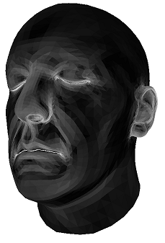
Curvature: Pre-Integrated BRDF
So where do we get curvature (1/radius)
  Similar triangles and derivatives.
c = length(fwidth(N)) /
length(fwidth(p_{mm}))
Notes:
And here we can see the result of applying this on a head model.
Note: This is made to visualize the curvature, but you should use the correct units from the diffusion profile and then correct for the range of curvatures in the lookup texture.

Slide 47
Curvature: Pre-Integrated BRDF
So where do we get curvature (1/radius)
  Similar triangles and derivatives.
Derivatives are constant within a triangle
  Sometimes this is fine
  If edges appear, store curvature in vertices or texture
Notes:
Unfortunately, since shader derivatives are constant within a triangle, we get a constant curvature value for each triangle using this approach.
For smooth meshes this isn’t usually a problem, but even if it does become a problem, we can pre-calculate curvature and store in our mesh vertices, or in an auxiliary texture. The trade off is we won’t get dynamic changes.

Slide 48
Three Problems to Solve
1.) Surface Curvature
Pre-integrated curvature-based BRDF
2.) Small Surface Bumps
Notes:
Okay, so now that we’ve talked about surface curvature, let’s look at the effect of scattering on small surface bumps

Slide 49
Per-Channel Bent Normals
BRDF works for smooth curvy surfaces
What about small bumps in normal maps?
  Light should scatter past several surface bumps
  Using curvature breaks down at small sizes
Let’s focus only on normals now
Notes:
So our modified BRDF works for very smooth and curvy surfaces
What about very small bumps in normal maps that are common on skin
In this case light should scatter past several surface bumps, so using curvature breaks down at small sizes.

Slide 50
Per-Channel Bent Normals
With a normal map we can sample neighbourhood
  We could take many samples, light, weight and accumulate
Or, can we pre-filter the normal map?
  Pre-filtering dot(N,L) is correct
  Pre-filtering max(0,dot(N,L)) isn’t strictly correct _{(but it’s close)}
  LEAN/CLEAN mapping does this for specular
Notes:
A unique thing about a normal map is, now we have easy access to the neighboring bumps in the surface.
So, we could for example:
- Take several samples from our normal map
- Perform diffuse lighting and then sum the results using our skin profile to weight them
- But that sounds very inefficient
What we would rather do, is pre-filter the normal map! So we can use one sample to get the same result.
It turns out pre-filtering the normals by just simply blurring them, is still correct if all we need is N.L
Unfortunately it isn’t strictly correct when we add diffuse self shadowing term (basically not allowing negative values, saturate(N.L)).
But it’s still very close

Slide 51
Per-Channel Bent Normals
Tangent:
  Normal maps can be acquired _{(Ma et al. 2007)}
  One technique applies light gradients to capture normals
  Different light colours produced different captured normals
Notes:
The best work that I think best demonstrates this, is actually trying to solve the inverse problem of capturing normal maps
- What these researchers found was when they used different colors of light in their capture system they got different normal maps out.

Slide 52
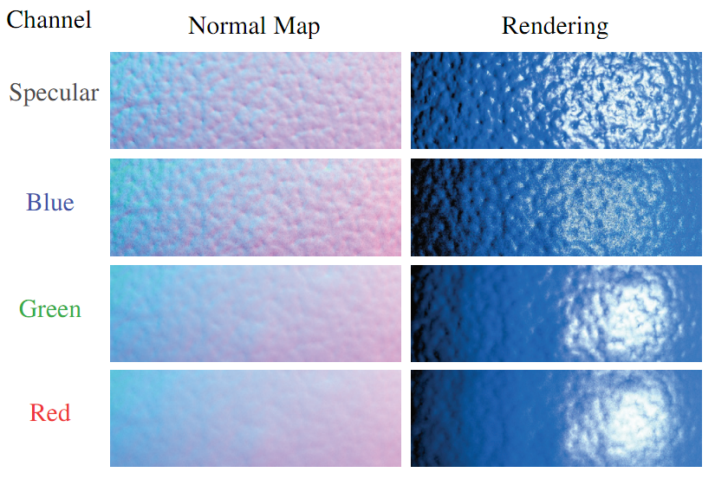
Per-Channel Bent Normals
Ma et al. 2007 - Rapid Acquisition of Specular and Diffuse Normal Maps

Slide 53
Per-Channel Bent Normals
Ma et al. 2007 - Rapid Acquisition of Specular and Diffuse Normal Maps

Slide 54
Per-Channel Bent Normals
Ma et al. 2007 - Rapid Acquisition of Specular and Diffuse Normal Maps

Slide 55
Per-Channel Bent Normals
Ma et al. 2007 - Rapid Acquisition of Specular and Diffuse Normal Maps
Notes:
This paper also had nice rendering results that used 4 normal maps.
Where each normal map was used to calculate red, green and blue diffuse light, and specular light respectively

Slide 56
Per-Channel Bent Normals
We don’t need captured normals to use this technique
Start with ‘true’ normal map (spec)
Pre-filter new normal maps with R/G/B skin profiles
Optimally we need 4 normals now
  R/G/B and Spec
  Looks great! Lots of memory!
Notes:
-However, we don’t need captured normal maps to use this technique
-Since blurring normal maps is adequate for pre-filtering
We can basically start with our true surface normal (the normal we would use for specular)
Pre-filter new normal maps for R/G/B using our skin profile again.
Optimally for this technique we need 4 normal maps
-I tried this and found it looked really good
But, that also takes a lot of memory
So there are some ways to optimize this

Slide 57
Bent Normals (Optimized)
A.) Use geometry and spec normals (blend the rest)
  Only works for certain art!
  Normal map must contain only details (wrinkles/pores)
B.) Use two normal samples (blend the rest)
  Works for all art!
  One normal-map, two samplers
  Clamp one sampler at blurred mip threshold
Notes:
Explain
Okay let’s look at some results

Slide 58
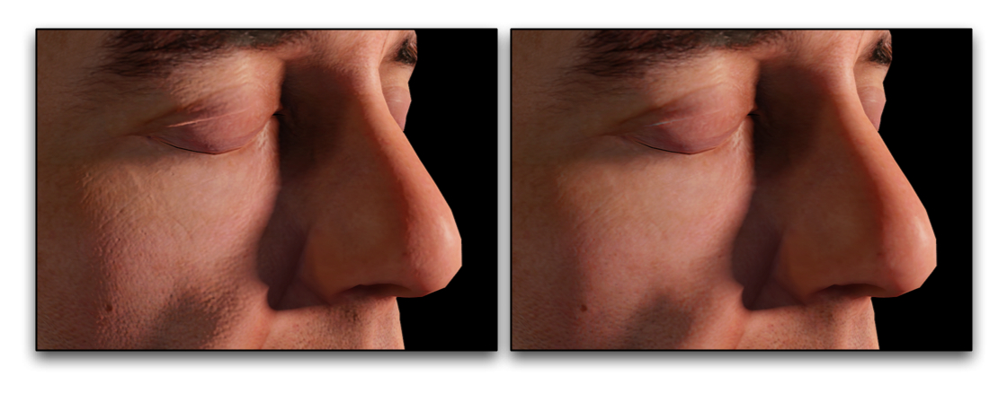
Bent Normals - Results
  Without bent normals
  With bent normals

Slide 59
Bent Normals - Results
Now we have pretty good solutions for:
  Curvy but smooth surfaces (pre-integrated BRDF)
  Flat but bumpy surfaces (pre-integrated normal maps)
These complement each other
BRDF chosen from prevailing curvature (geometry)
  Broad scattering from dominant surface
Bent normals fill in the gaps
  Fine-grained scattering of local details
Notes:
Explain

Slide 60
Three Problems to Solve
1.) Surface Curvature
Pre-integrated curvature-based BRDF
2.) ‘Small’ Surface Bumps
Pre-integrated bent normals
3.) Shadows
Pre-integrated shadow penumbrae

Slide 61
Shadows
What about shadows?
Shadows also give skin a characteristic look
Seems more difficult:
  Shadows depend on arbitrary occluders
  Can fall anywhere on the surface

Slide 62
Shadows
Turns out we can apply a very similar technique
Other approaches have used a texture lookup to mimic the look of skin_{(GDC 2005, Tatarchuk)}
In our work we apply the diffusion profiles
Notes:
Turns out we can apply a very similar technique
If we think of the problem from the perspective of the light, rather than from the perspective of the skin UV

Slide 63
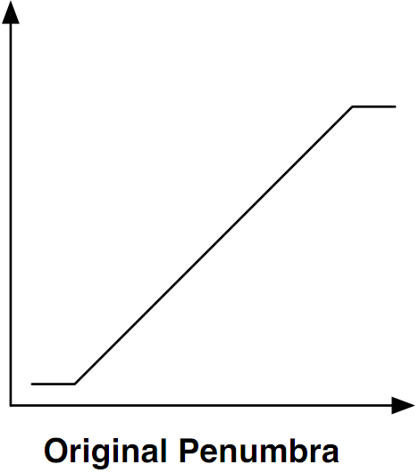
Shadows
Turns out we can apply a very similar technique
This is the shadow from a box filter
S(x)
Notes:
This is the result of blurring a hard shadow edge with a box filter during percentage closer filtering, or something like variance shadow maps
What I found is that it helps to think of this not as a shadow yet,
but just a fall-off function we have created from blurring a hard edge (step function)

Slide 64
Shadows
Turns out we can apply a very similar technique
This is the shadow from a box filter
S(x)
  Given the shadow value
Notes:
In that situation,
If we know the blur kernel we used (and again, assuming this is a hard shadow edge)
Then given the value of the value we get out of our shadow calculation…

Slide 65
Shadows
Turns out we can apply a very similar technique
This is the shadow from a box filter
S(x)
  Given the shadow value
  Invert the penumbra blur function
S⁻¹(x)
Notes:
We can actually invert this fall-off function (at least approximately)
And get the original position within our fall-off function. So the fall off function can be used as a distance.

Slide 66
Shadows
Turns out we can apply a very similar technique
This is the shadow from a box filter
S(x)
  Given the shadow value
  Invert the penumbra blur function
  Find the position within the shadow
S⁻¹(x)

Slide 67
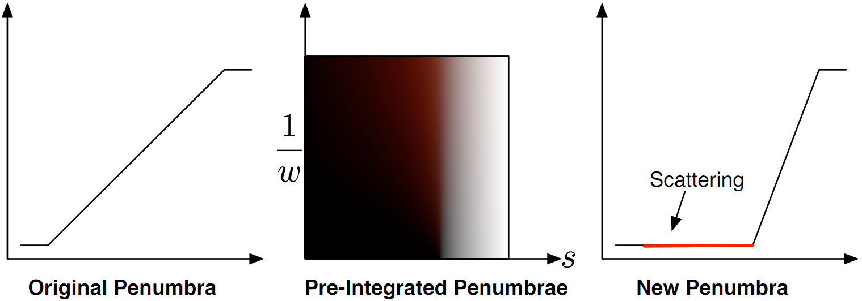
Shadows
Map to a smaller shadow with room for scattering
Notes:
And if have the position/distance in our fall-off function, we can basically specify a new fall-off function
One that leaves a bunch of extra space for scattering
Explain

Slide 68
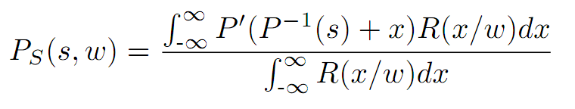
Shadows
Apply similar integration as our diffuse
Notes:
And then.. And I’m sure this is getting repetitive by now
- We can pre-integrate the effect of scattering into shadows using the skin diffusion profile

Slide 69

Shadows
Pre-integrate for different penumbra size _{(eg. due to slope)}
Notes:
And this is what we get.
So here, similar to in our diffuse calculation, we have a 2D lookup
This time the second dimension represents the size of our penumbra in world space
There might be different sizes due to the slope of the surface, or how much you blur your shadows
-This width can be calculated a number of ways. You can use surface slope wrt the light, or possibly even the derivative of the shadow itself.
Note, if we had something crazy like a dithered shadow map, we won’t have a hard edge and we might get incorrect scattering.
Also, in 2D the distance won’t quite be correct, but the look is what’s important

Slide 70
Shadows
Let’s look at some results compared to TSD

Slide 71
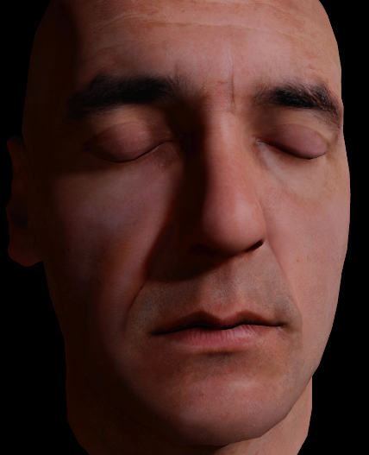
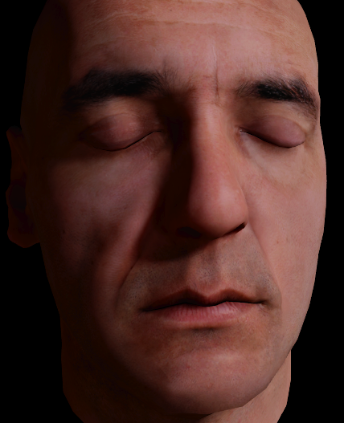
Pre-
Integrated
TSD

Slide 72
Results
TSD

Slide 73
Results
Pre-
Integrated
Notes:
Unfortunately the shadows jump a bit, I should have lined them up for a better comparison.

Slide 74
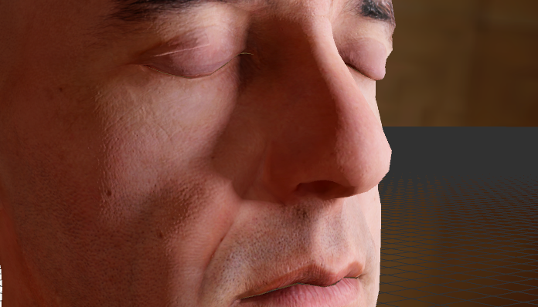
Results
Diffuse

Slide 75

Results
TSD

Slide 76

Results
Pre-Integrated
Notes:
Same here. Shadows on the cheek change a bit. Should be lined up to compare.
Note, spec is probably way too low, but this talk is mostly about SSS and spec is not affected by SSS.

Slide 77
Shadows
We need a wide penumbra to get lots of scattering
We used two different shadow techniques
In both cases it really helps to use extra shadow maps
  We can cheat: only render the head, not the whole scene
  Can be as low as 64² for one head (preferably 128²)
Notes:
Coming back to touch on shadows a bit
We need a large shadow blur kernel if we are going to use part of it for scattering
I want to talk about two improvements for rendering shadows:
- In both cases though, we found that it really helps if you dedicate some extra shadow maps just for close ups on characters
Explain cheating

Slide 78
Shadows - PCF
1.) Pixel Quad Amortization (16 shadow map texels per sample!)
  Pixels are rendered in quads – quad pixels can share work!
  8x8 PCF in 4 samples!
  Requires Nvidia card (but DX11 ‘fine’ ddx/ddy might fix that)
  Tell me if you try it with DX11 hardware!!
  See GPU Pro 2 for details
Notes:
One technique is called pixel quad amortization
And this is really a more general technique that I hope that will be more formally supported in the future APIs, but the one sentence summary of this is that hardware doesn’t actually render pixels, it renders quads on the screen. Since the derivative instructions compare neighboring pixels in a quad, we can basically share calculations across one quad. So we used this for PCF and we could basically reduce the number of PCF samples by a factor of 4.
- 8x8 PCF kernel that touches 64 shadow map texels with only 4 samples
Unfortunately this only works on certain hardware due to the different ways derivatives are calculated
I think DX11 might solve this, since they support both coarse and fine derivatives
Read more about this in GPU Pro 2
Please contact me if you try this in DX11

Slide 79
Shadows - VSMs
2.) Masked Variance Shadow maps
  Render only the head into it’s own small variance shadow map
  ‘Background’ causes bad variance artifacts!
  Include an extra channel as background mask (eg. A2B10G10R10)
  Blur the variance shadow map and mask
  Correct variance sample to remove the background percentage
  Correct the shadow calculation accordingly
    Background percentage = not shadowed
Notes:
-The second shadow map technique I want to mention is a variant on variance shadow maps
-Basically if you use variance shadows for characters I noticed that there are a lot of artifacts that become apparent
-Explain the reason this happens
-I found that when we used a dedicated shadow map
- Can basically correct from this by adding an extra channel in our variance shadow map (eg. 10 bits each)

Slide 80
Filmic Tone-mapping
All the images today use filmic tone-mapping
Certain shots (eg. sunlight) need a lot of light
Scattering occurs at the dark end of dynamic range
  If we try capture the bright light
  We invariably crush the darks into a small dynamic range
In summary, we need high dynamic range!
And a way to map it nicely to a LDR display

Slide 81
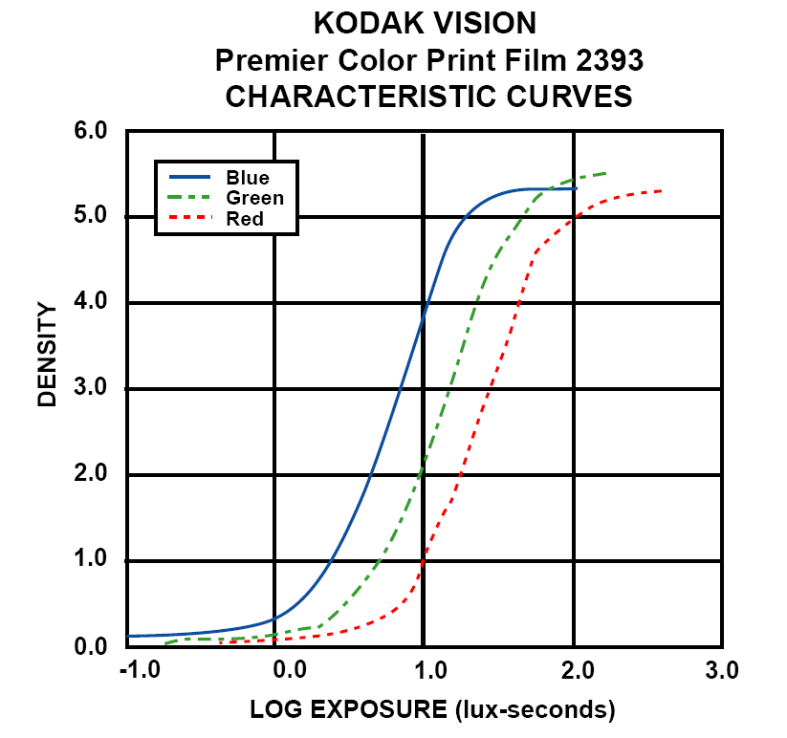
Filmic Tone-mapping
Kodak film
response curves
This is a nice
approximation: _{(Hejl 2009)}
x = max(0, LinearColor-0.004);
GammaColor = (x*(6.2*x+0.5))/
(x*(6.2*x+1.7)+0.06);
Notes:
Film actually looks a lot better than digital in this respect.

Slide 82

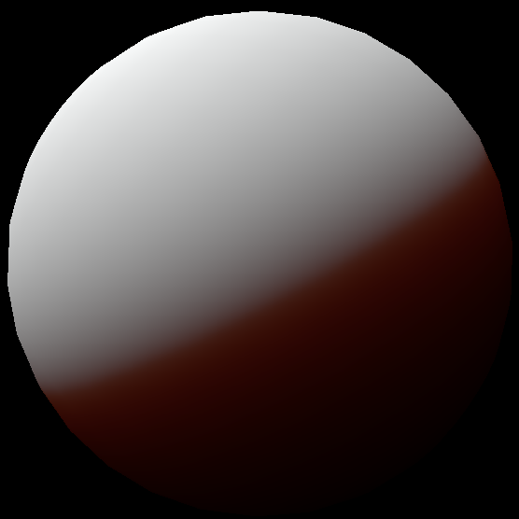
Filmic Tone-mapping
Without filmic tonemap
1x intensity
Larger size
Boring!

Slide 83
Filmic Tone-mapping
Without filmic tonemap
4x intensity
More interesting, but!
Saturated (clamped to 1.0)
Less saturated blacks

Slide 84
Filmic Tone-mapping
With filmic tonemap
4x intensity
Saturated blacks

Slide 85
Filmic Tone-mapping
Without filmic tonemap

Slide 86
Filmic Tone-mapping
With filmic tonemap

Slide 87
Filmic Tone-mapping
Digital cameras also have
this problem!
Left side is desired look
Right side is blown out
Film is much better

Slide 88
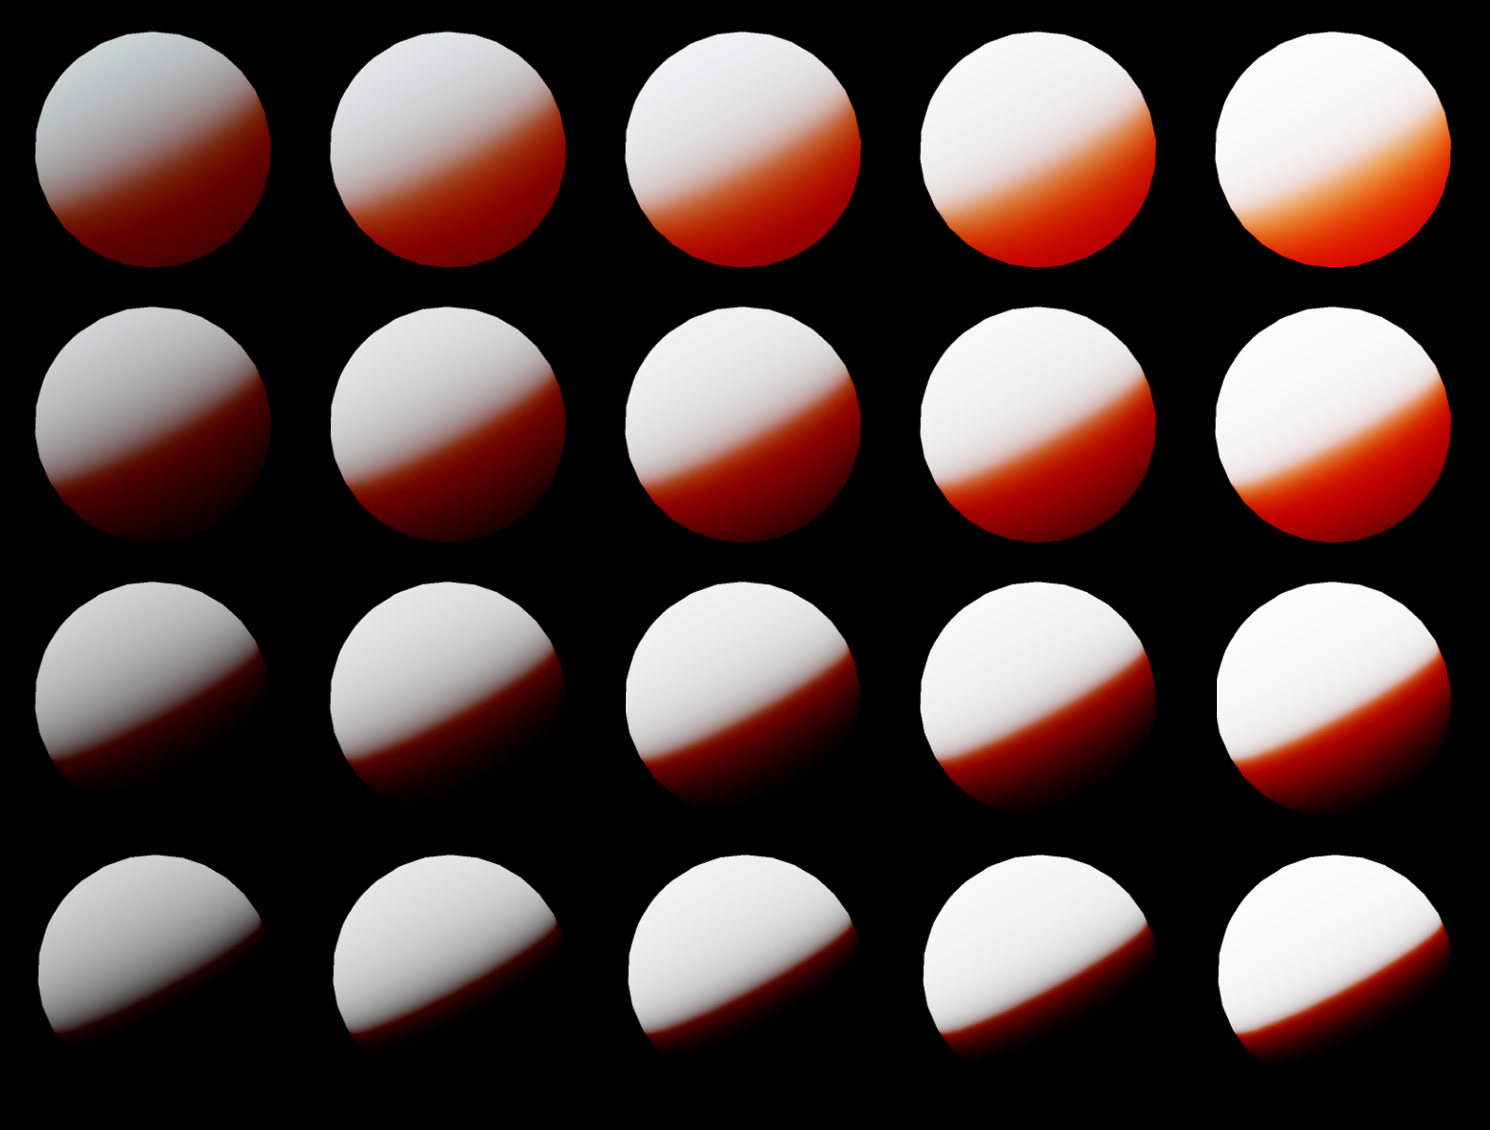
Filmic Tone-mapping
Varying size
and intensity
by powers of two
Still 251/255

Slide 89
Pre-Integrated Skin Shading
Future work:
  Approximate lookup textures with curve fitting
  Use additional axis of curvature in diffuse fall-off
  Include transmittance techniques
  When the detailed normal map gets blurred, we lose the small scattering effects from our normal map technique. Possibly we should bias the curvature lookup to account for this in the BRDF.

Slide 90
Pre-Integrated Skin Shading
Thanks to:
  George Borshukov
  Natalya Tatarchuk
  Google (where I work now)
  Everyone at Electronic Arts (where I used to work)

Slide 92
Curvature: Pre-Integrated BRDFs
Integrate all incoming light on a sphere_{(or a ring, it’s easier)}
_{Oops! saturate(cos())!}
Profile
Notes:
Thanks to Angelo Pesce for pointing out this cos should be clamped! The included code doesn’t have this mistake, but the included code integrates from -pi/2 to pi/2. This should be -pi to pi.

