Slide 1



Slide 2
Dynamic lighting in GOW3
Notes:
Here are some test notes

Slide 3


Slide 4
Motivation
RSX is a bottleneck
How do we use SPUs to improve lighting quality and keep it cheap in terms of RSX processing?
On PS3 the artists asked for more lights per pixel

Slide 5
Types of lights in GOW3
Ambient
Omni (point)
Directional
Notes:
In GOW3 we use 3 types of lights: Ambient, Omni(or point) and directional.

Slide 6
Types of lights in GOW3
Ambient
Omni (point)
Directional
Combined into single RGB interpolator
Notes:
Ambient lights are combined into a single RGB interpolator and are not part of out discussion.

Slide 7
Types of lights in GOW3
Ambient
Omni (point)
Directional
Represented as hybrid vertex lights
Notes:
Omni lights and Directional lights are represented using our hybrid vertex light model.

Slide 8
Hybrid vertex lights
Notes:
Hybrid in this case means that part of the calculation is done per-vertex and part of the calculation is done per-pixel. In our case we combine a heavyweight per-vertex SPU calculation with a reasonably lightweight fragment program code. Let’s take a closer look at how this all works.

Slide 9
Hybrid vertex lights
For 1 light identical to pixel lights
Notes:
First and very important requirement for our lighting model is that it should be equivalent to a pixel light in case of single light. Gives us a good looking base case to build on.

Slide 10
Hybrid vertex lights
For 1 light identical to pixel lights
For multiple lights
  Calculate distance falloff per vertex.
  Combine into a single Aggregate Light per-vertex
  Interpolate Aggregate Light Position per pixel
  Perform N dot L, N dot H etc. in the fragment program as if we had a single pixel light
Notes:
Calculate distance falloff per vertex, Combine into a single aggregate light per-vertex, Interpolate Aggregate Light Position per pixel. This is what allows us to make these lights identical to pixel lights in a single light case. Let’s see why it is so important to interpolate light position.

Slide 11
Interpolating Direction (wrong)
Light
A
B
Notes:
We have two vertices A and B and a Light. Let’s assume that we are interpolating light direction. Blue vectors in the picture are light directions that we would have stored per vertex. Let’s see what happens when we start calculating lighting in the fragment program for a pixel half way between A and B

Slide 12
Interpolating Direction (wrong)
Light
A
L=(½L_{A}+½L_{B})
B
Notes:
At first the interpolator will calculate this green vector for us. It will be half of the light vector from A plus half of the light vector from B and it will not be normalized. Now we will normalize it ourselves.

Slide 13
Interpolating Direction (wrong)
Light
A
L=normalize(½L_{A}+½L_{B})
B
Notes:
And look where it is pointing. According to our calculation the light has moved significantly.

Slide 14
Interpolating Direction (wrong)
Light
A
L=normalize(½L_{A}+½L_{B})
B
Notes:
This is definitely undesirable. This will produce significant artifacts right away even in the case of a single light. Basically every pixel in the triangle will be lit by a different light.

Slide 15
Interpolating Direction (wrong)
Light
A
L=normalize(½L_{A}+½L_{B})
B
WRONG
Notes:
This is wrong. Let’s do it differently.

Slide 16
Interpolating Position
Light
A
B
Notes:
Let’s interpolate light position instead. So we are not going to store light direction per vertex we will store light position. Now since the light position stored for A and light position stored for B are identical interpolation for the pixel in the middle of AB will not move the light. As a result when we calculate light vector in the fragment program it will be correct.

Slide 17
Interpolating Position
Light
A
B
L = Light_Pos−(½A+½B)
Notes:
The only thing remaining is to normalize it.

Slide 18
Interpolating Position
Light
A
B
Normalize(Light_Pos−(½A+½B))
Notes:
And we are ready to do our N dot L, N dot H and whatever else we calculate for out lighting model.

Slide 19
Interpolating Position
Light
A
B
Normalize(Light_Pos−(½A+½B))
BETTER:
Notes:
This is much better. We have established that we should store light positions per vertex instead of light directions. Now let me make a quick note about falloff function.

Slide 20
Falloff function 1/3
Smooth
Cheap
Hopefully, first derivative approaches 0 as the function itself approaches 0.
  Why?
Notes:
Lets take a lok at the picture

Slide 21
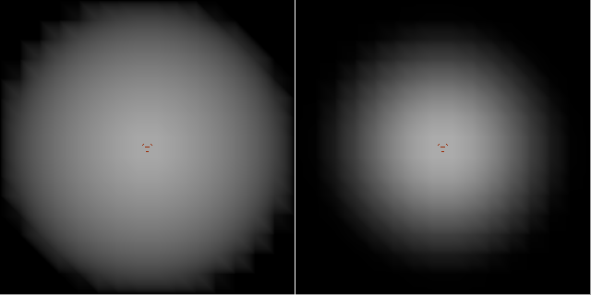
Falloff function 2/3
Identical directional lights shining straight down.
Left: Linear falloff. Right: our falloff
Falloff functions were set to reach zero at the same distance

Slide 22
Falloff function(3/3)
Notes:
Lets take a look at the picture.

Slide 23
We are storing light position per vertex
We have chosen our falloff function

Slide 24
How do we come up with that light position we are going to store per vertex?

Slide 25
How do we come up with that light position we are going to store per vertex?
Is it enough to just average light positions with weights based on falloff?

Slide 26
This is still not so good
Light 1
Light 0
Vertex V
Notes:
We have two lights Light 0 and Light 1 and a vertex I will call V.

Slide 27
This is still not so good
Light 1
Light 0
Vertex V
Assume: with falloff, intensities generated at Vertex V by Light 0 and Light 1 are equal.

Slide 28
This is still not so good
Light 1
Light 0
Vertex V
Assume: with falloff, intensities generated at Vertex V by Light 0 and Light 1 are equal.
Light weights will be also identical for simplicity set them to 1
Notes:
This assumption will make the reasoning simple, but will not change the nature of the problem that I am going to demonstrate.

Slide 29
This is still not so good
Aggregate
light
Light 1
Light 0
Vertex V
Assume: with falloff, intensities generated at Vertex V by Light 0 and Light 1 are equal.
Light weights will be also identical for simplicity set them to 1
Notes:
So aggregate light will end up half way between Light 0 and Light 1.

Slide 30
This is still not so good
Aggregate
light
Light 1
Light 0
Vertex V
Assume: with falloff, intensities generated at Vertex V by Light 0 and Light 1 are equal.
Light weights will be also identical for simplicity set them to 1
Notes:
Now let’s take a closer look at the light vectors. And angles between them. You will notice that light vector for the aggregate light is much closer to light vector for Light 1 than light vector for Light 0.

Slide 31
This is still not so good
Aggregate
light
Light 1
Light 0
Vertex V
Assume: with falloff, intensities generated at Vertex V by Light 0 and Light 1 are equal.
Light weights will be also identical for simplicity set them to 1
Resulting lighting will over-emphasize Light 1
Notes:
So the resulting lighting at vertex V will be much closer to lighting produced by Light 1, than Light 0. In essence this has an effect of over-emphasizing the lights that are far away compared to lights that are close by, regardless of intensity. Ideally we would like to place an aggregate light in such a way that lighting direction from it is midway between directions from Light 0 and Light 1.

Slide 32
This is still not so good
Ideal
aggregate light
Aggregate
light
Light 1
Light 0
Vertex V
Assume: with falloff, intensities generated at Vertex V by Light 0 and Light 1 are equal.
Light weights will be also identical for simplicity set them to 1
Resulting lighting will over-emphasize Light 1
Notes:
A quick summary of what we have learned so far:

Slide 33
Interpolating light directions per-pixel does not work
Averaging light positions per-vertex does not work
What do we do?

Slide 34
We will average light directions per-vertex
And re-create an aggregate light position before sending it to be interpolated per-pixel.
Notes:
Let’s see, how it all works.

Slide 35
“Better” approach
Light 1
Light 0
Vertex V
Notes:
Let’s examine the same setup as before. Two light affecting a vertex. Light weights are still identical and equal to 1.

Slide 36
“Better” approach
Light 1
Light 0
Vertex V
Subtract the world vertex position from each world light position to create relative vectors.
Notes:
The first thing we do is subtract world vertex position from light positions to calculate relative light vectors. Than we would normally calculate light weights. But, as I have mentioned, we assumed them to be identical and equal to 1 in this simplified case. Next we will divide the weights by the length of our relative vectors effectively turning our relative light vectors into normalized directions.

Slide 37
“Better” approach
Light 1
Light 0
L₀
L₁
Vertex V
Subtract the world vertex position from each world light position to create relative vectors.
Calculate lengths
Notes:
The first thing we do is subtract world vertex position from light positions to calculate relative light vectors. Than we would normally calculate light weights. But, as I have mentioned, we assumed them to be identical and equal to 1 in this simplified case. Next we will divide the weights by the length of our relative vectors effectively turning our relative light vectors into normalized directions.

Slide 38
“Better” approach
W₀ = 1/L₀
Light 1
Light 0
L₀
L₁
W₁ = 1/L₁
Vertex V
Subtract the world vertex position from each world light position to create relative vectors.
Calculate lengths and weights (remember light intensities are 1 for both lights)
Notes:
The first thing we do is subtract world vertex position from light positions to calculate relative light vectors. Than we would normally calculate light weights. But, as I have mentioned, we assumed them to be identical and equal to 1 in this simplified case. Next we will divide the weights by the length of our relative vectors effectively turning our relative light vectors into normalized directions.

Slide 39
“Better” approach
W₀ = 1/L₀
Light 1
Light 0
W₁ = 1/L₁
Vertex V
Subtract the world vertex position from each world light position to create relative vectors.
Calculate lengths and weights (remember light intensities are 1 for both lights)
Now multiply relative vectors by weights to go to direction domain
Notes:
The first thing we do is subtract world vertex position from light positions to calculate relative light vectors. Than we would normally calculate light weights. But, as I have mentioned, we assumed them to be identical and equal to 1 in this simplified case. Next we will divide the weights by the length of our relative vectors effectively turning our relative light vectors into normalized directions.

Slide 40
“Better” approach
Light 1
Light 0
W₀ = 1/L₀
W₁ = 1/L₁
Vertex V
Add up light directions
Notes:
And now we will add them up and accumulate the weight

Slide 41
“Better” approach
Light 1
Light 0
W₀ = 1/L₀
Vertex V
W₁ = 1/L₁
Add up light directions
Notes:
And now we will add them up and accumulate the weight

Slide 42
“Better” approach
Light 1
Light 0
W₀ = 1/L₀
W_{total}
+
Vertex V
W₁ = 1/L₁
Add up light directions
And accumulate weights
Notes:
And now we will add them up and accumulate the weight

Slide 43
“Better” approach
Light 1
Light 0
W₀ = 1/L₀
W_{total}
Vertex V
W₁ = 1/L₁
Add up light directions
And accumulate weights
Multiply aggregate direction by accumulated weight to go back to positions domain
Notes:
And now we will add them up and accumulate the weight

Slide 44
“Better” approach
Light 1
Light 0
Vertex V
We ended up with relative light vector for aggregate light
Notes:
Finally add back world position of the vertex to get aggregate light position.

Slide 45
“Better” approach
Light 1
Light 0
Vertex V
We ended up with relative light vector for aggregate light
Now add vertex world position to it to get world position of the aggregate light
Notes:
Let’s examine the math behind it in more detail.

Slide 46
“Better” approach math
Notes:
Let’s take a look at all the components of this scary formula.

Slide 47
“Better” approach math
L_{agg} is aggregate light position
Notes:
L aggregate is aggregate light position we are trying to calculate

Slide 48
“Better” approach math
L_{agg} is aggregate light position
L_{i} is light position for Light i
Notes:
Li is the position of current light. Remember, we loop through all of lights touching a given vertex.

Slide 49
“Better” approach math
L_{agg} is aggregate light position
L_{i} is light position for Light i
W_{i} is light weight for Light i based on intensity of Light i at V
Notes:
Wi is the light weight for each light calculated based on intensity that the light generates at vertex V. This is the thing that we assumed to be equal to 1 in the pictures before. Now we have to plug in the real value.

Slide 50
“Better” approach math
L_{agg} is aggregate light position
L_{i} is light position for Light i
W_{i} is light weight for Light i based on intensity of Light i at V
n is number of lights in the current light context
Notes:
N is the number of lights and weights

Slide 51
“Better” approach math
L_{agg} is aggregate light position
L_{i} is light position for Light i
W_{i} is light weight for Light i based on intensity of Light i at V
n is number of lights in the current light context
V is position of the vertex for which we combine lights
Notes:
An finally V is the world position of the vertex for which we are combining lights.

Slide 52
“Better” approach math
Light 0
Vertex V
L_{agg} is aggregate light position
L_{i} is light position for Light i
W_{i} is light weight for Light i based on intensity of Light i at V
n is number of lights in the current light context
V is position of the vertex for which we combine lights
Notes:
This is the relative light vector. Remember, from the picture?

Slide 53
“Better” approach math
Light 0
Vertex V
L_{agg} is aggregate light position
L_{i} is light position for Light i
W_{i} is light weight for Light i based on intensity of Light i at V
n is number of lights in the current light context
V is position of the vertex for which we combine lights
Notes:
This is the legth of the relative light vector.

Slide 54
“Better” approach math
Light 0
Vertex V
L_{agg} is aggregate light position
L_{i} is light position for Light i
W_{i} is light weight for Light i based on intensity of Light i at V
n is number of lights in the current light context
V is position of the vertex for which we combine lights
Notes:
This is light direction

Slide 55
“Better” approach math
Light 0
Vertex V
L_{agg} is aggregate light position
L_{i} is light position for Light i
W_{i} is light weight for Light i based on intensity of Light i at V
n is number of lights in the current light context
V is position of the vertex for which we combine lights
Notes:
And this is where we multiply it by the light weight

Slide 56
“Better” approach math
Light 0
Vertex V
L_{agg} is aggregate light position
L_{i} is light position for Light i
W_{i} is light weight for Light i based on intensity of Light i at V
n is number of lights in the current light context
V is position of the vertex for which we combine lights
Notes:
This is where we sum up our weighted directions

Slide 57
“Better” approach
Light 0
Vertex V
L_{agg} is aggregate light position
L_{i} is light position for Light i
W_{i} is light weight for Light i based on intensity of Light i at V
n is number of lights in the current light context
V is position of the vertex for which we combine lights
Notes:
This is where we accumulate the weight that will turn aggregate direction into aggregate relative light vector

Slide 58
“Better” approach
Light 0
Vertex V
L_{agg} is aggregate light position
L_{i} is light position for Light i
W_{i} is light weight for Light i based on intensity of Light i at V
n is number of lights in the current light context
V is position of the vertex for which we combine lights
Notes:
This is where we divide the aggregate direction by that accumulated weight. Now we have aggregate relative light vector.

Slide 59
“Better” approach math
Light 0
Vertex V
L_{agg} is aggregate light position
L_{i} is light position for Light i
W_{i} is light weight for Light i based on intensity of Light i at V
n is number of lights in the current light context
V is position of the vertex for which we combine lights
Notes:
And this is where we add the world position of the vertex to the aggregate relative light vector to obtain world position of the aggregate light that will be sent down the rest of the lighting pipeline.

Slide 60
We came up with a way to calculate aggregate light position
We have chosen our falloff function
Notes:
One thing we have neglected so far is: how to handle back facing lights.

Slide 61
Back facing lights
Since lights are combined without regard for shadowing, it is important to eliminate the contributions of lights which are back facing to the vertex.
Notes:
Turns out the solution is pretty simple. Just incorporate saturated N dot L into the calculaton of light weight.

Slide 62
Back facing lights
Notes:
This is what we do

Slide 63
Back facing lights
W_{i} is the weight of Light i
Notes:
Wi here is the same light weight we have discussed before. It is calculated based on light intensity and falloff.

Slide 64
Back facing lights
W_{i} is the weight of Light i
N_{v} is vertex normal at the vertex V
Notes:
We multiply it by a saturated N dot L where N is the vertex normal.

Slide 65
Back facing lights
W_{i} is the weight of Light i
N_{v} is vertex normal at the vertex V
L_{i} is light direction of Light i at vertex V
Notes:
And Li is the light vector for each light. Ok. We got rid of the back facing lights.

Slide 66
We came up with a way to calculate aggregate light position
We have chosen our falloff function
We know how to eliminate back facing lights
Is this enough?
Notes:
A quick summary of what we have so far. ….
As it turns out this solution is still not ideal. Let’s consider the following lighting setup:

Slide 67
This is still broken!
Notes:
We have a sphere lit by two directional lights that are shining almost but not quite opposite each other.

Slide 68
This is still broken!
A
B
Notes:
Let’s consider vertices located on the opposite sides of an imaginary equator separating areas lit by red light and blue light. Let’s take a closer look at vertices A and B.

Slide 69
This is still broken!
A
B
Notes:
Let’s consider lighting situation here.

Slide 70
This is still broken!
N_{a}
N_{b}
L_{red}
A
B
Notes:
A gets some contribution from the Red light since the dot product between light vector and the normal is positive. B gets no contribution from the Red light – it is back-facing.

Slide 71
This is still broken!
N_{a}
N_{b}
L_{red}
L_{blue}
A
B
Notes:
Instead B gets contribution of equal intensity from the Blue light. Let’s note that N dot L at both A and B are significantly less than 1. There is rather large angle between vetex normals and light vectors here, so we would expect the resulting lighting to be rather dim. Let’s consider what lighting parameters will be calculated for the pixel half way between A and B

Slide 72
This is still broken!
N_{a}
N_{b}
L_{red}
L_{blue}
A
P
B
Notes:
According to our light aggregation algorithm we will store the position of Red light in A and we will store the position of the Blue light in B. For the pixel P interpolation will place a resulting Purple light directly overhead!

Slide 73
This is still broken!
N_{a}
N_{b}
L_{red}
L_{blue}
A
P
B
Notes:
Right here!

Slide 74
This is still broken!
N_{a}
N_{p}
N_{b}
L_{red}
L_{blue}
L_{p}
A
P
B
Notes:
N dot L calculated in the fragment program will be exactly 1 assuming our picture here is completely symmetrical. This is much higher value than N dot L at either A or B. So we will see an unexpected bright purple higlight at P.

Slide 75
This is still broken!
N_{a}
N_{b}
L_{red}
L_{blue}
A
P
B
Notes:
And let’s take a look at a test rendering that proves this.

Slide 76
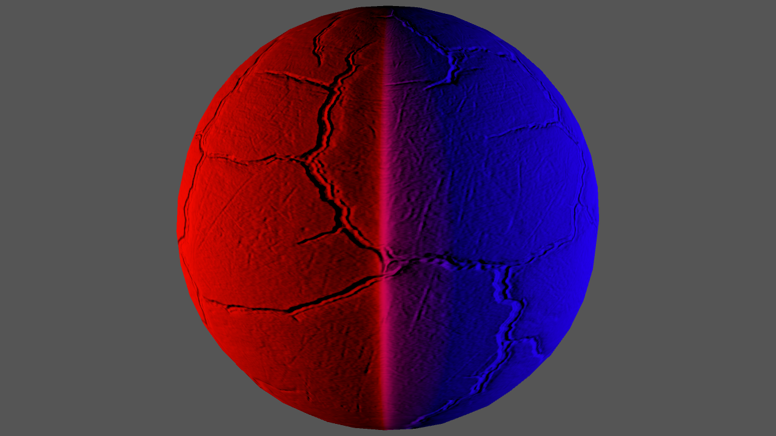

Slide 77
Fix it
In the fragment program we get light position interpolated from vertices
We then calculate the light vector and normalize it before computing N dot L
Stop normalizing if interpolated light vector if it is shorter than a threshold
Takes care of the problem nicely
Notes:
The solution turns out to be quite simple. In the fragment program we get the light position interpolated from vertices. After tha we calculate light vector by subtracting interpolated world position of the pixel from the interpolated position of the light.
Then we normalize this resulting light vector and start computng N dot L etc.

Slide 78
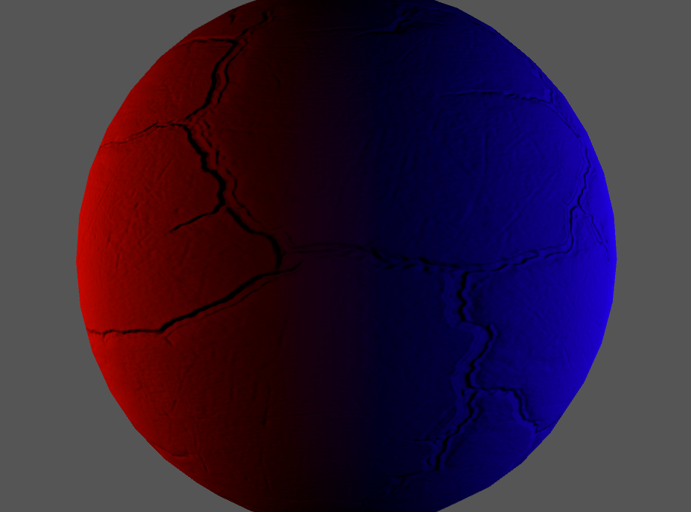
Notes:
Here is the same lighting setup with the fix.

Slide 79
We came up with a way to calculate aggregate light position
We know how to eliminate back facing lights
We have chosen our falloff function
Now we need a way to calculate aggregate light color.
Notes:
A quick summary of what we have so far. ….
As it turns out this solution is still not ideal. Let’s consider the following lighting setup:

Slide 80
Aggregate Light Color
Data to calculate a “physically correct” value is lost
We need to settle for something that will give reasonable result when interpolated in the fragment program
Notes:
In the fragment program we will not have access to the colors of individual lights. So data needed to calculate physically correct color value is lost.
We need to settle for something that will give reasonable

Slide 81
Our method
Notes:
At first we will calculate aggregate light position as discussed before, taking into account falloff, N dot L at the vertex etc.

Slide 82
Our method
Calculate aggregate light position
Notes:
Now let’s take normalized light direction for this aggregate light and also normalized light directions for actual lights in the scene.

Slide 83
Our method
Calculate aggregate light position
Calculate normalized light directions
Notes:
Here

Slide 84
Our method
Calculate aggregate light position
Calculate normalized light directions
Calculate dot products
Notes:
We will use these dot products as weights for blending individual light colors nto the aggregate light color.

Slide 85
Our method
Calculate aggregate light position
Calculate normalized light directions
Calculate dot products
x
+
x
=
Notes:
We will use these dot products as weights for blending individual light colors nto the aggregate light color. Now let’s take a look at the aggregate color formula.

Slide 86
Aggregate color formula
Notes:
Here it is. Let’s go over the components.

Slide 87
Aggregate color formula
C_{agg} is aggregate light color at the Vertex V
Notes:
This is aggregate light color, that we are trying to calculate.

Slide 88
Aggregate color formula
C_{agg} is aggregate light color at the Vertex V
C_{i} is color of Light i

Slide 89
Aggregate color formula
C_{agg} is aggregate light color at the Vertex V
C_{i} is color of Light i
L_{i} is direction to Light i at Vertex V

Slide 90
Aggregate color formula
C_{agg} is aggregate light color at the Vertex V
C_{i} is color of Light i
L_{i} is direction to Light i at Vertex V
L_{agg} is direction to aggregate light
Notes:
This is where we calculate our dot products

Slide 91
Aggregate color formula
C_{agg} is aggregate light color at the Vertex V
C_{i} is color of Light i
L_{i} is direction to Light i at Vertex V
L_{agg} is direction to aggregate light
x
+
x
=
Notes:
And this is where we do our summation.

Slide 92
How well does this approximate actual lighting by several lights?
Notes:
That’s the question, right? Let’s see what we are trying to approximate:

Slide 93
Why this works
This is what we are trying to approximate:
Notes:
That’s the question, right? Let’s see what we are trying to approximate:

Slide 94
Why this works
This is what we are trying to approximate:
Notes:
Ci is individual light color

Slide 95
Why this works
This is what we are trying to approximate:
Notes:
Times N dot L for that particular light. Now let’s make a simplifying assumption

Slide 96
Why this works
This is what we are trying to approximate:
Assume lights have a single scalar luminance value and no color.
Notes:
Times N dot L for that particular light. Now let’s make a simplifying assumption

Slide 97
Why this works
Aggregate light approximation (with luminances)
Exact luminance calculation
Notes:
Expression on the left is the summation over all front facing lights of N dot L for that light times luminance of that light.

Slide 98
Why this works
Aggregate light approximation (with luminances)
Our approximation
Exact luminance calculation
Notes:
Expression on the left is the summation over all front facing lights of N dot L for that light times luminance of that light.

Slide 99
Why this works
Aggregate light approximation (with luminances)
Notes:
Let’s pull N out of the summation first

Slide 100
Why this works
Aggregate light approximation (with luminances)
Notes:
This is what we end up with:

Slide 101
Why this works
Aggregate light approximation (with luminances)
Notes:
Now let’s introduce a variable to replace the summation on the far right

Slide 102
Why this works
Aggregate light approximation (with luminances)
Notes:
This thing becomes X, and this is the actual expression for it

Slide 103
Why this works
Aggregate light approximation (with luminances)
Notes:
This X is actually very closely related to aggregate light direction. Let’s see how:

Slide 104
Remember this?
Light 0
Vertex V
Notes:
First let’s assume no falloff and introduce our luminance. It will replace the light weight

Slide 105
Remember this?
Light 0
Vertex V
Notes:
Now lets remove vertex world position to get relative light vector

Slide 106
Remember this?
Light 0
Vertex V
Notes:
Now lets remove vertex world position to get relative light vector

Slide 107
Remember this?
Light 0
L_{agg}
Vertex V
Notes:
Now lets turn this into normalized direction

Slide 108
Remember this?
Light 0
L_{agg}
Vertex V
Notes:
Now lets turn this into normalized direction

Slide 109
Remember this?
Light 0
L_{agg}
Vertex V
Notes:
Let’s plug in individual light directions

Slide 110
Remember this?
Light 0
L_{agg}
Vertex V
Notes:
Now take note that circled things at the top and at the bottom in fact are just light direction for a particular light.

Slide 111
Remember this?
Light 0
L_{agg}
Vertex V
Notes:
This is what we finally get.

Slide 112
Remember this?
Light 0
L_{agg}
Vertex V
Notes:
But the thing at the top is nothing other than X that we have introduced earlier and at the bottom is the absolute value of X.

Slide 113
Why this works
Notes:
This X is actually very closely related to aggregate light direction. Let’s see how:

Slide 114
Why this works
Notes:
This X is actually very closely related to aggregate light direction. Let’s see how:

Slide 115
A note on vector arithmetic

Slide 116
A note on vector arithmetic
Adding multiple vectors
V₀

Slide 117
A note on vector arithmetic
Adding multiple vectors
V₁
V₀

Slide 118
A note on vector arithmetic
Adding multiple vectors
V₂
V₁
V₀

Slide 119
A note on vector arithmetic
Adding multiple vectors
V₂
V₁
V₀

Slide 120
A note on vector arithmetic
Adding multiple vectors
Length of the result
V₂
V₁
V₀

Slide 121
A note on vector arithmetic
Adding multiple vectors
Length of the result is equal to the sum of projections
V₂
V₁
V₀

Slide 122
A note on vector arithmetic
Adding multiple vectors
Length of the result is equal to the sum of projections
V₂
V₁
V₀

Slide 123
A note on vector arithmetic
Adding multiple vectors
Length of the result is equal to the sum of projections
V₂
V₁
V₀

Slide 124
A note on vector arithmetic
Adding multiple vectors
Length of the result is equal to the sum of projections
V₂
V₁
V₀

Slide 125
Last step

Slide 126
Last step

Slide 127
Last step

Slide 128
Last step

Slide 129
Last step

Slide 130
Last step

Slide 131
Last step
L_{Agg}

Slide 132
Last Step
Notes:
So our approximation for luminance is if fact exact.

Slide 133
Last Step
For luminance our approximation is exact
Notes:
So our approximation for luminance is if fact exact.

Slide 134
Extending to color
Extending to RGB:
Which is what we use

Slide 135
Implementation
We run our per-vertex lighting calculations as custom code in the EDGE job
Heavily optimized
Still keep PPU version running for reference and debugging

Slide 136
Conclusions
Reasonably cheap and good looking dynamic lights
Our artists like them. They can apply a lot of them per draw call.
Additional notes
  We are using very similar light aggregation in our baked vertex lighting
  This allows to treat baked lighting as yet another vertex light at render time.

Slide 137
Questions ?

Slide 138
History
Vector X is essentially the same as the light vector from The Light Field (Gershun, 1936) and the vector irradiance from The Irradiance Jacobian for Partially Occluded Polyhedral Sources (Arvo, 1994).

