Slide 2
Game Worlds from Polygon Soup: Visibility, Spatial Connectivity and Rendering
Hao Chen | Ari Silvennoinen | Natalya Tatarchuk
Bungie | Umbra Software | Bungie

Slide 3
Talk Outline
Game Environment
Previous Approach
New Approach
Implementation
Demo
Notes:
Hi, welcome everyone. My colleagues and I will talk about a topic that is becomes increasing important in games, that is how to construct a game environment out of polygon soups. There are many hard problems to solve and we have not solved all of them, and in this talk we can only scratch the surface and won’t be able to get into a lot of technical details as we’d like to. But hopefully at the end of the talk you’ll see that there is a lot more to a modern game than just rendering and a great portion of our R&D effort these days are devoted to making content production more efficient.
The outline of the talk is as follows. First I’ll give a brief intro to the problems we are trying to solve. Specifically, what is a game environment, what are the interesting problems related to game environments, and what have we done in the past. Then Ari Silvennoinen, from Umbra software, will present a technique for visibility and spatial connectivity, that is the result of a collaboration between Bungie and Umbra. Finally, Natasha, my colleague at Bungie will talk about how visibility is integrated with rendering, in our new multi-threaded renderer.

Slide 4
Halo Reach
Notes:
Here’s screenshot from Halo reach. A game scene like this is a complex composition of indoor and outdoor elements and a large number of static and dynamic objects. Beautiful rendering of a world like this keeps a player immersed in this world.

Slide 5
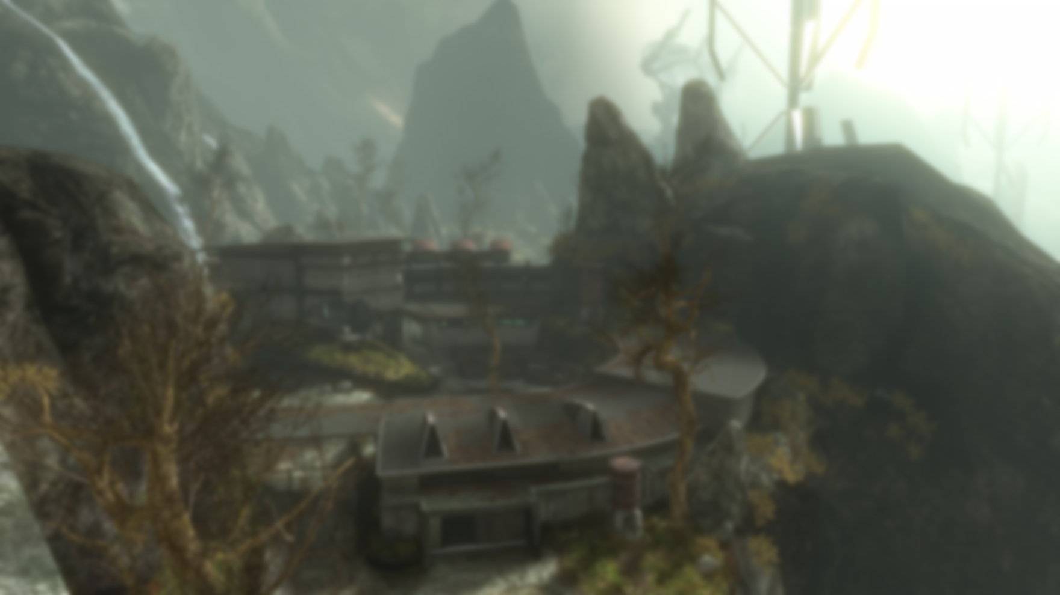
More than pretty pixels
AI perception
Activation
Object Attachment
Audibility
Caching/Paging
Path-finding
Collision/Physics
Visibility
Spatial Connectivity
Rendering
Notes:
But a game world is much more than just rendering pretty pixels. There is a lot going on behind the scene. AI need to sense its surroundings and plan its action. There are also many objects that we can not simulate all at the same time, so we need to activate some objects close to a player while deactivating others. As objects move around, they need to attach to the world, so we need efficient data structures to pin point every location and volumes that objects can attach to. When someone triggers a sound, we need to know if a player should be able hear it, and more importantly, how the sound is attenuated and propagated through space. Finally, in a console game we can’t load everything in memory, so it is a common practice to page in data as needed, often based on heurtistic such as potential visible set, or PVS. A game environment needs to fullfil all of these needs. To so, a game engine must supply a list of essential services, such as path-finding, collision detection and physics simulation, visibility culling, spatial connecitivity querries, and of course, rendering.

Slide 6
More than pretty pixels
AI perception
Activation
Object Attachment
Audibility
Caching/Paging
Path-finding
Collision/Physics
Visibility
Spatial Connectivity
Rendering
Notes:
There are interesting problems to solve and some of them are very hard in the context of a real time game, and because of the complexity of a game scene. In this talk, we will look at visibility, and a closely related topic, spatial connectivity, which forms the basis of many of the previously mentioned problems, and later on, we will talk about how these technqiues are integrated with a modern multi-core, multi-threaded renderer.

Slide 7
Background
Cells and portals
Potentially Visible Sets (PVS)
Occluder rasterization
Software rasterization
Hardware occlusion queries
GPGPU solutions
Spatial Connectivity
Watershed Transform
Automatic Portal Generation

Slide 8
Halo Approach
Cells and portals
Watertight shell geometry
Artists manually placed portals
Build a BSP tree from shell geometry
Floodfill BSP leaves into cells
Build cell connectivity
Notes:
In the Halo series of games, our solution to visibility an spatial connectivity is centered around cells and portals. To build a Halo level, we require water tight shell geometry. The artists construct these shells in 3D studio max. To segment one part of the world from another, an artist and designer must manually place portals, these are convex planar objects stiched into the shell geometry and they provide a two way link between adjacent spaces. To build the cell structure, we first build a BSP tree from the shell polygons. The resulting BSP leaves are convex volume of space. This BSP tree provides an association of every point in space, with its BSP leave. We also build a connectivity map of how the leaves are connected. We then flood fill the bsp leaves into cells, and the flood fill stops at a portal or a solid leaf. Finally, we build cell to cell connectivity, with portals as the links between them.

Slide 9
Pros
Unified visibility/spatial connectivity
Precise spatial decomposition
Inside/outside test
Great for indoor spaces with natural portals
Notes:
The cells and portals approach has some clear advantages. First, the cells and portal structure is used for visibility culling, we follow a standard portal traversal scheme by recursively traverse all of the portals and progressively shrinking the viewing frustums by clipping them to portal boundaries. At the same time, the connectivity graph, with cells are the nodes and the portals are the edges, provide a way for us to tell if and how a space is connected to another, and this structure is central to many core services such from AI activation to audibility. By using the actual geometry as BSP split planes, the spatial decomposition is precise, we can tell exactly, for every point, which space it belongs to. Further more, by using solid BSPs, we can tell of a point is in valid gameplay space, or is outside of the world, which is very useful for making many of our gameplay code robust. For indoor spaces, the scheme give us reasonable efficicency.

Slide 10
Cons
Manual portalization is non-trivial!
Watertightness is painful for content authoring
Force early level design decision
Optimized for indoor scene only.
Notes:
However, this approach also have many disadvantages. First of all, placing portals manually is a tedious and highly technical process. This require an artists to be able to visualize the spaces and how they are connected in their head! Most artists think of surfaces, not 3D space. Equally time-consuming is requiring that shell geometry be water-tight. This require all open space to be carefully stiched and capped. One of the most detrimental effect of the cells and portal approach, is that it require the level to be layed out ahead of time, in early phases of content construction. While this might not sound too bad in theory, in practice, a level designer often does not know how a level will play until it is populated with AI and sand box objects, and have gone through many user testing and design iterations. Not having the ability to change the level late in the game, or do so only at the huge expense of re-doing a bunch of work is a real problem. Finally, indoor scenes with natural portals are easily handled, but outdoor scenes with large draw distances with no clear portals require extremely un-intuive portalization, and even with that, only results in mediocre culling efficiencies.
All of these problems motivated us to look for a better approach to visibility and spatial connectivity. The starting point of the new approach is polygon soup.

Slide 11
Portalization Example

Slide 12
Polygon Soup!
Notes:
Polygon soup.

Slide 13
Polygon Soup
Just pieces jammed together
No water-tightness
No manual portals
Incremental construction/fast iteration.
Allow late design changes

Slide 14
General Idea
Sub-divide the scene
Voxelize the subdivided volume
Segment the voxels into regions
Build a connectivity graph between regions
Build simplified volumes from voxel regions
Notes:
The general idea is this. We first sub-divide the scene into chunks. For each chunk, we voxelize the sub-divided volume into empty voxels and occupied voxels, occipied voxels are ones that contained geometry. We then find a way to segment the voxels into regions, and we build a region to region connectivity graph, based on how voxels are connectected. Finally, we take each region, which is a group of connected voxels, and we build a simplified representation that we can query in run time.

Slide 15
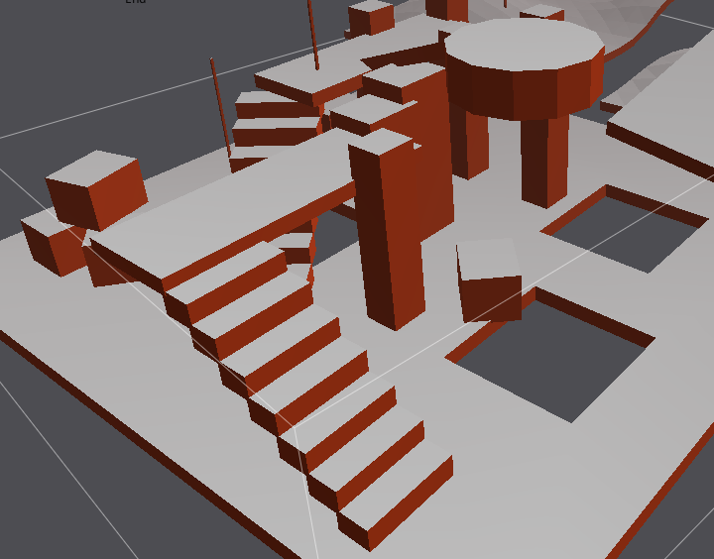
2D Example –Path Finding
Input Scene
[Recast Library: Mikko Mononen http://code.google.com/p/ recastnavigation/]
Notes:
The first one we tried is path-finding. Lucky, instead of implementing our own, we found a path-finding package by Mikko Moonen. I’ve included the link here. It is very robust and reasonably fast, and we ended up adopting it as part of our path-finding solution. Here is a simplified walk through of how it works, first, we voxelize the scene, and tag which voxels are walkable based on the slope of the surface and some other heuristics.

Slide 16
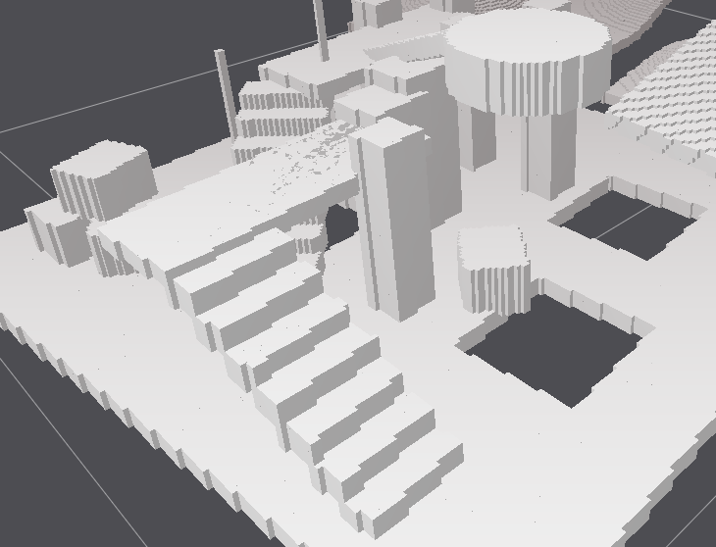
2D Example –Path Finding
Voxelization
Notes:
Then, we build a distance field like it is shown here. The grey scale color indicates

Slide 17
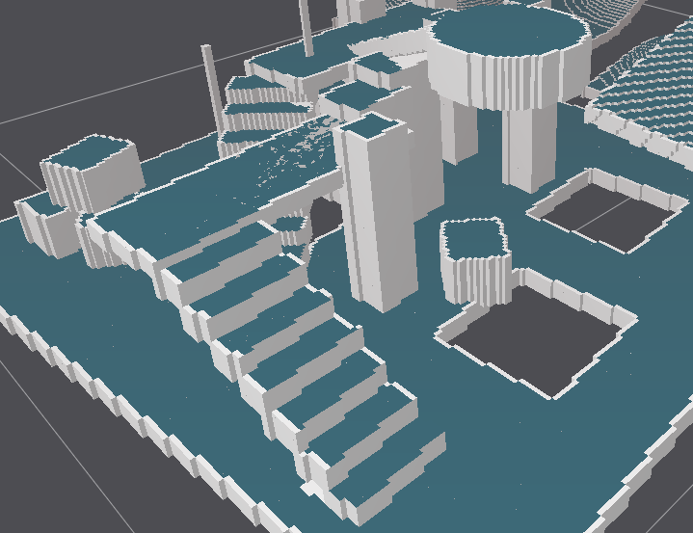
2D Example –Path Finding
“Walk-able” voxels
Notes:
The first one we tried is path-finding. Lucky, instead of implementing our own, we found a path-finding package by Mikko Moonen. I’ve included the link here. It is very robust and reasonably fast, and we ended up adopting it as part of our path-finding solution. Here is a simplified walk through of how it works, first, we voxelize the scene, and tag which voxels are walkable based on the slope of the surface and some other heuristics.

Slide 18
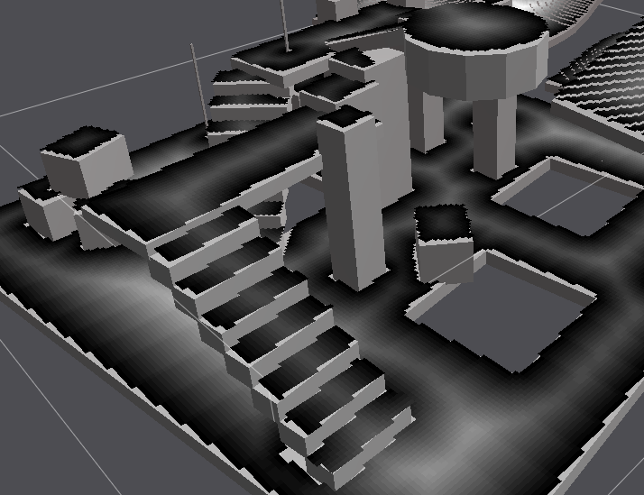
2D Example –Path Finding
Distance Field
Notes:
The first one we tried is path-finding. Lucky, instead of implementing our own, we found a path-finding package by Mikko Moonen. I’ve included the link here. It is very robust and reasonably fast, and we ended up adopting it as part of our path-finding solution. Here is a simplified walk through of how it works, first, we voxelize the scene, and tag which voxels are walkable based on the slope of the surface and some other heuristics.

Slide 19
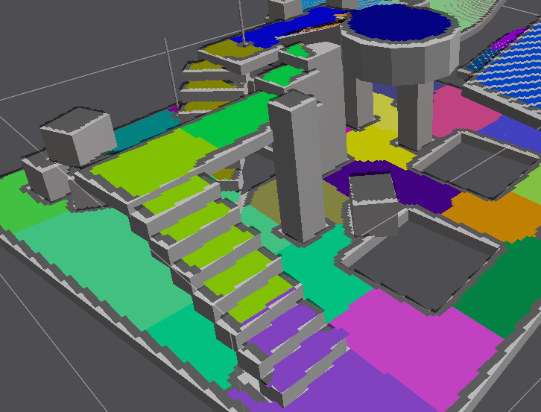
2D Example –Path Finding
2D Watershed Transform
Notes:
The first one we tried is path-finding. Lucky, instead of implementing our own, we found a path-finding package by Mikko Moonen. I’ve included the link here. It is very robust and reasonably fast, and we ended up adopting it as part of our path-finding solution. Here is a simplified walk through of how it works, first, we voxelize the scene, and tag which voxels are walkable based on the slope of the surface and some other heuristics.

Slide 20
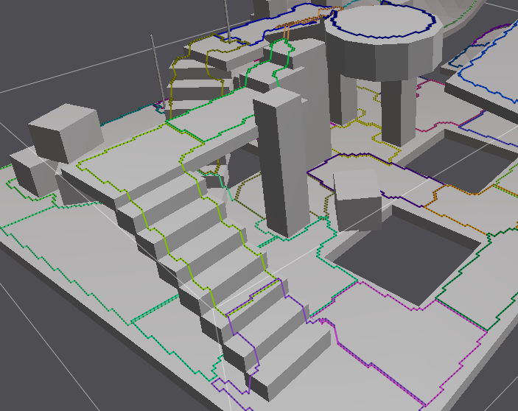
2D Example –Path Finding
Contour
Notes:
The first one we tried is path-finding. Lucky, instead of implementing our own, we found a path-finding package by Mikko Moonen. I’ve included the link here. It is very robust and reasonably fast, and we ended up adopting it as part of our path-finding solution. Here is a simplified walk through of how it works, first, we voxelize the scene, and tag which voxels are walkable based on the slope of the surface and some other heuristics.

Slide 21
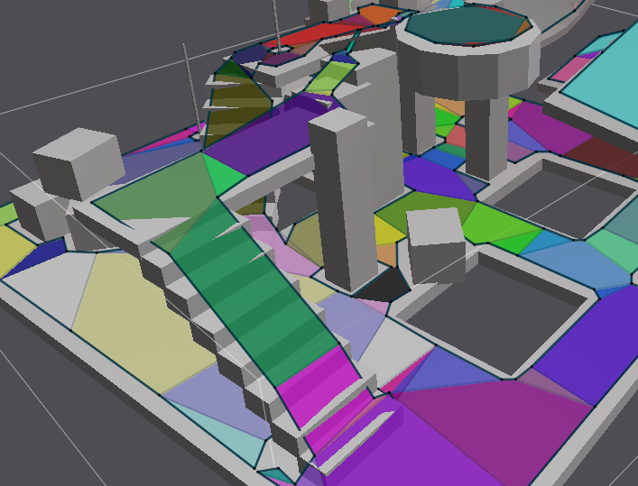
2D Example –Path Finding
Nav Mesh
Notes:
The first one we tried is path-finding. Lucky, instead of implementing our own, we found a path-finding package by Mikko Moonen. I’ve included the link here. It is very robust and reasonably fast, and we ended up adopting it as part of our path-finding solution. Here is a simplified walk through of how it works, first, we voxelize the scene, and tag which voxels are walkable based on the slope of the surface and some other heuristics.

Slide 22
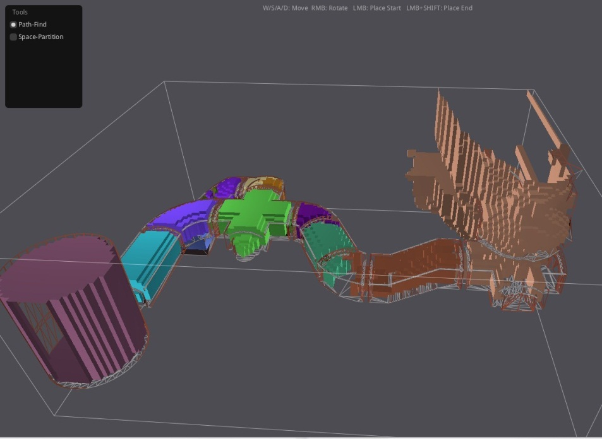
3D Watershed
Bungie & Zhe Jiang University Zhefeng Wu, Xinguo Liu

Slide 23
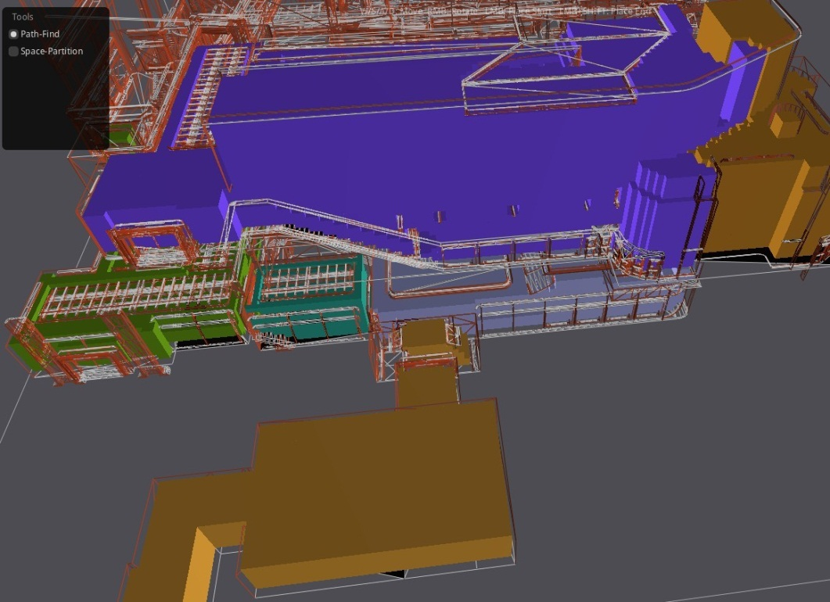
3D Watershed Transform

Slide 24
Problems
3D is considerably harder/slower
Over-segmentation (small regions)
Sensitive to scene changes
Simplified representation non-trivial
What about visibility?

Slide 25
Collaboration with Umbra
Automatic portal generation
Incremental/local updates
CPU based solution, low latency
Same solution for visibility and spatial connectivity
Handle doors and elevators
Precise around user placed portals
Fast run time / low memory fooprint

Slide 26
Umbra Solution
Polygon soup
Automatic cell and portal generation
Preprocess
Visibility and connectivity queries
Runtime
Notes:
Overview of the Umbra pipeline

Slide 27
Preprocess Overview
Polygon soup
Automatic cell and portal generation
Preprocess
Visibility and connectivity queries
Runtime

Slide 28
Preprocess Overview
Discretize the scene into voxels
Determine voxel connectivity with respect to input geometry
Propagate connectivity to find connected components
Determine portals between local connected components
Notes:
Key ideas:
We want our algorithm to be independent of geometric complexity and we achieve this by discretizing the scene into voxels
Focus on ambient space instead of occluder space

Slide 29
Tile Grid
Subdivide the input geometry into tiles
Notes:
The first step of our algorithm subdivides the input geometry into a tile grid.

Slide 30
Tile Grid
Subdivide the input geometry into tiles
Localizes computation
Distributed computing
Fast local changes
Notes:
Voxelization can take a lot of memory due to cubic complexity in resolution. Tile grid localizes the computation and helps to reduce the memory footprint. This means that we can effectively use higher resolution during the voxelization. Each tile is processed independently of each other, which means that we can easily distribute the computation on a per tile basis. In addition, the tiling scheme plays well with content iteration and local changes which affect only a few tiles are fast to compute.

Slide 31
Tile Voxelization
Compute a BSP tree for each tile
Notes:
The next step is to voxelize each tile by building a BSP-tree.

Slide 32
Tile Voxelization
Compute a BSP tree for each tile
Subdivide to discretization level
Skip empty space
Leaf nodes = voxels
Notes:
We subdivide the nodes as long as they intersect geometry or until we reach our discretization level. The discretization level can be thought of in terms of a smallest hole our algorithm can identify – anything smaller than this will be considered as solid space and will be effectively filled. This is a useful property which solves the problem of bad input geometry with small cracks and holes that other algorithms might be sensitive to. The result of this step is an adaptive voxelization of the tile, where the leaf nodes are our voxels.

Slide 33
From Voxels to Cells and Portals
Notes:
To understand how we build and propagate connectivity information in order to generate view cells and portals, let’s take a closer look what happens at the leaf node level and zoom in to the tree.

Slide 34
From Voxels to Cells and Portals
Classify voxels
Connect voxels
Local connected components represent view cells
Build portals between connected cells
Notes:
Cell and portal generation works by identifying the empty space, subdividing the empty space into cells and finally, connecting the cells with portals. Let’s take a look how this works one step at a time.

Slide 35
Voxel Classification
Classify voxels
Connect voxels
Local connected components represent view cells
Build portals between connected cells
Notes:
The first step is to classify voxels as solid or empty. We call a voxel solid if it intersects geometry. In the figure, all the green voxels are solid because they intersect the geometry.

Slide 36
Voxel Connectivity
Classify voxels
Connect voxels
Local connected components represent view cells
Build portals between connected cells
Notes:
The next step is to connect all empty voxels with their empty neighbors.

Slide 37
Voxel Connectivity
Classify voxels
Connect voxels
Local connected components represent view cells
Build portals between connected cells

Slide 38
Voxel Connectivity
Classify voxels
Connect voxels
Local connected components represent view cells
Build portals between connected cells

Slide 39
Voxel Connectivity
Classify voxels
Connect voxels
Local connected components represent view cells
Build portals between connected cells

Slide 40
Voxel Connectivity
Classify voxels
Connect voxels
Local connected components represent view cells
Build portals between connected cells

Slide 41
Cells
Classify voxels
Connect voxels
Local connected components represent view cells
Build portals between connected cells
Notes:
The next step is to propagate this connectivity information by flood filling the connected voxels to find out connected components. The flood fill is limited by a user controlled parameter to guarantee we always generate local connected components instead of huge global connected components. Note that the flood fill operation respects the original geometry and so it preserves the visibility and connectivity properties of the original scene module to discretization level.

Slide 42
Portals
Classify voxels
Build voxel connections
Local connected components represent view cells
Build portals between connected cells
Notes:
Initial portals are constructed by taking the empty voxels between neighboring view cells
These portals will be conservatively simplified in a later stage to produce reasonable output sizes

Slide 43
Portals
Classify voxels
Build voxel connections
Local connected components represent view cells
Build portals between connected cells
Notes:
Initial portals are constructed by taking the empty voxels between neighboring view cells
These portals will be conservatively simplified in a later stage to produce reasonable output sizes

Slide 44
Cell Graph
Optimize cells and portals to a runtime cell graph
Runtime algorithms are graph traversals

Slide 45
Cell Graph
Optimize cells and portals to a runtime cell graph
Runtime algorithms are graph traversals
Graph structure allows limited dynamic changes

Slide 46
Runtime Algorithms
Polygon soup
Automatic cell and portal generation
Preprocess
Visibility and connectivity queries
Runtime

Slide 47
Connectivity Algorithms
Connectivity is encoded in the precomputed cell graph
Connectivity queries are just graph traversals
Examples:
Find connected region (region == set of view cells)
Find shortest 3D path
Intersection queries
Ray casts
Combinations: Ray cast -> connected region -> objects in region
Lot’s of possibilities for simulation and AI

Slide 48
Visibility Algorithms
Practical analytic visibility in the cell graph
Axis aligned portals enable effective algorithms
From point visibility queries
From region visibility queries
Volumetric visibility
We can choose to be aggressive or conservative

Slide 49
Potentially Visible Sets
Deterministic conservative visibility
Computation time is directly related to culling efficiency
Every solution is useful
Sampling based visibility solvers can take long time to converge
Additional use cases:
Identify visibility hotspots
Cull always hidden triangles
Cull always hidden lightmaps
Notes:
The cell graph enables a practical way of computing conservative visibility in a deterministic way. Instead of relying on sampling a set of randomly distributed rays, we can trace beams in the cell graph and solve visibility analytically. This algorithm has also the useful property that the solution improves as you give it more computation time. It is also possible to obtain useful solutions in a short time, since the result is always conservative. This is in contrast to an aggressive, sampling based visibility solver, where it can take a long time to get a useful result due to false occlusion artifacts.
In addition to culling, PVS has other potential use cases. For instance, we could create artist tools to help identifying visibility hotspots, cull hidden triangles to optimize the scene geometry or find visible surfaces for lightmap resolution assignment.

Slide 50
Portal Culling
How to traverse 100K+ portals fast?
Recursive algorithm does not scale
Many paths to one cell – combinatorial explosion
Rasterization based approach
BSP-style front-to-back traversal
Update coverage buffer on entry and exit
Fast – 16 pixels at a time with 128-bit SIMD vectors
Notes:
Traditional recursive portal culling algorithms have trouble scaling to our portal counts. The reason for this lies in the fact that the number of times each cells gets visited is not bounded from above. Also, the number of possible paths from the camera to a given cell increases with the number of cells, so this leads to a combinatorial explosion.
We chose a screen space approach to ensure that cells are only visited once during the traversal. We traverse the portals in a front-to-back order and update a custom coverage buffer each time we enter or exit a portal. The coverage buffer essentially stores mask of visible pixels and allows for efficient coverage tests. It is worth noting that portal traversal introduces a lot of overdraw so the rasterization step must be very efficient. Our coverage buffer has 8-bit precision so we are able to compute 16 pixels at a time using 128-bit SIMD vector operations. In fact, the rasterization step is so fast that the bottleneck is currently in the graph traversal.

Slide 51
Renderer Integration
Focus on the pipeline, not on rendering techniques
Visibility integration with game state extraction and rendering
Notes:
Now that Ari have described you how the visibility algorithm is implemented, let’s take a look how we’ve integrated it into our renderer, specifically focusing on how we drive game state data extraction based on visibility results. Notice that I won’t be delving in deeper details of specific rendering techniques, rather focus on how we’ve integrated visibility computation with game state extraction and rendering.

Slide 52
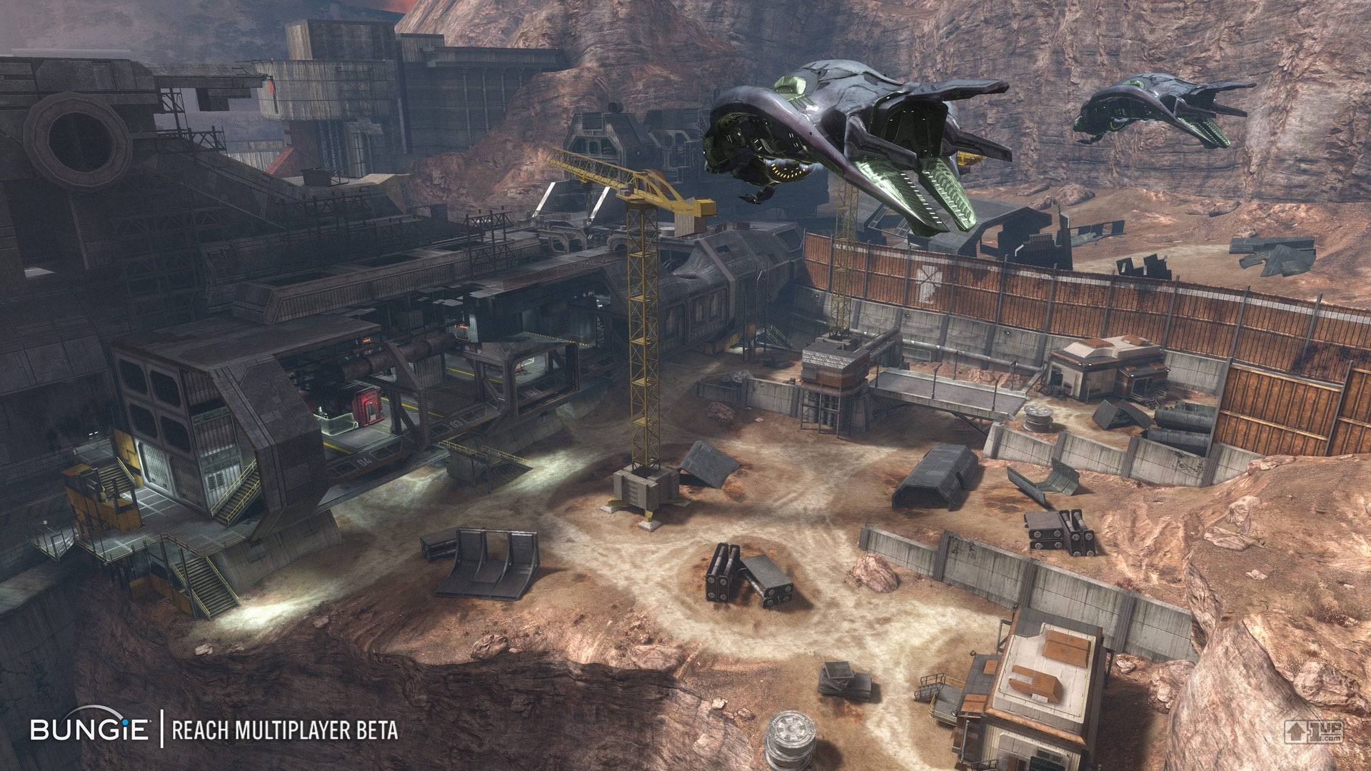
Halo Reach Game Loop
Notes:
Let’s take a look at the way we’ve implemented this in Halo Reach.

Slide 53
Halo Reach Game Loop
Coarse-grain parallelism
System on a thread
Notes:
Halo Reach was designed in the Halo engine, with coarse grained parallelism for Xbox 360 which has 3 separate CPU cores, with 2 hardware threads each core. The engine was converted to utilize this level of parallelism by mapping major game functions to a small number of threads, for example, rendering, audio, simulation, where each CPU thread was also mapped to a HW thread.

Slide 54
Halo Reach Game Loop
Coarse-grain parallelism
System on a thread
Explicit synchronization through state mirroring
Notes:
Synchronization was handled explicitly by sharing data through manual game state mirrors and through read-write assessors.
Game state in this case refers to all deterministic data that affects game play. In Halo games, rendering started after simulation thread finished its work.

Slide 55
Halo Reach Game Loop
Coarse-grain parallelism
System on a thread
Explicit synchronization through state mirroring
Mostly manual load-balancing
Notes:
This ‘system-on-a-thread’ approach resulted in mostly static system-wide load-balancing.

Slide 56
Halo Reach Game Loop
Simulation loop @ 30 hz
HW Thread 0
Job kernel
HW Thread 1
HW Thread 2
Render loop @ 30 hz
HW Thread 3
Audio loop
HW Thread 4
Job kernel, debug logging
Async tasks, I/O, misc.
HW Thread 5
Notes:
Let’s take a look at how these systems were laid out on HW threads in the Halo Reach engine.

Slide 57
Halo Reach Game Loop
Simulation loop @ 30 hz
HW Thread 0
Job kernel
HW Thread 1
HW Thread 2
Render loop @ 30 hz
HW Thread 3
Audio loop
HW Thread 4
Job kernel, debug logging
Async tasks, I/O, misc.
HW Thread 5
Notes:
In this model, the simulation (thread 0), and threads 1, 4, 5 are producer threads (as in they produce the game data for current frame)

Slide 58
Halo Reach Game Loop
Simulation loop @ 30 hz
HW Thread 0
Job kernel
HW Thread 1
HW Thread 2
Render loop @ 30 hz
HW Thread 3
Audio loop
HW Thread 4
Job kernel, debug logging
Async tasks, I/O, misc.
HW Thread 5
Notes:
And the render and audio consume this data during the next game tick (output threads).

Slide 59
Halo Reach: Simulation Thread (MP)
Simulation loop: 75-100%
HW Thread 0
Job kernel: 20-30%
HW Thread 1
HW Thread 2
Render loop: 70-100%
HW Thread 3
Audio loop: 50-80%
HW Thread 4
Job kernel, debug logging: 20-30%
Async tasks, socket polling, misc: 10-30% with bursts of 100% utilization
HW Thread 5
Notes:
If we look at the Halo Reach simulation loop across all hardware threads, when we start processing a frame, we start by doing a few milliseconds’ worth of global systems update and networking receive (in the multiplayer case) on the simulation thread.

Slide 60
Halo Reach: Simulation Thread (MP)
Simulation loop: 75-100%
HW Thread 0
Object Update
Job kernel: 20-30%
HW Thread 1
HW Thread 2
Render loop: 70-100%
HW Thread 3
Audio loop: 50-80%
HW Thread 4
Job kernel, debug logging: 20-30%
Async tasks, socket polling, misc: 10-30% with bursts of 100% utilization
HW Thread 5
Notes:
Next we start processing object update for this frame. Before we start processing objects behavior update, we poll the camera to compute predictive camera envelope. What this means is that within the current frame, the camera cannot rotate more than a few degrees, nor can we have teleporting within a single frame. But we know that we can re-poll the input to update the camera later in the frame. Before object update and move is completed, we cannot start processing rendering in this game loop.

Slide 61
Halo Reach: Simulation Thread (MP)
Simulation loop: 75-100%
HW Thread 0
Object Update
Havok Update
Obj move
Job kernel: 20-30%
HW Thread 1
HW Thread 2
Render loop: 70-100%
HW Thread 3
Audio loop: 50-80%
HW Thread 4
Job kernel, debug logging: 20-30%
Async tasks, socket polling, misc: 10-30% with bursts of 100% utilization
HW Thread 5
Notes:
Next we have physics processing and object move which executes in parallel computing animation compositing, skeleton update, IK, etc. Note that we’re already running jobs at this point for some of our computations.

Slide 62
Halo Reach: Simulation Thread (MP)
Simulation loop: 75-100%
HW Thread 0
Object Update
Havok Update
Obj move
Job kernel: 20-30%
HW Thread 1
HW Thread 2
Render loop: 70-100%
HW Thread 3
Audio loop: 50-80%
HW Thread 4
Job kernel, debug logging: 20-30%
Async tasks, socket polling, misc: 10-30% with bursts of 100% utilization
HW Thread 5
Notes:
After we finish object update and perform remaining tasks, we re-pool the camera input again and update the final camera. At this point we’re reading for rendering.

Slide 63
Halo Reach: Simulation Thread (MP)
Simulation loop: 75-100%
HW Thread 0
Object Update
Havok Update
Obj move
Job kernel: 20-30%
HW Thread 1
HW Thread 2
Render loop: 70-100%
HW Thread 3
Audio loop: 50-80%
HW Thread 4
Job kernel, debug logging: 20-30%
Async tasks, socket polling, misc: 10-30% with bursts of 100% utilization
HW Thread 5
Notes:
But remember that we have a system on a thread parallelism in this case. So this meant that we need to copy the entirety of game state (about 20MBs of it for Halo Reach) so that the simulation thread is free to process the next frame, and the rendering thread can submit the current frame to GPU. One of the reasons is because we actually compute visibility AFTER we copy the game state, so we don’t know WHAT game data we need. In our case, this meant that we had a serial task of copying 20MBs worth of gamestate. This is time consuming (~3ms) and also means that we’re double-buffering the entirety of game state. Note that game state here refers to deterministic game state data only!. (see my talk @ stanford on Bungie.net to be posted this week to find out more about how we handle determinism in our game)

Slide 64
Halo Reach: Simulation Thread (MP)
Simulation loop: 75-100%
HW Thread 0
Object Update
Havok Update
Obj move
Job kernel: 20-30%
HW Thread 1
game state mirror
HW Thread 2
frame is published for rendering
Render loop: 70-100%
HW Thread 3
Audio loop: 50-80%
HW Thread 4
Job kernel, debug logging: 20-30%
Async tasks, socket polling, misc: 10-30% with bursts of 100% utilization
HW Thread 5
Notes:
Once game state is copied, we mark it as published for consumption by the render thread. At this point the game state is unlocked and we free up simulation thread to process the next frame.

Slide 65
Halo Reach: Render Thread (MP)
Simulation loop: 75-100%
HW Thread 0
Object Update
Havok Update
Obj move
Job kernel: 20-30%
HW Thread 1
HW Thread 2
Render loop: 70-100%
Player Viewport 1
Player Viewport 2
HW Thread 3
Audio loop: 50-80%
HW Thread 4
Job kernel, debug logging: 20-30%
Async tasks, socket polling, misc: 10-30% with bursts of 100% utilization
HW Thread 5
Notes:
Render thread is responsible for consuming the output of simulation thread (the resulting game state).
In multiplayer we can have multiple (up to 4) viewports. Each viewport is submitted on the render thread.

Slide 66
Halo Reach: Render Thread (MP)
Simulation loop: 75-100%
HW Thread 0
Object Update
Havok Update
Obj move
Job kernel: 20-30%
HW Thread 1
HW Thread 2
Render loop: 70-100%
Player Viewport 1
Player Viewport 2
PV1: Visib
PV1: Submission
PV2: Visib
PV2: Submission
HW Thread 3
Audio loop: 50-80%
HW Thread 4
Job kernel, debug logging: 20-30%
Async tasks, socket polling, misc: 10-30% with bursts of 100% utilization
HW Thread 5
Notes:
Render thread does serial processing of visibility for each player view
Sequentially submit to the GPU
For each viewport, we compute:
Visibility
Submission, which has direct access to all of the gamestate mirror at all times

Slide 67
Halo Reach: Thread Utilization
Simulation loop: 75-100% utilized
HW Thread 0
Job kernel: 20-30% utilized
HW Thread 1
HW Thread 2
Render loop: 70-100% utilized
HW Thread 3
Audio loop: 50-80% utilized
HW Thread 4
Job kernel, debug logging: 20-30% utilized
Async tasks, I/O, misc: 10-30% with bursts of 100% utilization
HW Thread 5
Notes:
As you can see, our utilization of the overall system varied by the HW thread, with many threads having loads of under utilized CPU time, and some threads (simulation, render loop, and in bursts async thread) having much heavier utilization.

Slide 68
Halo Reach: Thread Utilization
Simulation loop: 75-100% utilized
HW Thread 0
Job kernel: 20-30% utilized
HW Thread 1
HW Thread 2
Render loop: 70-100% utilized
HW Thread 3
Audio loop: 50-80% utilized
HW Thread 4
Job kernel, debug logging: 20-30% utilized
Async tasks, I/O, misc: 10-30% with bursts of 100% utilization
HW Thread 5
Notes:
The challenge with coarse-grain multi-threading is that with static load balancing we are always paying for the maximum workload for each thread. However, in many cases, we may have threads that are underutilized (busy wait circumstances, for example, or because there isn’t sufficient workload in a given frame). With coarse grain manual synchronization, we can’t dynamically load balance.

Slide 69
Can We Do Better?
Observation #1: We don’t need the entire game state for rendering

Slide 70
Gamestate and Visibility
In Reach, game state extraction happens before we do visibility
That’s why we have to copy the entire game state
Expensive (in ms and memory footprint)
Notes:
We can immediately start looking at the fact that we’re currently mirroring the entirety of game state prior to computing visibility and rendering.
This incurs performance cost in both ms for memcopy and actual double-buffering of the entire game state.

Slide 71
Reduce CPU Latency
Visibility is a large chunk of CPU time on render thread
Yet we have CPU time is under utilized
Underutilized HW threads
And not to mention other platforms!
Notes:
Previously couldn’t compute visibility until after game state update finished. Furthermore, all visibility computation was done serially on the render thread. However, we had loads of CPU time under utilized during simulation game tick – yet the question is – how do we move visibility computation to utilize those threads better?

Slide 72
Gamestate and Visibility
But we can invert that operation
Only copy data for visible objects out of game state
Only extract data for objects that will be rendered
Notes:
We can consider inverting the operation – start by computing visibility for current thread, and then extract and prepare data only for visible objects.

Slide 73
Extract Post Visibility
Better: Drive game extraction and processing based on results of visibility
Only extract data for visible objects (both static and dynamic)
No need to double buffer the entire game state
Only buffer game data for the per-frame transient state for visible objects
Smaller memory footprint
Notes:
This ensures that our transient mirror of game state data is going to be significantly smaller – we always assume that number of visible objects is going to be significantly smaller than the entirety of the world.

Slide 74
Better Load Balancing
Start by splitting off visibility computation into jobs per view
This includes visibility computations for player, shadow, reflection views
Visibility jobs can have viewport-to-viewport dependencies
Can reuse results of one visibility job computation as input to another
Notes:
The first thing we can do to reduce overall CPU latency for visibility computations is to convert visibility computations into jobs. Each viewport’s visibility can be moved into a job, and we can use job dependency to express dependency on the results of visibility computations for one view on another.

Slide 75
Reducing Input Latency
Stagger visibility computation at the same time as game object update
Start static visibility early with predictive camera early in the frame
Start this before we do object update
Notes:
However, if we simply add visibility computation to happen during the game tick on the simulation thread in a brute force manner (even by moving it into jobs), all we would accomplish is lighten the load on the render thread – and increase the workload on simulation thread. We want to ensure that we’re reducing the overall input latency.
To accomplish that, we can start visibility computation for static environment as early as possible in the frame. And that’s the bulk of visibility computation!. We compute our predictive camera envelope as before, and as soon as we know it, we start conservative visibility computation for our views. This ensures that we’re never going to see an object dropped, rather, we might have some additional objects rendered in the worst case scenario. So no visible pops!.
This in itself allows us to stagger visibility computation and reduce overall CPU latency for the simulation game tick (because we now can finish visibility computations much earlier in the frame). And as soon as we know the results of static visibility computation, we can start performing other operations (extracting game state, etc.)

Slide 76
Improve CPU Latency
Run expensive CPU render operations for visible objects only
Just make sure to run this after visibility
These would be render-only operations (skinning, cloth sim, polygon sorting) – they do not affect game play
Notes:
The other improvement we can add is to only run expensive CPU operations as jobs for visible object only. This is done as part render prepare operations, which include data extraction from game state and running objects prepare jobs. These jobs include render-only functionality, such as any CPU vertex operations (skinning, simulation, etc.), polygon sorting or any transparency sorting, etc.

Slide 77
An Improved Game Loop
Simulation loop: 75-100%
HW Thread 0
Predict camera envelope
Job kernel: 20-30%
HW Thread 1
HW Thread 2
Render loop: 70-100%
HW Thread 3
Audio loop: 50-80%
HW Thread 4
Job kernel, debug logging: 20-30%
Async tasks, socket polling, misc: 10-30% with bursts of 100% utilization
HW Thread 5
Notes:
So with that in mind, let’s take a look at the improved game loop. Start by doing networking receive, and then as soon as you can figure out the camera! Now – we know that in order to keep latency low this WILL NOT be the final player camera, but we can still start predictive visibility computation based on this camera information. So - Predict camera envelope at the beginning of the frame

Slide 78
An Improved Game Loop
Simulation loop: 75-100%
HW Thread 0
Job kernel: 20-30%
HW Thread 1
Determine render views next
HW Thread 2
Render loop: 70-100%
HW Thread 3
Audio loop: 50-80%
HW Thread 4
Job kernel, debug logging: 20-30%
Async tasks, socket polling, misc: 10-30% with bursts of 100% utilization
HW Thread 5
Notes:
Player and shadow views setup

Slide 79
An Improved Game Loop
Simulation loop: 75-100%
HW Thread 0
Object Update/Move
Job kernel: 20-30%
HW Thread 1
Start static objects’ (environment) visibility and broadphase dynamic objects visibility for render views as jobs on available threads: player, shadows, etc.
HW Thread 2
Render loop: 70-100%
HW Thread 3
Audio loop: 50-80%
HW Thread 4
Job kernel, debug logging: 20-30%
Async tasks, socket polling, misc: 10-30% with bursts of 100% utilization
HW Thread 5
Notes:
Now we can immediately start static visibility in jobs – a fair amount of the scene can be static geometry so this is a large chunk of final visibility computation. The resulting visibility must be conservative, so we may render a few more objects on the screen – but frame processing time is improved, so input latency is improved.
Broadphase: clusters.

Slide 80
An Improved Game Loop
Simulation loop: 75-100%
HW Thread 0
Object Update/Move
Job kernel: 20-30%
HW Thread 1
Execute object update jobs
HW Thread 2
Render loop: 70-100%
HW Thread 3
Audio loop: 50-80%
HW Thread 4
Job kernel, debug logging: 20-30%
Async tasks, socket polling, misc: 10-30% with bursts of 100% utilization
HW Thread 5
Notes:
Next we are going object move jobs (animation decompression, curve compositing, IK)

Slide 81
An Improved Game Loop
Simulation loop: 75-100%
HW Thread 0
Object Update/Move
Job kernel: 20-30%
HW Thread 1
Run render prepare for static environment rendering jobs (bake precompiled command buffers, etc.)
HW Thread 2
Render loop: 70-100%
HW Thread 3
Audio loop: 50-80%
HW Thread 4
Job kernel, debug logging: 20-30%
Async tasks, socket polling, misc: 10-30% with bursts of 100% utilization
HW Thread 5
Notes:
Prepare static environment rendering jobs (bake precompiled command buffers, etc.)

Slide 82
An Improved Game Loop
Simulation loop: 75-100%
HW Thread 0
Object Update/Move
Job kernel: 20-30%
HW Thread 1
Finalize camera (poll input)
HW Thread 2
Render loop: 70-100%
HW Thread 3
Audio loop: 50-80%
HW Thread 4
Job kernel, debug logging: 20-30%
Async tasks, socket polling, misc: 10-30% with bursts of 100% utilization
HW Thread 5

Slide 83
An Improved Game Loop
Simulation loop: 75-100%
HW Thread 0
Object Update/Move
Job kernel: 20-30%
HW Thread 1
Compute narrow phase dynamic objects visibility (as jobs)
HW Thread 2
Render loop: 70-100%
HW Thread 3
Audio loop: 50-80%
HW Thread 4
Job kernel, debug logging: 20-30%
Async tasks, socket polling, misc: 10-30% with bursts of 100% utilization
HW Thread 5
Notes:
Once we finished object and physics update we can update the camera and then start computing visibility computation for dynamic objects. AT this point, the simulation thread is stalled since we need to lock gamestate.

Slide 84
An Improved Game Loop
Simulation loop: 75-100%
HW Thread 0
Object Update/Move
Job kernel: 20-30%
HW Thread 1
Preparing visible dynamic objects and extracting game state data for them (in jobs)
HW Thread 2
Render loop: 70-100%
HW Thread 3
Audio loop: 50-80%
HW Thread 4
Job kernel, debug logging: 20-30%
Async tasks, socket polling, misc: 10-30% with bursts of 100% utilization
HW Thread 5
Notes:
Once we finished visibility for dynamic objects, we then extract game state data for visible dynamic objects. At that point, we unlock gamestate and simulation thread is ready to continue with further processing.

Slide 85
An Improved Game Loop
Simulation loop: 75-100%
HW Thread 0
Object Update/Move
Job kernel: 20-30%
HW Thread 1
HW Thread 2
Render loop: 70-100%
Execute final prepare jobs to finalize frame packet data
HW Thread 3
Audio loop: 50-80%
HW Thread 4
Job kernel, debug logging: 20-30%
Async tasks, socket polling, misc: 10-30% with bursts of 100% utilization
HW Thread 5
Notes:
Then we finalize the frame packet for this frame that contains transient per-frame data ready for rendering consumption. At this point we can also run any jobs to finalize the data in the frame packet (if we need to do any further sorting of draw calls, etc.)

Slide 86
An Improved Game Loop
Simulation loop: 75-100%
HW Thread 0
Object Update/Move
\
Job kernel: 20-30%
HW Thread 1
Publish the frame for rendering
HW Thread 2
Render loop: 70-100%
HW Thread 3
Audio loop: 50-80%
HW Thread 4
Job kernel, debug logging: 20-30%
Async tasks, socket polling, misc: 10-30% with bursts of 100% utilization
HW Thread 5
Notes:
And at this point, current frame is ready for consumption by the render submission

Slide 87
Streamlined Submission Thread
Havok Update
Simulation loop: 75-100%
HW Thread 0
Object Update
Obj move
Job kernel: 20-30%
HW Thread 1
HW Thread 2
Render loop: 70-100%
HW Thread 3
Audio loop: 50-80%
Render submission job
HW Thread 4
Job kernel, debug logging: 20-30%
Async tasks, socket polling, misc: 10-30% with bursts of 100% utilization
HW Thread 5
Notes:
Render submission becomes a streamlined job and just submits the draw commands based on the contents of the prepared frame packet to the GPU directly. Submit operates on the output of prepare, and statically cached renderable data and submits GPU commands. Submit has no access to gamestate, it’s an output processor only (outputs to GPU).

Slide 88
Benefits
Decouple game-state traversal from drawing
Better CPU utilization with staggered visibility computation
Earlier results for each frame mean reduced input latency
Notes:
The benefits that we see with this approach is that it allows us to decouple game-state traversal (both of the scene graph and of objects) from rendering. It also allow us to move visibility computation out of the render thread and multi-thread visibility computation from the get-go. We can start visibility computation earlier in the frame.
Drive render stage execution via jobs operating on individual render components and feature renderer interfaces rather than directly on game objects.
The code executed on the render thread should not rely on object inspection at run-time.
Switch to push the volatile data values for visible objects from the game thread to the renderer – only for visible objects, and only a small part of data for the entirety of objects. Essentially, publish object-dependent material parameters from the game thread to the render thread.

Slide 89
Benefits
Decouple game-state traversal from drawing
Better CPU utilization with staggered visibility computation
Render thread becomes a streamlined kernel processor
Notes:
The resulting render thread becomes largely a dumb stream processor; almost all control flow has already been executed prior to the render thread processing. All that is left to do is submit to the GPU.

Slide 90
A Simple Little Job Tree
Notes:
Actual job graph from our renderer
6 views
Visibility computation
Data extraction and preparing
Rendering and submission to the GPU

Slide 91
Future Work
Predict dynamic objects visibility with temporal bounding volume
Fixup after final camera and object positions are known
Notes:
Base on predictive camera envelope and objects’ temporal bounding volumes
Also conservative visibility
Fix up at the end of the frame when actual camera used for rendering and object positions are known

