Slide 2
Real-Time Order Independent Transparency and Indirect Illumination Using Direct3D 11
Jason Yang and Jay McKee

Slide 3
…Continued from Last Year Depth of Field using Summed Area Tables

Slide 4
Today’s Overview
Fast creation of linked lists of arbitrary size on the GPU using D3D11
Integration into the standard graphics pipeline
Demonstrates compute from rasterized data
DirectCompute features in Pixel Shader
Examples:
Order Independent Transparency (OIT)
Indirect Shadowing
Notes:
Building data structures from the graphics pipeline

Slide 5
Background
A-buffer – Carpenter ‘84
CPU side linked list per-pixel for anti-aliasing
Fixed array per-pixel
F-buffer, stencil routed A-buffer, Z³ buffer, and k-buffer, Slice map, bucket depth peeling
Multi-pass
Depth peeling methods for transparency
Recent
Freepipe, PreCalc [DX11 SDK]

Slide 6
Linked List Construction
Two Buffers
Head pointer buffer
addresses/offsets
Initialized to end-of-list (EOL) value (e.g., -1)
Node buffer
arbitrary payload data + “next pointer”
Each shader thread
Retrieve and increment global counter value
Atomic exchange into head pointer buffer
Add new entry into the node buffer at location from step 1
Notes:
Creating reverse linked list

Slide 7
Order Independent Transparency Construction by Example
Classical problem in computer graphics
Correct rendering of semi-transparent geometry requires sorting – blending is an order dependent operation
Sometimes sorting triangles is enough but not always
Difficult to sort: Multiple meshes interacting (many draw calls)
Impossible to sort: Intersecting triangles (must sort fragments)
Try doing this in PowerPoint!

Slide 8
Order Independent Transparency with Per-Pixel Linked Lists
Computes correct transparency
Good performance
Works with depth and stencil testing
Works with and without MSAA
Example of programmable blend

Slide 9
Algorithm Overview
0. Render opaque scene objects
Render transparent scene objects
Screen quad resolves and composites fragment lists

Slide 10
Step 0 – Render Opaque
Render all opaque geometry normally
Render Target

Slide 11
Algorithm Overview
0. Render opaque scene objects
Render transparent scene objects
All fragments are stored using per-pixel linked lists
Store fragment’s: color, alpha, & depth
Screen quad resolves and composites fragment lists

Slide 12
Setup
Two buffers
Screen sized head pointer buffer
Node buffer – large enough to handle all fragments
Render as usual
Disable render target writes

Slide 13
Step 1 – Create Linked List
Head Pointer Buffer
-1
-1
-1
-1
-1
-1
-1
-1
-1
-1
-1
-1
-1
-1
-1
-1
-1
-1
Render Target
-1
-1
-1
-1
-1
-1
-1
-1
-1
-1
-1
-1
-1
-1
-1
-1
-1
-1
Counter = 0
Node Buffer
0
1
2
3
4
5
6
…

Slide 14
Step 1 – Create Linked List
Head Pointer Buffer
-1
-1
-1
-1
-1
-1
-1
-1
-1
-1
-1
-1
-1
-1
-1
-1
-1
-1
Render Target
-1
-1
-1
-1
-1
-1
-1
-1
-1
-1
-1
-1
-1
-1
-1
-1
-1
-1
Counter = 0
Node Buffer
0
1
2
3
4
5
6
…

Slide 15
Step 1 – Create Linked List
Head Pointer Buffer
-1
-1
-1
-1
-1
-1
-1
0
-1
-1
-1
-1
-1
-1
-1
-1
-1
-1
Render Target
-1
-1
-1
-1
-1
-1
-1
-1
-1
-1
-1
-1
-1
-1
-1
-1
-1
-1
Counter = 1
Node Buffer
0
1
2
3
4
5
6
…

Slide 16
Step 1 – Create Linked List
Head Pointer Buffer
-1
-1
-1
-1
-1
-1
-1
0
-1
-1
-1
-1
-1
-1
-1
-1
-1
-1
Render Target
-1
-1
-1
-1
-1
-1
-1
-1
-1
-1
-1
-1
-1
-1
-1
-1
-1
-1
Counter = 1
Node Buffer
0
1
2
3
4
5
6
…
0.87
-1

Slide 17
Step 1 – Create Linked List
Head Pointer Buffer
-1
-1
-1
-1
-1
-1
-1
0
-1
-1
-1
-1
-1
-1
-1
-1
-1
-1
Render Target
-1
-1
-1
-1
-1
-1
-1
-1
-1
1
2
-1
-1
-1
-1
-1
-1
-1
Counter = 3
Node Buffer
0
1
2
3
4
5
6
…
0.87
0.89
0.90
Culled due to existing scene geometry depth.
-1
-1
-1

Slide 18
Step 1 – Create Linked List
-1
-1
-1
-1
-1
-1
-1
3
4
-1
-1
-1
-1
-1
-1
-1
-1
-1
Render Target
-1
-1
-1
-1
-1
-1
-1
-1
-1
1
2
-1
-1
-1
-1
-1
-1
-1
Counter = 5
Node Buffer
0
1
2
3
4
5
6
…
0.87
0.89
0.90
0.65
0.65
-1
-1
-1
0
-1

Slide 19
Step 1 – Create Linked List
-1
-1
-1
-1
-1
-1
-1
5
4
-1
-1
-1
-1
-1
-1
-1
-1
-1
Render Target
-1
-1
-1
-1
-1
-1
-1
-1
-1
1
2
-1
-1
-1
-1
-1
-1
-1
Counter = 6
Node Buffer
0
1
2
3
4
5
6
…
0.87
0.89
0.90
0.65
0.65
0.71
-1
-1
-1
0
-1
3

Slide 20
Node Buffer Counter
Counter allocated in GPU memory (i.e. a buffer)
Atomic updates
Contention issues
DX11 Append feature
Linear writes to a buffer
Implicit writes
Append()
Explicit writes
IncrementCounter()
Standard memory operations
Up to 60% faster than memory counters

Slide 21
Algorithm Overview
0. Render opaque scene objects
Render transparent scene objects
Screen quad resolves and composites fragment lists
Single pass
Pixel shader sorts associated linked list (e.g., insertion sort)
Composite fragments in sorted order with background
Output final fragment

Slide 22
Step 2 – Render Fragments
Head Pointer Buffer
-1
-1
-1
-1
-1
-1
-1
5
4
-1
-1
-1
-1
-1
-1
-1
-1
-1
Render Target
-1
-1
-1
-1
-1
-1
-1
-1
-1
1
2
-1
-1
-1
-1
-1
-1
-1
Node Buffer
0
1
2
3
4
5
6
…
(0,0)->(1,1):
Fetch Head Pointer: -1
-1 indicates no fragment to render
0.87
0.89
0.90
0.65
0.65
0.71
-1
-1
-1
0
-1
3

Slide 23
Step 2 – Render Fragments
Head Pointer Buffer
-1
-1
-1
-1
-1
-1
-1
5
4
-1
-1
-1
-1
-1
-1
-1
-1
-1
Render Target
-1
-1
-1
-1
-1
-1
-1
-1
-1
1
2
-1
-1
-1
-1
-1
-1
-1
Node Buffer
0
1
2
3
4
5
6
…
(1,1):
Fetch Head Pointer: 5
Fetch Node Data (5)
Walk the list and store in temp array
0.87
0.89
0.90
0.65
0.65
0.71
-1
-1
-1
0
-1
3
0.71
0.65
0.87

Slide 24
Step 2 – Render Fragments
-1
-1
-1
-1
-1
-1
-1
5
4
-1
-1
-1
-1
-1
-1
-1
-1
-1
Render Target
-1
-1
-1
-1
-1
-1
-1
-1
-1
1
2
-1
-1
-1
-1
-1
-1
-1
Node Buffer
0
1
2
3
4
5
6
…
(1,1):
Sort temp array
Blend colors and write out
0.87
0.89
0.90
0.65
0.65
0.71
-1
-1
-1
0
-1
3
0.65
0.71
0.87
Notes:
Insertion sort

Slide 25
Step 2 – Render Fragments
Head Pointer Buffer
-1
-1
-1
-1
-1
-1
-1
5
4
-1
-1
-1
-1
-1
-1
-1
-1
-1
Render Target
-1
-1
-1
-1
-1
-1
-1
-1
-1
1
2
-1
-1
-1
-1
-1
-1
-1
Node Buffer
0
1
2
3
4
5
6
…
0.87
0.89
0.90
0.65
0.65
0.71
-1
-1
-1
0
-1
3

Slide 26
Anti-Aliasing
Store coverage information in the linked list
Resolve on per-sample
Execute a shader at each sample location
Use MSAA hardware
Resolve per-pixel
Execute a shader at each pixel location
Average all sample contributions within the shader
Notes:
Sub-pixel intersections
Pros:
Slightly faster than per-sample execution
Can be done with a Compute Shader
Cons:
Destination Render Target is single sample
Depthstencil testing is not available for early rejection

Slide 27
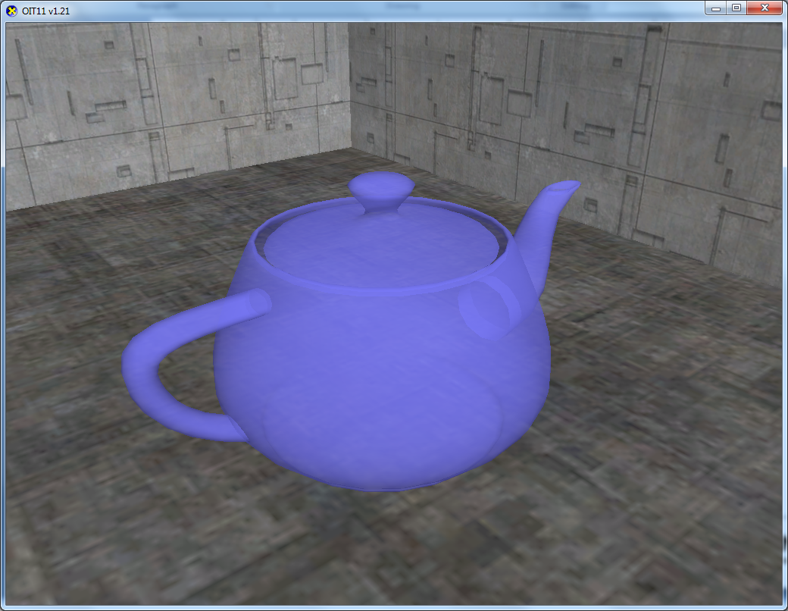
Demo

Slide 28
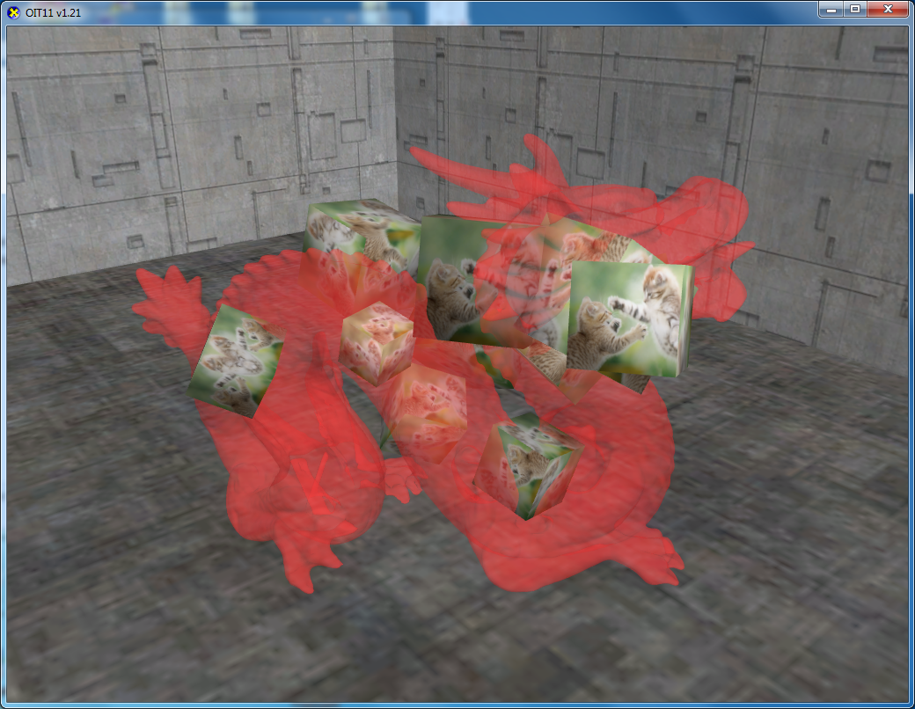
Performance Comparison
 | Teapot | Dragon
Linked List | 743 fps | 338 fps
Precalc | 285 fps | 143 fps
Depth Peeling | 579 fps | 45 fps
Bucket Depth Peeling | --- | 256 fps
Dual Depth Peeling | --- | 94 fps
Performance scaled to ATI Radeon HD 5770

Slide 29
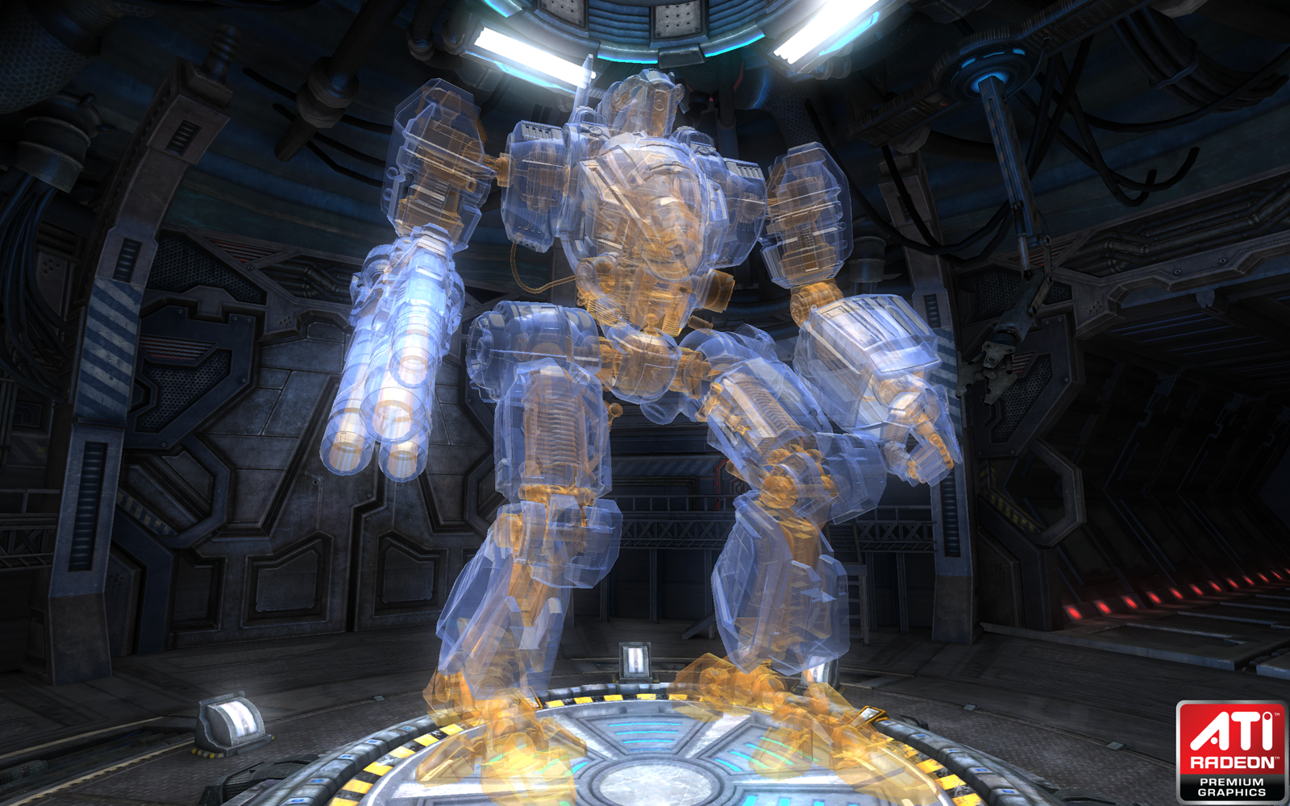
Mecha Demo
602K scene triangles
254K transparent triangles

Slide 30
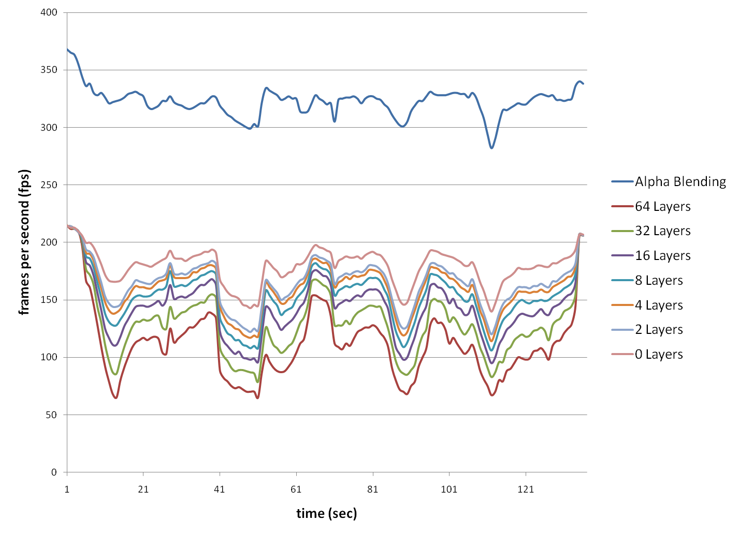
Layers
Notes:
Worst case 370K fragments filling 40% of the frame
2ms to store the fragments
3.3ms 0->64 fps

Slide 31
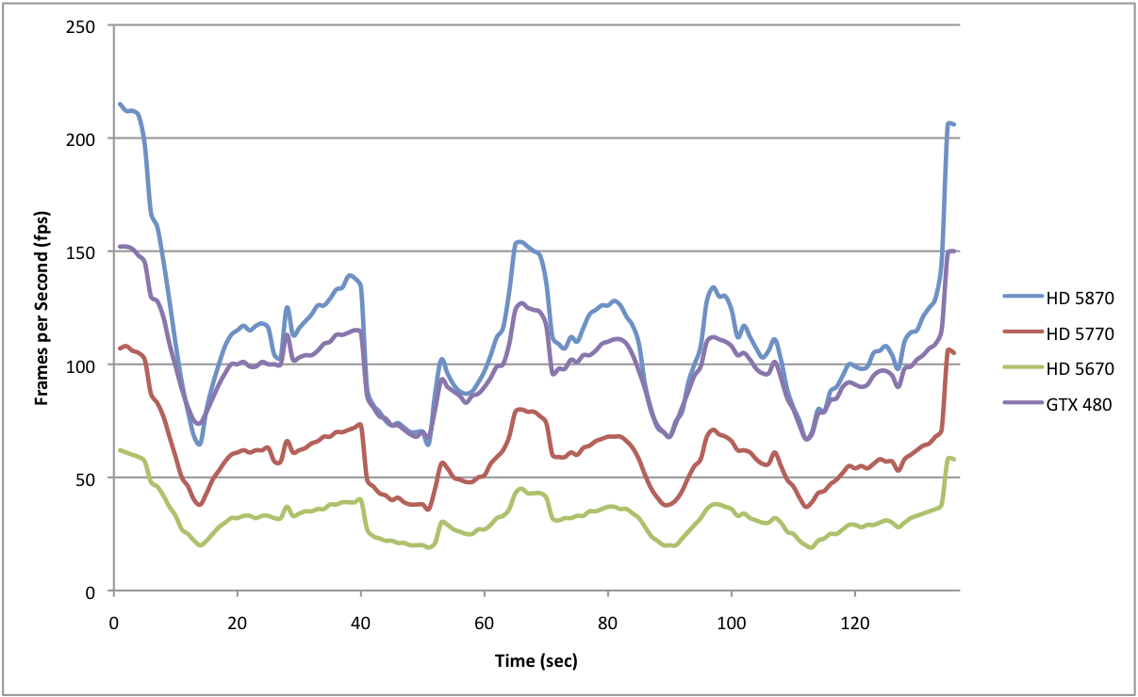
Scaling
Notes:
112 -> 60 fps -> 32fps

Slide 32
Indirect Illumination with Indirect Shadows using DirectX 11

Slide 33
Why Indirect Shadowing?
Help perceive subtle dynamic changes occuring in a scene.
Adds helpful cues for depth perception.
Indirect light contribution on scene pixels more accurate.
Especially important for visual experience and gameplay when environments are dimmly lit or action happens away from direct light.

Slide 34
4 Phases:
Create 3D grid holding blocker geometry for indirect shadowing. (use DX11 Compute Shader)
Generate Reflective Shadow Maps (RSMs).
Indirect Light
Indirect Shadowing

Slide 35
PHASE #1
Create 3D grid containing blocker geometry for shadowing.

Slide 36
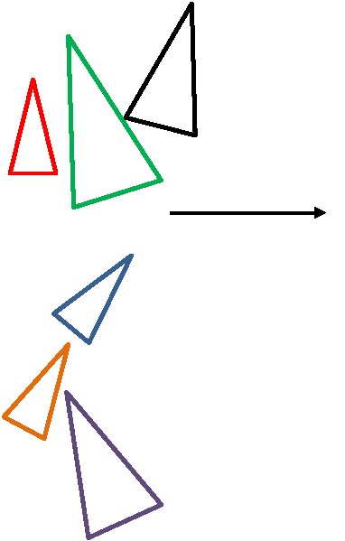
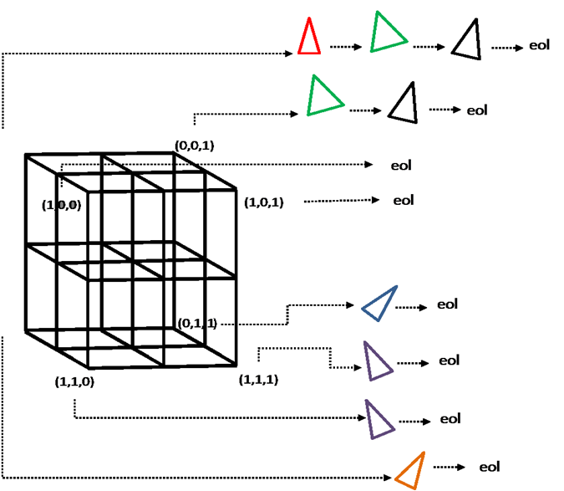
Create 3D grid for shadow blocker geometry
(0,0,0)
eol = End of list (0xffffffff)
Insert triangles of low LOD versions of blocker geometry into cells of 3D grid
(0,1,0)

Slide 37
PHASE #2
Generate RSMs

Slide 38
Reflective Shadow Map
RSM is like a standard shadow map but with added information such as color, normal, flux, etc.
Pixels in RSM considered as point light sources for 1 bounce indirect light.
Create 1 RSM for each light source you want to contribute indirect light.

Slide 39
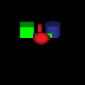
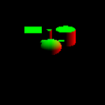
RSM ~ G-Buffer for lights
Position
Color
Normal

Slide 40
PHASE #3
Indirect Light

Slide 41
Indirect Light
At this point, assumed you have:
Main scene G-buffer with color, position, normal
Generated RSMs with color, position, normal
Separate indirect light and indirect shadow phases so you can use different buffer sizes based on performance needs.
In this example both phases use 1/4 size buffer.

Slide 42
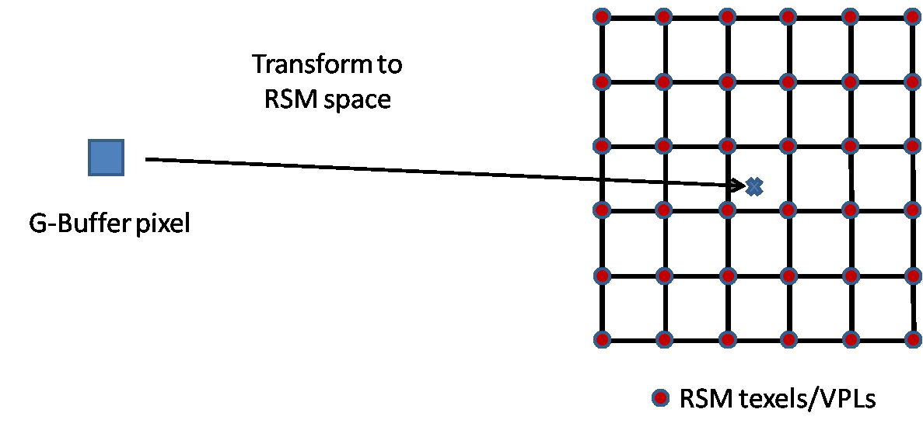
Full-screen quad. For each scene pixel:
Transform scene pixel position
and normal to RSM space

Slide 43
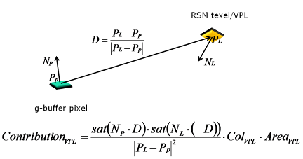
Indirect Light Accumulate
For each scene pixel, loop through RSM
kernel pixels, do standard lighting calculation between RSM kernel pixel and scene pixel and accumulate light.

Slide 44
Problem!
Too many samples per kernel will kill performance…but we need very large kernel to get good visual results.
For decent results need >= 512x512 as well as big kernel >= 80x80

Slide 45
Solution:
Don’t use the full kernel for each screen pixel.
Instead, use dithered pattern of pixels which only considers 1 out of NxN pixels each time in the light accumulation loop.
Dithered pattern position uses scene pixel screen position modulo N.

Slide 46
Indirect Lighting
However, the dithered pattern used to calculate indirect light falling on screen pixel still won’t be smooth…
Perform bilateral filter with up-sample to smooth things out and go to main scene image size.

Slide 47
PHASE #4
Indirect Shadowing

Slide 48
Indirect Shadowing
Similar steps, full screen quad, transform scene pixel to RSM, but instead of lighting calculation…
Accumulate the amount of *blocked* light between RSM kernel and scene pixel.

Slide 49
How do you estimate amount of blocked light?
Trace N rays from scene pixel to RSM kernel pixels and check for blocking triangles from the 3D grid step.
Accumulate indirect light from *blocked* RSM kernel pixels only!
Apply bilateral filter and up-sample.
SUBTRACT result from indirect light in previous step.

Slide 50
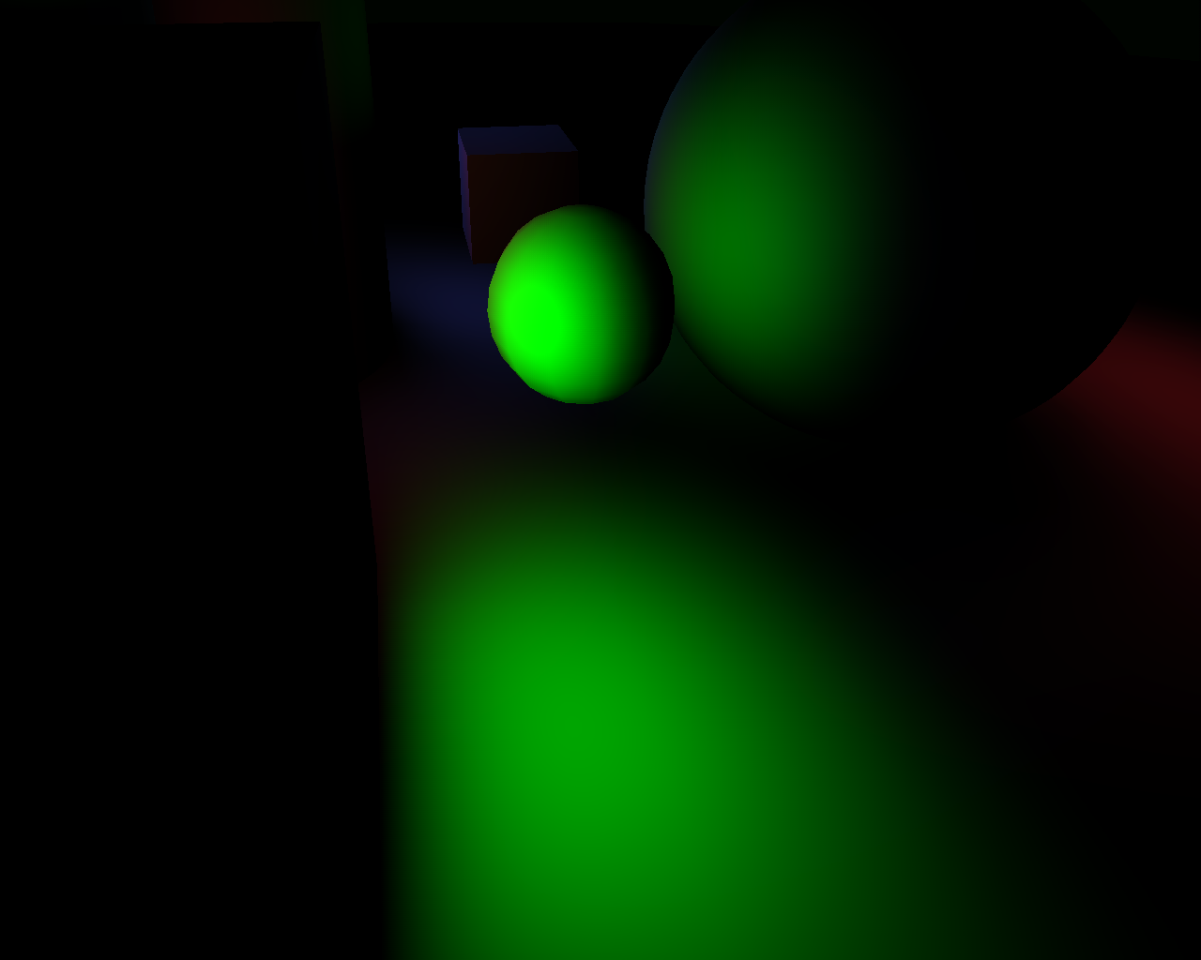
Indirect Light

Slide 51
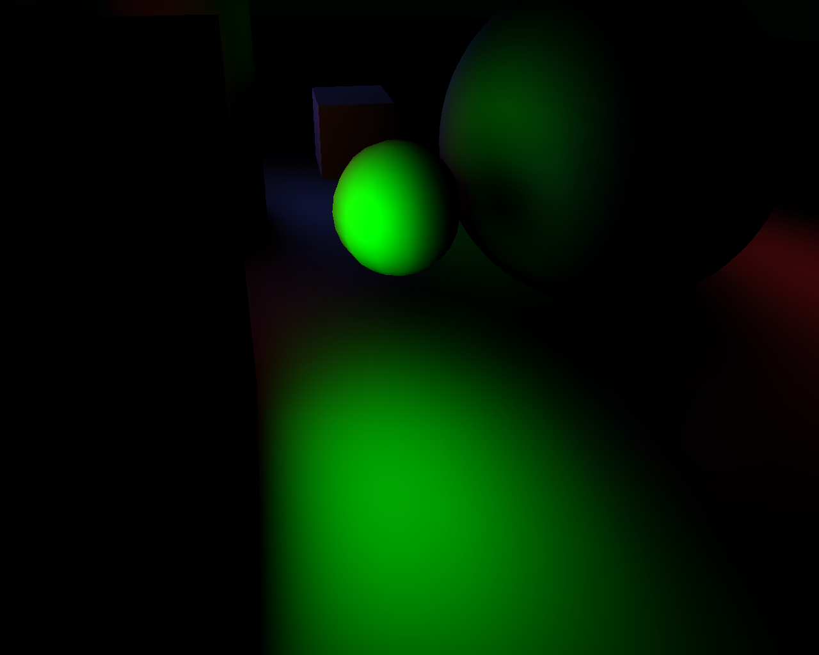
After Indirect Shadowing

Slide 52
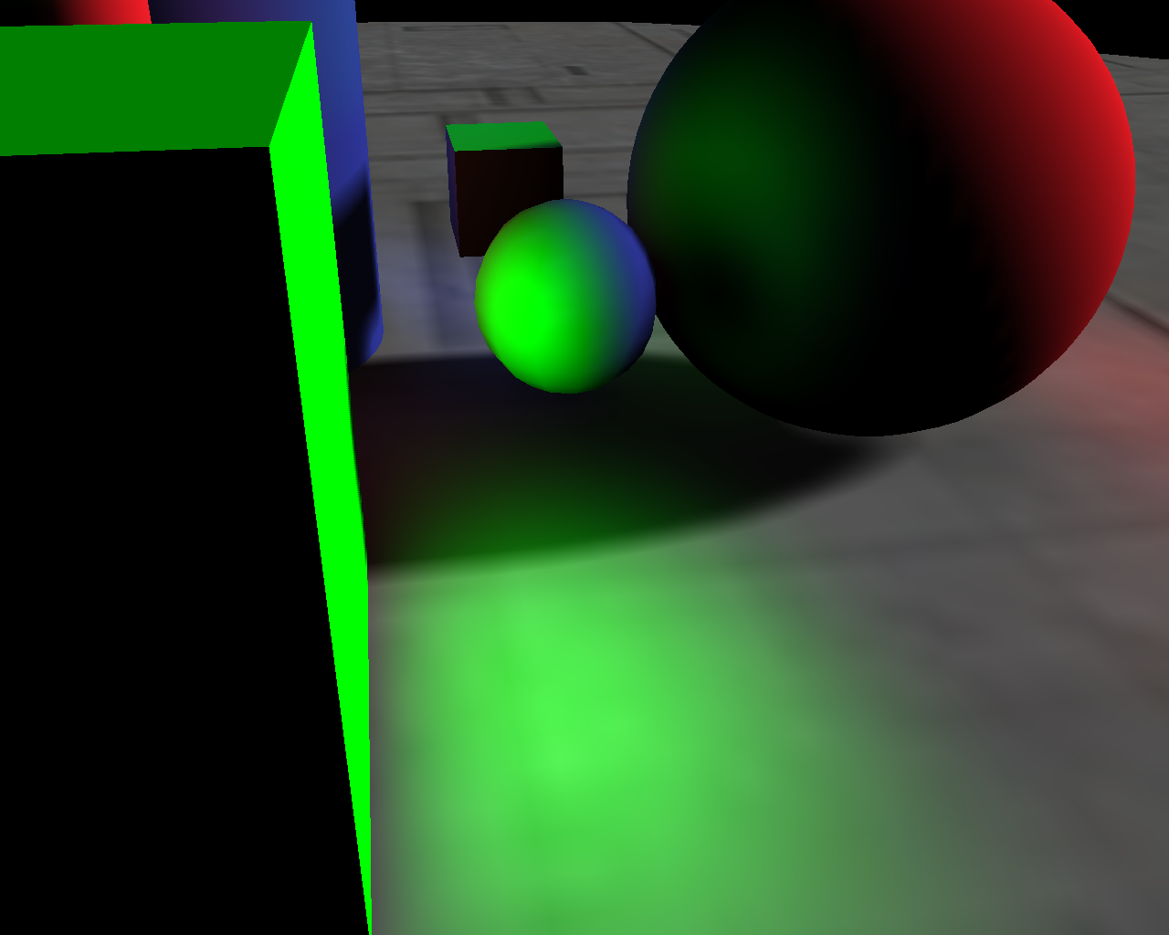
Full Scene

Slide 53
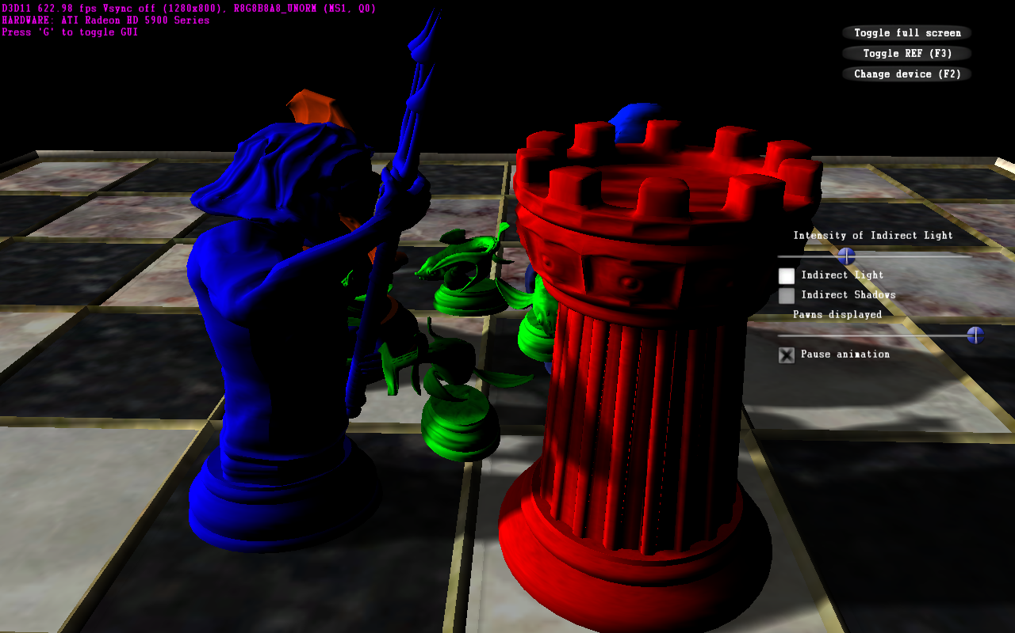
No Indirect Lighting

Slide 54
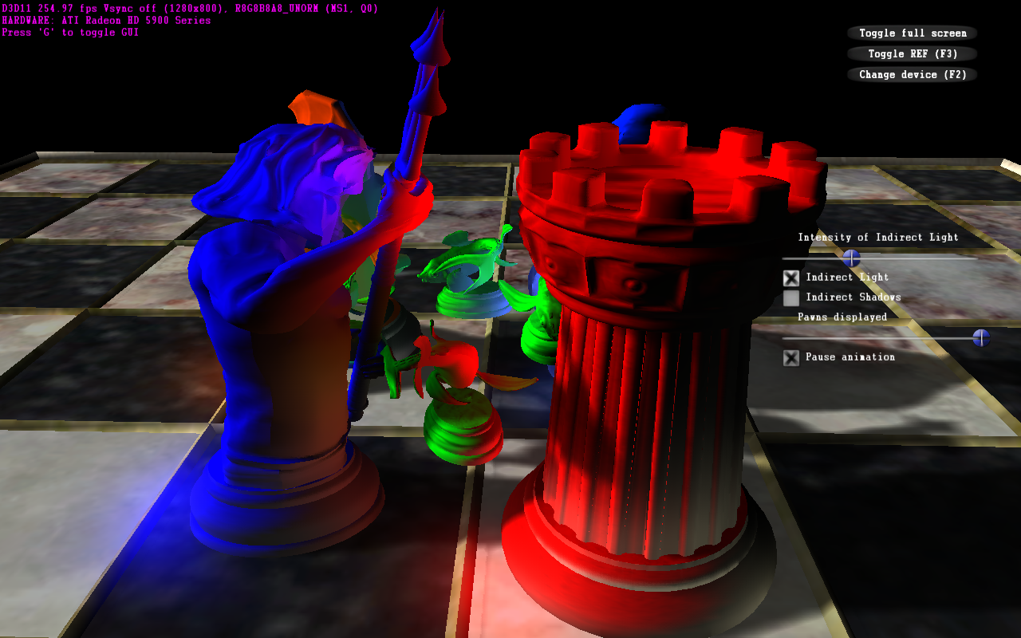
With Indirect Lighting

Slide 55
Indirect Lighting + Shadowing

Slide 56
Demo Time

Slide 57
Summary:
Fairly simple implementation. All but the 3D grid phase is probably in your pipeline today.
Fully dynamic. No pre-generated data required.
Offers a “playground” to experiment with ray-casting and per-pixel data structures in DX11.
70-110 fps on AMD HD5970
12800x800 -- 9 shadow rays per pixel
32x32x32 grid. -- ~6000 blocker triangles per frame

Slide 58
Thanks
Holger Grün, Nicolas Thibieroz, Justin Hensley, Abe Wiley, Dan Roeger, David Hoff, and Tom Frisinger – AMD
Chris Oat – Rockstar New England
Jakub Klarowicz – Techland

Slide 59
References
Yang J., Hensley J., Grün H., Thibieroz N.: Real-Time Concurrent Linked List Construction on the GPU. In Rendering Techniques 2010: Eurographics Symposium on Rendering (2010), vol. 29, Eurographics.
Grün H., Thibieroz N.: OIT and Indirect Illumination using DX11 Linked Lists. In Proceedings of Game Developers Conference 2010 (Mar. 2010). http://developer.amd.com/gpu_assets/OIT%20and%20Indirect%20Illumination%20using%20DX11%20Linked%20Lists_forweb.ppsx

Slide 60
Questions?
http://developer.amd.com/samples/demos/pages/ATIRadeonHD5800SeriesRealTimeDemos.aspx

Slide 61
Code Example
RWStructuredBuffer RWStructuredCounter;
RWTexture2D<int> tRWFragmentListHead;
RWTexture2D<float4> tRWFragmentColor;
RWTexture2D<int2> tRWFragmentDepthAndLink;
[earlydepthstencil]
void PS( PsInput input )
{
float4 vFragment = ComputeFragmentColor(input);
int2 vScreenAddress = int2(input.vPositionSS.xy);
// Get counter value and increment
int nNewFragmentAddress = RWStructuredCounter.IncrementCounter();
if ( nNewFragmentAddress == FRAGMENT_LIST_NULL ) { return; }
// Update head buffer
int nOldFragmentAddress;
InterlockedExchange(tRWFragmentListHead[vScreenAddress], nNewHeadAddress, nOldHeadAddress );
// Write the fragment attributes to the node buffer
int2 vAddress = GetAddress( nNewFragmentAddress );
tRWFragmentColor[vAddress] = vFragment;
tRWFragmentDepthAndLink[vAddress] = int2( int(saturate(input.vPositionSS.z))*0x7fffffff), nOldFragmentAddress );
return;
}

