Slide 1
Advances in Real-Time Rendering in 3D Graphics and Games course (I & II)
Siggraph 2010
Los Angeles, CA

Slide 2
Introduction: Graphics Feature Development for Games
Natalya Tatarchuk
Bungie

Slide 3
More Than Pretty Pixels
Visual bar for computer games has risen sharply
It’s assumed that a AAA title is going to have outstanding visuals
Focus on the whole package
Treat game as a cohesive collection of features
Make smart choices of what to focus on
Notes:
We often hear people ask: “is graphics a solved problem”? “Are we done now”? Well, no, far from it.
In previous generations it was enough to focus on normal mapping or some other technique that made the pretty pixels prettier. It was enough of a challenge just to get it to work. While there’s a lot of innovation still happening in those areas, in pushing the hardware to the limit;
Now that’s not enough – we have to do more! (with often less frame and memory budget..)
Rather than any one or two key graphics features

Slide 4
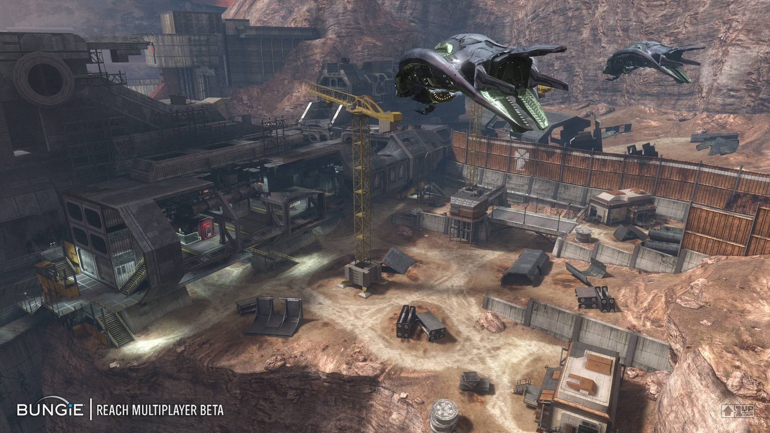
Notes:
Even if graphics is crucial to the game (like Halo Reach, which you see in this image), you still have to distribute your budget among your features for a given frame. Graphics is not the only thing that’s competing for the performance budget (33 or 16 ms) - but certainly one of the most performance-critical aspects of the game. If we break down the frame you see here, you’ll see elements of a complex world, many hero vehicles and characters at once, effects, destructible environments, detailed lighting, terrain, far away elements of the environment, and that’s just the tip of the iceberg!
So we have to be smart about what features we choose.

Slide 5
How Will You Stand Out From The Crowd?
Focus on what matters to the end user
Notes:
Differentiation is important. Many games are hitting the photoreal bar right now and even more will in the future
So, how will you stand out from the crowd: focus on what matters to the end user
Example: RPG versus first-person shooter – different priorities
Whatever details that the user can perceive for the game genre your’re working on
What is the quality that they can feel during game play
Sometimes it’s not trivial to know what really matters to the end user
Many times we, as graphics programmers, get hung up on perfect shadows, etc., but it’s possible that the audience for your game won’t care about it.
Starting in Halo3 we had user-created screenshots. When we looked at the shots that users created, and what they felt excited about – we noticed that it wasn’t necessarily correlated to what we as graphics programmers spent most time on. For examples, players always loved shots of big explosions, nice shiny armor shots, and pick out little things that we didn’t they would pick out. That tells us that what a graphics programmer sees and what the end user sees is not always the same!. (though many times they compliment each other nicely).

Slide 6
How Will You Stand Out From The Crowd?
Focus on what matters to the end user
It’s all about player experience!
In the player’s living room!
Notes:
Make sure you’re looking at the results the same way that the player would be looking at. Must author your content for the same visual target and resolution as you expect your player to view it.

Slide 7
How Will You Stand Out From The Crowd?
Focus on what matters to the end user
Use graphics as a story-telling element
Graphics is a realization of artistic vision
Notes:
Use graphics as a story-telling agent. Making stories more compelling, making worlds more immersive. Setting the mood: atmospheres, time of day, lighting, shadows, shading: what conveys the sense of surroundings and the sense of the story. Graphics is the vehicle that delivers that to the player and makes them feel the story that the game designers had in mind. For example, Anton Kaplanyan will talk about how Crytek used their deferred renderer to make the next-gen environments of Crysis 2 come alive.
Use the concept for your game to drive what graphics features are important for your implementation. In the end, it’s about artistry, and not about fancy technology in isolation (Artistry – not technology for technology’s sake). A good example of that is the method that the guys from Avalanche used to translate Pixar’s vision into the medium of games, or how the artists’ vision for characters was executed in Uncharted 2.

Slide 8
Games Are a Unique Medium
Games are about pixels in motion
Notes:
Dynamic techniques are crucial
Games are not a static medium
Games are 4D: time is a very important dimension!
It’s just about screenshots!
Don’t overlook the time axis
Temporal coherence! A fair amount of time for SSAO, lighting, shadow techniques goes into removing artifacts that are tolerable in a static image but become very aggravating to the player when moving around (for example, dancing aliasing in shadows, or the shower door effect in SSAO implementations). That’s just an example of a common theme in many talks today.

Slide 9
Games Are a Unique Medium
Games are about pixels in motion
Don’t forget about input lag
Design and gameplay needs to define what gets exposed to the player
Notes:
Input lag requirements vary for each game genre
How does your feature influence the input lag
The design of your game controls what you need to expose for your features- and what you should focus on. Alex Vlachos will talk in the later part of the day how design of Portal 2 influenced the design of his water flow system – and how the water flow system influenced the game play.

Slide 10
You Don’t Always Know What They’ll Do
Players will tend to break whatever constraints you’ve created for your technique
Famous last words:
“They’d never wonder into that corner and see this, right?
“We’ll never have this many smoke plumes on the screen at once…”
“Who knew that he was going to kick himself on the head?!”
Robust handling of edge conditions matters

Slide 11
It’s All About the Pipeline
Content longevity and content production efficiency are key
Polish == iteration
Good IP is alive for ~5 years; great IP – 10+!
This means all assets are likely to be around for just as long
Can’t go through and rework them for big budget titles for every new release
Notes:
Successful games are not cheap to produce
Great part of that cost is content generation
Techniques that improve content workflow are crucial
Including offline toolchain techniques
Titles often live for 3-4 years (through out their development cycle). Good IP will be alive for 5 years, great IP – 10! Now the asserts that were created for a particular technique

Slide 12
What Makes A Technique Successful in Games?
Integration with the artist workflow and the engine / tools pipeline
30% : 70%
Notes:
A common theme in the talks throughout the course is how does a graphics feature go through the pipeline. For example, Per Einarsson and Sam Martin will discuss how they integrated global illumination into Frostbite’s engine and their choices along the way. Robert Kihl will talk about how they improved the artist workflow for generation of destructible environments.

Slide 13
What Makes A Technique Successful in Games?
Integration with the artist workflow and the engine / tools pipeline
Does it effect gameplay positively?
Examples: water flow / GI / thousands of lights in a deferred renderer / shadows, and many more…

Slide 14
Not Just About Performance
What are the artist controls?
How does it deal with other elements in the game? (effects, leaf systems, etc.)
Multi-platform support
Notes:
A good technique is judged not just on performance alone
We Know We Can Optimize Shaders…
How the heck do we get this thing into memory? Runtime storage, load times, runtime bandwidth considerations… Can it be stored in an efficient manner on the GPU?

Slide 15
What Are the Goals for This Course?
Bring you the latest techniques from the game development community
With focus on practical, pipeline-friendly techniques
Share common challenges encountered during game development (wrt graphics techniques)
With the eye toward the future
Inspire new research directions!

Slide 16
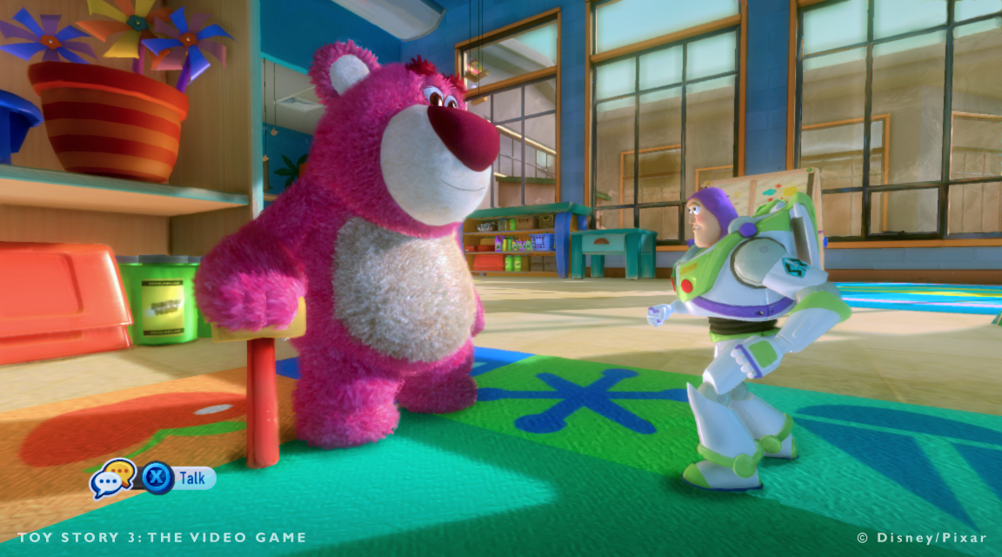
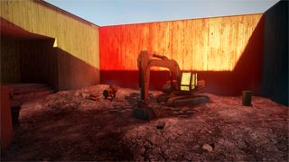
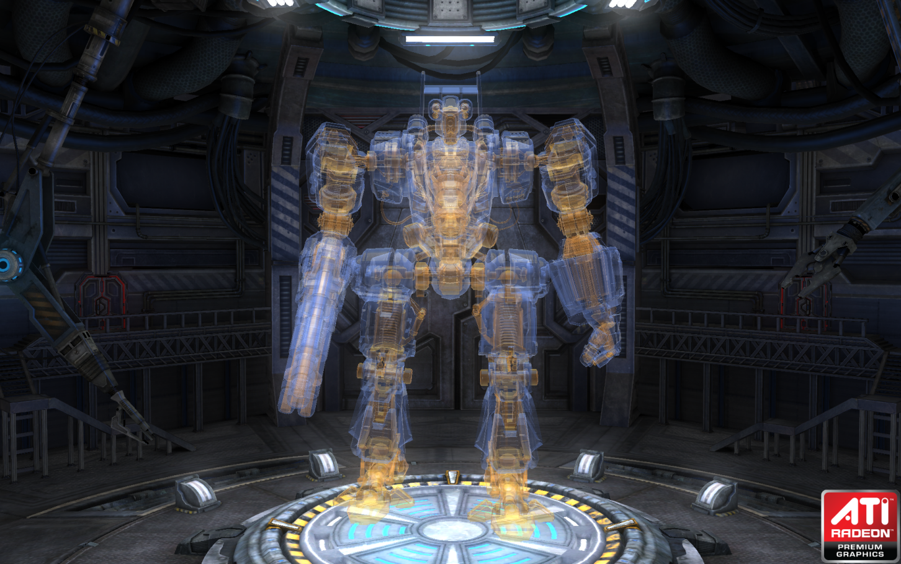
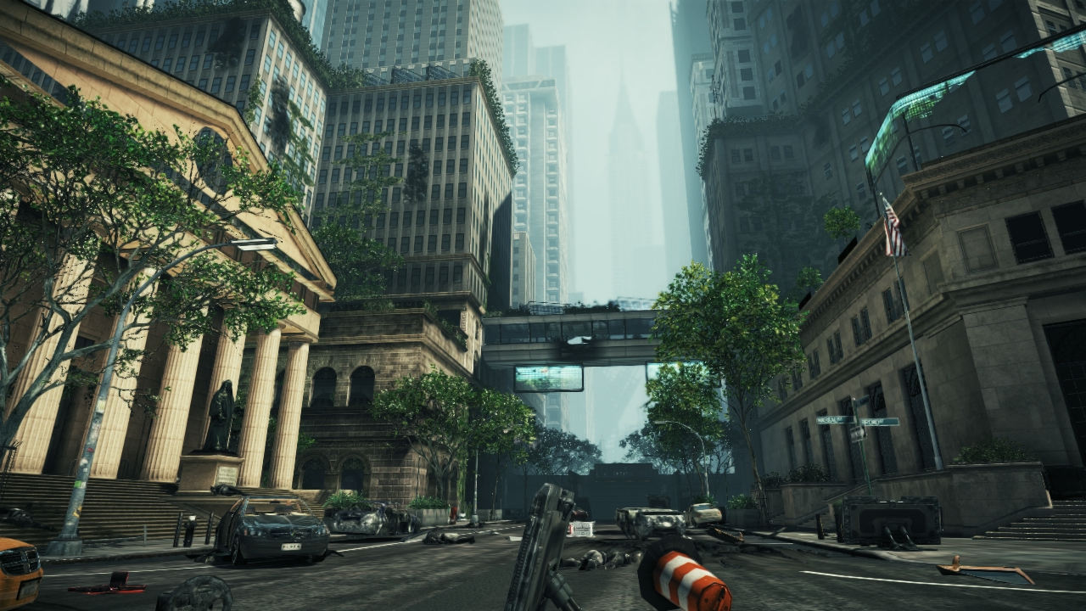
Advances in Real-Time Rendering in 3D Graphics and Games I
Wednesday, 28 July | 9:00 AM - 12:15 PM | Room 515 AB
9:00 ^{am} | Tatarchuk Introduction
9:05 ^{am} | Ownby, Hall and Hall Rendering techniques in Toy Story 3
9:55 ^{am} | Einarsson, Martin A Real-Time Radiosity Architecture for Video Games
10:45 ^{am} | Yang, McKee Real-Time Order Independent Transparency and Indirect Illumination using Direct3D 11
11:30 ^{am} | Kaplayan CryENGINE 3: Reaching the Speed of Light

Slide 17
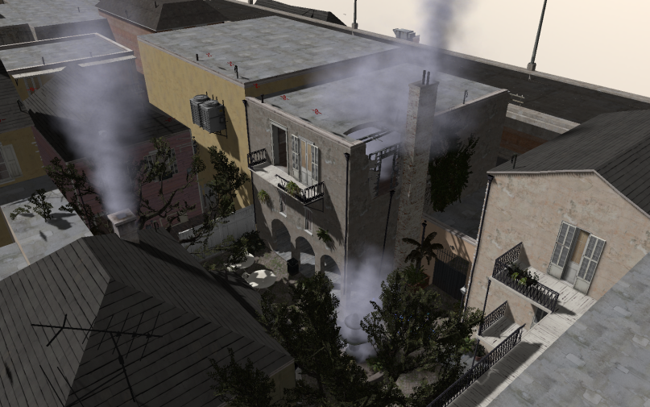
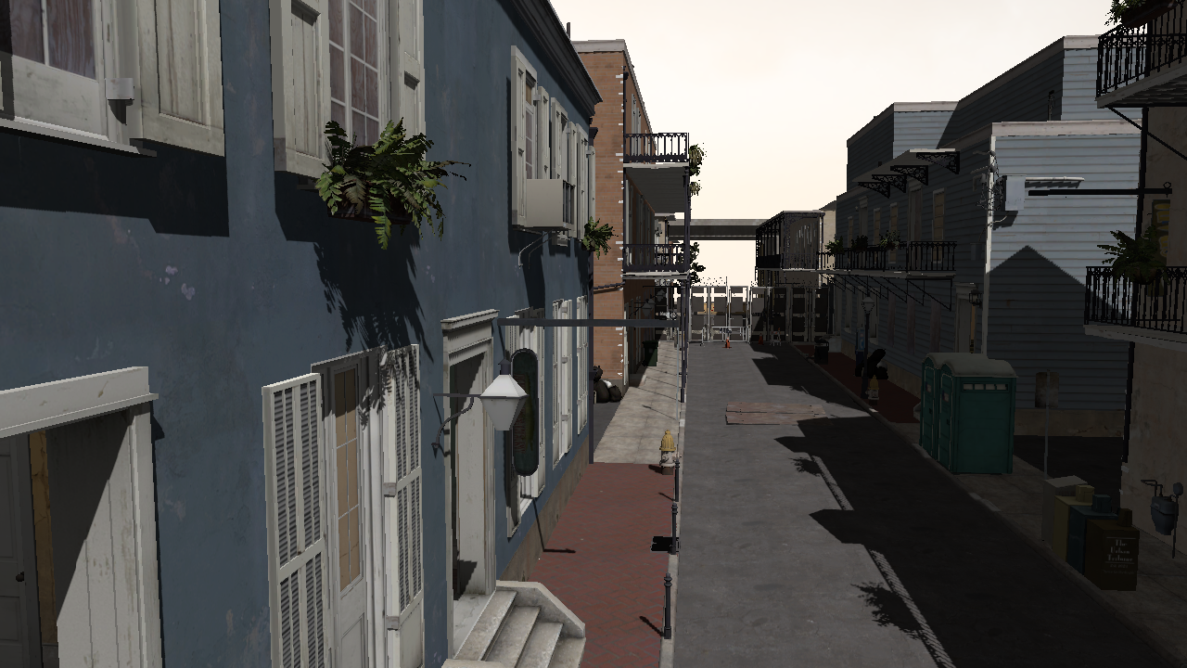
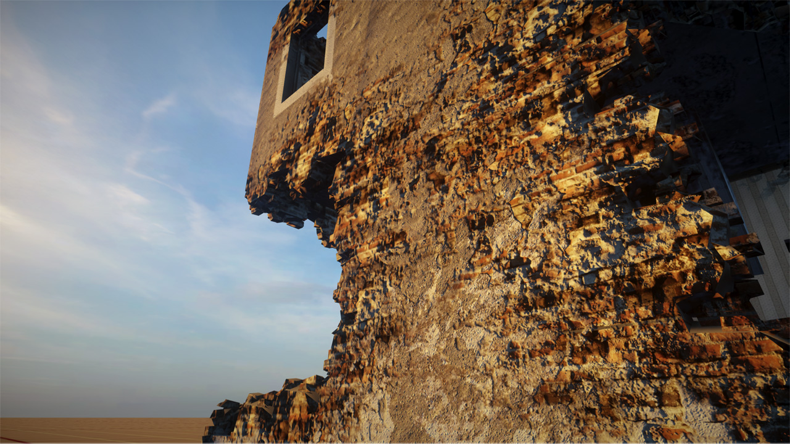
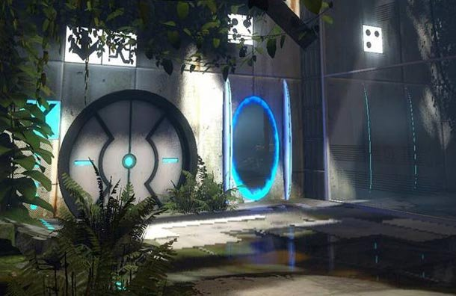
Advances in Real-Time Rendering in 3D Graphics and Games II
Wednesday, 28 July | 2:00 PM - 5:15 PM | Room 515 AB
2:00 ^{pm} | Lauritzen Sample Distribution Shadow Maps
2:25 ^{pm} | Salvi Adaptive Volumetric Shadow Maps
2:55 ^{pm} | Hable Uncharted 2: Character Lighting and Shading
3:45 ^{pm} | Kihl Destruction Masking in Frostbite 2 using Volume Distance Fields
4:10 ^{pm} | Vlachos Water Flow in Portal 2
5:00 ^{pm} | General Q&A

