Slide 2
Uncharted 2: Character Lighting and Shading
John Hable
Naughty Dog

Slide 3
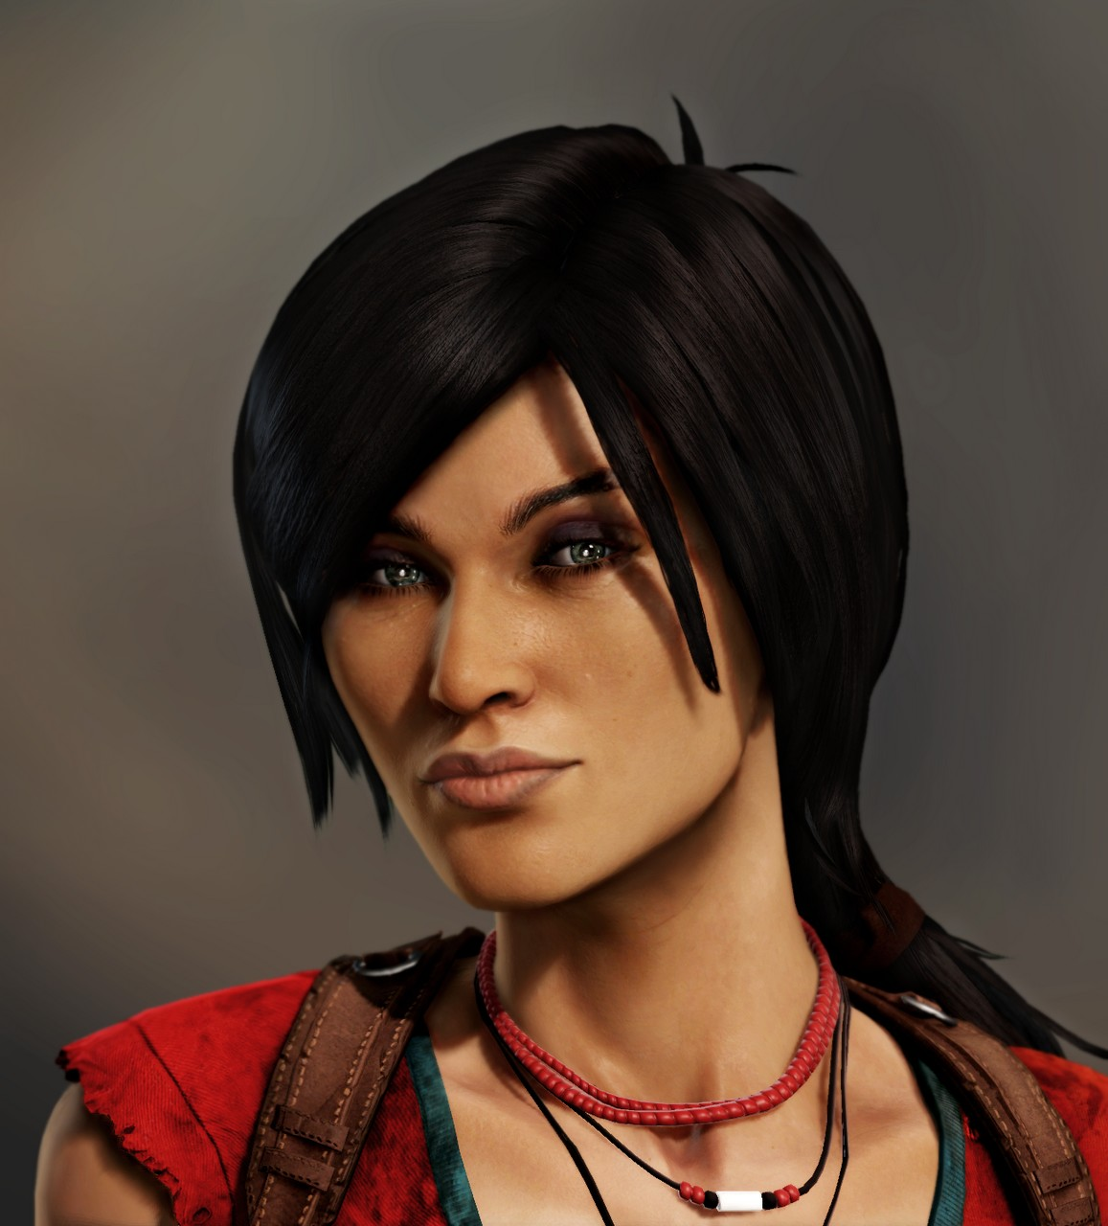
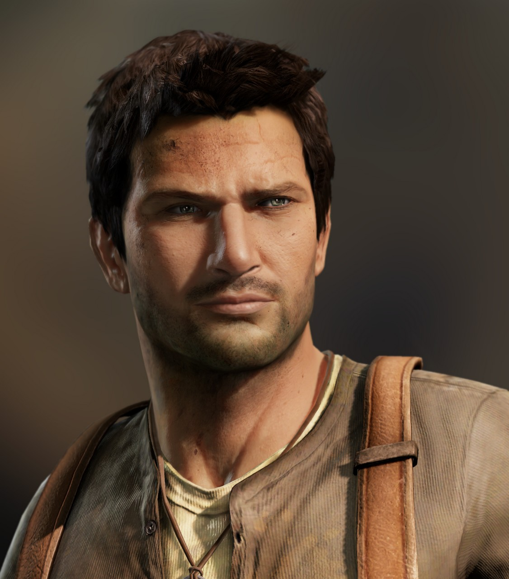
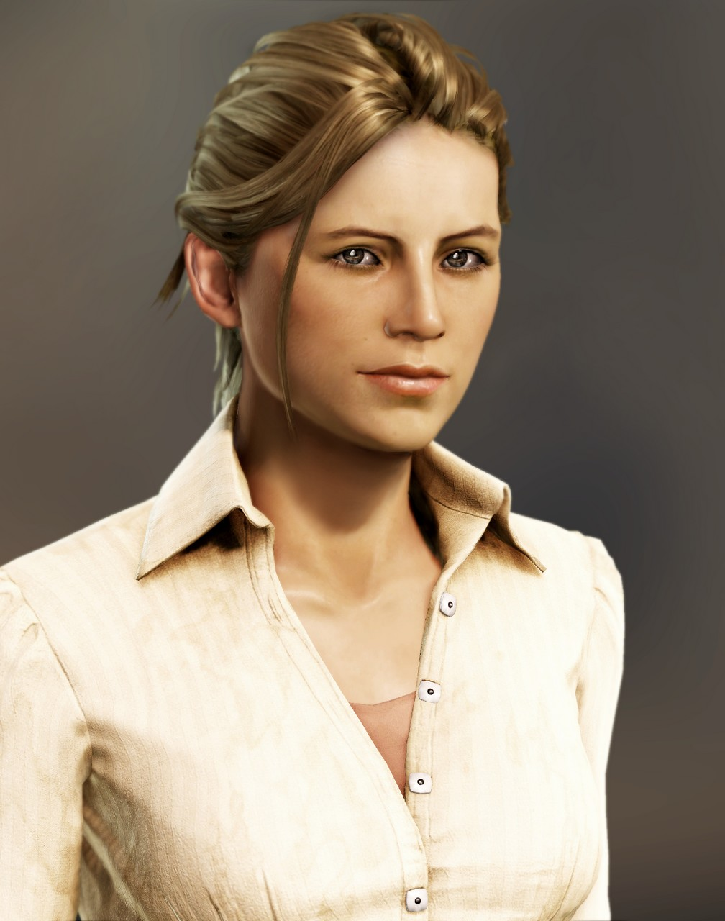
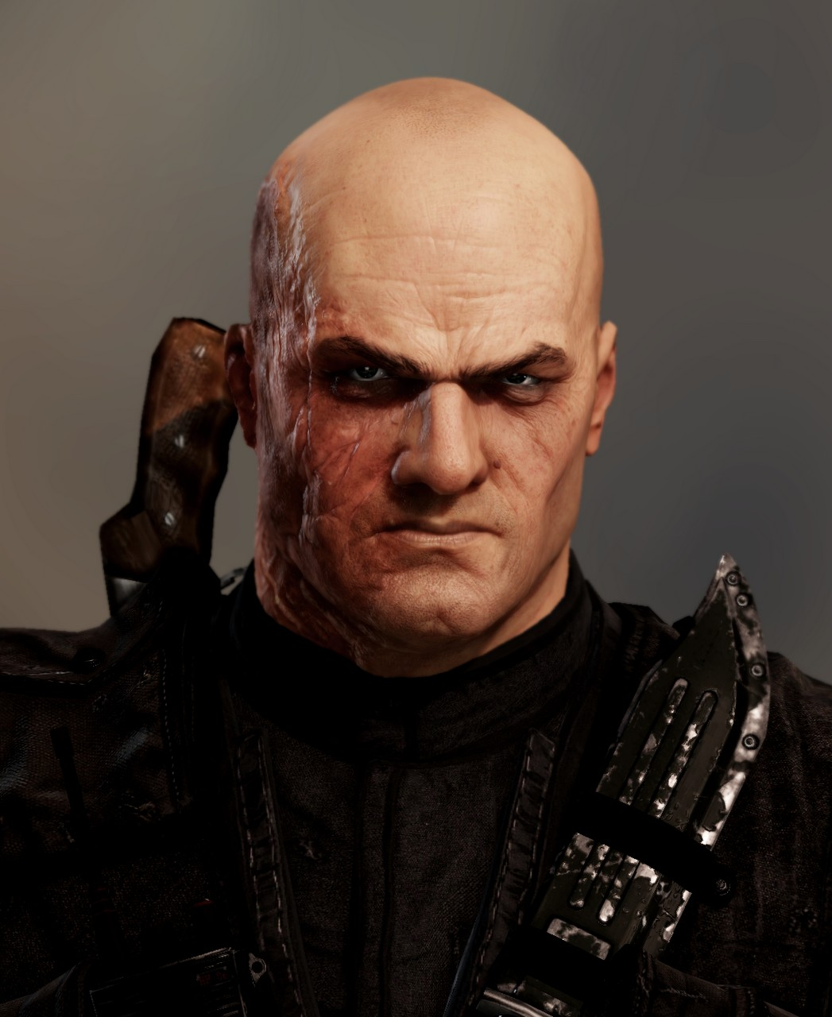
Focus: Characters

Slide 4
Drake
Notes:
You play as Drake, the loveable rogue. Check out this link for more character development: http://www.penny-arcade.com/comic/2009/10/19/.

Slide 5
Chloe

Slide 6
Elena

Slide 7
Lazaravic

Slide 8
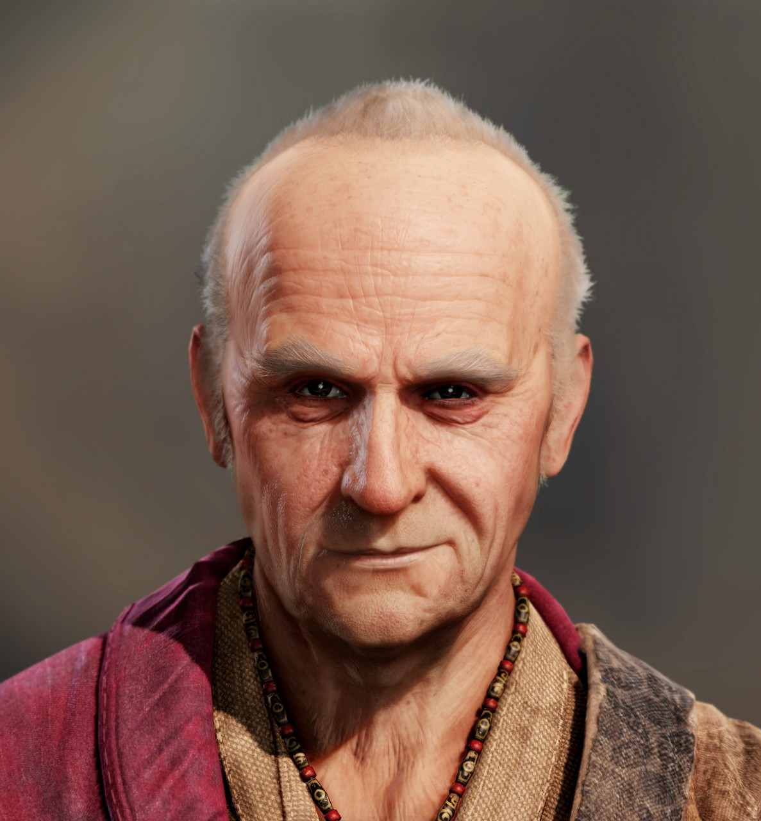
Shafer

Slide 9
Todo List:
Skin
Hair
Cloth
5 Secrets

Slide 10
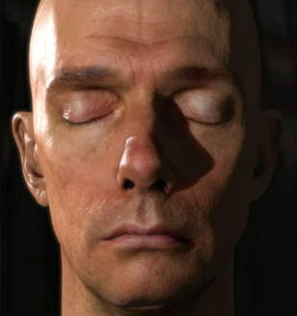
Skin
Efficient Rendering of Human Skin, Eugene d'Eon, David Luebke, and Eric Enderton, Eurographics 2007
NVIDIA Human Head Demo
Compare with real shots.
Notes:
The best implementation of skin in realtime that I’ve seen is the NVIDIA Human Head demo.

Slide 11
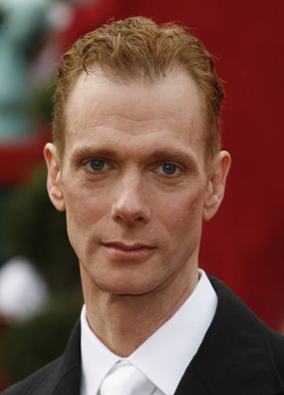
Doug Jones
http://www.omnipop.com/artist-details.php?BID=69
http://www.collider.com/uploads/imageGallery/Doug_Jones/doug_jones.jpg
Notes:
When you look at the render on the left vs. an actual picture of Doug Jones, there is a certain fleshiness that is hard to explain. That’s what I like about the NVIDIA technique. On some level, it just “feels” like skin.

Slide 12
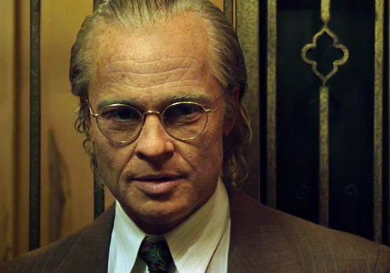
Benjamin Button
Yikes!
Notes:
Obviously, movies can go much farther than we can in realtime. We’ll catch up eventually…I hope.

Slide 13
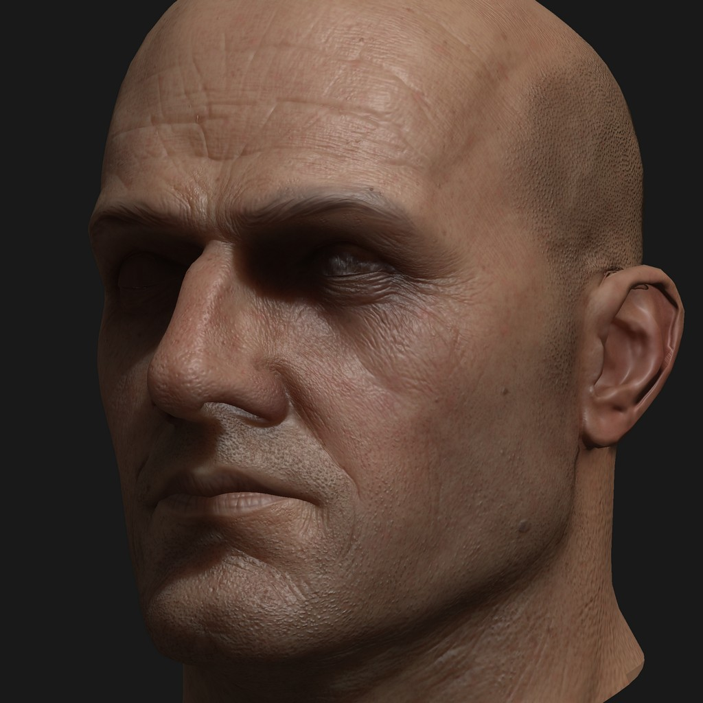
Let’s Test!
Lazaravic
RenderMonkey
Notes:
This next section with show lots of pictures using Lazarevic from U2. Note that these tests are in Rendermonkey, not the game engine.

Slide 14
Compare 5-ish Approaches
1. Standard Diffuse
2. Nvidia Approach
3a. 12-Tap Separate
Do 12-Tap blur as separate shader.
3b. 12-Tap Combined
Do 12-Tap blur in final render pass.
4. Bent Normals
5. Blended Normals

Slide 15
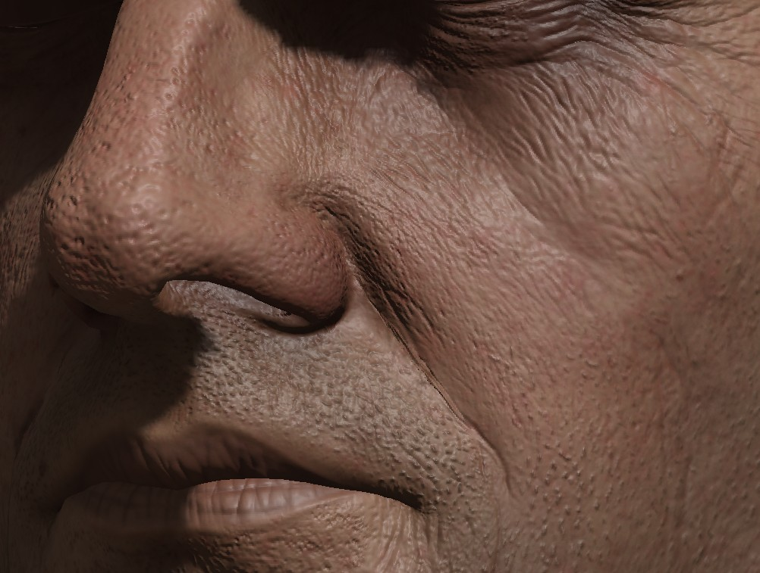
1) Standard Diffuse
Notes:
Lazaravic with standard dot(N,L) lighting.

Slide 16
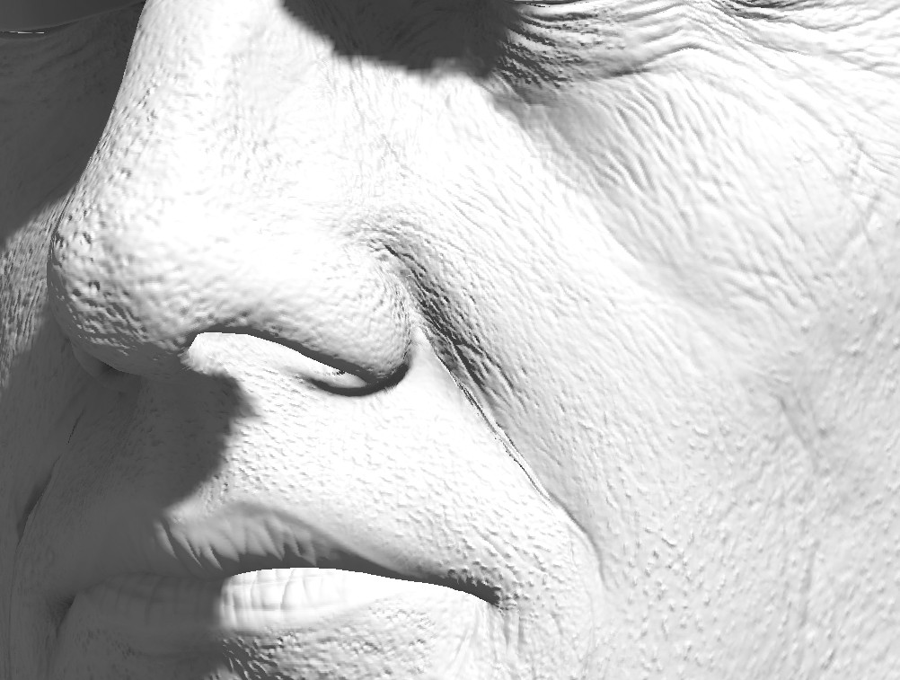
Lighting-Only

Slide 17
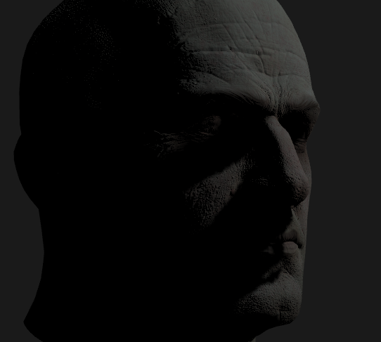
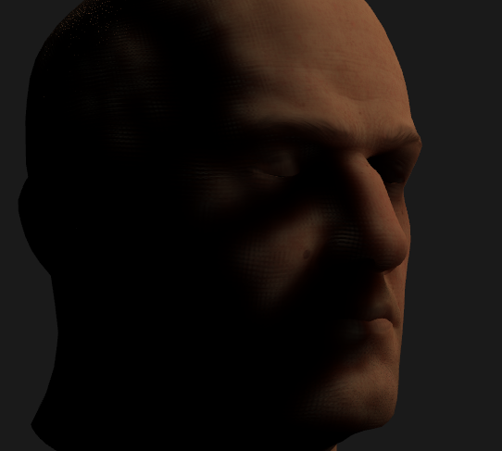
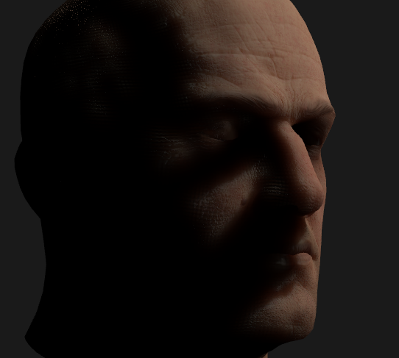
2) NVIDIA Human Head Demo
Non-SSS
SSS
Combined
Notes:
The NVIDIA technique divides light into diffuse light that gets absorbed and immediately retransmitted, versus light that bounces around inside the skin for a while before exiting. Not that the SSS light is more red-ish.

Slide 18
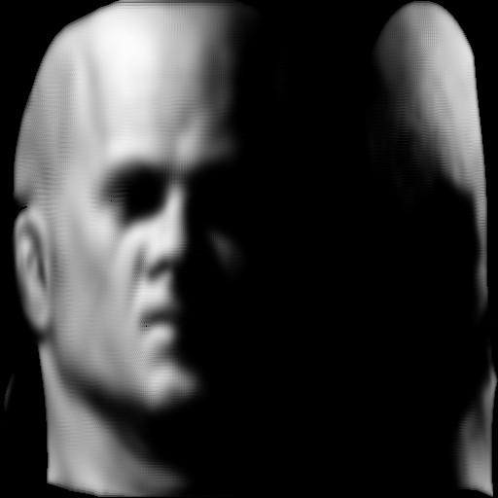
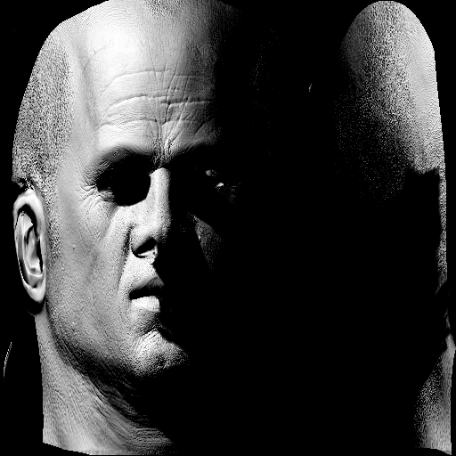
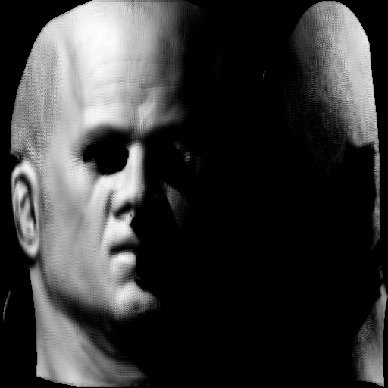
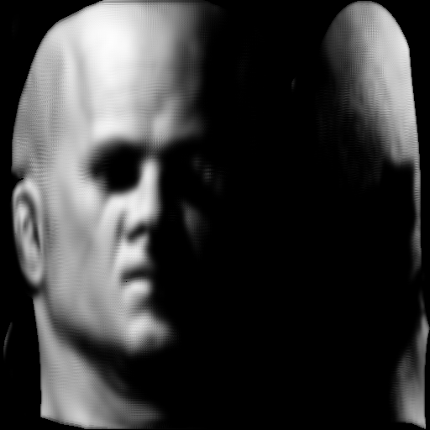
2) NVIDIA Human Head Demo
Efficient Rendering of Human Skin, Eugene d'Eon, David Luebke, and Eric Enderton, Eurographics 2007

Slide 19
2) NVIDIA Approach
Combine Blurs
diffColor = direct*float3(.233,.455,.649);
diffColor += lm1*float3(.100,.336,.344);
diffColor += lm2*float3(.118,.198,.0);
diffColor += lm3*float3(.113,.007,.007);
diffColor += lm4*float3(.358,.004,.0);
diffColor += lm5*float3(.078,0,0);
Notes:
Their approach uses essentially 6 layers of blur.

Slide 20
2) NVIDIA Approach
Combine Blurs
diffColor = direct*float3(.233,.455,.649);
diffColor += lm1*float3(.100,.336,.344);
diffColor += lm2*float3(.118,.198,.0);
diffColor += lm3*float3(.113,.007,.007);
diffColor += lm4*float3(.358,.004,.0);
diffColor += lm5*float3(.078,0,0);
Notes:
The first layer is essentially no blur. This simulates light that gets absorbed and immediately retransmitted.

Slide 21
2) NVIDIA Approach
Combine Blurs
diffColor = direct*float3(.233,.455,.649);
diffColor += lm1*float3(.100,.336,.344);
diffColor += lm2*float3(.118,.198,.0);
diffColor += lm3*float3(.113,.007,.007);
diffColor += lm4*float3(.358,.004,.0);
diffColor += lm5*float3(.078,0,0);
Notes:
The use weights for all 5 lightmaps to simulate the light that bounces inside the skin.

Slide 22
2) NVIDIA Approach
Combine Blurs
diffColor = direct*float3(.233,.455,.649);
diffColor += lm1*float3(.100,.336,.344);
diffColor += lm2*float3(.118,.198,.0);
diffColor += lm3*float3(.113,.007,.007);
diffColor += lm4*float3(.358,.004,.0);
diffColor += lm5*float3(.078,0,0);

Slide 23
2) NVIDIA Approach

Slide 24
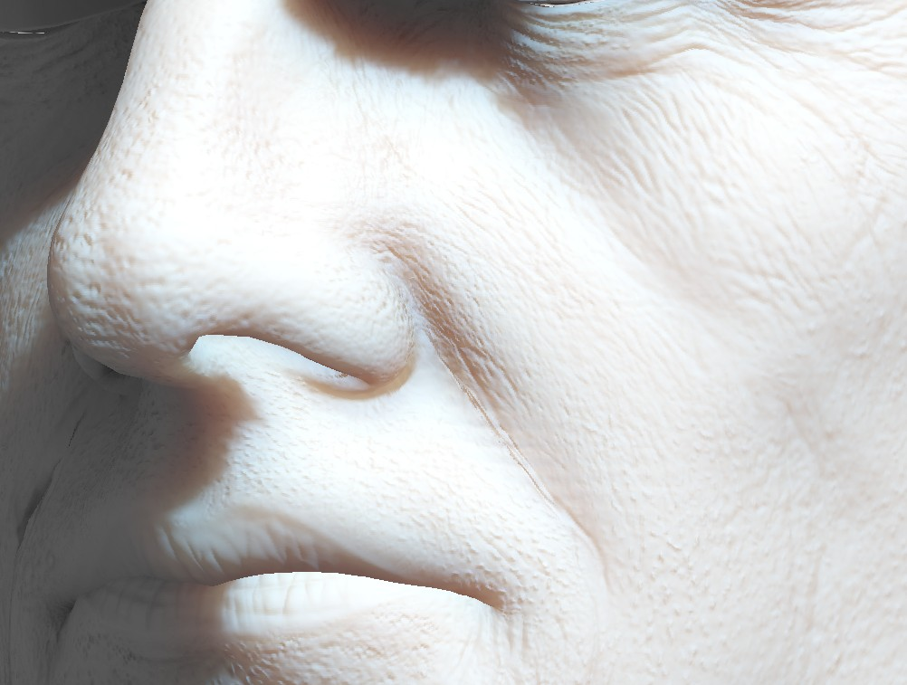
Lighting-Only
Lambertian vs. NVIDIA
Notes:
The left side is a standard dot(N,L) and the right is with the NVIDIA skin shading.

Slide 25
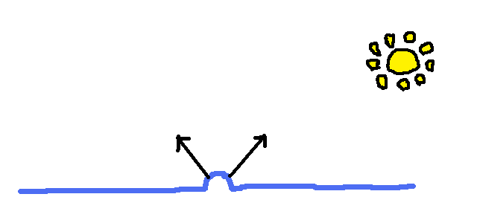
Why it works?
Red bleeds
Blue/Green not so much
Towards Light: Cyan-ish
Away From Light: Red-ish
Notes:
Key point: The normals that point towards the light tend to look more cyan-ish and the normals that point away tend to be more red-ish.

Slide 26
Lighting-Only
Lambertian vs. NVIDIA
Notes:
Comparison of pure dot(N,L) diffuse to the NVIDI SSS technique.

Slide 27
2) NVIDIA Approach
Looks awesome
Final blur is 100x100
Exact calculation of blur with 10k samples
Lots of passes
Lots of blurs
Lots of memory
Cheaper way that looks close enough?
Notes:
Their approach looks great, but is very expensive in both memory.

Slide 28
3) 12-Tap Approximation
NVIDIA

Slide 29
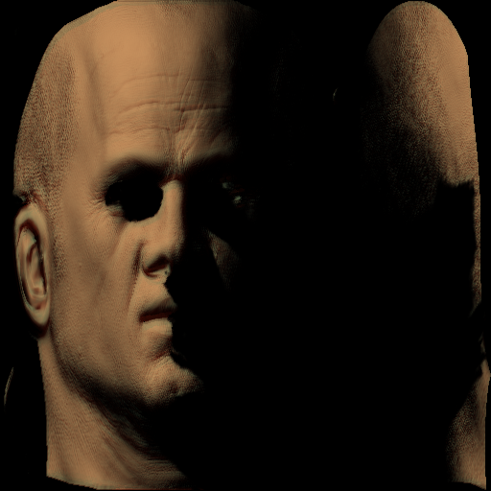
3) 12-Tap Approximation
NVIDIA
ShaderX7
Notes:
Instead of using 5 gaussian blurs, we’ll try to approximate that with a single 12-tap blur. It’s not as good, but much, much cheaper.

Slide 30
3) 12-Tap Approximation
From ShaderX7 (Hable, Borshukov, and Hejl)
Do a single 12-tap blur
float3 blurJitteredWeights[13] =
{
{ 0.220441, 0.437000, 0.635000 },
{ 0.076356, 0.064487, 0.039097 },
{ 0.116515, 0.103222, 0.064912 },
{ 0.064844, 0.086388, 0.062272 },
{ 0.131798, 0.151695, 0.103676 },
{ 0.025690, 0.042728, 0.033003 },
{ 0.048593, 0.064740, 0.046131 },
{ 0.048092, 0.003042, 0.000400 },
{ 0.048845, 0.005406, 0.001222 },
{ 0.051322, 0.006034, 0.001420 },
{ 0.061428, 0.009152, 0.002511 },
{ 0.030936, 0.002868, 0.000652 },
{ 0.073580, 0.023239, 0.009703 },
};
float2 blurJitteredSamples[13] =
{
{ 0.000000, 0.000000 },
{ 1.633992, 0.036795 },
{ 0.177801, 1.717593 },
{ -0.194906, 0.091094 },
{ -0.239737, -0.220217 },
{ -0.003530, -0.118219 },
{ 1.320107, -0.181542 },
{ 5.970690, 0.253378 },
{ -1.089250, 4.958349 },
{ -4.015465, 4.156699 },
{ -4.063099, -4.110150 },
{ -0.638605, -6.297663 },
{ 2.542348, -3.245901 },
};
Notes:
Check the ShaderX7 chapter for more detail.

Slide 31
3) 12-Tap Approximation
float3 blurJitteredWeights[13] =
{
{ 0.220441, 0.437000, 0.635000 },
{ 0.076356, 0.064487, 0.039097 },
{ 0.116515, 0.103222, 0.064912 },
{ 0.064844, 0.086388, 0.062272 },
{ 0.131798, 0.151695, 0.103676 },
{ 0.025690, 0.042728, 0.033003 },
{ 0.048593, 0.064740, 0.046131 },
{ 0.048092, 0.003042, 0.000400 },
{ 0.048845, 0.005406, 0.001222 },
{ 0.051322, 0.006034, 0.001420 },
{ 0.061428, 0.009152, 0.002511 },
{ 0.030936, 0.002868, 0.000652 },
{ 0.073580, 0.023239, 0.009703 },
}

Slide 32
3) 12-Tap Approximation
float3 blurJitteredWeights[13] =
{
{ 0.220441, 0.437000, 0.635000 },
{ 0.076356, 0.064487, 0.039097 },
{ 0.116515, 0.103222, 0.064912 },
{ 0.064844, 0.086388, 0.062272 },
{ 0.131798, 0.151695, 0.103676 },
{ 0.025690, 0.042728, 0.033003 },
{ 0.048593, 0.064740, 0.046131 },
{ 0.048092, 0.003042, 0.000400 },
{ 0.048845, 0.005406, 0.001222 },
{ 0.051322, 0.006034, 0.001420 },
{ 0.061428, 0.009152, 0.002511 },
{ 0.030936, 0.002868, 0.000652 },
{ 0.073580, 0.023239, 0.009703 },
}

Slide 33
3) 12-Tap Approximation
float3 blurJitteredWeights[13] =
{
{ 0.220441, 0.437000, 0.635000 },
{ 0.076356, 0.064487, 0.039097 },
{ 0.116515, 0.103222, 0.064912 },
{ 0.064844, 0.086388, 0.062272 },
{ 0.131798, 0.151695, 0.103676 },
{ 0.025690, 0.042728, 0.033003 },
{ 0.048593, 0.064740, 0.046131 },
{ 0.048092, 0.003042, 0.000400 },
{ 0.048845, 0.005406, 0.001222 },
{ 0.051322, 0.006034, 0.001420 },
{ 0.061428, 0.009152, 0.002511 },
{ 0.030936, 0.002868, 0.000652 },
{ 0.073580, 0.023239, 0.009703 },
}

Slide 34
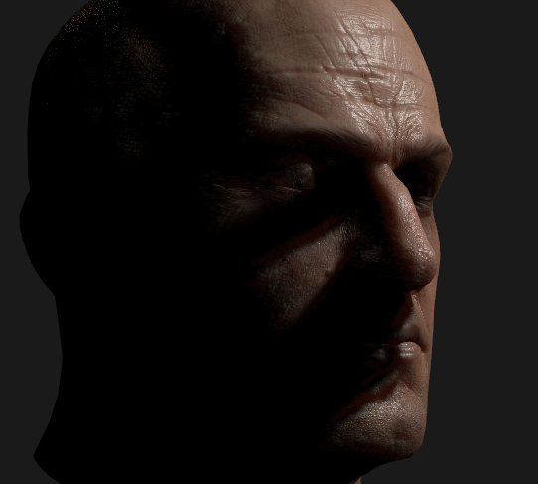
3) 12-Tap Approach
A: Separate Blur

Slide 35
3) 12-Tap Approach
B: Combined Blur

Slide 36
3) 12-Tap Approximation
Separate Blur
Render to Lightmap
Blur Lightmap with 12 taps
Render Final Scene
Combined Blur
Render to Lightmap
Render Final Scene, with 12 taps from lightmap
Both are fine

Slide 37
12-Tap Separate

Slide 38
12-Tap Combined

Slide 39
4) Bent Normals (?)
Pretend R/G/B come from different Normals
R closer to Geometry, GB closer to Normal Map
Diffuse Calculation 3 Times

Slide 40
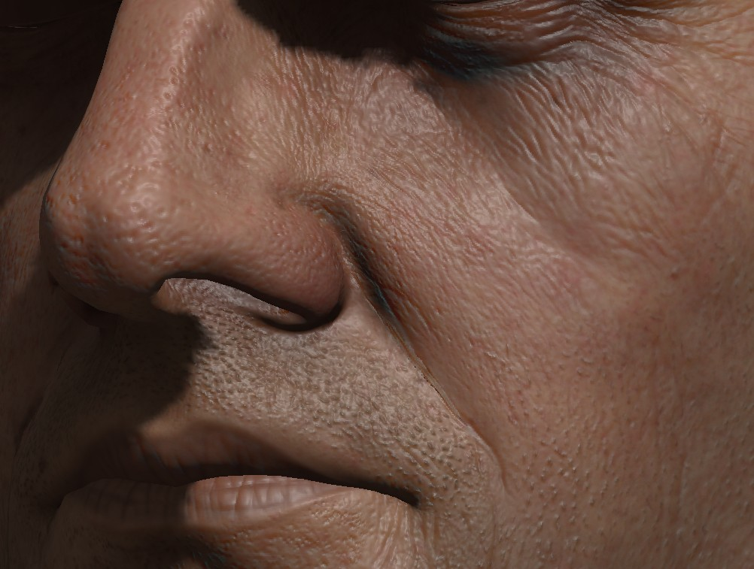
4) Bent Normals

Slide 41
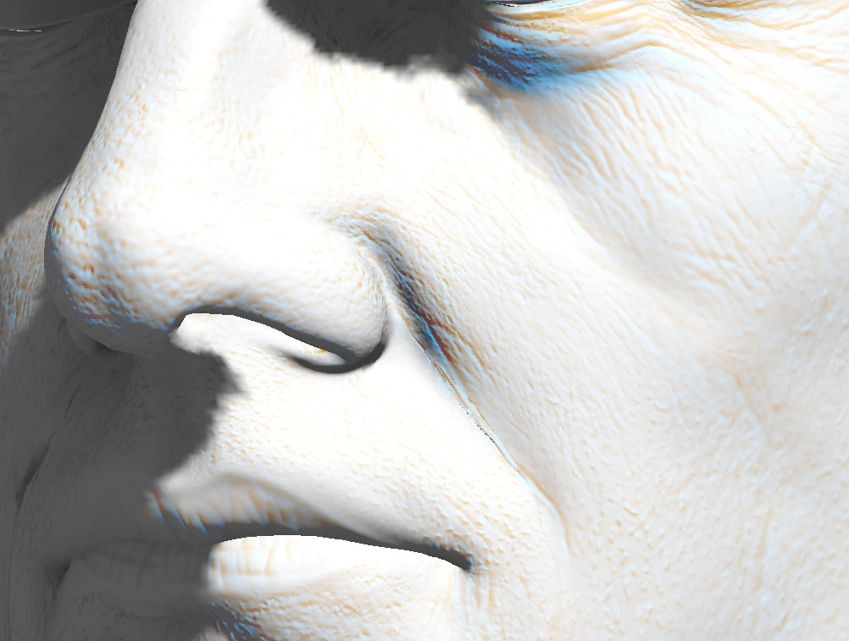
4) Bent Normals
Notes:
Notice how using different normals for R/G/B seems to cause some blue spottiness.

Slide 42
Why so blue?
Dot Products
At extreme angles, you can have cases where diffuseR = 0 and diffuseB = 1
Or vice-versa
Notes:
That’s because you have cases where the blue diffuse is near 1 and the red diffuse is near 0.

Slide 43
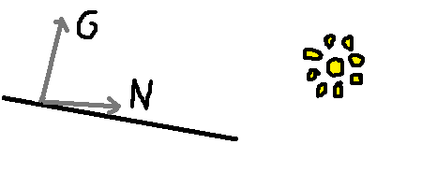
5) Blended Normals (?)
Another Hack
Diffuse(L,G), Diffuse(L,N), and Lerp
Blue/Green stays put, Red bleeds
Can have Red but no Blue/Green
Can NOT have Blue/Green but no Red
Notes:
Another approach is to do a diffuse calculation for the Geometry and Normal Mapped normals, and lerp between them taking more red from the Geometry normal and more Green/Blue from the normal mapped normal.

Slide 44
5) Blended Normals

Slide 45
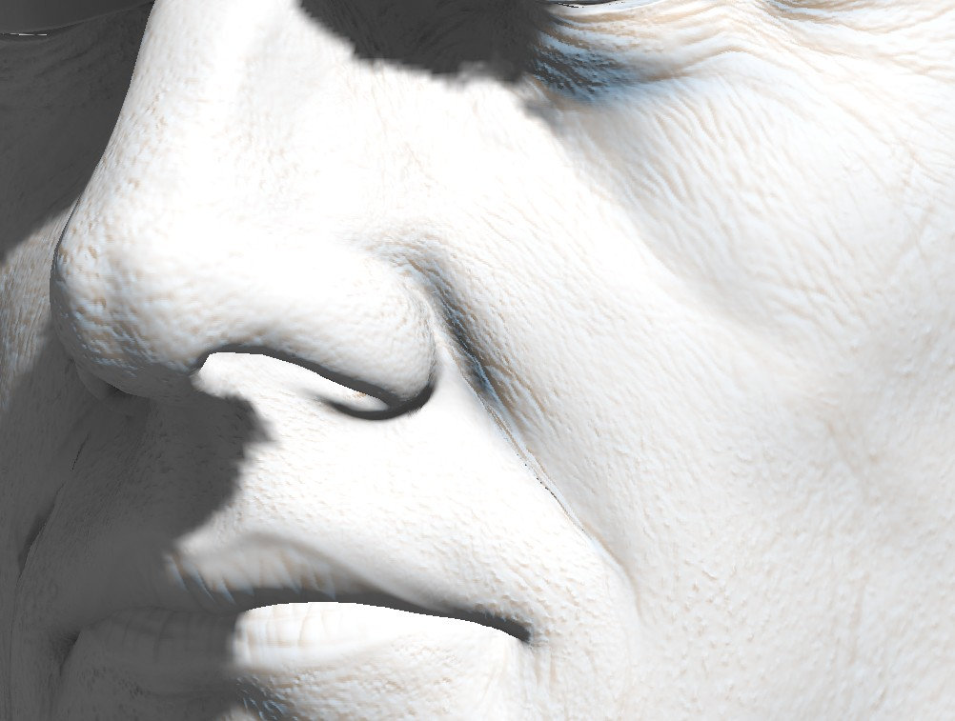
Still Kinda Blue

Slide 46
Recap
1. Standard Diffuse
2. Nvidia Approach
3. 12-Tap Combined
Do 12-Tap blur as separate shader.
3a. 12-Tap Merged
Do 12-Tap blur in final render pass.
4. Bent Normals
5. Blended Normals

Slide 47
1) Straight Diffuse

Slide 48
2) NVIDIA Approach

Slide 49
3a) 12-Tap Separate

Slide 50
3b) 12-Tap Combined

Slide 51
4) Bent Normals

Slide 52
5) Blended Normals

Slide 53
1) Standard Diffuse

Slide 54
2) NVIDIA Approach

Slide 55
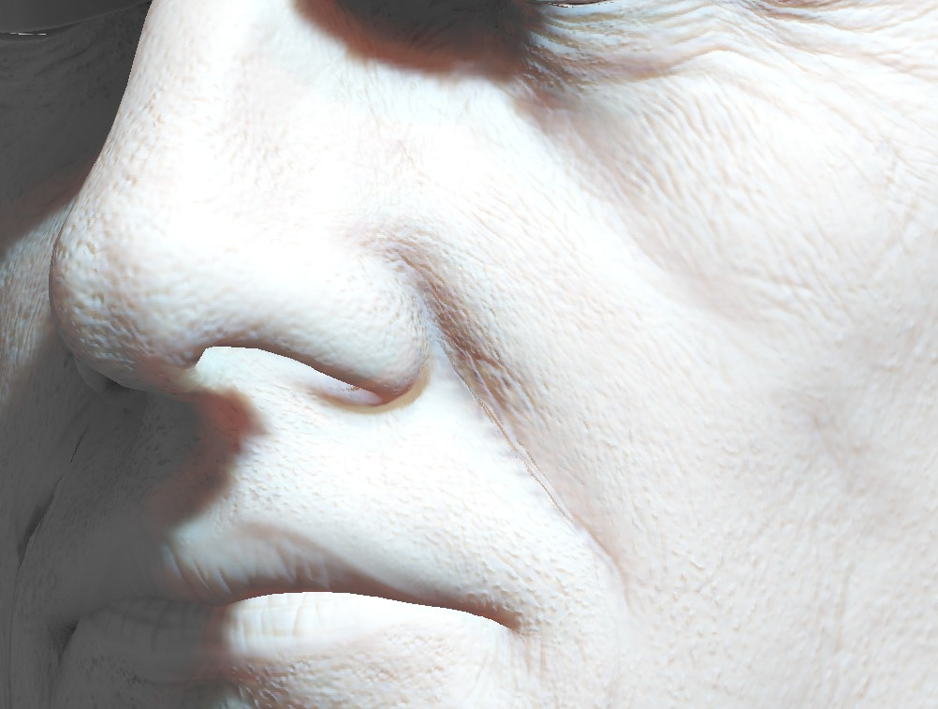
3a) 12-Tap Separate

Slide 56
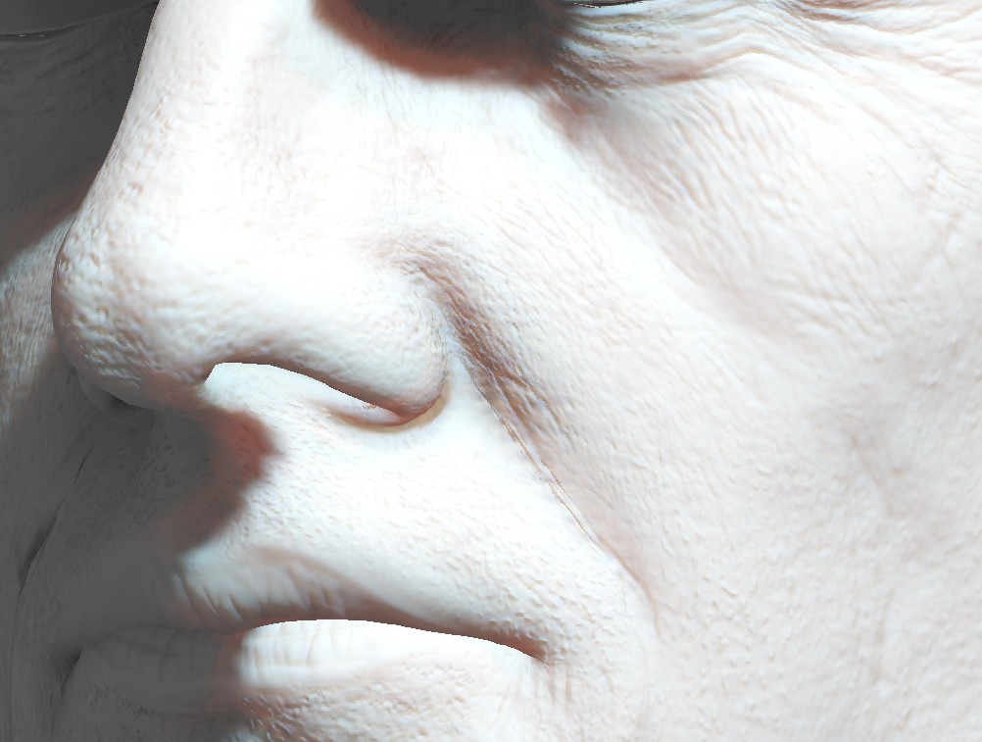
3b) 12-Tap Combined

Slide 57
4) Bent Normals

Slide 58
5) Blended Normals

Slide 59
What did we do?
Cutscenes:
3b) 12-Tap Combined
In Game
5) Blended Normals
12-Tap Combined cost .4ms per head
Difference didn’t balance the cost

Slide 60
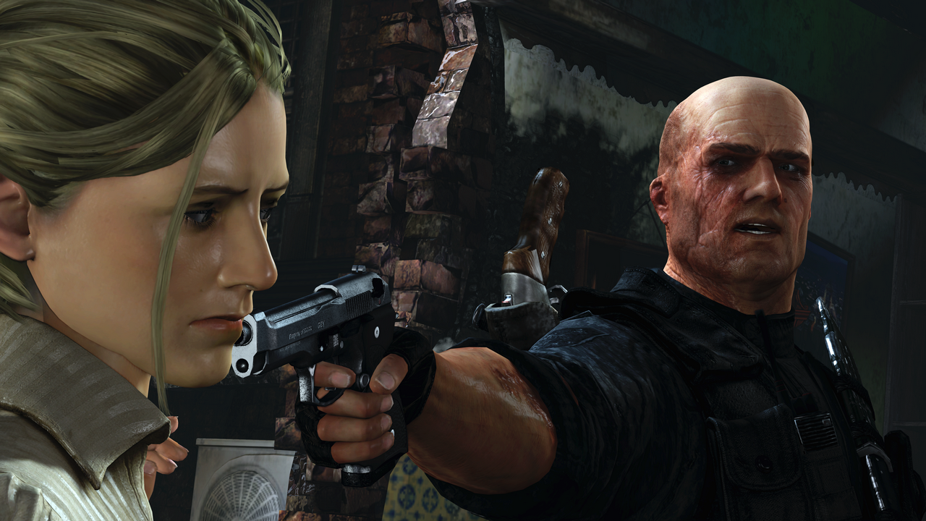
Cutscenes

Slide 61
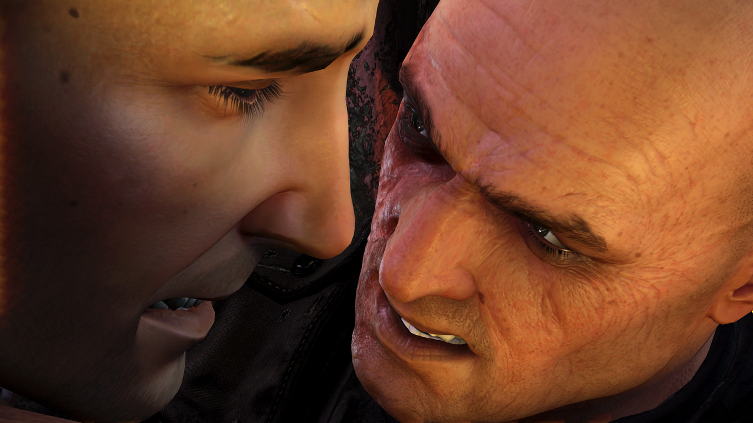
Cutscenes
Notes:
Sometimes, in cutscenes, the shots get pretty close, so we need the quality.

Slide 62
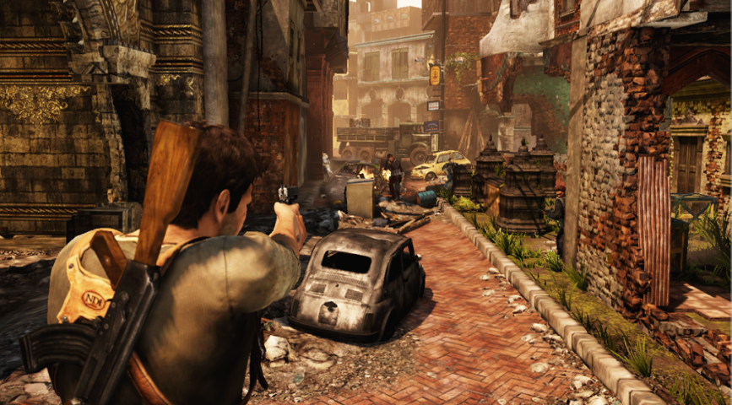
Normal Gameplay
Notes:
You spend most of normal gameplay staring at the back of Drake’s neck, so a separate pass for SSS was not worth the cost.

Slide 63
Limitations
Resolution
Seams

Slide 64
Conclusion
SSS really helps
Do what makes sense for you
Do better than Blinn-Phong

Slide 65
Hair

Slide 66
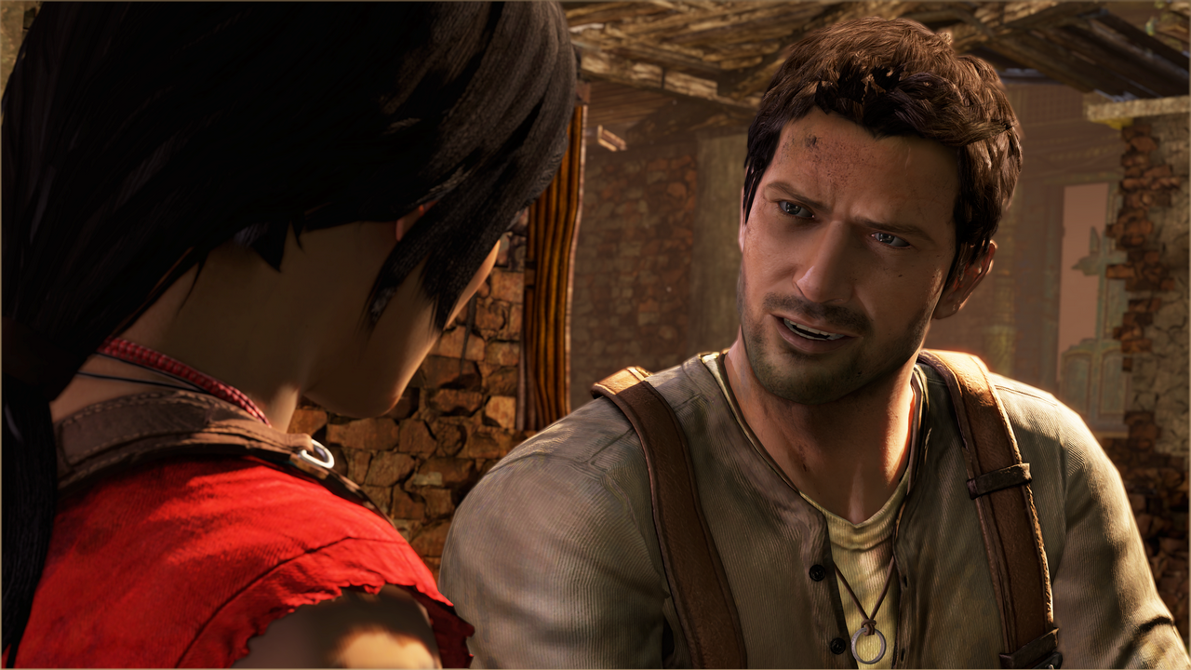
Hair

Slide 67
Hair
Stolen from Thorsten Sheuermann
http://developer.amd.com/media/gpu_assets/Scheuermann_HairSketchSlides.pdf
Kajiya-Kay

Slide 68
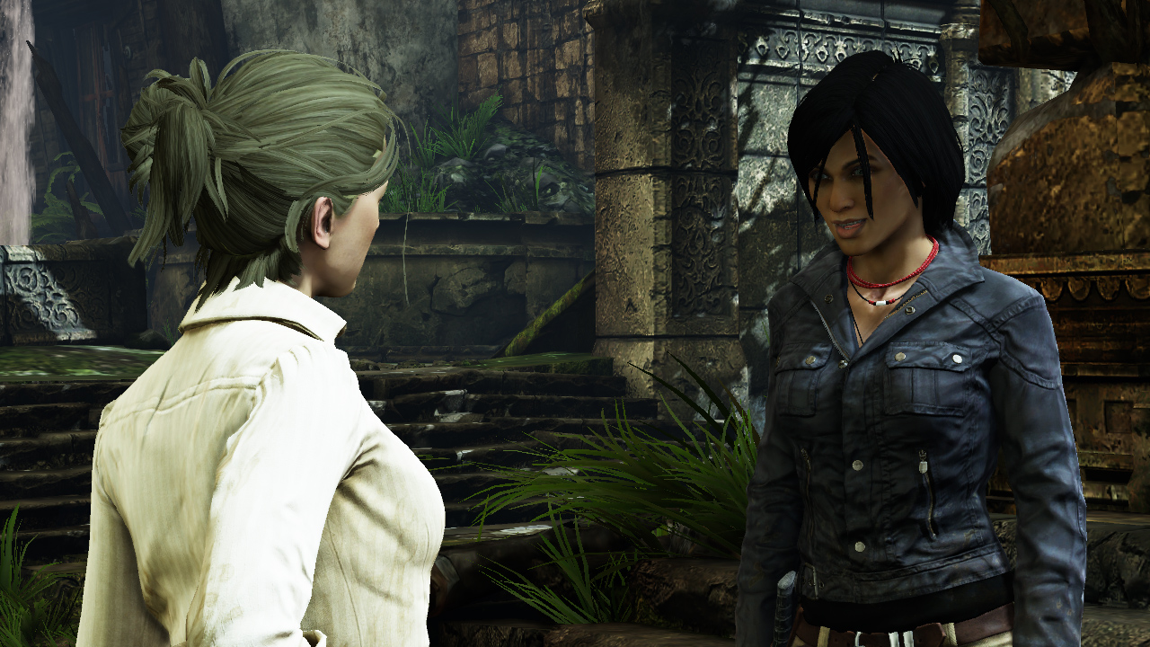
Specular Off

Slide 69
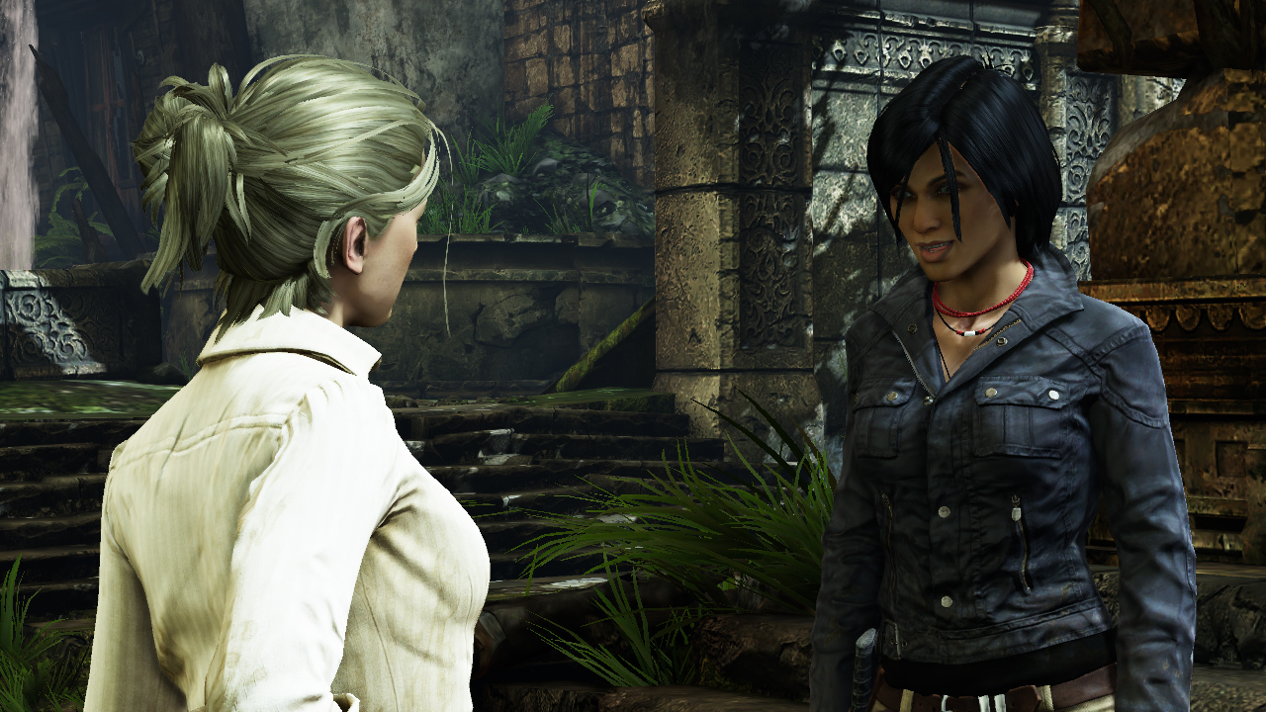
Combined

Slide 70
Notes
Slight Wraparound Diffuse
Kajiya-Kay Specular
No self-shadowing
Looks into largest cascade w/extra bias
Diffuse Map as Specular Mask
Partially Desaturated
Deferred lights use Blinn-Phong

Slide 71
Conclusions
Anisotropic
Do better than Blinn-Phong

Slide 72
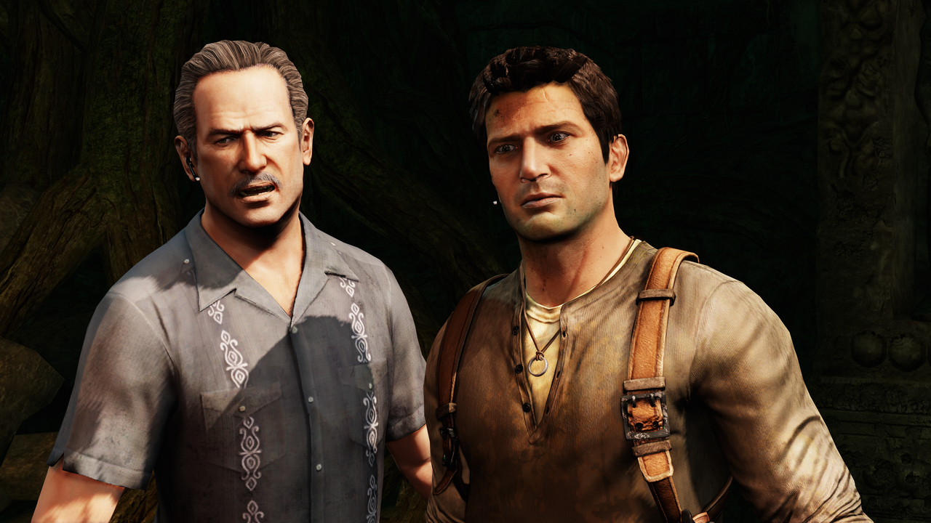
Cloth

Slide 73
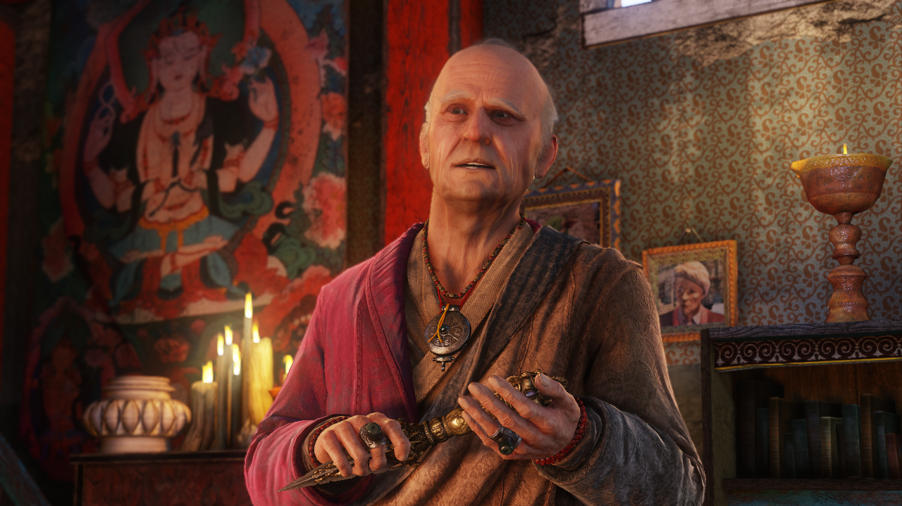
Cloth

Slide 74
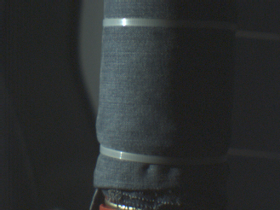
Diffuse-Only, Right?

Slide 75
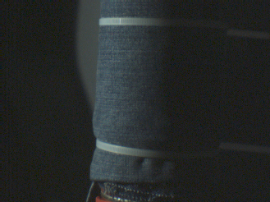
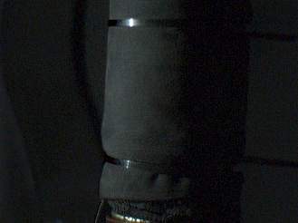
Separated
Diffuse
Final
Specular

Slide 76
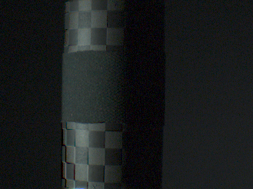
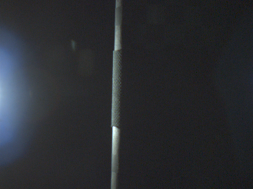
Specular
Fresnel?

Slide 77
Cloth
“Examples of completely diffuse materials include Cloth and Cardboard”
Nope!
Sidenote: Cardboard is actually really shiny
Cloth has some Fresnel too

Slide 78
U2 Cloth
Rim Lobe, Inner Lobe, Remaining Diffuse

Slide 79
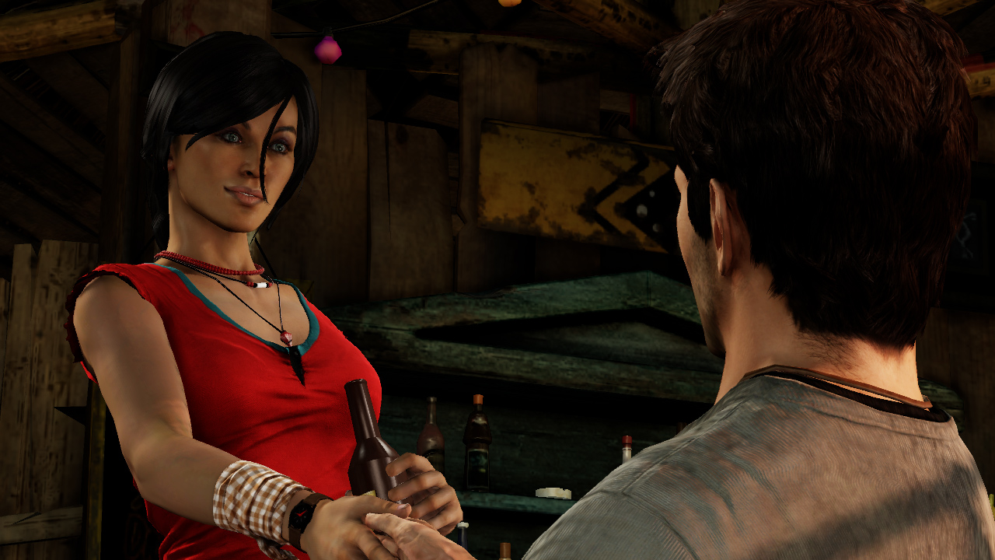
U2 Cloth
Final

Slide 80
OurCloth()
{
VdotN = saturate( dot( V, N ) );
Rim = RimScale * pow( VdotN, RimExp );
Inner = InnerScale * pow( 1-VdotN, InnerExp );
Lambert = LambertScale;
ClothMultiplier = Rim + Inner + Lambert;
FinalDiffuseLight *= ClothMultiplier;
}

Slide 81
Cloth
Not based on light direction
Looks better than nothing
Hanno: “Doesn’t look that great, but it’s hard to screw up.”

Slide 82
Conclusions
Do something, anything

Slide 83
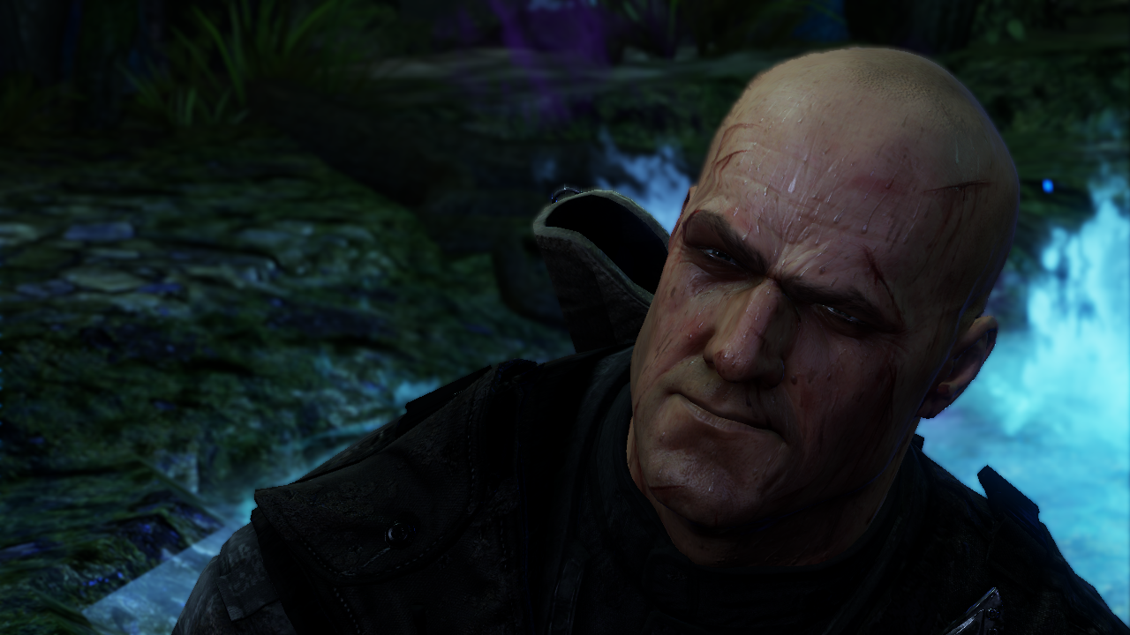
5 Secrets

Slide 84
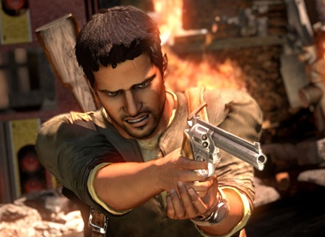
Secret #1
Avoid the hacks as long as possible
Notes:
The left shot is one of the first released screenshots before a lot of the tech got in. The one on the right is what we shipped. The one on the left has lots of hacks that we eventually took out, such as that orange glow around Drake’s skin.

Slide 85
Hacks Don’t Work!
Hacks look great in still images.
Don’t work when you move the light/camera.
Photoshop tricks only work in stills

Slide 86
Secret #2
Avoid Wraparound Lighting Models
A few exceptions (I.e. Hair)
diff=.5+.5*dot(N,L)
As opposed to: diff=saturate(dot(N,L))
VFX/Photography: Ignore this point

Slide 87
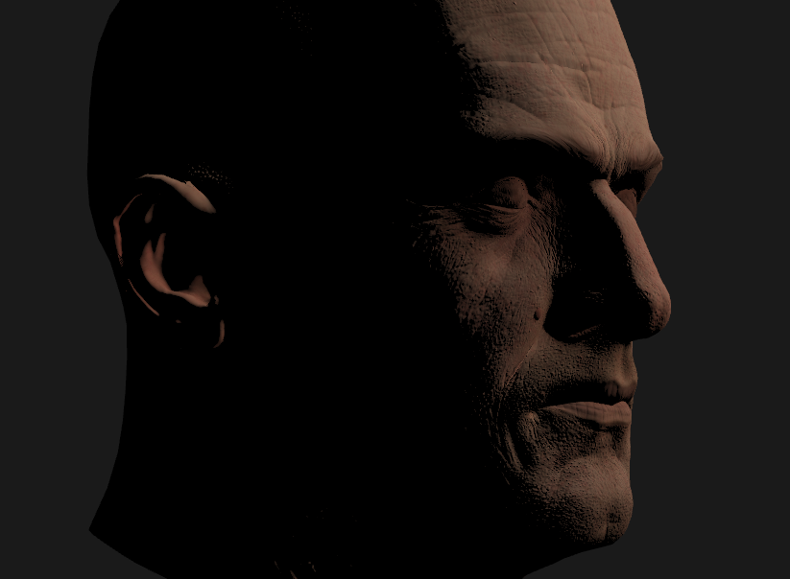
Secret #2
Lambert.
Looks too crunchy.

Slide 88
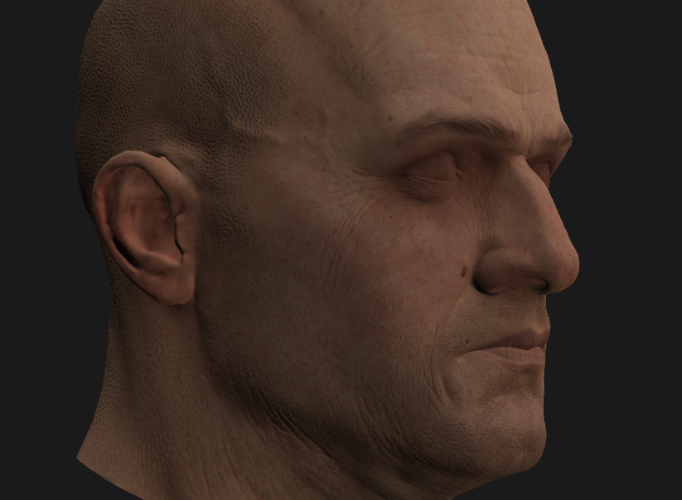
Secret #2
Wraparound
Do you want your key light to look like this?
Looks ok for ambient.

Slide 89
Secret #2
You want this.

Slide 90
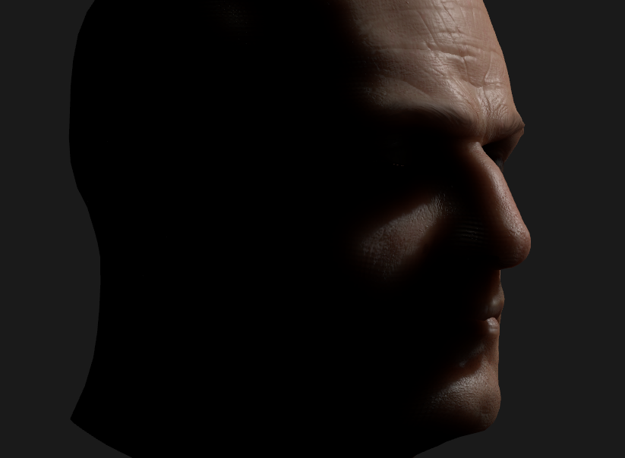
Secret #2
With SSS
Looks fine.
Disclaimer for Film / Photography

Slide 91
Harsh Falloff
Harsh Falloff is your friend
If you use it right
Don’t wrap light to make skin softer
Instead change your shading model
Doesn’t apply to VFX and Photography

Slide 92
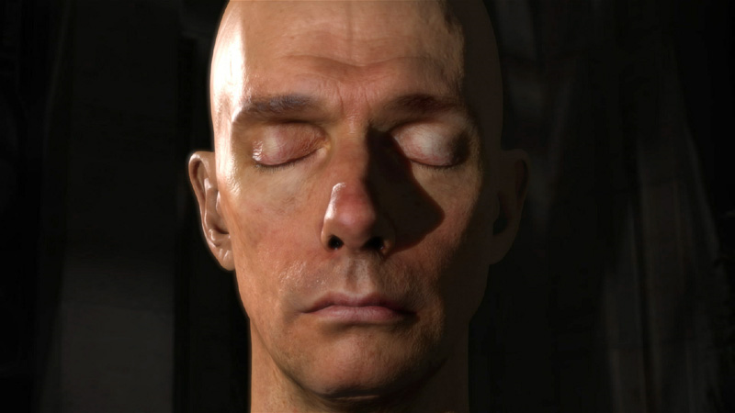
NVIDIA Demo
Notes:
Notice that the NVIDIA demo has a harsh falloff. It looks great if you do everything else right, which is why that demo is the gold standard for skin in realtime.

Slide 93
Secret #3
Avoid Blurry Maps on Faces
Have detail in Diffuse Map
Have crazy detail in Normal Map
It should look terrible in Maya

Slide 94
NVIDIA Demo
Notes:
Since he looks fleshy, you would think that he has blurry maps.

Slide 95
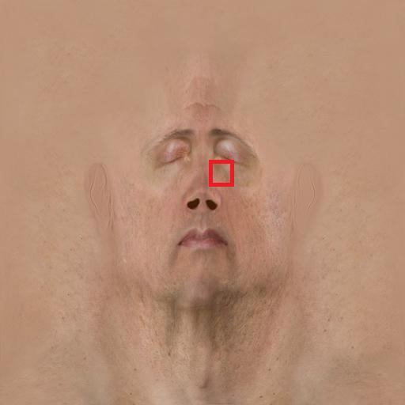
NVIDIA Human Head Maps
Diffuse Maps

Slide 96
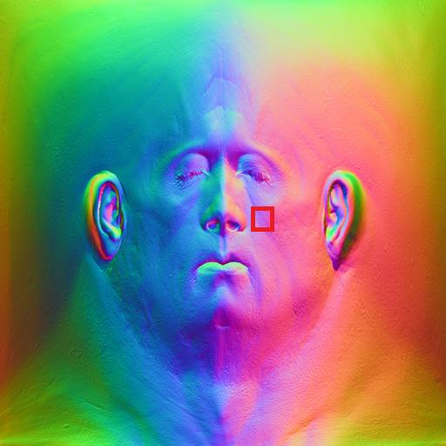
NVIDIA Human Head Maps
Normal Maps (world space?)

Slide 97
NVIDIA Human Head Maps
Don’t paint soft maps
Paint very crunchy detailed maps
Let lighting model soften it
Notes:
In the demo, they have extremely detailed maps and they use the lighting model to soften it.

Slide 98
Heads
Softening via lighting model.
Notes:
IMO what makes skin look right is how light bleeds around the normals. If you paint soft maps with no detail in the normals, it just looks flat.

Slide 99
Maps
Crank the detail!
Notes:
Notice that there is more detail in the shot on the right. For U2, we really cranked the detail in the maps and the strength of the normals and then let the lighting model soften it.

Slide 100
Secret #4
Don’t bake too much lighting into diffuse maps
Especially AO
Becomes Unlightable

Slide 101
Drake’s Shirt
Looks fine in Sunlight
Very boring in Shadows

Slide 102
Drake’s Shirt
Create Light Rig
Ambient Light

Slide 103
AO into Diffuse
Apply to Diffuse
Better Ambient
The Catch?

Slide 104
The Unlightables
151
(151/255)^2.2=0.315
(35/255)^2.2=0.0126
25x!!!
Full histogram in ambient
35
Notes:
Don’t bake too much AO into your diffuse maps.

Slide 105
Solution
Leave AO map separate
Can be lower-res
direct=diffuseMap*diffuseLight
ambient=diffuseMap*aoMap*ambientLight
diffuseColor=direct+ambient

Slide 106
The Unlightables
Contrast between Sun and Shadow
Doesn’t happen if your diffuse maps have too much black
Tech isn’t enough for HDR Lighting
HDR vs. Flat and Contrasty
Notes:
You get HDR lighting from having high dynamic range in your LIGHTING. I see a lot of games that have all the tech for HDR lighting, but it still looks flat. The reason 99% of the time is that they have too much black in their textures. For an example of a game doing a really good job of managing their textures, check out Mirror’s Edge.

Slide 107
Secret #5
Make sure your AO and Diffuse match
We screwed this up
Don’t play telephone

Slide 108
Chloe-Intro
White Direct
Yellow-ish Ambient

Slide 109
Chloe
Direct Too High (White)
Ambient Too Low (Yellow)

Slide 110
Drake
Direct Too Low (White)
Ambient Too High (Yellow)

Slide 111
Where’s his tongue?
Notes:
Go through the cutscenes again and look for Drake’s tongue. You’ll see what I mean.

Slide 112
Conclusions
Custom Shading Models
If you tried these things in the past
Take a second look if your lighting has improved
Linear-Space Lighting
Notes:
I’m a big fan of custom lighting models (i.e. beyond Blinn-Phong). Btw, doing proper Linear-Space Lighting is more important than everything in this presentation combined.

Slide 113
References
Practical Real-Time Hair Rendering and Shading, Thorsten Scheuermann, Siggraph Sketch, 2004
http://www.shaderwrangler.com/publications/
Efficient Rendering of Human Skin, Eugene d'Eon, David Luebke, and Eric Enderton, Eurographics 2007
http://http.developer.nvidia.com/GPUGems3/gpugems3_ch14.html
Fast Skin Shading, John Hable, George Borshukov, and Jim Hejl, ShaderX7, 2008
http://www.shaderx7.com/TOC.html

Slide 114
Done!

