Slide 1
What’s Minecraft?
A computer game. You start in an undeveloped world.
Notes:
First, how many people know what Minecraft is?

Slide 2
What’s Minecraft?
Everything is modifiable. You can build a house…

Slide 3
Many Block Types
Notes:
There are hundreds of block types, many with special physical properties

Slide 4
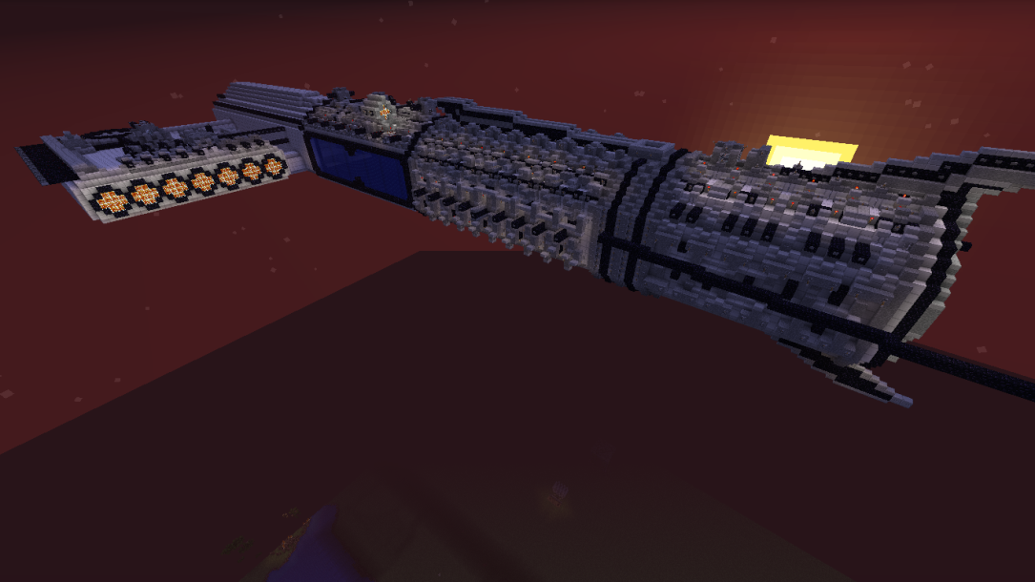
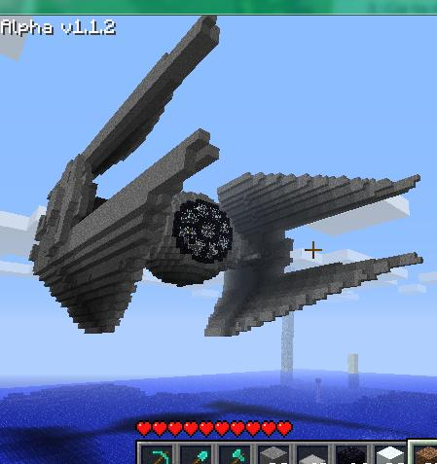
Things Built
Starships, for example

Slide 5
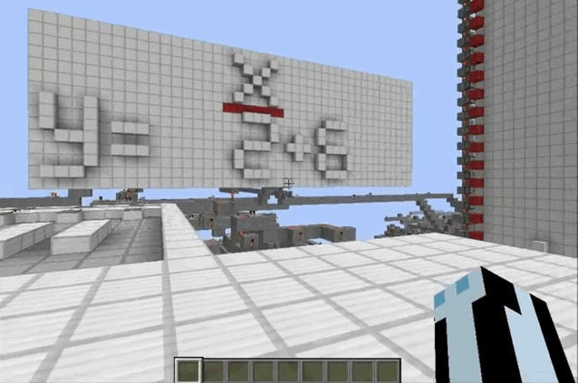
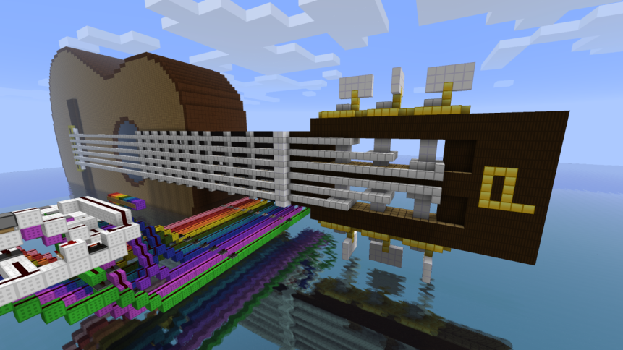
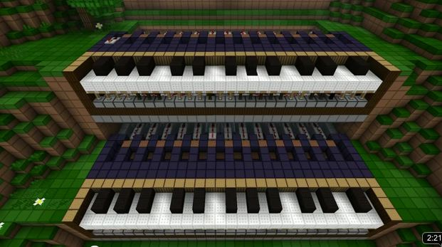
Things Built
Working computers, calculators, instruments…
Notes:
Redstone wiring allows AND, OR, flip-flops, clock cycles, etc.
You can make the guitar play by standing on different plates for various chords. The frets also depress to show the fingering.

Slide 6
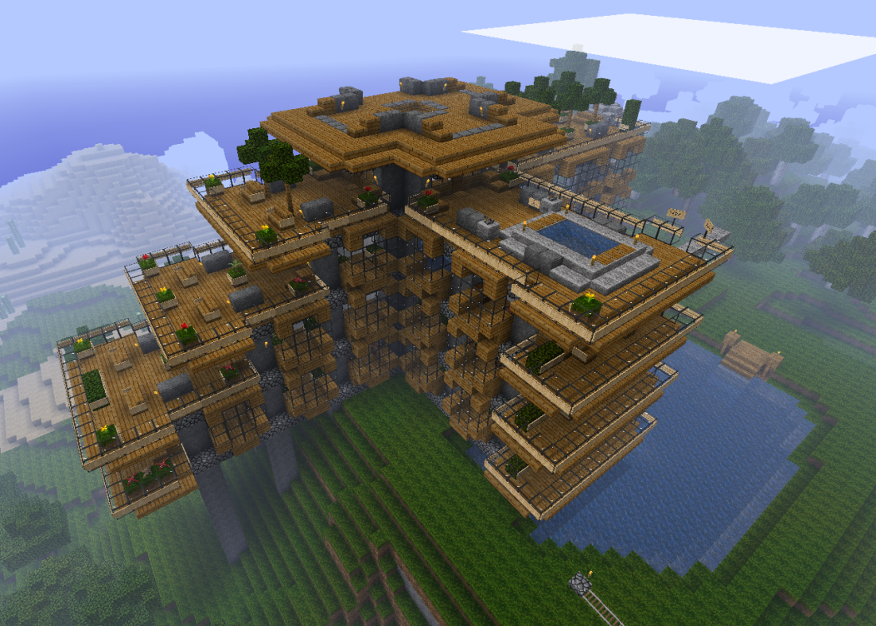
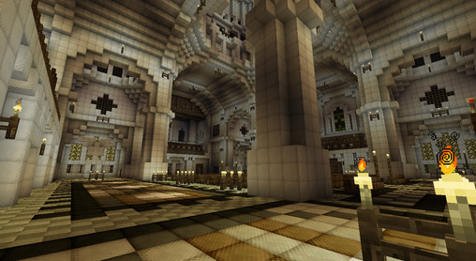
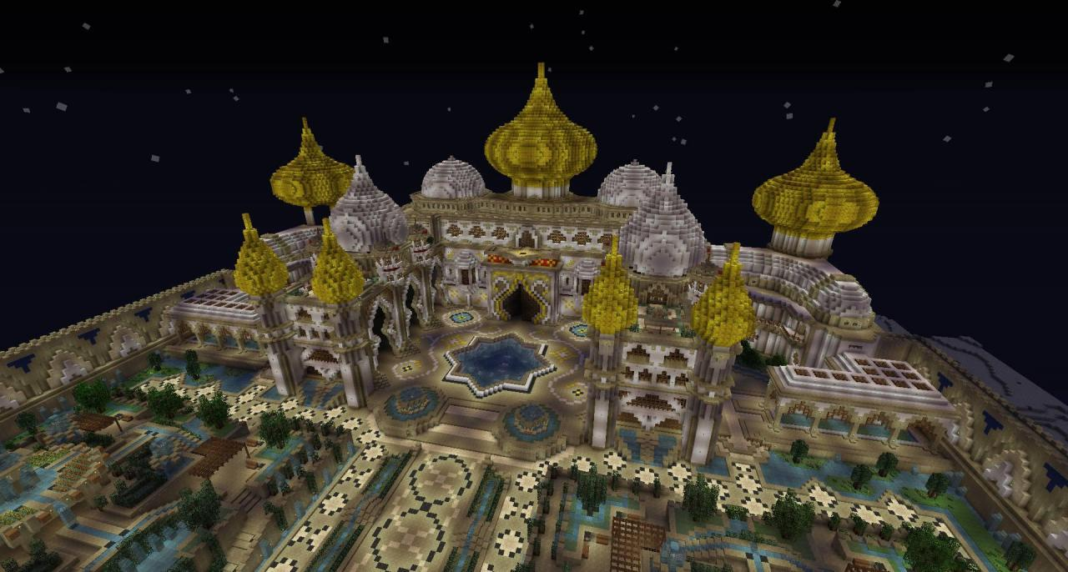
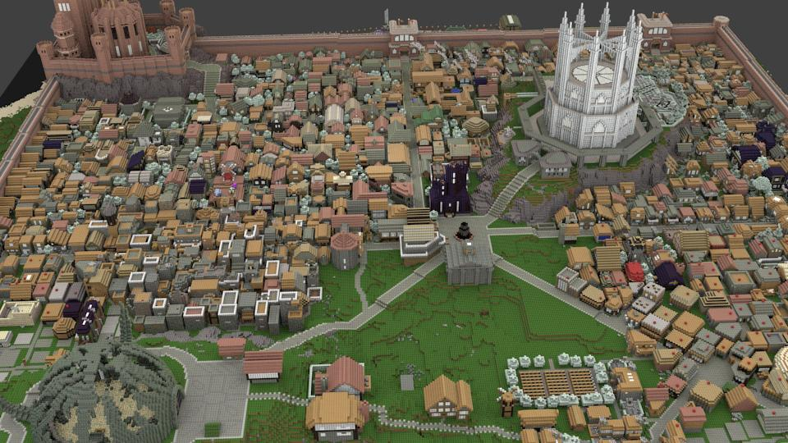
Things Built
and many, many buildings
Notes:
Every user is an architect – world’s easiest and most tedious modeler. 11 month old learns to put block A on block B.

Slide 7
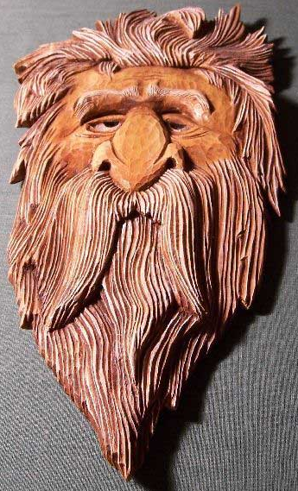
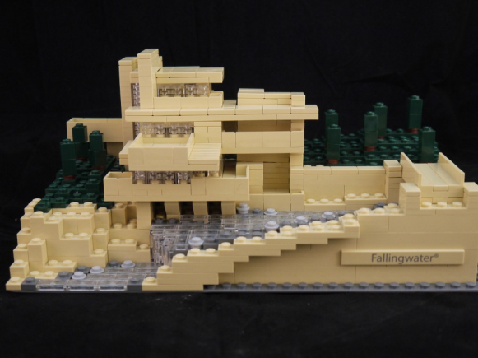
Subtractive vs. Additive Manufacturing
Subtractive:
Carving wood or stone
Drilling holes in a piece of metal
Additive:
Making a sculpture by adding clay
Building using Legos

Slide 8
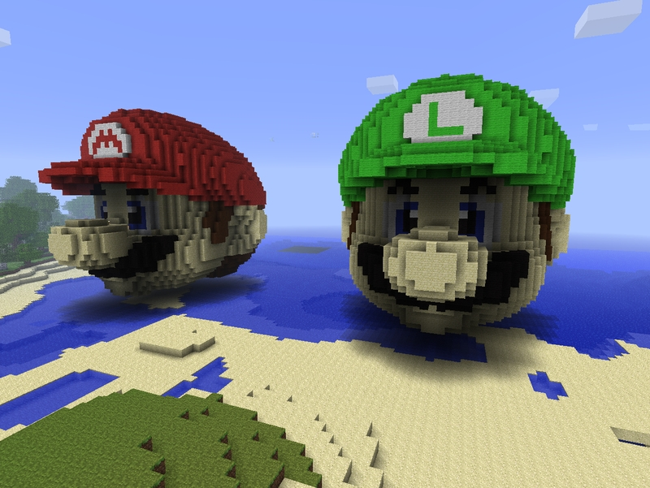
What’s Minecraft?
Is it additive or subtractive?

Slide 9
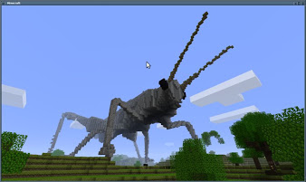
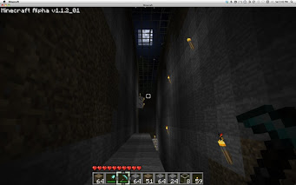
Minecraft is…
Mostly additive: you add blocks to make stuff, such as giant insects
Sometimes it’s subtractive, like when you carve away a hill or make a basement.

Slide 10
3D Printing
Is also called “Additive Manufacturing”.
It’s like building in very tiny blocks put in a grid. You tell the machine which blocks you want filled in. Think of very tiny Lego blocks.
These little blocks are sometimes called “voxels” – sort of like “volume pixel”.

Slide 11
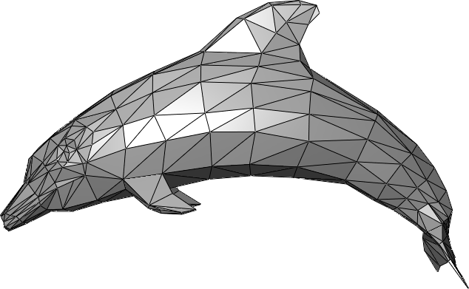
How to Make a Model
Describes what the surface of the model is.
It’s all just
triangles!

Slide 12
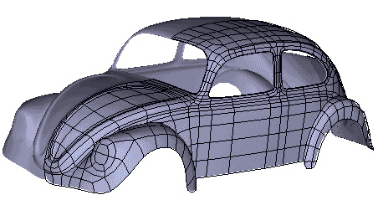
Watertight Surfaces
You need to make sure your triangles make a solid object.
This one isn’t solid.

Slide 13
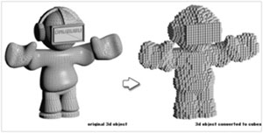
Conversion
The 3D printer’s software converts from a surface to a bunch of voxels.

Slide 14
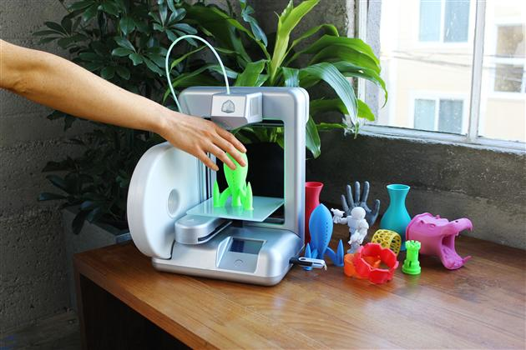
Printing a Model
This surface is then chopped into horizontal slices, like a deli meat cutter.
Each slice is then
filled in by the
3D printer, layer
by layer.

Slide 15
Materials
Plastic, metals, ceramic, sandstone, chocolate, rubber, even liver. More new ones all the time!
Would toothpaste
work?

Slide 16
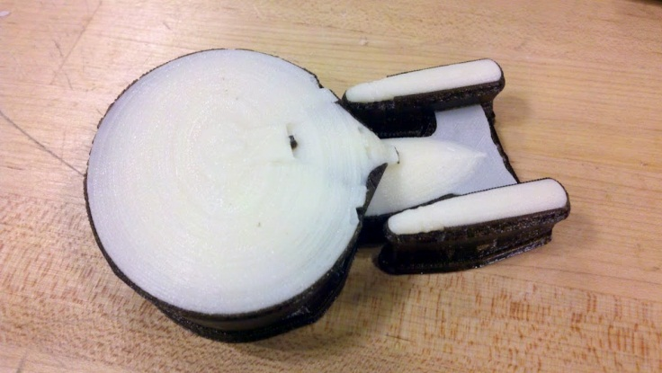
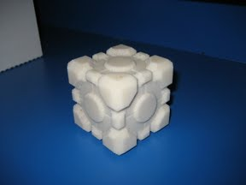
First 3D printing of Minecraft
Minecraft and 3D printing look like a great fit.
Minecraft.print() by two students at MIT:
Notes:
You are looking at their entire gallery.

Slide 17
Mineways
Free program I wrote for fun.
Select a “box” in your world to create a model.
Takes Minecraft blocks (voxels) and figures out the triangles.
Color 3D printers can print in full color.
Notes:
Time permitting, do a demo here.

Slide 18
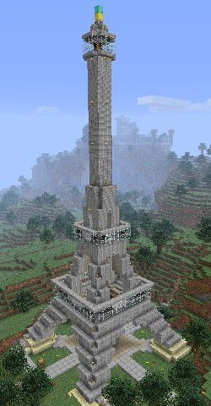
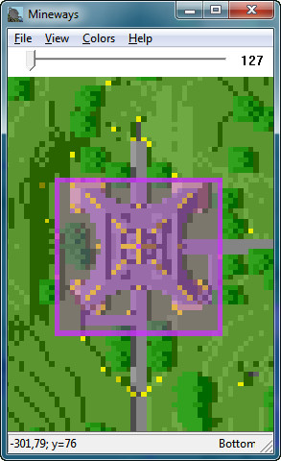
Demo
Notes:
Time permitting, do a demo here.

Slide 19
Steps
Build in gravel or sand (not sandstone) in Minecraft.
Export using Mineways (we’ll help!) - uncheck “Hollow parts” near bottom of options.
Preview with MeshLab
3D print or upload to Shapeways

Slide 20
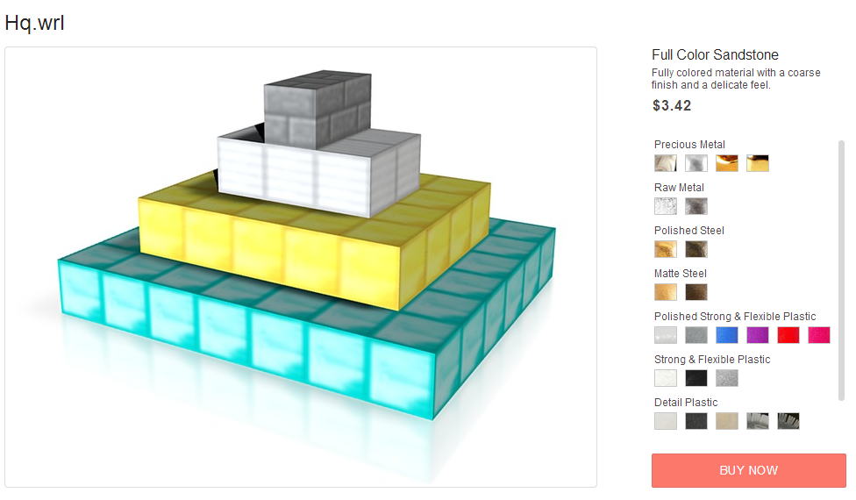
Let’s Do It!

Slide 21
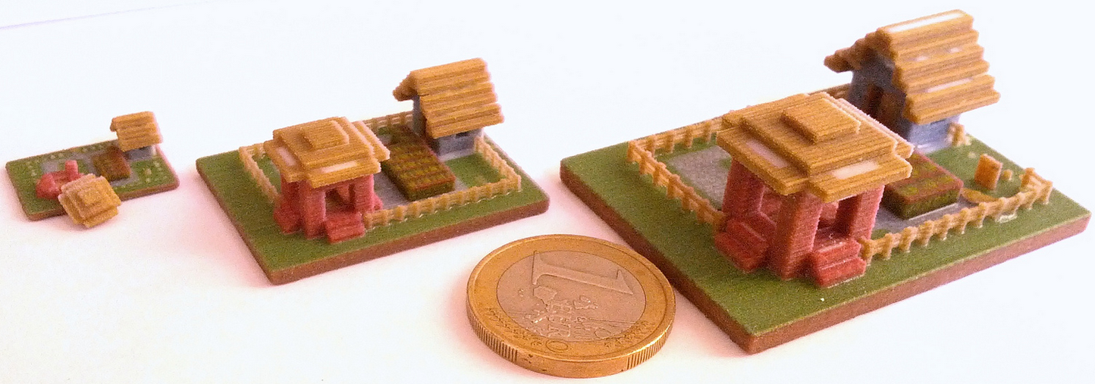
Wall Thickness
Unlike Minecraft, if you make things in the real world, they might not work.

Slide 22
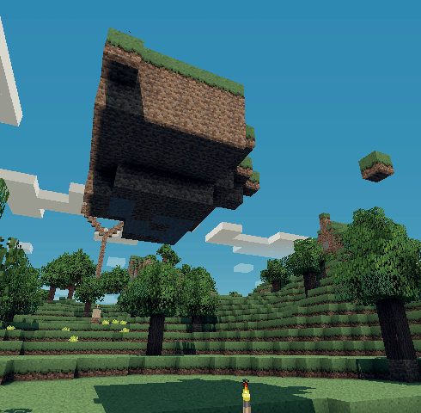
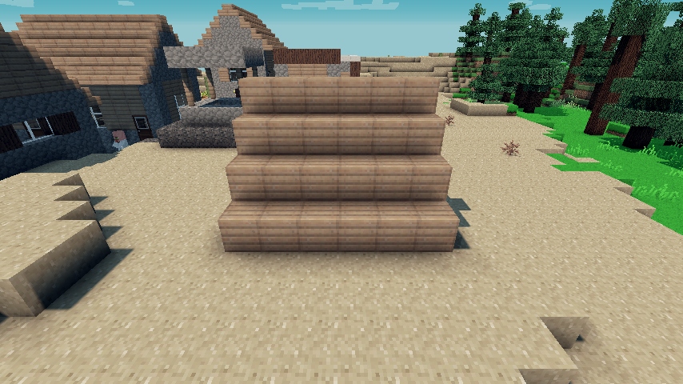
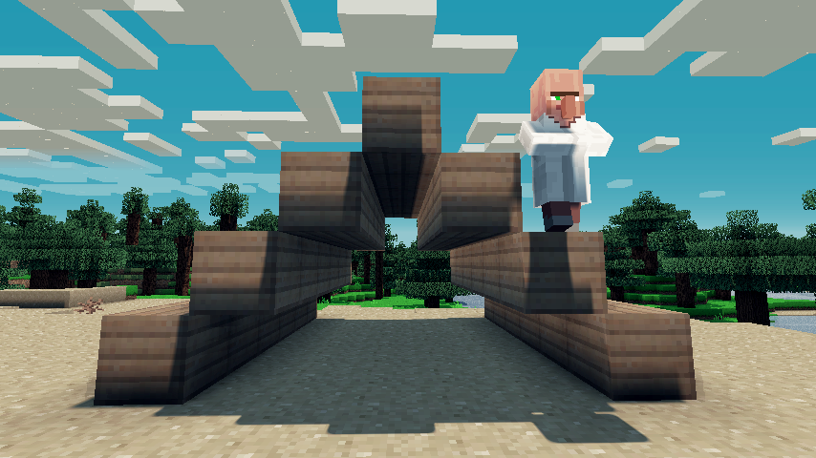
Floating Object Problem
Some obvious problems, some not so obvious
Notes:
Floating islands won’t export well. Well, they will, but they won’t float any more. Surfaces can be formed that do not connect.

Slide 23
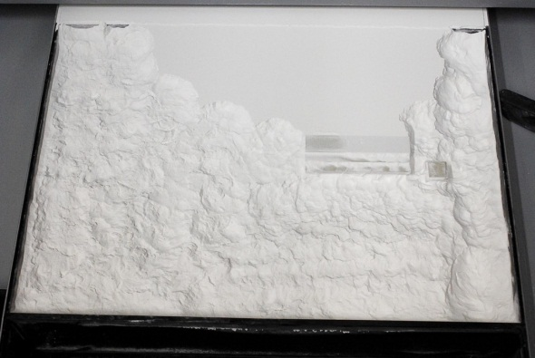
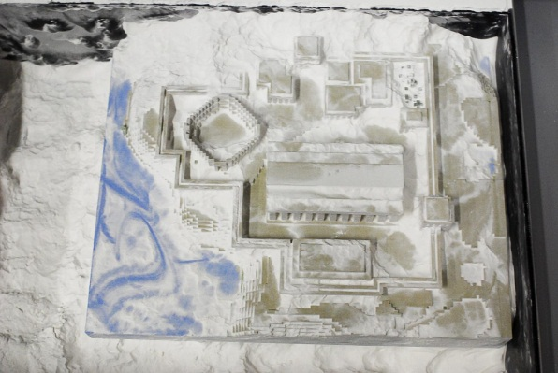
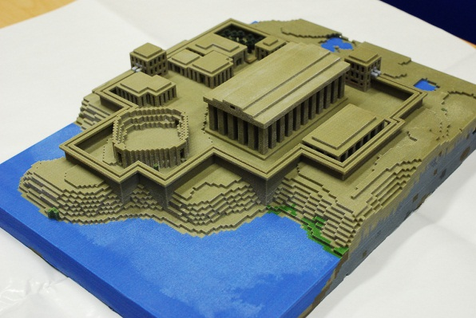
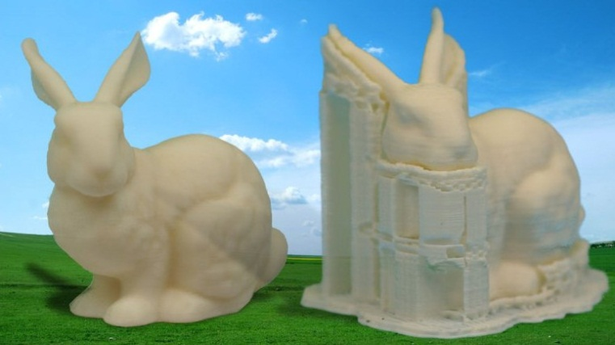
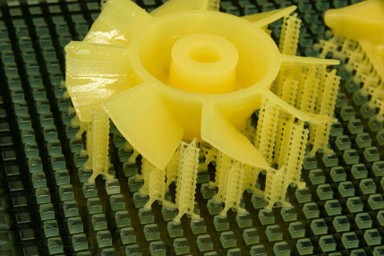
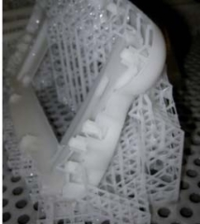
Floating Can Be Fine
Some 3D printers need no support structures:
Some printers do:
Notes:
No support structures are needed because the printer prints a layer at a time. The unsolidified material supports the layers above it.

Slide 24
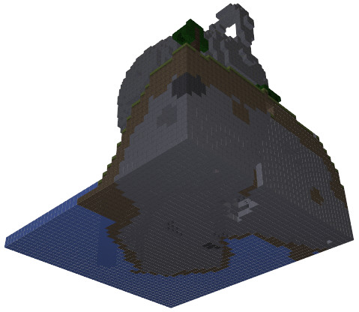
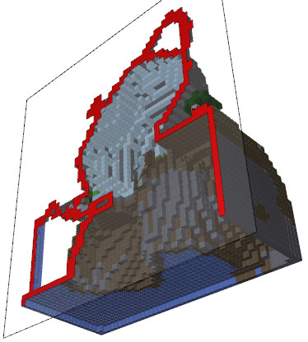
Don’t Print What You Can’t See
Hollowing can cut costs by 3x or more.
My trick is to fill in all interior “bubbles” found, then hollow out the single solid mass.

Slide 25
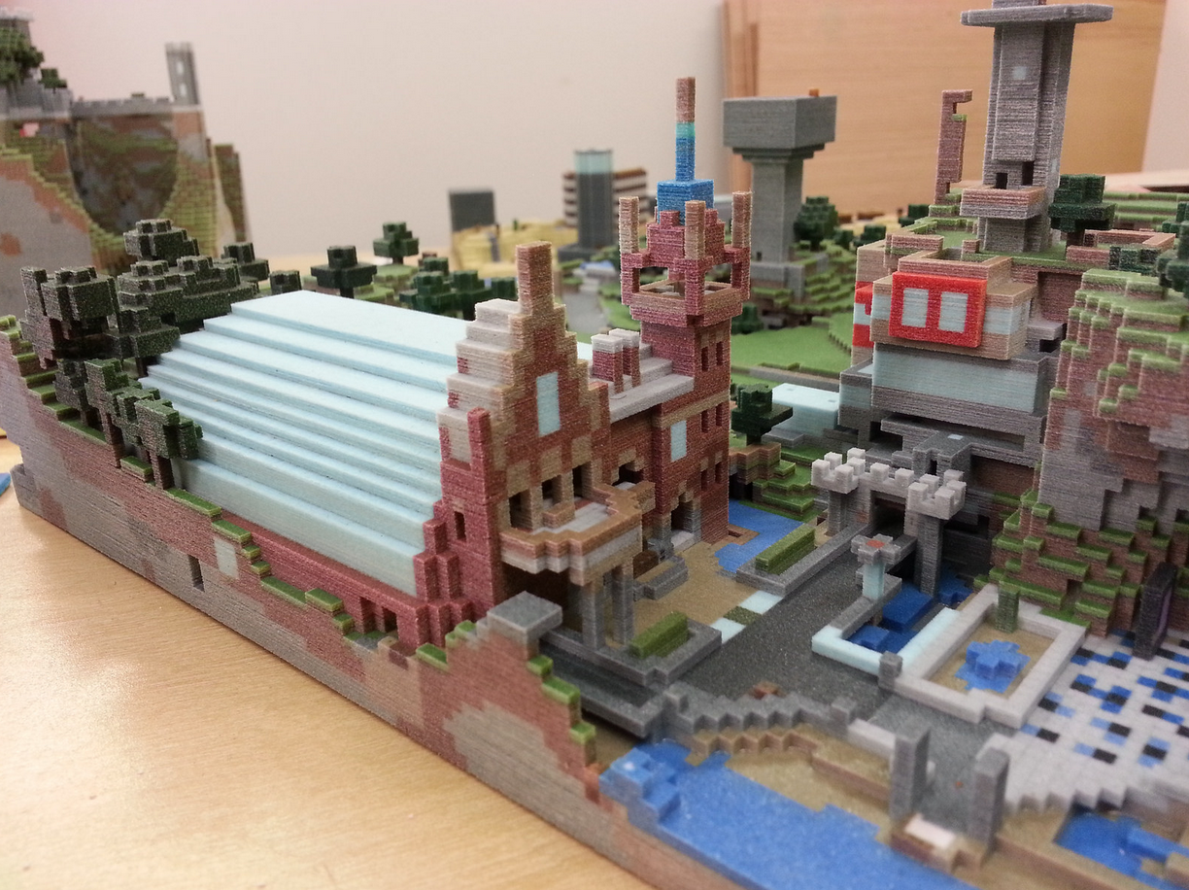
Big is Fun
But, larger costs more.

Slide 26
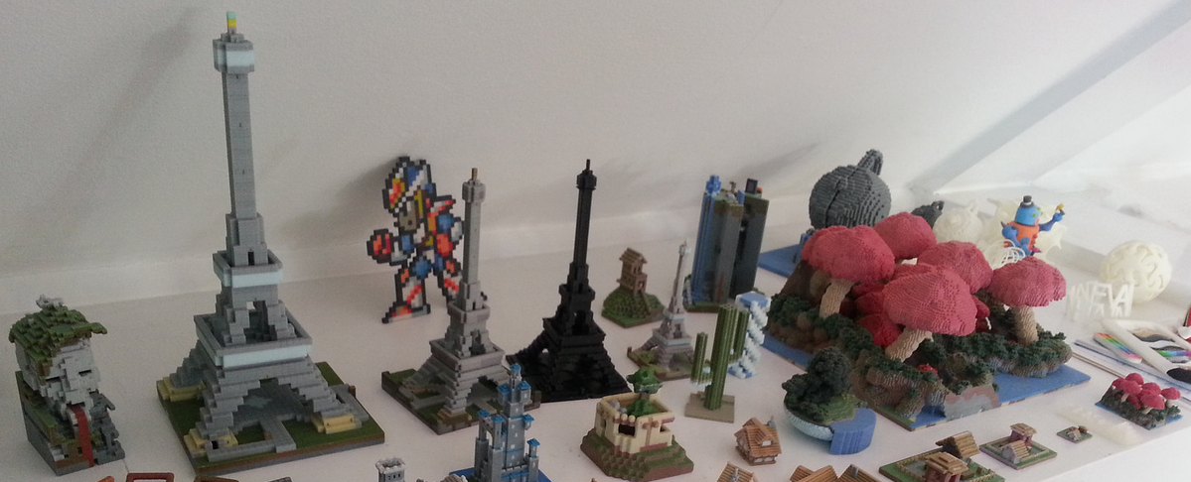
Eiffel Quiz
How many 6 inch Eiffels together weigh the same as a single 12 inch Eiffel?
Notes:
8 – not only that, but the large eiffel takes about 8 times longer to print!

Slide 27
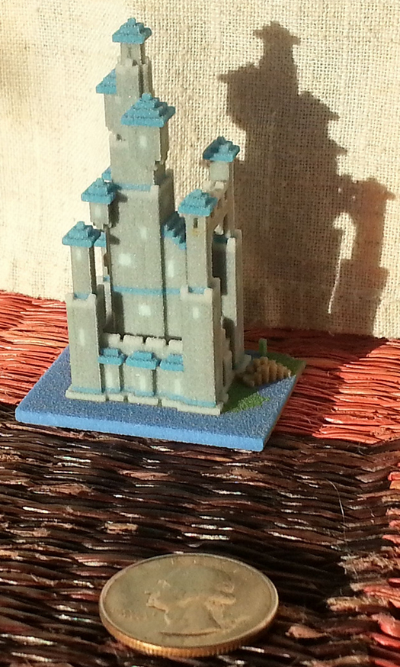
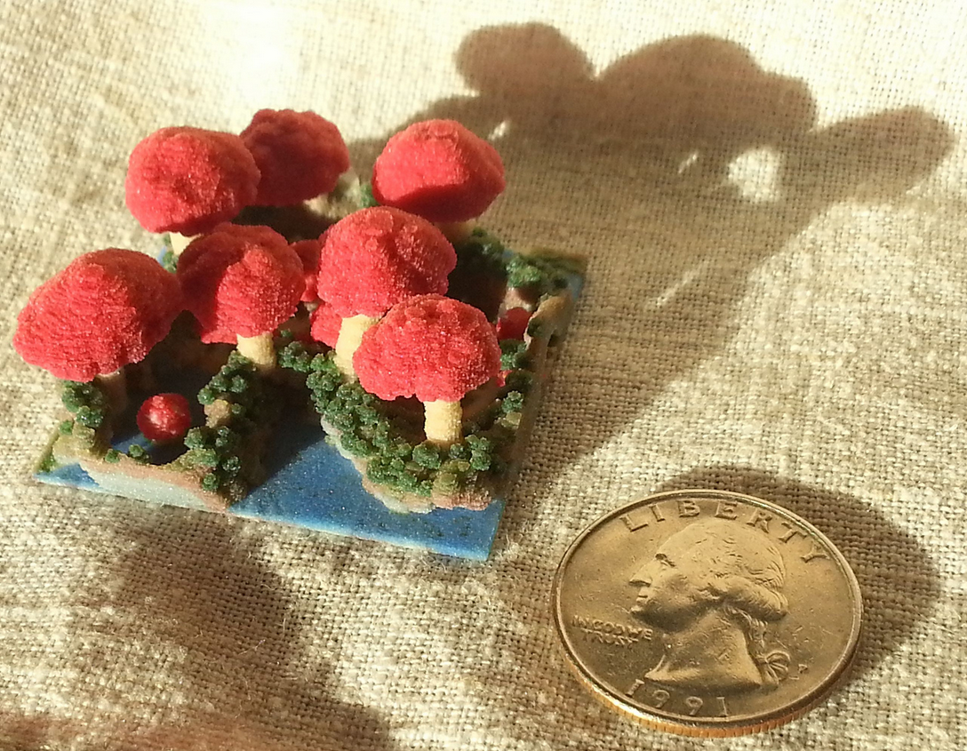
Smaller is Cuter is Cheaper is Faster
Also, complexity is free!

Slide 28
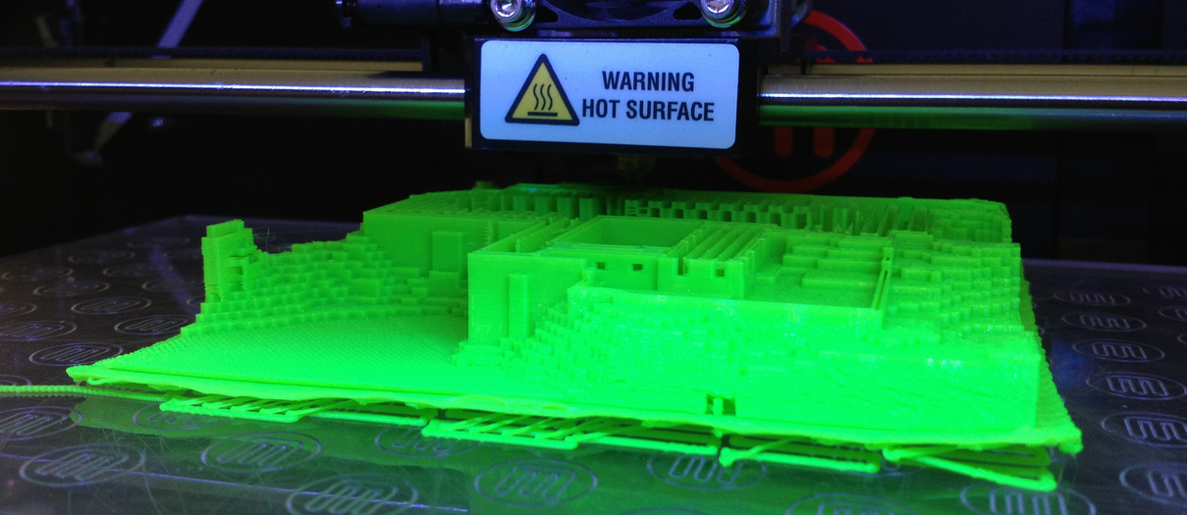
Gravel
Our 3D printer today can print only gravel (and sand) structures easily.
Notes:
No support structures are needed because the printer prints a layer at a time. The unsolidified material supports the layers above it.

Slide 29
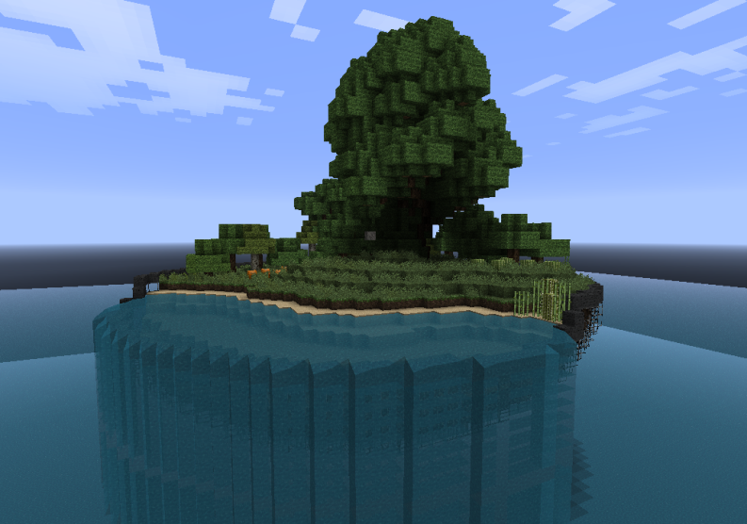
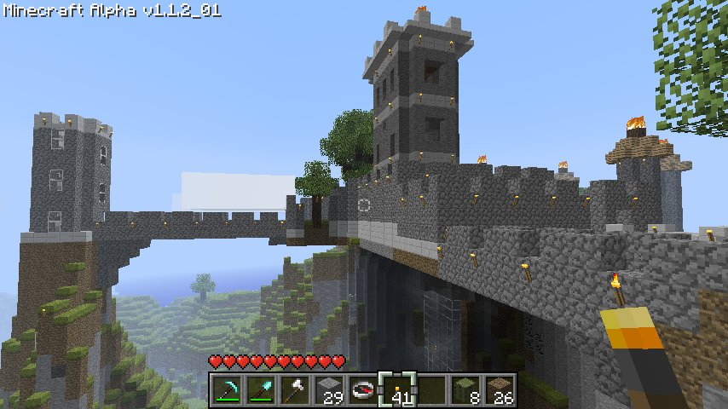
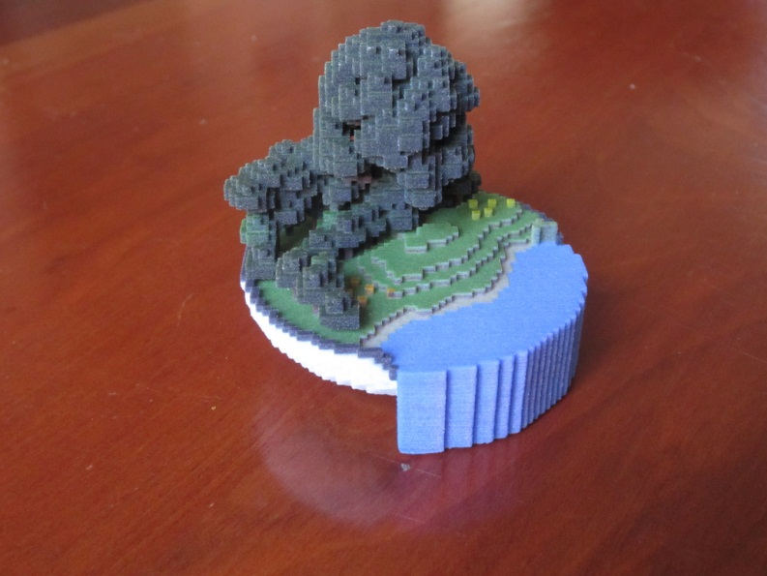
Some Examples
Sentinel Castle, by Mauricio Vives World in a Bowl, by Nefashu

Slide 30
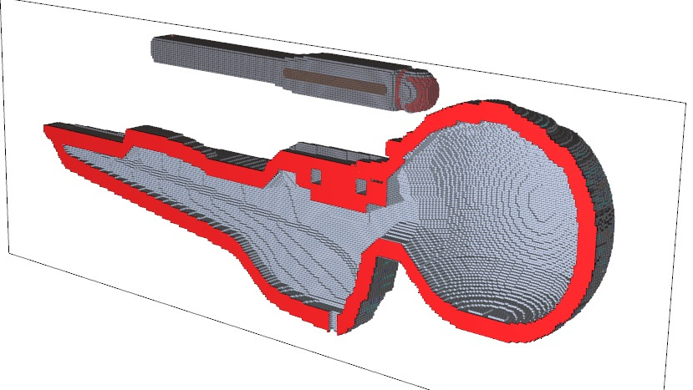
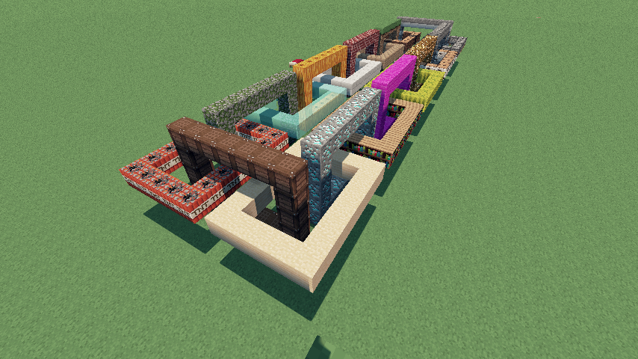
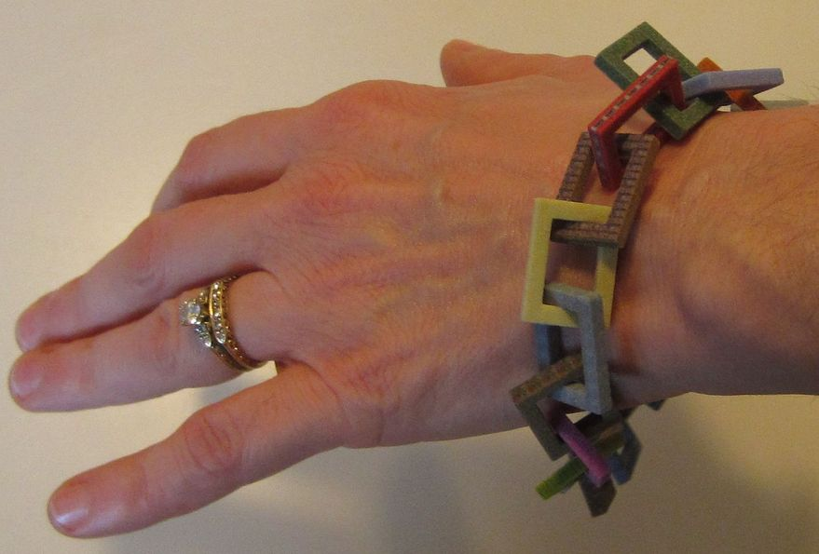
Still More Examples
Olympic starship, by Momentaneously Chainlandia, by combineelite
Notes:
The starship is actually two separate prints, the struts to the nacelles are sturdy plastic. The chain has objects floating in the world, so no gravity can be a help.

Slide 31
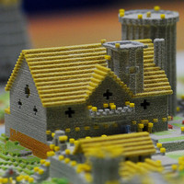
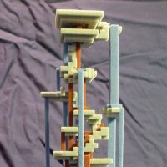
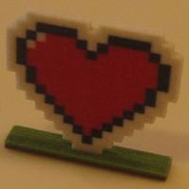
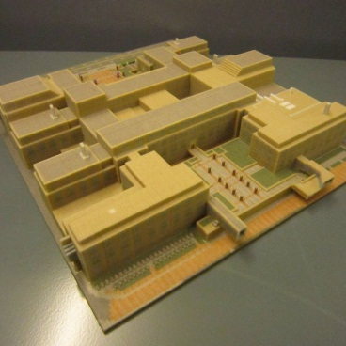
And More

Slide 32
And You Can Make Pictures
Image made with Arnold, by Estopero. Appears on the cover of “3D Artist” magazine.
Notes:
When it appeared on the cover, the Mario and Luigi on the left will be gone – the magazine was concerned about legal issues.

Slide 33
A Practical Use
Northwestern University Campus, by Ben Rothman
Notes:
http://www.northbynorthwestern.com/story/student-recreates-north-campus-in-minecraft/
Pictures at http://benthemonkey.imgur.com/

Slide 34
A Practical Use
Ford Engineering Design Center, by Ben Rothman

Slide 35
A Practical Use
Ford Engineering Design Center, by Ben Rothman

Slide 36
A Practical Use
Ford Engineering Design Center, by Ben Rothman

Slide 37
Or, the Whole Campus…
Northwestern University, by Ben Rothman

Slide 38
No Printer?
I don’t have one, either. I use two print service firms:
Shapeways: cheapest, and slowest
Sculpteo: more expensive, faster

Slide 39
Pro Tips for Mineways
The “[“ and “]” keys adjust the selected bottom level up and down.
Middle-mouse can also select height.
Control-X: eXport again with same options.
Import Settings lets you load a previous exported file for its settings.
Color Schemes let you remove various types of blocks.

Slide 40
Go Have Fun!

Slide 41
Notes
These slides download from http://bit.ly/mineparts
Mineways is at http://mineways.com
Minecraft is at http://minecraft.net
Shapeways is at http://shapeways.com
Sculpteo is at http://sculpteo.com
This presentation uses images under Fair Use for educational purposes. The images should not otherwise be reused or distributed without permission from the owners.

Slide 42
Leftovers…

Slide 43
Additive Manufacturing
Here’s one type of printer, it lays down layers:

Slide 44
Then Subtractive
Then you dig your model out:

Slide 45
More Subtraction
Then vacuum it:

Slide 46
A Bit More
Then clean with pressurized air:

Slide 47
The Last Step
Then douse with superglue.

