Slide 1
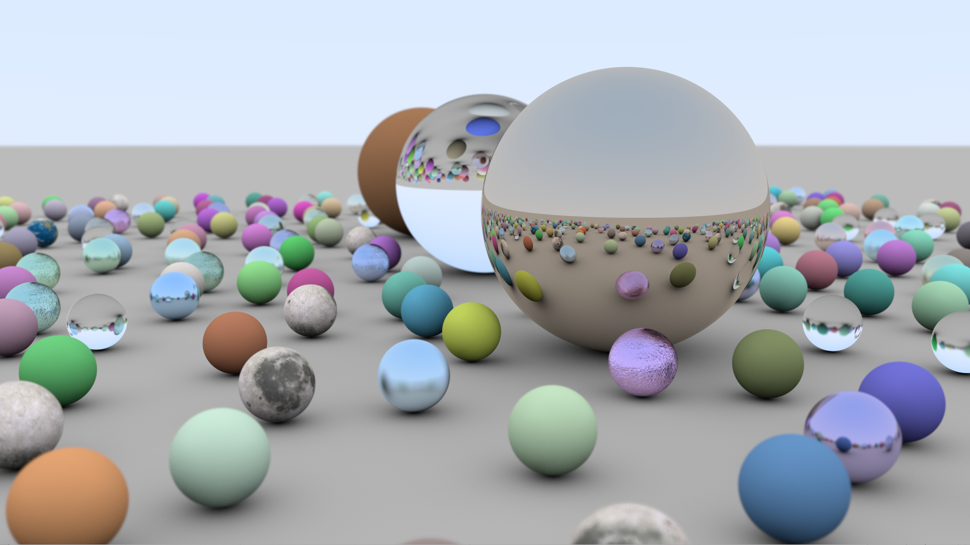
Ray Tracing, at Last
Eric Haines
NVIDIA
erich@acm.org
erichaines.com

Slide 2
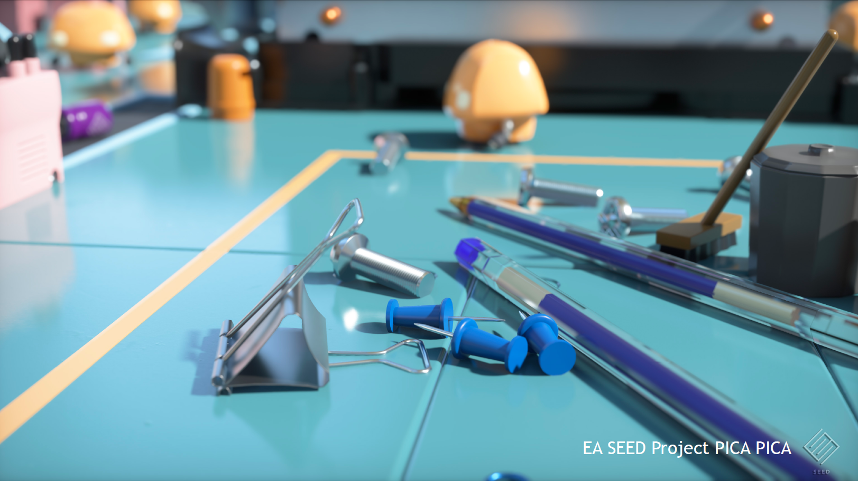
There is an old joke that goes, “Ray tracing is the technology of the future, and it always will be!” – David Kirk
Notes:
http://www.pcper.com/article.php?aid=530

Slide 3
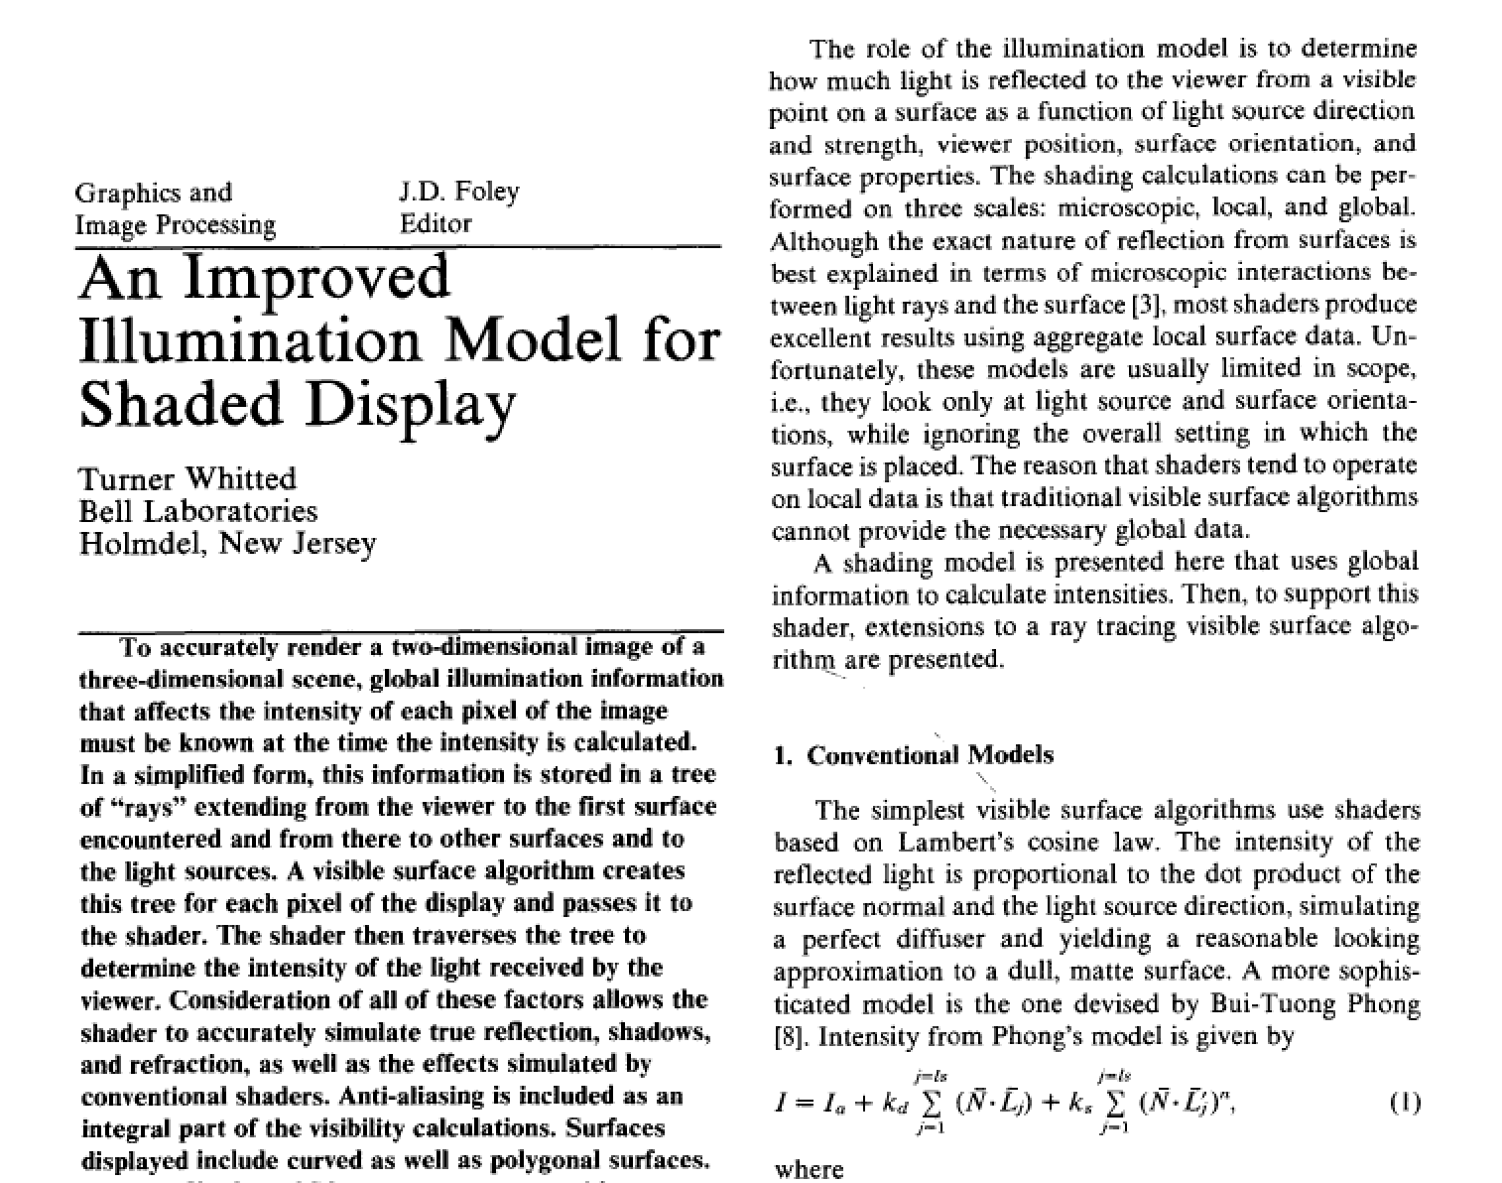
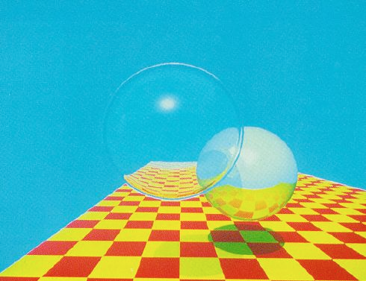
Back in 1980…
included a bounding volume hierarchy
reflection and refraction
adaptive antialiasing
Notes:
He even talks about previous ray tracing algorithms, such as MAGI and Arthur Appel 1968. Douglas Kay in 1979, ”TRANSPARENCY FOR COMPUTER SYNTHESIZED IMAGES”, almost did it.

Slide 4
1980: Whitted-Style Ray Tracing
For each pixel
Send ray from eye into scene
Send a ray from the intersection to each light: shadows
Spawn a new color ray for each reflection & refraction
highly polished surface
Notes:
74 minutes on a VAX-11/780, 640 x 480

Slide 5
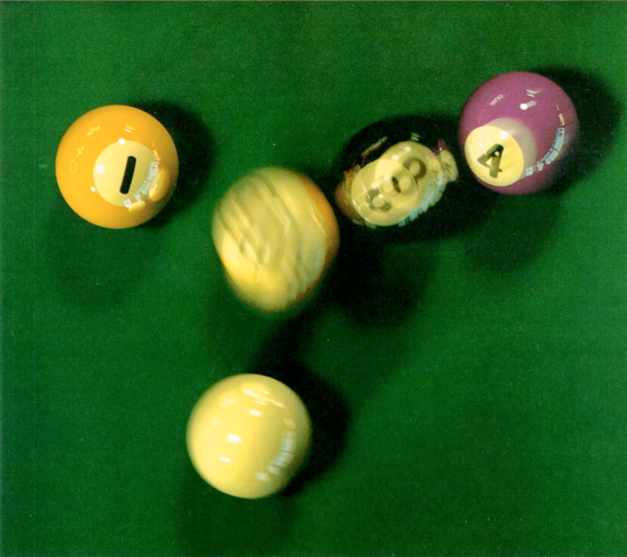
1984: Cook Stochastic (“Distributed”) Ray Tracing
Allow shadow rays to go to a random point on area light.
Allow specular rays to be perturbed specularly around the ideal reflection.
Shoot sometime during the frame for motion blur.
glossy surface
Notes:
https://graphics.pixar.com/library/indexAuthorRobert_L_Cook.html

Slide 6
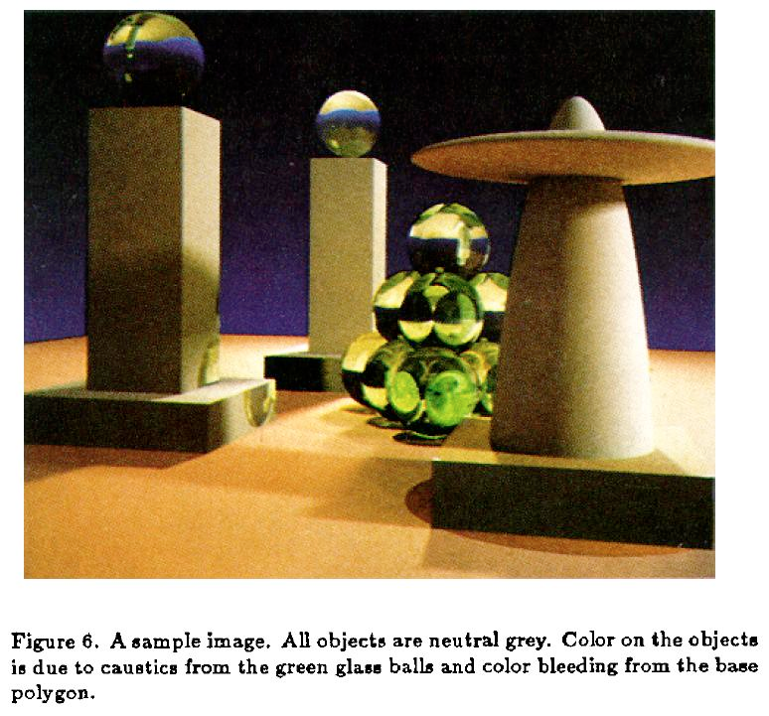
1986: Kajiya-Style Diffuse Interreflection
Path tracing: shoot each ray and follow it along a series of interreflections.
“The Rendering Equation”
Guaranteed to give the right answer at the limit.
diffuse surface reflection

Slide 7
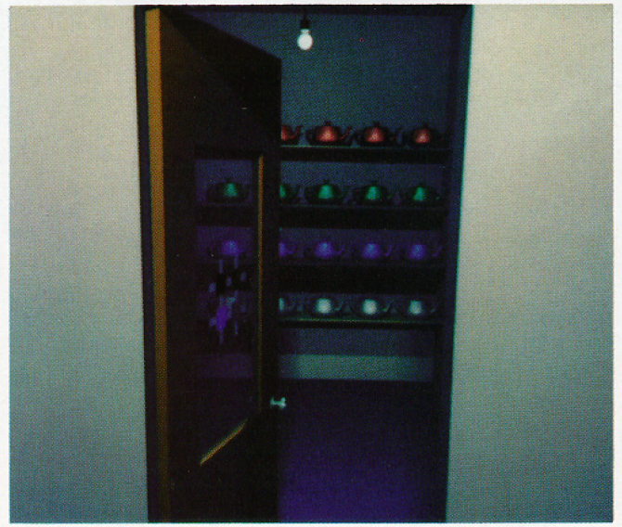
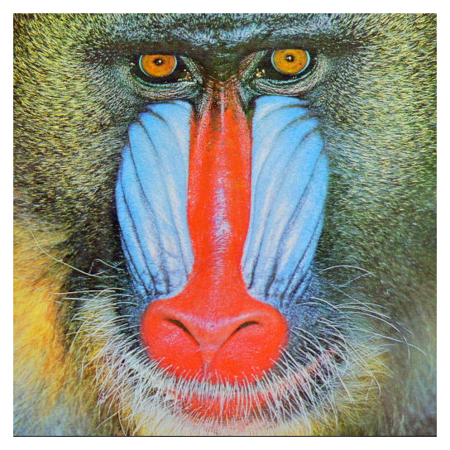
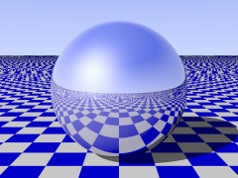
1987: AT&T Pixel Machine
AT&T Pixel Machine. Interactive postage-stamp-sized ray-traced mirror sphere atop a Mandrill.
+
But could be more serious: 50K objects in 25 minutes/frame.
Notes:
Turner Whitted: football field of Cray computers, each with an R G and B light on top. Sphereflake on pixel machine ran in 30 seconds, 16 seconds a year later due to software tuning. http://www.realtimerendering.com/resources/RTNews/html/rtnews4a.html#art4

Slide 8
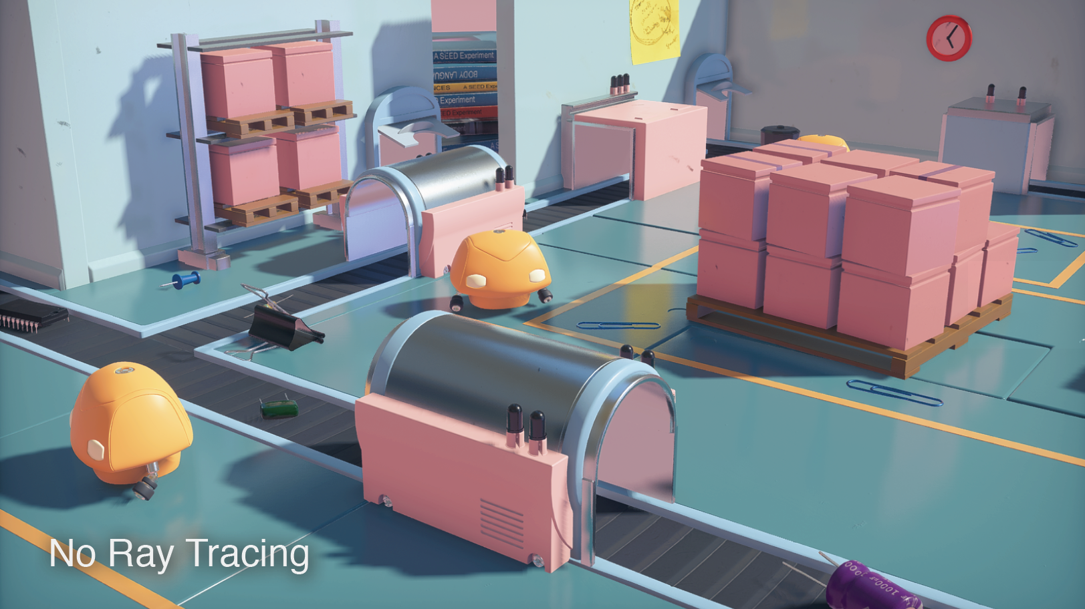
“… the brute-force approach … is ridiculously expensive.” - Sutherland, Sproull, and Schumacker, A Characterization of Ten Hidden-Surface Algorithms, 1974
Notes:
Which algorithm is this? About the z-buffer algorithm. Brute force beats elegance on transistor count. Uniform data structures much cheaper to put into silicon.
128 MB in 1971 would have cost $59,360 in 2018 dollars.

Slide 9
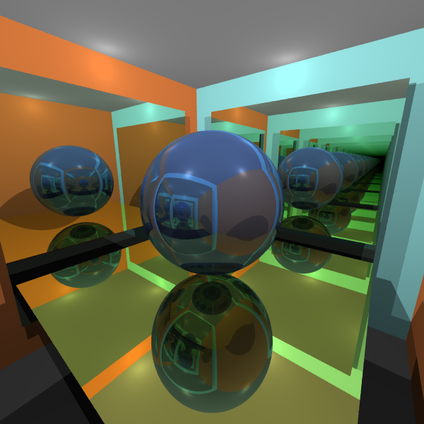
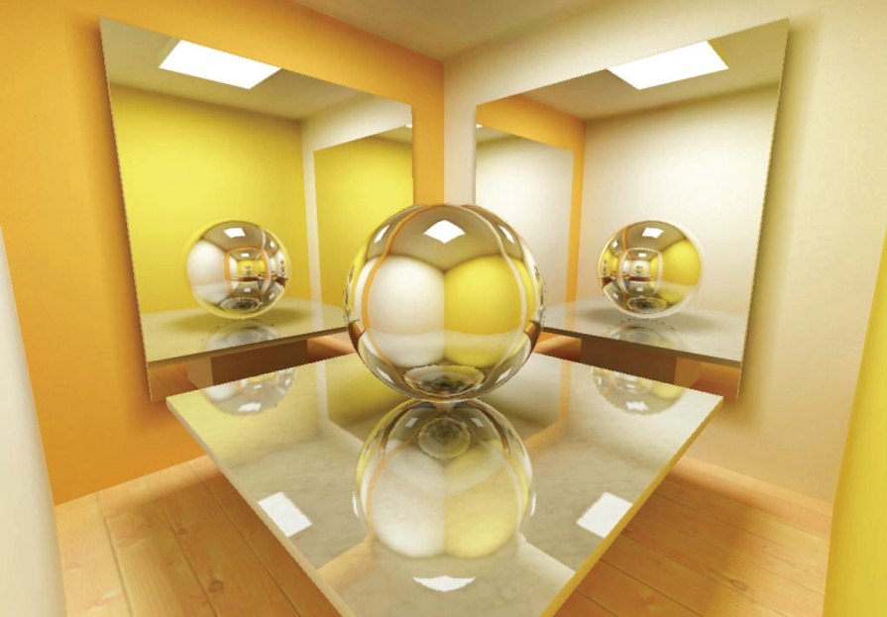
Rasterization vs. Ray Tracing
Rasterization loop:
For each object
For each pixel – closer?
Ray Tracing loop:
For each pixel
For each object – closest?
Timothy Cooper
Kasper Høy Nielsen
Notes:
Which is ray traced? The image on the left is actually ray traced (note the mirrors on the right going to infinity), the one on the right is actually rasterized.

Slide 10
Rasterization’s Advantages
Send the triangle or mesh and then forget it.
Triangle doesn’t need to be resident on PC GPU.
Memory coherence for single viewpoint for triangle and its textures.
Assumes triangle covers a fair number of pixels.

Slide 11
Ray Tracing’s Advantages
Rays are independent of each other, so can be traced as needed vs. lock-step fashion.
But incoherent rays can cause cache misses – slow.
No limitations such as one Z-buffer value stored.
But, each transparent object may spawn a new ray.

Slide 12
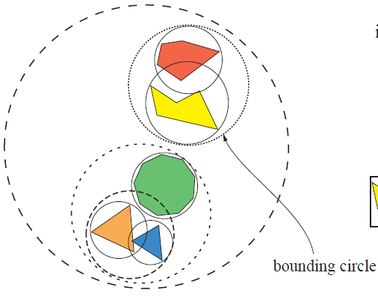
The Bounding Volume Hierarchy (BVH)
This data structure mostly won the efficiency data structure wars
Usual program: build BVH as preprocess
per frame: if needed, update BVH
trace rays
Building a BVH is typically O(N log N) for N objects
Updating a BVH is typically O(N) for N objects
Traversing a BVH (i.e., tracing a ray) is typically O(logN)
Notes:
Nested grids do see use for voxel/volume rendering, and k-d trees for point clouds

Slide 13
Fake News
Ray Tracing’s O(log N) beats Rasterization’s O(N)
Rasterization can benefit from:
Hierarchical frustum culling (also using a BVH)
Level of detail culling and simplification
Occlusion culling in various forms
Hierarchical Z buffer

Slide 14
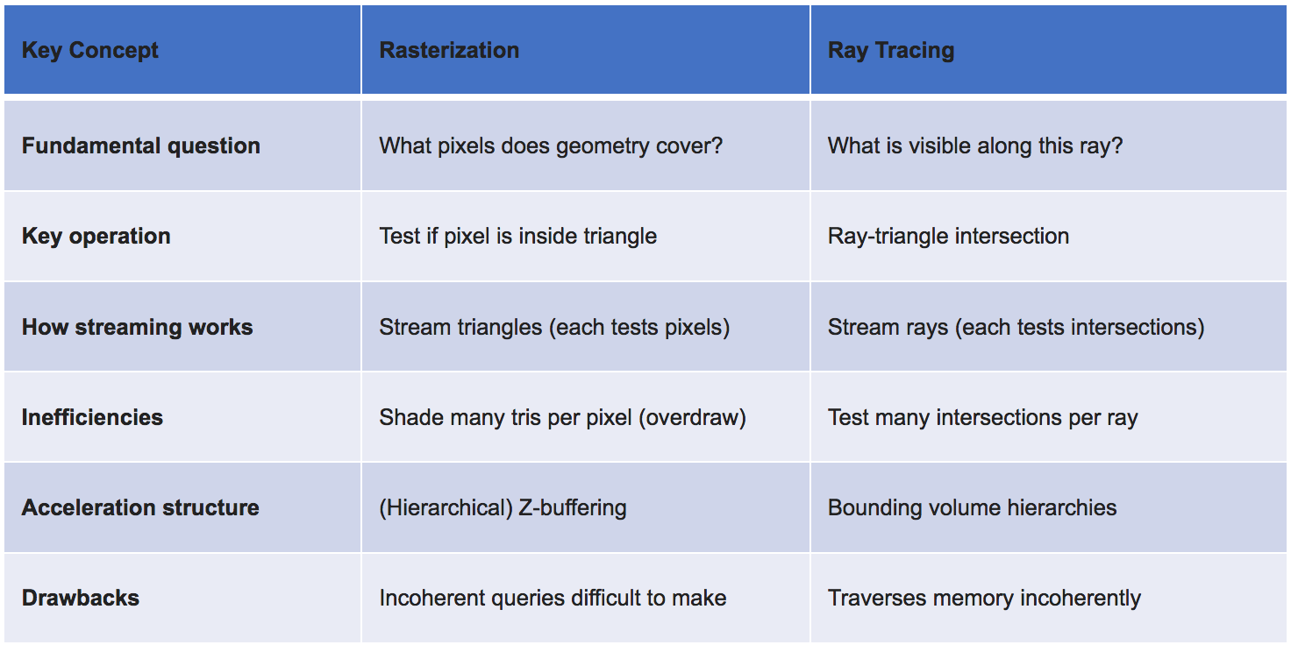
Rasterization and Ray Tracing
Notes:
Pete Shirley’s slide

Slide 15
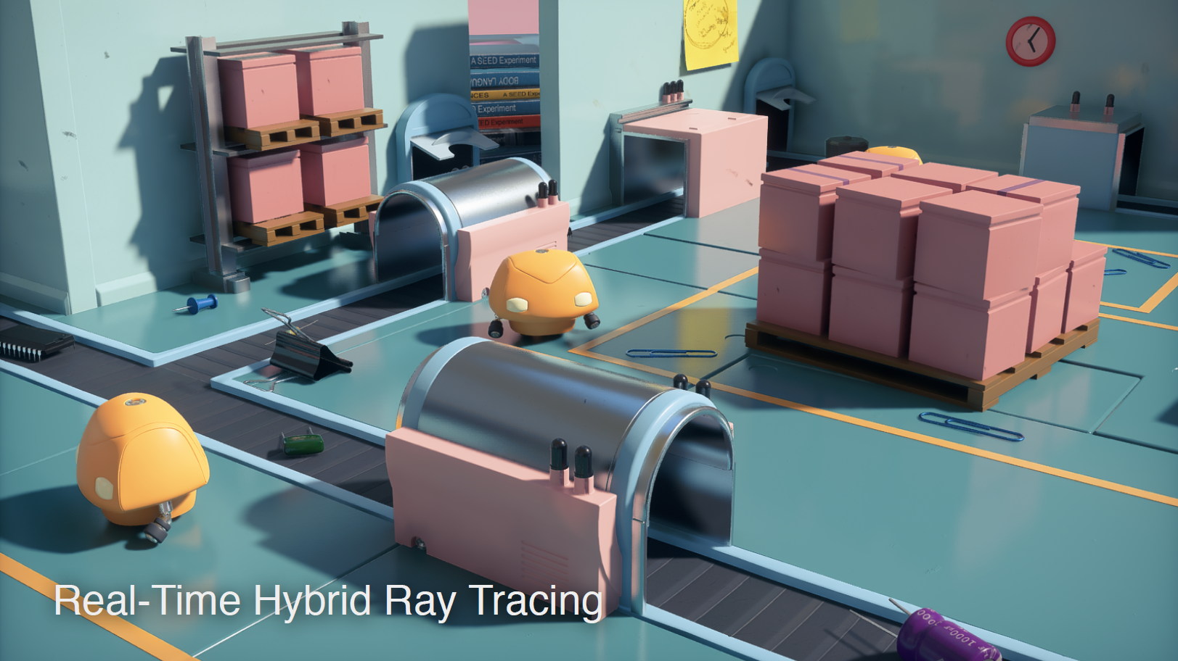
Pretty soon, computers will be fast. – Billy Zelsnack
Notes:
However, it still takes up to twenty seconds for me to find what’s in a directory when I double-click it.

Slide 16
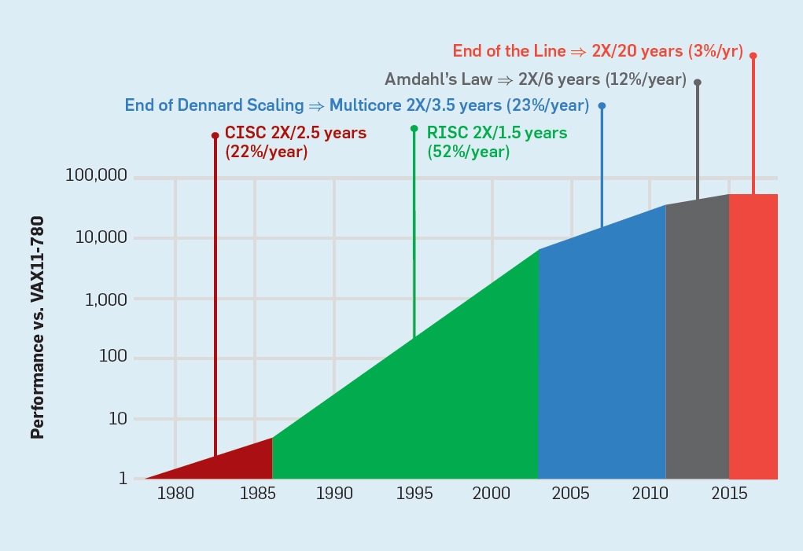
Moore’s Law is Ending (Really!)
From Norman P. Jouppi, Cliff Young, Nishant Patil, David Patterson, “A Domain-Specific Architecture for Deep Neural Networks,” Communications of the ACM, September 2018, Vol. 61 No. 9, Pages 50-59.
Notes:
NVIDIA is based on this idea.

Slide 17
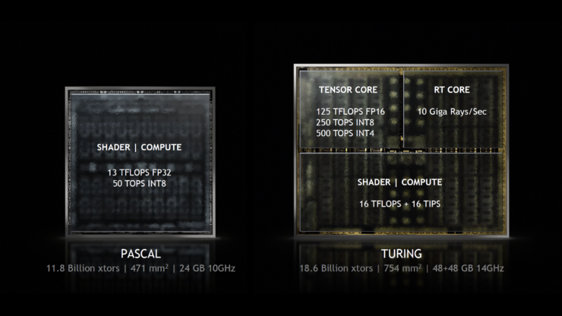
More Special-Purpose Hardware

Slide 18
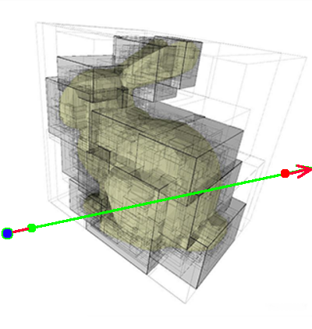
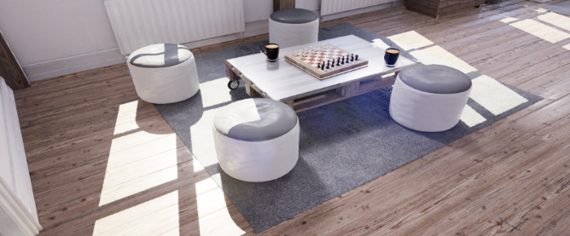
RT Cores
RT Cores perform
Ray-BVH Traversal
Instancing: 1 Level
Ray-Triangle Intersection
Return to Streaming Multiprocessors for
Multi-level Instancing
Custom Intersection
Shading
Notes:
SM – streaming multiprocessor

Slide 19
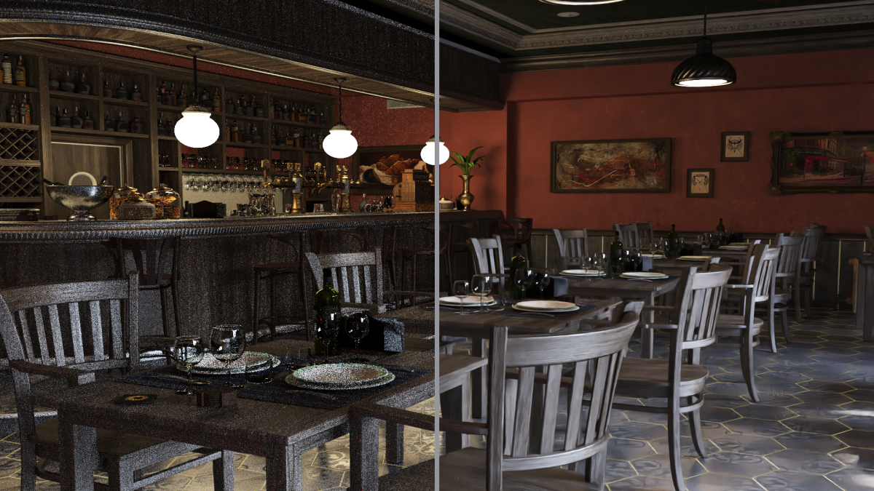
Denoising
Identical time
Notes:
Tensor cores: evidence that fast denoising (enabled by tensor cores) helps a lot for ray tracing

Slide 20
Denoising – Zoom In
Notes:
Tensor cores: evidence that fast denoising (enabled by tensor cores) helps a lot for ray tracing
John Henry vs. the Steam Drill

Slide 21
Denoising by Effect
Notes:
Specialized non-graphical data for denoising, like tangents for hairs.
Even films use denoising
https://developer.nvidia.com/gameworks-ray-tracing

Slide 22
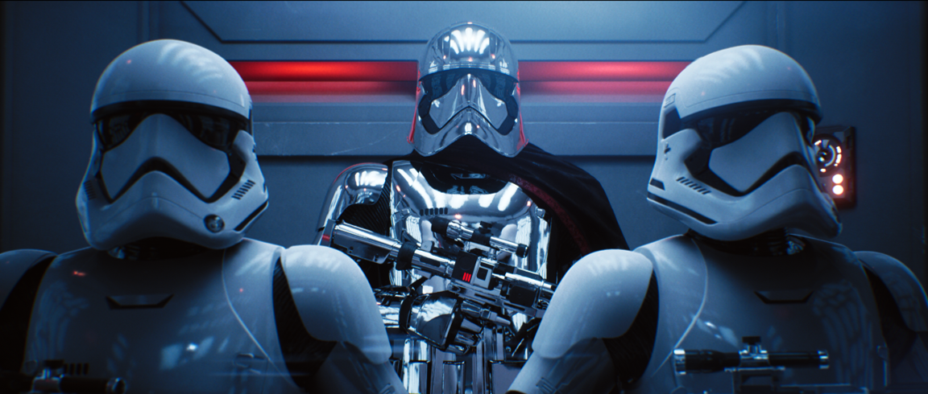
A Single RTX (a.k.a. Turing) Card
Notes:
At GDC in March ‘18, we ran this Star Wars demo in real time -- on 4 water-cooled Volta GPUs. Today, we can run this demo on a single Turing, Quadro RTX 800. https://vimeo.com/291876490https://vimeo.com/291876490

Slide 23
Notes:
At GDC in March ‘18, we ran this Star Wars demo in real time -- on 4 water-cooled Volta GPUs. Today, we can run this demo on a single Turing, Quadro RTX 800. https://vimeo.com/291876490https://vimeo.com/291876490

Slide 24
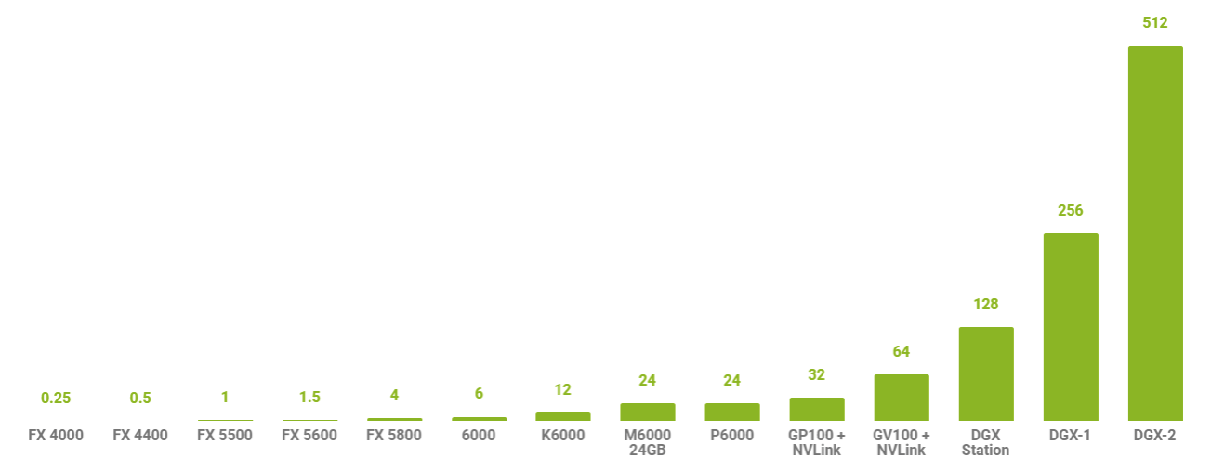
GPU Memory Capacity in Gigabytes
16x Tesla V100’s
for AI - $399,000
350 lbs.
RTX 2080 Ti
high-end gaming - $1169
Quadro RTX 800
for pros - $6300
GTX 1050
budget gaming - $150
Notes:
3840 x 2160 pixels takes 33 MB (including alpha) – means 30 images is 1 GB

Slide 25
Rasterization
State of the art current real-time graphics quality
Notes:
Rasterization

Slide 26
Ray Tracing
With RTX raytracing
Notes:
With RTX

Slide 27
Rasterization
SCREEN-SPACE AMBIENT OCCLUSION
BAKED LIGHTING
Notes:
Rasterizations uses tricks and techniques like screen space ambient occlusion to darken nooks and crannies giving the illusion of ambient lighting shadows.
In fact in scenes where the lights are static (not moving) – we often use “light baking” to pre generate light maps which are simply greyscale images of light distribution applied to surfaces. And so long as things don’t move very much – the lighting conditions are very well reproduced.
It is a quick and efficient method, but it uses approximations and the result uses up texture memory so is often quite low res…

Slide 28
Ray Tracing
GLOBAL ILLUMINATION
Notes:
In contrast – this is what a ray traced image will look like – as it uses a technique called global illumination. Notice the detailed light and shadows on the towel, compared to the previous image... these little details bring a scene together and make it seem more realistic.
Global illumination enables true ray-traced shadows to be created quickly resulting in much more detailed and lifelike images

Slide 29
Rasterization
SCREEN-SPACE REFLECTIONS
ENVIRONMENT MAPS
Notes:
Screen space reflections are an attempt to represent reflections quickly using the entire screen to do the approximations. The results are good, but there are limits to the types of reflections that can be created and the quality is less than perfect due to the nature of the algorithms being used.

Slide 30
Ray Tracing
RAY TRACED REFLECTIONS
Notes:
Ray traced reflections are much more accurate and realistic, producing the reflections just as they would occur in real life. Ray traced reflections are computationally much more complex than screen space reflections requiring the power of NVIDIA RTX technology and Volta GPUs to compute the reflections at interactive rates.

Slide 31
Rasterization
SCREEN-SPACE REFRACTION
DEPTH SORTING
Notes:
Refraction, light passing obliquely through one object and on to another, is commonly done using screen-space techniques, much like screen space ambient occlusion, using a single pass to compute the refracted portions of the image. Refractions are extremely tough to do, especially through curved surfaces like this glass here. For example – you have probably seen the sun refracting off a swimming pool on a sunny day and noticed that the light actually dances thru the water as it gets refracted, and creates light patterns called caustics…You don’t see that here with rasterized graphics…The results sacrifices accuracy for speed, providing reasonable results quickly.

Slide 32
Ray Tracing
CAUSTICS
Notes:
RTX Technology can do true ray tracing using caustics to accurately project the rays through curved surfaces or objects or refractive materials. The result is lifelike, accurate images, created at interactive rates.

Slide 33
SUBSURFACE SHADING APPROXIMATION
Notes:
There are objects that partially absorb light and reflect back at the subsurface level. Jade is a common example but gummy bears and our skin do that as well. Our skin is really transparent but light reaches under the surface and lights the blood giving it a reddish hue. This is called subsurface scattering…with rasterization we really can’t recreated this phenomenon accurately. The gummy bears actually look opaque here... Calculating subsurface scattering is computationally intensive. To improve performance, many current implementations use approximations to create sub surfaces. Again we trade accuracy for performance. The little bears on the table are gummy bears, they should be translucent and cast interesting shadows. The picture here renders them opaque, not exactly as they would appear in real life.

Slide 34
SUBSURFACE SCATTERING
Notes:
Ray tracing has the power to create more realistic shadows at interactive frame rates. In the picture above, the gummy bears not only cast shadows, but are translucent. RTX technology renders them realistically, generating the an image more akin to what you would see in real life.

Slide 36
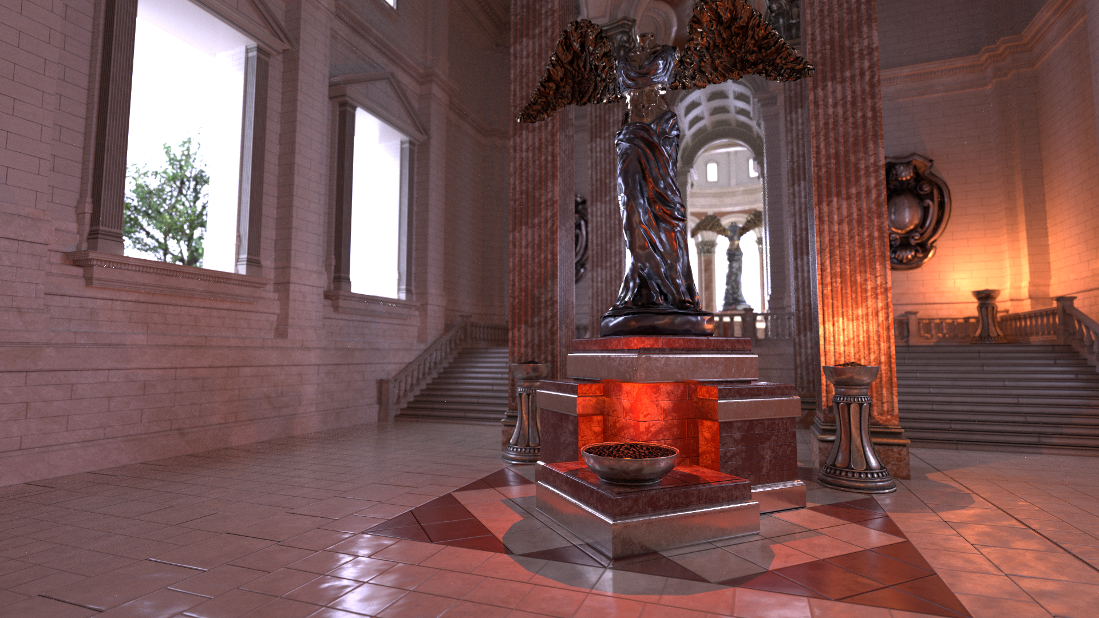
GPUs are the only type of parallel processor that has ever seen widespread success... because developers generally don’t know they are parallel! – Matt Pharr, circa 2008

Slide 37
DirectX Rasterization Pipeline
What do shaders do in today’s widely-used rasterization pipeline?
Merge each pixel into the final output image (e.g., doing blending)
Usually done with special-purpose hardware
Hides optimizations like memory compression and converting image formats
Per-Vertex
Tessellation Shading Stages
Per-Primitive
Per-Pixel
Vertex Shader
Hull Shader
Tessellator Shader
Domain Shader
Geometry Shader
Rasterizer
Fragment Shader
Output
(ROP)
Notes:
Actually different for most mobile, where the triangles are retained and thrown against multiple tiles.

Slide 38
DirectX Ray Tracing Pipeline
So what might a simplified ray tracing pipeline look like?
One advantage of ray tracing:
Algorithmically, much easier to add recursion
Take input pixel position, generate ray(s)
Shade hit points;
(Optional) generate recursive ray(s)
Intersect Rays
With Scene
Output
Input: Set of Pixels
Output: Final Image
Please note:
A very simplified representation
Notes:
Actually different for most mobile, where the triangles are retained and thrown against multiple tiles.

Slide 39
DirectX Ray Tracing Shaders
Pipeline is split into five new shaders:
A ray generation shader defines how to start ray tracing
Intersection shader(s) define how rays intersect geometry
Miss shader(s) define behavior when rays miss geometry
Closest-hit shader(s) run once per ray (e.g., to shade the final hit)
Any-hit¹ shader(s) run once per hit (e.g., to determine transparency)
An new, unrelated sixth shader:
A callable shader can be launched from another shader stage
¹Note: Read spec for more advanced usage, since meaning of “any” may not match your expectations

Slide 40
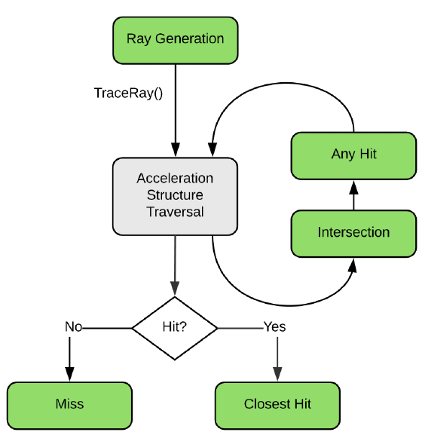
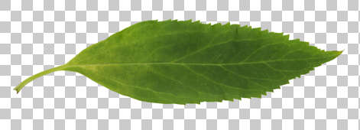
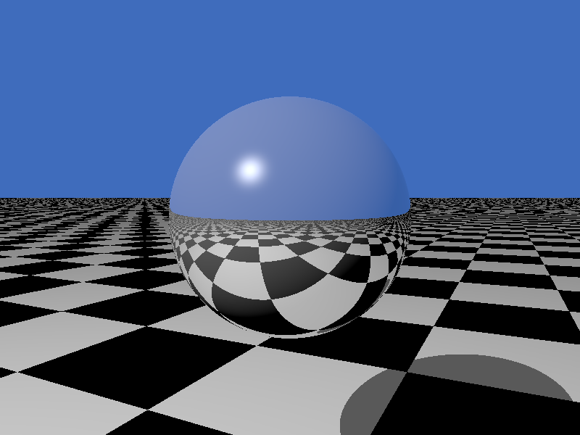
DirectX Ray Tracing Flow
Notes:
http://www.realtimerendering.com/Real-Time_Rendering_4th-Real-Time_Ray_Tracing.pdf

Slide 41
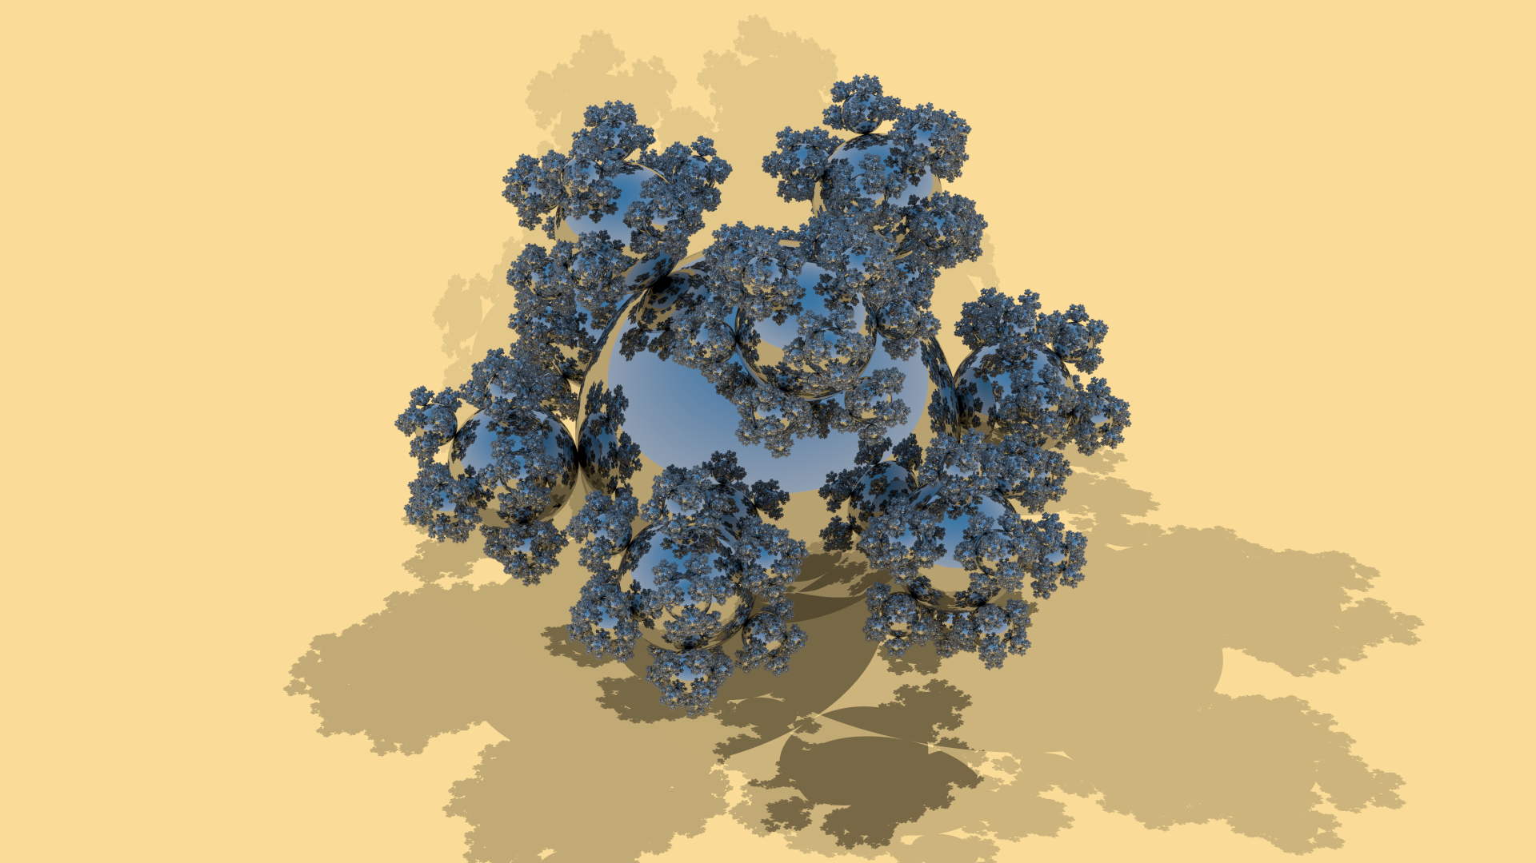
Demo Time
Notes:
http://erich.realtimerendering.com/rtrt/index.html

Slide 42
Uses of Fast Ray Tracing
In video games, of course. But also for development:
Fast baking for global illumination
Generate ground truth image for comparison
And possibly other interesting (ab)uses of the GPU
In film production:
Save artists time waiting
Possibly even final frames
Notes:
http://erich.realtimerendering.com/rtrt/index.html

Slide 43
Ways to Get Farther
Do that extra thing, something you enjoy:
Work on some project you like, in a team or on your own.
Volunteer at any conference, for any position – help is always needed.
Make a great web site collecting information on some topic. REGISTER A URL.
Volunteer to help review papers in an area you know well.
Write articles on things you know or things you’ve tried. Write a book. ☺
Work tips:
Ask questions when you don’t know. Get over looking ignorant – everyone is.
Solo is fine, failing solo is fine, but failing with others is less likely – get help.
Don’t toot your own horn – let others sing your praises.
Don’t “networking on purpose.” But, when you’re in a line at a conference, start up a conversation with your neighbors. Everyone knows about something you don’t.
Notes:
See my site about why you want a URL: http://www.realtimerendering.com/blog/moving-targets-and-why-theyre-bad/
People think you know something if you write a book. And, dozens of dollars to be made!

Slide 44
The Dangers of Ray Tracing

Slide 45
The Dangers of Ray Tracing

Slide 46
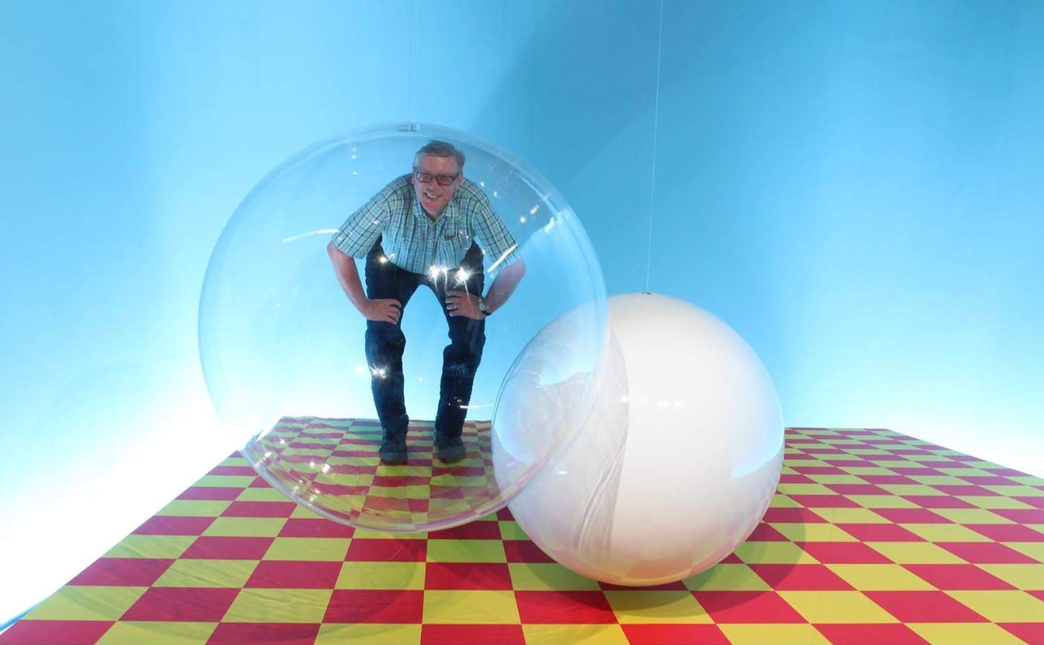
Questions?
realtimerendering.com
erichaines.com

Slide 47
How I Got Here, I Think
Over the past 35 years, I’ve:
Helped teach An Introduction to Ray Tracing course at SIGGRAPH (1987)
Made a ray tracing benchmark test suite, Standard Procedural Databases (1987)
Created an informal journal: Ray Tracing News (1988)
Coauthored An Introduction to Ray Tracing (1989)
Helped with Graphics Gems: author, reviewer, code repo (1990-1995-present)
Coauthored Real-Time Rendering (1999, 2002, 2008, 2018)
Co-chaired I3D Symposium (general 2006, papers 2007)
Helped found a Gems-like journal: journal of graphics tools (1996)
Co-founded open access version, Journal of Computer Graphics Techniques (2011)
Created Interactive 3D Graphics MOOC (2013-present)
Co-editing Ray Tracing Gems right now (2018-2019). 12 days left to contribute!
All this time, contributed to SIGGRAPH and ACM TOG in various ways: courses, panels, art show, studio session, webmaster, etc.
Notes:
16/17 things over 35 years = 1 thing every two years

